Slide 1


Apostasy or Rapture?
(2 Thessalonians 2:3A)
Dr. Andy Woods
Senior Pastor – Sugar Land Bible Church
President – Chafer Theological Seminary

Slide 2


2 Thessalonians 2:3
“Let no one in any way deceive you, for it will not come unless the apostasy [apostasia; departure] comes first, and the man of lawlessness is revealed, the son of destruction.”

Slide 3
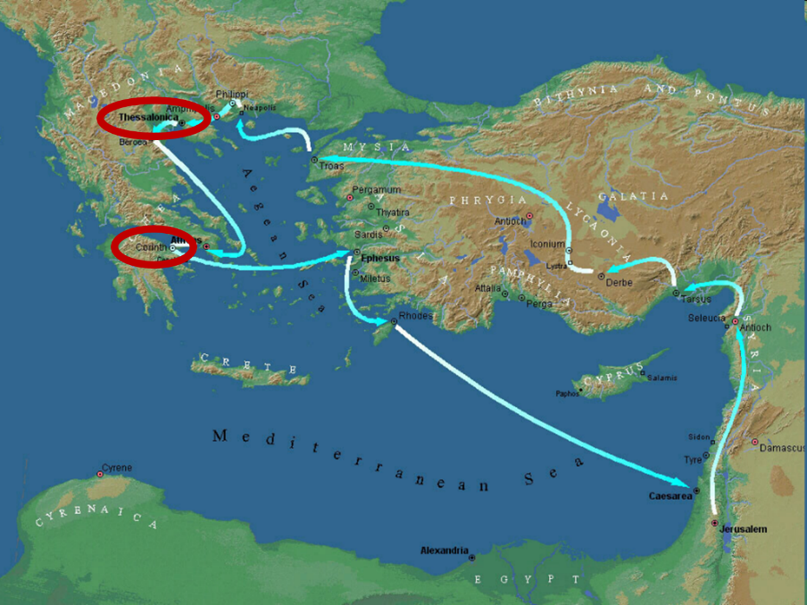

Slide 4
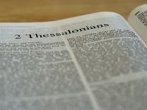
2 Thessalonians 2:1-12
Problem (2:1-2)
Prerequisites for the Day of the Lord (2:3-12)
  The apostasy (2:3a)
  Advent of the lawless one (2:3b-4)
  Removal of the restrainer (2:5-7)
  Destruction of the lawless one (2:8-9)
  Destruction of lawless one’s followers (2:10-12)

Slide 5

2 Thessalonians 2:2
“that you not be quickly shaken from your composure or be disturbed either by a spirit or a message or a letter as if from us, to the effect that the day of the Lord [the Tribulation] has come.”

Slide 6
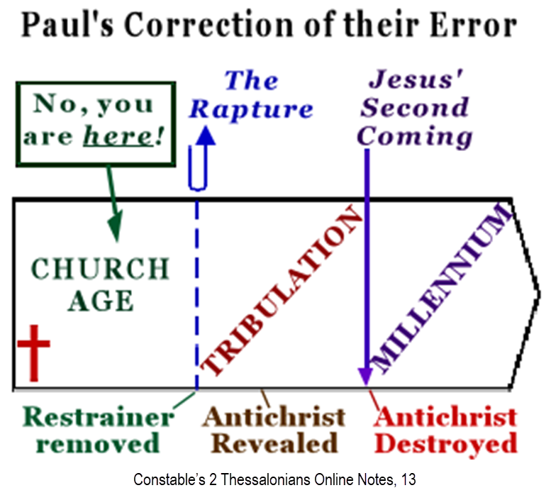

Slide 7
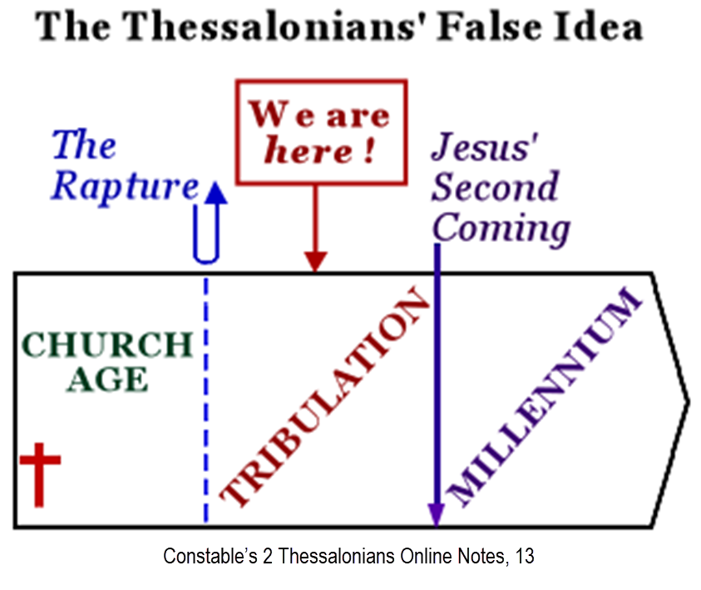

Slide 8
2 Thessalonians 2:1-12
Problem (2:1-2)
Prerequisites for the Day of the Lord (2:3-12)
  The apostasy (2:3a)
  Advent of the lawless one (2:3b-4)
  Removal of the restrainer (2:5-7)
  Destruction of the lawless one (2:8-9)
  Destruction of lawless one’s followers (2:10-12)

Slide 9
2 Thessalonians 2:1-12
Problem (2:1-2)
Prerequisites for the Day of the Lord (2:3-12)
  The apostasy (2:3a)
  Advent of the lawless one (2:3b-4)
  Removal of the restrainer (2:5-7)
  Destruction of the lawless one (2:8-9)
  Destruction of lawless one’s followers (2:10-12)

Slide 10

Apostasy? (2:3a)
Spiritual departure (Acts 21:21) – Unbelieving world embracing the antichrist
Physical departure (Acts 12:10; 2 Cor. 12:8) – Rapture

Slide 11
Apostasy? (2:3a)
Spiritual departure (Acts 21:21) – Unbelieving world embracing the antichrist
Physical departure (Acts 12:10; 2 Cor. 12:8) – Rapture

Slide 12
Spiritual Departure Options
Apostasy of the Church (pre-rapture)
Apostasy of the World (post-rapture)
Apostasy of Israel (Dan. 9:27)

Slide 13
Apostasy? (2:3a)
Spiritual departure (Acts 21:21) – Unbelieving world embracing the antichrist
Physical departure (Acts 12:10; 2 Cor. 12:8) – Rapture

Slide 14
2 Thessalonians 2:3
“Let no one in any way deceive you, for it will not come unless the apostasy [apostasia] comes first [prōton], and the man of lawlessness is revealed, the son of destruction.”

Slide 15
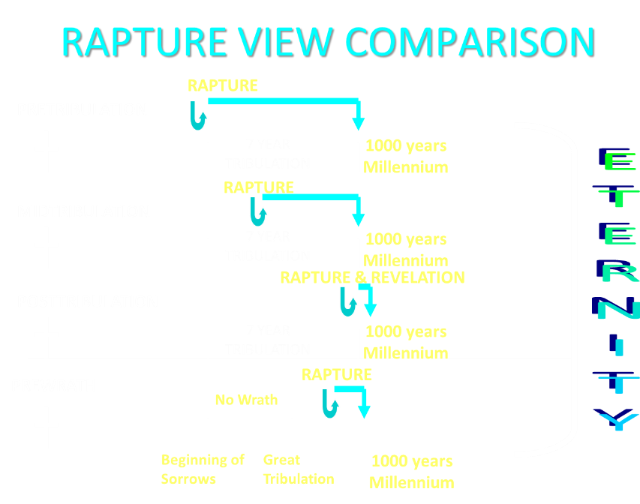

Slide 16


Slide 17

10 Cumulative Reasons Favoring Physical Departure
There have always been doctrinal departures
2 Thess. was an early letter
The definite article before apostasia
Noun apostasia can refer to physical departure
Verb aphistēmi can refer to physical departure

Slide 18
10 Cumulative Reasons Favoring Physical Departure
Extended context favors physical departure
Immediate context favors physical departure
2 Thess. 2:2 is a review course
Early Bible translations favor physical departure
Physical departure is held by credible scholars

Slide 19

Answering Objections to the Physical Departure View
Greek from the Koine period?
Subtraction from the Last Days will be characterized by continual apostasy?
Rapture is passive and apostasy is active?
Incongruence with verse 1?
Paul is re-assuring the Thessalonians that they had not already missed the rapture; therefore, it would be incomprehensible to read, “the rapture cannot have happened unless the rapture happens first”

Slide 20
Answering Objections to the Physical Departure View
Greek from the Koine period?
Subtraction from the Last Days will be characterized by continual apostasy?
Rapture is passive and apostasy is active?
Incongruence with verse 1?
Paul is re-assuring the Thessalonians that they had not already missed the rapture; therefore, it would be incomprehensible to read, “the rapture cannot have happened unless the rapture happens first”

Slide 21
2 Thessalonians 2:2-3 (NKJV)
“² not to be soon shaken in mind or troubled, either by spirit or by word or by letter, as if from us, as though the day of Christ [rapture] had come. ³ Let no man deceive you by any means: for that day [rapture] shall not come, except there come a falling away [rapture] first, and that man of sin be revealed, the son of perdition”

Slide 22
2 Thessalonians 2:3 (NASB)
“² that you not be quickly shaken from your composure or be disturbed either by a spirit or a message or a letter as if from us, to the effect that the day of the Lord [the tribulation period] has come. ³ Let no one in any way deceive you, for it [the tribulation period] will not come unless the apostasy [apostasia] comes first, and the man of lawlessness is revealed, the son of destruction.”

Slide 23

Genesis 1:5
“God called the light day, and the darkness He called night. And there was evening and there was morning, one day.”

Slide 24


Slide 25


Slide 26


Slide 27
1 Thessalonians 5:2-3 (NKJV)
“² For you yourselves know perfectly that the day of the Lord so comes as a thief in the night. ³ For when they say, “Peace and safety!” then sudden destruction comes upon them, as labor pains upon a pregnant woman. And they shall not escape.”

Slide 28
2 Thessalonians 2:2
“that you not be quickly shaken from your composure or be disturbed either by a spirit or a message or a letter as if from us, to the effect that the day of the Lord [the Tribulation ] has come.”

Slide 29
2 Thessalonians 2:1-12
Problem (2:1-2)
Prerequisites for the Day of the Lord (2:3-12)
  The departure (2:3a)
  Advent of the lawless one (2:3b-4)
  Removal of the restrainer (2:5-7)
  Destruction of the lawless one (2:8-9)
  Destruction of lawless one’s followers (2:10-12)

Slide 30
2 Thessalonians 2:1-12
Problem (2:1-2)
Prerequisites for the Day of the Lord 2:3-12)
  The departure (2:3a)
  Advent of the lawless one (2:3b-4)
  Removal of the restrainer (2:5-7)
  Destruction of the lawless one (2:8-9)
  Destruction of lawless one’s followers (2:10-12)

Slide 31
10 Reasons Favoring Physical Departure
There have always been doctrinal departures
2 Thess. was an early letter
The definite article before apostasia
Noun apostasia can refer to physical departure
Verb aphistēmi can refer to physical departure

Slide 32
10 Reasons Favoring Physical Departure
Extended context favors physical departure
Immediate context favors physical departure
2 Thess. 2:2 is a review course
Early Bible translations favor physical departure
Physical departure is held by credible scholars

Slide 33
Answering Objections to the Physical Departure View
Greek from the Koine period?
Subtraction from the Last Days will be characterized by continual apostasy?
Rapture is passive and apostasy is active?
Incongruence with verse 1?
Paul is re-assuring the Thessalonians that they had not already missed the rapture; therefore, it would be incomprehensible to read, “the rapture cannot have happened unless the rapture happens first”

Slide 34
2 Thessalonians 2:3
“Let no one in any way deceive you, for it will not come unless the apostasy [apostasia] comes first [prōton], and the man of lawlessness is revealed, the son of destruction.”

Slide 36
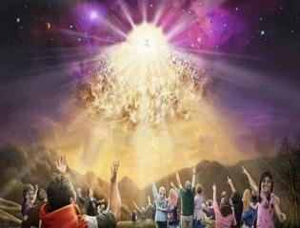
Titus 2:13
“Looking for the blessed hope and the appearing of the glory of our great God and Savior, Christ Jesus.”

Slide 37
2 Thessalonians 2:1-12
Problem (2:1-2)
Prerequisites for the Day of the Lord (2:3-12)
  The departure (2:3a)
  Advent of the lawless one (2:3b-4)
  Removal of the restrainer (2:5-7)
  Destruction of the lawless one (2:8-9)
  Destruction of lawless one’s followers (2:10-12)

Slide 38
2 Thessalonians 2:3
“Let no one in any way deceive you, for it will not come unless the apostasy [apostasia] comes first [prōton], and the man [anthrōpos] of lawlessness is revealed, the son of destruction.”

Slide 39

Revelation 13:16-18
¹⁶ And he causes all, the small and the great, and the rich and the poor, and the free men and the slaves, to be given a mark on their right hand or on their forehead, ¹⁷ and he provides that no one will be able to buy or to sell, except the one who has the mark, either the name of the beast or the number of his name. ¹⁸ Here is wisdom. Let him who has understanding calculate the number of the beast, for the number is that of a man [anthrōpos]; and his number is six hundred and sixty-six.
39

Slide 41

Revelation 20:10
“And the devil who deceived them was thrown into the lake of fire and brimstone, where the beast and the false prophet are also; and they will be tormented day and night forever (aiōn) and ever (aiōn).”

Slide 42


Slide 43
2 Thessalonians 2:3
“Let no one in any way deceive you, for it will not come unless the apostasy [apostasia] comes first [prōton], and the man [anthrōpos] of lawlessness [anomia] is revealed, the son of destruction.”

Slide 44


Daniel 7:25
“He will speak out against the Most High and wear down the saints of the Highest One, and he will intend to make alterations in times and in law; and they will be given into his hand for a time, times, and half a time.”

Slide 45


Genesis 1:14
Then God said, “Let there be lights in the expanse of the heavens to separate the day from the night, and let them be for signs and for seasons and for days and years.”

Slide 46

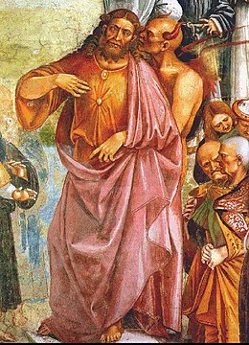
Daniel 11:36
“Then the king will do as he pleases, and he will exalt and magnify himself above every god and will speak monstrous things against the God of gods; and he will prosper until the indignation is finished, for that which is decreed will be done.”

Slide 47
2 Thessalonians 2:3
“Let no one in any way deceive you, for it will not come unless the apostasy [apostasia] comes first [prōton], and the man [anthrōpos] of lawlessness [anomia] is revealed [apokulypsis], the son of destruction.”

Slide 48

Revelation 1:1
“The Revelation [apokalypsis] of Jesus Christ, which God gave Him to show to His bond-servants, the things which must soon take place; and He sent and communicated it by His angel to His bond-servant John.”

Slide 49


2 Thessalonians 2:6-7
⁶And you know what restrains [katechon; neuter] him now, so that in his time he will be revealed. ⁷For the mystery of lawlessness is already at work; only he who now restrains [katechōn; masculine] will do so until he is taken out of the way.

Slide 50
Daniel 9:27
“And he will make a firm covenant with the many for one week, but in the middle of the week he will put a stop to sacrifice and grain offering; and on the wing of abominations will come one who makes desolate, even until a complete destruction, one that is decreed, is poured out on the one who makes desolate.”

Slide 53

1st Six Seals (Revelation 6)
SEAL 1 – 6:1-2 – Advent of antichrist
SEAL 2 – 6:3-4 – War
SEAL 3 – 6:5-6 – Famine
SEAL 4 – 6:7-8 – Death
SEAL 5 – 6:9-11 – Martyrdoms
SEAL 6 – 6:12-17 – Cosmic disturbances

Slide 54
2 Thessalonians 2:3
“Let no one in any way deceive you, for it will not come unless the apostasy [apostasia] comes first [prōton], and the man [anthrōpos] of lawlessness [anomia] is revealed, the son of destruction.”

Slide 55
Daniel 9:27
“And he will make a firm covenant with the many for one week, but in the middle of the week he will put a stop to sacrifice and grain offering; and on the wing of abominations will come one who makes desolate, even until a complete destruction, one that is decreed, is poured out on the one who makes desolate.”

Slide 56


2 Thessalonians 2:9
“that is, the one whose coming is in accord with the activity of Satan, with all power and signs and false wonders.”

Slide 57
Daniel 11:36
“Then the king will do as he pleases, and he will exalt and magnify himself above every god and will speak monstrous things against the God of gods; and he will prosper until the indignation is finished, for that which is decreed will be done.”

Slide 58
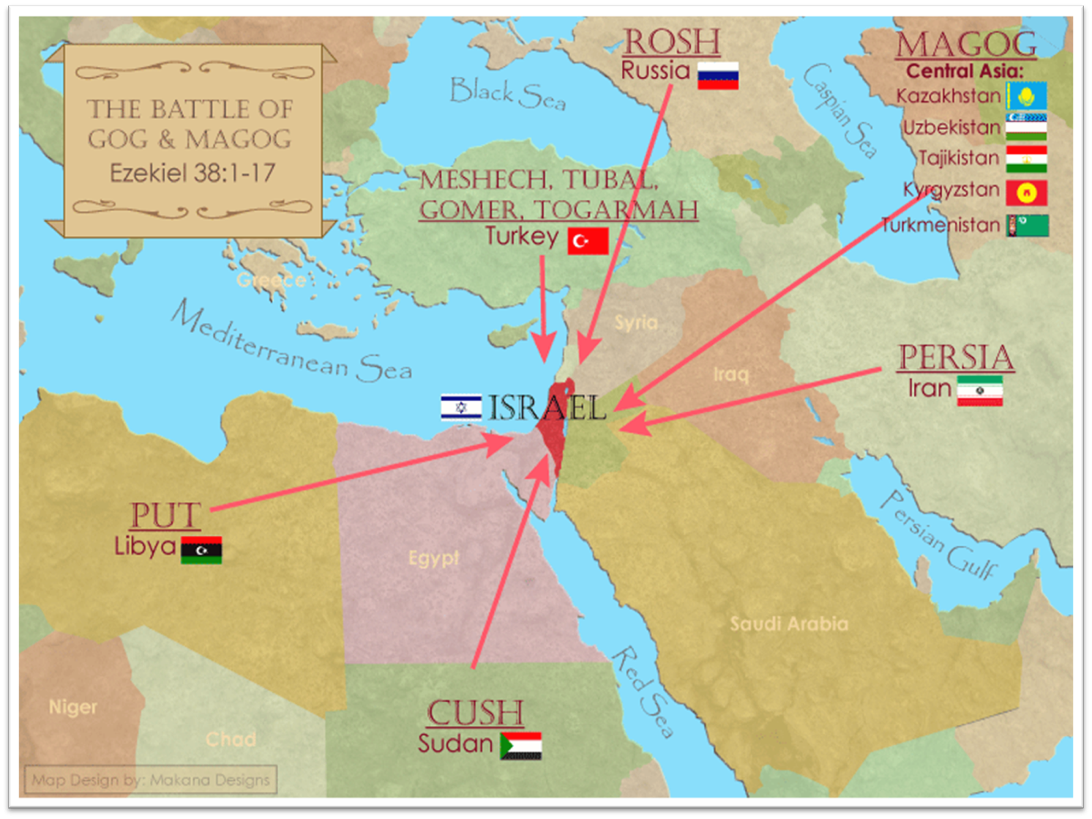
Saudi Arabia

Slide 59
Daniel 9:27
“And he will make a firm covenant with the many for one week, but in the middle of the week he will put a stop to sacrifice and grain offering; and on the wing of abominations will come one who makes desolate, even until a complete destruction, one that is decreed, is poured out on the one who makes desolate.”

Slide 60
Daniel 9:26
“Then after the sixty-two weeks the Messiah will be cut off and have nothing, and the people of the prince who is to come will destroy the city and the sanctuary. And its end will come with a flood; even to the end there will be war; desolations are determined.”

Slide 62
Daniel 9:27
“And he will make a firm covenant with the many for one week, but in the middle of the week he will put a stop to sacrifice and grain offering; and on the wing of abominations will come one who makes desolate, even until a complete destruction, one that is decreed, is poured out on the one who makes desolate.”

Slide 65
Daniel 11:31
“Forces from him will arise, desecrate the sanctuary fortress, and do away with the regular sacrifice. And they will set up the abomination of desolation.”

Slide 66
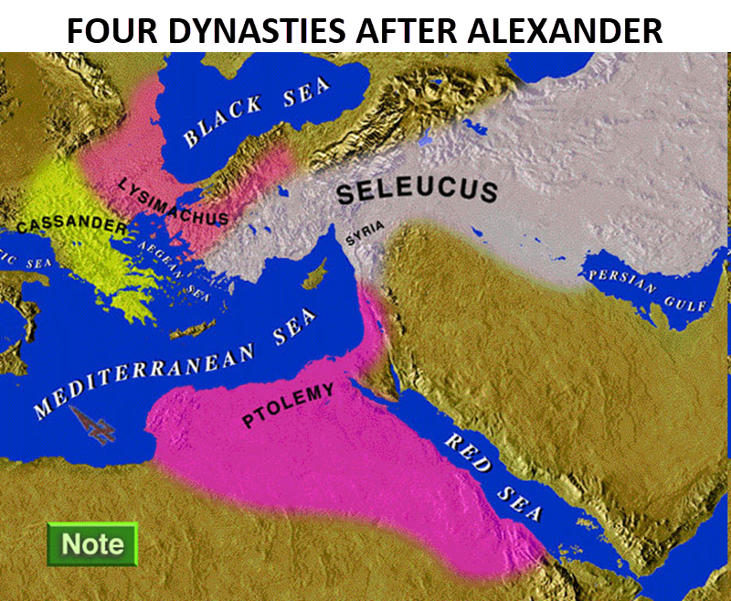

Slide 67
Intertestamental Chronology (Dates BC)
SELEUCIDS
Seleucus I 312-281
Antiochus I 281-261
Antiochus II 261-246
Seleucus II 246-226
Seleucus III 226-223
Antiochus III 223-187
Seleucus IV Philapator 187-175
Antiochus IV Epiphanes 175-163

Slide 68

HANUKKAH
The Maccabean revolt
December 25th 164 BC : the temple is liberated and rededicated
1 & 2 Maccabees
The miracle of the lamp oil
Hanukkah “Feast of Dedication” (festival of lights).
Christmas / Jewish Holiday
John 10:22-24

Slide 69
Levitical Feasts (Lev. 23)
Feast | Season | Purpose | Type
Passover | Spring | Redemption | 1 Cor. 5:7
Unleavened Bread | Spring | Separation | John 6:35
1st fruits | Spring | Praise | 1 Cor. 15:20
Pentecost | Spring | Praise | Acts 2:1-4
Trumpets | Fall | New Year | Matt. 24:31
Atonement | Fall | Lev 16 | Zech. 12:10
Booths | Fall | Wilderness provision | Zech. 14:16-18

Slide 70


Slide 71
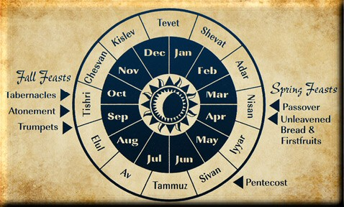

Slide 73

Ecclesiastes 1:9
“That which has been is that which will be, And that which has been done is that which will be done. So there is nothing new under the sun.”

Slide 74
Daniel 9:27
“And he will make a firm covenant with the many for one week, but in the middle of the week he will put a stop to sacrifice and grain offering; and on the wing of abominations will come one who makes desolate, even until a complete destruction, one that is decreed, is poured out on the one who makes desolate.”

Slide 77

Daniel 12:7
“I heard the man dressed in linen, who was above the waters of the river, as he raised his right hand and his left toward heaven, and swore by Him who lives forever that it would be for a time, times, and half a time; and as soon as they finish shattering the power of the holy people, all these events will be completed.”

Slide 78

Zechariah 13:8-9
⁸“It will come about in all the land,” Declares the Lord, “That two parts in it will be cut off and perish; But the third will be left in it. ⁹“And I will bring the third part through the fire, Refine them as silver is refined, And test them as gold is tested. They will call on My name, And I will answer them; I will say, ‘They are My people,’ And they will say, ‘The Lord is my God.’ ”

Slide 79
Zechariah 12:10
“I will pour out on the house of David and on the inhabitants of Jerusalem, the Spirit of grace and of supplication, so that they will look on Me whom they have pierced; and they will mourn for Him, as one mourns for an only son, and they will weep bitterly over Him like the bitter weeping over a firstborn.”

Slide 80
Romans 11:25-26
“²⁵ For I do not want you, brethren, to be uninformed of this mystery—so that you will not be wise in your own estimation—that a partial hardening has happened to Israel until the fullness of the Gentiles has come in; ²⁶ and so all Israel will be saved; just as it is written, ‘The Deliverer will come from Zion, He will remove ungodliness from Jacob.’”

Slide 81

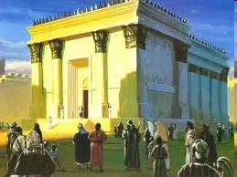
Israel’s Four Temples
Solomon’s pre exilic temple (Kings and Chronicles)
Zerubbabel’s post exilic temple (Ezra 1-6; John 2:20)
Antichrist's temple (Dan 9:27; Matt 24:15; 2 Thess 2:4; Rev 11:1-2)
Millennial temple (Ezek 40-48)

Slide 82
Israel’s Four Temples
Solomon’s pre exilic temple (Kings and Chronicles)
Zerubbabel’s post exilic temple (Ezra 1-6; John 2:20)
Antichrist's temple (Dan 9:27; Matt 24:15; 2 Thess 2:4; Rev 11:1-2)
Millennial temple (Ezek 40-48)

Slide 83
Matthew 24:15-16, 20
“¹⁵ Therefore when you see the abomination of desolation which was spoken of through Daniel the prophet, standing in the holy place (let the reader understand) ¹⁶ then those who are in Judea must flee to the mountains…²⁰ But pray that your flight will not be in the winter, or on a Sabbath.”

Slide 84
The Stage Is Being Set
Rebirth of Israel in 1948
Israel’s desire for peace
Desire among some Jews to Rebuild 3rd Jewish temple and Restore the sacrificial system
  Source: Randall Price “Ready to Rebuild”

Slide 85
The Stage Is Being Set
Rebirth of Israel in 1948
Israel’s desire for peace
Desire among some Jews to Rebuild 3rd Jewish temple and Restore the sacrificial system
  Source: Randall Price “Ready to Rebuild”

Slide 86
The Stage Is Being Set
Rebirth of Israel in 1948
Israel’s desire for peace
Desire among some Jews to Rebuild 3rd Jewish temple and Restore the sacrificial system
  Source: Randall Price “Ready to Rebuild”

Slide 87
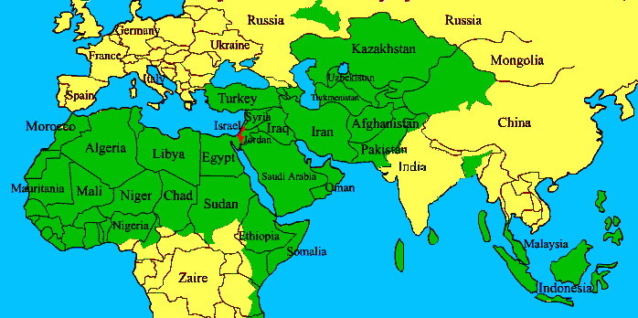
ISRAEL

Slide 88
The Stage Is Being Set
Rebirth of Israel in 1948
Israel’s desire for peace
Desire among some Jews to Rebuild 3rd Jewish temple and Restore the sacrificial system
  Source: Randall Price “Ready to Rebuild”

Slide 89


Slide 90


Slide 91
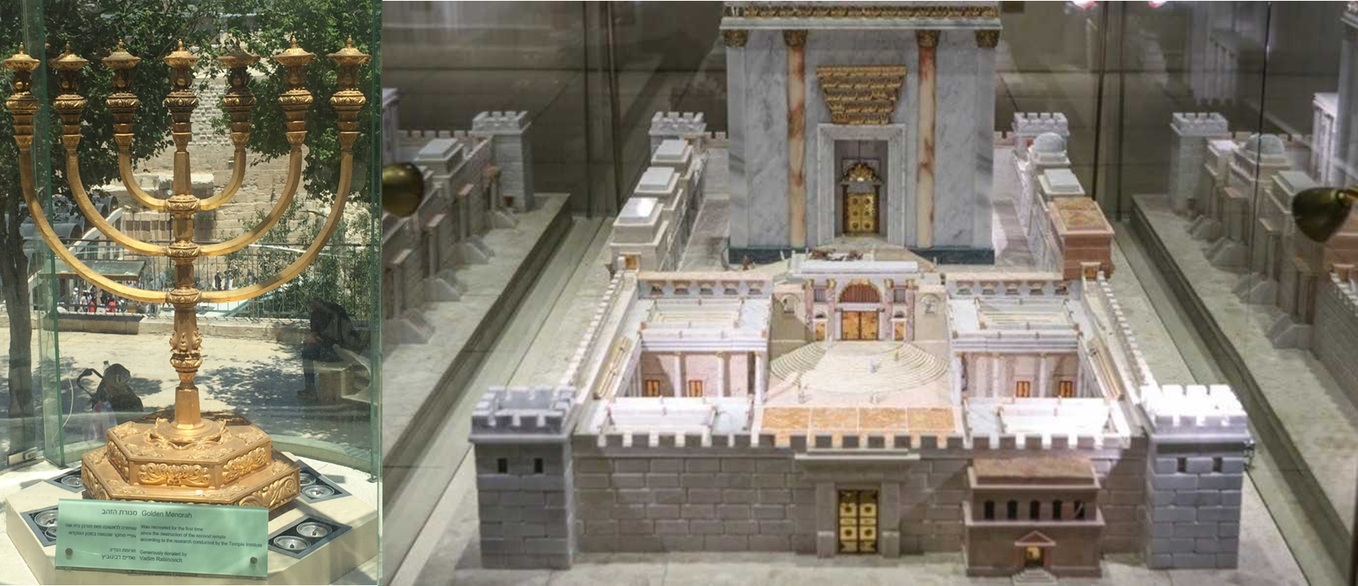

Slide 92
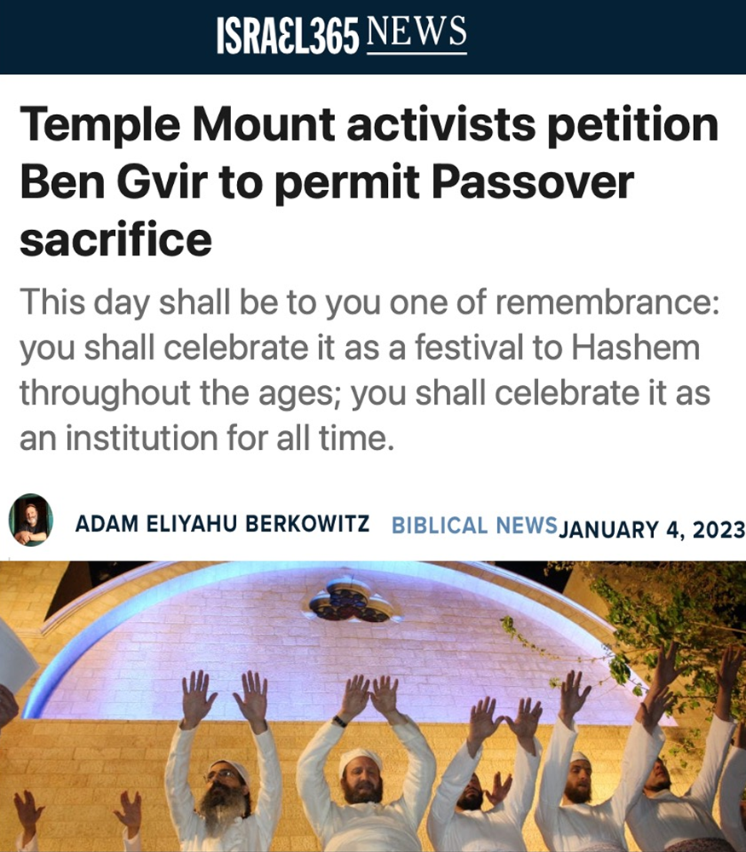

Slide 93
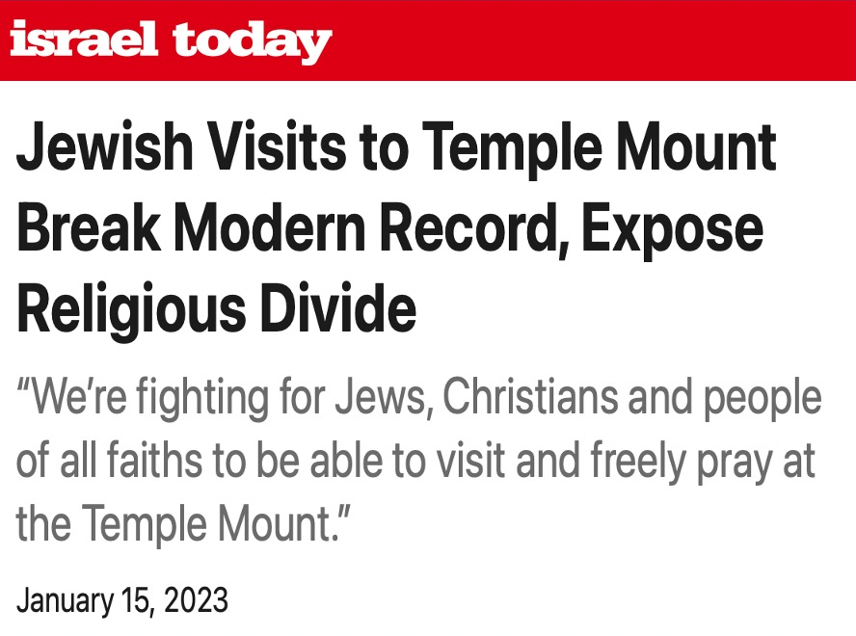

Slide 94


Slide 95
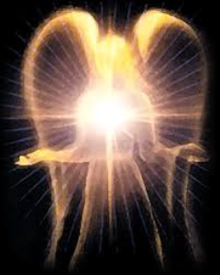
Original State and First Sin (cont’d)
Isaiah 14:12-15
    5 “I will” statements
    Ascend to heaven (13)
    Raise my throne above the stars of God (13)
    Sit enthroned on the Mt. of the Assembly (13)
    Ascend above the tops of the clouds (14)
    Make myself like the Most High (14)

Slide 96
Original State and First Sin (cont’d)
Isaiah 14:12-15
    5 “I will” statements
    Ascend to heaven (13)
    Raise my throne above the stars of God (13)
    Sit enthroned on the Mt. of the Assembly (13)
    Ascend above the tops of the clouds (14)
    Make myself like the Most High (14)

Slide 97


Isaiah 14:14
“I will ascend above the heights of the clouds; I will make myself like the Most High.”

Slide 98

Satan’s Tactics (2 Cor 2:11)
  Adds to God’s Word (3:1; 2:16-17)
  Challenges God’s goodness (3:1; 2:16-17)
  Subtracts from God’s Word (3:4; 2:17)
  Offers wisdom without submission to God (3:5; Prov 1:7)

Slide 99
2 Thessalonians 2:1-12
Problem (2:1-2)
Prerequisites for the Day of the Lord (2:3-12)
  The departure (2:3a)
  Advent of the lawless one (2:3b-4)
  Removal of the restrainer (2:5-7)
  Destruction of the lawless one (2:8-9)
  Destruction of lawless one’s followers (2:10-12)

Slide 100

Paul’s Various Rapture Terms
parousia | 2 Thess. 2:1
episynagōgē | 2 Thess. 2:1
apokalypsis | 1 Cor. 1:7
epiphaneia | Titus 2:13
rhyomai | 1 Thess. 1:10
harpazō | 1 Thess. 4:17
apostasia | 2 Thess. 2:3a

Slide 101
Conclusion

Slide 102
2 Thessalonians 2:1-12
Problem (2:1-2)
Prerequisites for the Day of the Lord (2:3-12)
  The departure (2:3a)
  Advent of the lawless one (2:3b-4)
  Removal of the restrainer (2:5-7)
  Destruction of the lawless one (2:8-9)
  Destruction of lawless one’s followers (2:10-12)

