Slide 1
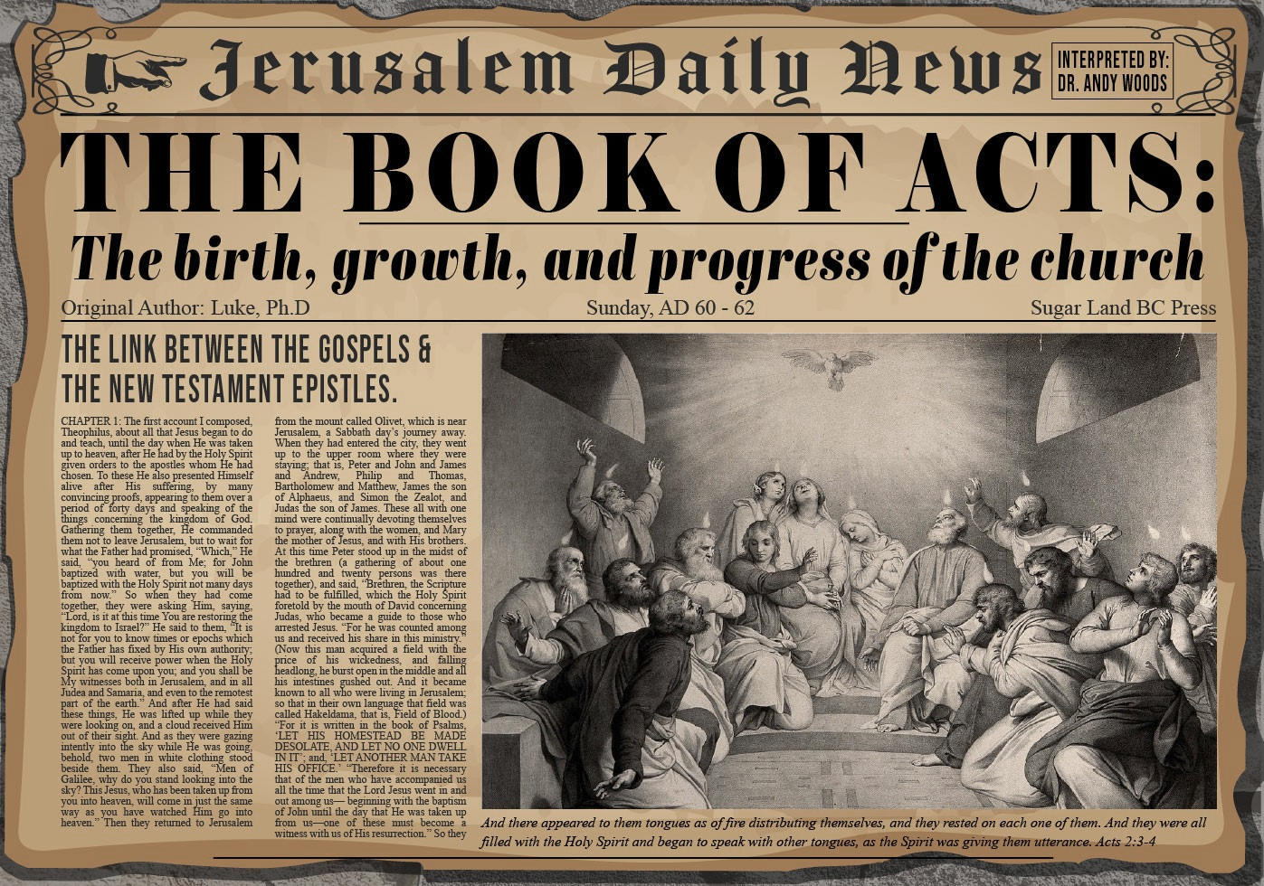


Slide 2
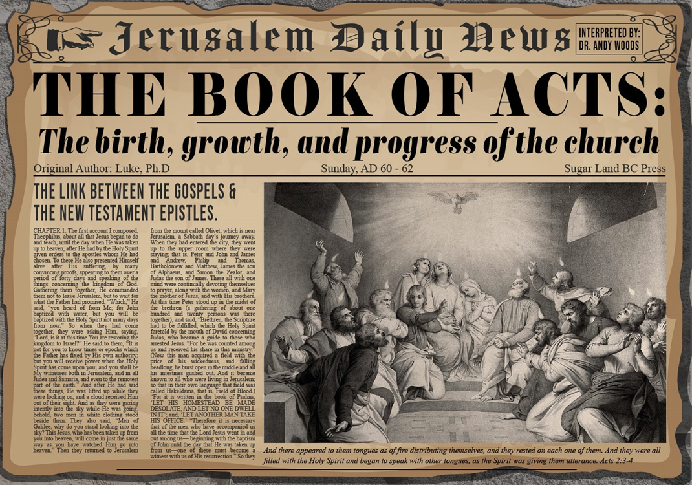
Acts 5:12‒42
Church’s Second Persecution
  Apostles’ Power (5:12-16)
  Apostles' Persecution (5:17-42)

Slide 3
II. Apostles’ Persecution
Acts 5:17-42
  Apostles’ arrest (17-26)
  Apostles’ examination (27-33)
  Gamaliel’s interruption & advice (34-39)
  Results (40-42)

Slide 4
Acts 5:27-33
Apostles’ Examination
      Apostles brought in (27)
      High priest’s accusations (28)
      Apostles’ response (29-32)
      Sanhedrin’s reaction (33)

Slide 5
Acts 5:29-32
Apostles’ Response
      Necessity of civil disobedience (29)
      Presentation of the Messiah (30-31)
      Witnesses (32)

Slide 6
Acts 5:30-31
Presentation of the Messiah
      Fulfilment of the Covenants (30a)
      Death (30b)
      Exaltation (31a)
      Messiah’s purpose (31b)

Slide 7
Acts 5:30-31
Presentation of the Messiah
      Fulfilment of the Covenants (30a)
      Death (30b)
      Exaltation (31a)
      Messiah’s purpose (31b)

Slide 8
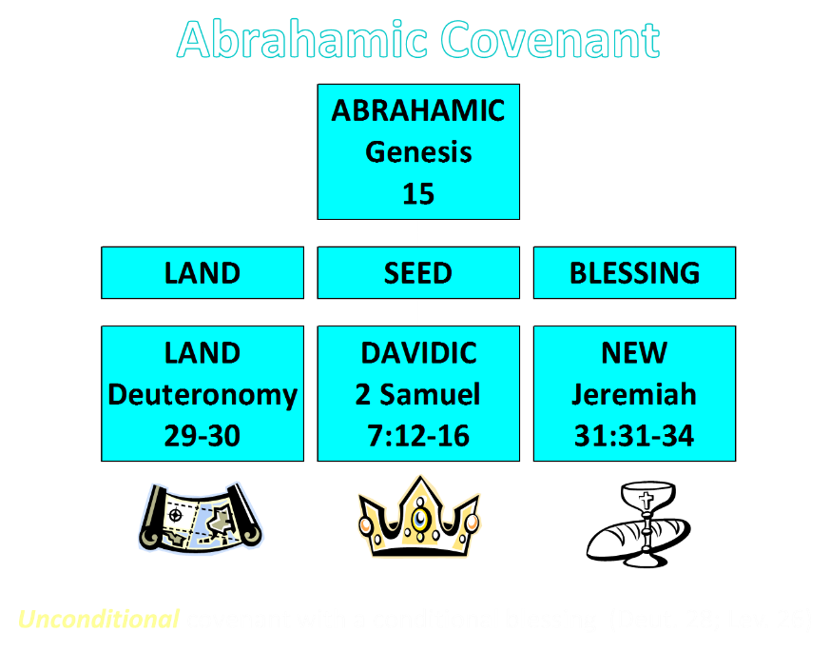

Slide 9
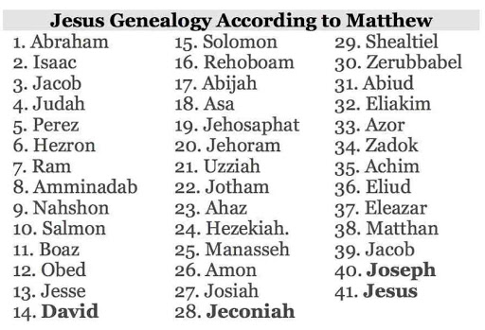

Slide 10
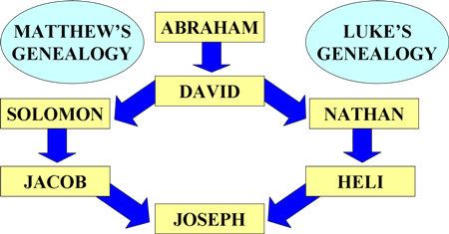
Matthean and Lukan Genealogies

Slide 11
Acts 5:30-31
Presentation of the Messiah
      Fulfilment of the Covenants (30a)
      Death (30b)
      Exaltation (31a)
      Messiah’s purpose (31b)

Slide 12

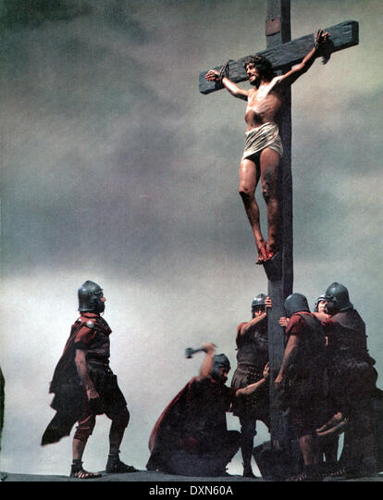
Acts 2:23
“this Man, delivered over by the predetermined plan and foreknowledge of God, you nailed to a cross by the hands of godless men and put Him to death.”

Slide 13
Acts 5:30-31
Presentation of the Messiah
      Fulfilment of the Covenants (30a)
      Death (30b)
      Exaltation (31a)
      Messiah’s purpose (31b)

Slide 14
Acts 2:15-35
Refutation of the Charge of Drunkenness
      Too early (15)
      Use of Joel 2:28-32 (16-21)
      Christ’s miracles (22)
      Crucifixion (23)
      Resurrection (24)
      Use of Psalm 16:8-11 (25-29)
      Use of Psalm 132:11 (30-32)
      High priestly ministry (33)
      Use of Psalm 110:1 (34-35)

Slide 15

Daniel 9:26
“Then after the sixty-two weeks the Messiah will be cut off and have nothing, and the people of the prince who is to come will destroy the city and the sanctuary. And its end will come with a flood; even to the end there will be war; desolations are determined.”

Slide 16
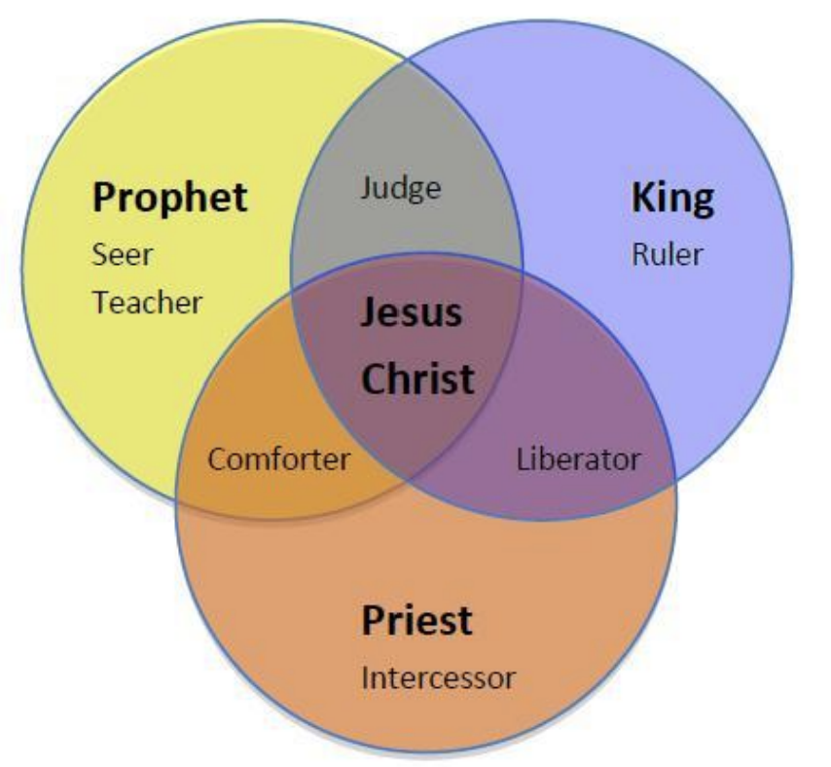
CHRIST’S THREE OFFICES
Prophet (First Coming)
Priest (Present Session)
King (Second Coming)

Slide 17
Acts 5:30-31
Presentation of the Messiah
      Fulfilment of the Covenants (30a)
      Death (30b)
      Exaltation (31a)
      Messiah’s purpose (31b)

Slide 18

Matthew 23:37-39
³⁷ “Jerusalem, Jerusalem, who kills the prophets and stones those who are sent to her! How often I wanted to gather [episynagō] your children together, the way a hen gathers [episynagō] her chicks under her wings, and you were unwilling. ³⁸ Behold, your house is being left to you desolate! ³⁹ For I say to you, from now on you will not see Me until you say, ‘Blessed is He who comes in the name of the Lord!’”

Slide 19
Acts 5:29-32
Apostles’ Response
      Necessity of civil disobedience (29)
      Presentation of the Messiah (30-31)
      Witnesses (32)

Slide 20
Acts 5:32
Witnesses
      Apostolic (32a)
      Holy Spirit (32b)

Slide 21
Acts 5:32
Witnesses
      Apostolic (32a)
      Holy Spirit (32b)

Slide 22
What Happened to Christ’s Disciples?
Disciple | Place | Martyrdom
James the Son of Alpheus | Jerusalem | Clubbed to death
Simon the Zealot | Jerusalem | Martyred
James the Son of Zebedee | Judea (Acts 12:2) | Executed
Thaddeus | Mesopotamia | Beaten to death
Peter | Babylon, Rome | Crucified upside down
Matthew | Parthia (Tehran) | Beheaded
Notes:
109 prophecies…
Peter Stoner – SCIENCE SPEAKS, An Evaluation of Certain Christian Evidences
To fulfill just 8 prophecies =1 X 10 to the twenty-eighth power!
Can we visualize this with an illustration? Suppose we took an atheistic professor, blindfolded him and covered the state of Texas two feet deep with silver dollars. Then we put a check on one of those silver dollars and mixed them up. The odds of one person fulfilling just these eight prophecies would be the same as this atheistic professor selecting the silver dollar upon which we have placed a check, in his first try.
https://www.bereanpublishers.com/the-odds-of-eight-messianic-prophecies-coming-true/

Slide 23
What Happened to Christ’s Disciples?
Disciple | Place | Martyrdom
John | Asia Minor, Patmos, Ephesus | Fried in boiling oil
Philip | E. Turkey | Tortured & crucified
Thomas | India | Speared
Bartholomew | India | Flayed & crucified
Andrew | Ukraine, Russia, Greece | Hanged
Notes:
109 prophecies…
Peter Stoner – SCIENCE SPEAKS, An Evaluation of Certain Christian Evidences
To fulfill just 8 prophecies =1 X 10 to the twenty-eighth power!
Can we visualize this with an illustration? Suppose we took an atheistic professor, blindfolded him and covered the state of Texas two feet deep with silver dollars. Then we put a check on one of those silver dollars and mixed them up. The odds of one person fulfilling just these eight prophecies would be the same as this atheistic professor selecting the silver dollar upon which we have placed a check, in his first try.
https://www.bereanpublishers.com/the-odds-of-eight-messianic-prophecies-coming-true/

Slide 24
Acts 5:32
Witnesses
      Apostolic (32a)
      Holy Spirit (32b)

Slide 25
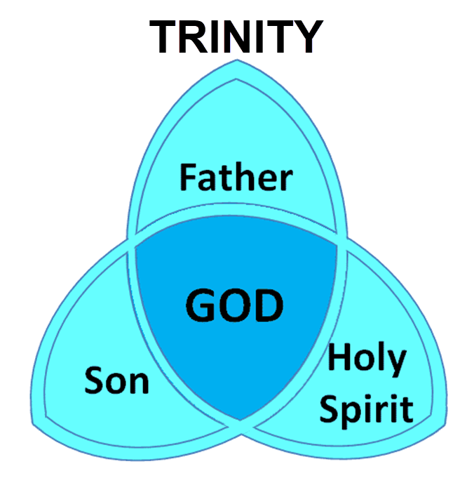

Slide 26
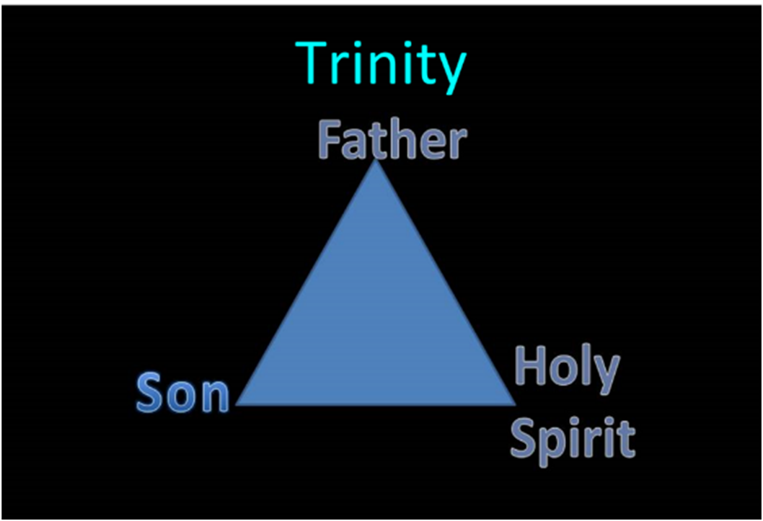

Slide 27
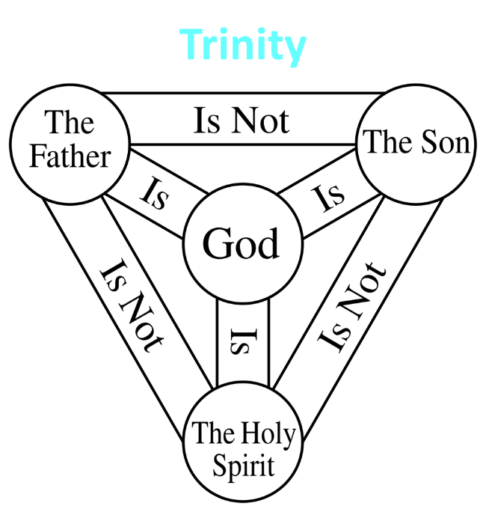

Slide 28


John 3:36
“The one who believes in the Son has eternal life; but the one who does not obey the Son will not see life, but the wrath of God remains on him.”

Slide 29
John 14:16-17
¹⁶ I will ask the Father, and He will give you another Helper, that He may be with you forever; ¹⁷ that is the Spirit of truth, whom the world cannot receive, because it does not see Him or know Him, but you know Him because He abides with you and will be in you.

Slide 30
Acts 5:27-33
Apostles’ Examination
      Apostles brought in (27)
      High priest’s accusations (28)
      Apostles’ response (29-32)
      Sanhedrin’s reaction (33)

Slide 31
Acts 5:33
Sanhedrin’s Reaction
      Conviction (33a)
      Rage (33b)

Slide 32
Acts 5:33
Sanhedrin’s Reaction
      Conviction (33a)
      Rage (33b)

Slide 33
John 16:7–11
⁷ “But I tell you the truth, it is to your advantage that I go away; for if I do not go away, the Helper will not come to you; but if I go, I will send Him to you. ⁸ “And He, when He comes, will convict the world concerning sin and righteousness and judgment; ⁹ concerning sin, because they do not believe in Me; ¹⁰ and concerning righteousness, because I go to the Father and you no longer see Me; ¹¹ and concerning judgment, because the ruler of this world has been judged.

Slide 34
Acts 5:33
Sanhedrin’s Reaction
      Conviction (33a)
      Rage (33b)

Slide 35
II. Apostles’ Persecution
Acts 5:17-42
  Apostles’ arrest (17-26)
  Apostles’ examination (27-33)
  Gamaliel’s interruption & advice (34-39)
  Results (40-42)

Slide 36
Acts 5:34-39
Gamaliel’s Interruption & Advice
      Gamaliel’s background (34)
      Gamaliel’s address (35-39)

Slide 37
Acts 5:34-39
Gamaliel’s Interruption & Advice
      Gamaliel’s background (34)
      Gamaliel’s address (35-39)

Slide 38
Acts 5:34
Gamaliel’s Background
      Introduction (34a)
      Command (34b)

Slide 39
Acts 5:34
Gamaliel’s Background
      Introduction (34a)
      Command (34b)

Slide 40
Acts 5:34
Gamaliel’s Background
      Introduction (34a)
      Command (34b)

Slide 41
Acts 5:34-39
Gamaliel’s Interruption & Advice
      Gamaliel’s background (34)
      Gamaliel’s address (35-39)

Slide 42
Acts 5:35-39
Gamaliel’s Address
      Need for caution (35)
      Two parallel illustrations (36-37)
      Application (38-39)

Slide 43
Acts 5:35-39
Gamaliel’s Address
      Need for caution (35)
      Two parallel illustrations (36-37)
      Application (38-39)

Slide 44
Acts 5:35-39
Gamaliel’s Address
      Need for caution (35)
      Two parallel illustrations (36-37)
      Application (38-39)

Slide 45
Acts 5:36-37
Two Parallel Illustrations
      Theudas (36)
      Judas of Galilee (37)

Slide 46
Acts 5:36-37
Two Parallel Illustrations
      Theudas (36)
      Judas of Galilee (37)

Slide 47
Acts 5:36-37
Two Parallel Illustrations
      Theudas (36)
      Judas of Galilee (37)

Slide 48
Acts 5:35-39
Gamaliel’s Address
      Need for caution (35)
      Two parallel illustrations (36-37)
      Application (38-39)

Slide 49
Acts 5:38-39
Application
      Command (38a)
      Reason (38b-39)

Slide 50
Acts 5:38-39
Application
      Command (38a)
      Reason (38b-39)

Slide 51
Acts 5:38-39
Application
      Command (38a)
      Reason (38b-39)

Slide 52
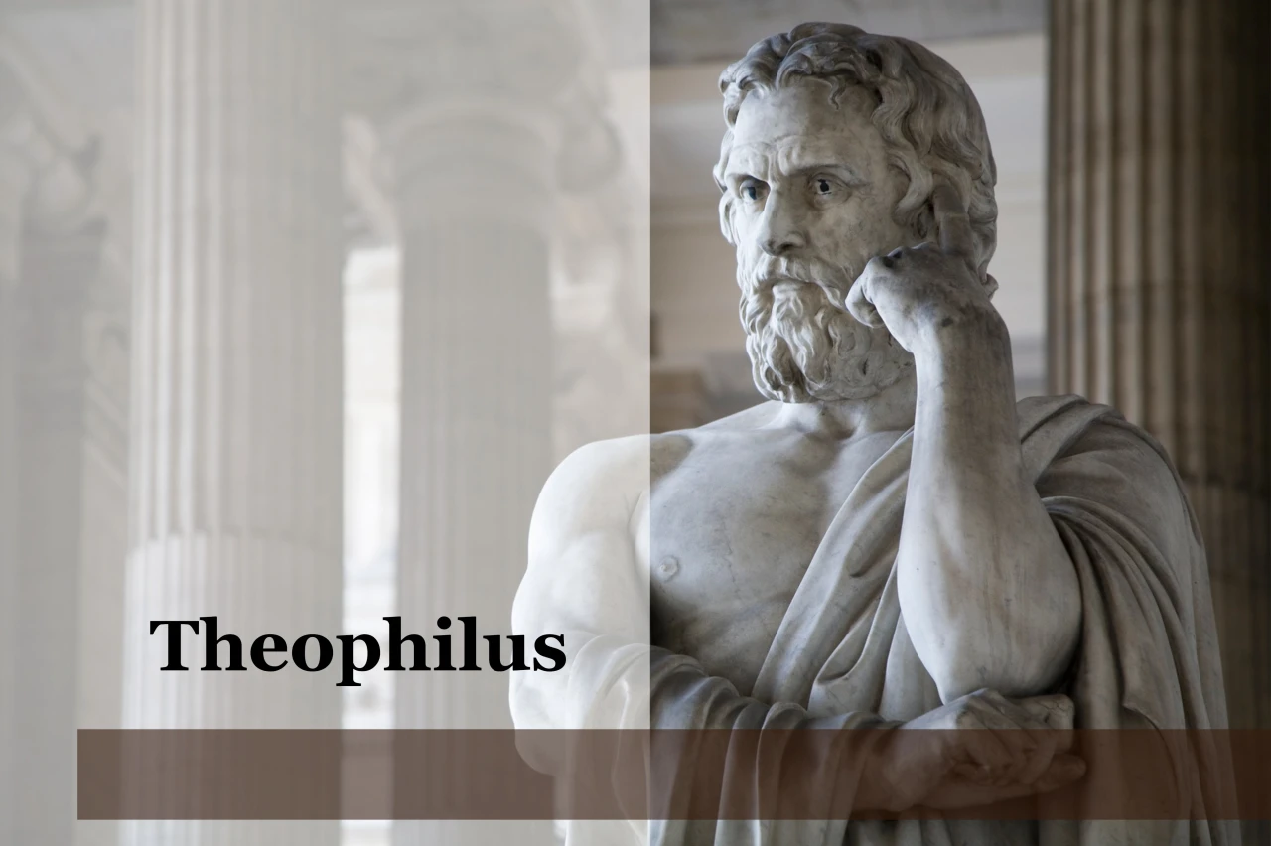
Purpose
  To present Theophilus with an orderly account of the birth and growth of the church so as to affirm him in what he has believed.

Slide 53

Message
  Birth and growth of the church numerically, geographically, ethnically.
  Components
  Numerically (progress reports)
  Geographically (From Jerusalem to Rome)
  Ethnically (From Judaism to Gentile domination)

Slide 54

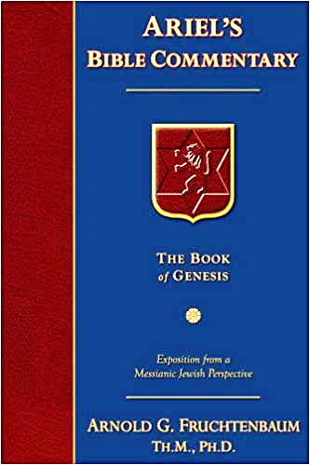
Dr. Arnold G. Fruchtenbaum
The Book of Acts, 143
“Some have taken Gamaliel’s words and turned them into divine truth. However, Luke simply recorded what Gamaliel said without confirming the validity of the words. This was Gamaliel’s personal opinion; it was not a biblical truth. Many things that are not of God (such as false religions and cults) have prospered. One must be careful not to use someone’s opinion as biblical truth.”

Slide 55
II. Apostles’ Persecution
Acts 5:17-42
  Apostles’ arrest (17-26)
  Apostles’ examination (27-33)
  Gamaliel’s interruption & advice (34-39)
  Results (40-42)

Slide 56
Acts 5:40-42
Results
      Sanhedrin (40)
      Results (41-42)

Slide 57
Acts 5:40-42
Results
      Sanhedrin (40)
      Results (41-42)

Slide 58
Acts 5:40
Sanhedrin
      Agreement with Gamaliel (40a)
      Summoned the Apostles (40b)
      Punished the Apostles (40c)
      Charged the Apostles (40d)
      Released the Apostles (40e)

Slide 59
Acts 5:40
Sanhedrin
      Agreement with Gamaliel (40a)
      Summoned the Apostles (40b)
      Punished the Apostles (40c)
      Charged the Apostles (40d)
      Released the Apostles (40e)

Slide 60
Acts 5:40
Sanhedrin
      Agreement with Gamaliel (40a)
      Summoned the Apostles (40b)
      Punished the Apostles (40c)
      Charged the Apostles (40d)
      Released the Apostles (40e)

Slide 61
Acts 5:40
Sanhedrin
      Agreement with Gamaliel (40a)
      Summoned the Apostles (40b)
      Punished the Apostles (40c)
      Charged the Apostles (40d)
      Released the Apostles (40e)

Slide 62
Acts 5:40
Sanhedrin
      Agreement with Gamaliel (40a)
      Summoned the Apostles (40b)
      Punished the Apostles (40c)
      Charged the Apostles (40d)
      Released the Apostles (40e)

Slide 63
Acts 5:40
Sanhedrin
      Agreement with Gamaliel (40a)
      Summoned the Apostles (40b)
      Punished the Apostles (40c)
      Charged the Apostles (40d)
      Released the Apostles (40e)

Slide 64
Acts 5:40-42
Results
      Sanhedrin (40)
      Results (41-42)

Slide 65
Acts 5:41-42
Apostles
      Joy (41)
      Zeal (42)

Slide 66
Acts 5:41-42
Apostles
      Joy (41)
      Zeal (42)

Slide 67
Acts 5:41-42
Apostles
      Joy (41)
      Zeal (42)

Slide 68
Conclusion

Slide 69
Acts 5:12‒42
Church’s Second Persecution
  Apostles’ Power (5:12-16)
  Apostles' Persecution (5:17-42)

