Slide 1
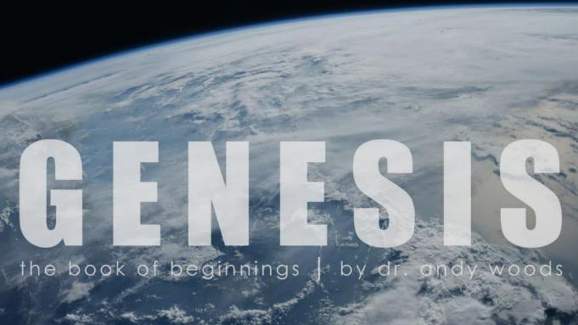
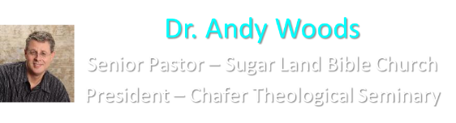
Genesis 12‒50
Israel’s Birth & Preservation

Slide 2
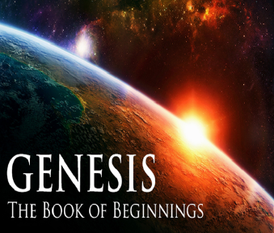
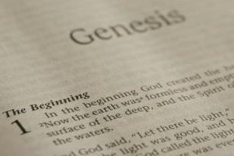
GENESIS STRUCTURE
  Genesis 12-50 (four people)
    Abraham (12:1–25:11)
    Isaac (25:12–26:35)
    Jacob (27–36)
    Joseph (37–50)

Slide 3
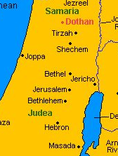

Slide 4
Genesis 35:1-29
Transitionary Information
  Jacob’s journey to Bethel (35:1-8)
  Divine appearance (35:9-15)
  Benjamin’s birth (35:16-20)
  Reuben loses the birthright (35:21-22a)
  Jacob’s dozen (35:22b-26)
  Isaac’s death (35:27-29)

Slide 5
IV. Genesis 35:21-22a
Reuben Loses the Birthright
    Geographical marker (21)
    Reuben’s sin (22a)

Slide 6
IV. Genesis 35:21-22a
Reuben Loses the Birthright
    Geographical marker (21)
    Reuben’s sin (22a)

Slide 7
IV. Genesis 35:21-22a
Reuben Loses the Birthright
    Geographical marker (21)
    Reuben’s sin (22a)

Slide 8
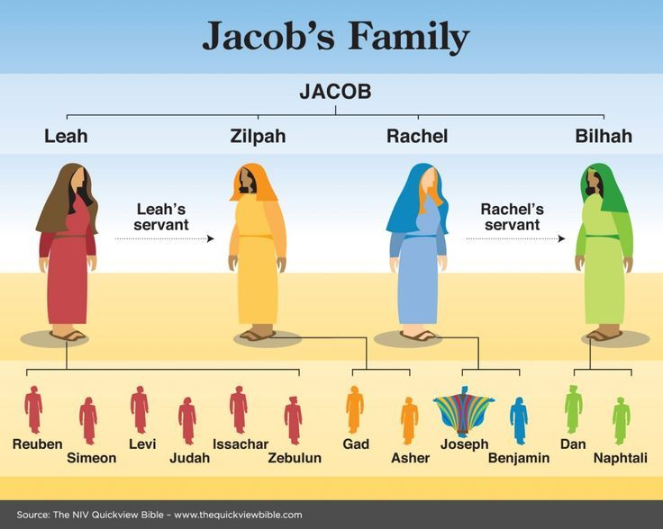

Slide 9
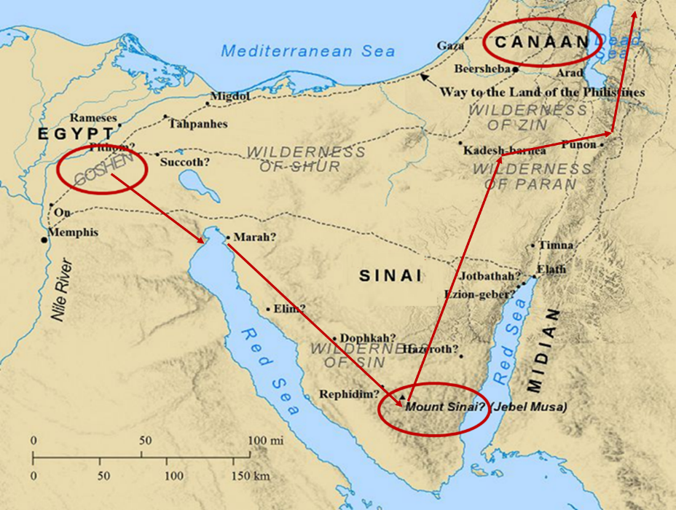

Slide 10
Messiah must be from the tribe of Judah
Genesis 49:10

Slide 11
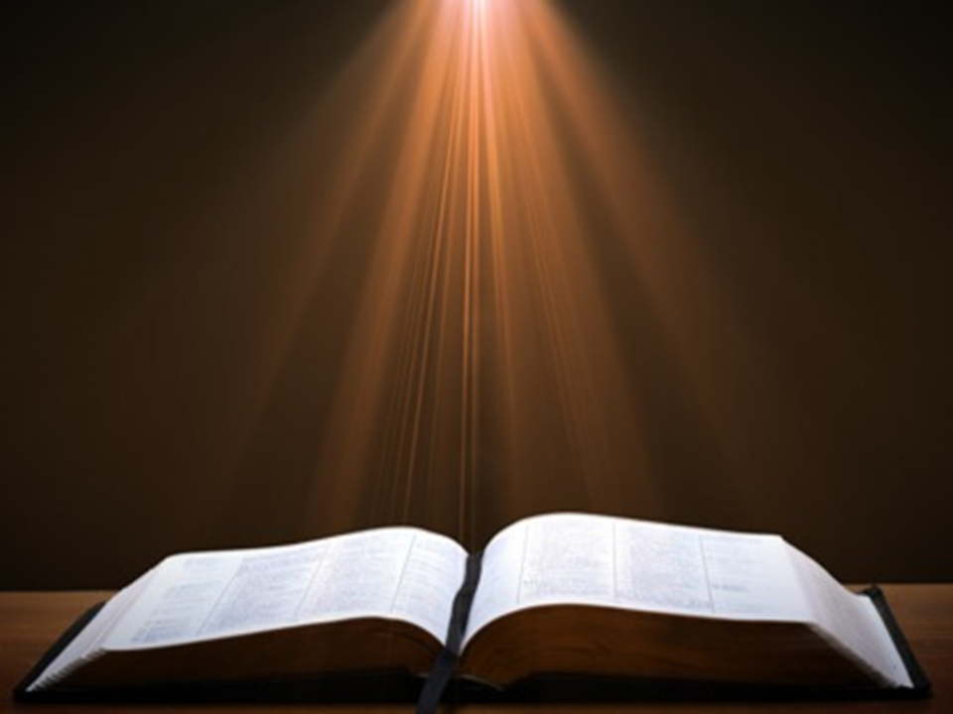
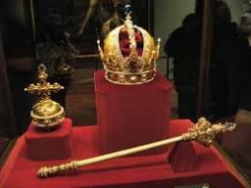
Genesis 49:10
“The scepter shall not depart from Judah, Nor the ruler’s staff from between his feet, Until Shiloh comes, And to him shall be the obedience of the peoples.”

Slide 12
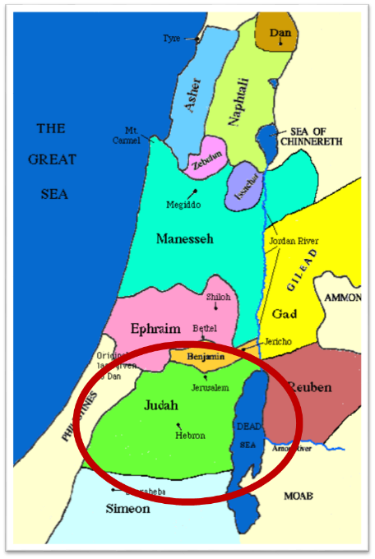

Slide 13
Messiah must be from the tribe of Judah
Genesis 49:10
Revelation 5:5

Slide 14
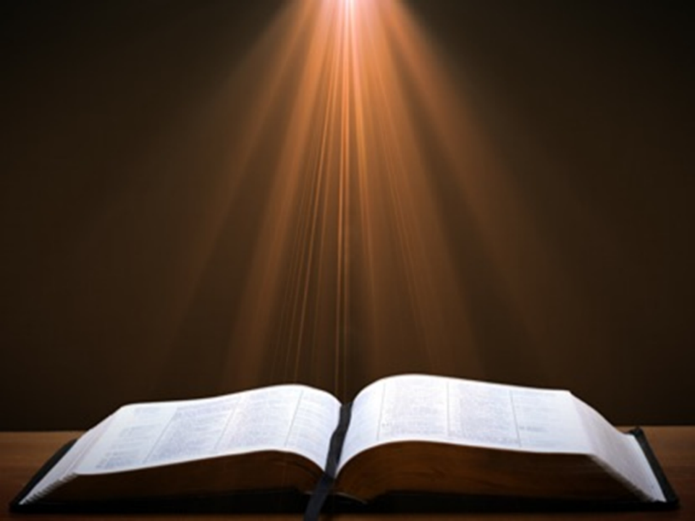
Revelation 5:5
“and one of the elders said to me, “Stop weeping; behold, the Lion that is from the tribe of Judah, the Root of David, has overcome so as to open the book and its seven seals.”

Slide 15
Matthew 19:28
“And Jesus said to them, ‘Truly I say to you, that you who have followed Me, in the regeneration when the Son of Man will sit on His glorious throne, you also shall sit upon twelve thrones, judging the twelve tribes of Israel.’”

Slide 16
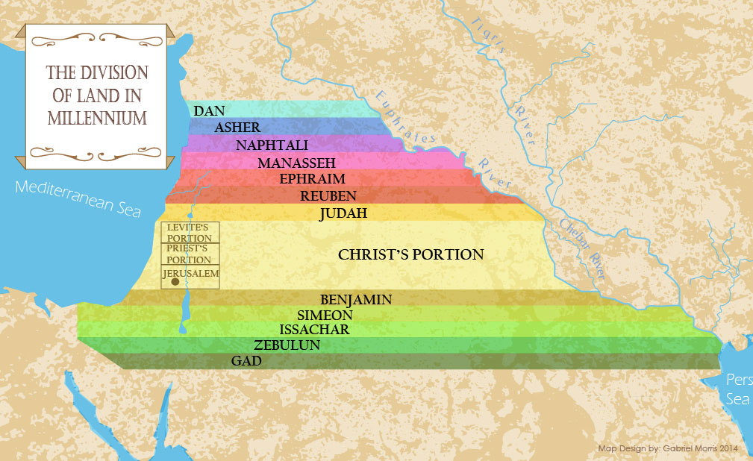

Slide 17

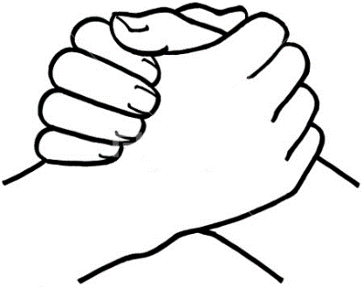
John 10:27-29
“²⁷ My sheep hear My voice, and I know them, and they follow Me; ²⁸ and I give eternal life to them, and they will never perish [ou mē; aiōnia]; and no one will snatch them out of My hand. ²⁹ My Father, who has given them to Me, is greater than all; and no one is able to snatch them out of the Father’s hand.”

Slide 18
Romans 8:29–30
²⁹ For those whom He foreknew, He also predestined to become conformed to the image of His Son, so that He would be the firstborn among many brethren; ³⁰ and these whom He predestined, He also called; and these whom He called, He also justified; and these whom He justified, He also glorified.

Slide 19
1 Peter 1:4–5
^{“4} to obtain an inheritance which is imperishable and undefiled and will not fade away, reserved in heaven for you, ⁵ who are protected by the power of God through faith for a salvation ready to be revealed in the last time.”

Slide 20

2 Corinthians 5:10
“For we must all appear before the judgment seat of Christ, so that each one may be recompensed for his deeds in the body, according to what he has done, whether good or bad.”

Slide 21
Scripture’s Four Judgments
Name | Sheep and Goat | Judgment of the Jews | Bema Seat | Great White Throne
Scripture | Matt 25:31-46 | Ezek 20:33-44 | 1 Cor 3:10-15 | Rev 20:11-15
Place | Earth, Jerusalem | Earth, wilderness | Heaven | Earth
Audience | Gentile Tribulation survivors | Jewish Tribulation survivors | Church Age believers | All unsaved
When | After Tribulation | After Tribulation | After rapture | After Millennium
Purpose | Saved Gentiles enter kingdom | Saved Jews enter kingdom | Reward believers | Degree of punishment in hell
Evaluation | Treatment of Christ’s brethren | Passing under shepherd’s rod | Works taken through fire | Not in the book; judged by books

Slide 22
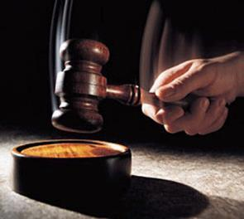
Why?
Not to judge sin (John 19:30)
Not to determine salvation (John 5:24)
But rather to give or not give rewards

Slide 23

1 Corinthians 3:10-15
¹⁰ According to the grace of God which was given to me, like a wise master builder I laid a foundation, and another is building on it. But each man must be careful how he builds on it. ¹¹ For no man can lay a foundation other than the one which is laid, which is Jesus Christ. ¹² Now if any man builds on the foundation with gold, silver, precious stones, wood, hay, straw, ¹³ each man’s work will become evident; for the day will show it because it is to be revealed with fire, and the fire itself will test the quality of . . .

Slide 24
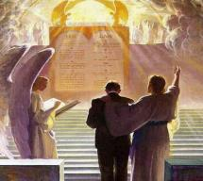
1 Corinthians 3:10-15
. . . each man’s work. ¹⁴ If any man’s work which he has built on it remains, he will receive a reward. ¹⁵ If any man’s work is burned up, he will suffer loss; but he himself will be saved, yet so as through fire.

Slide 25
Scripture’s Five Crowns (Rev 4:10: 3:11; 2 John 8)
SCRIPTURE | CROWN | PURPOSE
1 Cor. 9:24-27 | Incorruptible | Gaining mastery over the flesh
1 Thess. 2:19-20 | Rejoicing | Soul winning
Jas. 1:12; Rev. 2:10 | Life | Enduring trials
1 Pet. 5:2-4 | Glory | Shepherding God’s people
2 Tim. 4:8 | Righteousness | Longing for His appearing

Slide 26
1 Corinthians 9:24-27
“Do you not know that those who run in a race all run, but only one receives the prize? Run in such a way that you may win. ²⁵ Everyone who competes in the games exercises self-control in all things. They then do it to receive a perishable wreath, but we an imperishable. ²⁶ Therefore I run in such a way, as not without aim; I box in such a way, as not beating the air; ²⁷ but I discipline my body and make it my slave, so that, after I have preached to others, I myself will not be disqualified.”

Slide 27
Scripture’s Five Crowns (Rev 4:10: 3:11; 2 John 8)
SCRIPTURE | CROWN | PURPOSE
1 Cor. 9:24-27 | Incorruptible | Gaining mastery over the flesh
1 Thess. 2:19-20 | Rejoicing | Soul winning
Jas. 1:12; Rev. 2:10 | Life | Enduring trials
1 Pet. 5:2-4 | Glory | Shepherding God’s people
2 Tim. 4:8 | Righteousness | Longing for His appearing

Slide 28

Samuel Hoyt
“The Judgment Seat of Christ in Theological Perspective,” Part 2, Bibliotheca Sacra, electronic media.
“The judgment seat of Christ might be compared to a commencement ceremony. At graduation there is some measure of disappointment and remorse that one did not do better and work harder. However, at such an event the overwhelming emotion is joy, not remorse. The graduates do not leave the auditorium weeping because they did not earn better grades. Rather, they are thankful that they have been graduated, and they are grateful for what they did achieve. To overdo the sorrow aspect of the judgment seat of Christ is to make heaven hell. To under do the sorrow aspect is to make faithfulness inconsequential” (underlining mine).

Slide 29
Genesis 35:1-29
Transitionary Information
  Jacob’s journey to Bethel (35:1-8)
  Divine appearance (35:9-15)
  Benjamin’s birth (35:16-20)
  Reuben loses the birthright (35:21-22a)
  Jacob’s dozen (35:22b-26)
  Isaac’s death (35:27-29)

Slide 30
V. Genesis 35:22b-26
Jacob’s Dozen
    Introduction (22b)
    Jacob’s dozen (23-26a)
    Conclusion (26b)

Slide 31
V. Genesis 35:22b-26
Jacob’s Dozen
    Introduction (22b)
    Jacob’s dozen (23-26a)
    Conclusion (26b)

Slide 33
V. Genesis 35:22b-26
Jacob’s Dozen
    Introduction (22b)
    Jacob’s dozen (23-26a)
    Conclusion (26b)

Slide 34
Genesis 35:23-26a
Jacob’s Dozen
      Leah’s six sons (23)
      Rachel’s two sons (24)
      Bilhah’s two sons (25)
      Zilpah’s two sons (26a)

Slide 35
Genesis 35:23-26a
Jacob’s Dozen
      Leah’s six sons (23)
      Rachel’s two sons (24)
      Bilhah’s two sons (25)
      Zilpah’s two sons (26a)

Slide 37
Genesis 49:10
“The scepter shall not depart from Judah, Nor the ruler’s staff from between his feet, Until Shiloh comes, And to him shall be the obedience of the peoples.”

Slide 38
Genesis 35:23-26a
Jacob’s Dozen
      Leah’s six sons (23)
      Rachel’s two sons (24)
      Bilhah’s two sons (25)
      Zilpah’s two sons (26a)

Slide 40
Genesis 35:23-26a
Jacob’s Dozen
      Leah’s six sons (23)
      Rachel’s two sons (24)
      Bilhah’s two sons (25)
      Zilpah’s two sons (26a)

Slide 42
Genesis 35:23-26a
Jacob’s Dozen
      Leah’s six sons (23)
      Rachel’s two sons (24)
      Bilhah’s two sons (25)
      Zilpah’s two sons (26a)

Slide 44
V. Genesis 35:22b-26
Jacob’s Dozen
    Introduction (22b)
    Jacob’s dozen (23-26a)
    Conclusion (26b)

Slide 45
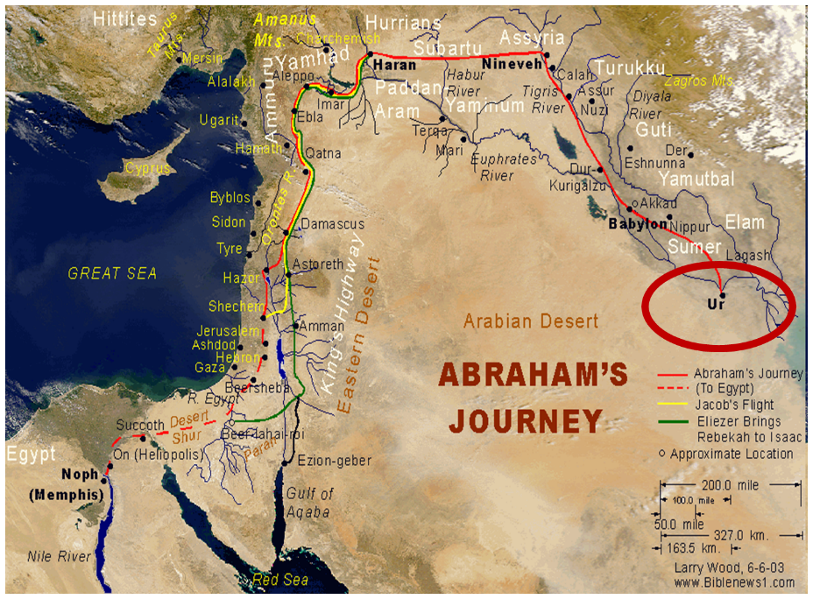

Slide 47
Genesis 35:1-29
Transitionary Information
  Jacob’s journey to Bethel (35:1-8)
  Divine appearance (35:9-15)
  Benjamin’s birth (35:16-20)
  Reuben loses the birthright (35:21-22a)
  Jacob’s dozen (35:22b-26)
  Isaac’s death (35:27-29)

Slide 48
VI. Genesis 35:27-29
Isaac’s Death
    Reunion of Isaac and Jacob (27)
    Isaac’s total years (28)
    Isaac’s death (29)

Slide 49
VI. Genesis 35:27-29
Isaac’s Death
    Reunion of Isaac and Jacob (27)
    Isaac’s total years (28)
    Isaac’s death (29)

Slide 50
Genesis 35:27
Reunion of Isaac and Jacob
      Contact (27a)
      Place (27b)

Slide 51
Genesis 35:27
Reunion of Isaac and Jacob
      Contact (27a)
      Place (27b)

Slide 53
Genesis 35:27
Reunion of Isaac and Jacob
      Contact (27a)
      Place (27b)

Slide 54
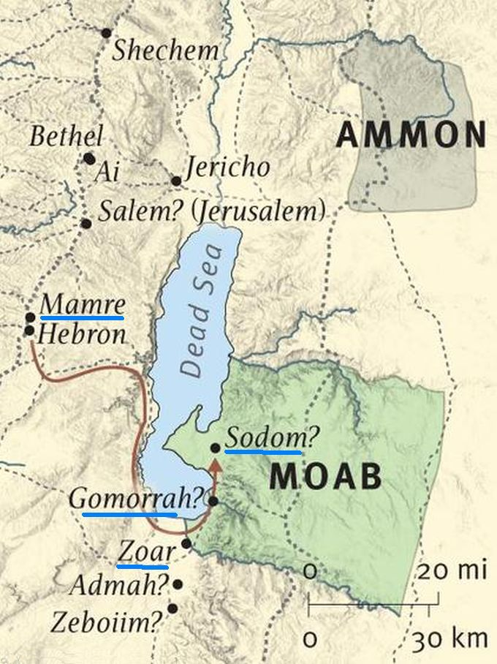

Slide 55
VI. Genesis 35:27-29
Isaac’s Death
    Reunion of Isaac and Jacob (27)
    Isaac’s total years (28)
    Isaac’s death (29)

Slide 56
VI. Genesis 35:27-29
Isaac’s Death
    Reunion of Isaac and Jacob (27)
    Isaac’s total years (28)
    Isaac’s death (29)

Slide 57
Genesis 35:29
Isaac’s Death
      Death (29a)
      Full of days (29b)
      Burial (29c)

Slide 58
Genesis 35:29
Isaac’s Death
      Death (29a)
      Full of days (29b)
      Burial (29c)

Slide 59
“Death” in the Old Testament
māwet: “Death is the consequences and the punishment of sin. It originated with sin. A grand theme of the Old Testament is God’s holiness, which separates Him from all that is in harmony with His character. Death, then, in the Old Testament means ultimate separation from God due to sin.”
Elmer B. Smick, “māwet," in Theological Wordbook of the Old Testament, ed. R. Laird Harris and Gleason L. Archer and Bruce K. Waltke(Chicago: Moody, 1980), 1:1169.

Slide 60
“Death” in the New Testament
thanatos: “that separation (whether natural or violent) of the soul from the body by which the life on earth is ended.”
Joseph Henry Thayer, Death - Thanatos, Greek-English Lexicon of the New Testament Being Grmm's Wilke's Clavis Novi Testamenti (Grand Rapids: Zondervan, 1977), 282.

Slide 61

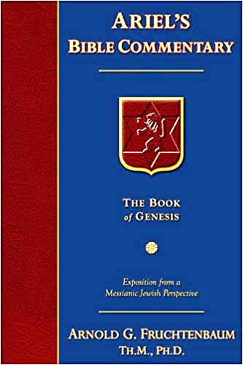
Dr. Arnold G. Fruchtenbaum
The Book of Genesis, 392
“This phrase ‘gathered to his people’ is used ten times, and only in the Pentateuch: Genesis 25:8, of Abraham; 25:17, of Ishmael; 35:29, of Isaac; 49:29, of Jacob; 49:33, of Jacob; Numbers 20:24, of Aaron; 20:26, of Aaron; 27:13, of Moses; 31:2, of Moses; and Deuteronomy 32:50, of Aaron and Moses. A parallel phrase is gathered to his fathers in Genesis 15:15 and 47:30.”

Slide 63

Daniel 12:1-2
“¹ Now at that time Michael, the great prince who stands guard over the sons of your people, will arise. And there will be a time of distress such as never occurred since there was a nation until that time; and at that time your people, everyone who is found written in the book, will be rescued. ² Many of those who sleep in the dust of the ground will awake, these to everlasting life, but the others to disgrace and everlasting contempt.”

Slide 64
Genesis 35:29
Isaac’s Death
      Death (29a)
      Full of days (29b)
      Burial (29c)

Slide 65

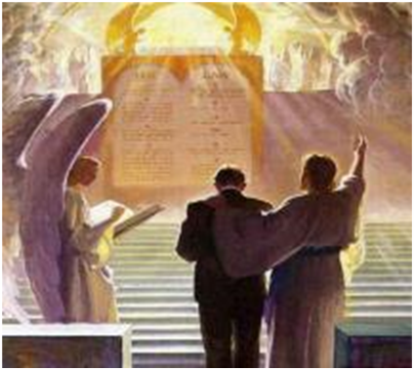
2 Timothy 4:7-8
“⁷ I have fought the good fight, I have finished the course, I have kept the faith; ⁸ in the future there is reserved for me the crown of righteousness, which the Lord, the righteous Judge, will award to me on that day; and not only to me, but also to all who have loved His appearing.”

Slide 66
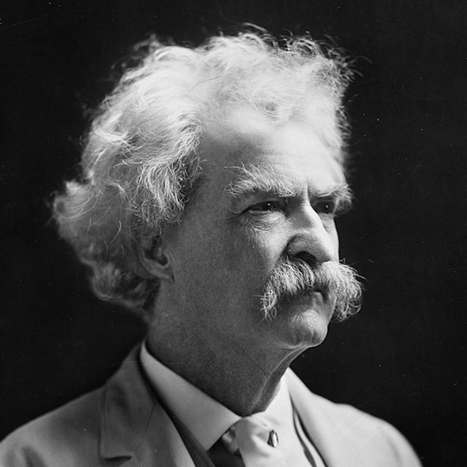
Mark Twain
Autobiography, 2:37
“A myriad of men are born; they labor and sweat and struggle for bread; they squabble and scold and fight; they scramble for little mean advantages over each other. Age creeps upon them and infirmities follow; shames and humiliations bring down their prides and their vanities. Those they love are taken from them, and the joy of life is turned to aching grief. The burden of pain, care, and misery grows heavier year by year. At length ambition is dead, pride is dead, vanity is dead; longing for release is in their place. It comes at last-the only un-poisoned gift earth ever had for them-and they vanish from a world where they were of no consequence; where they achieved nothing, where they were a mistake and a failure and a foolishness; where they left no sign that they have existed – a world that will lament them a day and forget them forever.”

Slide 67
Genesis 35:29
Isaac’s Death
      Death (29a)
      Full of days (29b)
      Burial (29c)

Slide 69
Genesis 12‒25
Abraham’s Early Journeys
Unconditional promises (Gen. 12:1-3) From Haran to Canaan (Gen. 12:4-5) In Canaan (Gen. 12:6-9) In Egypt (Gen. 12:10-20) Abram and Lot Separate (Gen. 13:1-13) Reaffirmation of Abram’s promises (Gen. 13:14-18) Abram Rescues Lot (14:1-24) Abrahamic Covenant (15:1-21) Hagar & Ishmael (16:1-16) Circumcision (Gen. 17:1-27) | Sodom & Gomorrah (Gen. 18‒19) Abraham & Abimelech (Gen. 20) Isaac’s birth (Gen. 21:1-7) Ishmael’s expulsion (21:8-21) Abraham & Abimelech’s covenant (21:22-34) Abraham sacrifices Isaac (22) Sarah’s death (23) Isaac’s marriage (24) Abraham & Keturah (25:1-6) Abraham’s death (25:7-11)

Slide 70
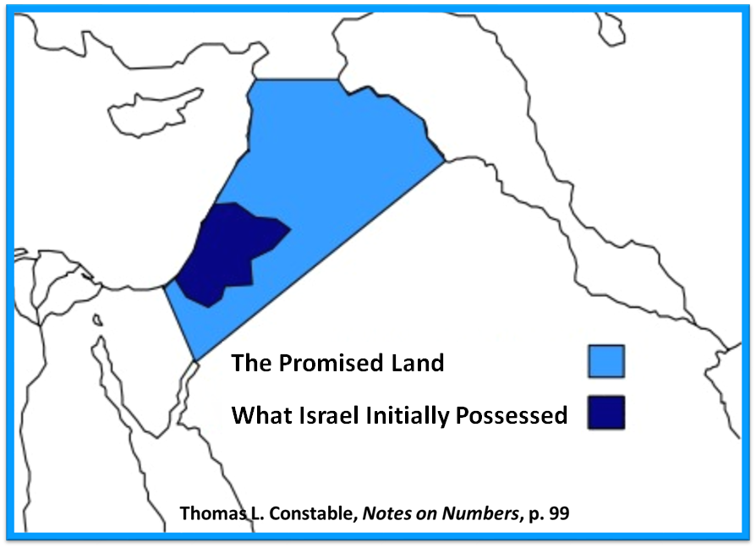

Slide 71
Conclusion

Slide 72
Genesis 35:1-29
Transitionary Information
  Jacob’s journey to Bethel (35:1-8)
  Divine appearance (35:9-15)
  Benjamin’s birth (35:16-20)
  Reuben loses the birthright (35:21-22a)
  Jacob’s dozen (35:22b-26)
  Isaac’s death (35:27-29)

Slide 73
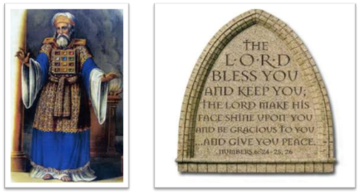
²⁴ The Lord bless you, and keep you; ²⁵ The Lord make His face shine on you, And be gracious to you; ²⁶ The Lord lift up His countenance on you, And give you peace.
Numbers 6:24–26 (NASB95)

