Slide 1


Apostasy or Rapture?
(2 Thessalonians 2:3A)
Dr. Andy Woods
Senior Pastor – Sugar Land Bible Church
President – Chafer Theological Seminary

Slide 2


2 Thessalonians 2:3
“Let no one in any way deceive you, for it will not come unless the apostasy [apostasia; departure] comes first, and the man of lawlessness is revealed, the son of destruction.”

Slide 3
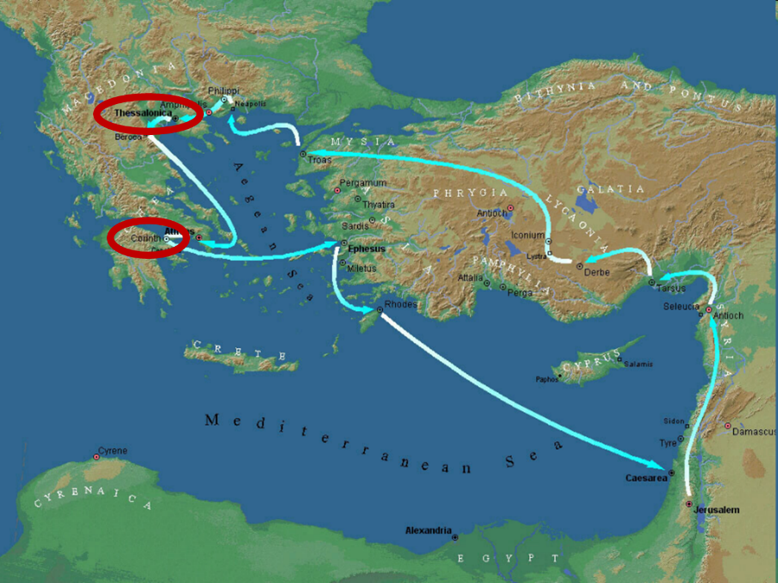

Slide 4

2 Thessalonians 2:1-12
Problem (2:1-2)
Prerequisites for the Day of the Lord (2:3-12)
  The apostasy (2:3a)
  Advent of the lawless one (2:3b-4)
  Removal of the restrainer (2:5-7)
  Destruction of the lawless one (2:8-9)
  Destruction of lawless one’s followers (2:10-12)

Slide 5

2 Thessalonians 2:2
“that you not be quickly shaken from your composure or be disturbed either by a spirit or a message or a letter as if from us, to the effect that the day of the Lord [the Tribulation ] has come.”

Slide 6
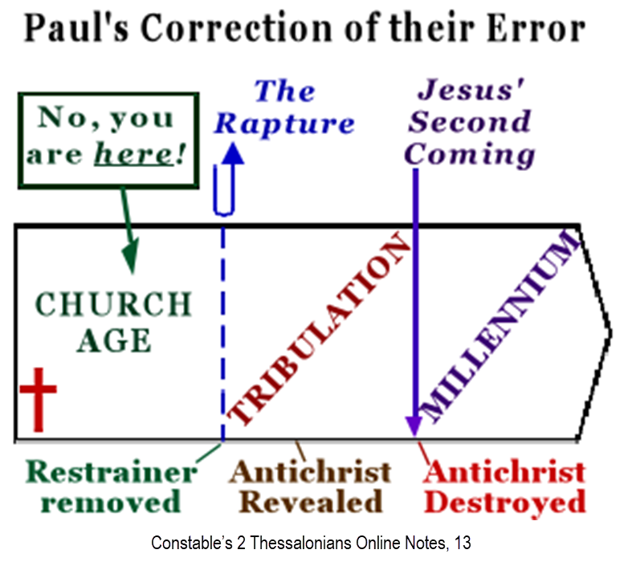

Slide 7
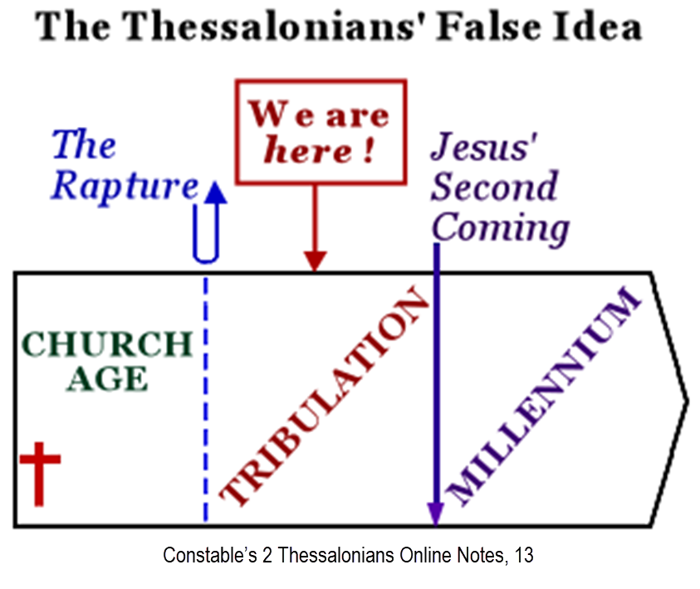

Slide 8
2 Thessalonians 2:1-12
Problem (2:1-2)
Prerequisites for the Day of the Lord (2:3-12)
  The apostasy (2:3a)
  Advent of the lawless one (2:3b-4)
  Removal of the restrainer (2:5-7)
  Destruction of the lawless one (2:8-9)
  Destruction of lawless one’s followers (2:10-12)

Slide 9
2 Thessalonians 2:1-12
Problem (2:1-2)
Prerequisites for the Day of the Lord (2:3-12)
  The apostasy (2:3a)
  Advent of the lawless one (2:3b-4)
  Removal of the restrainer (2:5-7)
  Destruction of the lawless one (2:8-9)
  Destruction of lawless one’s followers (2:10-12)

Slide 10

Apostasy? (2:3a)
Spiritual departure (Acts 21:21) – Unbelieving world embracing the antichrist
Physical departure (Acts 12:10; 2 Cor. 12:8) – Rapture

Slide 11
Apostasy? (2:3a)
Spiritual departure (Acts 21:21) – Unbelieving world embracing the antichrist
Physical departure (Acts 12:10; 2 Cor. 12:8) – Rapture

Slide 12
Spiritual Departure Options
Apostasy of the Church (pre-rapture)
Apostasy of the World (post-rapture)
Apostasy of Israel (Dan. 9:27)

Slide 13
Apostasy? (2:3a)
Spiritual departure (Acts 21:21) – Unbelieving world embracing the antichrist
Physical departure (Acts 12:10; 2 Cor. 12:8) – Rapture

Slide 14
2 Thessalonians 2:3
“Let no one in any way deceive you, for it will not come unless the apostasy [apostasia] comes first [prōton], and the man of lawlessness is revealed, the son of destruction.”

Slide 15
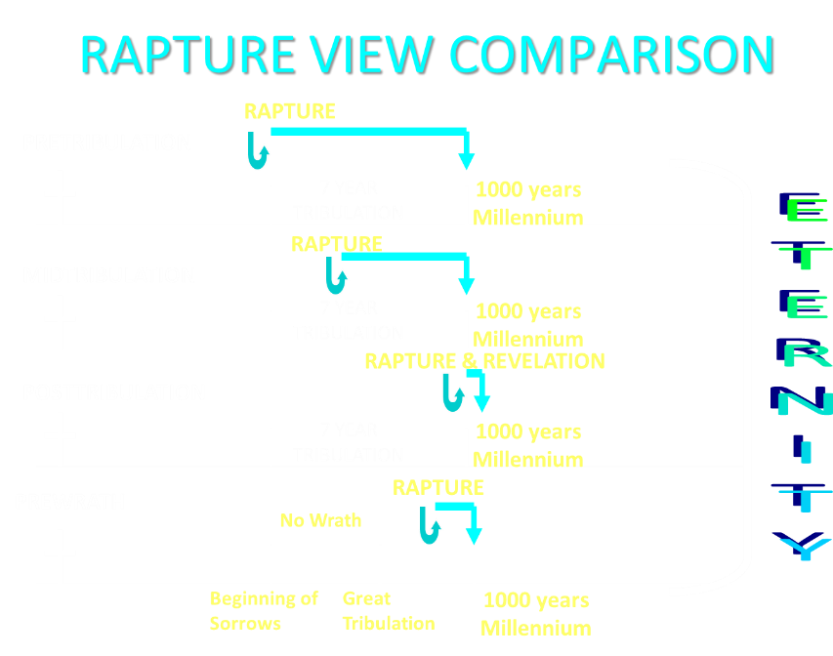

Slide 16


Slide 17

10 Cumulative Reasons Favoring Physical Departure
There have always been doctrinal departures
2 Thess. was an early letter
The definite article before apostasia
Noun apostasia can refer to physical departure
Verb aphistēmi can refer to physical departure

Slide 18
10 Cumulative Reasons Favoring Physical Departure
Extended context favors physical departure
Immediate context favors physical departure
2 Thess. 2:2 is a review course
Early Bible translations favor physical departure
Physical departure is held by credible scholars

Slide 19

Physical Departure Adherents
Kenneth Wuest |  | Paul Lee Tan*
E. Schuyler English |  | Arnold Fruchtenbaum*
J. Dwight Pentecost |  | Tim LaHaye
H. Wayne House* |  | Thomas Ice
Stanley Ellison |  | Don Stewart
J.S. Mabie |  | Robert Thieme
Allen McRae |  | Gordon Olson*
Gordon Lewis |  | J. Vernon McGee*
Henry Morris* |  | Jimmy DeYoung*
John. R. Rice |  | J.D. Farag
David Olander* |  | David Hocking
J. Carl Laney* |  | Jimmy Swaggart*
Grant Jeffrey |  | Chuck Smith*
Myron Houghton*

Slide 20

Answering Objections to the Physical Departure View
Greek from the Koine period?
Subtraction from the Last Days will be characterized by continual apostasy?
Rapture is passive and apostasy is active?
Incongruence with verse 1?
Paul is re-assuring the Thessalonians that they had not already missed the rapture; therefore, it would be incomprehensible to read, “the rapture cannot have happened unless the rapture happens first”

Slide 21
Answering Objections to the Physical Departure View
Greek from the Koine period?
Subtraction from the Last Days will be characterized by continual apostasy?
Rapture is passive and apostasy is active?
Incongruence with verse 1?
Paul is re-assuring the Thessalonians that they had not already missed the rapture; therefore, it would be incomprehensible to read, “the rapture cannot have happened unless the rapture happens first”

Slide 22
H. Wayne House
"Apostasia in 2 Thessalonians 2:3: Apostasy of Rapture?," in When the Trumpet Sounds: Today's Foremost Authorities Speak out on End-Time Controversies, ed. Thomas Ice and Timothy Demy (Eugene, OR: Harvest House, 1995), 273.
“The noun form allows for apostasia as a simple departure in the classical period, proved by examples from Liddell and Scott...If one says that this is not important because the meaning is only classical or ancient and thus lost its meaning by the time of the New Testament, then I may turn to the same root meaning of apostasia in the patristic era immediately following the New Testament period, as indicated in the definitions for the noun form in Lampe's Patristic Greek Lexicon. Although the noun used in the sense of spatial departure is not the normal meaning…during New Testament times, the word is found with this meaning in time periods before and after the New Testament era, and it is likely to have been understood this way at least sometimes.”

Slide 23

Entries for Apostasia in Liddell & Scott
Rebellion against God
Apostasy
Departure
Disappearance
Distance
Henry Liddell & Henry Scott, A Greek English Lexicon (Oxford: Oxford University Press, 1940), 218.

Slide 24
Entries for Apostasia in Lampe’s A Patristic Greek Lexicon
Revolt
Defection
Apostasy from paganism, Judaism, Christianity, orthodoxy
Divorce
Departure
Standing aloof
G. W. H. Lampe, A Patristic Greek Lexicon (Oxford: Clarnedon Press, 1961), 208.

Slide 25
Answering Objections to the Physical Departure View
Greek from the Koine period?
Subtraction from the Last Days will be characterized by continual apostasy?
Rapture is passive and apostasy is active?
Incongruence with verse 1?
Paul is re-assuring the Thessalonians that they had not already missed the rapture; therefore, it would be incomprehensible to read, “the rapture cannot have happened unless the rapture happens first”

Slide 26
ORDER OF PAUL’S LETTERS | ORDER OF PAUL’S LETTERS
1. | Galatians | A.D. 49
2. | 1‒2 Thessalonians | A.D. 51
3. | 1‒2 Corinthians | A.D. 56
4. | Romans | A.D. 57
5. | Ephesians, Colossians, Philemon, Philippians | A.D. 60‒62
6. | 1 Timothy, Titus | A.D. 62‒66
7. | 2 Timothy | A.D. 67

Slide 27
1 Timothy 4:1
“But the Spirit explicitly says that in later times some will fall away [aphistēmi] from the faith, paying attention to deceitful spirits and doctrines of demons.”

Slide 28
2 Thessalonians 2:3
“Let no one in any way deceive you, for it will not come unless the apostasy [apostasia] comes first [prōton], and the man of lawlessness is revealed, the son of destruction.”

Slide 29
Answering Objections to the Physical Departure View
Greek from the Koine period?
Subtraction from the Last Days will be characterized by continual apostasy?
Rapture is passive and apostasy is active?
Incongruence with verse 1?
Paul is re-assuring the Thessalonians that they had not already missed the rapture; therefore, it would be incomprehensible to read, “the rapture cannot have happened unless the rapture happens first”

Slide 30

Mark Hitchcock
Mark and Jeff Kinley Hitchcock, The Coming Apostasy: Exposing the Sabatoge of Christianity from Within (Carol Stream, Ill: Tyndale, 2017), 191
“Since the word apostasia means ‘departure,’ some have understood the term ‘the apostasy’ to be the physical departure of the church itself—that is, the Rapture, since the Rapture will be a physical departure of believers from the earth. If this view were correct, it would definitely place the Rapture before the Tribulation, which would be a slam dunk for the pre-Tribulation Rapture position. While this is attractive to pretribulationalists, there are six main reasons to reject a physical departure as the meaning of apostasia in this context:”

Slide 31
Mark Hitchcock
Mark and Jeff Kinley Hitchcock, The Coming Apostasy: Exposing the Sabatoge of Christianity from Within (Carol Stream, Ill: Tyndale, 2017), 191
“(1) In classical Greek, hē apostasia (‘the apostasy’) was used to denote a political or military rebellion. (2) In the Septuagint (the Greek translation of the Old Testament), this term was used of rebellion against God (see Joshua 22:22; Jeremiah 2:19). (3) In 2 Maccabees 2:15 (a noncanonical book written in the time between the Old and New Testaments), it is used of apostasy to paganism. (4) In Acts 21:21, the only other use of the noun in the New Testament, it refers to apostasy or spiritual departure from Moses.”

Slide 32
Mark Hitchcock
Mark and Jeff Kinley Hitchcock, The Coming Apostasy: Exposing the Sabatoge of Christianity from Within (Carol Stream, Ill: Tyndale, 2017), 191
“(1) In classical Greek, hē apostasia (‘the apostasy’) was used to denote a political or military rebellion. (2) In the Septuagint (the Greek translation of the Old Testament), this term was used of rebellion against God (see Joshua 22:22; Jeremiah 2:19). (3) In 2 Maccabees 2:15 (a noncanonical book written in the time between the Old and New Testaments), it is used of apostasy to paganism. (4) In Acts 21:21, the only other use of the noun in the New Testament, it refers to apostasy or spiritual departure from Moses.”

Slide 33
Entries for Apostasia in Liddell & Scott
Rebellion against God
Apostasy
Departure
Disappearance
Distance
Henry Liddell & Henry Scott, A Greek English Lexicon (Oxford: Oxford University Press, 1940), 218.

Slide 34
Mark Hitchcock
Mark and Jeff Kinley Hitchcock, The Coming Apostasy: Exposing the Sabatoge of Christianity from Within (Carol Stream, Ill: Tyndale, 2017), 191
“(1) In classical Greek, hē apostasia (‘the apostasy’) was used to denote a political or military rebellion. (2) In the Septuagint (the Greek translation of the Old Testament), this term was used of rebellion against God (see Joshua 22:22; Jeremiah 2:19). (3) In 2 Maccabees 2:15 (a noncanonical book written in the time between the Old and New Testaments), it is used of apostasy to paganism. (4) In Acts 21:21, the only other use of the noun in the New Testament, it refers to apostasy or spiritual departure from Moses.”

Slide 35
Mark Hitchcock
Mark and Jeff Kinley Hitchcock, The Coming Apostasy: Exposing the Sabatoge of Christianity from Within (Carol Stream, Ill: Tyndale, 2017), 191
“(1) In classical Greek, hē apostasia (‘the apostasy’) was used to denote a political or military rebellion. (2) In the Septuagint (the Greek translation of the Old Testament), this term was used of rebellion against God (see Joshua 22:22; Jeremiah 2:19). (3) In 2 Maccabees 2:15 (a noncanonical book written in the time between the Old and New Testaments), it is used of apostasy to paganism. (4) In Acts 21:21, the only other use of the noun in the New Testament, it refers to apostasy or spiritual departure from Moses.”

Slide 36
Acts 21:21
“and they have been told about you, that you are teaching all the Jews who are among the Gentiles to forsake [apostasia] Moses, telling them not to circumcise their children nor to walk according to the customs.”

Slide 37
2 Thessalonians 2:3
“Let no one in any way deceive you, for it will not come unless the apostasy [apostasia] comes first, and the man of lawlessness is revealed, the son of destruction.”

Slide 38
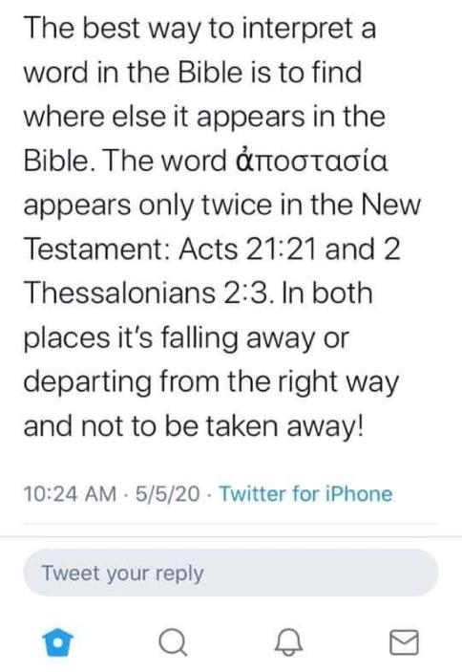


Slide 39
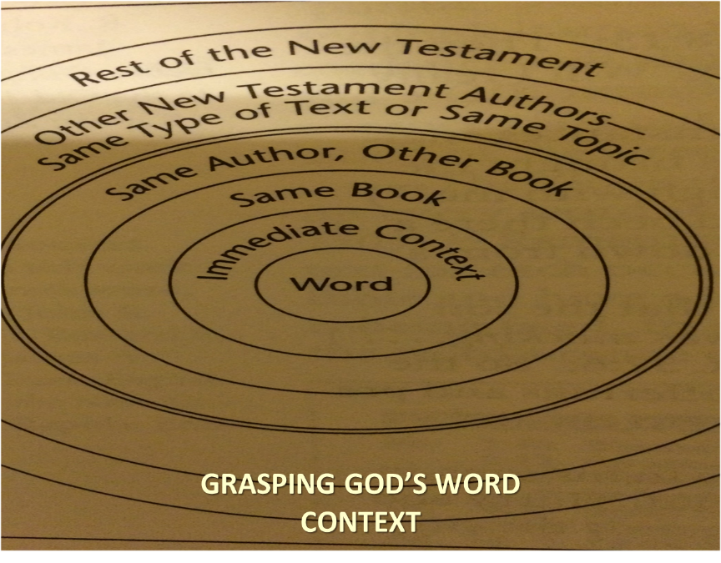

Slide 40
THE APOSTASIA
2 Thessalonians 2:3a | Acts 21:21
Pauline authorship | Lukan authorship
Paul speaking | Paul not speaking (v. 20)
Mosaic Law not mentioned | Departure from the Mosaic Law
Epistolary genre | Narrative genre
Definite article | No definite article

Slide 41
Mark Hitchcock
Mark and Jeff Kinley Hitchcock, The Coming Apostasy: Exposing the Sabatoge of Christianity from Within (Carol Stream, Ill: Tyndale, 2017), 191
“(5) The Rapture is not an act of departure by the saints; the saints are passive not active participants. (6) In 2 Thessalonians 2:1, Paul refers to the Rapture as ‘our gathering together to Him.’ It seems strange to use this unlikely term (‘the apostasy’) for the same thing in the immediate context. (These six points are from D. Edmond Hiebert, 1 & 2 Thessalonians [Chicago: Moody Press, 1971], 331.) For these reasons, most expositors have understood ‘the rebellion’ (apostasy) not as the physical departure of the church at the Rapture but rather as doctrinal, theological, and moral departure from the truth.”

Slide 42
Mark Hitchcock
Mark and Jeff Kinley Hitchcock, The Coming Apostasy: Exposing the Sabatoge of Christianity from Within (Carol Stream, Ill: Tyndale, 2017), 191
“(5) The Rapture is not an act of departure by the saints; the saints are passive not active participants. (6) In 2 Thessalonians 2:1, Paul refers to the Rapture as ‘our gathering together to Him.’ It seems strange to use this unlikely term (‘the apostasy’) for the same thing in the immediate context. (These six points are from D. Edmond Hiebert, 1 & 2 Thessalonians [Chicago: Moody Press, 1971], 331.) For these reasons, most expositors have understood ‘the rebellion’ (apostasy) not as the physical departure of the church at the Rapture but rather as doctrinal, theological, and moral departure from the truth.”

Slide 43
Mark Hitchcock
Mark and Jeff Kinley Hitchcock, The Coming Apostasy: Exposing the Sabatoge of Christianity from Within (Carol Stream, Ill: Tyndale, 2017), 191
“(5) The Rapture is not an act of departure by the saints; the saints are passive not active participants. (6) In 2 Thessalonians 2:1, Paul refers to the Rapture as ‘our gathering together to Him.’ It seems strange to use this unlikely term (‘the apostasy’) for the same thing in the immediate context. (These six points are from D. Edmond Hiebert, 1 & 2 Thessalonians [Chicago: Moody Press, 1971], 331.) For these reasons, most expositors have understood ‘the rebellion’ (apostasy) not as the physical departure of the church at the Rapture but rather as doctrinal, theological, and moral departure from the truth.”

Slide 44
2 Thessalonians 2:1
“Now we request you, brethren, with regard to the coming of our Lord Jesus Christ and our gathering together to Him.”

Slide 45

Paul’s Various Rapture Terms
parousia | 2 Thess. 2:1
episynagōgē | 2 Thess. 2:1
apokalypsis | 1 Cor. 1:7
epiphaneia | Titus 2:13
rhyomai | 1 Thess. 1:10
harpazō | 1 Thess. 4:17
apostasia | 2 Thess. 2:3a

Slide 46
Mark Hitchcock
Mark and Jeff Kinley Hitchcock, The Coming Apostasy: Exposing the Sabatoge of Christianity from Within (Carol Stream, Ill: Tyndale, 2017), 191
“(5) The Rapture is not an act of departure by the saints; the saints are passive not active participants. (6) In 2 Thessalonians 2:1, Paul refers to the Rapture as ‘our gathering together to Him.’ It seems strange to use this unlikely term (‘the apostasy’) for the same thing in the immediate context. (These six points are from D. Edmond Hiebert, 1 & 2 Thessalonians [Chicago: Moody Press, 1971], 331.) For these reasons, most expositors have understood ‘the rebellion’ (apostasy) not as the physical departure of the church at the Rapture but rather as doctrinal, theological, and moral departure from the truth.”

Slide 47
D. Edmond Hiebert
The Thessalonian Epistles. Chicago: Moody Press, 1971. Page 306
"Nowhere else does the Scripture speak of the rapture as 'the departure.' A departure denotes an act on the part of the individual or company departing. But the rapture is not an act of departure on the part of the saints. In the rapture the church is passive, not active. At the rapture, the church is 'caught up' or 'snatched away,' an event wherein the Lord acts to transport believers from earth into His presence (1 Thess. 4:16-17). Everything that takes place with the believers at the rapture is initiated by the Lord and done by Him.”

Slide 48
D. Edmond Hiebert
The Thessalonian Epistles. Chicago: Moody Press, 1971. Page 306
"Nowhere else does the Scripture speak of the rapture as 'the departure.' A departure denotes an act on the part of the individual or company departing. But the rapture is not an act of departure on the part of the saints. In the rapture the church is passive, not active. At the rapture, the church is 'caught up' or 'snatched away,' an event wherein the Lord acts to transport believers from earth into His presence (1 Thess. 4:16-17). Everything that takes place with the believers at the rapture is initiated by the Lord and done by Him.”

Slide 49

Matthew 4:4
“But He answered and said, “It is written, ‘Man shall not live on bread alone, but on every word that proceeds out of the mouth of God.’”

Slide 50
Matthew 5:18
“For truly I say to you, until heaven and earth pass away, not the smallest letter or stroke shall pass from the Law until all is accomplished.”

Slide 51
Answering Objections to the Physical Departure View
Greek from the Koine period?
Subtraction from the Last Days will be characterized by continual apostasy?
Rapture is passive and apostasy is active?
Incongruence with verse 1?
Paul is re-assuring the Thessalonians that they had not already missed the rapture; therefore, it would be incomprehensible to read, “the rapture cannot have happened unless the rapture happens first”

Slide 52
2 Thessalonians 2:1
“Now we request you, brethren, with regard to the coming [parousia] of our Lord Jesus Christ and our gathering [episynagōgē] together to Him.”

Slide 53
2 Thessalonians 2:3
“Let no one in any way deceive you, for it will not come unless the apostasy [apostasia] comes first, and the man of lawlessness is revealed, the son of destruction.”

Slide 54

D. Edmond Hiebert
The Thessalonian Epistles. Chicago: Moody Press, 1971. Page 306
"Paul has just referred to the rapture as 'our gathering together unto him' (v. 1); why then should he now use this unlikely term to mean the same thing?”

Slide 55
Mark Hitchcock
Mark and Jeff Kinley Hitchcock, The Coming Apostasy: Exposing the Sabatoge of Christianity from Within (Carol Stream, Ill: Tyndale, 2017), 191
“(5) The Rapture is not an act of departure by the saints; the saints are passive not active participants. (6) In 2 Thessalonians 2:1, Paul refers to the Rapture as ‘our gathering together to Him.’ It seems strange to use this unlikely term (‘the apostasy’) for the same thing in the immediate context. (These six points are from D. Edmond Hiebert, 1 & 2 Thessalonians [Chicago: Moody Press, 1971], 331.) For these reasons, most expositors have understood ‘the rebellion’ (apostasy) not as the physical departure of the church at the Rapture but rather as doctrinal, theological, and moral departure from the truth.”

Slide 56
Paul’s Various Rapture Terms
parousia | 2 Thess. 2:1
episynagōgē | 2 Thess. 2:1
apokalypsis | 1 Cor. 1:7
epiphaneia | Titus 2:13
rhyomai | 1 Thess. 1:10
harpazō | 1 Thess. 4:17
apostasia | 2 Thess. 2:3a

Slide 57
Answering Objections to the Physical Departure View
Greek from the Koine period?
Subtraction from the Last Days will be characterized by continual apostasy?
Rapture is passive and apostasy is active?
Incongruence with verse 1?
Paul is re-assuring the Thessalonians that they had not already missed the rapture; therefore, it would be incomprehensible to read, “the rapture cannot have happened unless the rapture happens first”

Slide 58
2 Thessalonians 2:2-3 (NKJV)
“² not to be soon shaken in mind or troubled, either by spirit or by word or by letter, as if from us, as though the day of Christ had come. ³ Let no man deceive you by any means: for that day shall not come, except there come a falling away first, and that man of sin be revealed, the son of perdition”

Slide 59
2 Thessalonians 2:3 (NASB)
“² that you not be quickly shaken from your composure or be disturbed either by a spirit or a message or a letter as if from us, to the effect that the day of the Lord has come. ³ Let no one in any way deceive you, for it will not come unless the apostasy [apostasia] comes first, and the man of lawlessness is revealed, the son of destruction.”

Slide 60

Genesis 1:5
“God called the light day, and the darkness He called night. And there was evening and there was morning, one day.”

Slide 61


Slide 62


Slide 63


Slide 64
1 Thessalonians 5:2-3 (NKJV)
“² For you yourselves know perfectly that the day of the Lord so comes as a thief in the night. ³ For when they say, “Peace and safety!” then sudden destruction comes upon them, as labor pains upon a pregnant woman. And they shall not escape.”

Slide 65
2 Thessalonians 2:2
“that you not be quickly shaken from your composure or be disturbed either by a spirit or a message or a letter as if from us, to the effect that the day of the Lord [the Tribulation ] has come.”

Slide 66
2 Thessalonians 2:1-12
Problem (2:1-2)
Prerequisites for the Day of the Lord (2:3-12)
  The departure (2:3a)
  Advent of the lawless one (2:3b-4)
  Removal of the restrainer (2:5-7)
  Destruction of the lawless one (2:8-9)
  Destruction of lawless one’s followers (2:10-12)

Slide 67
2 Thessalonians 2:1-12
Problem (2:1-2)
Prerequisites for the Day of the Lord 2:3-12)
  The departure (2:3a)
  Advent of the lawless one (2:3b-4)
  Removal of the restrainer (2:5-7)
  Destruction of the lawless one (2:8-9)
  Destruction of lawless one’s followers (2:10-12)

Slide 68
Conclusion

Slide 69
10 Reasons Favoring Physical Departure
There have always been doctrinal departures
2 Thess. was an early letter
The definite article before apostasia
Noun apostasia can refer to physical departure
Verb aphistēmi can refer to physical departure

Slide 70
10 Reasons Favoring Physical Departure
Extended context favors physical departure
Immediate context favors physical departure
2 Thess. 2:2 is a review course
Early Bible translations favor physical departure
Physical departure is held by credible scholars

Slide 71
2 Thessalonians 2:3
“Let no one in any way deceive you, for it will not come unless the apostasy [apostasia] comes first [prōton], and the man of lawlessness is revealed, the son of destruction.”

Slide 73

Titus 2:13
“Looking for the blessed hope and the appearing of the glory of our great God and Savior, Christ Jesus.”

Slide 74
2 Thessalonians 2:1-12
Problem (2:1-2)
Prerequisites for the Day of the Lord (2:3-12)
  The departure (2:3a)
  Advent of the lawless one (2:3b-4)
  Removal of the restrainer (2:5-7)
  Destruction of the lawless one (2:8-9)
  Destruction of lawless one’s followers (2:10-12)

