Slide 1
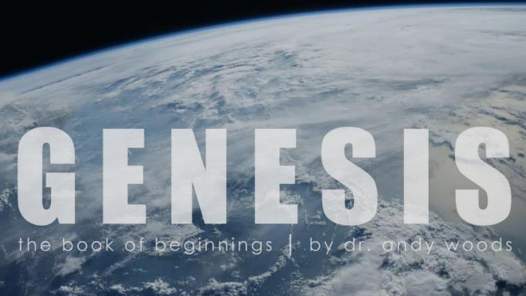

Genesis 12‒50
Israel’s Birth & Preservation

Slide 2
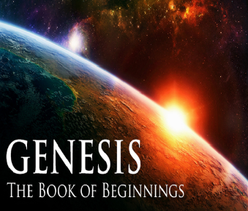
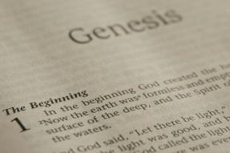
GENESIS STRUCTURE
  Genesis 12-50 (four people)
    Abraham (12:1–25:11)
    Isaac (25:12–26:35)
    Jacob (27–36)
    Joseph (37–50)

Slide 3
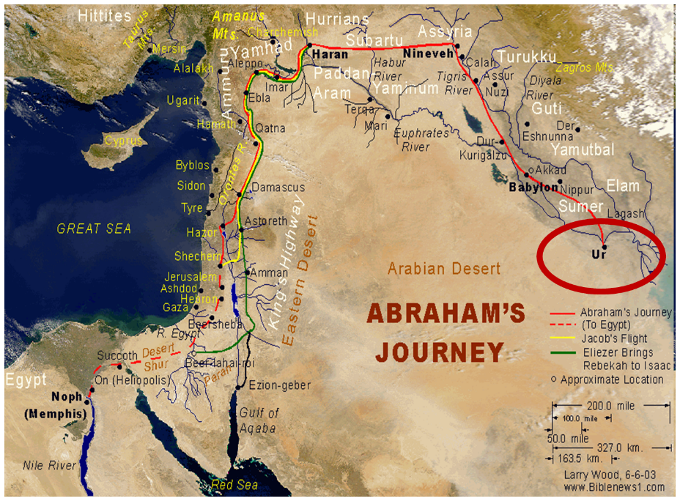

Slide 4
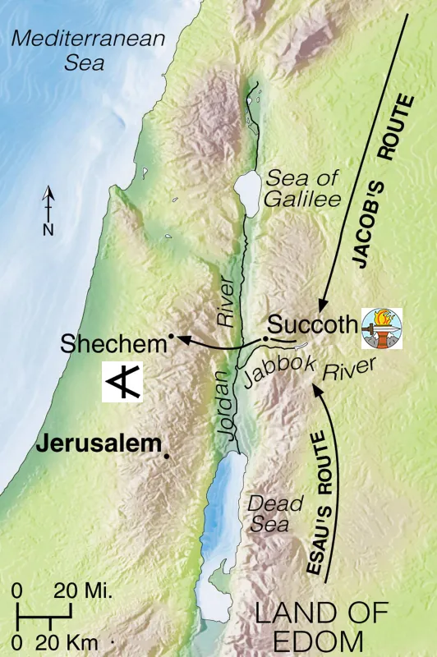


Slide 5
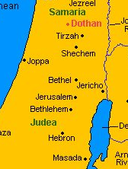

Slide 6
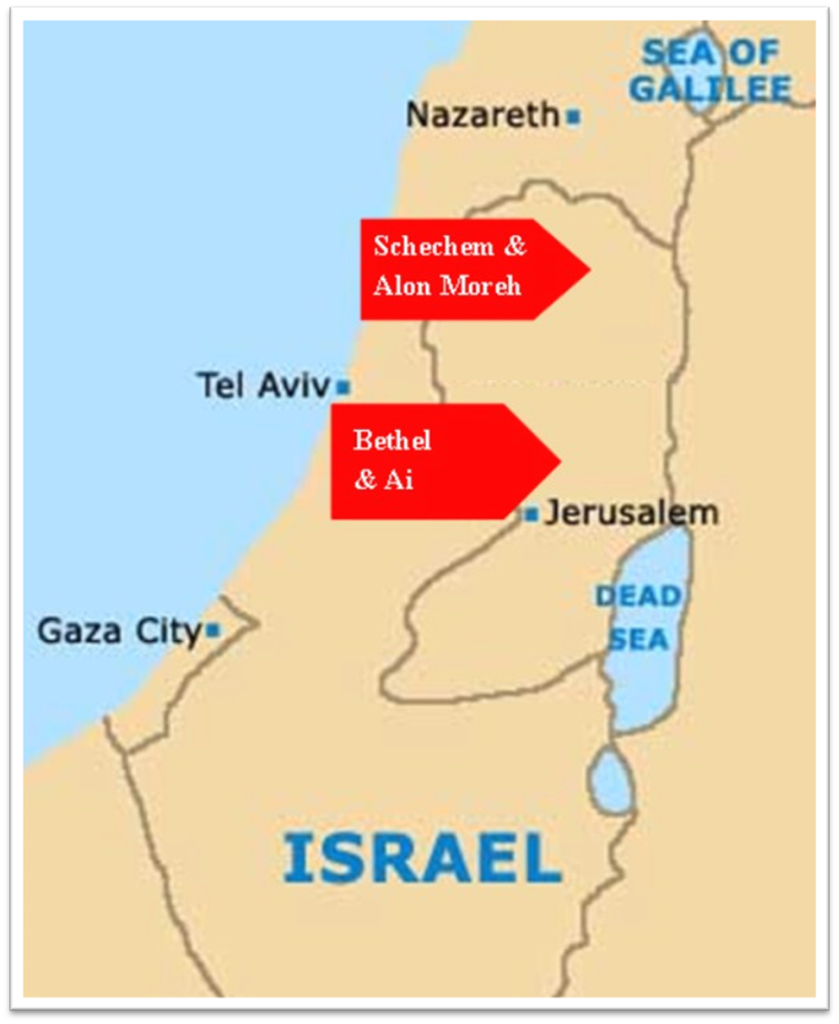

Slide 7
Genesis 35:1-29
Transitionary Information
  Jacob’s journey to Bethel (35:1-8)
  Divine appearance (35:9-15)
  Benjamin’s birth (35:16-20)
  Reuben loses the birthright (35:21-22a)
  Jacob’s dozen (35:22b-26)
  Isaac’s death (35:27-29)

Slide 8
III. Genesis 35:16-20
Benjamin’s Birth
    Circumstances (16a)
    Benjamin’s birth (16b-18)
    Rachel’s death (19-20)

Slide 9
III. Genesis 35:16-20
Benjamin’s Birth
    Circumstances (16a)
    Benjamin’s birth (16b-18)
    Rachel’s death (19-20)

Slide 11
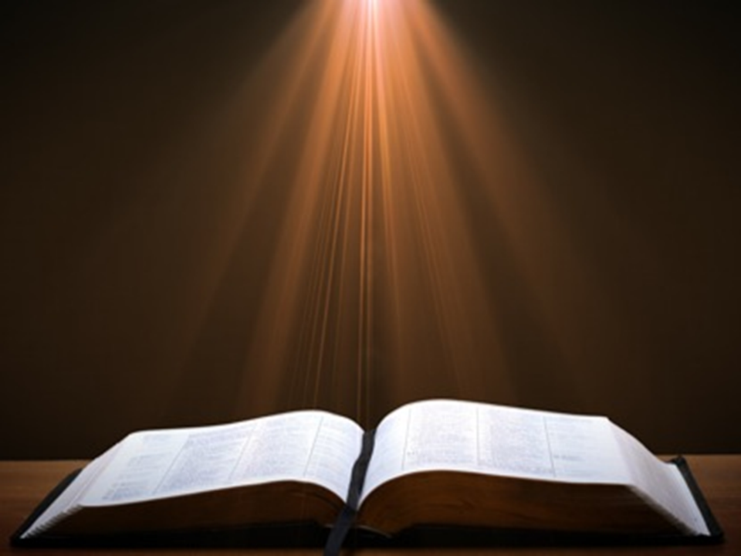
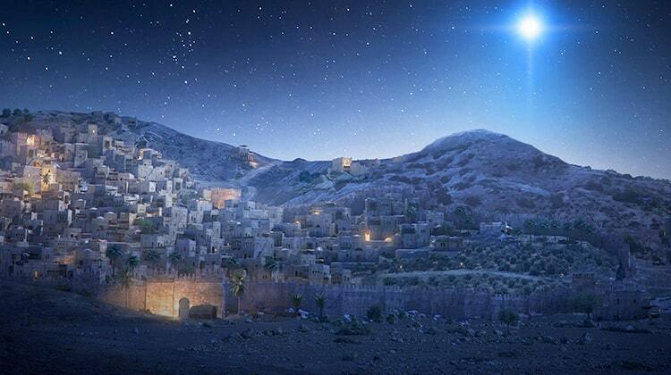
Micah 5:2
“But as for you, Bethlehem Ephrathah, Too little to be among the clans of Judah, From you One will go forth for Me to be ruler in Israel. His goings forth are from long ago, From the days of eternity.”

Slide 12
Genesis 12‒25
Abraham’s Early Journeys
Unconditional promises (Gen. 12:1-3) From Haran to Canaan (Gen. 12:4-5) In Canaan (Gen. 12:6-9) In Egypt (Gen. 12:10-20) Abram and Lot Separate (Gen. 13:1-13) Reaffirmation of Abram’s promises (Gen. 13:14-18) Abram Rescues Lot (14:1-24) Abrahamic Covenant (15:1-21) Hagar & Ishmael (16:1-16) Circumcision (Gen. 17:1-27) | Sodom & Gomorrah (Gen. 18‒19) Abraham & Abimelech (Gen. 20) Isaac’s birth (Gen. 21:1-7) Ishmael’s expulsion (21:8-21) Abraham & Abimelech’s covenant (21:22-34) Abraham sacrifices Isaac (22) Sarah’s death (23) Isaac’s marriage (24) Abraham & Keturah (25:1-6) Abraham’s death (25:7-11)

Slide 13
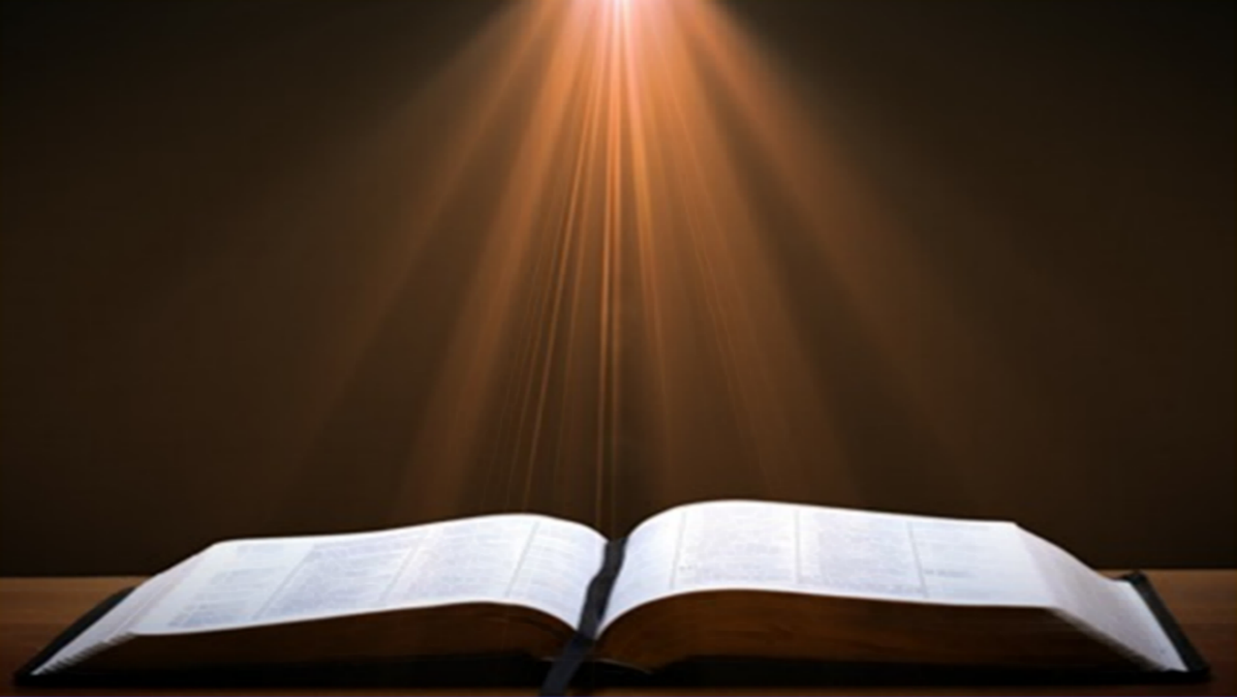
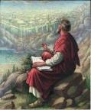
Ecclesiastes 1:9
“That which has been is that which will be, And that which has been done is that which will be done. So there is nothing new under the sun.”

Slide 14
III. Genesis 35:16-20
Benjamin’s Birth
    Circumstances (16a)
    Benjamin’s birth (16b-18)
    Rachel’s death (19-20)

Slide 15
Genesis 35:16b-18
Benjamin’s Birth
      Labor (16a)
      Birth (17)
      Naming (18)

Slide 16
Genesis 35:16b-18
Benjamin’s Birth
      Labor (16a)
      Birth (17)
      Naming (18)

Slide 17
Genesis 35:16b-18
Benjamin’s Birth
      Labor (16a)
      Birth (17)
      Naming (18)

Slide 18
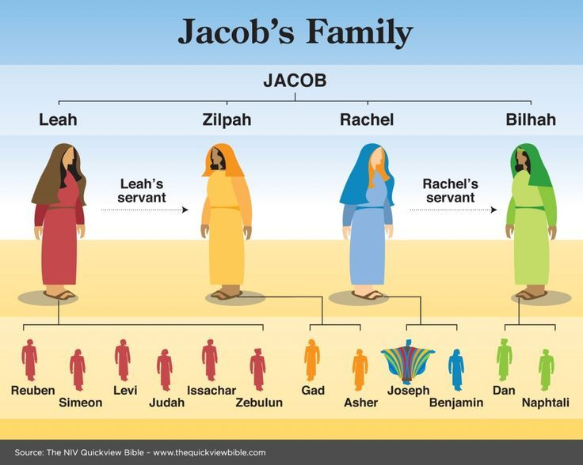

Slide 20
Genesis 35:16b-18
Benjamin’s Birth
      Labor (16a)
      Birth (17)
      Naming (18)

Slide 21
Genesis 35:18
Naming
      Rachel’s naming (18a-b)
      Jacob’s naming (18c)

Slide 22
Genesis 35:18
Naming
      Rachel’s naming (18a-b)
      Jacob’s naming (18c)

Slide 23
Genesis 35:18
Rachel’s Naming
      Circumstances (18a)
      Name (18b)

Slide 24
Genesis 35:18
Rachel’s Naming
      Circumstances (18a)
      Name (18b)

Slide 25

Woman
(3:16)
  Painful child birth (3:16a)
  Relational conflict (3:16b)

Slide 26

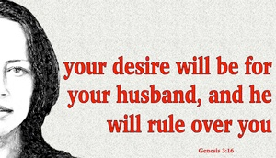
Genesis 3:16
“To the woman He said, ‘I will greatly multiply Your pain in childbirth, In pain you will bring forth children; Yet your desire [TESHUQAH] will be for your husband, And he will rule over you.’”

Slide 27
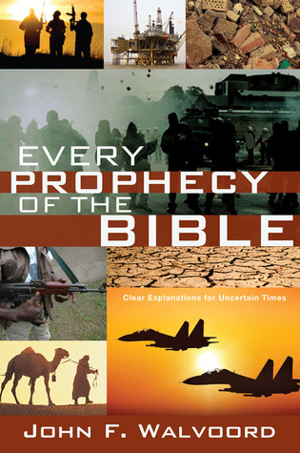

Slide 28
“Death” in the Old Testament
māwet: “Death is the consequences and the punishment of sin. It originated with sin. A grand theme of the Old Testament is God’s holiness, which separates Him from all that is in harmony with His character. Death, then, in the Old Testament means ultimate separation from God due to sin.”
Elmer B. Smick, “māwet," in Theological Wordbook of the Old Testament, ed. R. Laird Harris and Gleason L. Archer and Bruce K. Waltke(Chicago: Moody, 1980), 1:1169.

Slide 29
“Death” in the New Testament
thanatos: “that separation (whether natural or violent) of the soul from the body by which the life on earth is ended.”
Joseph Henry Thayer, Death - Thanatos, Greek-English Lexicon of the New Testament Being Grmm's Wilke's Clavis Novi Testamenti (Grand Rapids: Zondervan, 1977), 282.

Slide 30
Genesis 35:18
Rachel’s Naming
      Circumstances (18a)
      Name (18b)

Slide 31
Genesis 35:18
Naming
      Rachel’s naming (18a-b)
      Jacob’s naming (18c)

Slide 32
III. Genesis 35:16-20
Benjamin’s Birth
    Circumstances (16a)
    Benjamin’s birth (16b-18)
    Rachel’s death (19-20)

Slide 33
Genesis 35:19-20
Rachel’s Death
      Death (19a)
      Burial (19b)
      Marker (20)

Slide 34
Genesis 35:19-20
Rachel’s Death
      Death (19a)
      Burial (19b)
      Marker (20)

Slide 35

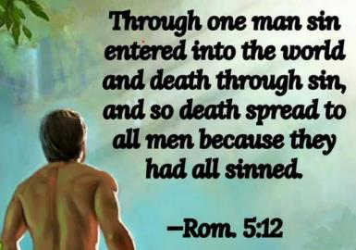
Genesis 2:16-17
“¹⁶ The Lord God commanded the man, saying, ‘From any tree of the garden you may eat freely; ¹⁷ but from the tree of the knowledge of good and evil you shall not eat, for in the day that you eat from it you will surely die (muwth).’”

Slide 36
Genesis 3:19
“By the sweat of your face You will eat bread, Till you return to the ground, Because from it you were taken; For you are dust, And to dust you shall return.”

Slide 38

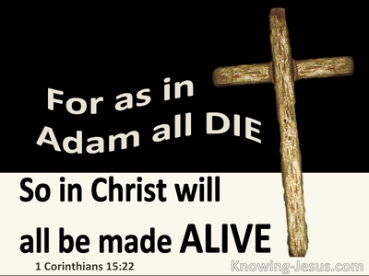
1 Corinthians 15:21-22
“²¹ For since by a man came death, by a man also came the resurrection of the dead. ²² For as in Adam all die, so also in Christ all will be made alive.”

Slide 39

Romans 5:12
“Therefore, just as through one man sin entered into the world, and death through sin, and so death spread to all men, because all sinned—.”

Slide 40
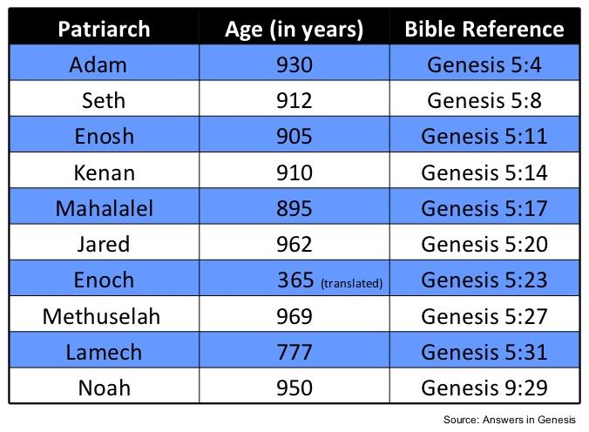

Slide 41
Genesis 35:19-20
Rachel’s Death
      Death (19a)
      Burial (19b)
      Marker (20)

Slide 42
Micah 5:2
“But as for you, Bethlehem Ephrathah, Too little to be among the clans of Judah, From you One will go forth for Me to be ruler in Israel. His goings forth are from long ago, From the days of eternity.”

Slide 43
Genesis 35:19-20
Rachel’s Death
      Death (19a)
      Burial (19b)
      Marker (20)

Slide 44
Genesis 35:1-29
Transitionary Information
  Jacob’s journey to Bethel (35:1-8)
  Divine appearance (35:9-15)
  Benjamin’s birth (35:16-20)
  Reuben loses the birthright (35:21-22a)
  Jacob’s dozen (35:22b-26)
  Isaac’s death (35:27-29)

Slide 45
IV. Genesis 35:21-22a
Reuben Loses the Birthright
    Geographical marker (21)
    Reuben’s sin (22a)

Slide 46
IV. Genesis 35:21-22a
Reuben Loses the Birthright
    Geographical marker (21)
    Reuben’s sin (22a)

Slide 47
IV. Genesis 35:21-22a
Reuben Loses the Birthright
    Geographical marker (21)
    Reuben’s sin (22a)

Slide 49

1 Corinthians 3:10-15
¹⁰ According to the grace of God which was given to me, like a wise master builder I laid a foundation, and another is building on it. But each man must be careful how he builds on it. ¹¹ For no man can lay a foundation other than the one which is laid, which is Jesus Christ. ¹² Now if any man builds on the foundation with gold, silver, precious stones, wood, hay, straw, ¹³ each man’s work will become evident; for the day will show it because it is to be revealed with fire, and the fire itself will test the quality of . . .

Slide 50
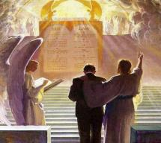
1 Corinthians 3:10-15
. . . each man’s work. ¹⁴ If any man’s work which he has built on it remains, he will receive a reward. ¹⁵ If any man’s work is burned up, he will suffer loss; but he himself will be saved, yet so as through fire.

Slide 51
Scripture’s Five Crowns (Rev 4:10: 3:11; 2 John 8)
SCRIPTURE | CROWN | PURPOSE
1 Cor. 9:24-27 | Incorruptible | Gaining mastery over the flesh
1 Thess. 2:19-20 | Rejoicing | Soul winning
Jas. 1:12; Rev. 2:10 | Life | Enduring trials
1 Pet. 5:2-4 | Glory | Shepherding God’s people
2 Tim. 4:8 | Righteousness | Longing for His appearing

Slide 52
1 Corinthians 9:24-27
“Do you not know that those who run in a race all run, but only one receives the prize? Run in such a way that you may win. ²⁵ Everyone who competes in the games exercises self-control in all things. They then do it to receive a perishable wreath, but we an imperishable. ²⁶ Therefore I run in such a way, as not without aim; I box in such a way, as not beating the air; ²⁷ but I discipline my body and make it my slave, so that, after I have preached to others, I myself will not be disqualified.”

Slide 54
Genesis 35:1-29
Transitionary Information
  Jacob’s journey to Bethel (35:1-8)
  Divine appearance (35:9-15)
  Benjamin’s birth (35:16-20)
  Reuben loses the birthright (35:21-22a)
  Jacob’s dozen (35:22b-26)
  Isaac’s death (35:27-29)

Slide 55
V. Genesis 35:22b-26
Jacob’s Dozen
    Introduction (22b)
    Jacob’s dozen (23-26a)
    Conclusion (26b)

Slide 56
V. Genesis 35:22b-26
Jacob’s Dozen
    Introduction (22b)
    Jacob’s dozen (23-26a)
    Conclusion (26b)

Slide 58
V. Genesis 35:22b-26
Jacob’s Dozen
    Introduction (22b)
    Jacob’s dozen (23-26a)
    Conclusion (26b)

Slide 59
Genesis 35:23-26a
Jacob’s Dozen
      Leah’s six sons (23)
      Rachel’s two sons (24)
      Bilhah’s two sons (25)
      Zilpah’s two sons (26b)

Slide 60
Genesis 35:23-26a
Jacob’s Dozen
      Leah’s six sons (23)
      Rachel’s two sons (24)
      Bilhah’s two sons (25)
      Zilpah’s two sons (26b)

Slide 62
Genesis 35:23-26a
Jacob’s Dozen
      Leah’s six sons (23)
      Rachel’s two sons (24)
      Bilhah’s two sons (25)
      Zilpah’s two sons (26b)

Slide 64
Genesis 35:23-26a
Jacob’s Dozen
      Leah’s six sons (23)
      Rachel’s two sons (24)
      Bilhah’s two sons (25)
      Zilpah’s two sons (26b)

Slide 66
Genesis 35:23-26a
Jacob’s Dozen
      Leah’s six sons (23)
      Rachel’s two sons (24)
      Bilhah’s two sons (25)
      Zilpah’s two sons (26b)

Slide 68
V. Genesis 35:22b-26
Jacob’s Dozen
    Introduction (22b)
    Jacob’s dozen (23-26a)
    Conclusion (26b)

Slide 70
Genesis 35:1-29
Transitionary Information
  Jacob’s journey to Bethel (35:1-8)
  Divine appearance (35:9-15)
  Benjamin’s birth (35:16-20)
  Reuben loses the birthright (35:21-22a)
  Jacob’s dozen (35:22b-26)
  Isaac’s death (35:27-29)

Slide 71
VI. Genesis 35:27-29
Isaac’s Death
    Reunion of Isaac and Jacob (27)
    Isaac’s total years (28)
    Isaac’s death (29)

Slide 72
VI. Genesis 35:27-29
Isaac’s Death
    Reunion of Isaac and Jacob (27)
    Isaac’s total years (28)
    Isaac’s death (29)

Slide 73
Genesis 35:27
Reunion of Isaac and Jacob
      Contact (27a)
      Place (27b)

Slide 74
Genesis 35:27
Reunion of Isaac and Jacob
      Contact (27a)
      Place (27b)

Slide 76
Genesis 35:27
Reunion of Isaac and Jacob
      Contact (27a)
      Place (27b)

Slide 77
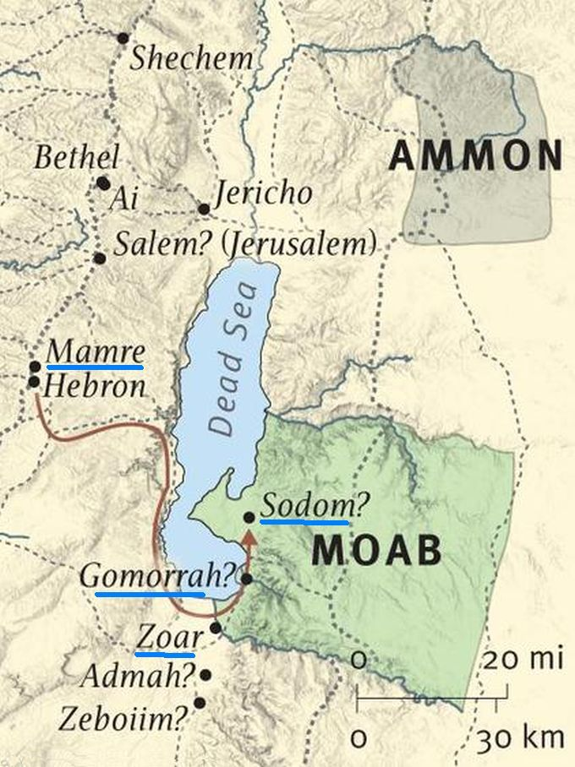

Slide 78
VI. Genesis 35:27-29
Isaac’s Death
    Reunion of Isaac and Jacob (27)
    Isaac’s total years (28)
    Isaac’s death (29)

Slide 79
VI. Genesis 35:27-29
Isaac’s Death
    Reunion of Isaac and Jacob (27)
    Isaac’s total years (28)
    Isaac’s death (29)

Slide 80
Genesis 35:29
Isaac’s Death
      Death (29a)
      Full of days (29b)
      Burial (29c)

Slide 81
Genesis 35:29
Isaac’s Death
      Death (29a)
      Full of days (29b)
      Burial (29c)

Slide 82
“Death” in the Old Testament
māwet: “Death is the consequences and the punishment of sin. It originated with sin. A grand theme of the Old Testament is God’s holiness, which separates Him from all that is in harmony with His character. Death, then, in the Old Testament means ultimate separation from God due to sin.”
Elmer B. Smick, “māwet," in Theological Wordbook of the Old Testament, ed. R. Laird Harris and Gleason L. Archer and Bruce K. Waltke(Chicago: Moody, 1980), 1:1169.

Slide 83
“Death” in the New Testament
thanatos: “that separation (whether natural or violent) of the soul from the body by which the life on earth is ended.”
Joseph Henry Thayer, Death - Thanatos, Greek-English Lexicon of the New Testament Being Grmm's Wilke's Clavis Novi Testamenti (Grand Rapids: Zondervan, 1977), 282.

Slide 84

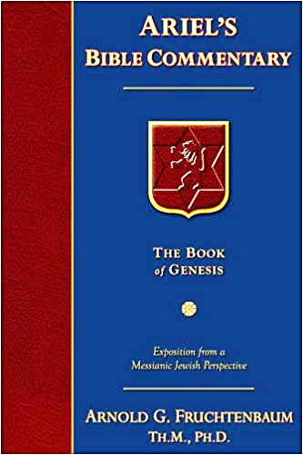
Dr. Arnold G. Fruchtenbaum
The Book of Genesis, 392
“This phrase ‘gathered to his people’ is used ten times, and only in the Pentateuch: Genesis 25:8, of Abraham; 25:17, of Ishmael; 35:29, of Isaac; 49:29, of Jacob; 49:33, of Jacob; Numbers 20:24, of Aaron; 20:26, of Aaron; 27:13, of Moses; 31:2, of Moses; and Deuteronomy 32:50, of Aaron and Moses. A parallel phrase is gathered to his fathers in Genesis 15:15 and 47:30.”

Slide 86

Daniel 12:1-2
“¹ Now at that time Michael, the great prince who stands guard over the sons of your people, will arise. And there will be a time of distress such as never occurred since there was a nation until that time; and at that time your people, everyone who is found written in the book, will be rescued. ² Many of those who sleep in the dust of the ground will awake, these to everlasting life, but the others to disgrace and everlasting contempt.”

Slide 87
Genesis 35:29
Isaac’s Death
      Death (29a)
      Full of days (29b)
      Burial (29c)

Slide 88

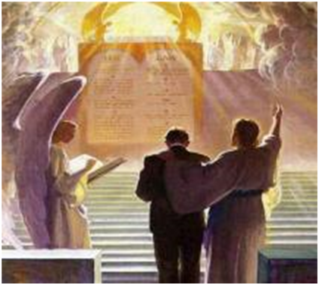
2 Timothy 4:7-8
“⁷ I have fought the good fight, I have finished the course, I have kept the faith; ⁸ in the future there is reserved for me the crown of righteousness, which the Lord, the righteous Judge, will award to me on that day; and not only to me, but also to all who have loved His appearing.”

Slide 89
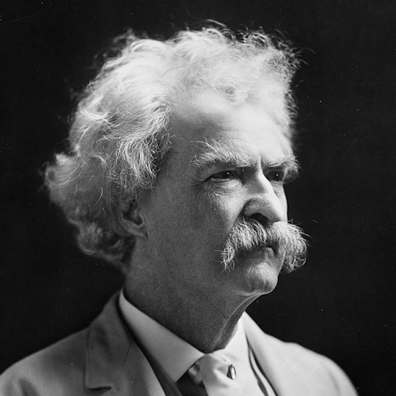
Mark Twain
Autobiography, 2:37
“A myriad of men are born; they labor and sweat and struggle for bread; they squabble and scold and fight; they scramble for little mean advantages over each other. Age creeps upon them and infirmities follow; shames and humiliations bring down their prides and their vanities. Those they love are taken from them, and the joy of life is turned to aching grief. The burden of pain, care, and misery grows heavier year by year. At length ambition is dead, pride is dead, vanity is dead; longing for release is in their place. It comes at last-the only un-poisoned gift earth ever had for them-and they vanish from a world where they were of no consequence; where they achieved nothing, where they were a mistake and a failure and a foolishness; where they left no sign that they have existed – a world that will lament them a day and forget them forever.”

Slide 90
Genesis 35:29
Isaac’s Death
      Death (29a)
      Full of days (29b)
      Burial (29c)

Slide 92
Genesis 12‒25
Abraham’s Early Journeys
Unconditional promises (Gen. 12:1-3) From Haran to Canaan (Gen. 12:4-5) In Canaan (Gen. 12:6-9) In Egypt (Gen. 12:10-20) Abram and Lot Separate (Gen. 13:1-13) Reaffirmation of Abram’s promises (Gen. 13:14-18) Abram Rescues Lot (14:1-24) Abrahamic Covenant (15:1-21) Hagar & Ishmael (16:1-16) Circumcision (Gen. 17:1-27) | Sodom & Gomorrah (Gen. 18‒19) Abraham & Abimelech (Gen. 20) Isaac’s birth (Gen. 21:1-7) Ishmael’s expulsion (21:8-21) Abraham & Abimelech’s covenant (21:22-34) Abraham sacrifices Isaac (22) Sarah’s death (23) Isaac’s marriage (24) Abraham & Keturah (25:1-6) Abraham’s death (25:7-11)

Slide 93
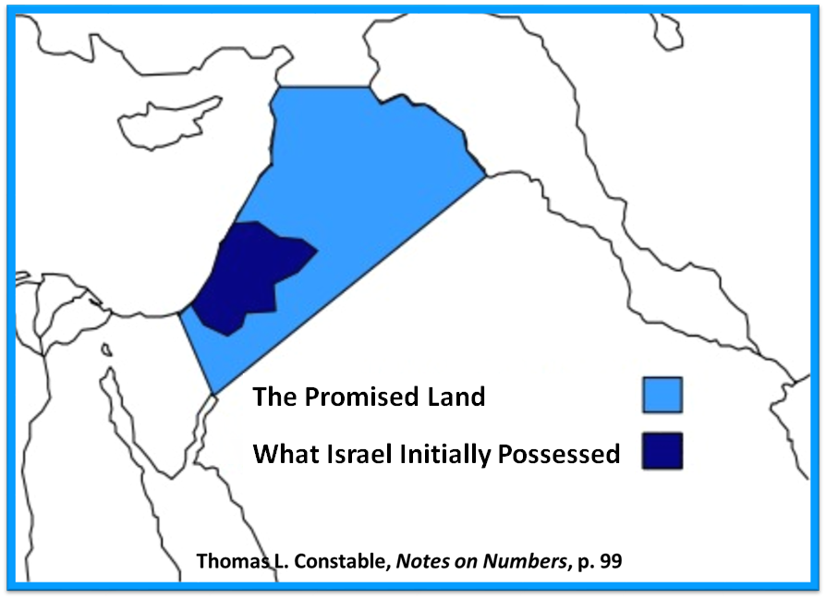

Slide 94
Conclusion

Slide 95
Genesis 35:1-29
Transitionary Information
  Jacob’s journey to Bethel (35:1-8)
  Divine appearance (35:9-15)
  Benjamin’s birth (35:16-20)
  Reuben loses the birthright (35:21-22a)
  Jacob’s dozen (35:22b-26)
  Isaac’s death (35:27-29)

Slide 96
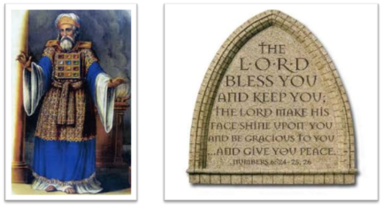
²⁴ The Lord bless you, and keep you; ²⁵ The Lord make His face shine on you, And be gracious to you; ²⁶ The Lord lift up His countenance on you, And give you peace.
Numbers 6:24–26 (NASB95)

