Slide 1


Apostasy or Rapture?
(2 Thessalonians 2:3A)
Dr. Andy Woods
Senior Pastor – Sugar Land Bible Church
President – Chafer Theological Seminary

Slide 2


2 Thessalonians 2:3
“Let no one in any way deceive you, for it will not come unless the apostasy [apostasia] comes first, and the man of lawlessness is revealed, the son of destruction.”

Slide 3
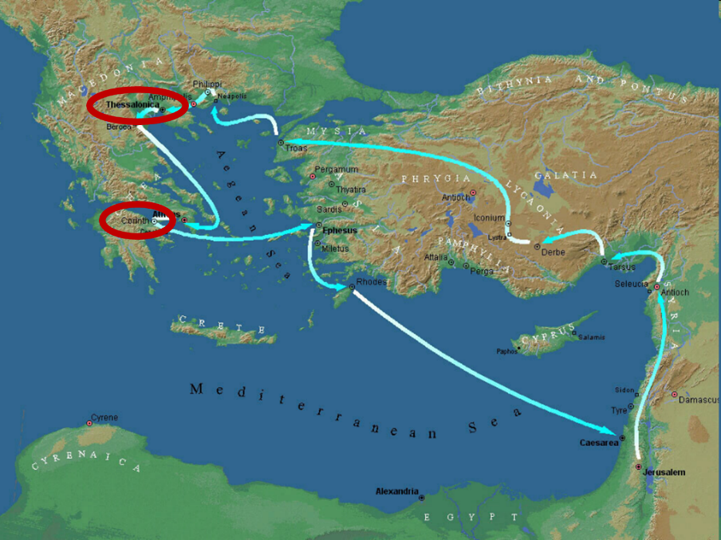

Slide 4

2 Thessalonians 2:1-12
Problem (2:1-2)
Prerequisites for the Day of the Lord (2:3-12)
  The apostasy (2:3a)
  Advent of the lawless one (2:3b-4)
  Removal of the restrainer (2:5-7)
  Destruction of the lawless one (2:8-9)
  Destruction of lawless one’s followers (2:10-12)

Slide 5

2 Thessalonians 2:2
“that you not be quickly shaken from your composure or be disturbed either by a spirit or a message or a letter as if from us, to the effect that the day of the Lord has come.”

Slide 6
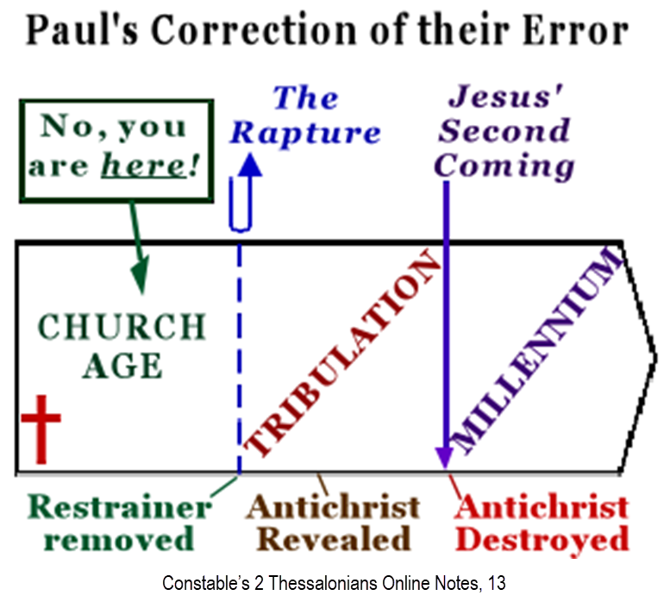

Slide 7
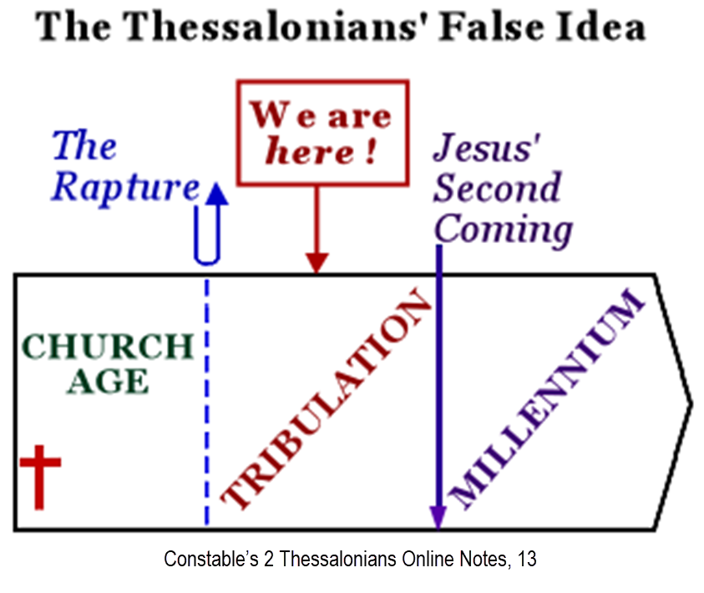

Slide 8
2 Thessalonians 2:1-12
Problem (2:1-2)
Prerequisites for the Day of the Lord (2:3-12)
  The apostasy (2:3a)
  Advent of the lawless one (2:3b-4)
  Removal of the restrainer (2:5-7)
  Destruction of the lawless one (2:8-9)
  Destruction of lawless one’s followers (2:10-12)

Slide 9
2 Thessalonians 2:1-12
Problem (2:1-2)
Prerequisites for the Day of the Lord (2:3-12)
  The apostasy (2:3a)
  Advent of the lawless one (2:3b-4)
  Removal of the restrainer (2:5-7)
  Destruction of the lawless one (2:8-9)
  Destruction of lawless one’s followers (2:10-12)

Slide 10

Apostasy? (2:3a)
Spiritual departure (Acts 21:21) – Unbelieving world embracing the antichrist
Physical departure (Acts 12:10; 2 Cor. 12:8) – Rapture

Slide 11
Apostasy? (2:3a)
Spiritual departure (Acts 21:21) – Unbelieving world embracing the antichrist
Physical departure (Acts 12:10; 2 Cor. 12:8) – Rapture

Slide 12
Spiritual Departure Options
Apostasy of the Church (pre-rapture)
Apostasy of the World (post-rapture)
Apostasy of Israel (Dan. 9:27)

Slide 13
Apostasy? (2:3a)
Spiritual departure (Acts 21:21) – Unbelieving world embracing the antichrist
Physical departure (Acts 12:10; 2 Cor. 12:8) – Rapture

Slide 14
2 Thessalonians 2:3
“Let no one in any way deceive you, for it will not come unless the apostasy [apostasia] comes first [prōton], and the man of lawlessness is revealed, the son of destruction.”

Slide 15
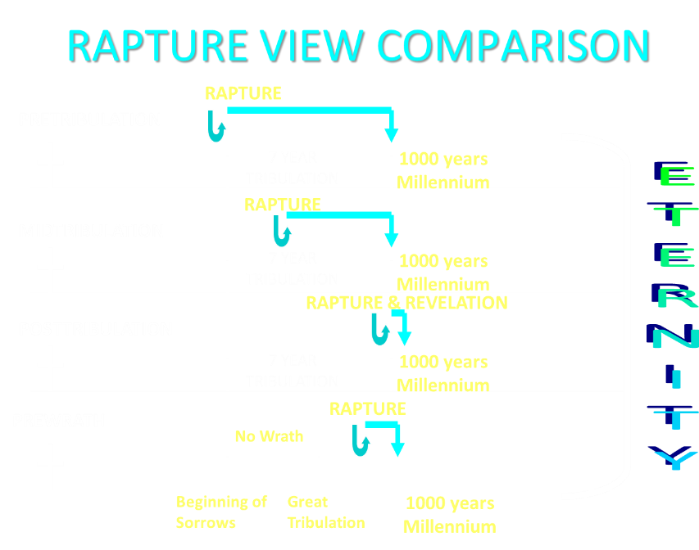

Slide 16
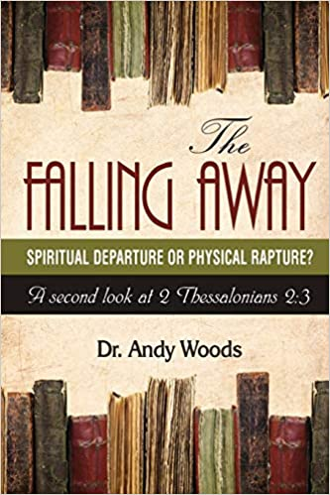

Slide 17

10 Reasons Favoring Physical Departure
There have always been doctrinal departures
2 Thess. was an early letter
The definite article before apostasia
Noun apostasia can refer to physical departure
Verb aphistēmi can refer to physical departure

Slide 18
10 Reasons Favoring Physical Departure
Extended context favors physical departure
Immediate context favors physical departure
2 Thess. 2:2 is a review course
Early Bible translations favor physical departure
Physical departure is held by credible scholars

Slide 19

Physical Departure Adherents
Kenneth Wuest |  | Paul Lee Tan*
E. Schuyler English |  | Arnold Fruchtenbaum*
J. Dwight Pentecost |  | Tim LaHaye
H. Wayne House* |  | Thomas Ice
Stanley Ellison |  | Don Stewart
J.S. Mabie |  | Robert Thieme
Allen McRae |  | Gordon Olson*
Gordon Lewis |  | J. Vernon McGee*
Henry Morris* |  | Jimmy DeYoung*
John. R. Rice |  | J.D. Farag
David Olander* |  | David Hocking
J. Carl Laney* |  | Jimmy Swaggart*
Grant Jeffrey |  | Chuck Smith*
Myron Houghton*

Slide 20

Dr. Myron J. Hughton
Myron Houghton, The Rapture in 2 Thessalonians 2:1-10, Faith Pulpit, Faith
Baptist Theological Seminary, Ankeny, Iowa, April 2002.
“Reason # 1: The word which is translated ‘falling away’ can refer to a physical departure. Note that this argument does not say that the word always or even normally has this meaning. ‘Departure, disappearance’ is the second meaning given for this Greek word in A Greek-English Lexicon, by Liddell & Scott, I, 218. Part of the problem here is that this word is used only twice in the New Testament—here and also in Acts 21:21, where Paul is told that some accuse him of teaching a departure from Moses. In this latter passage, this word is used in the sense of a religious apostasy. In the LXX (the Greek translation of the Old Testament), this word or an older form is found in Joshua 22:22, 1 Kings 21:13, 2 Chronicles 29:19, 33:19, Isaiah 30:1, and Jeremiah 2:19. In these cases, the word also has the idea of religious departure. However, either the context or a descriptive phrase is used to . . .
https://faithpulpit.faith.edu/posts/the-rapture-in-2-thessalonians-21-10

Slide 21
Dr. Myron J. Hughton
Myron Houghton, The Rapture in 2 Thessalonians 2:1-10, Faith Pulpit, Faith
Baptist Theological Seminary, Ankeny, Iowa, April 2002.
…indicate that a religious apostasy is meant. Therefore, it might be argued that the word itself was more general.” “In the New Testament, the verb form of this word is used fifteen times (Luke 2:27, 4:13, 8:13, 22:29; Acts 5:37,38, 12:10, 15:38, 19:9, 22:29; 2 Corinthians 12:8; 1 Timothy 4:1, 6:5; 2 Timothy 2:19; and Hebrews 3:12). Of the fifteen references, only three have reference to a religious departure, and these three are qualified by context (Luke 8:13) or by a descriptive phrase (1 Timothy 4:1—‘from the faith’ and Hebrews 3:12—‘from the living God’). It is clear from some of the remaining references that a physical departure is meant (the angel who delivered Peter from prison departed from him—Acts 12:10, and Paul prayed that a thorn in the flesh might depart from him—2 Corinthians 12:8.) This word is translated departynge by William Tyndale (c. 1526), by Cranmer (1539), . . .
https://faithpulpit.faith.edu/posts/the-rapture-in-2-thessalonians-21-10

Slide 22
Dr. Myron J. Hughton
Myron Houghton, The Rapture in 2 Thessalonians 2:1-10, Faith Pulpit, Faith
Baptist Theological Seminary, Ankeny, Iowa, April 2002.
…and by the Geneva Bible (1557). Beza (1565) translated it departing.” “Reason # 2: The use of the definite article (‘the’) lends support to the view that the falling away is the rapture. The basic function of the article ‘is to point out an object or to draw attention to it. Its use with a word makes the word stand out distinctly,’ (Dana and Mantey, A Manual Grammar of the Greek New Testament, 137). Paul is not speaking of A falling away but THE falling away. In all probability, Paul is referring to some subject he has previously discussed with the Thessalonians. Robertson agrees with this use of the article in this verse. He states: ‘And the use of the definite article (the) seems to mean that Paul had spoken to the Thessalonians about it.’ (Word Pictures in the New Testament, IV, 49) Now, if this is the use of the article in 2 Thessalonians 2:3, one would expect to find a place, either in . . .
https://faithpulpit.faith.edu/posts/the-rapture-in-2-thessalonians-21-10

Slide 23
Dr. Myron J. Hughton
Myron Houghton, The Rapture in 2 Thessalonians 2:1-10, Faith Pulpit, Faith
Baptist Theological Seminary, Ankeny, Iowa, April 2002.
… 1 or 2 Thessalonians, where Paul previously referred to a departure from the faith. This writer knows of no such reference. However, there is previous reference to the rapture of the church in 1 Thessalonians 4:13–17 and 2 Thessalonians 2:1.” “Reason # 3: Paul’s style of writing in this chapter also lends support to the idea that the ‘falling away’ is the rapture. In verse 3, Paul states that two events must occur before the day of the Lord can come, namely (1) the ‘falling away,’ and (2) the revealing of the man of sin. Paul’s reference to this second event seems to be more fully described in verses 8–9. If, indeed, this is Paul’s style, then verses 6 and 7, which describe the removal of the Holy Spirit and the church, would be a more detailed explanation of the first event in verse 3 (the ‘falling away’). Reason # 4: Paul’s purpose in writing lends support to the view that the ‘falling away’…
https://faithpulpit.faith.edu/posts/the-rapture-in-2-thessalonians-21-10

Slide 24
Dr. Myron J. Hughton
Myron Houghton, The Rapture in 2 Thessalonians 2:1-10, Faith Pulpit, Faith
Baptist Theological Seminary, Ankeny, Iowa, April 2002.
. . .is the rapture. Remember the setting. The Thessalonian believers were being persecuted for their faith, and they thought they were in the Tribulation. Paul writes to tell them that they can’t possibly be in the Tribulation because two things have to occur before the Tribulation can begin: the ‘falling away’ and the revelation of the man of sin. If religious apostasy is a means by which Paul expects the Thessalonians to know whether or not they are in the Tribulation, then he has failed to prove his point because there has always been religious apostasy, even in the time of the apostle Paul, and the Thessalonians were not in a position to distinguish any present apostasy from ‘THE apostasy.’ However, if Paul was referring to the rapture of the church, then the Thessalonians could know with certainty that they could not yet be in the Tribulation.”
https://faithpulpit.faith.edu/posts/the-rapture-in-2-thessalonians-21-10

Slide 25
J. Vernon McGee
Thru the Bible with J. Vernon McGee. 5 vols. Pasadena, Calif.: Thru The Bible Radio; and Nashville: Thomas Nelson, Inc., 1983. 5:413.
“Paul says that before the Day of the Lord begins there must first come a removing. There are two kinds of removing that are going to take place. First, the organized church will depart from the faith‒that is what we call apostasy. But there will be total apostasy when the Lord comes, and that cannot take place until the true church is removed. The Lord asked… ‘when the Son of man cometh [to the earth], shall He find faith...?’ (Luke 18:8). When He says, ‘the faith,’ He means that body of truth which He left here. The answer to His question is no, He will not find faith here when He returns.”

Slide 26
J. Vernon McGee
Thru the Bible with J. Vernon McGee. 5 vols. Pasadena, Calif.: Thru The Bible Radio; and Nashville: Thomas Nelson, Inc., 1983. 5:413.
“There will be total apostasy because of two things: (1) the organization of the church has separated from the faith—it has apostatized and (2) there has been another departure, the departure of the true church from the earth. The departure of the true church leads into the total apostatizing of the organized church. The Day of The Lord cannot begin‒nor the Great Tribulation period‒until the departure of the true church has taken place.”

Slide 27

Milton Terry
Biblical Hermeneutics: A Treatise on the Interpretation of the Old and New Testaments (1885; reprint, Grand Rapids: Zondervan, 1947), 205.
Milton Terry explains: “A fundamental principle in grammatico-historical exposition is that the words and sentences can have but one significance in one and the same connection. The moment we neglect this principle we drift upon a sea of uncertainty and conjecture.”

Slide 28
David Olander
David Olander, The Greatness of the Rapture (Fort Worth, TX: Tyndale Seminary Press, 2015). 100-101.
“Apostasy has a basic root meaning of departure, departure from, or standing apart from. The question in Second Thessalonians is a departure from what? Context is the key for understanding many words in the text. Scripture uses the term apostasy in several ways…Paul had written to the Thessalonians about another departure of the church (1 Thessalonians 4:13–18) and her gathering together unto Him (2 Thessalonians 2:1). This is the rapture and a legitimate use of the word departure, stand apart, or apostasy. Historically the word can easily mean this. Once the church has departed. (been raptured) there is not one believer left on the planet. This would be a total complete apostasy in several ways. In essence, one departure, or an apostasy causes the other and Paul could have easily used the word he did, referring to the secondary part (those left behind on the planet) in total.”

Slide 29
Jimmy De Young
Prophetic Prospective – Daily Devotional
“Our key verse for this devotional, verse 3, has become somewhat controversial. There are those that believe that the Antichrist will come when the ‘falling away’ of the church, apostasy in the Church, has happened. This then seems to be saying that the church will be here when the Antichrist appears. This belief comes from a wrong understanding of the Greek word used in the passage and translated, ‘a falling away’…A close and careful word study of the Greek word apostasia will conclude that the true meaning of the word is found in the phrase, ‘departing from one place and going to another’, not a falling away from the doctrines of the church.”

Slide 30
Jimmy De Young
Prophetic Prospective – Daily Devotional
“If the word ‘apostasia’ was communicating that ‘apostasy’ was what it was talking about then the Rapture and the coming of the Antichrist would have happened during the writing of II Thessalonians. Apostasy had infiltrated the early church by the time Paul wrote this passage. What Paul is saying here is that the Antichrist, the ‘Son of Perdition’, would not come until the Church departs from one place and goes to another. That is what happens at the Rapture. The scenario for the future according to all prophetic passages is that the Rapture takes all Christians into Heaven and then the Antichrist appears on earth…Let me remind you that all preparations have been made for the temple to be built in . . .

Slide 31
Jimmy De Young
Prophetic Prospective – Daily Devotional
. . . Jerusalem. False teachers and deception presently are a part of our society today, which indicates that Antichrist is nearing his appearance on earth. Remember, before the appearance of Antichrist and the temple is built, the Rapture happens. Actually the Rapture could happen at any moment. Be ready!”

Slide 32
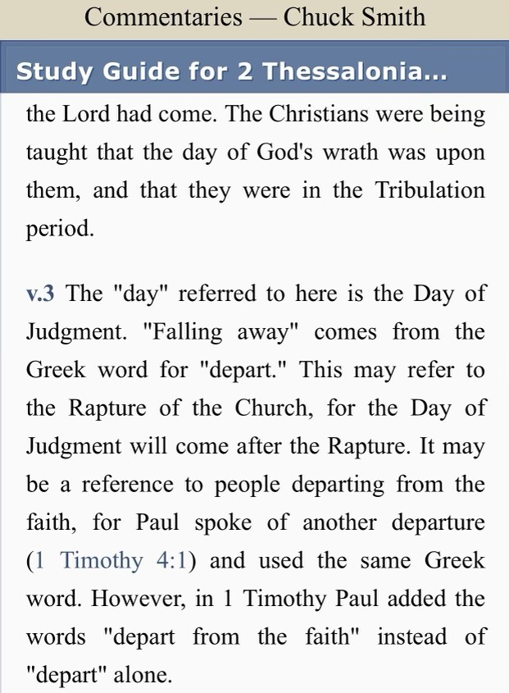

Slide 33
1 Timothy 4:1
“But the Spirit explicitly says that in later times some will fall away [aphistēmi] from the faith, paying attention to deceitful spirits and doctrines of demons.”

Slide 34
Paul Lee Tan
Paul Lee Tan, The Interpretation of Prophecy (Dallas, TX: Paul Lee Tan Prophetic Ministries, 2015; reprint, Dallas, TX: Paul Lee Tan Prophetic Ministries, 2015). 341.
“What precisely does Paul mean when he says that ‘the falling away’ (2:3) must come before the tribulation? The definite article ‘the’ denotes that this will be a definitive event, an event distinct from the appearance of the Man of Sin. The Greek word for ‘falling away’, taken by itself, does not mean religious apostasy or defection. Neither does the word mean ‘to fall,’ as the Greeks have another word for that. The best translation of the word is ‘to depart.’ The apostle Paul refers here to a definitive event, which he calls ‘the departure,’ and which will occur just before the start of the tribulation. This is the rapture of the church.”

Slide 35
Paul Lee Tan
Paul Lee Tan, The Interpretation of Prophecy (Dallas, TX: Paul Lee Tan Prophetic Ministries, 2015; reprint, Dallas, TX: Paul Lee Tan Prophetic Ministries, 2015). 341, n. 2.
“The apostle Paul uses this word in 1 Timothy 4:1, ‘some shall depart from the faith.’ The necessity for qualifying the word with the phrase ‘from the faith’ shows of the word taken by itself has no such connotation.”

Slide 36
1 Timothy 4:1
“But the Spirit explicitly says that in later times some will fall away [aphistēmi] from the faith, paying attention to deceitful spirits and doctrines of demons.”

Slide 37

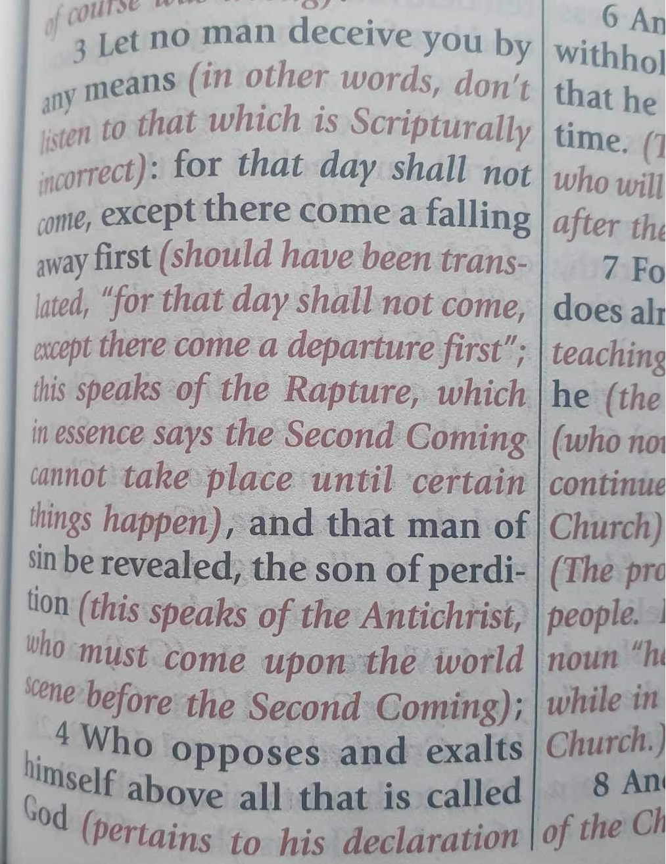

Slide 38

Answering Objections to the Physical Departure View
Greek from the Koine period?
Subtraction from the Last Days will be characterized by continual apostasy?
Rapture is passive and apostasy is active?
Incongruence with verse 1?
Paul is re-assuring the Thessalonians that they had not already missed the rapture; therefore, it would be incomprehensible to read, “the rapture cannot have happened unless the rapture happens first”

Slide 39
Answering Objections to the Physical Departure View
Greek from the Koine period?
Subtraction from the Last Days will be characterized by continual apostasy?
Rapture is passive and apostasy is active?
Incongruence with verse 1?
Paul is re-assuring the Thessalonians that they had not already missed the rapture; therefore, it would be incomprehensible to read, “the rapture cannot have happened unless the rapture happens first”

Slide 40
H. Wayne House
"Apostasia in 2 Thessalonians 2:3: Apostasy of Rapture?," in When the Trumpet Sounds: Today's Foremost Authorities Speak out on End-Time Controversies, ed. Thomas Ice and Timothy Demy (Eugene, OR: Harvest House, 1995), 273.
“The noun form allows for apostasia as a simple departure in the classical period, proved by examples from Liddell and Scott...If one says that this is not important because the meaning is only classical or ancient and thus lost its meaning by the time of the New Testament, then I may turn to the same root meaning of apostasia in the patristic era immediately following the New Testament period, as indicated in the definitions for the noun form in Lampe's Patristic Greek Lexicon. Although the noun used in the sense of spatial departure is not the normal meaning…during New Testament times, the word is found with this meaning in time periods before and after the New Testament era, and it is likely to have been understood this way at least sometimes.”

Slide 41

Entries for Apostasia in Liddell & Scott
Rebellion against God
Apostasy
Departure
Disappearance
Distance
Henry Liddell & Henry Scott, A Greek English Lexicon (Oxford: Oxford University Press, 1940), 218.

Slide 42
Entries for Apostasia in Lampe’s A Patristic Greek Lexicon
Revolt
Defection
Apostasy from paganism, Judaism, Christianity, orthodoxy
Divorce
Departure
Standing aloof
G. W. H. Lampe, A Patristic Greek Lexicon (Oxford: Clarnedon Press, 1961), 208.

Slide 43
Answering Objections to the Physical Departure View
Greek from the Koine period?
Subtraction from the Last Days will be characterized by continual apostasy?
Rapture is passive and apostasy is active?
Incongruence with verse 1?
Paul is re-assuring the Thessalonians that they had not already missed the rapture; therefore, it would be incomprehensible to read, “the rapture cannot have happened unless the rapture happens first”

Slide 44
ORDER OF PAUL’S LETTERS | ORDER OF PAUL’S LETTERS
1. | Galatians | A.D. 49
2. | 1‒2 Thessalonians | A.D. 51
3. | 1‒2 Corinthians | A.D. 56
4. | Romans | A.D. 57
5. | Ephesians, Colossians, Philemon, Philippians | A.D. 60‒62
6. | 1 Timothy, Titus | A.D. 62‒66
7. | 2 Timothy | A.D. 67

Slide 45
1 Timothy 4:1
“But the Spirit explicitly says that in later times some will fall away [aphistēmi] from the faith, paying attention to deceitful spirits and doctrines of demons.”

Slide 46
2 Thessalonians 2:3
“Let no one in any way deceive you, for it will not come unless the apostasy [apostasia] comes first [prōton], and the man of lawlessness is revealed, the son of destruction.”

Slide 47
Answering Objections to the Physical Departure View
Greek from the Koine period?
Subtraction from the Last Days will be characterized by continual apostasy?
Rapture is passive and apostasy is active?
Incongruence with verse 1?
Paul is re-assuring the Thessalonians that they had not already missed the rapture; therefore, it would be incomprehensible to read, “the rapture cannot have happened unless the rapture happens first”

Slide 48

Mark Hitchcock
Mark and Jeff Kinley Hitchcock, The Coming Apostasy: Exposing the Sabatoge of Christianity from Within (Carol Stream, Ill: Tyndale, 2017), 191
“Since the word apostasia means ‘departure,’ some have understood the term ‘the apostasy’ to be the physical departure of the church itself—that is, the Rapture, since the Rapture will be a physical departure of believers from the earth. If this view were correct, it would definitely place the Rapture before the Tribulation, which would be a slam dunk for the pre-Tribulation Rapture position. While this is attractive to pretribulationalists, there are six main reasons to reject a physical departure as the meaning of apostasia in this context:”

Slide 49
Mark Hitchcock
Mark and Jeff Kinley Hitchcock, The Coming Apostasy: Exposing the Sabatoge of Christianity from Within (Carol Stream, Ill: Tyndale, 2017), 191
“(1) In classical Greek, hē apostasia (‘the apostasy’) was used to denote a political or military rebellion. (2) In the Septuagint (the Greek translation of the Old Testament), this term was used of rebellion against God (see Joshua 22:22; Jeremiah 2:19). (3) In 2 Maccabees 2:15 (a noncanonical book written in the time between the Old and New Testaments), it is used of apostasy to paganism. (4) In Acts 21:21, the only other use of the noun in the New Testament, it refers to apostasy or spiritual departure from Moses.”

Slide 50
Mark Hitchcock
Mark and Jeff Kinley Hitchcock, The Coming Apostasy: Exposing the Sabatoge of Christianity from Within (Carol Stream, Ill: Tyndale, 2017), 191
“(1) In classical Greek, hē apostasia (‘the apostasy’) was used to denote a political or military rebellion. (2) In the Septuagint (the Greek translation of the Old Testament), this term was used of rebellion against God (see Joshua 22:22; Jeremiah 2:19). (3) In 2 Maccabees 2:15 (a noncanonical book written in the time between the Old and New Testaments), it is used of apostasy to paganism. (4) In Acts 21:21, the only other use of the noun in the New Testament, it refers to apostasy or spiritual departure from Moses.”

Slide 51
Acts 21:21
“and they have been told about you, that you are teaching all the Jews who are among the Gentiles to forsake [apostasia] Moses, telling them not to circumcise their children nor to walk according to the customs.”

Slide 52
2 Thessalonians 2:3
“Let no one in any way deceive you, for it will not come unless the apostasy [apostasia] comes first, and the man of lawlessness is revealed, the son of destruction.”

Slide 53
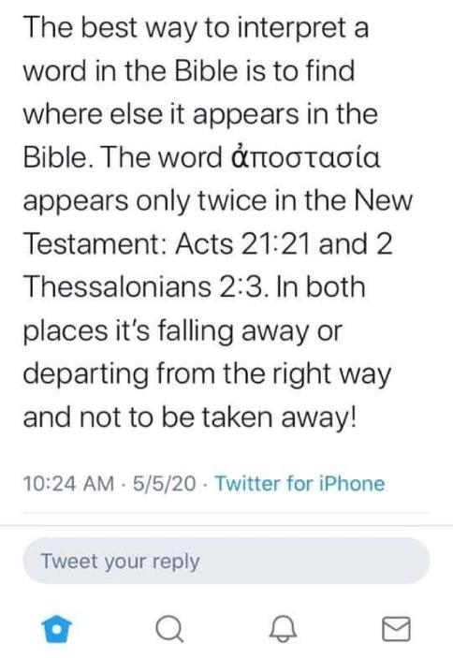


Slide 54
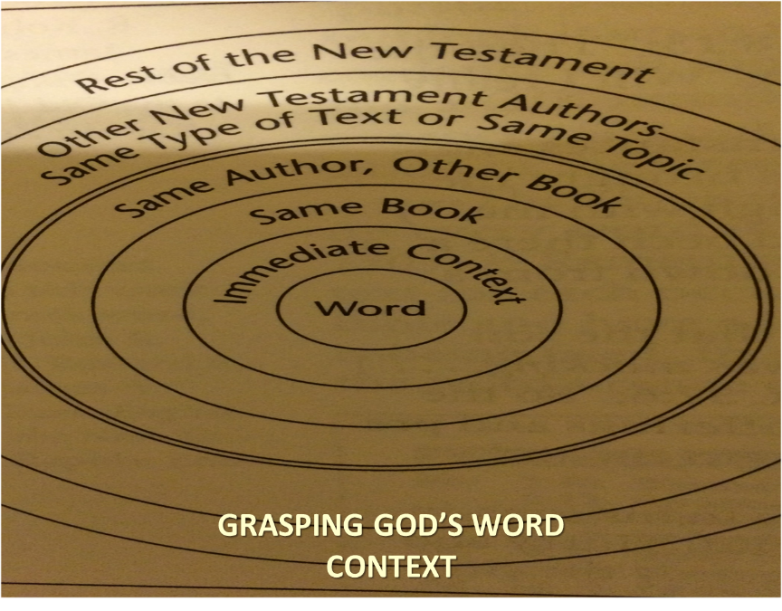

Slide 55
THE APOSTASIA
2 Thessalonians 2:3a | Acts 21:21
Pauline authorship | Lukan authorship
Paul speaking | Paul not speaking (v. 20)
Mosaic Law not mentioned | Departure from the Mosaic Law
Epistolary genre | Narrative genre
Definite article | No definite article

Slide 56
Mark Hitchcock
Mark and Jeff Kinley Hitchcock, The Coming Apostasy: Exposing the Sabatoge of Christianity from Within (Carol Stream, Ill: Tyndale, 2017), 191
“(5) The Rapture is not an act of departure by the saints; the saints are passive not active participants. (6) In 2 Thessalonians 2:1, Paul refers to the Rapture as ‘our gathering together to Him.’ It seems strange to use this unlikely term (‘the apostasy’) for the same thing in the immediate context. (These six points are from D. Edmond Hiebert, 1 & 2 Thessalonians [Chicago: Moody Press, 1971], 331.) For these reasons, most expositors have understood ‘the rebellion’ (apostasy) not as the physical departure of the church at the Rapture but rather as doctrinal, theological, and moral departure from the truth.”

Slide 57
D. Edmond Hiebert
The Thessalonian Epistles. Chicago: Moody Press, 1971. Page 306
"Nowhere else does the Scripture speak of the rapture as 'the departure.' A departure denotes an act on the part of the individual or company departing. But the rapture is not an act of departure on the part of the saints. In the rapture the church is passive, not active. At the rapture, the church is 'caught up' or 'snatched away,' an event wherein the Lord acts to transport believers from earth into His presence (1 Thess. 4:16-17). Everything that takes place with the believers at the rapture is initiated by the Lord and done by Him.”

Slide 58

Matthew 4:4
“But He answered and said, “It is written, ‘Man shall not live on bread alone, but on every word that proceeds out of the mouth of God.’”

Slide 59
Matthew 5:18
“For truly I say to you, until heaven and earth pass away, not the smallest letter or stroke shall pass from the Law until all is accomplished.”

Slide 60
Answering Objections to the Physical Departure View
Greek from the Koine period?
Subtraction from the Last Days will be characterized by continual apostasy?
Rapture is passive and apostasy is active?
Incongruence with verse 1?
Paul is re-assuring the Thessalonians that they had not already missed the rapture; therefore, it would be incomprehensible to read, “the rapture cannot have happened unless the rapture happens first”

Slide 61
2 Thessalonians 2:1
“Now we request you, brethren, with regard to the coming [parousia] of our Lord Jesus Christ and our gathering [episynagōgē] together to Him.”

Slide 62
2 Thessalonians 2:3
“Let no one in any way deceive you, for it will not come unless the apostasy [apostasia] comes first, and the man of lawlessness is revealed, the son of destruction.”

Slide 63

D. Edmond Hiebert
The Thessalonian Epistles. Chicago: Moody Press, 1971. Page 306
"Paul has just referred to the rapture as 'our gathering together unto him' (v. 1); why then should he now use this unlikely term to mean the same thing?”

Slide 64
Mark Hitchcock
Mark and Jeff Kinley Hitchcock, The Coming Apostasy: Exposing the Sabatoge of Christianity from Within (Carol Stream, Ill: Tyndale, 2017), 191
“(5) The Rapture is not an act of departure by the saints; the saints are passive not active participants. (6) In 2 Thessalonians 2:1, Paul refers to the Rapture as ‘our gathering together to Him.’ It seems strange to use this unlikely term (‘the apostasy’) for the same thing in the immediate context. (These six points are from D. Edmond Hiebert, 1 & 2 Thessalonians [Chicago: Moody Press, 1971], 331.) For these reasons, most expositors have understood ‘the rebellion’ (apostasy) not as the physical departure of the church at the Rapture but rather as doctrinal, theological, and moral departure from the truth.”

Slide 65

Paul’s Various Rapture Terms
parousia | 2 Thess. 2:1
episynagōgē | 2 Thess. 2:1
apokalypsis | 1 Cor. 1:7
epiphaneia | Titus 2:13
rhyomai | 1 Thess. 1:10
harpazō | 1 Thess. 4:17
apostasia | 2 Thess. 2:3a

Slide 66
Answering Objections to the Physical Departure View
Greek from the Koine period?
Subtraction from the Last Days will be characterized by continual apostasy?
Rapture is passive and apostasy is active?
Incongruence with verse 1?
Paul is re-assuring the Thessalonians that they had not already missed the rapture; therefore, it would be incomprehensible to read, “the rapture cannot have happened unless the rapture happens first”

Slide 67
2 Thessalonians 2:2-3 (NKJV)
“² not to be soon shaken in mind or troubled, either by spirit or by word or by letter, as if from us, as though the day of Christ had come. ³ Let no man deceive you by any means: for that day shall not come, except there come a falling away first, and that man of sin be revealed, the son of perdition”

Slide 68
2 Thessalonians 2:3 (NASB)
“² that you not be quickly shaken from your composure or be disturbed either by a spirit or a message or a letter as if from us, to the effect that the day of the Lord has come. ³ Let no one in any way deceive you, for it will not come unless the apostasy [apostasia] comes first, and the man of lawlessness is revealed, the son of destruction.”

Slide 69
2 Thessalonians 2:1-12
Problem (2:1-2)
Prerequisites for the Day of the Lord (2:3-12)
  The apostasy (2:3a)
  Advent of the lawless one (2:3b-4)
  Removal of the restrainer (2:5-7)
  Destruction of the lawless one (2:8-9)
  Destruction of lawless one’s followers (2:10-12)

Slide 70
2 Thessalonians 2:1-12
Problem (2:1-2)
Prerequisites for the Day of the Lord (2:3-12)
  The apostasy (2:3a)
  Advent of the lawless one (2:3b-4)
  Removal of the restrainer (2:5-7)
  Destruction of the lawless one (2:8-9)
  Destruction of lawless one’s followers (2:10-12)

Slide 71
Conclusion

Slide 72
10 Reasons Favoring Physical Departure
There have always been doctrinal departures
2 Thess. was an early letter
The definite article before apostasia
Noun apostasia can refer to physical departure
Verb aphistēmi can refer to physical departure

Slide 73
10 Reasons Favoring Physical Departure
Extended context favors physical departure
Immediate context favors physical departure
2 Thess. 2:2 is a review course
Early Bible translations favor physical departure
Physical departure is held by credible scholars

Slide 75

Titus 2:13
“Looking for the blessed hope and the appearing of the glory of our great God and Savior, Christ Jesus.”

Slide 76
2 Thessalonians 2:1-12
Problem (2:1-2)
Prerequisites for the Day of the Lord (2:3-12)
  The apostasy (2:3a)
  Advent of the lawless one (2:3b-4)
  Removal of the restrainer (2:5-7)
  Destruction of the lawless one (2:8-9)
  Destruction of lawless one’s followers (2:10-12)

