Slide 1
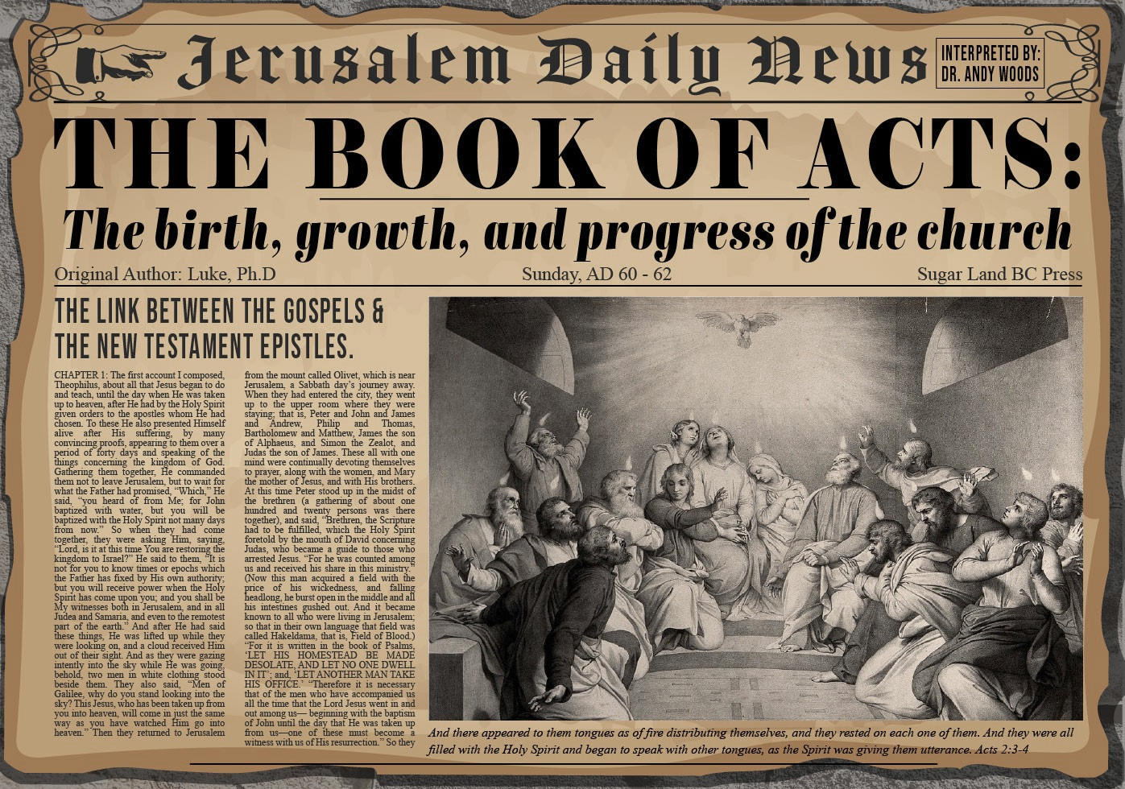


Slide 2
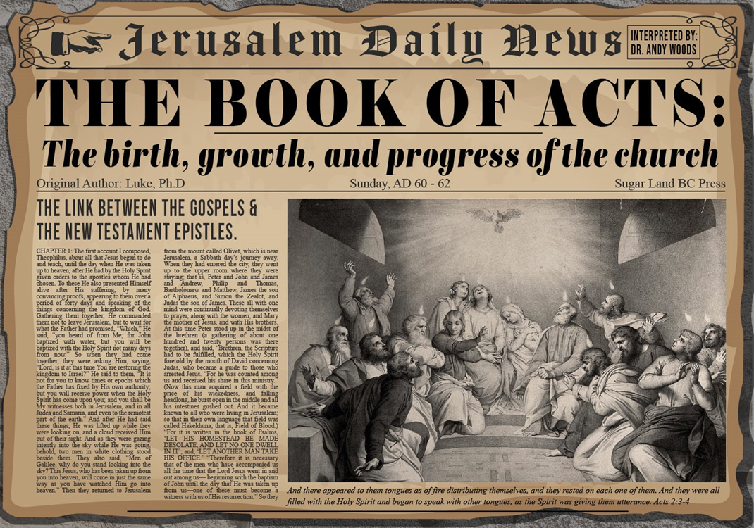
Acts 5:12‒42
Church’s Second Persecution
  Apostles’ Power (5:12-16)
  Apostles' Persecution (5:17-42)

Slide 3
Acts 5:17-26
Apostles’ Arrest
      Arrest’s cause & instigators (17-18)
      Divine rescue (19-21a)
      Sanhedrin’s meeting (21b-24)
      Apostles’ second arrest (25-26)

Slide 4
Acts 5:19-21a
Divine Rescue
      Means (19)
      Command (20)
      Apostolic obedience (21a)

Slide 5
Acts 5:19-21a
Divine Rescue
      Means (19)
      Command (20)
      Apostolic obedience (21a)

Slide 6
Acts 5:19-21a
Divine Rescue
      Means (19)
      Command (20)
      Apostolic obedience (21a)

Slide 7
Acts 2:15-35
Refutation of the Charge of Drunkenness
      Too early (15)
      Use of Joel 2:28-32 (16-21)
      Christ’s miracles (22)
      Crucifixion (23)
      Resurrection (24)
      Use of Psalm 16:8-11 (25-29)
      Use of Psalm 132:11 (30-32)
      High priestly ministry (33)
      Use of Psalm 110:1 (34-35)

Slide 8
Acts 3:13-15
Israel’s Rejection of Her Messiah
      God sent His Son (13a)
      Delivered to Pilate (13b)
      Rejection of the Holy & Righteous One (14)
      Killed the Prince of Life (15a)
      Messiah was Resurrected (15b)

Slide 9
Acts 5:19-21a
Divine Rescue
      Means (19)
      Command (20)
      Apostolic obedience (21a)

Slide 10
Acts 5:17-26
Apostles’ Arrest
      Arrest’s cause & instigators (17-18)
      Divine rescue (19-21a)
      Sanhedrin’s meeting (21b-24)
      Apostles’ second arrest (25-26)

Slide 11
Acts 5:21b-24
Sanhedrin’s Meeting
      Assembly (21b)
      Empty prison (21c-23)
      Rulers’ response (24)

Slide 12
Acts 5:21b-24
Sanhedrin’s Meeting
      Assembly (21b)
      Empty prison (21c-23)
      Rulers’ response (24)

Slide 13
Acts 5:21b-24
Sanhedrin’s Meeting
      Assembly (21b)
      Empty prison (21c-23)
      Rulers’ response (24)

Slide 14
Acts 5:21c-23
Empty Prison
      Officers sent (21c)
      Finding of empty prison (22a)
      Officers’ report (22b-23)

Slide 15
Acts 5:21c-23
Empty Prison
      Officers sent (21c)
      Finding of empty prison (22a)
      Officers’ report (22b-23)

Slide 16
Acts 5:21c-23
Empty Prison
      Officers sent (21c)
      Finding of empty prison (22a)
      Officers’ report (22b-23)

Slide 17
Acts 5:21c-23
Empty Prison
      Officers sent (21c)
      Finding of empty prison (22a)
      Officers’ report (22b-23)

Slide 18
Acts 5:21b-24
Sanhedrin’s Meeting
      Assembly (21b)
      Empty prison (21c-23)
      Rulers’ response (24)

Slide 19
Acts 5:17-26
Apostles’ Arrest
      Arrest’s cause & instigators (17-18)
      Divine rescue (19-21a)
      Sanhedrin’s meeting (21b-24)
      Apostles’ second arrest (25-26)

Slide 20
Acts 5:25-26
Apostle’s Second Arrest
      Rulers’ discovery (25)
      Apostles’ arrest (26)

Slide 21
Acts 5:25-26
Apostle’s Second Arrest
      Rulers’ discovery (25)
      Apostles’ arrest (26)

Slide 22
Acts 5:25-26
Apostle’s Second Arrest
      Rulers’ discovery (25)
      Apostles’ arrest (26)

Slide 23
II. Apostles’ Persecution
Acts 5:17-42
  Apostles’ arrest (17-26)
  Apostles’ examination (27-33)
  Gamaliel’s interruption & advice (34-39)
  Results (40-42)

Slide 24
Acts 5:27-33
Apostles’ Examination
      Apostles brought in (27)
      High priest’s accusations (28)
      Apostles’ response (29-32)
      Sanhedrin’s reaction (33)

Slide 25
Acts 5:27-33
Apostles’ Examination
      Apostles brought in (27)
      High priest’s accusations (28)
      Apostles’ response (29-32)
      Sanhedrin’s reaction (33)

Slide 26
Acts 5:27-33
Apostles’ Examination
      Apostles brought in (27)
      High priest’s accusations (28)
      Apostles’ response (29-32)
      Sanhedrin’s reaction (33)

Slide 27
Acts 5:28
High Priest’s Accusations
      Violation of the command (28a)
      Brought guilt upon us (28b)

Slide 28
Acts 5:28
High Priest’s Accusations
      Violation of the command (28a)
      Brought guilt upon us (28b)

Slide 29

Emphasis of 2 Timothy
“By my count, there are twenty-seven explicit commands given in the body of this letter. In 27 words Paul tells pastors what to focus on. You have to be blind to miss the thrust of Paul's instructions here, because eighteen of those commands--fully two-thirds--have to do with the ministry of the Word.”
Daniel Wallace, “Crisis of the Word: A Message to Pastors or Would-be Pastors,”
Conservative Theological Journal 1, no. 2 (August 1997): 108.

Slide 30
Acts 5:28
High Priest’s Accusations
      Violation of the command (28a)
      Brought guilt upon us (28b)

Slide 31


Acts 4:12
“And there is salvation in no one else; for there is no other name under heaven that has been given among men by which we must [dei] be saved.”

Slide 32
Acts 5:27-33
Apostles’ Examination
      Apostles brought in (27)
      High priest’s accusations (28)
      Apostles’ response (29-32)
      Sanhedrin’s reaction (33)

Slide 33
Acts 5:29-32
Apostles’ Response
      Necessity of civil disobedience (29)
      Presentation of the Messiah (30-31)
      Witnesses (32)

Slide 34
Acts 5:29-32
Apostles’ Response
      Necessity of civil disobedience (29)
      Presentation of the Messiah (30-31)
      Witnesses (32)

Slide 35


Matthew 16:18
“I also say to you that you are Peter, and upon this rock I will build [oikodomeō] My church; and the gates of Hades WILL NOT overpower it.”

Slide 36
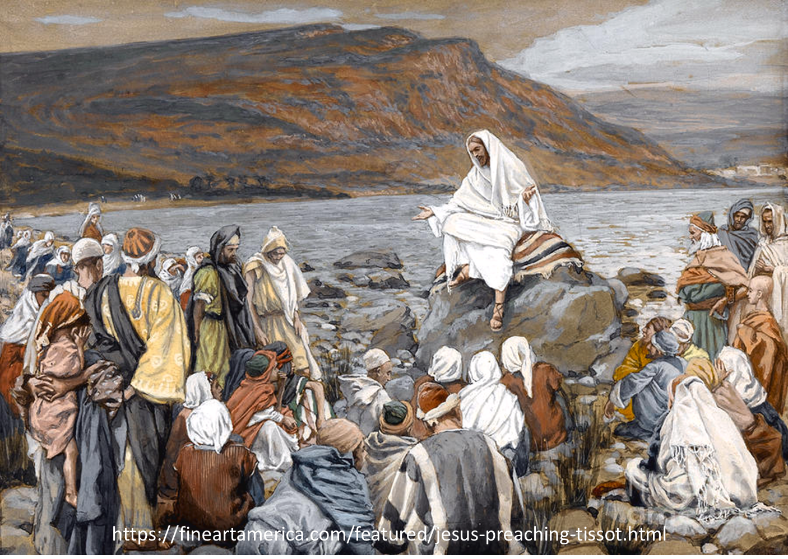
Luke 4:43
“But He said to them, “I must [dei] preach the kingdom of God to the other cities also, for I was sent for this purpose.”

Slide 37
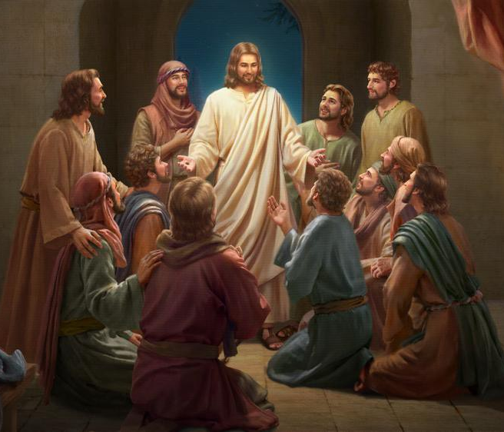
Luke 24:44
“Now He said to them, “These are My words which I spoke to you while I was still with you, that all things which are written about Me in the Law of Moses and the Prophets and the Psalms must [dei] be fulfilled.”

Slide 38
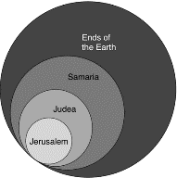
Acts 1:8
“but you will receive power when the Holy Spirit has come upon you; and you shall be My witnesses both in Jerusalem, and in all Judea and Samaria, and even to the remotest part of the earth.”

Slide 39
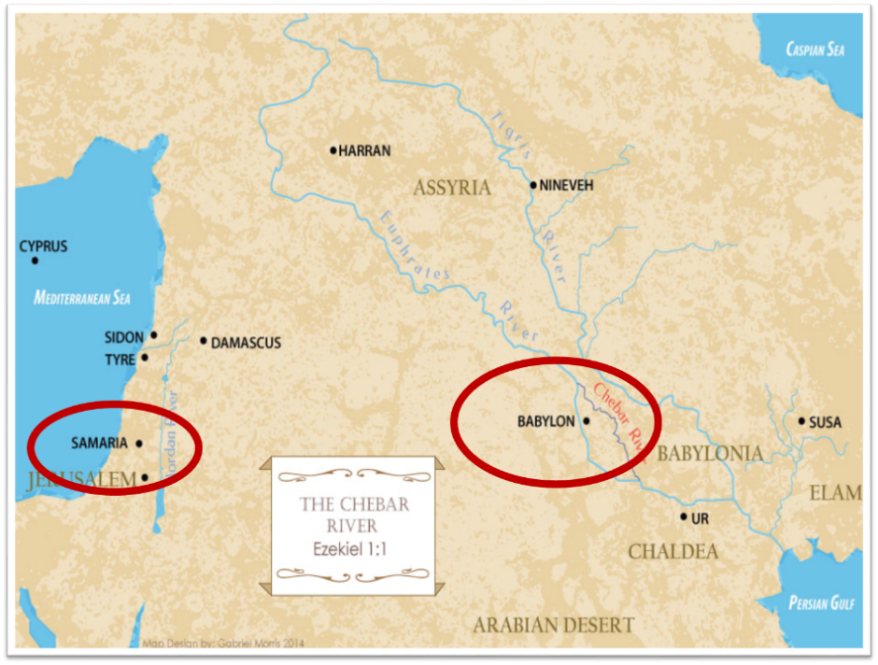

Slide 40
Daniel Outline
  Chiasm “Aramaic” ( 2-7)
1. Gentile History (2)
  2. Protection (3)
    3. Revelation to a gentile king (4)
    3. Revelation to a gentile king (5)
  2. Protection (6)
1. Gentile history (7)

Slide 41
Daniel Outline
  Chiasm “Aramaic” ( 2-7)
1. Gentile History (2)
  2. Protection (3)
    3. Revelation to a gentile king (4)
    3. Revelation to a gentile king (5)
  2. Protection (6)
1. Gentile history (7)

Slide 42
Acts 5:29-32
Apostles’ Response
      Necessity of civil disobedience (29)
      Presentation of the Messiah (30-31)
      Witnesses (32)

Slide 43
Acts 5:30-31
Presentation of the Messiah
      Fulfilment of the Covenants (30a)
      Death (30b)
      Exaltation (31a)
      Messiah’s purpose (31b)

Slide 44
Acts 5:30-31
Presentation of the Messiah
      Fulfilment of the Covenants (30a)
      Death (30b)
      Exaltation (31a)
      Messiah’s purpose (31b)

Slide 45
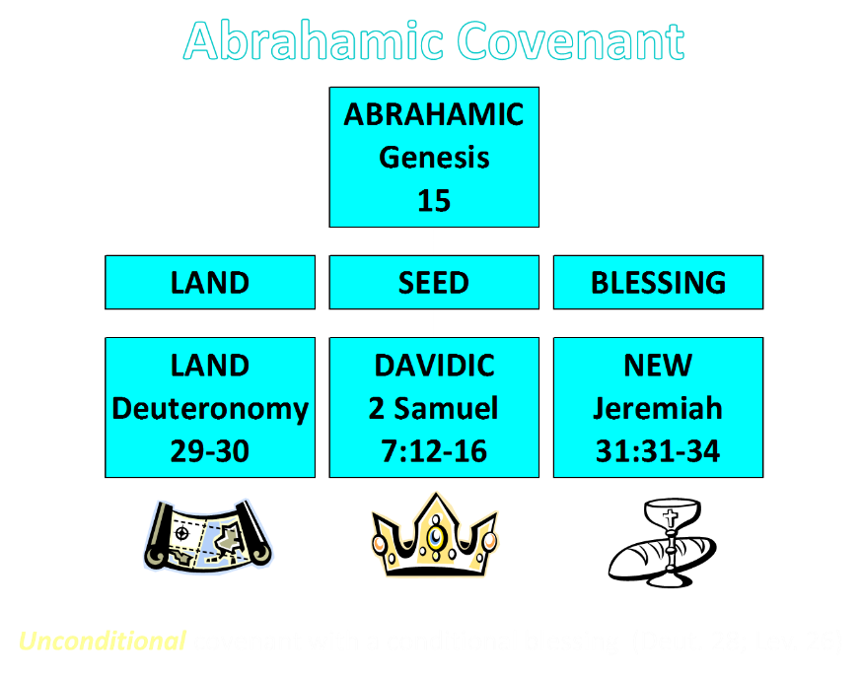

Slide 46
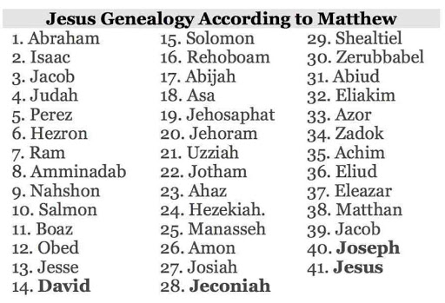

Slide 47
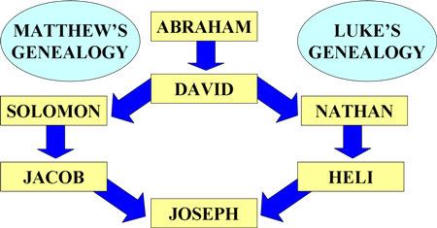
Matthean and Lukan Genealogies

Slide 48
Acts 5:30-31
Presentation of the Messiah
      Fulfilment of the Covenants (30a)
      Death (30b)
      Exaltation (31a)
      Messiah’s purpose (31b)

Slide 49

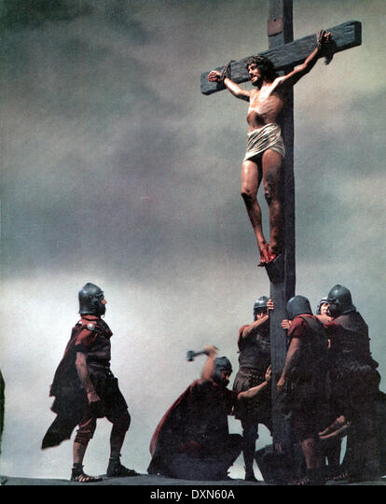
Acts 2:23
“this Man, delivered over by the predetermined plan and foreknowledge of God, you nailed to a cross by the hands of godless men and put Him to death.”

Slide 50
Acts 5:30-31
Presentation of the Messiah
      Fulfilment of the Covenants (30a)
      Death (30b)
      Exaltation (31a)
      Messiah’s purpose (31b)

Slide 51
Acts 2:15-35
Refutation of the Charge of Drunkenness
      Too early (15)
      Use of Joel 2:28-32 (16-21)
      Christ’s miracles (22)
      Crucifixion (23)
      Resurrection (24)
      Use of Psalm 16:8-11 (25-29)
      Use of Psalm 132:11 (30-32)
      High priestly ministry (33)
      Use of Psalm 110:1 (34-35)

Slide 52

Daniel 9:26
“Then after the sixty-two weeks the Messiah will be cut off and have nothing, and the people of the prince who is to come will destroy the city and the sanctuary. And its end will come with a flood; even to the end there will be war; desolations are determined.”

Slide 53
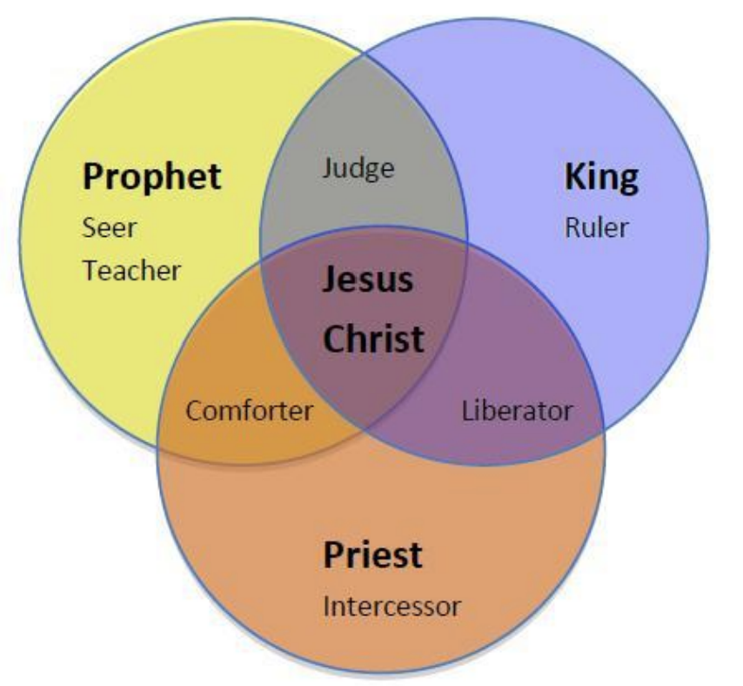
CHRIST’S THREE OFFICES
Prophet (First Coming)
Priest (Present Session)
King (Second Coming)

Slide 54
Acts 5:30-31
Presentation of the Messiah
      Fulfilment of the Covenants (30a)
      Death (30b)
      Exaltation (31a)
      Messiah’s purpose (31b)

Slide 55
Matthew 23:37-39
³⁷ “Jerusalem, Jerusalem, who kills the prophets and stones those who are sent to her! How often I wanted to gather [episynagō] your children together, the way a hen gathers [episynagō] her chicks under her wings, and you were unwilling. ³⁸ Behold, your house is being left to you desolate! ³⁹ For I say to you, from now on you will not see Me until you say, ‘Blessed is He who comes in the name of the Lord!’”

Slide 56
Acts 5:29-32
Apostles’ Response
      Necessity of civil disobedience (29)
      Presentation of the Messiah (30-31)
      Witnesses (32)

Slide 57
Acts 5:32
Witnesses
      Apostolic (32a)
      Holy Spirit (32b)

Slide 58
Acts 5:32
Witnesses
      Apostolic (32a)
      Holy Spirit (32b)

Slide 59
What Happened to Christ’s Disciples?
Disciple | Place | Martyrdom
James the Son of Alpheus | Jerusalem | Clubbed to death
Simon the Zealot | Jerusalem | Martyred
James the Son of Zebedee | Judea (Acts 12:2) | Executed
Thaddeus | Mesopotamia | Beaten to death
Peter | Babylon, Rome | Crucified upside down
Matthew | Parthia (Tehran) | Beheaded
Notes:
109 prophecies…
Peter Stoner – SCIENCE SPEAKS, An Evaluation of Certain Christian Evidences
To fulfill just 8 prophecies =1 X 10 to the twenty-eighth power!
Can we visualize this with an illustration? Suppose we took an atheistic professor, blindfolded him and covered the state of Texas two feet deep with silver dollars. Then we put a check on one of those silver dollars and mixed them up. The odds of one person fulfilling just these eight prophecies would be the same as this atheistic professor selecting the silver dollar upon which we have placed a check, in his first try.
https://www.bereanpublishers.com/the-odds-of-eight-messianic-prophecies-coming-true/

Slide 60
What Happened to Christ’s Disciples?
Disciple | Place | Martyrdom
John | Asia Minor, Patmos, Ephesus | Fried in boiling oil
Philip | E. Turkey | Tortured & crucified
Thomas | India | Speared
Bartholomew | India | Flayed & crucified
Andrew | Ukraine, Russia, Greece | Hanged
Notes:
109 prophecies…
Peter Stoner – SCIENCE SPEAKS, An Evaluation of Certain Christian Evidences
To fulfill just 8 prophecies =1 X 10 to the twenty-eighth power!
Can we visualize this with an illustration? Suppose we took an atheistic professor, blindfolded him and covered the state of Texas two feet deep with silver dollars. Then we put a check on one of those silver dollars and mixed them up. The odds of one person fulfilling just these eight prophecies would be the same as this atheistic professor selecting the silver dollar upon which we have placed a check, in his first try.
https://www.bereanpublishers.com/the-odds-of-eight-messianic-prophecies-coming-true/

Slide 61
Acts 5:32
Witnesses
      Apostolic (32a)
      Holy Spirit (32b)

Slide 62
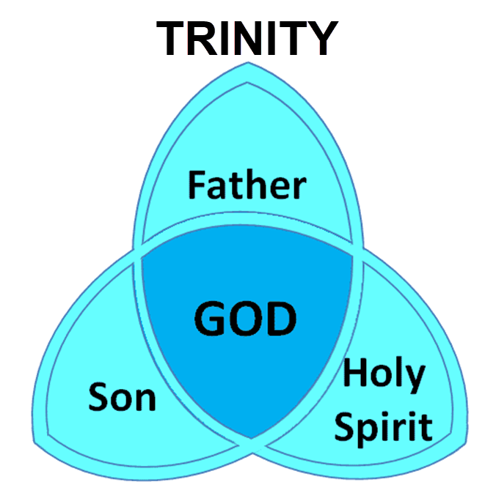

Slide 63
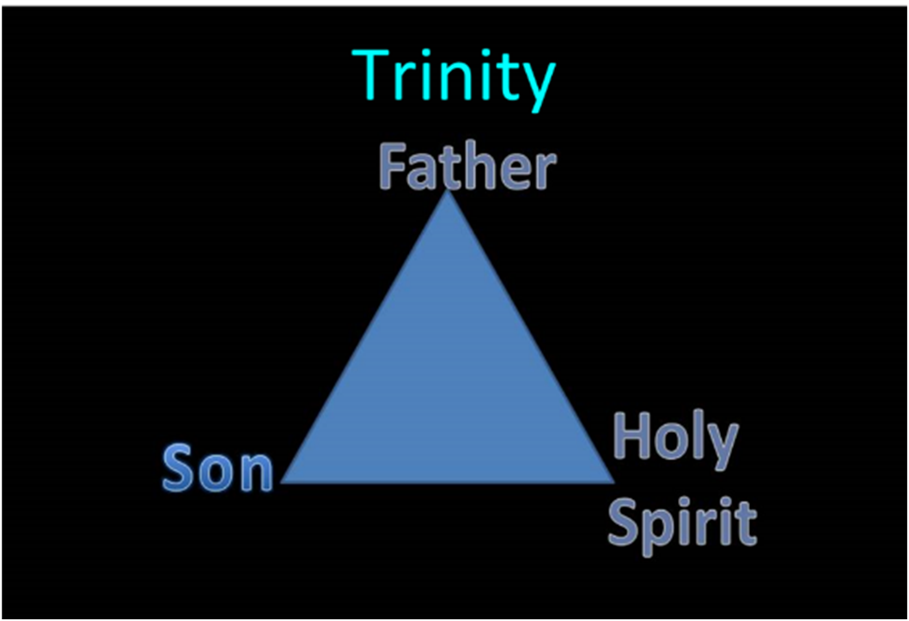

Slide 64
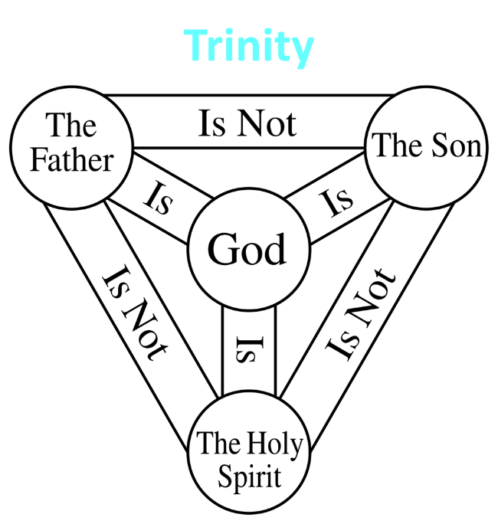

Slide 65


John 3:36
^{36 “}The one who believes in the Son has eternal life; but the one who does not obey the Son will not see life, but the wrath of God remains on him.”

Slide 66
John 14:16-17
¹⁶ I will ask the Father, and He will give you another Helper, that He may be with you forever; ¹⁷ that is the Spirit of truth, whom the world cannot receive, because it does not see Him or know Him, but you know Him because He abides with you and will be in you.

Slide 67
Acts 5:27-33
Apostles’ Examination
      Apostles brought in (27)
      High priest’s accusations (28)
      Apostles’ response (29-32)
      Sanhedrin’s reaction (33)

Slide 68
Acts 5:33
Sanhedrin’s Reaction
      Conviction (33a)
      Rage (33b)

Slide 69
Acts 5:33
Sanhedrin’s Reaction
      Conviction (33a)
      Rage (33b)

Slide 70
John 16:7–11
⁷ “But I tell you the truth, it is to your advantage that I go away; for if I do not go away, the Helper will not come to you; but if I go, I will send Him to you. ⁸ “And He, when He comes, will convict the world concerning sin and righteousness and judgment; ⁹ concerning sin, because they do not believe in Me; ¹⁰ and concerning righteousness, because I go to the Father and you no longer see Me; ¹¹ and concerning judgment, because the ruler of this world has been judged.

Slide 71
Acts 5:33
Sanhedrin’s Reaction
      Conviction (33a)
      Rage (33b)

Slide 72
II. Apostles’ Persecution
Acts 5:17-42
  Apostles’ arrest (17-26)
  Apostles’ examination (27-33)
  Gamaliel’s interruption & advice (34-39)
  Results (40-42)

Slide 73
Acts 5:34-39
Gamaliel’s Interruption & Advice
      Gamaliel’s background (34)
      Gamaliel’s address (35-39)

Slide 74
Acts 5:34-39
Gamaliel’s Interruption & Advice
      Gamaliel’s background (34)
      Gamaliel’s address (35-39)

Slide 75
Acts 5:34
Gamaliel’s Background
      Introduction (34a)
      Command (34b)

Slide 76
Acts 5:34
Gamaliel’s Background
      Introduction (34a)
      Command (34b)

Slide 77
Acts 5:34
Gamaliel’s Background
      Introduction (34a)
      Command (34b)

Slide 78
Acts 5:34-39
Gamaliel’s Interruption & Advice
      Gamaliel’s background (34)
      Gamaliel’s address (35-39)

Slide 79
Acts 5:35-39
Gamaliel’s Address
      Need for caution (35)
      Two parallel illustrations (36-37)
      Application (38-39)

Slide 80
Acts 5:35-39
Gamaliel’s Address
      Need for caution (35)
      Two parallel illustrations (36-37)
      Application (38-39)

Slide 81
Acts 5:35-39
Gamaliel’s Address
      Need for caution (35)
      Two parallel illustrations (36-37)
      Application (38-39)

Slide 82
Acts 5:36-37
Two Parallel Illustrations
      Theudas (36)
      Judas of Galilee (37)

Slide 83
Acts 5:36-37
Two Parallel Illustrations
      Theudas (36)
      Judas of Galilee (37)

Slide 84
Acts 5:36-37
Two Parallel Illustrations
      Theudas (36)
      Judas of Galilee (37)

Slide 85
Acts 5:35-39
Gamaliel’s Address
      Need for caution (35)
      Two parallel illustrations (36-37)
      Application (38-39)

Slide 86
Acts 5:38-39
Application
      Command (38a)
      Reason (38b-39)

Slide 87
Acts 5:38-39
Application
      Command (38a)
      Reason (38b-39)

Slide 88
Acts 5:38-39
Application
      Command (38a)
      Reason (38b-39)

Slide 89
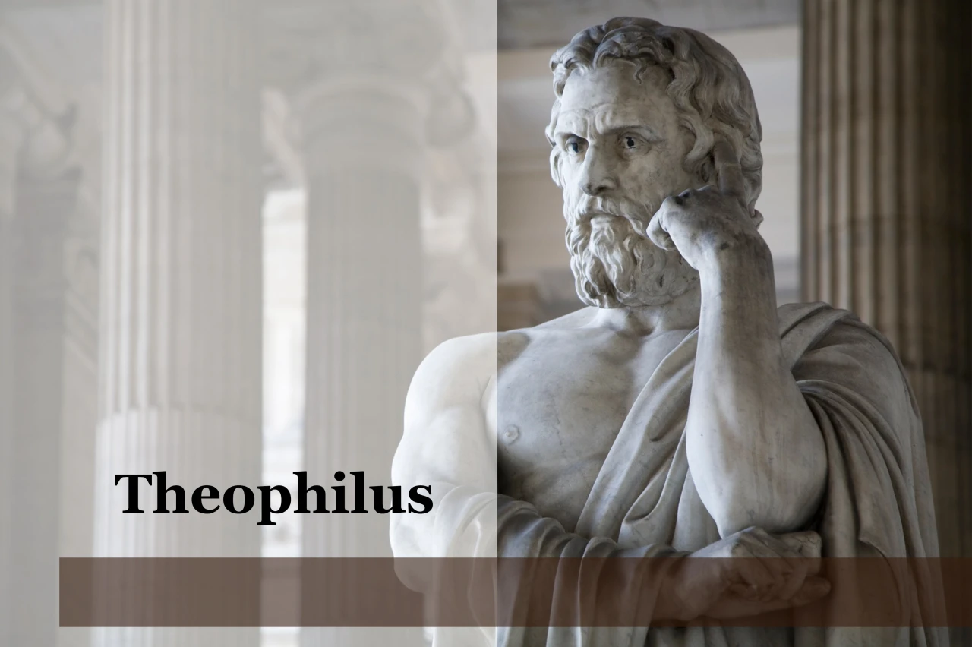
Purpose
  To present Theophilus with an orderly account of the birth and growth of the church so as to affirm him in what he has believed.

Slide 90

Message
  Birth and growth of the church numerically, geographically, ethnically.
  Components
  Numerically (progress reports)
  Geographically (From Jerusalem to Rome)
  Ethnically (From Judaism to Gentile domination)

Slide 91

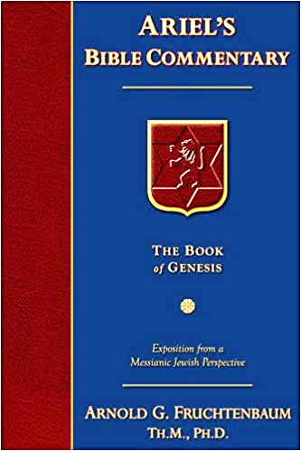
Dr. Arnold G. Fruchtenbaum
The Book of Acts, 143
“Some have taken Gamaliel’s words and turned them into divine truth. However, Luke simply recorded what Gamaliel said without confirming the validity of the words. This was Gamaliel’s personal opinion; it was not a biblical truth. Many things that are not of God (such as false religions and cults) have prospered. One must be careful not to use someone’s opinion as biblical truth.”

Slide 92
II. Apostles’ Persecution
Acts 5:17-42
  Apostles’ arrest (17-26)
  Apostles’ examination (27-33)
  Gamaliel’s interruption & advice (34-39)
  Results (40-42)

Slide 93
Acts 5:40-42
Results
      Sanhedrin (40)
      Results (41-42)

Slide 94
Acts 5:40-42
Results
      Sanhedrin (40)
      Results (41-42)

Slide 95
Acts 5:40
Sanhedrin
      Agreement with Gamaliel (40a)
      Summoned the Apostles (40b)
      Punished the Apostles (40c)
      Charged the Apostles (40d)
      Released the Apostles (40e)

Slide 96
Acts 5:40
Sanhedrin
      Agreement with Gamaliel (40a)
      Summoned the Apostles (40b)
      Punished the Apostles (40c)
      Charged the Apostles (40d)
      Released the Apostles (40e)

Slide 97
Acts 5:40
Sanhedrin
      Agreement with Gamaliel (40a)
      Summoned the Apostles (40b)
      Punished the Apostles (40c)
      Charged the Apostles (40d)
      Released the Apostles (40e)

Slide 98
Acts 5:40
Sanhedrin
      Agreement with Gamaliel (40a)
      Summoned the Apostles (40b)
      Punished the Apostles (40c)
      Charged the Apostles (40d)
      Released the Apostles (40e)

Slide 99
Acts 5:40
Sanhedrin
      Agreement with Gamaliel (40a)
      Summoned the Apostles (40b)
      Punished the Apostles (40c)
      Charged the Apostles (40d)
      Released the Apostles (40e)

Slide 100
Acts 5:40
Sanhedrin
      Agreement with Gamaliel (40a)
      Summoned the Apostles (40b)
      Punished the Apostles (40c)
      Charged the Apostles (40d)
      Released the Apostles (40e)

Slide 101
Acts 5:40-42
Results
      Sanhedrin (40)
      Results (41-42)

Slide 102
Acts 5:41-42
Apostles
      Joy (41)
      Zeal (42)

Slide 103
Acts 5:41-42
Apostles
      Joy (41)
      Zeal (42)

Slide 104
Acts 5:41-42
Apostles
      Joy (41)
      Zeal (42)

Slide 105
Conclusion

Slide 106
Acts 5:12‒42
Church’s Second Persecution
  Apostles’ Power (5:12-16)
  Apostles' Persecution (5:17-42)

