Slide 1
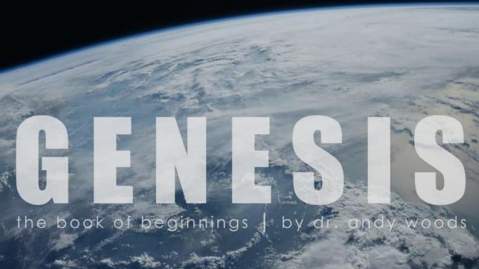

Genesis 12‒50
Israel’s Birth & Preservation

Slide 2
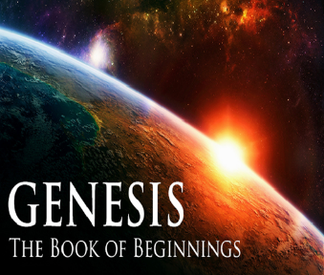
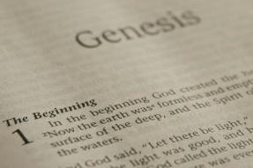
GENESIS STRUCTURE
  Genesis 12-50 (four people)
    Abraham (12:1–25:11)
    Isaac (25:12–26:35)
    Jacob (27–36)
    Joseph (37–50)

Slide 3
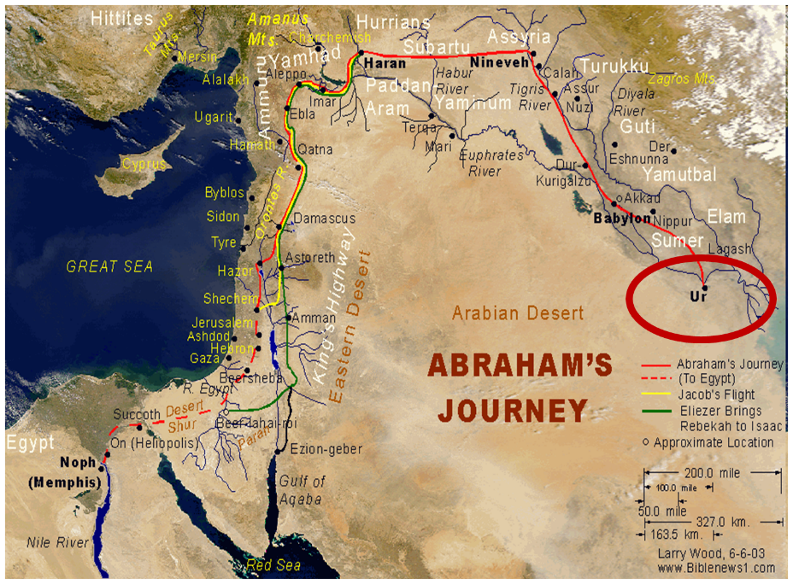

Slide 4
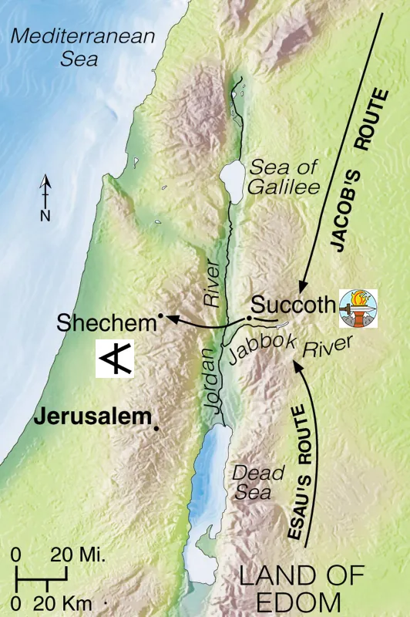


Slide 5
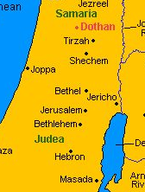

Slide 6
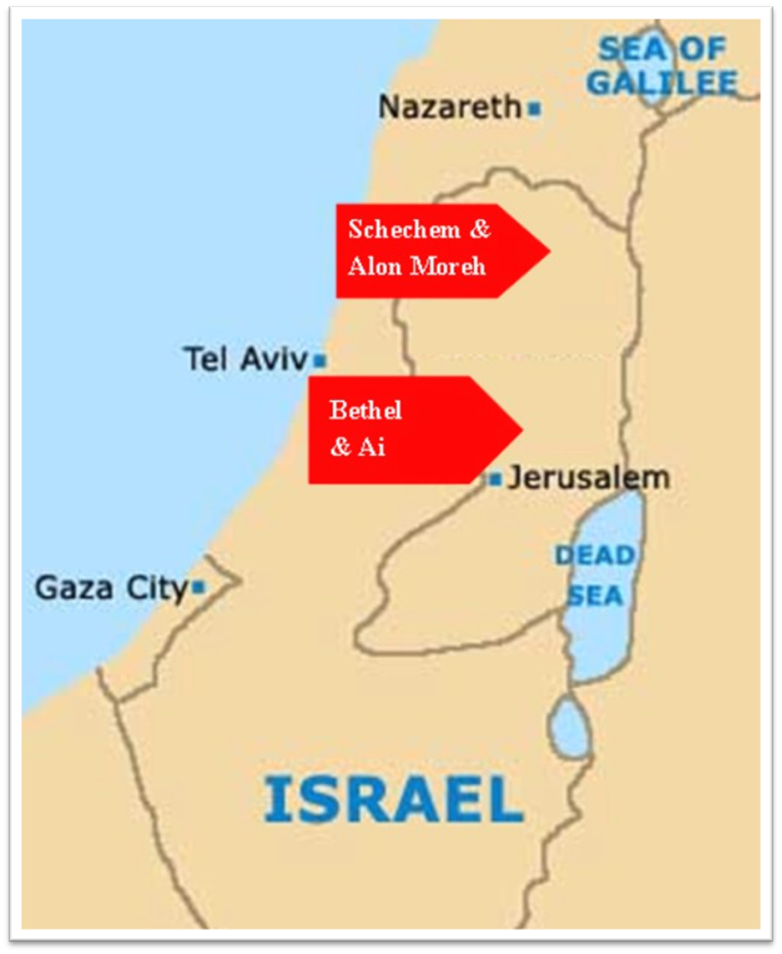

Slide 7
Genesis 35:1-29
Transitionary Information
  Jacob’s journey to Bethel (35:1-8)
  Divine appearance (35:9-15)
  Benjamin’s birth (35:16-20)
  Reuben loses the birthright (35:21-22a)
  Jacob’s dozen (35:22b-26)
  Isaac’s death (35:27-29)

Slide 8
II. Genesis 35:9-15
Divine Appearance
    Divine appearance (9)
    Jacob’s name change confirmed (10)
    Abrahamic Covenant reconfirmed (11-12)
    God’s appearance terminated (13)
    Jacob’s response (14-15)

Slide 9
II. Genesis 35:9-15
Divine Appearance
    Divine appearance (9)
    Jacob’s name change confirmed (10)
    Abrahamic Covenant reconfirmed (11-12)
    God’s appearance terminated (13)
    Jacob’s response (14-15)

Slide 10
New Promises
Genesis 12:1-3
    Land (Gen. 12:1b)
    Great nation (Gen. 12:2a)
    Personal blessing (Gen. 12:2b)
    Great name (Gen. 12:2c)
    Blessing to others (Gen. 12:2d)
    Blessing to blessers (Gen. 12:3a)
    Cursing to cursers (Gen. 12:3b)
    Blessing to the world (Gen. 12:3c)

Slide 12
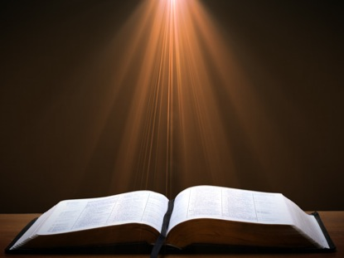
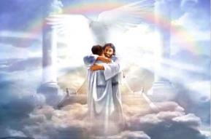
Ephesians 1:3
“Blessed be the God and Father of our Lord Jesus Christ, who has blessed us with every spiritual blessing in the heavenly places in Christ.”

Slide 13
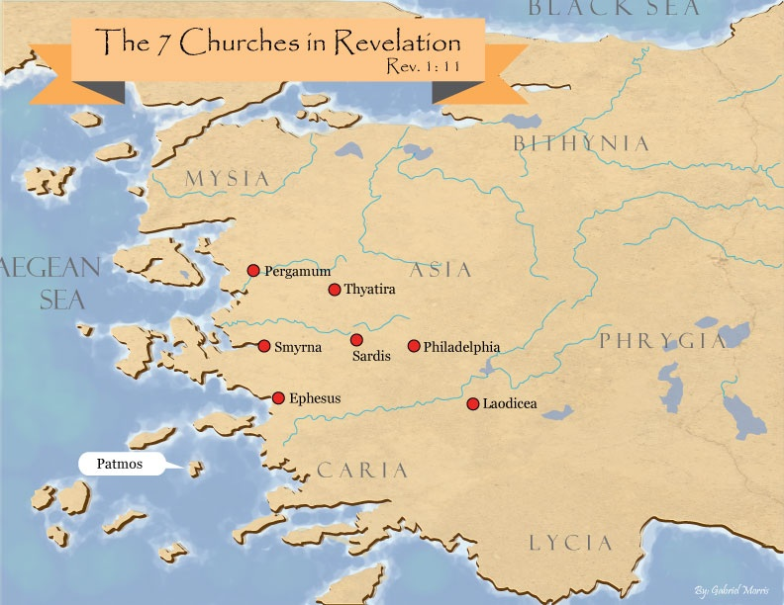
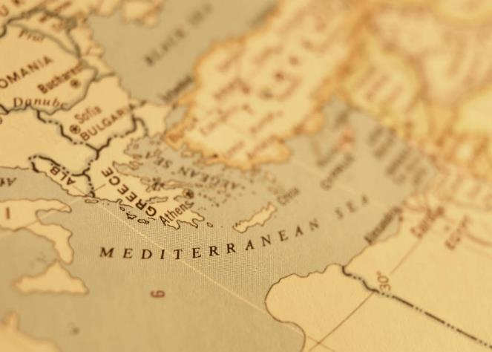

Slide 14

Revelation 2:9
“I know your tribulation and your poverty (but you are rich), and the blasphemy by those who say they are Jews and are not, but are a synagogue of Satan.”

Slide 15
II. Genesis 35:9-15
Divine Appearance
    Divine appearance (9)
    Jacob’s name change confirmed (10)
    Abrahamic Covenant reconfirmed (11-12)
    God’s appearance terminated (13)
    Jacob’s response (14-15)

Slide 16
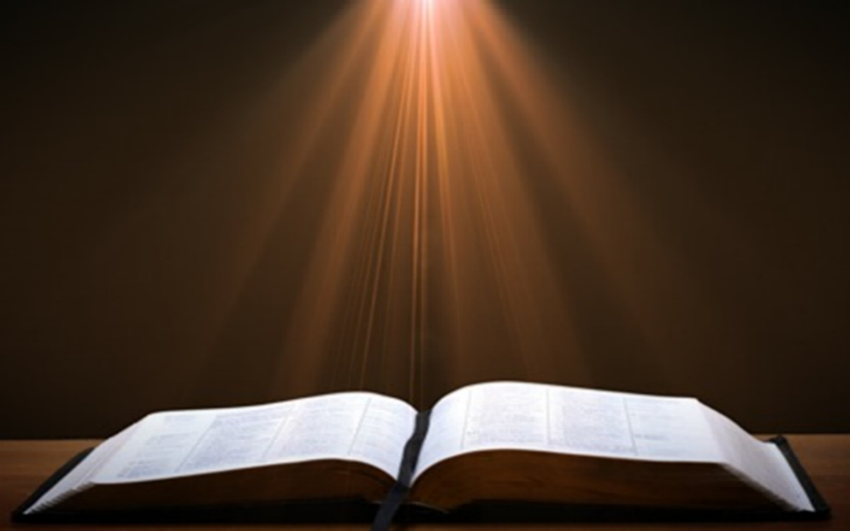
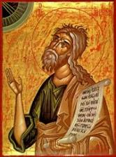
Jeremiah 30:6-7
“⁶ Ask now, and see If a male can give birth. Why do I see every man With his hands on his loins, as a woman in childbirth? And why have all faces turned pale? ⁷ Alas! for that day is great, There is none like it; And it is the time of Jacob’s distress (Gen. 32:8; 35:10), But he will be saved from it.”

Slide 17
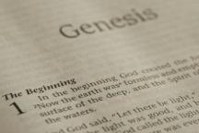
Beginning Themes
Universe Life Man Marriage Evil Clothing | Religion Salvation Language Government Nations Israel
Morris, Genesis Record, 18-20

Slide 18

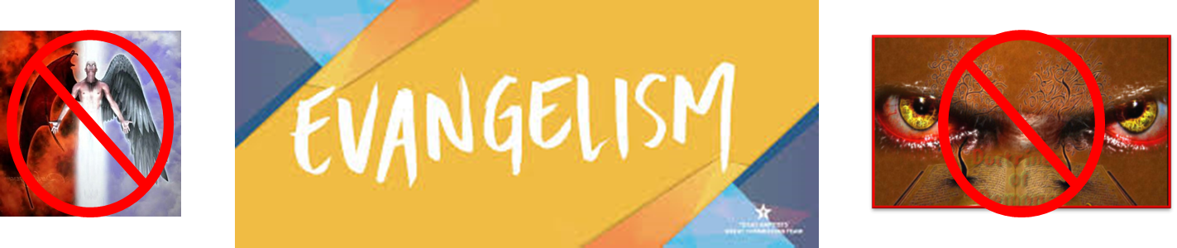
Matthew 16:18
“I also say to you that you are Peter, and upon this rock I will build [oikodomeō] My church; and the gates of Hades WILL NOT overpower it.”

Slide 20
II. Genesis 35:9-15
Divine Appearance
    Divine appearance (9)
    Jacob’s name change confirmed (10)
    Abrahamic Covenant reconfirmed (11-12)
    God’s appearance terminated (13)
    Jacob’s response (14-15)

Slide 21
Genesis 35:11-12
Abrahamic Covenant Reconfirmed
      God’s self-identification (11a)
      Command (11b)
      Jacob’s posterity (11c-12)

Slide 22
Genesis 35:11-12
Abrahamic Covenant Reconfirmed
      God’s self-identification (11a)
      Command (11b)
      Jacob’s posterity (11c-12)

Slide 23
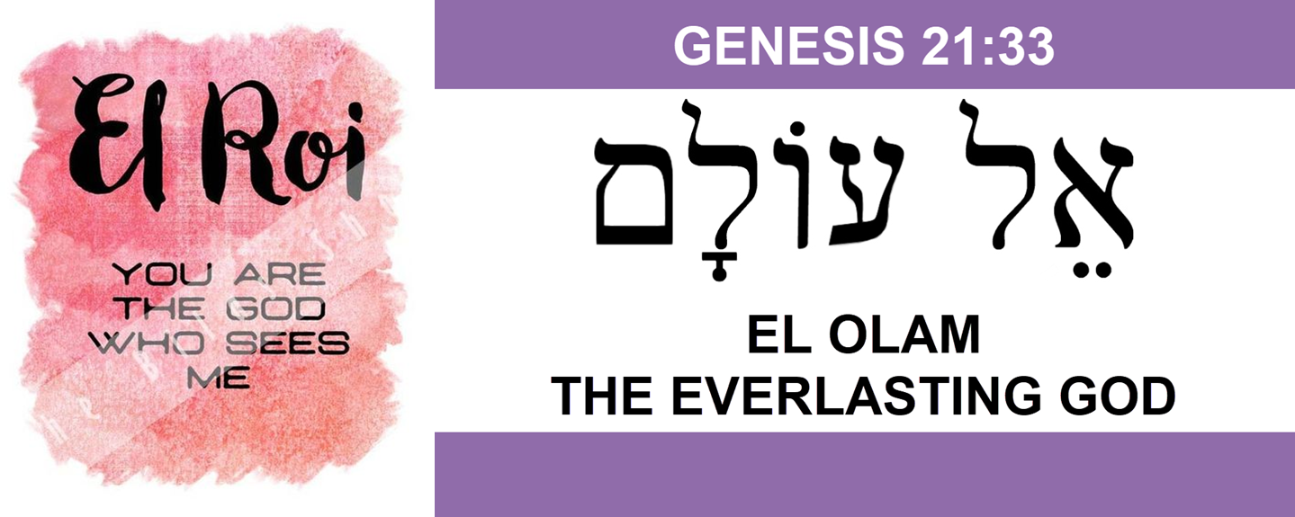

Slide 25
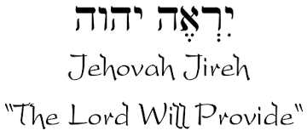

Slide 26
Names for God in Genesis
Elohim (1:1) - Power
Yahweh (2:4) - Relational
El Roi (Gen. 16:13) – Aware
El Olam (21:33) – Eternal
Jehovah Jireh (22:14) - Provision
God Isaac Feared (31:42, 53) - Reverenced
God, the God of Israel (33:20) – National
El Bethel (35:7) – The God of the House of God
El Shaddai (17:1; 35:11) – Almighty

Slide 27
Genesis 35:11-12
Abrahamic Covenant Reconfirmed
      God’s self-identification (11a)
      Command (11b)
      Jacob’s posterity (11c-12)

Slide 28
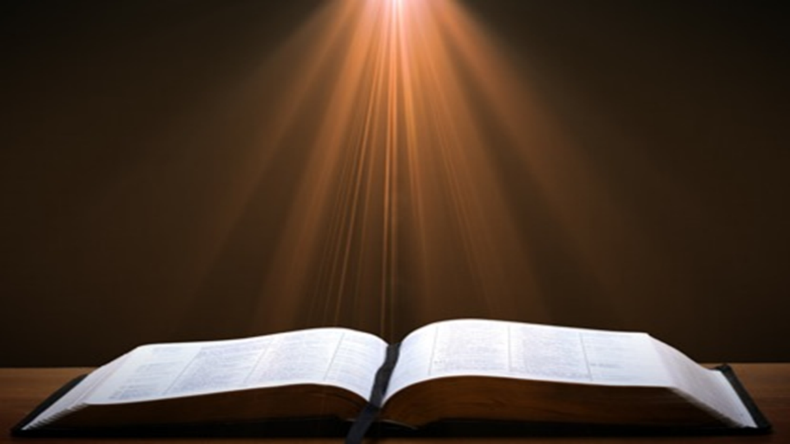
Genesis 1:26-28
²⁶ Then God said, “Let Us make man in Our image, according to Our likeness; and let them rule over the fish of the sea and over the birds of the sky and over the cattle and over all the earth, and over every creeping thing that creeps on the earth.” ²⁷ God created man in His own image, in the image of God He created him; male and female He created them. ²⁸ God blessed them; and God said to them, “Be fruitful and multiply, and fill the earth, and subdue it; and rule over the fish of the sea and over the birds of the sky and over every living thing that moves on the earth.”

Slide 29

Names & Titles Demonstrating Satan’s
Post-Fall, Earthly Authority
(Job 1:7; 2:2; Luke 4:5-8; Rom. 8:19-22)
  Prince of this world (John 12:31; 14:30; 16:11)
  God of this age (2 Cor. 4:4)
  Prince and power of the air (Eph. 2:2)
  Who the believer wrestles with (Eph. 6:12)
  Roaring lion (1 Pet. 5:8)
  Whole world lies in his power (1 John 5:19)

Slide 30
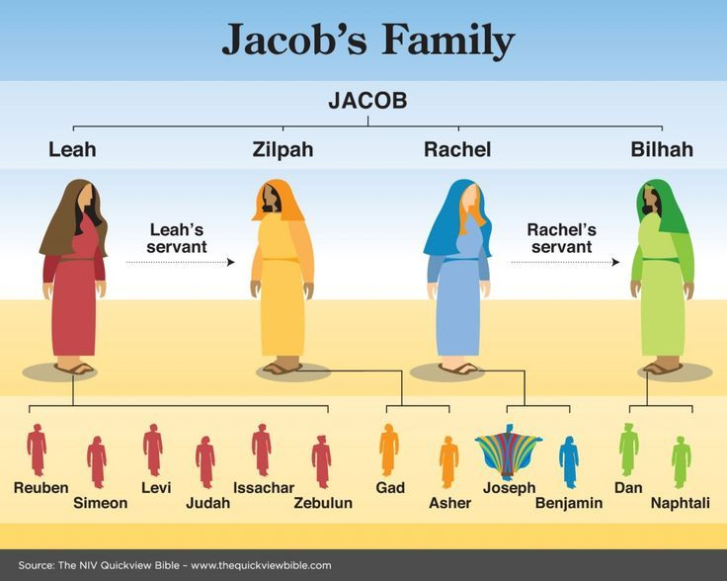

Slide 31
Genesis 35:11-12
Abrahamic Covenant Reconfirmed
      God’s self-identification (11a)
      Command (11b)
      Jacob’s posterity (11c-12)

Slide 32
Genesis 35:11c-12
Jacob’s Posterity
      Nation (11c)
      Company of nations (11d)
      Kings (11e)
      Land (12)

Slide 33
Genesis 35:11c-12
Jacob’s Posterity
      Nation (11c)
      Company of nations (11d)
      Kings (11e)
      Land (12)

Slide 34

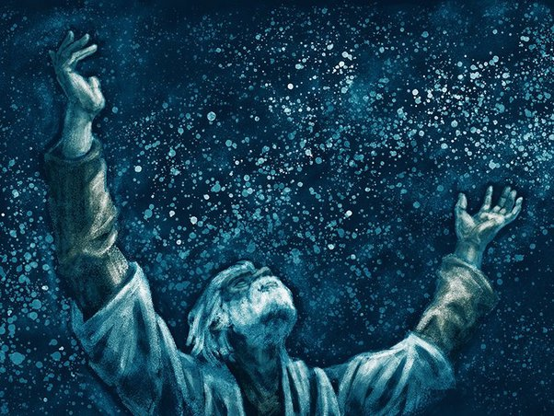
Genesis 12:3
“And I will bless those who bless you, And the one who curses you I will curse. And in you all the families of the earth will be blessed.”

Slide 35

Numbers 24:17
“I see him, but not now; I behold him, but not near; A star shall come forth from Jacob, A scepter shall rise from Israel, And shall crush through the forehead of Moab, And tear down all the sons of Sheth.”

Slide 36
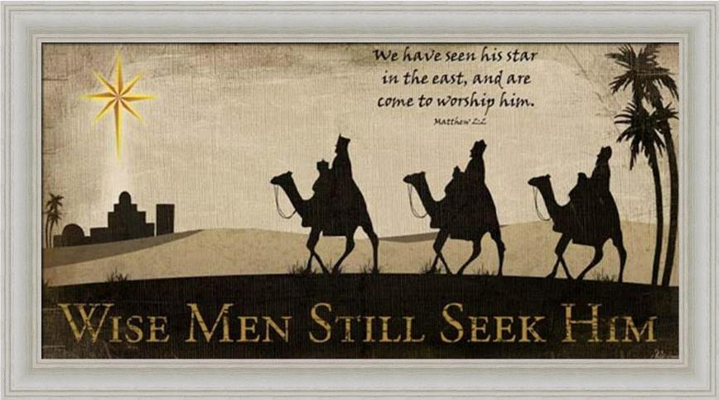

Slide 37
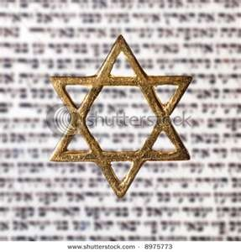
Israel’s Three Blessings to the World
(Gen 12:3b)
Scripture (Rom 3:2)
Savior (John 4:22)
Kingdom (Isa 2:2-3)

Slide 38
Genesis 35:11c-12
Jacob’s Posterity
      Nation (11c)
      Company of nations (11d)
      Kings (11e)
      Land (12)

Slide 39
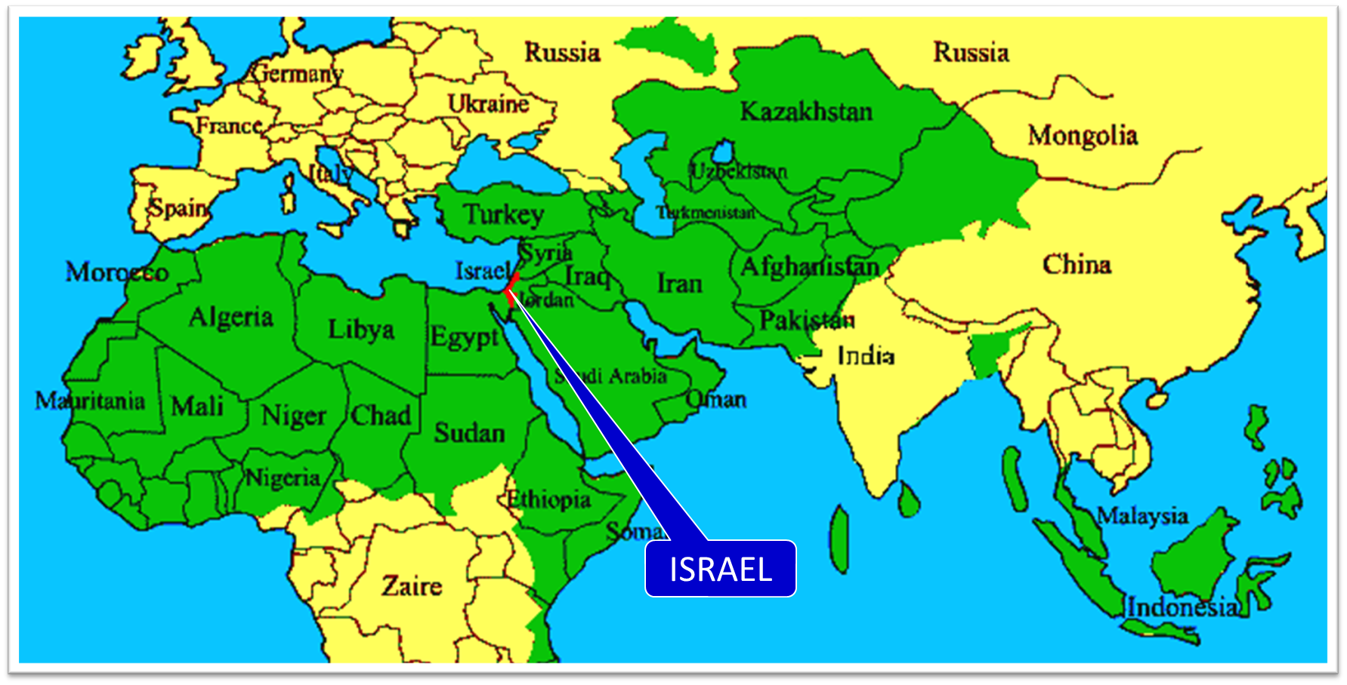

Slide 40

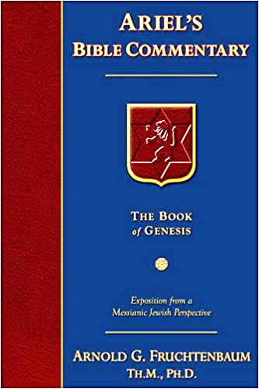
Dr. Arnold G. Fruchtenbaum
The Book of Genesis, 503-4
“However, no other nation than Israel came out of Jacob. The Hebrew word kahal is used here, relating to a company of nations. This word is used uniquely of Jacob; it was not used in reference to Abraham. It is the same word that is used of the congregation of Israel. Therefore, a company of nations was not a reference to other nations, as it was in the case of Abraham, but a reference to the Tribes of Israel. The way it should read is that a company of tribes will come out of Jacob, and so indeed a company of Twelve Tribes comprise this one nation. It may very well be that this also was intended to mean that there will be such a multitude of Jewish descendants as to appear to be many nations, as is the case in 48:19.”

Slide 41
Beginning Themes
Universe Life Man Marriage Evil Clothing | Religion Salvation Language Government Nations Israel
Morris, Genesis Record, 18-20

Slide 42
Genesis 35:11c-12
Jacob’s Posterity
      Nation (11c)
      Company of nations (11d)
      Kings (11e)
      Land (12)

Slide 43
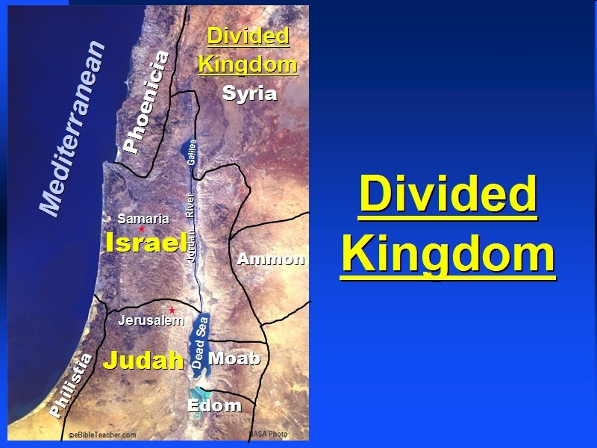

Slide 44

Good and Bad Kings
North – 19 kings (all bad)
South – 20 kings (8 good; significance of Gen 49:10)

Slide 45
Genesis 35:11c-12
Jacob’s Posterity
      Nation (11c)
      Company of nations (11d)
      Kings (11e)
      Land (12)

Slide 46
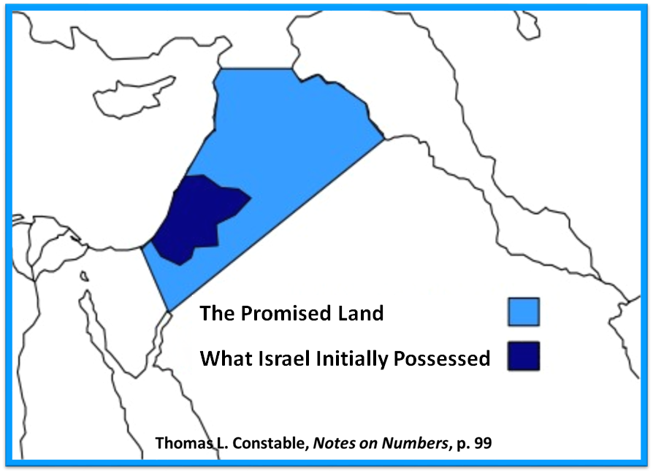

Slide 47
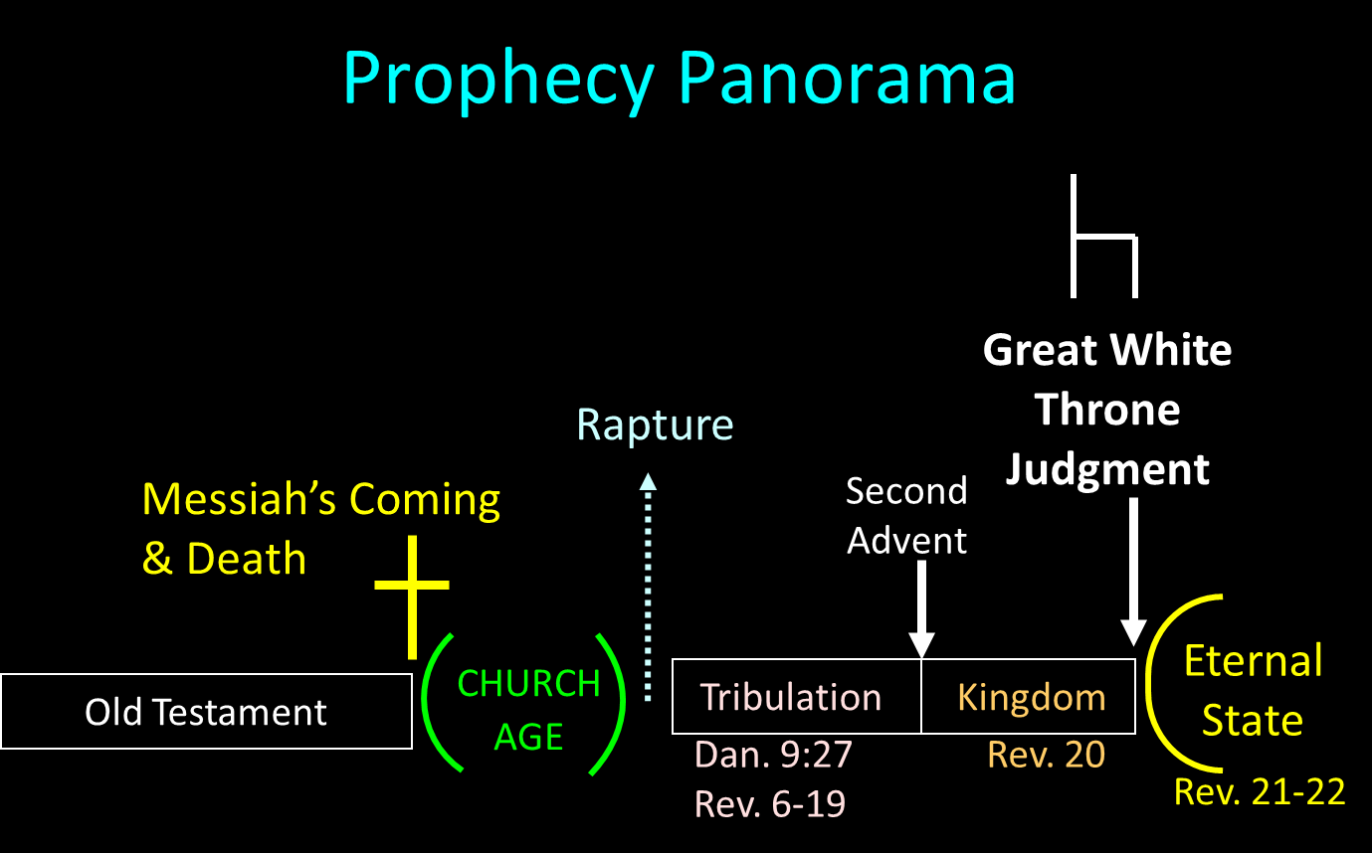

Slide 48

Daniel 12:1-2
“¹ Now at that time Michael, the great prince who stands guard over the sons of your people, will arise. And there will be a time of distress such as never occurred since there was a nation until that time; and at that time your people, everyone who is found written in the book, will be rescued. ² Many of those who sleep in the dust of the ground will awake, these to everlasting life, but the others to disgrace and everlasting contempt.”

Slide 49
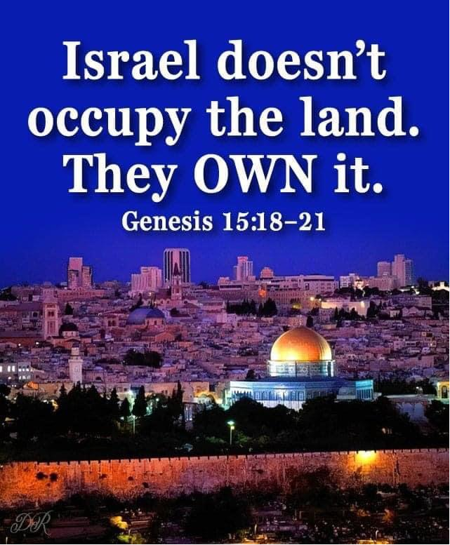

Slide 50

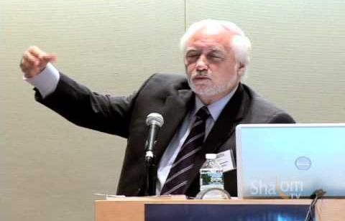
Dr. Jacques Gauthier
Canadian international lawyer

Slide 51
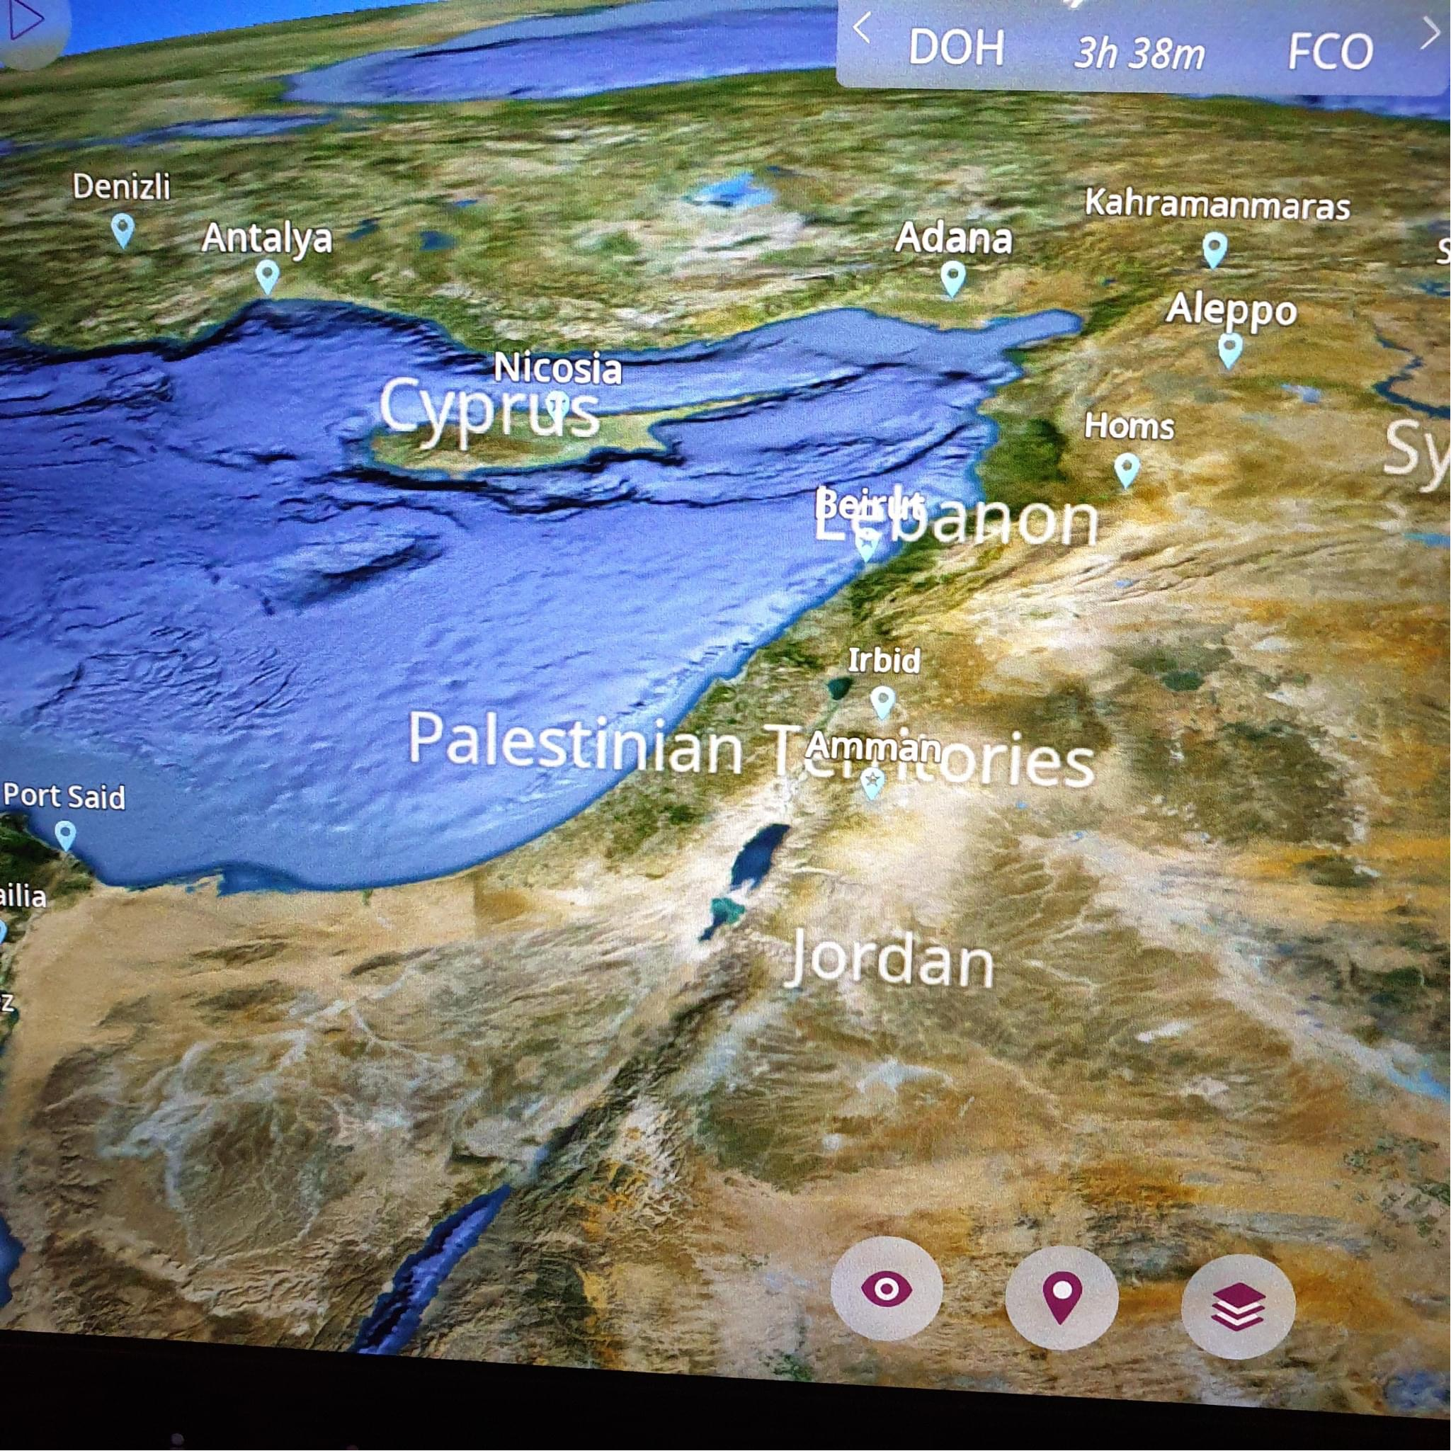

Slide 52
II. Genesis 35:9-15
Divine Appearance
    Divine appearance (9)
    Jacob’s name change confirmed (10)
    Abrahamic Covenant reconfirmed (11-12)
    God’s appearance terminated (13)
    Jacob’s response (14-15)

Slide 53


Jude 3
“Beloved, while I was making every effort to write you about our common salvation, I felt the necessity to write to you appealing that you contend earnestly for the faith that was once for all time handed down to the saints.”

Slide 54
Revelation 22:18-19
“I testify to everyone who hears the words of the prophecy of this book: if anyone adds to them, God will add to him the plagues which are written in this book; ¹⁹ and if anyone takes away from the words of the book of this prophecy, God will take away his part from the tree of life and from the holy city, which are written in this book.”

Slide 55
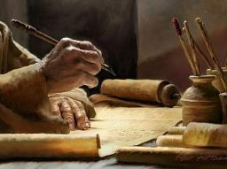
2 Timothy 3:16-17
“¹⁶ All Scripture is inspired by God [theopneustos] and profitable for teaching, for reproof, for correction, for training in righteousness; ¹⁷ so that the man of God may be adequate, equipped for every good work.”

Slide 56

2 Peter 1:3-4
“³ Seeing that His divine power has granted to us everything pertaining to life and godliness, through the true knowledge of Him who called us by His own glory and excellence. ⁴For by these He has granted to us His precious and magnificent promises, so that by them you may become partakers of the divine nature, having escaped the corruption that is in the world by lust.”

Slide 57
II. Genesis 35:9-15
Divine Appearance
    Divine appearance (9)
    Jacob’s name change confirmed (10)
    Abrahamic Covenant reconfirmed (11-12)
    God’s appearance terminated (13)
    Jacob’s response (14-15)

Slide 58
Genesis 35:14-15
Jacob’s Response
      Memorial pillar (14)
      Naming (15)

Slide 59
Genesis 35:14-15
Jacob’s Response
      Memorial pillar (14)
      Naming (15)

Slide 60
Genesis 35:14-15
Jacob’s Response
      Memorial pillar (14)
      Naming (15)

Slide 61
Genesis 35:1-29
Transitionary Information
  Jacob’s journey to Bethel (35:1-8)
  Divine appearance (35:9-15)
  Benjamin’s birth (35:16-20)
  Reuben loses the birthright (35:21-22a)
  Jacob’s dozen (35:22b-26)
  Isaac’s death (35:27-29)

Slide 62
III. Genesis 35:16-20
Benjamin’s Birth
    Circumstances (16a)
    Benjamin’s birth (16b-18)
    Rachel’s death (19-20)

Slide 63
III. Genesis 35:16-20
Benjamin’s Birth
    Circumstances (16a)
    Benjamin’s birth (16b-18)
    Rachel’s death (19-20)

Slide 65
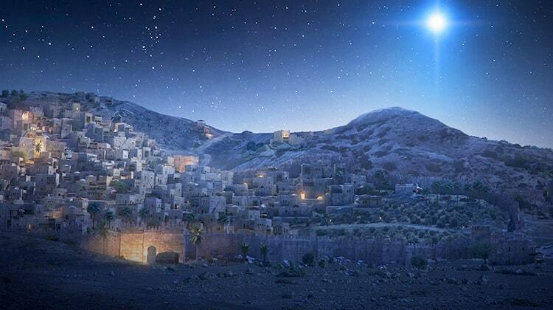
Micah 5:2
“But as for you, Bethlehem Ephrathah, Too little to be among the clans of Judah, From you One will go forth for Me to be ruler in Israel. His goings forth are from long ago, From the days of eternity.”

Slide 66
III. Genesis 35:16-20
Benjamin’s Birth
    Circumstances (16a)
    Benjamin’s birth (16b-18)
    Rachel’s death (19-20)

Slide 67
Genesis 35:16b-18
Benjamin’s Birth
      Labor (16a)
      Birth (17)
      Naming (18)

Slide 68
Genesis 35:16b-18
Benjamin’s Birth
      Labor (16a)
      Birth (17)
      Naming (18)

Slide 69
Genesis 35:16b-18
Benjamin’s Birth
      Labor (16a)
      Birth (17)
      Naming (18)

Slide 72
Genesis 35:16b-18
Benjamin’s Birth
      Labor (16a)
      Birth (17)
      Naming (18)

Slide 73
Genesis 35:18
Naming
      Rachel’s naming (18a-b)
      Jacob’s naming (18c)

Slide 74
Genesis 35:18
Naming
      Rachel’s naming (18a-b)
      Jacob’s naming (18c)

Slide 75
Genesis 35:18
Rachel’s Naming
      Circumstances (18a)
      Name (18b)

Slide 76
Genesis 35:18
Rachel’s Naming
      Circumstances (18a)
      Name (18b)

Slide 77

Woman
(3:16)
  Painful child birth (3:16a)
  Relational conflict (3:16b)

Slide 78

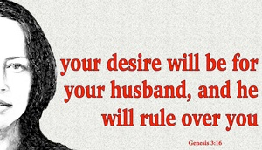
Genesis 3:16
“To the woman He said, ‘I will greatly multiply Your pain in childbirth, In pain you will bring forth children; Yet your desire [TESHUQAH] will be for your husband, And he will rule over you.’”

Slide 79
“Death” in the Old Testament
māwet: “Death is the consequences and the punishment of sin. It originated with sin. A grand theme of the Old Testament is God’s holiness, which separates Him from all that is in harmony with His character. Death, then, in the Old Testament means ultimate separation from God due to sin.”
Elmer B. Smick, “māwet," in Theological Wordbook of the Old Testament, ed. R. Laird Harris and Gleason L. Archer and Bruce K. Waltke(Chicago: Moody, 1980), 1:1169.

Slide 80
“Death” in the New Testament
thanatos: “that separation (whether natural or violent) of the soul from the body by which the life on earth is ended.”
Joseph Henry Thayer, Death - Thanatos, Greek-English Lexicon of the New Testament Being Grmm's Wilke's Clavis Novi Testamenti (Grand Rapids: Zondervan, 1977), 282.

Slide 81
Genesis 35:18
Rachel’s Naming
      Circumstances (18a)
      Name (18b)

Slide 82
Genesis 35:18
Naming
      Rachel’s naming (18a-b)
      Jacob’s naming (18c)

Slide 83
III. Genesis 35:16-20
Benjamin’s Birth
    Circumstances (16a)
    Benjamin’s birth (16b-18)
    Rachel’s death (19-20)

Slide 84
Genesis 35:19-20
Rachel’s Death
      Death (19a)
      Burial (19b)
      Marker (20)

Slide 85
Genesis 35:19-20
Rachel’s Death
      Death (19a)
      Burial (19b)
      Marker (20)

Slide 86
Genesis 35:19-20
Rachel’s Death
      Death (19a)
      Burial (19b)
      Marker (20)

Slide 87
Micah 5:2
“But as for you, Bethlehem Ephrathah, Too little to be among the clans of Judah, From you One will go forth for Me to be ruler in Israel. His goings forth are from long ago, From the days of eternity.”

Slide 88
Genesis 35:19-20
Rachel’s Death
      Death (19a)
      Burial (19b)
      Marker (20)

Slide 89
Genesis 35:1-29
Transitionary Information
  Jacob’s journey to Bethel (35:1-8)
  Divine appearance (35:9-15)
  Benjamin’s birth (35:16-20)
  Reuben loses the birthright (35:21-22a)
  Jacob’s dozen (35:22b-26)
  Isaac’s death (35:27-29)

Slide 90
IV. Genesis 35:21-22a
Reuben Loses the Birthright
    Geographical marker (21)
    Reuben’s sin (22a)

Slide 91
IV. Genesis 35:21-22a
Reuben Loses the Birthright
    Geographical marker (21)
    Reuben’s sin (22a)

Slide 92
IV. Genesis 35:21-22a
Reuben Loses the Birthright
    Geographical marker (21)
    Reuben’s sin (22a)

Slide 94

1 Corinthians 3:10-15
¹⁰ According to the grace of God which was given to me, like a wise master builder I laid a foundation, and another is building on it. But each man must be careful how he builds on it. ¹¹ For no man can lay a foundation other than the one which is laid, which is Jesus Christ. ¹² Now if any man builds on the foundation with gold, silver, precious stones, wood, hay, straw, ¹³ each man’s work will become evident; for the day will show it because it is to be revealed with fire, and the fire itself will test the quality of . . .

Slide 95
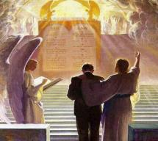
1 Corinthians 3:10-15
. . . each man’s work. ¹⁴ If any man’s work which he has built on it remains, he will receive a reward. ¹⁵ If any man’s work is burned up, he will suffer loss; but he himself will be saved, yet so as through fire.

Slide 96
Scripture’s Five Crowns (Rev 4:10: 3:11; 2 John 8)
SCRIPTURE | CROWN | PURPOSE
1 Cor. 9:24-27 | Incorruptible | Gaining mastery over the flesh
1 Thess. 2:19-20 | Rejoicing | Soul winning
Jas. 1:12; Rev. 2:10 | Life | Enduring trials
1 Pet. 5:2-4 | Glory | Shepherding God’s people
2 Tim. 4:8 | Righteousness | Longing for His appearing

Slide 97
Genesis 35:1-29
Transitionary Information
  Jacob’s journey to Bethel (35:1-8)
  Divine appearance (35:9-15)
  Benjamin’s birth (35:16-20)
  Reuben loses the birthright (35:21-22a)
  Jacob’s dozen (35:22b-26)
  Isaac’s death (35:27-29)

Slide 98
V. Genesis 35:22b-26
Jacob’s Dozen
    Introduction (22b)
    Jacob’s dozen (23-26a)
    Conclusion (26b)

Slide 99
V. Genesis 35:22b-26
Jacob’s Dozen
    Introduction (22b)
    Jacob’s dozen (23-26a)
    Conclusion (26b)

Slide 101
V. Genesis 35:22b-26
Jacob’s Dozen
    Introduction (22b)
    Jacob’s dozen (23-26a)
    Conclusion (26b)

Slide 102
Genesis 35:23-26a
Jacob’s Dozen
      Leah’s six sons (23)
      Rachel’s two sons (24)
      Bilhah’s two sons (25)
      Zilpah’s two sons (26b)

Slide 103
Genesis 35:23-26a
Jacob’s Dozen
      Leah’s six sons (23)
      Rachel’s two sons (24)
      Bilhah’s two sons (25)
      Zilpah’s two sons (26b)

Slide 105
Genesis 35:23-26a
Jacob’s Dozen
      Leah’s six sons (23)
      Rachel’s two sons (24)
      Bilhah’s two sons (25)
      Zilpah’s two sons (26b)

Slide 107
Genesis 35:23-26a
Jacob’s Dozen
      Leah’s six sons (23)
      Rachel’s two sons (24)
      Bilhah’s two sons (25)
      Zilpah’s two sons (26b)

Slide 109
Genesis 35:23-26a
Jacob’s Dozen
      Leah’s six sons (23)
      Rachel’s two sons (24)
      Bilhah’s two sons (25)
      Zilpah’s two sons (26b)

Slide 111
V. Genesis 35:22b-26
Jacob’s Dozen
    Introduction (22b)
    Jacob’s dozen (23-26a)
    Conclusion (26b)

Slide 113
Genesis 35:1-29
Transitionary Information
  Jacob’s journey to Bethel (35:1-8)
  Divine appearance (35:9-15)
  Benjamin’s birth (35:16-20)
  Reuben loses the birthright (35:21-22a)
  Jacob’s dozen (35:22b-26)
  Isaac’s death (35:27-29)

Slide 114
VI. Genesis 35:27-29
Isaac’s Death
    Reunion of Isaac and Jacob (27)
    Isaac’s total years (28)
    Isaac’s death (29)

Slide 115
VI. Genesis 35:27-29
Isaac’s Death
    Reunion of Isaac and Jacob (27)
    Isaac’s total years (28)
    Isaac’s death (29)

Slide 116
Genesis 35:27
Reunion of Isaac and Jacob
      Contact (27a)
      Place (27b)

Slide 117
Genesis 35:27
Reunion of Isaac and Jacob
      Contact (27a)
      Place (27b)

Slide 119
Genesis 35:27
Reunion of Isaac and Jacob
      Contact (27a)
      Place (27b)

Slide 120
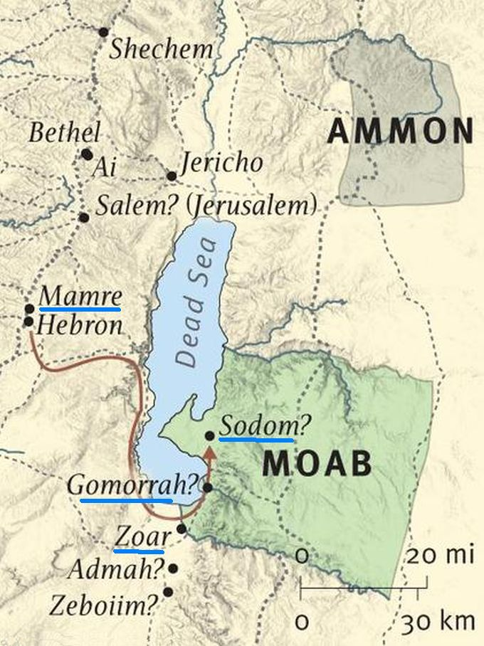

Slide 121
VI. Genesis 35:27-29
Isaac’s Death
    Reunion of Isaac and Jacob (27)
    Isaac’s total years (28)
    Isaac’s death (29)

Slide 122
VI. Genesis 35:27-29
Isaac’s Death
    Reunion of Isaac and Jacob (27)
    Isaac’s total years (28)
    Isaac’s death (29)

Slide 123
Genesis 35:29
Isaac’s Death
      Death (29a)
      Full of days (29b)
      Burial (29c)

Slide 124
Genesis 35:29
Isaac’s Death
      Death (29a)
      Full of days (29b)
      Burial (29c)

Slide 125
“Death” in the Old Testament
māwet: “Death is the consequences and the punishment of sin. It originated with sin. A grand theme of the Old Testament is God’s holiness, which separates Him from all that is in harmony with His character. Death, then, in the Old Testament means ultimate separation from God due to sin.”
Elmer B. Smick, “māwet," in Theological Wordbook of the Old Testament, ed. R. Laird Harris and Gleason L. Archer and Bruce K. Waltke(Chicago: Moody, 1980), 1:1169.

Slide 126
“Death” in the New Testament
thanatos: “that separation (whether natural or violent) of the soul from the body by which the life on earth is ended.”
Joseph Henry Thayer, Death - Thanatos, Greek-English Lexicon of the New Testament Being Grmm's Wilke's Clavis Novi Testamenti (Grand Rapids: Zondervan, 1977), 282.

Slide 127
Dr. Arnold G. Fruchtenbaum
The Book of Genesis, 392
“This phrase ‘gathered to his people’ is used ten times, and only in the Pentateuch: Genesis 25:8, of Abraham; 25:17, of Ishmael; 35:29, of Isaac; 49:29, of Jacob; 49:33, of Jacob; Numbers 20:24, of Aaron; 20:26, of Aaron; 27:13, of Moses; 31:2, of Moses; and Deuteronomy 32:50, of Aaron and Moses. A parallel phrase is gathered to his fathers in Genesis 15:15 and 47:30.”

Slide 129
Daniel 12:1-2
“¹ Now at that time Michael, the great prince who stands guard over the sons of your people, will arise. And there will be a time of distress such as never occurred since there was a nation until that time; and at that time your people, everyone who is found written in the book, will be rescued. ² Many of those who sleep in the dust of the ground will awake, these to everlasting life, but the others to disgrace and everlasting contempt.”

Slide 130
Genesis 35:29
Isaac’s Death
      Death (29a)
      Full of days (29b)
      Burial (29c)

Slide 131

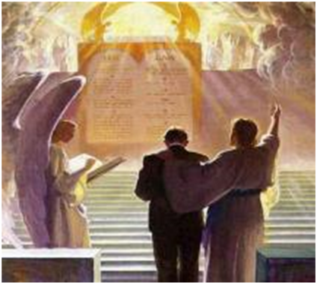
2 Timothy 4:7-8
“⁷ I have fought the good fight, I have finished the course, I have kept the faith; ⁸ in the future there is reserved for me the crown of righteousness, which the Lord, the righteous Judge, will award to me on that day; and not only to me, but also to all who have loved His appearing.”

Slide 132
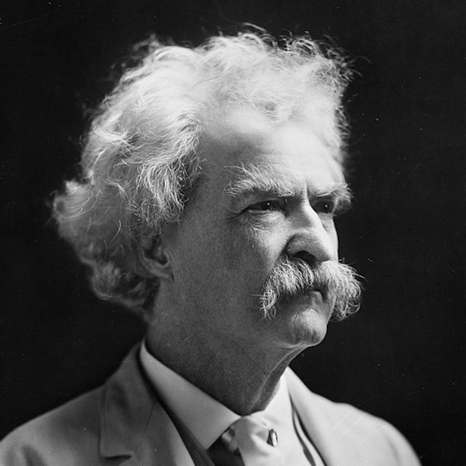
Mark Twain
Autobiography, 2:37
“A myriad of men are born; they labor and sweat and struggle for bread; they squabble and scold and fight; they scramble for little mean advantages over each other. Age creeps upon them and infirmities follow; shames and humiliations bring down their prides and their vanities. Those they love are taken from them, and the joy of life is turned to aching grief. The burden of pain, care, and misery grows heavier year by year. At length ambition is dead, pride is dead, vanity is dead; longing for release is in their place. It comes at last-the only un-poisoned gift earth ever had for them-and they vanish from a world where they were of no consequence; where they achieved nothing, where they were a mistake and a failure and a foolishness; where they left no sign that they have existed – a world that will lament them a day and forget them forever.”

Slide 133
Genesis 35:29
Isaac’s Death
      Death (29a)
      Full of days (29b)
      Burial (29c)

Slide 135
Genesis 12‒25
Abraham’s Early Journeys
Unconditional promises (Gen. 12:1-3) From Haran to Canaan (Gen. 12:4-5) In Canaan (Gen. 12:6-9) In Egypt (Gen. 12:10-20) Abram and Lot Separate (Gen. 13:1-13) Reaffirmation of Abram’s promises (Gen. 13:14-18) Abram Rescues Lot (14:1-24) Abrahamic Covenant (15:1-21) Hagar & Ishmael (16:1-16) Circumcision (Gen. 17:1-27) | Sodom & Gomorrah (Gen. 18‒19) Abraham & Abimelech (Gen. 20) Isaac’s birth (Gen. 21:1-7) Ishmael’s expulsion (21:8-21) Abraham & Abimelech’s covenant (21:22-34) Abraham sacrifices Isaac (22) Sarah’s death (23) Isaac’s marriage (24) Abraham & Keturah (25:1-6) Abraham’s death (25:7-11)

Slide 137
Conclusion

Slide 138
Genesis 35:1-29
Transitionary Information
  Jacob’s journey to Bethel (35:1-8)
  Divine appearance (35:9-15)
  Benjamin’s birth (35:16-20)
  Reuben loses the birthright (35:21-22a)
  Jacob’s dozen (35:22b-26)
  Isaac’s death (35:27-29)

Slide 139
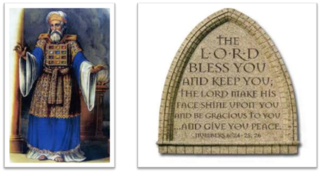
²⁴ The Lord bless you, and keep you; ²⁵ The Lord make His face shine on you, And be gracious to you; ²⁶ The Lord lift up His countenance on you, And give you peace.
Numbers 6:24–26 (NASB95)

