Slide 1
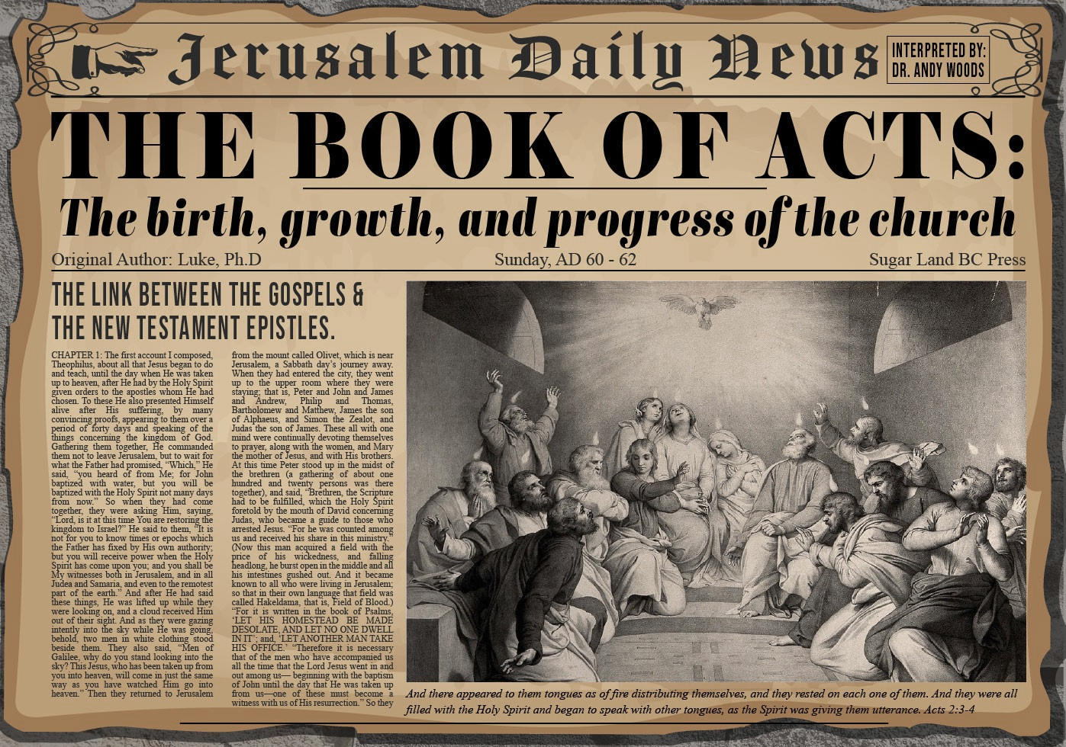


Slide 2
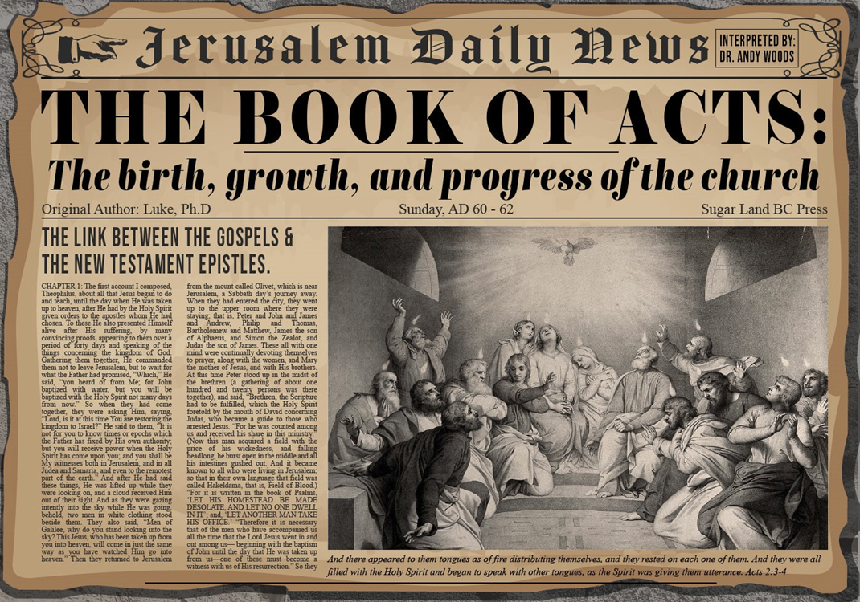
Acts 5:12‒42
Church’s Second Persecution
  Apostles’ Power (5:12-16)
  Apostles' Persecution (5:17-42)

Slide 3
Acts 5:12‒42
Church’s Second Persecution
  Apostles’ Power (5:12-16)
  Apostles' Persecution (5:17-42)

Slide 4
I. Apostles’ Power
Acts 5:12-26
  Apostolic authority (12)
  General population’s response (13)
  Church’s growth (14)
  Peter’s unique abilities (15)
  Apostle’s reputation spread (16)

Slide 5
I. Apostles’ Power
Acts 5:12-26
  Apostolic authority (12)
  General population’s response (13)
  Church’s growth (14)
  Peter’s unique abilities (15)
  Apostle’s reputation spread (16)

Slide 6
Acts 5:12
Apostolic Authority
      Apostolic signs (12a)
      Believers’ spirit (12b)

Slide 7
Acts 5:12
Apostolic Authority
      Apostolic signs (12a)
      Believers’ spirit (12b)

Slide 8

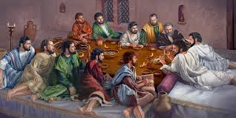
Ephesians 2:20
“having been built on the foundation of the apostles and prophets, Christ Jesus Himself being the corner stone.”

Slide 9

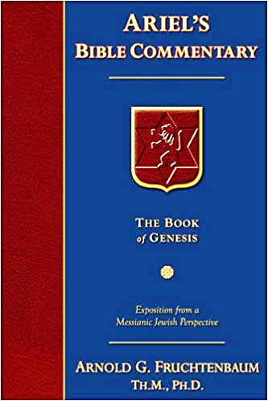
Dr. Arnold G. Fruchtenbaum
The Book of Acts, 129
“Verse 12 provides evidence of apostolic authority. The account of the second persecution of the church begins by describing the apostolic signs (v. 12a). Again it is important to note that in the book of Acts, only the apostles and the apostolic [de]legates, who were appointed by the apostles by the laying on of hands, were able to perform miracles, signs, and wonders (e.g. Acts 6:8).[113] This fact has come out four times before (Acts 2:43; 3:6-7; 4:22, 33), and now it is repeated once again in this verse.”

Slide 10
Acts 5:12
Apostolic Authority
      Apostolic signs (12a)
      Believers’ spirit (12b)

Slide 11
I. Apostles’ Power
Acts 5:12-26
  Apostolic authority (12)
  General population’s response (13)
  Church’s growth (14)
  Peter’s unique abilities (15)
  Apostle’s reputation spread (16)

Slide 12
I. Apostles’ Power
Acts 5:12-26
  Apostolic authority (12)
  General population’s response (13)
  Church’s growth (14)
  Peter’s unique abilities (15)
  Apostle’s reputation spread (16)

Slide 13
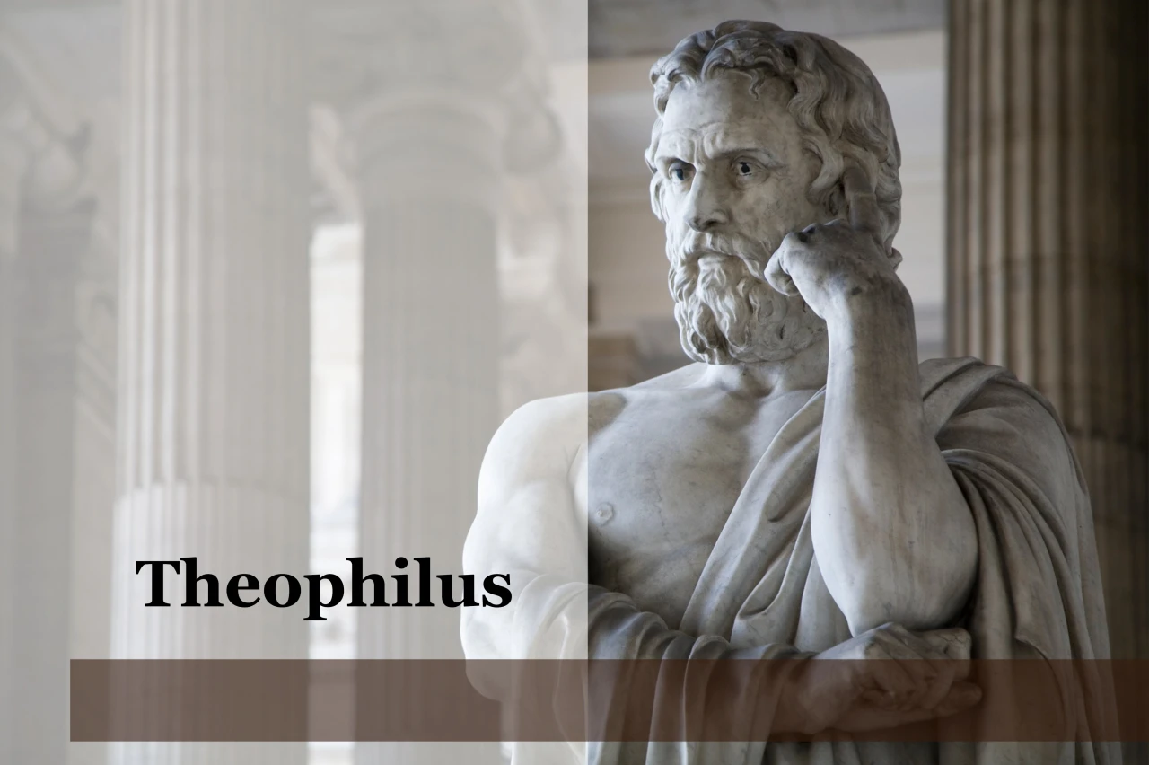
Purpose
  To present Theophilus with an orderly account of the birth and growth of the church so as to affirm him in what he has believed.

Slide 14

Message
  Birth and growth of the church numerically, geographically, ethnically.
  Components
  Numerically (progress reports)
  Geographically (From Jerusalem to Rome)
  Ethnically (From Judaism to Gentile domination)

Slide 15
Progress Reports
  Clearest:
    Acts 2:47; 4:4; 6:7; 9:31; 12:24; 16:5; 19:20; 28:30-31
  Less clear:
    Acts 1:13, 15; 2:41; 4:4:31; 5:14, 42; 8:25, 40; 11:21; 13:49; 17:6

Slide 16
I. Apostles’ Power
Acts 5:12-26
  Apostolic authority (12)
  General population’s response (13)
  Church’s growth (14)
  Peter’s unique abilities (15)
  Apostle’s reputation spread (16)

Slide 17

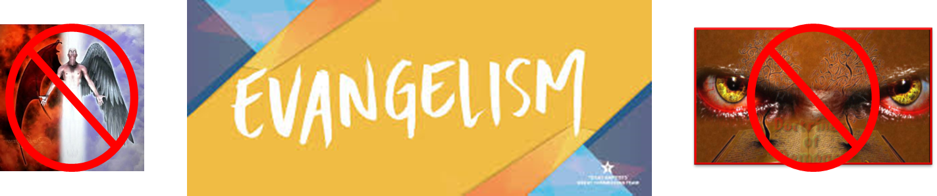
Matthew 16:18
“I also say to you that you are Peter, and upon this rock I will build [oikodomeō] My church; and the gates of Hades WILL NOT overpower it.”

Slide 18
From Peter to Paul
Reference | Center | Person | Place | Outreach
Acts 1–12 | Jerusalem | Peter | Jerusalem, Judea, Samaria | Jewish
Acts 13–28 | Antioch | Paul | Uttermost parts | Gentiles

Slide 19
From Peter to Paul
Peter | Paul
Heals a man lame from birth (3:1-11) | Heals a man lame from birth (14:8-18)
Heals by shadow (5:15-16) | Heals by handkerchief (19:11-12)
Success is a cause of jealousy (5:17) | Success is a cause of jealousy (13:45)
Confronts a sorcerer (8:9-24) | Confronts a sorcerer (13:6-11)
Raises Dorcas (9:36-41) | Raises Eutychus (20:9-12)
Jailed and miraculously freed (12:3-19) | Jailed and miraculously freed (16:25-34)

Slide 20
I. Apostles’ Power
Acts 5:12-26
  Apostolic authority (12)
  General population’s response (13)
  Church’s growth (14)
  Peter’s unique abilities (15)
  Apostle’s reputation spread (16)

Slide 21
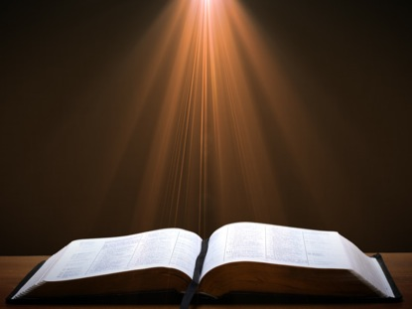
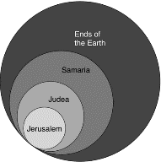
Acts 1:8
“but you will receive power when the Holy Spirit has come upon you; and you shall be My witnesses both in Jerusalem, and in all Judea and Samaria, and even to the remotest part of the earth.”

Slide 22
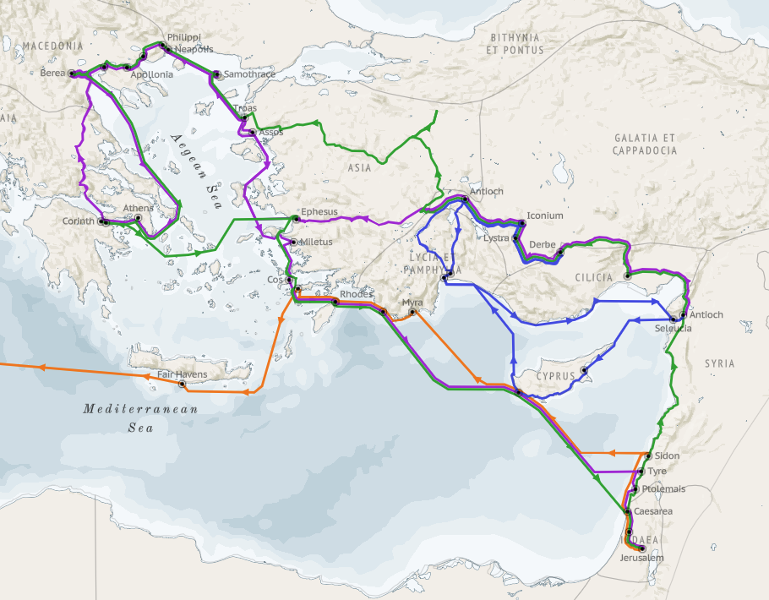
Structure (Acts 1:8)
  Jerusalem (Acts 1–7)
  Judea and Samaria (Acts 8–12)
  Remotest part of the earth (Acts 13–28)
  1st missionary journey (Acts 13–14)
  Jerusalem council (Acts 15:1-35)
  2nd missionary journey (Acts 15:36 –18:22)
  3rd missionary journey (Acts 18:23–21:17)
  Trip to Rome (Acts 21:18–28:31)

Slide 23
Dr. Arnold G. Fruchtenbaum
The Book of Acts, 131
“They brought two categories of people to the apostles for healing: those with physical problems and those who had demonic problems. The latter group also may have had physical illnesses, but in their case, the physical issues were caused by demons. This verse makes a clear distinction between mere physical sickness and demonic problems. It is wrong to teach that all physical afflictions are caused by demons. In fact, the majority of physical ailments are due to human frailty, not due to sin or to demons.”

Slide 24
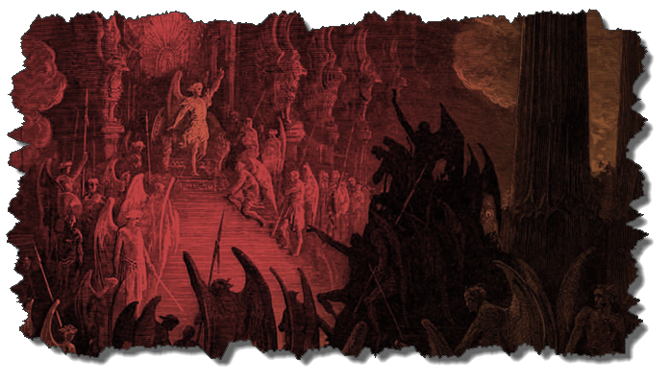
Not all Physical Infirmities are Attributable to Satan/Demon
  Matt 8:5-13
  Matt 9:19-20, 27-30
  Matt 12:9-14
  Matt 14:35-36

Slide 25

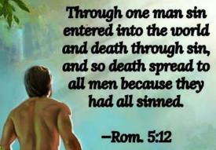
Genesis 3:19
“By the sweat of your face You will eat bread, Till you return to the ground, Because from it you were taken; For you are dust, And to dust you shall return.”

Slide 26
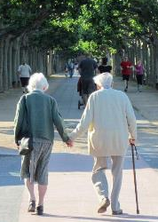
2 Cor. 4:16
“Therefore, we do not lose heart, but though our outer man is decaying, yet our inner man is being renewed day by day.”

Slide 27
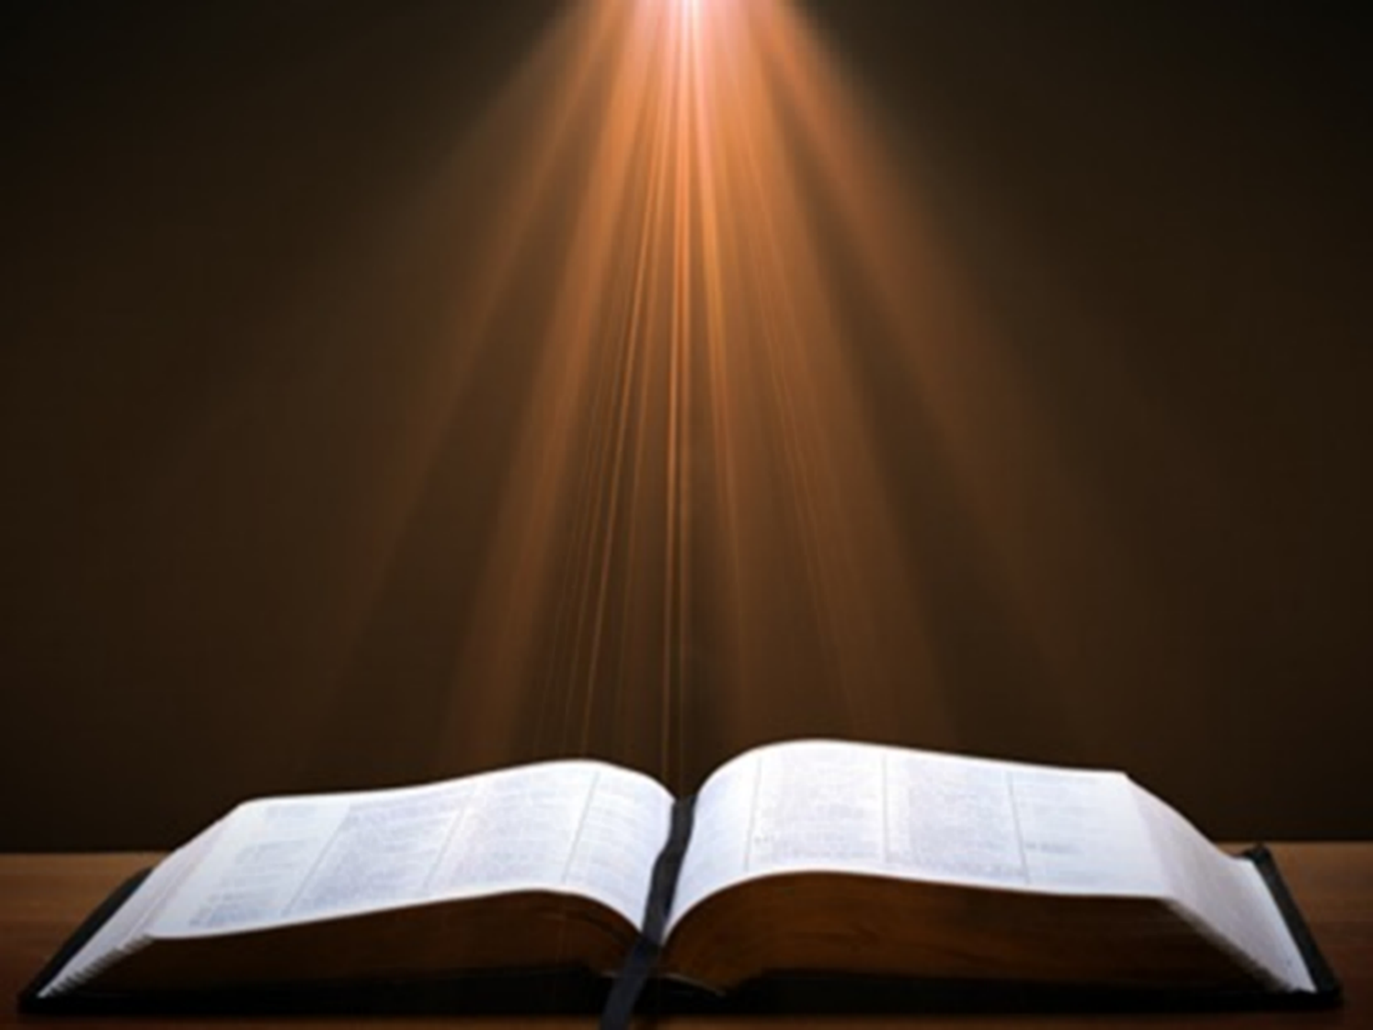
Romans 8:19-22
¹⁹ For the anxious longing of the creation waits eagerly for the revealing of the sons of God. ²⁰ For the creation was subjected to futility, not willingly, but because of Him who subjected it, in hope ²¹ that the creation itself also will be set free from its slavery to corruption into the freedom of the glory of the children of God. ²² For we know that the whole creation groans and suffers the pains of childbirth together until now.

Slide 28
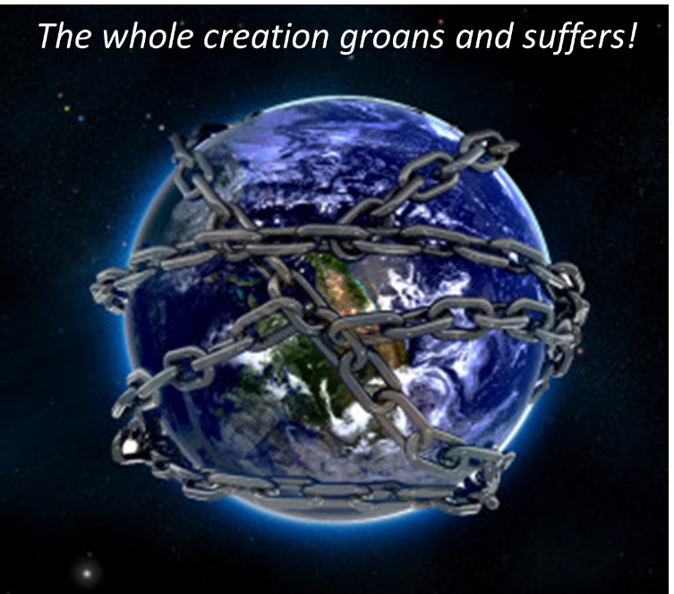

Slide 29
Dr. Arnold G. Fruchtenbaum
The Book of Acts, 131-32
“One at a time, one by one, everyone who came to the apostles walked away cured. This is certainly not true of faith healers today. There have been people who have gone to faith healers and have come back claiming to have been healed, but a year later they were dead of that very thing they were ‘healed’ of. Merely exercising ‘positive confession’ will not do any more than ‘positive thinking’ will do. These mental exercises may heal psychosomatic problems, but they will not heal genuine physical ailments. God may choose to heal miraculously; He may choose to heal through medical treatment today; He may choose not to heal at all. Although faith healers claim to be performing the same miracles as the apostles, they cannot do what these apostles did.”

Slide 30
Acts 5:12‒42
Church’s Second Persecution
  Apostles’ Power (5:12-16)
  Apostles' Persecution (5:17-42)

Slide 31
II. Apostles’ Persecution
Acts 5:17-42
  Apostles’ arrest (17-26)
  Apostles’ examination (27-33)
  Gamaliel’s interruption & advice (34-39)
  Results (40-42)

Slide 32
II. Apostles’ Persecution
Acts 5:17-42
  Apostles’ arrest (17-26)
  Apostles’ examination (27-33)
  Gamaliel’s interruption & advice (34-39)
  Results (40-42)

Slide 33
Acts 5:17-26
Apostles’ Arrest
      Arrest’s cause & instigators (17-18)
      Divine rescue (19-21a)
      Sanhedrin’s meeting (21b-24)
      Apostles’ second arrest (25-26)

Slide 34
Acts 5:17-26
Apostles’ Arrest
      Arrest’s cause & instigators (17-18)
      Divine rescue (19-21a)
      Sanhedrin’s meeting (21b-24)
      Apostles’ second arrest (25-26)

Slide 35
Acts 2:15-35
Refutation of the Charge of Drunkenness
      Too early (15)
      Use of Joel 2:28-32 (16-21)
      Christ’s miracles (22)
      Crucifixion (23)
      Resurrection (24)
      Use of Psalm 16:8-11 (25-29)
      Use of Psalm 132:11 (30-32)
      High priestly ministry (33)
      Use of Psalm 110:1 (34-35)

Slide 36
Acts 3:13-15
Israel’s Rejection of Her Messiah
      God sent His Son (13a)
      Delivered to Pilate (13b)
      Rejection of the Holy & Righteous One (14)
      Killed the Prince of Life (15a)
      Messiah was Resurrected (15b)

Slide 37
From Peter to Paul
Reference | Center | Person | Place | Outreach
Acts 1–12 | Jerusalem | Peter | Jerusalem, Judea, Samaria | Jewish
Acts 13–28 | Antioch | Paul | Uttermost parts | Gentiles

Slide 38
From Peter to Paul
Peter | Paul
Heals a man lame from birth (3:1-11) | Heals a man lame from birth (14:8-18)
Heals by shadow (5:15-16) | Heals by handkerchief (19:11-12)
Success is a cause of jealousy (5:17) | Success is a cause of jealousy (13:45)
Confronts a sorcerer (8:9-24) | Confronts a sorcerer (13:6-11)
Raises Dorcas (9:36-41) | Raises Eutychus (20:9-12)
Jailed and miraculously freed (12:3-19) | Jailed and miraculously freed (16:25-34)

Slide 39
Acts 5:17-26
Apostles’ Arrest
      Arrest’s cause & instigators (17-18)
      Divine rescue (19-21a)
      Sanhedrin’s meeting (21b-24)
      Apostles’ second arrest (25-26)

Slide 40
Acts 5:19-21a
Divine Rescue
      Means (19)
      Command (20)
      Apostolic obedience (21a)

Slide 41
Acts 5:19-21a
Divine Rescue
      Means (19)
      Command (20)
      Apostolic obedience (21a)

Slide 42
Acts 5:19-21a
Divine Rescue
      Means (19)
      Command (20)
      Apostolic obedience (21a)

Slide 43
Acts 5:19-21a
Divine Rescue
      Means (19)
      Command (20)
      Apostolic obedience (21a)

Slide 44
Acts 5:17-26
Apostles’ Arrest
      Arrest’s cause & instigators (17-18)
      Divine rescue (19-21a)
      Sanhedrin’s meeting (21b-24)
      Apostles’ second arrest (25-26)

Slide 45
Acts 5:21b-24
Sanhedrin’s Meeting
      Assembly (21b)
      Empty prison (21c-23)
      Rulers’ response (24)

Slide 46
Acts 5:21b-24
Sanhedrin’s Meeting
      Assembly (21b)
      Empty prison (21c-23)
      Rulers’ response (24)

Slide 47
Acts 5:21b-24
Sanhedrin’s Meeting
      Assembly (21b)
      Empty prison (21c-23)
      Rulers’ response (24)

Slide 48
Acts 5:21c-23
Empty Prison
      Officers sent (21c)
      Finding of empty prison (22a)
      Officers’ report (22b-23)

Slide 49
Acts 5:21c-23
Empty Prison
      Officers sent (21c)
      Finding of empty prison (22a)
      Officers’ report (22b-23)

Slide 50
Acts 5:21c-23
Empty Prison
      Officers sent (21c)
      Finding of empty prison (22a)
      Officers’ report (22b-23)

Slide 51
Acts 5:21c-23
Empty Prison
      Officers sent (21c)
      Finding of empty prison (22a)
      Officers’ report (22b-23)

Slide 52
Acts 5:21b-24
Sanhedrin’s Meeting
      Assembly (21b)
      Empty prison (21c-23)
      Rulers’ response (24)

Slide 53
Acts 5:17-26
Apostles’ Arrest
      Arrest’s cause & instigators (17-18)
      Divine rescue (19-21a)
      Sanhedrin’s meeting (21b-24)
      Apostles’ second arrest (25-26)

Slide 54
Acts 5:25-26
Apostle’s Second Arrest
      Rulers’ discovery (25)
      Apostles’ arrest (26)

Slide 55
Acts 5:25-26
Apostle’s Second Arrest
      Rulers’ discovery (25)
      Apostles’ arrest (26)

Slide 56
Acts 5:25-26
Apostle’s Second Arrest
      Rulers’ discovery (25)
      Apostles’ arrest (26)

Slide 57
II. Apostles’ Persecution
Acts 5:17-42
  Apostles’ arrest (17-26)
  Apostles’ examination (27-33)
  Gamaliel’s interruption & advice (34-39)
  Results (40-42)

Slide 58
Acts 5:27-33
Apostles’ Examination
      Apostles brought in (27)
      High priest’s accusations (28)
      Apostles’ response (29-32)
      Sanhedrin’s reaction (33)

Slide 59
Acts 5:27-33
Apostles’ Examination
      Apostles brought in (27)
      High priest’s accusations (28)
      Apostles’ response (29-32)
      Sanhedrin’s reaction (33)

Slide 60
Acts 5:27-33
Apostles’ Examination
      Apostles brought in (27)
      High priest’s accusations (28)
      Apostles’ response (29-32)
      Sanhedrin’s reaction (33)

Slide 61
Acts 5:28
High Priest’s Accusations
      Violation of the command (28a)
      Brought guilt upon us (28b)

Slide 62
Acts 5:28
High Priest’s Accusations
      Violation of the command (28a)
      Brought guilt upon us (28b)

Slide 63

Emphasis of 2 Timothy
“By my count, there are twenty-seven explicit commands given in the body of this letter. In 27 words Paul tells pastors what to focus on. You have to be blind to miss the thrust of Paul's instructions here, because eighteen of those commands--fully two-thirds--have to do with the ministry of the Word.”
Daniel Wallace, “Crisis of the Word: A Message to Pastors or Would-be Pastors,”
Conservative Theological Journal 1, no. 2 (August 1997): 108.

Slide 64
Acts 5:28
High Priest’s Accusations
      Violation of the command (28a)
      Brought guilt upon us (28b)

Slide 65
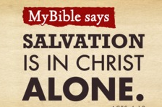
Acts 4:12
“And there is salvation in no one else; for there is no other name under heaven that has been given among men by which we must [dei] be saved.”

Slide 66
Acts 5:27-33
Apostles’ Examination
      Apostles brought in (27)
      High priest’s accusations (28)
      Apostles’ response (29-32)
      Sanhedrin’s reaction (33)

Slide 67
Acts 5:29-32
Apostles’ Response
      Necessity of civil disobedience (29)
      Presentation of the Messiah (30-31)
      Witnesses (32)

Slide 68
Acts 5:29-32
Apostles’ Response
      Necessity of civil disobedience (29)
      Presentation of the Messiah (30-31)
      Witnesses (32)

Slide 69
Matthew 16:18
“I also say to you that you are Peter, and upon this rock I will build [oikodomeō] My church; and the gates of Hades WILL NOT overpower it.”

Slide 70
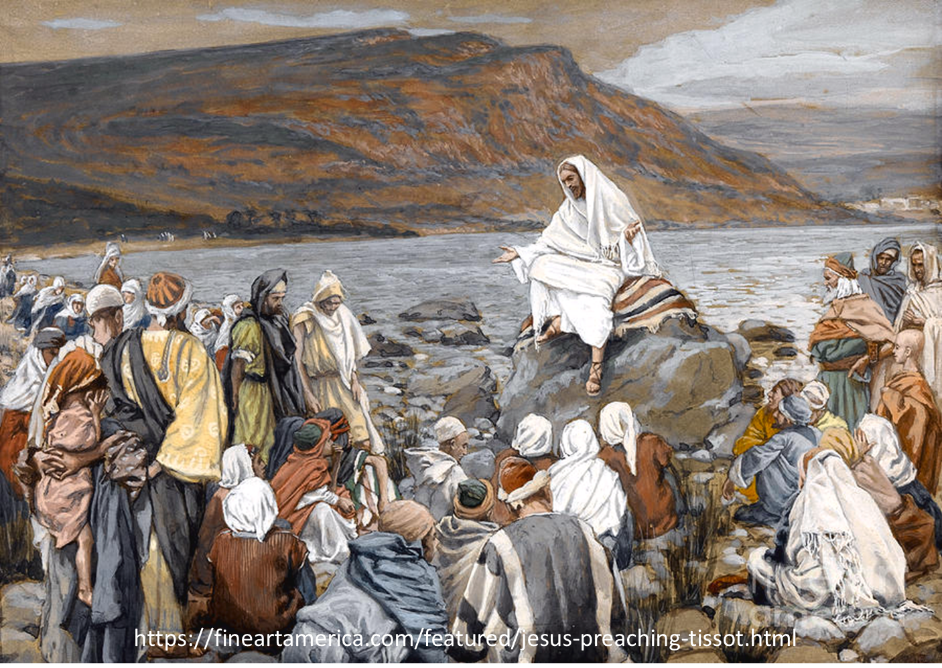
Luke 4:43
“But He said to them, “I must [dei] preach the kingdom of God to the other cities also, for I was sent for this purpose.”

Slide 71
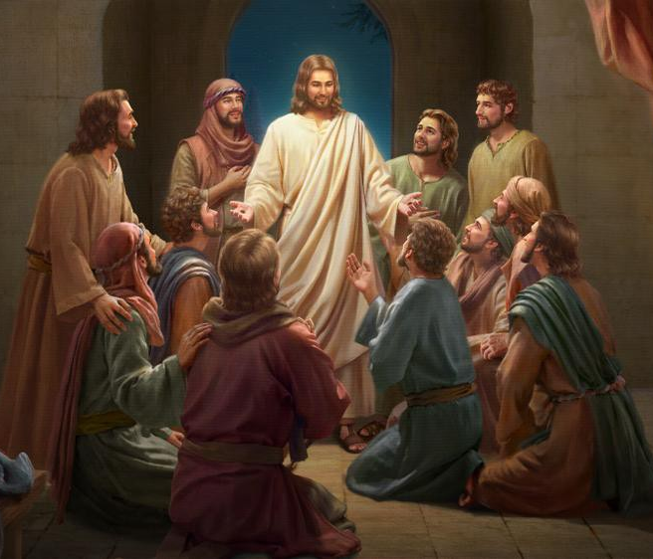
Luke 24:44
“Now He said to them, “These are My words which I spoke to you while I was still with you, that all things which are written about Me in the Law of Moses and the Prophets and the Psalms must [dei] be fulfilled.”

Slide 72
Acts 1:8
“but you will receive power when the Holy Spirit has come upon you; and you shall be My witnesses both in Jerusalem, and in all Judea and Samaria, and even to the remotest part of the earth.”

Slide 73
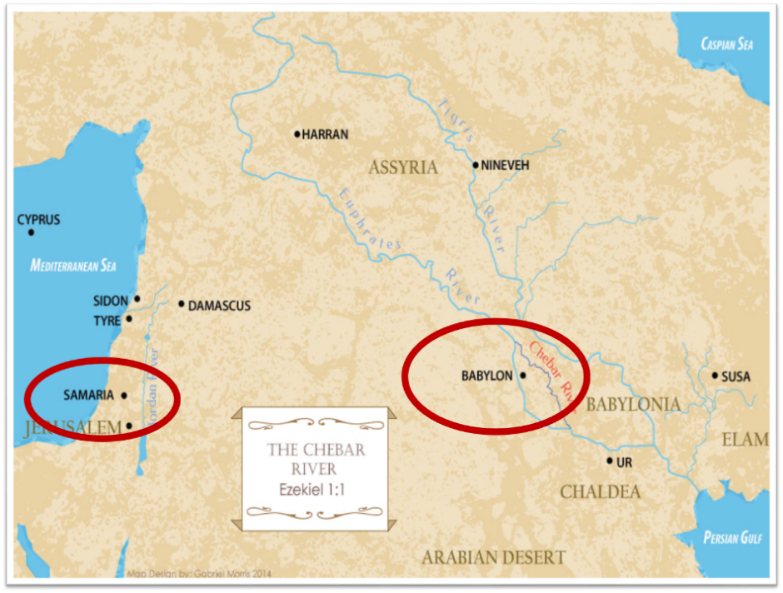

Slide 74
Daniel Outline
  Chiasm “Aramaic” ( 2-7)
1. Gentile History (2)
  2. Protection (3)
    3. Revelation to a gentile king (4)
    3. Revelation to a gentile king (5)
  2. Protection (6)
1. Gentile history (7)

Slide 75
Daniel Outline
  Chiasm “Aramaic” ( 2-7)
1. Gentile History (2)
  2. Protection (3)
    3. Revelation to a gentile king (4)
    3. Revelation to a gentile king (5)
  2. Protection (6)
1. Gentile history (7)

Slide 76
Acts 5:29-32
Apostles’ Response
      Necessity of civil disobedience (29)
      Presentation of the Messiah (30-31)
      Witnesses (32)

Slide 77
Acts 5:30-31
Presentation of the Messiah
      Fulfilment of the Covenants (30a)
      Death (30b)
      Exaltation (31a)
      Messiah’s purpose (31b)

Slide 78
Acts 5:30-31
Presentation of the Messiah
      Fulfilment of the Covenants (30a)
      Death (30b)
      Exaltation (31a)
      Messiah’s purpose (31b)

Slide 79
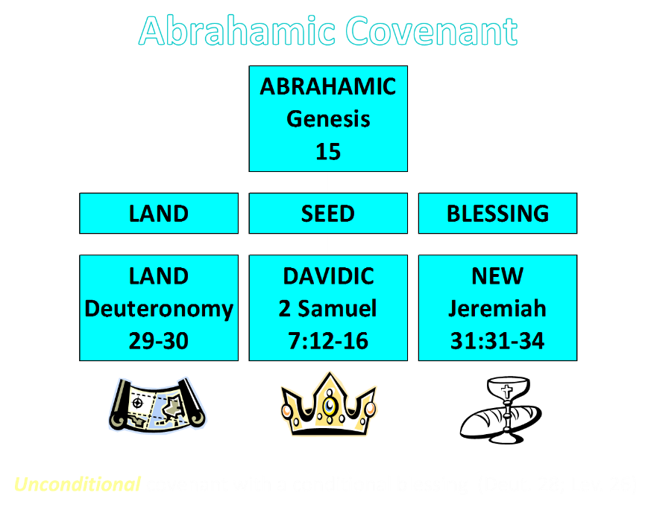

Slide 80
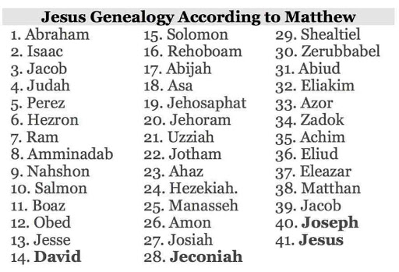

Slide 81
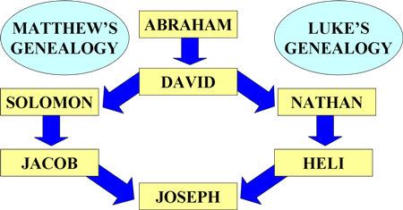
Matthean and Lukan Genealogies

Slide 82
Acts 5:30-31
Presentation of the Messiah
      Fulfilment of the Covenants (30a)
      Death (30b)
      Exaltation (31a)
      Messiah’s purpose (31b)

Slide 83

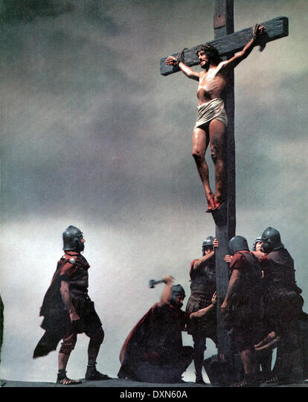
Acts 2:23
“this Man, delivered over by the predetermined plan and foreknowledge of God, you nailed to a cross by the hands of godless men and put Him to death.”

Slide 84
Acts 5:30-31
Presentation of the Messiah
      Fulfilment of the Covenants (30a)
      Death (30b)
      Exaltation (31a)
      Messiah’s purpose (31b)

Slide 85
Acts 2:15-35
Refutation of the Charge of Drunkenness
      Too early (15)
      Use of Joel 2:28-32 (16-21)
      Christ’s miracles (22)
      Crucifixion (23)
      Resurrection (24)
      Use of Psalm 16:8-11 (25-29)
      Use of Psalm 132:11 (30-32)
      High priestly ministry (33)
      Use of Psalm 110:1 (34-35)

Slide 86

Daniel 9:26
“Then after the sixty-two weeks the Messiah will be cut off and have nothing, and the people of the prince who is to come will destroy the city and the sanctuary. And its end will come with a flood; even to the end there will be war; desolations are determined.”

Slide 87
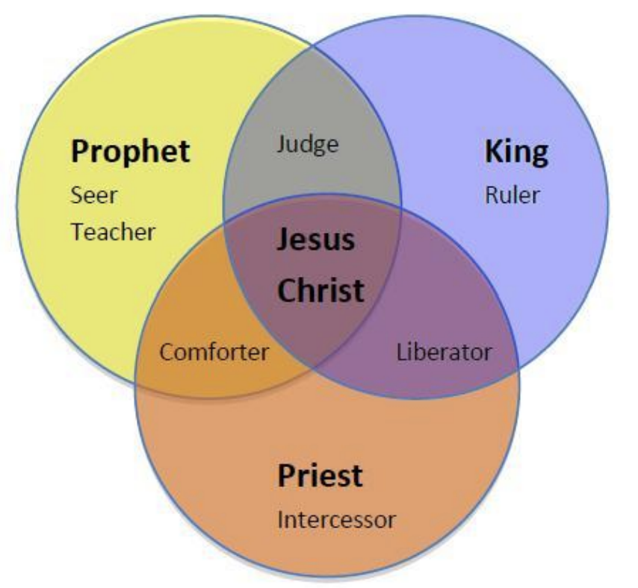
CHRIST’S THREE OFFICES
Prophet (First Coming)
Priest (Present Session)
King (Second Coming)

Slide 88
Acts 5:30-31
Presentation of the Messiah
      Fulfilment of the Covenants (30a)
      Death (30b)
      Exaltation (31a)
      Messiah’s purpose (31b)

Slide 89
Matthew 23:37-39
³⁷ “Jerusalem, Jerusalem, who kills the prophets and stones those who are sent to her! How often I wanted to gather [episynagō] your children together, the way a hen gathers [episynagō] her chicks under her wings, and you were unwilling. ³⁸ Behold, your house is being left to you desolate! ³⁹ For I say to you, from now on you will not see Me until you say, ‘Blessed is He who comes in the name of the Lord!’”

Slide 90
Acts 5:29-32
Apostles’ Response
      Necessity of civil disobedience (29)
      Presentation of the Messiah (30-31)
      Witnesses (32)

Slide 91
Acts 5:32
Witnesses
      Apostolic (32a)
      Holy Spirit (32b)

Slide 92
Acts 5:32
Witnesses
      Apostolic (32a)
      Holy Spirit (32b)

Slide 93
What Happened to Christ’s Disciples?
Disciple | Place | Martyrdom
James the Son of Alpheus | Jerusalem | Clubbed to death
Simon the Zealot | Jerusalem | Martyred
James the Son of Zebedee | Judea (Acts 12:2) | Executed
Thaddeus | Mesopotamia | Beaten to death
Peter | Babylon, Rome | Crucified upside down
Matthew | Parthia (Tehran) | Beheaded
Notes:
109 prophecies…
Peter Stoner – SCIENCE SPEAKS, An Evaluation of Certain Christian Evidences
To fulfill just 8 prophecies =1 X 10 to the twenty-eighth power!
Can we visualize this with an illustration? Suppose we took an atheistic professor, blindfolded him and covered the state of Texas two feet deep with silver dollars. Then we put a check on one of those silver dollars and mixed them up. The odds of one person fulfilling just these eight prophecies would be the same as this atheistic professor selecting the silver dollar upon which we have placed a check, in his first try.
https://www.bereanpublishers.com/the-odds-of-eight-messianic-prophecies-coming-true/

Slide 94
What Happened to Christ’s Disciples?
Disciple | Place | Martyrdom
John | Asia Minor, Patmos, Ephesus | Fried in boiling oil
Philip | E. Turkey | Tortured & crucified
Thomas | India | Speared
Bartholomew | India | Flayed & crucified
Andrew | Ukraine, Russia, Greece | Hanged
Notes:
109 prophecies…
Peter Stoner – SCIENCE SPEAKS, An Evaluation of Certain Christian Evidences
To fulfill just 8 prophecies =1 X 10 to the twenty-eighth power!
Can we visualize this with an illustration? Suppose we took an atheistic professor, blindfolded him and covered the state of Texas two feet deep with silver dollars. Then we put a check on one of those silver dollars and mixed them up. The odds of one person fulfilling just these eight prophecies would be the same as this atheistic professor selecting the silver dollar upon which we have placed a check, in his first try.
https://www.bereanpublishers.com/the-odds-of-eight-messianic-prophecies-coming-true/

Slide 95
Acts 5:32
Witnesses
      Apostolic (32a)
      Holy Spirit (32b)

Slide 96
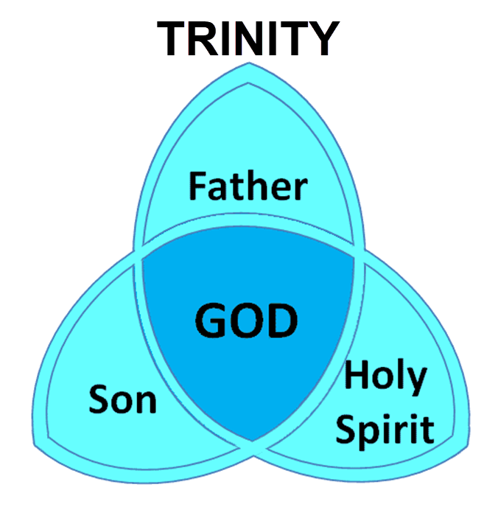

Slide 97
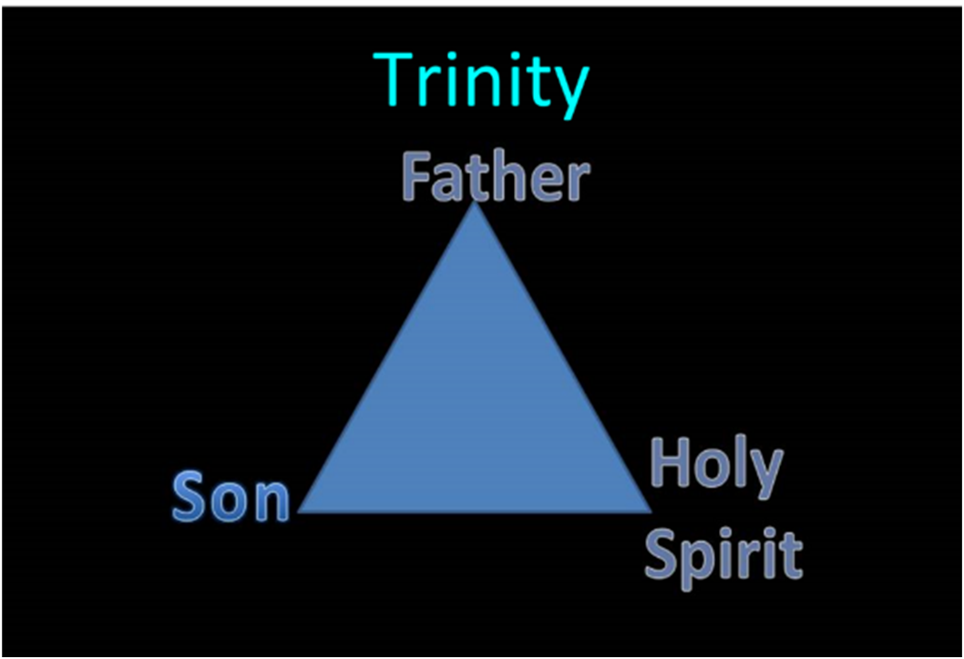

Slide 98
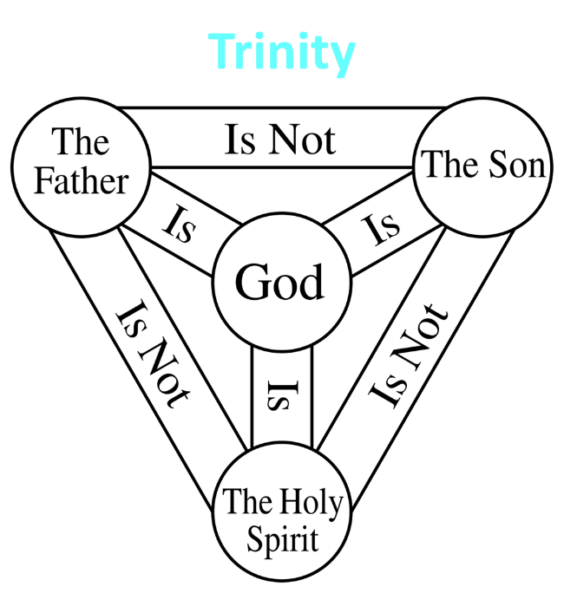

Slide 99


John 14:16-17
¹⁶ I will ask the Father, and He will give you another Helper, that He may be with you forever; ¹⁷ that is the Spirit of truth, whom the world cannot receive, because it does not see Him or know Him, but you know Him because He abides with you and will be in you.

Slide 100
Acts 5:27-33
Apostles’ Examination
      Apostles brought in (27)
      High priest’s accusations (28)
      Apostles’ response (29-32)
      Sanhedrin’s reaction (33)

Slide 101
Acts 5:33
Sanhedrin’s Reaction
      Conviction (33a)
      Rage (33b)

Slide 102
Acts 5:33
Sanhedrin’s Reaction
      Conviction (33a)
      Rage (33b)

Slide 103
John 16:7–11
⁷ “But I tell you the truth, it is to your advantage that I go away; for if I do not go away, the Helper will not come to you; but if I go, I will send Him to you. ⁸ “And He, when He comes, will convict the world concerning sin and righteousness and judgment; ⁹ concerning sin, because they do not believe in Me; ¹⁰ and concerning righteousness, because I go to the Father and you no longer see Me; ¹¹ and concerning judgment, because the ruler of this world has been judged.

Slide 104
Acts 5:33
Sanhedrin’s Reaction
      Conviction (33a)
      Rage (33b)

Slide 105
II. Apostles’ Persecution
Acts 5:17-42
  Apostles’ arrest (17-26)
  Apostles’ examination (27-33)
  Gamaliel’s interruption & advice (34-39)
  Results (40-42)

Slide 106
Acts 5:34-39
Gamaliel’s Interruption & Advice
      Gamaliel’s background (34)
      Gamaliel’s address (35-39)

Slide 107
Acts 5:34-39
Gamaliel’s Interruption & Advice
      Gamaliel’s background (34)
      Gamaliel’s address (35-39)

Slide 108
Acts 5:34
Gamaliel’s Background
      Introduction (34a)
      Command (34b)

Slide 109
Acts 5:34
Gamaliel’s Background
      Introduction (34a)
      Command (34b)

Slide 110
Acts 5:34
Gamaliel’s Background
      Introduction (34a)
      Command (34b)

Slide 111
Acts 5:34-39
Gamaliel’s Interruption & Advice
      Gamaliel’s background (34)
      Gamaliel’s address (35-39)

Slide 112
Acts 5:35-39
Gamaliel’s Address
      Need for caution (35)
      Two parallel illustrations (36-37)
      Application (38-39)

Slide 113
Acts 5:35-39
Gamaliel’s Address
      Need for caution (35)
      Two parallel illustrations (36-37)
      Application (38-39)

Slide 114
Acts 5:35-39
Gamaliel’s Address
      Need for caution (35)
      Two parallel illustrations (36-37)
      Application (38-39)

Slide 115
Acts 5:36-37
Two Parallel Illustrations
      Theudas (36)
      Judas of Galilee (37)

Slide 116
Acts 5:36-37
Two Parallel Illustrations
      Theudas (36)
      Judas of Galilee (37)

Slide 117
Acts 5:36-37
Two Parallel Illustrations
      Theudas (36)
      Judas of Galilee (37)

Slide 118
Acts 5:35-39
Gamaliel’s Address
      Need for caution (35)
      Two parallel illustrations (36-37)
      Application (38-39)

Slide 119
Acts 5:38-39
Application
      Command (38a)
      Reason (38b-39)

Slide 120
Acts 5:38-39
Application
      Command (38a)
      Reason (38b-39)

Slide 121
Acts 5:38-39
Application
      Command (38a)
      Reason (38b-39)

Slide 122
Purpose
  To present Theophilus with an orderly account of the birth and growth of the church so as to affirm him in what he has believed.

Slide 123
Message
  Birth and growth of the church numerically, geographically, ethnically.
  Components
  Numerically (progress reports)
  Geographically (From Jerusalem to Rome)
  Ethnically (From Judaism to Gentile domination)

Slide 124
Dr. Arnold G. Fruchtenbaum
The Book of Acts, 143
“Some have taken Gamaliel’s words and turned them into divine truth. However, Luke simply recorded what Gamaliel said without confirming the validity of the words. This was Gamaliel’s personal opinion; it was not a biblical truth. Many things that are not of God (such as false religions and cults) have prospered. One must be careful not to use someone’s opinion as biblical truth.”

Slide 125
II. Apostles’ Persecution
Acts 5:17-42
  Apostles’ arrest (17-26)
  Apostles’ examination (27-33)
  Gamaliel’s interruption & advice (34-39)
  Results (40-42)

Slide 126
Acts 5:40-42
Results
      Sanhedrin (40)
      Results (41-42)

Slide 127
Acts 5:40-42
Results
      Sanhedrin (40)
      Results (41-42)

Slide 128
Acts 5:40
Sanhedrin
      Agreement with Gamaliel (40a)
      Summoned the Apostles (40b)
      Punished the Apostles (40c)
      Charged the Apostles (40d)
      Released the Apostles (40e)

Slide 129
Acts 5:40
Sanhedrin
      Agreement with Gamaliel (40a)
      Summoned the Apostles (40b)
      Punished the Apostles (40c)
      Charged the Apostles (40d)
      Released the Apostles (40e)

Slide 130
Acts 5:40
Sanhedrin
      Agreement with Gamaliel (40a)
      Summoned the Apostles (40b)
      Punished the Apostles (40c)
      Charged the Apostles (40d)
      Released the Apostles (40e)

Slide 131
Acts 5:40
Sanhedrin
      Agreement with Gamaliel (40a)
      Summoned the Apostles (40b)
      Punished the Apostles (40c)
      Charged the Apostles (40d)
      Released the Apostles (40e)

Slide 132
Acts 5:40
Sanhedrin
      Agreement with Gamaliel (40a)
      Summoned the Apostles (40b)
      Punished the Apostles (40c)
      Charged the Apostles (40d)
      Released the Apostles (40e)

Slide 133
Acts 5:40
Sanhedrin
      Agreement with Gamaliel (40a)
      Summoned the Apostles (40b)
      Punished the Apostles (40c)
      Charged the Apostles (40d)
      Released the Apostles (40e)

Slide 134
Acts 5:40-42
Results
      Sanhedrin (40)
      Results (41-42)

Slide 135
Acts 5:41-42
Apostles
      Joy (41)
      Zeal (42)

Slide 136
Acts 5:41-42
Apostles
      Joy (41)
      Zeal (42)

Slide 137
Acts 5:41-42
Apostles
      Joy (41)
      Zeal (42)

Slide 138
Conclusion

Slide 139
Acts 5:12‒42
Church’s Second Persecution
  Apostles’ Power (5:12-16)
  Apostles' Persecution (5:17-42)

