Slide 1
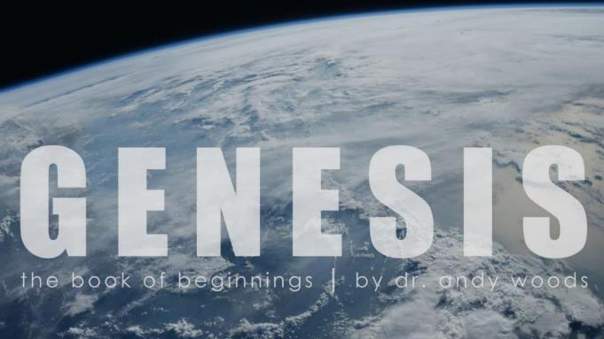

Genesis 12‒50
Israel’s Birth & Preservation

Slide 2
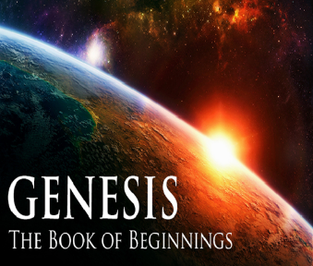
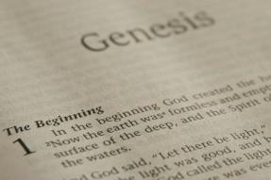
GENESIS STRUCTURE
  Genesis 12-50 (four people)
    Abraham (12:1–25:11)
    Isaac (25:12–26:35)
    Jacob (27–36)
    Joseph (37–50)

Slide 3
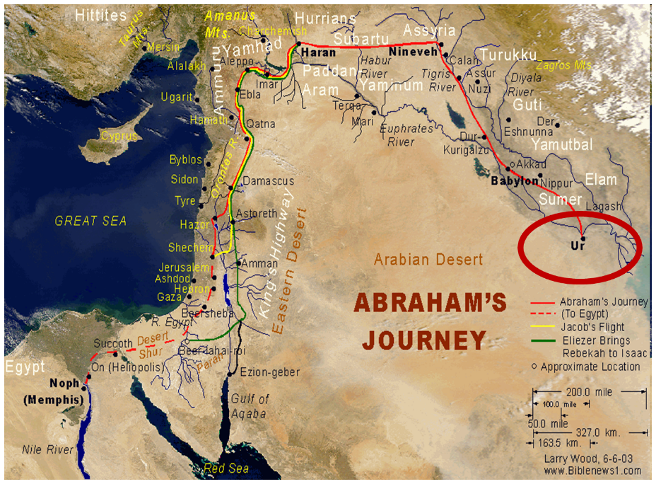

Slide 4
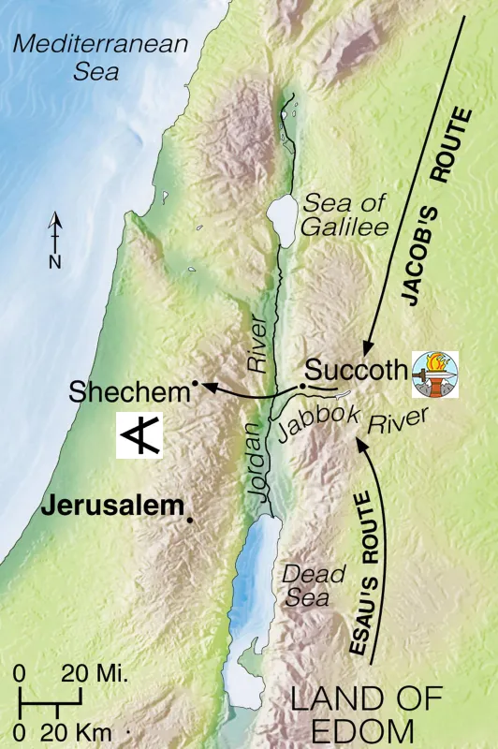


Slide 5
Genesis 35:1-29
Transitionary Information
  Jacob’s journey to Bethel (35:1-8)
  Divine appearance (35:9-15)
  Benjamin’s birth (35:16-20)
  Reuben loses the birthright (35:21-22a)
  Jacob’s dozen (35:22b-26)
  Isaac’s death (35:27-29)

Slide 6
Genesis 35:1-29
Transitionary Information
  Jacob’s journey to Bethel (35:1-8)
  Divine appearance (35:9-15)
  Benjamin’s birth (35:16-20)
  Reuben loses the birthright (35:21-22a)
  Jacob’s dozen (35:22b-26)
  Isaac’s death (35:27-29)

Slide 7
I. Genesis 35:1-8
Jacob’s Journey to Bethel
    Divine revelation (1a)
    Two commands (1b-c)
    Related to Jacob’s household (2)
    Goal of the journey (3)
    Spiritual cleansing (4)
    Journey (5)
    Arrival at Bethel (6)
    Naming (7)
    Deborah’s death (8)

Slide 8
I. Genesis 35:1-8
Jacob’s Journey to Bethel
    Divine revelation (1a)
    Two commands (1b-c)
    Related to Jacob’s household (2)
    Goal of the journey (3)
    Spiritual cleansing (4)
    Journey (5)
    Arrival at Bethel (6)
    Naming (7)
    Deborah’s death (8)

Slide 9
New Promises
Genesis 12:1-3
    Land (Gen. 12:1b)
    Great nation (Gen. 12:2a)
    Personal blessing (Gen. 12:2b)
    Great name (Gen. 12:2c)
    Blessing to others (Gen. 12:2d)
    Blessing to blessers (Gen. 12:3a)
    Cursing to cursers (Gen. 12:3b)
    Blessing to the world (Gen. 12:3c)

Slide 10
I. Genesis 35:1-8
Jacob’s Journey to Bethel
    Divine revelation (1a)
    Two commands (1b-c)
    Related to Jacob’s household (2)
    Goal of the journey (3)
    Spiritual cleansing (4)
    Journey (5)
    Arrival at Bethel (6)
    Naming (7)
    Deborah’s death (8)

Slide 11
Genesis 35:1b-c
Two Commands
      Dwell in Bethel (1b)
      Build an Altar (1c)

Slide 12
Genesis 35:1b-c
Two Commands
      Dwell in Bethel (1b)
      Build an Altar (1c)

Slide 13
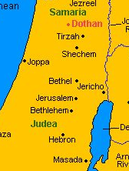

Slide 14
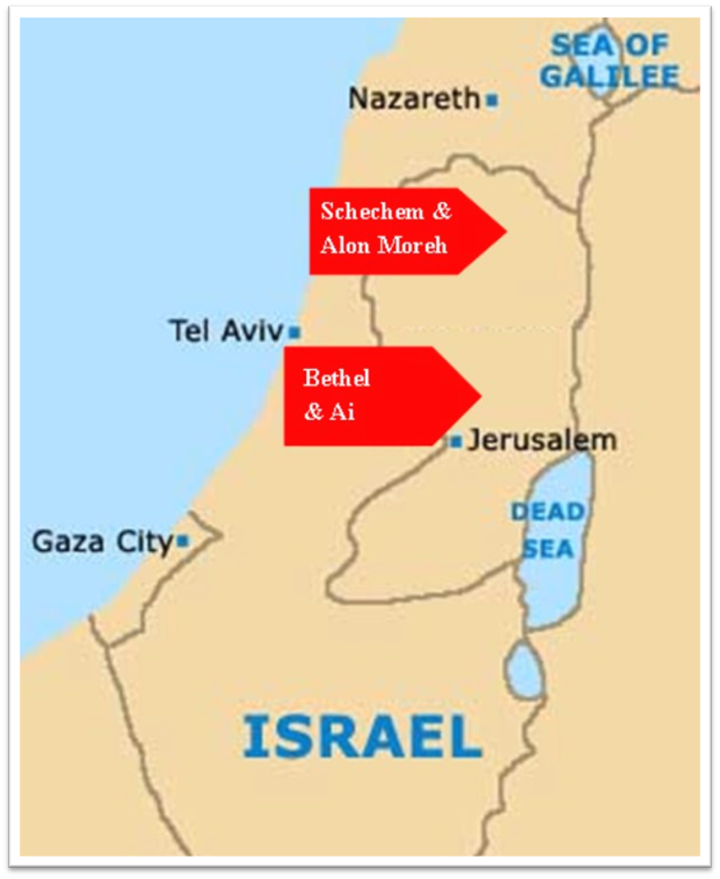

Slide 15
Genesis 35:1b-c
Two Commands
      Dwell in Bethel (1b)
      Build an Altar (1c)

Slide 16
I. Genesis 35:1-8
Jacob’s Journey to Bethel
    Divine revelation (1a)
    Two commands (1b-c)
    Related to Jacob’s household (2)
    Goal of the journey (3)
    Spiritual cleansing (4)
    Journey (5)
    Arrival at Bethel (6)
    Naming (7)
    Deborah’s death (8)

Slide 17
Genesis 35:2
Related to Jacob’s Household
      Addressees (2a)
      Three commands (2b-d)

Slide 18
Genesis 35:2
Related to Jacob’s Household
      Addressees (2a)
      Three commands (2b-d)

Slide 19
Genesis 35:2
Related to Jacob’s Household
      Addressees (2a)
      Three commands (2b-d)

Slide 20
Genesis 35:2b-d
Three Commands
      Put away foreign gods (2b)
      Purify yourselves (2c)
      Change garments (2d)

Slide 21
Genesis 35:2b-d
Three Commands
      Put away foreign gods (2b)
      Purify yourselves (2c)
      Change garments (2d)

Slide 22
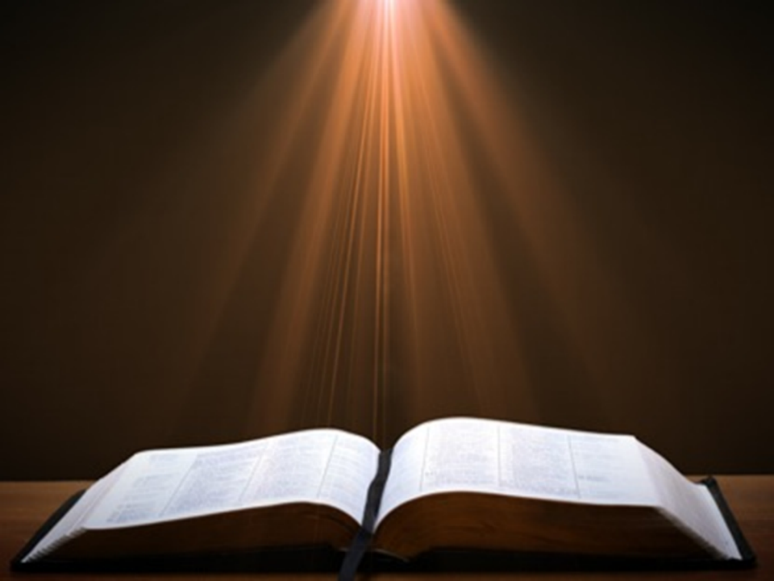
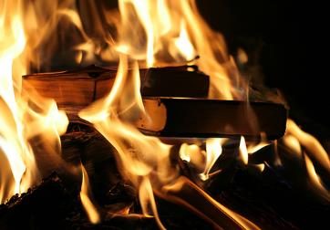
Acts 19:19
“And many of those who practiced magic brought their books together and began burning them in the sight of everyone; and they counted up the price of them and found it fifty thousand pieces of silver.”

Slide 23


Charles Ryrie
The Ryrie Study Bible
“19:19 Magic. Magical spells written on scrolls. Fifty thousand pieces of silver. If the silver drachma is meant, the value would have been the equivalent of about 138 years’ pay for a rural worker.”

Slide 24
Genesis 35:2b-d
Three Commands
      Put away foreign gods (2b)
      Purify yourselves (2c)
      Change garments (2d)

Slide 25
Genesis 35:2b-d
Three Commands
      Put away foreign gods (2b)
      Purify yourselves (2c)
      Change garments (2d)

Slide 26
I. Genesis 35:1-8
Jacob’s Journey to Bethel
    Divine revelation (1a)
    Two commands (1b-c)
    Related to Jacob’s household (2)
    Goal of the journey (3)
    Spiritual cleansing (4)
    Journey (5)
    Arrival at Bethel (6)
    Naming (7)
    Deborah’s death (8)

Slide 27

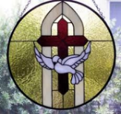
John 14:16-17
¹⁶ I will ask the Father, and He will give you another Helper, that He may be with you forever; ¹⁷ that is the Spirit of truth, whom the world cannot receive, because it does not see Him or know Him, but you know Him because He abides with you and will be in you.

Slide 28
I. Genesis 35:1-8
Jacob’s Journey to Bethel
    Divine revelation (1a)
    Two commands (1b-c)
    Related to Jacob’s household (2)
    Goal of the journey (3)
    Spiritual cleansing (4)
    Journey (5)
    Arrival at Bethel (6)
    Naming (7)
    Deborah’s death (8)

Slide 29
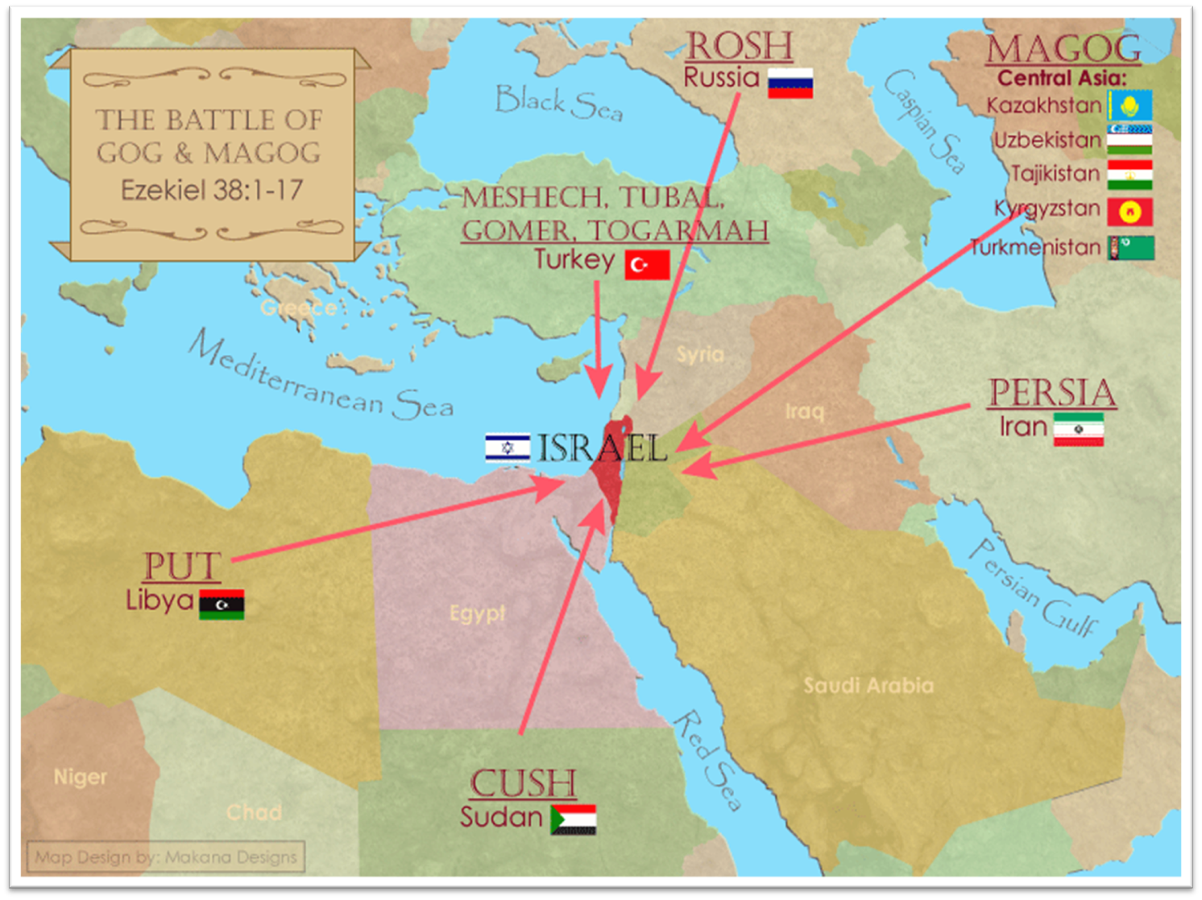
Saudi Arabia
29

Slide 30
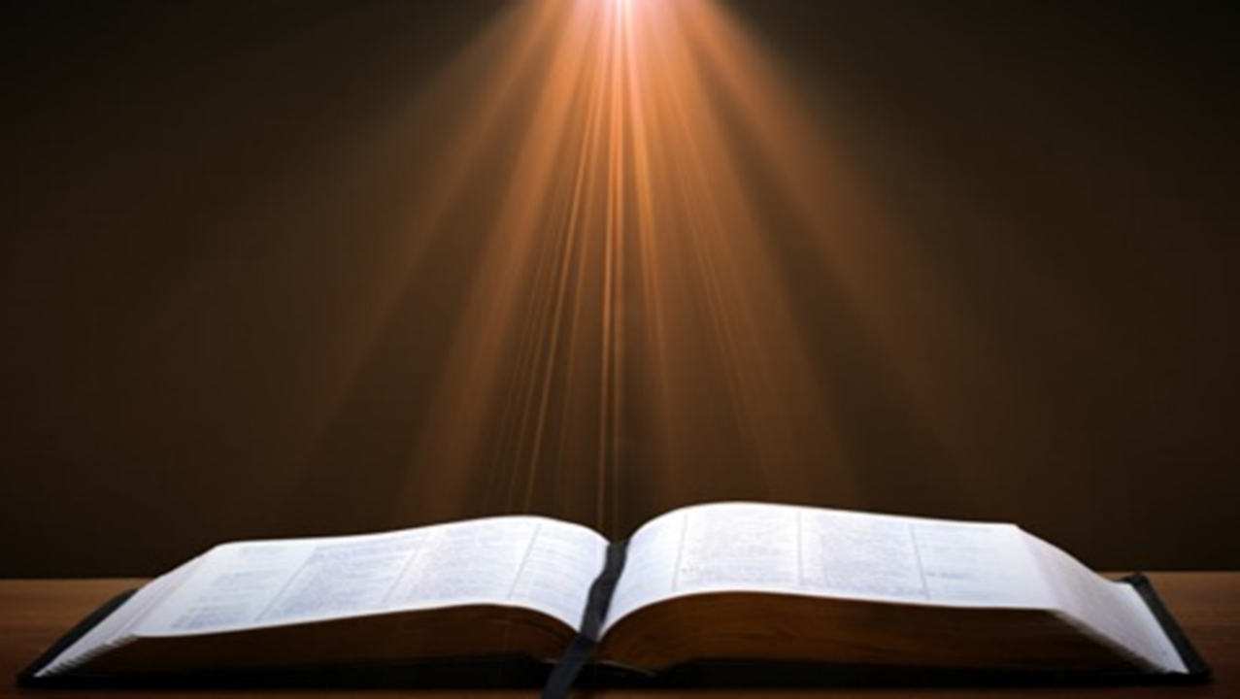
Ezekiel 38:13
“Sheba and Dedan and the merchants of Tarshish with all its villages will say to you, ‘Have you come to capture spoil? Have you assembled your company to seize plunder, to carry away silver and gold, to take away cattle and goods, to capture great spoil?’”

Slide 31
I. Genesis 35:1-8
Jacob’s Journey to Bethel
    Divine revelation (1a)
    Two commands (1b-c)
    Related to Jacob’s household (2)
    Goal of the journey (3)
    Spiritual cleansing (4)
    Journey (5)
    Arrival at Bethel (6)
    Naming (7)
    Deborah’s death (8)

Slide 34
I. Genesis 35:1-8
Jacob’s Journey to Bethel
    Divine revelation (1a)
    Two commands (1b-c)
    Related to Jacob’s household (2)
    Goal of the journey (3)
    Spiritual cleansing (4)
    Journey (5)
    Arrival at Bethel (6)
    Naming (7)
    Deborah’s death (8)

Slide 37
I. Genesis 35:1-8
Jacob’s Journey to Bethel
    Divine revelation (1a)
    Two commands (1b-c)
    Related to Jacob’s household (2)
    Goal of the journey (3)
    Spiritual cleansing (4)
    Journey (5)
    Arrival at Bethel (6)
    Naming (7)
    Deborah’s death (8)

Slide 38
Genesis 34:7
Naming
      Built an altar (7a)
      Name: El Bethel El (7b)

Slide 39
Genesis 35:7
Naming
      Built an altar (7a)
      Name: El Bethel El (7b)

Slide 40
Genesis 35:7
Naming
      Built an altar (7a)
      Name: El Bethel El (7b)

Slide 41
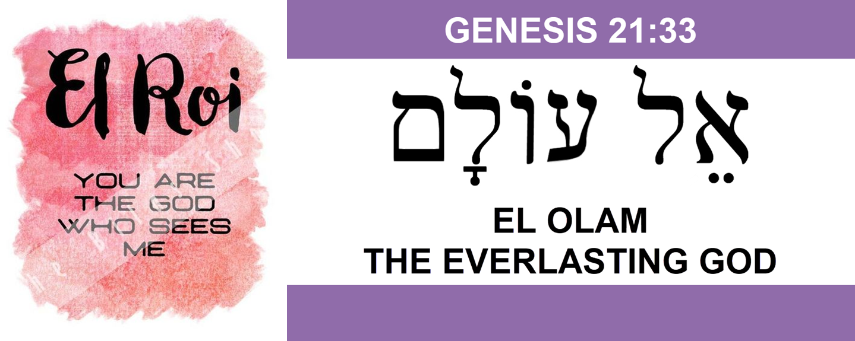

Slide 43
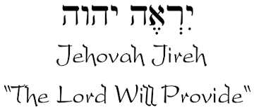

Slide 44
Names for God in Genesis
Elohim (1:1) - Power
Yahweh (2:4) - Relational
El Roi (Gen. 16:13) – Aware
El Olam (21:33) – Eternal
Jehovah Jireh (22:14) - Provision
God Isaac Feared (31:42, 53) - Reverenced
God, the God of Israel (33:20) – National
El Bethel (35:7) – The God of the House of God
El Shaddai (35:11) – Almighty

Slide 45
I. Genesis 35:1-8
Jacob’s Journey to Bethel
    Divine revelation (1a)
    Two commands (1b-c)
    Related to Jacob’s household (2)
    Goal of the journey (3)
    Spiritual cleansing (4)
    Journey (5)
    Arrival at Bethel (6)
    Naming (7)
    Deborah’s death (8)

Slide 46
Genesis 35:8
Deborah’s Death
      Death (8a)
      Burial (8b)
      Result (8c)

Slide 47
Genesis 35:8
Deborah’s Death
      Death (8a)
      Burial (8b)
      Result (8c)

Slide 48

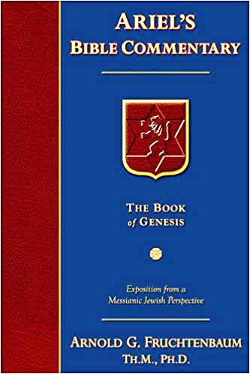
Dr. Arnold G. Fruchtenbaum
The Book of Genesis, 502
“Genesis 35:8 records the death of Deborah: And Deborah Rebekah’s nurse died. This is the first acknowledgement that Rebekah’s nurse (24:59) was part of the household of Jacob. The fact that she was now part of the household of Jacob and not part of the household of Isaac shows that by now, Rebekah, Jacob’s mother, had died. Apparently, Rebekah died while Jacob was in Haran, and Deborah joined him in Haran and then came back to the Land with Jacob. This would have made Deborah about one hundred eighty years old at her death.”

Slide 49
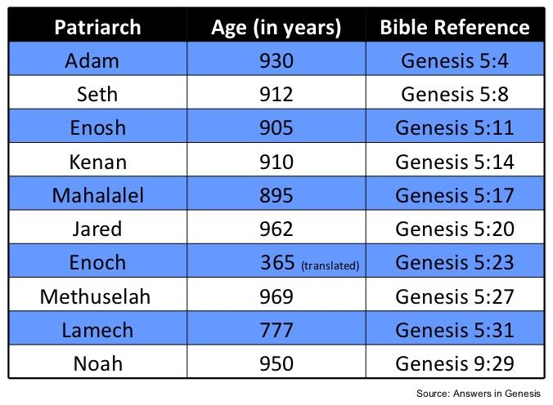

Slide 50
Genesis 35:8
Deborah’s Death
      Death (8a)
      Burial (8b)
      Result (8c)

Slide 51
Genesis 35:8
Deborah’s Death
      Death (8a)
      Burial (8b)
      Result (8c)

Slide 52
Genesis 35:1-29
Transitionary Information
  Jacob’s journey to Bethel (35:1-8)
  Divine appearance (35:9-15)
  Benjamin’s birth (35:16-20)
  Reuben loses the birthright (35:21-22a)
  Jacob’s dozen (35:22b-26)
  Isaac’s death (35:27-29)

Slide 53
II. Genesis 35:9-15
Divine Appearance
    Divine appearance (9)
    Jacob’s name change confirmed (10)
    Abrahamic Covenant reconfirmed (11-12)
    God’s appearance terminated (13)
    Jacob’s response (14-15)

Slide 54
II. Genesis 35:9-15
Divine Appearance
    Divine appearance (9)
    Jacob’s name change confirmed (10)
    Abrahamic Covenant reconfirmed (11-12)
    God’s appearance terminated (13)
    Jacob’s response (14-15)

Slide 55
New Promises
Genesis 12:1-3
    Land (Gen. 12:1b)
    Great nation (Gen. 12:2a)
    Personal blessing (Gen. 12:2b)
    Great name (Gen. 12:2c)
    Blessing to others (Gen. 12:2d)
    Blessing to blessers (Gen. 12:3a)
    Cursing to cursers (Gen. 12:3b)
    Blessing to the world (Gen. 12:3c)

Slide 56
II. Genesis 35:9-15
Divine Appearance
    Divine appearance (9)
    Jacob’s name change confirmed (10)
    Abrahamic Covenant reconfirmed (11-12)
    God’s appearance terminated (13)
    Jacob’s response (14-15)

Slide 57
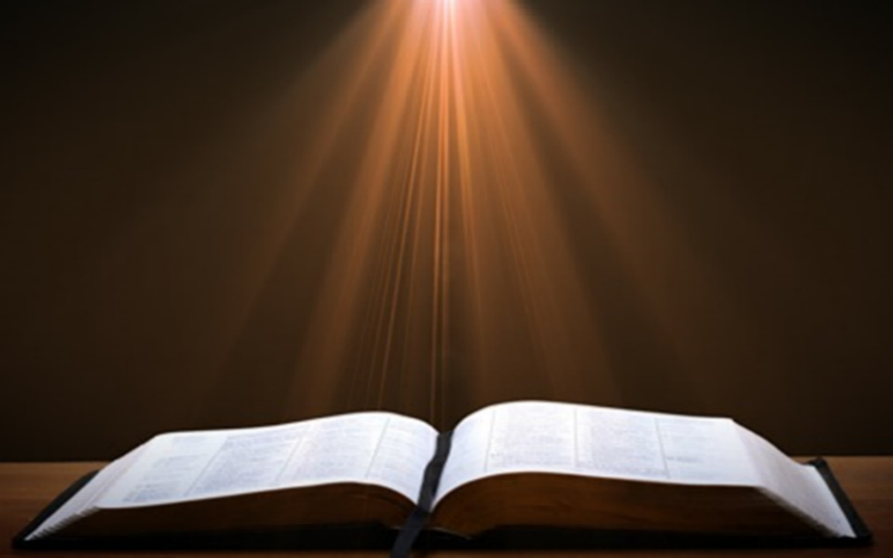
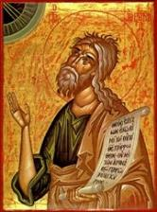
Jeremiah 30:6-7
“⁶ Ask now, and see If a male can give birth. Why do I see every man With his hands on his loins, as a woman in childbirth? And why have all faces turned pale? ⁷ Alas! for that day is great, There is none like it; And it is the time of Jacob’s distress (Gen. 32:8; 35:10), But he will be saved from it.”

Slide 58
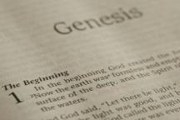
Beginning Themes
Universe Life Man Marriage Evil Clothing | Religion Salvation Language Government Nations Israel
Morris, Genesis Record, 18-20

Slide 59

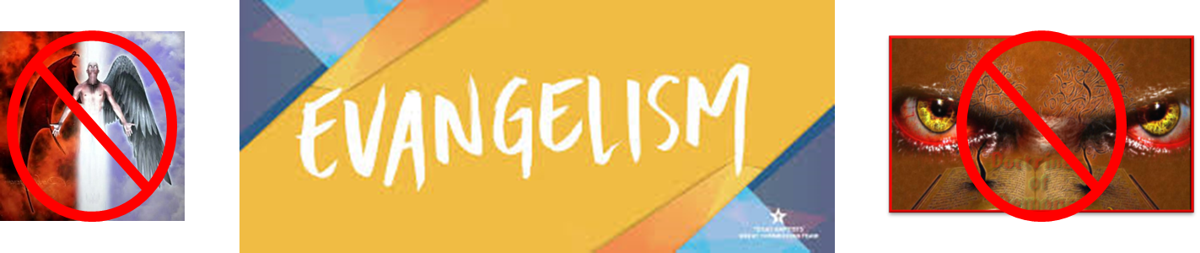
Matthew 16:18
“I also say to you that you are Peter, and upon this rock I will build [oikodomeō] My church; and the gates of Hades WILL NOT overpower it.”

Slide 60
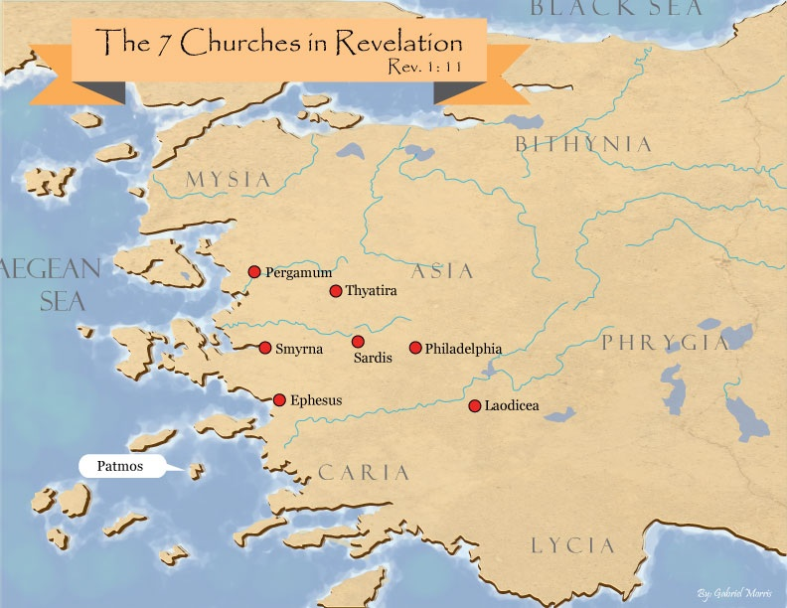
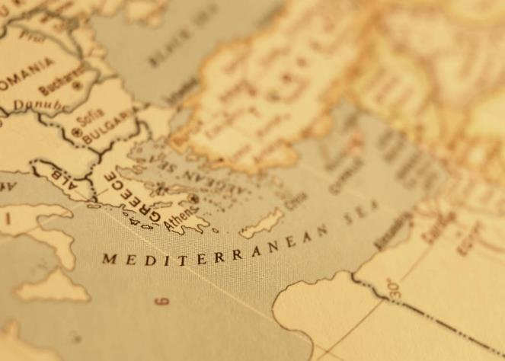

Slide 61
II. Genesis 35:9-15
Divine Appearance
    Divine appearance (9)
    Jacob’s name change confirmed (10)
    Abrahamic Covenant reconfirmed (11-12)
    God’s appearance terminated (13)
    Jacob’s response (14-15)

Slide 62
Genesis 35:11-12
Abrahamic Covenant Reconfirmed
      God’s self-identification (11a)
      Command (11b)
      Jacob’s posterity (11c-12)

Slide 63
Genesis 35:11-12
Abrahamic Covenant Reconfirmed
      God’s self-identification (11a)
      Command (11b)
      Jacob’s posterity (11c-12)

Slide 67
Names for God in Genesis
Elohim (1:1) - Power
Yahweh (2:4) - Relational
El Roi (Gen. 16:13) – Aware
El Olam (21:33) – Eternal
Jehovah Jireh (22:14) - Provision
God Isaac Feared (31:42, 53) - Reverenced
God, the God of Israel (33:20) – National
El Bethel (35:7) – The God of the House of God
El Shaddai (35:11) – Almighty

Slide 68
Genesis 35:11-12
Abrahamic Covenant Reconfirmed
      God’s self-identification (11a)
      Command (11b)
      Jacob’s posterity (11c-12)

Slide 69

Genesis 1:26-28
²⁶ Then God said, “Let Us make man in Our image, according to Our likeness; and let them rule over the fish of the sea and over the birds of the sky and over the cattle and over all the earth, and over every creeping thing that creeps on the earth.” ²⁷ God created man in His own image, in the image of God He created him; male and female He created them. ²⁸ God blessed them; and God said to them, “Be fruitful and multiply, and fill the earth, and subdue it; and rule over the fish of the sea and over the birds of the sky and over every living thing that moves on the earth.”

Slide 70
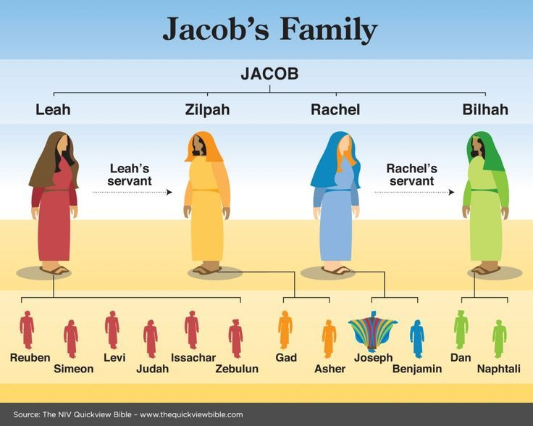

Slide 71
Genesis 35:11-12
Abrahamic Covenant Reconfirmed
      God’s self-identification (11a)
      Command (11b)
      Jacob’s posterity (11c-12)

Slide 72
Genesis 35:11c-12
Jacob’s Posterity
      Nation (11c)
      Company of nations (11d)
      Kings (11e)
      Land (12)

Slide 73
Genesis 35:11c-12
Jacob’s Posterity
      Nation (11c)
      Company of nations (11d)
      Kings (11e)
      Land (12)

Slide 74
Genesis 35:11c-12
Jacob’s Posterity
      Nation (11c)
      Company of nations (11d)
      Kings (11e)
      Land (12)

Slide 75
Beginning Themes
Universe Life Man Marriage Evil Clothing | Religion Salvation Language Government Nations Israel
Morris, Genesis Record, 18-20

Slide 76
Genesis 35:11c-12
Jacob’s Posterity
      Nation (11c)
      Company of nations (11d)
      Kings (11e)
      Land (12)

Slide 77
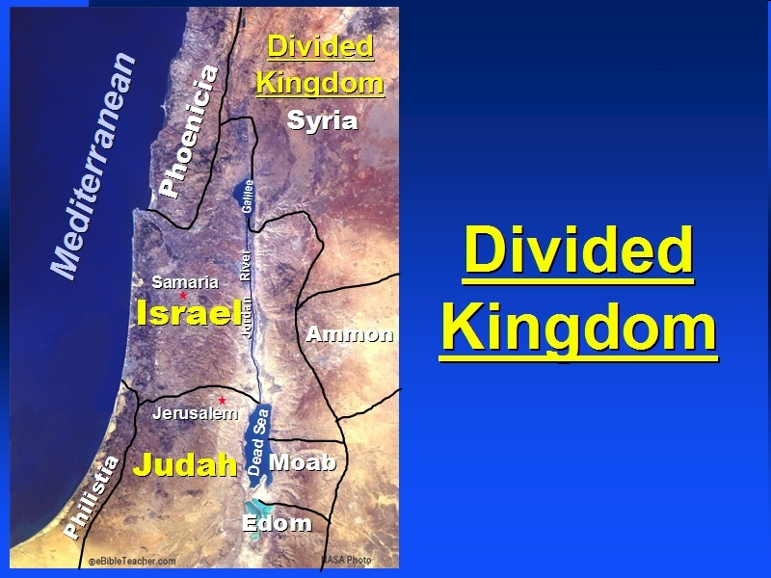

Slide 78

Good and Bad Kings
North – 19 kings (all bad)
South – 20 kings (8 good; significance of Gen 49:10)

Slide 79
Genesis 35:11c-12
Jacob’s Posterity
      Nation (11c)
      Company of nations (11d)
      Kings (11e)
      Land (12)

Slide 80
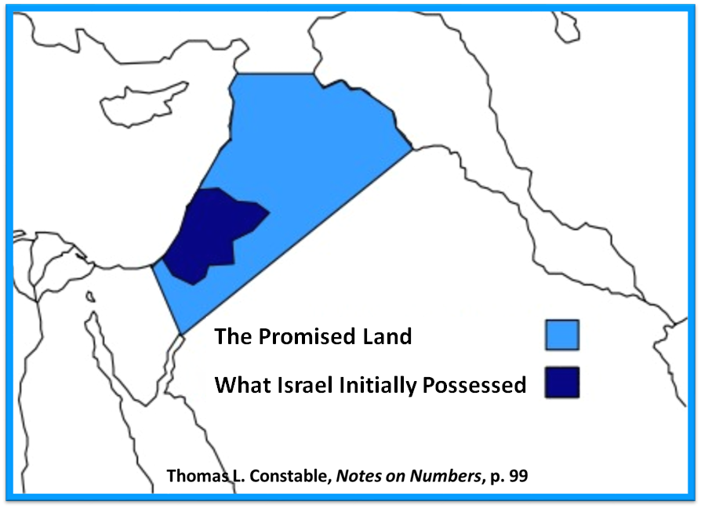

Slide 81
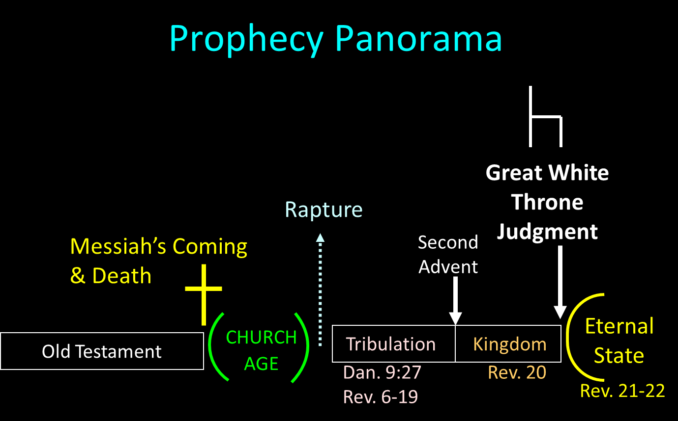

Slide 82
II. Genesis 35:9-15
Divine Appearance
    Divine appearance (9)
    Jacob’s name change confirmed (10)
    Abrahamic Covenant reconfirmed (11-12)
    God’s appearance terminated (13)
    Jacob’s response (14-15)

Slide 83


Jude 3
“Beloved, while I was making every effort to write you about our common salvation, I felt the necessity to write to you appealing that you contend earnestly for the faith that was once for all time handed down to the saints.”

Slide 84
Revelation 22:18-19
“I testify to everyone who hears the words of the prophecy of this book: if anyone adds to them, God will add to him the plagues which are written in this book; ¹⁹ and if anyone takes away from the words of the book of this prophecy, God will take away his part from the tree of life and from the holy city, which are written in this book.”

Slide 85
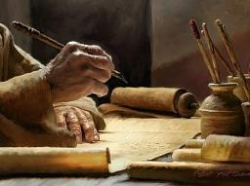
2 Timothy 3:16-17
“¹⁶ All Scripture is inspired by God [theopneustos] and profitable for teaching, for reproof, for correction, for training in righteousness; ¹⁷ so that the man of God may be adequate, equipped for every good work.”

Slide 86

2 Peter 1:3-4
“³ Seeing that His divine power has granted to us everything pertaining to life and godliness, through the true knowledge of Him who called us by His own glory and excellence. ⁴For by these He has granted to us His precious and magnificent promises, so that by them you may become partakers of the divine nature, having escaped the corruption that is in the world by lust.”

Slide 87
II. Genesis 35:9-15
Divine Appearance
    Divine appearance (9)
    Jacob’s name change confirmed (10)
    Abrahamic Covenant reconfirmed (11-12)
    God’s appearance terminated (13)
    Jacob’s response (14-15)

Slide 88
Genesis 35:14-15
Jacob’s Response
      Memorial pillar (14)
      Naming (15)

Slide 89
Genesis 35:14-15
Jacob’s Response
      Memorial pillar (14)
      Naming (15)

Slide 90
Genesis 35:14-15
Jacob’s Response
      Memorial pillar (14)
      Naming (15)

Slide 91
Genesis 35:1-29
Transitionary Information
  Jacob’s journey to Bethel (35:1-8)
  Divine appearance (35:9-15)
  Benjamin’s birth (35:16-20)
  Reuben loses the birthright (35:21-22a)
  Jacob’s dozen (35:22b-26)
  Isaac’s death (35:27-29)

Slide 92
III. Genesis 35:16-20
Benjamin’s Birth
    Circumstances (16a)
    Benjamin’s birth (16b-18)
    Rachel’s death (19-20)

Slide 93
III. Genesis 35:16-20
Benjamin’s Birth
    Circumstances (16a)
    Benjamin’s birth (16b-18)
    Rachel’s death (19-20)

Slide 95

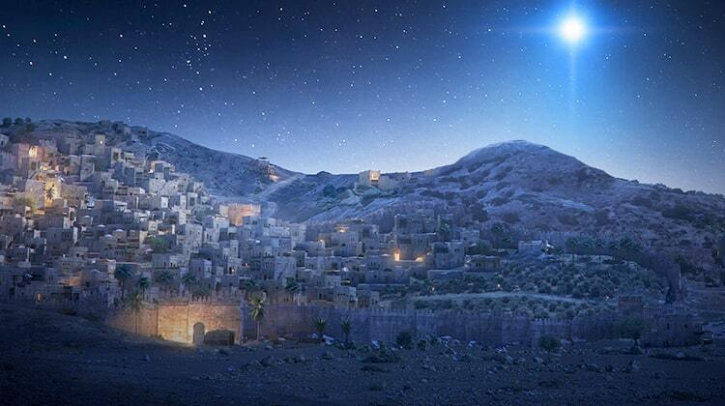
Micah 5:2
“But as for you, Bethlehem Ephrathah, Too little to be among the clans of Judah, From you One will go forth for Me to be ruler in Israel. His goings forth are from long ago, From the days of eternity.”

Slide 96
III. Genesis 35:16-20
Benjamin’s Birth
    Circumstances (16a)
    Benjamin’s birth (16b-18)
    Rachel’s death (19-20)

Slide 97
Genesis 35:16b-18
Benjamin’s Birth
      Labor (16a)
      Birth (17)
      Naming (18)

Slide 98
Genesis 35:16b-18
Benjamin’s Birth
      Labor (16a)
      Birth (17)
      Naming (18)

Slide 99
Genesis 35:16b-18
Benjamin’s Birth
      Labor (16a)
      Birth (17)
      Naming (18)

Slide 102
Genesis 35:16b-18
Benjamin’s Birth
      Labor (16a)
      Birth (17)
      Naming (18)

Slide 103
Genesis 35:18
Naming
      Rachel’s naming (18a-b)
      Jacob’s naming (18c)

Slide 104
Genesis 35:18
Naming
      Rachel’s naming (18a-b)
      Jacob’s naming (18c)

Slide 105
Genesis 35:18
Rachel’s Naming
      Circumstances (18a)
      Name (18b)

Slide 106
Genesis 35:18
Rachel’s Naming
      Circumstances (18a)
      Name (18b)

Slide 107

Woman
(3:16)
  Painful child birth (3:16a)
  Relational conflict (3:16b)

Slide 108

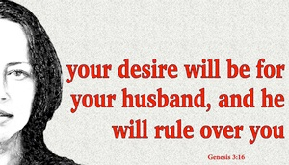
Genesis 3:16
“To the woman He said, ‘I will greatly multiply Your pain in childbirth, In pain you will bring forth children; Yet your desire [TESHUQAH] will be for your husband, And he will rule over you.’”

Slide 109
“Death” in the Old Testament
māwet: “Death is the consequences and the punishment of sin. It originated with sin. A grand theme of the Old Testament is God’s holiness, which separates Him from all that is in harmony with His character. Death, then, in the Old Testament means ultimate separation from God due to sin.”
Elmer B. Smick, “māwet," in Theological Wordbook of the Old Testament, ed. R. Laird Harris and Gleason L. Archer and Bruce K. Waltke(Chicago: Moody, 1980), 1:1169.

Slide 110
“Death” in the New Testament
thanatos: “that separation (whether natural or violent) of the soul from the body by which the life on earth is ended.”
Joseph Henry Thayer, Death - Thanatos, Greek-English Lexicon of the New Testament Being Grmm's Wilke's Clavis Novi Testamenti (Grand Rapids: Zondervan, 1977), 282.

Slide 111
Genesis 35:18
Rachel’s Naming
      Circumstances (18a)
      Name (18b)

Slide 112
Genesis 35:18
Naming
      Rachel’s naming (18a-b)
      Jacob’s naming (18c)

Slide 113
III. Genesis 35:16-20
Benjamin’s Birth
    Circumstances (16a)
    Benjamin’s birth (16b-18)
    Rachel’s death (19-20)

Slide 114
Genesis 35:19-20
Rachel’s Death
      Death (19a)
      Burial (19b)
      Marker (20)

Slide 115
Genesis 35:19-20
Rachel’s Death
      Death (19a)
      Burial (19b)
      Marker (20)

Slide 116
Genesis 35:19-20
Rachel’s Death
      Death (19a)
      Burial (19b)
      Marker (20)

Slide 117
Micah 5:2
“But as for you, Bethlehem Ephrathah, Too little to be among the clans of Judah, From you One will go forth for Me to be ruler in Israel. His goings forth are from long ago, From the days of eternity.”

Slide 118
Genesis 35:19-20
Rachel’s Death
      Death (19a)
      Burial (19b)
      Marker (20)

Slide 119
Genesis 35:1-29
Transitionary Information
  Jacob’s journey to Bethel (35:1-8)
  Divine appearance (35:9-15)
  Benjamin’s birth (35:16-20)
  Reuben loses the birthright (35:21-22a)
  Jacob’s dozen (35:22b-26)
  Isaac’s death (35:27-29)

Slide 120
IV. Genesis 35:21-22a
Reuben Loses the Birthright
    Geographical marker (21)
    Reuben’s sin (22a)

Slide 121
IV. Genesis 35:21-22a
Reuben Loses the Birthright
    Geographical marker (21)
    Reuben’s sin (22a)

Slide 122
IV. Genesis 35:21-22a
Reuben Loses the Birthright
    Geographical marker (21)
    Reuben’s sin (22a)

Slide 124

1 Corinthians 3:10-15
¹⁰ According to the grace of God which was given to me, like a wise master builder I laid a foundation, and another is building on it. But each man must be careful how he builds on it. ¹¹ For no man can lay a foundation other than the one which is laid, which is Jesus Christ. ¹² Now if any man builds on the foundation with gold, silver, precious stones, wood, hay, straw, ¹³ each man’s work will become evident; for the day will show it because it is to be revealed with fire, and the fire itself will test the quality of . . .

Slide 125
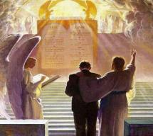
1 Corinthians 3:10-15
. . . each man’s work. ¹⁴ If any man’s work which he has built on it remains, he will receive a reward. ¹⁵ If any man’s work is burned up, he will suffer loss; but he himself will be saved, yet so as through fire.

Slide 126
Scripture’s Five Crowns (Rev 4:10: 3:11; 2 John 8)
SCRIPTURE | CROWN | PURPOSE
1 Cor. 9:24-27 | Incorruptible | Gaining mastery over the flesh
1 Thess. 2:19-20 | Rejoicing | Soul winning
Jas. 1:12; Rev. 2:10 | Life | Enduring trials
1 Pet. 5:2-4 | Glory | Shepherding God’s people
2 Tim. 4:8 | Righteousness | Longing for His appearing

Slide 127
Genesis 35:1-29
Transitionary Information
  Jacob’s journey to Bethel (35:1-8)
  Divine appearance (35:9-15)
  Benjamin’s birth (35:16-20)
  Reuben loses the birthright (35:21-22a)
  Jacob’s dozen (35:22b-26)
  Isaac’s death (35:27-29)

Slide 128
V. Genesis 35:22b-26
Jacob’s Dozen
    Introduction (22b)
    Jacob’s dozen (23-26a)
    Conclusion (26b)

Slide 129
V. Genesis 35:22b-26
Jacob’s Dozen
    Introduction (22b)
    Jacob’s dozen (23-26a)
    Conclusion (26b)

Slide 131
V. Genesis 35:22b-26
Jacob’s Dozen
    Introduction (22b)
    Jacob’s dozen (23-26a)
    Conclusion (26b)

Slide 132
Genesis 35:23-26a
Jacob’s Dozen
      Leah’s six sons (23)
      Rachel’s two sons (24)
      Bilhah’s two sons (25)
      Zilpah’s two sons (26b)

Slide 133
Genesis 35:23-26a
Jacob’s Dozen
      Leah’s six sons (23)
      Rachel’s two sons (24)
      Bilhah’s two sons (25)
      Zilpah’s two sons (26b)

Slide 135
Genesis 35:23-26a
Jacob’s Dozen
      Leah’s six sons (23)
      Rachel’s two sons (24)
      Bilhah’s two sons (25)
      Zilpah’s two sons (26b)

Slide 137
Genesis 35:23-26a
Jacob’s Dozen
      Leah’s six sons (23)
      Rachel’s two sons (24)
      Bilhah’s two sons (25)
      Zilpah’s two sons (26b)

Slide 139
Genesis 35:23-26a
Jacob’s Dozen
      Leah’s six sons (23)
      Rachel’s two sons (24)
      Bilhah’s two sons (25)
      Zilpah’s two sons (26b)

Slide 141
V. Genesis 35:22b-26
Jacob’s Dozen
    Introduction (22b)
    Jacob’s dozen (23-26a)
    Conclusion (26b)

Slide 143
Genesis 35:1-29
Transitionary Information
  Jacob’s journey to Bethel (35:1-8)
  Divine appearance (35:9-15)
  Benjamin’s birth (35:16-20)
  Reuben loses the birthright (35:21-22a)
  Jacob’s dozen (35:22b-26)
  Isaac’s death (35:27-29)

Slide 144
VI. Genesis 35:27-29
Isaac’s Death
    Reunion of Isaac and Jacob (27)
    Isaac’s total years (28)
    Isaac’s death (29)

Slide 145
VI. Genesis 35:27-29
Isaac’s Death
    Reunion of Isaac and Jacob (27)
    Isaac’s total years (28)
    Isaac’s death (29)

Slide 146
Genesis 35:27
Reunion of Isaac and Jacob
      Contact (27a)
      Place (27b)

Slide 147
Genesis 35:27
Reunion of Isaac and Jacob
      Contact (27a)
      Place (27b)

Slide 149
Genesis 35:27
Reunion of Isaac and Jacob
      Contact (27a)
      Place (27b)

Slide 150
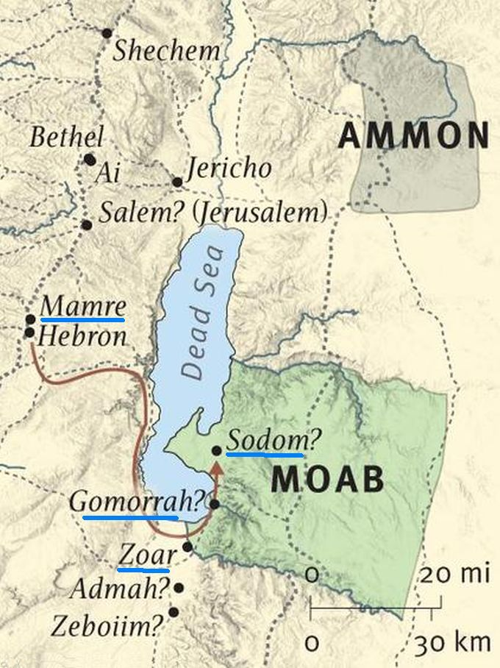

Slide 151
VI. Genesis 35:27-29
Isaac’s Death
    Reunion of Isaac and Jacob (27)
    Isaac’s total years (28)
    Isaac’s death (29)

Slide 152
VI. Genesis 35:27-29
Isaac’s Death
    Reunion of Isaac and Jacob (27)
    Isaac’s total years (28)
    Isaac’s death (29)

Slide 153
Genesis 35:29
Isaac’s Death
      Death (29a)
      Full of days (29b)
      Burial (29c)

Slide 154
Genesis 35:29
Isaac’s Death
      Death (29a)
      Full of days (29b)
      Burial (29c)

Slide 155
“Death” in the Old Testament
māwet: “Death is the consequences and the punishment of sin. It originated with sin. A grand theme of the Old Testament is God’s holiness, which separates Him from all that is in harmony with His character. Death, then, in the Old Testament means ultimate separation from God due to sin.”
Elmer B. Smick, “māwet," in Theological Wordbook of the Old Testament, ed. R. Laird Harris and Gleason L. Archer and Bruce K. Waltke(Chicago: Moody, 1980), 1:1169.

Slide 156
“Death” in the New Testament
thanatos: “that separation (whether natural or violent) of the soul from the body by which the life on earth is ended.”
Joseph Henry Thayer, Death - Thanatos, Greek-English Lexicon of the New Testament Being Grmm's Wilke's Clavis Novi Testamenti (Grand Rapids: Zondervan, 1977), 282.

Slide 157
Dr. Arnold G. Fruchtenbaum
The Book of Genesis, 392
“This phrase ‘gathered to his people’ is used ten times, and only in the Pentateuch: Genesis 25:8, of Abraham; 25:17, of Ishmael; 35:29, of Isaac; 49:29, of Jacob; 49:33, of Jacob; Numbers 20:24, of Aaron; 20:26, of Aaron; 27:13, of Moses; 31:2, of Moses; and Deuteronomy 32:50, of Aaron and Moses. A parallel phrase is gathered to his fathers in Genesis 15:15 and 47:30.”

Slide 159

Daniel 12:1-2
“¹ Now at that time Michael, the great prince who stands guard over the sons of your people, will arise. And there will be a time of distress such as never occurred since there was a nation until that time; and at that time your people, everyone who is found written in the book, will be rescued. ² Many of those who sleep in the dust of the ground will awake, these to everlasting life, but the others to disgrace and everlasting contempt.”

Slide 160
Genesis 35:29
Isaac’s Death
      Death (29a)
      Full of days (29b)
      Burial (29c)

Slide 161

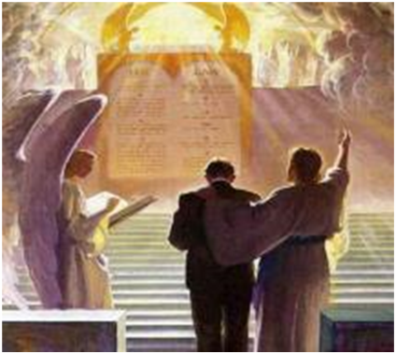
2 Timothy 4:7-8
“⁷ I have fought the good fight, I have finished the course, I have kept the faith; ⁸ in the future there is reserved for me the crown of righteousness, which the Lord, the righteous Judge, will award to me on that day; and not only to me, but also to all who have loved His appearing.”

Slide 162
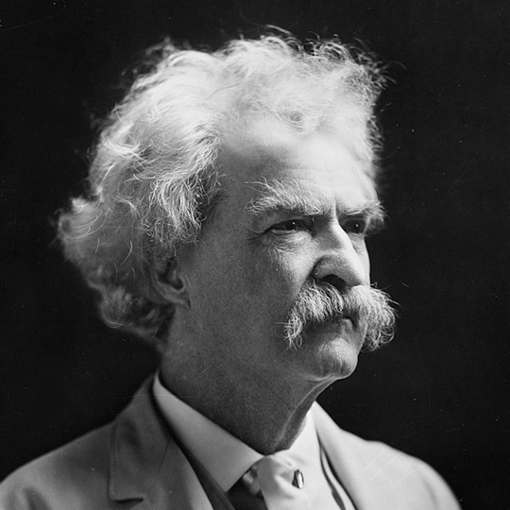
Mark Twain
Autobiography, 2:37
“A myriad of men are born; they labor and sweat and struggle for bread; they squabble and scold and fight; they scramble for little mean advantages over each other. Age creeps upon them and infirmities follow; shames and humiliations bring down their prides and their vanities. Those they love are taken from them, and the joy of life is turned to aching grief. The burden of pain, care, and misery grows heavier year by year. At length ambition is dead, pride is dead, vanity is dead; longing for release is in their place. It comes at last-the only un-poisoned gift earth ever had for them-and they vanish from a world where they were of no consequence; where they achieved nothing, where they were a mistake and a failure and a foolishness; where they left no sign that they have existed – a world that will lament them a day and forget them forever.”

Slide 163
Genesis 35:29
Isaac’s Death
      Death (29a)
      Full of days (29b)
      Burial (29c)

Slide 165
Genesis 12‒25
Abraham’s Early Journeys
Unconditional promises (Gen. 12:1-3) From Haran to Canaan (Gen. 12:4-5) In Canaan (Gen. 12:6-9) In Egypt (Gen. 12:10-20) Abram and Lot Separate (Gen. 13:1-13) Reaffirmation of Abram’s promises (Gen. 13:14-18) Abram Rescues Lot (14:1-24) Abrahamic Covenant (15:1-21) Hagar & Ishmael (16:1-16) Circumcision (Gen. 17:1-27) | Sodom & Gomorrah (Gen. 18‒19) Abraham & Abimelech (Gen. 20) Isaac’s birth (Gen. 21:1-7) Ishmael’s expulsion (21:8-21) Abraham & Abimelech’s covenant (21:22-34) Abraham sacrifices Isaac (22) Sarah’s death (23) Isaac’s marriage (24) Abraham & Keturah (25:1-6) Abraham’s death (25:7-11)

Slide 167
Conclusion

Slide 168
Genesis 35:1-29
Transitionary Information
  Jacob’s journey to Bethel (35:1-8)
  Divine appearance (35:9-15)
  Benjamin’s birth (35:16-20)
  Reuben loses the birthright (35:21-22a)
  Jacob’s dozen (35:22b-26)
  Isaac’s death (35:27-29)

Slide 169
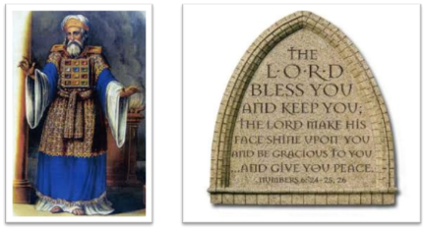
²⁴ The Lord bless you, and keep you; ²⁵ The Lord make His face shine on you, And be gracious to you; ²⁶ The Lord lift up His countenance on you, And give you peace.
Numbers 6:24–26 (NASB95)

