Slide 1
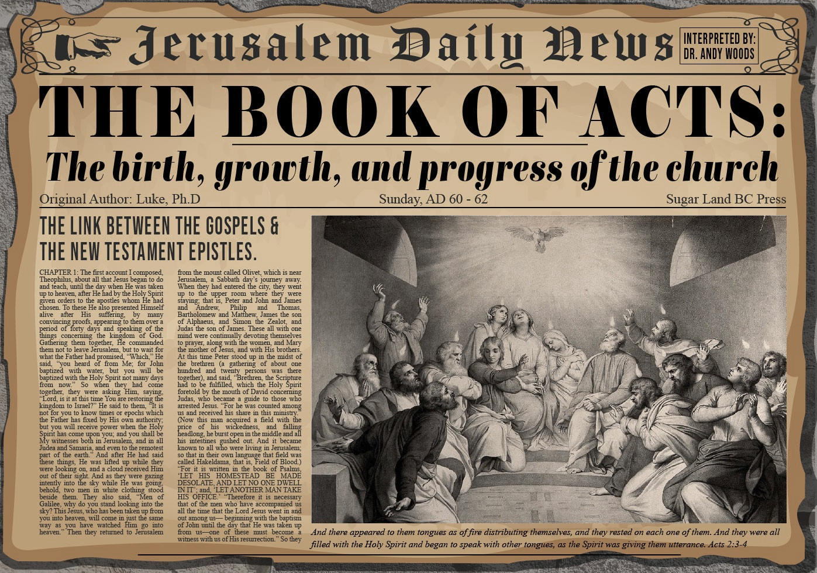


Slide 2
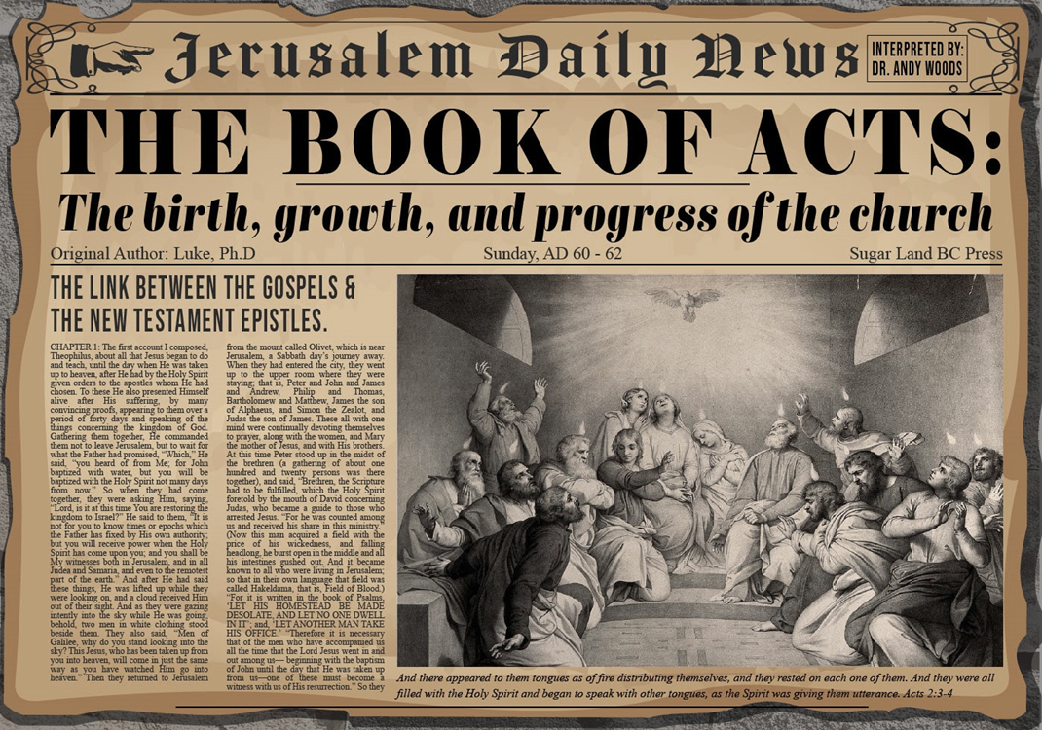
Acts 4:1‒5:11
Summary
  Apostles Arrested (4:1-4)
  Apostles Examined (4:5-12)
  Sanhedrin’s Decision (4:13-22)
  Apostles’ Prayer (4:23-31)
  Pre-Ananias and Sapphira (4:32-37)
  Ananias and Sapphira (5:1-11)

Slide 3
Ananias and Sapphira
Acts 5:1-11
  Ananias’ Discipline (1-6)
  Sapphira’s Discipline (7-10)
  Result (11)

Slide 4
Ananias and Sapphira
Acts 5:1-11
  Ananias’ Discipline (1-6)
  Sapphira’s Discipline (7-10)
  Result (11)

Slide 5
Acts 5:1-6
Ananias’ Discipline
      Deed (1-2)
      Peter’s Accusation (3-4)
      Ananias’ Discipline (5-6)

Slide 6
Acts 5:1-6
Ananias’ Discipline
      Deed (1-2)
      Peter’s Accusation (3-4)
      Ananias’ Discipline (5-6)

Slide 7
Acts 5:1-2
Deed
      Sale (1)
      Conspiracy (2)

Slide 8
Acts 5:1-2
Deed
      Sale (1)
      Conspiracy (2)

Slide 9
Acts 5:1-2
Deed
      Sale (1)
      Conspiracy (2)

Slide 10
Acts 5:1-6
Ananias’ Discipline
      Deed (1-2)
      Peter’s Accusation (3-4)
      Ananias’ Discipline (5-6)

Slide 11
Acts 5:3-4
Peter’s Accusation
      Guilty parties (3)
      Couple’s responsibility (4)

Slide 12
Acts 5:3-4
Peter’s Accusation
      Guilty parties (3)
      Couple’s responsibility (4)

Slide 13
Acts 5:3-4
Peter’s Accusation
      Guilty parties (3)
      Couple’s responsibility (4)

Slide 14
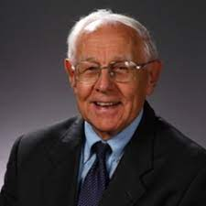

Dr. Stanley Toussaint
The Book of Acts, The Bible Knowledge Commentary, p. 365.
“The fact that believers had the right to keep their money shows that this was not Christian socialism. It was a free-will arrangement for the support of the church, used only temporarily because evidently the early church expected Christ to come in their generation.”

Slide 15
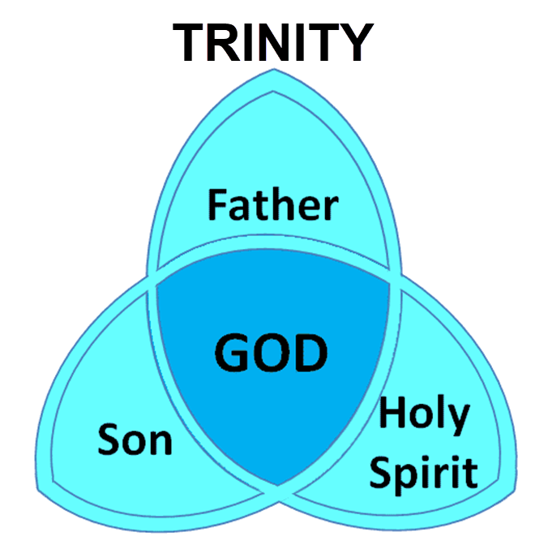

Slide 16
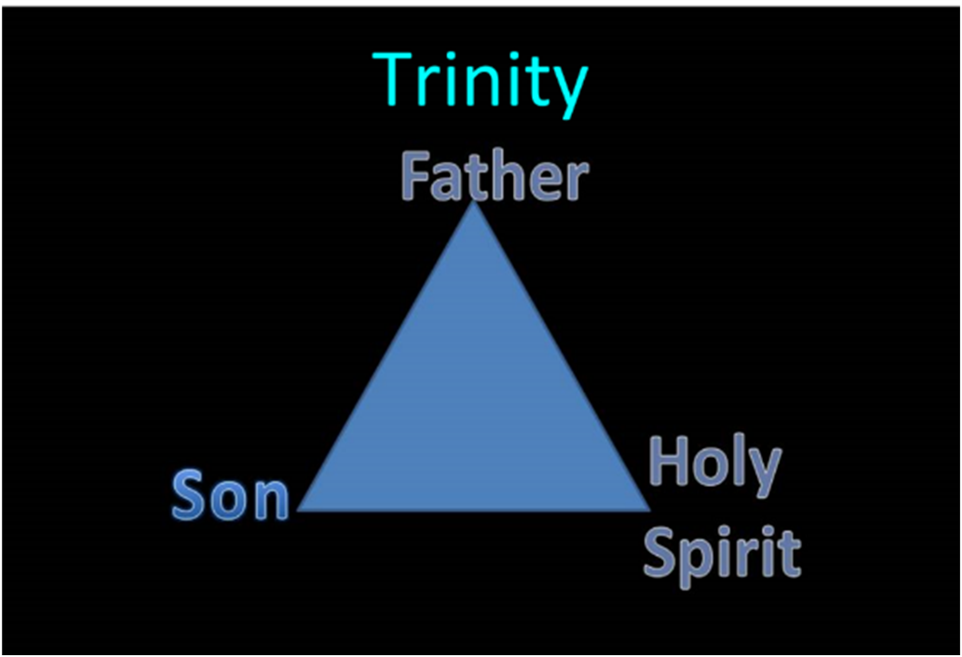

Slide 17
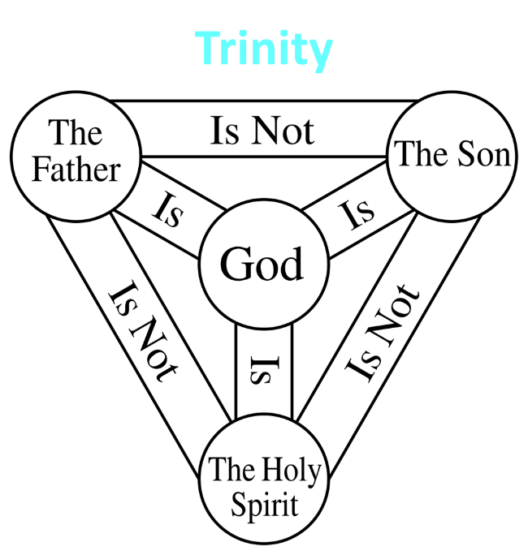

Slide 18
12/12/4/4
Romans 12
1 Corinthians 12
1 Peter 4
Ephesians 4

Slide 19
Acts 5:1-6
Ananias’ Discipline
      Deed (1-2)
      Peter’s Accusation (3-4)
      Ananias’ Discipline (5-6)

Slide 20
Acts 5:5-6
Ananias's Discipline
      Death (5)
      Burial (6)

Slide 21
Acts 5:5-6
Ananias's Discipline
      Death (5)
      Burial (6)

Slide 22
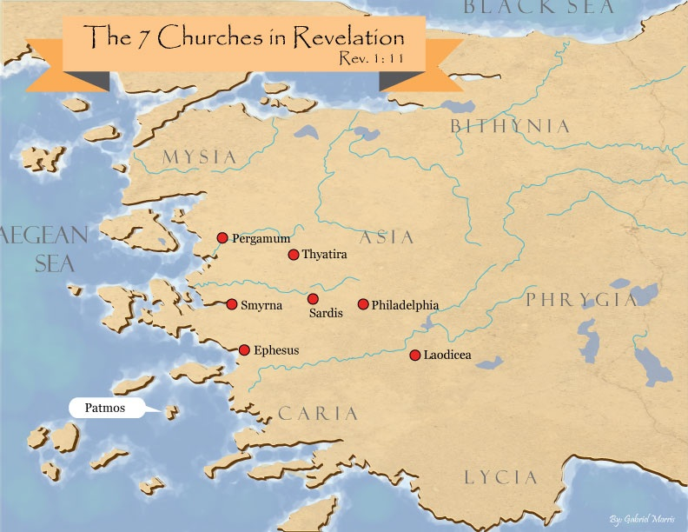


Slide 23

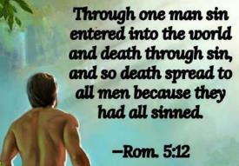
Genesis 3:19
“By the sweat of your face You will eat bread, Till you return to the ground, Because from it you were taken; For you are dust, And to dust you shall return.”

Slide 24
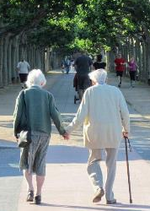
2 Cor. 4:16
“Therefore, we do not lose heart, but though our outer man is decaying, yet our inner man is being renewed day by day.”

Slide 25

Romans 8:19-22
¹⁹ For the anxious longing of the creation waits eagerly for the revealing of the sons of God. ²⁰ For the creation was subjected to futility, not willingly, but because of Him who subjected it, in hope ²¹ that the creation itself also will be set free from its slavery to corruption into the freedom of the glory of the children of God. ²² For we know that the whole creation groans and suffers the pains of childbirth together until now.

Slide 26
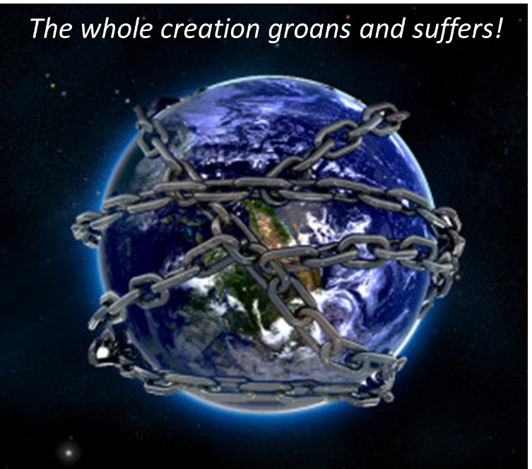

Slide 27
Acts 5:5-6
Ananias's Discipline
      Death (5)
      Burial (6)

Slide 28
Ananias and Sapphira
Acts 5:1-11
  Ananias’ Discipline (1-6)
  Sapphira’s Discipline (7-10)
  Result (11)

Slide 29
Acts 5:7-10
Sapphira's’ Discipline
      Sin (7-8)
      Peter’s confrontation & judgment (9)
      Death and burial (10)

Slide 30
Acts 5:7-10
Sapphira's’ Discipline
      Sin (7-8)
      Peter’s confrontation & judgment (9)
      Death and burial (10)

Slide 31
Acts 5:7-10
Sapphira's’ Discipline
      Sin (7-8)
      Peter’s confrontation & judgment (9)
      Death and burial (10)

Slide 32
Acts 5:7-10
Sapphira's’ Discipline
      Sin (7-8)
      Peter’s confrontation & judgment (9)
      Death and burial (10)

Slide 33
Ananias and Sapphira
Acts 5:1-11
  Ananias’ Discipline (1-6)
  Sapphira’s Discipline (7-10)
  Result (11)

Slide 34
Acts 5:11
Result
      Fear within the congregation (11a)
      Fear outside the congregation (11b)

Slide 35
Acts 5:11
Result
      Fear within the congregation (11a)
      Fear outside the congregation (11b)

Slide 36

Acts 2:47
“praising God and having favor with all the people. And the Lord was adding to their number day by day those who were being saved.” (NASB)
“praising God and having favor with all the people. And the Lord added to the church daily those who were being saved.” (NKJV)

Slide 37
Author | Written | Earliest MSS | Time Span | No. MSS
Cesar | 100 to 44 b.c. | a.d. 900 | 1000 | 10
Plato | 427 to 347 b.c. | a.d. 900 | 1200 | 7
Thucydides | 460 to 400 b.c. | a.d. 900 | 1300 | 8
Tacitus | a.d. 100 | a.d. 1100 | 1000 | 20
Suetonius | a.d. 75 to 160 | a.d. 950 | 800 | 8
Homer (Illiad) | 900 b.c. | a.d. 400 | 500 | 643
New Testament | a.d. 40 to 100 | a.d. 125 | 25 to 50 | 24,000
Cesar | 100 to 44 b.c. | a.d. 900 | 1000 | 10
http://creationrevolution.com/2012/05/should-we-trust-the-bible/

Slide 38
Manuscript Evidence for Ancient Writings
Author | Written | Earliest Fragment/Copy | Time Span in Years | Number of Manuscripts
Cesar | 100 to 44 b.c. | a.d. 900 | 1000 | 10
Plato | 427 to 347 b.c. | a.d. 900 | 1200 | 7
Thucydides | 460 to 400 b.c. | a.d. 900 | 1300 | 8
Tacitus | a.d. 100 | a.d. 1100 | 1000 | 20
Suetonius | a.d. 75 to 160 | a.d. 950 | 800 | 8
Homer (Illiad) | 900 b.c. | a.d. 400 | 500 | 643
New Testament | a.d. 40 to 100 | a.d. 125 | 25 to 50 | 24,000
Information in this chart can be found in various sources. This chart was adapted from: Christian Apologetics, by Norman Geisler, 1976, p. 307; and Evidence That Demands a Verdict, by Josh McDowell, 1979, pp. 42, 43.

Slide 39


Dr. Arnold Fruchtenbaum
Arnold G. Fruchtenbaum, “Israel and the Church,” in Issues in Dispensationalism, ed. Wesley R. Willis and John R. Master (Chicago: Moody, 1994), 118.
“In the book of Acts, both Israel and the Church exist simultaneously. The term Israel is used twenty times and ekklēsia (Church) nineteen times, yet the two groups are always kept distinct.”

Slide 41
Acts 5:11
Result
      Fear within the congregation (11a)
      Fear outside the congregation (11b)

Slide 42
Acts 5:1-11
Three Concluding Observations
      Peter’s apostolic authority (Matt. 16:19)
      Discipline is always stricter at the start of a new dispensations (Lev. 10:1-2)
      Judgment begins in the house of the Lord (1 Pet. 4:17)

Slide 43
Acts 5:1-11
Three Concluding Observations
      Peter’s apostolic authority (Matt. 16:19)
      Discipline is always stricter at the start of a new dispensations (Lev. 10:1-2)
      Judgment begins in the house of the Lord (1 Pet. 4:17)

Slide 44

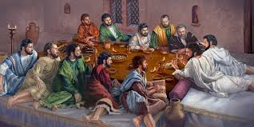
Ephesians 2:20
“having been built on the foundation of the apostles and prophets, Christ Jesus Himself being the corner stone.”

Slide 45
Acts 5:1-11
Three Concluding Observations
      Peter’s apostolic authority (Matt. 16:19)
      Discipline is always stricter at the start of a new dispensations (Lev. 10:1-2)
      Judgment begins in the house of the Lord (1 Pet. 4:17)

Slide 46
Acts 5:1-11
Three Concluding Observations
      Peter’s apostolic authority (Matt. 16:19)
      Discipline is always stricter at the start of a new dispensations (Lev. 10:1-2)
      Judgment begins in the house of the Lord (1 Pet. 4:17)

Slide 47
Conclusion

Slide 48
Acts 4:1‒5:11
Summary
  Apostles Arrested (4:1-4)
  Apostles Examined (4:5-12)
  Sanhedrin’s Decision (4:13-22)
  Apostles’ Prayer (4:23-31)
  Pre-Ananias and Sapphira (4:32-37)
  Ananias and Sapphira (5:1-11)

