Slide 1
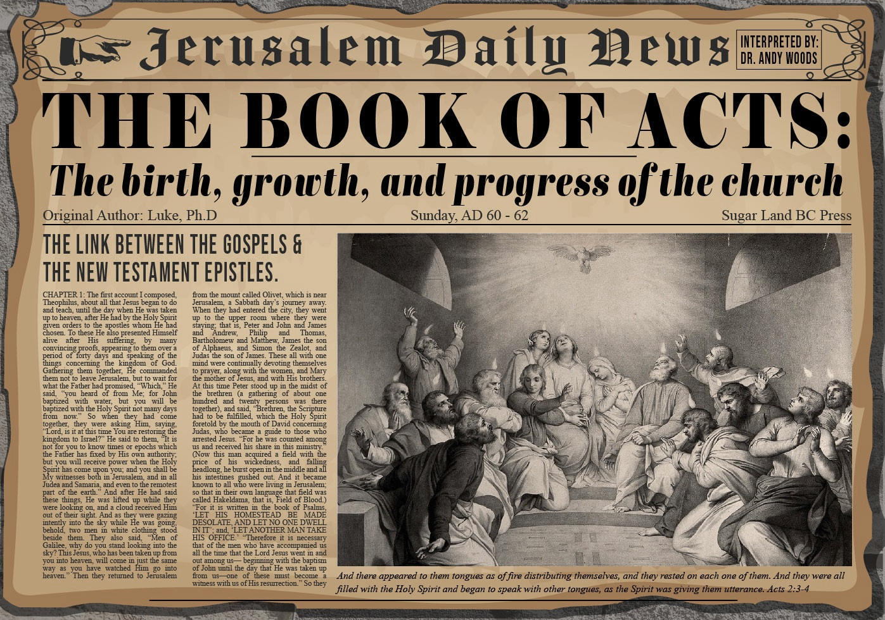


Slide 2
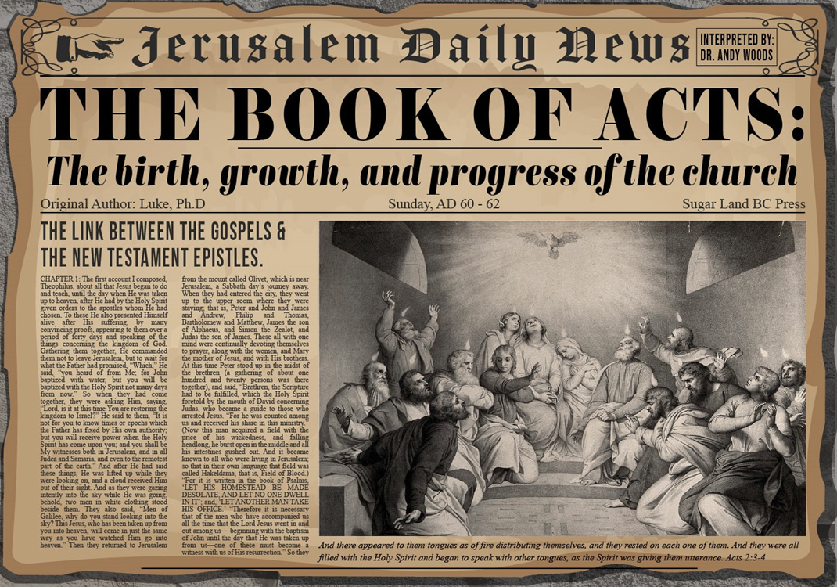
Acts 4:1‒5:11
Summary
  Apostles Arrested (4:1-4)
  Apostles Examined (4:5-12)
  Sanhedrin’s Decision (4:13-22)
  Apostles’ Prayer (4:23-31)
  Pre-Ananias and Sapphira (4:32-37)
  Ananias and Sapphira (5:1-11)

Slide 3
Pre-Ananias and Sapphira
Acts 4:32-37
  Community of the Saints (32-35)
  Barnabas’ Positive Example (36-37)

Slide 4
Pre-Ananias and Sapphira
Acts 4:32-37
  Community of the Saints (32-35)
  Barnabas’ Positive Example (36-37)

Slide 5
Acts 4:32-35
Community of the Saints
      Characteristics of the Church (32-33)
      Community of the Church (34-35)

Slide 6
Acts 4:32-35
Community of the Saints
      Characteristics of the Church (32-33)
      Community of the Church (34-35)

Slide 7
Acts 4:32-33
Characteristics of the Church
      Multitude (32a)
      Sharing (32b)
      Apostolic witness (33a)
      Grace (33b)

Slide 8
Acts 4:32-33
Characteristics of the Church
      Multitude (32a)
      Sharing (32b)
      Apostolic witness (33a)
      Grace (33b)

Slide 9
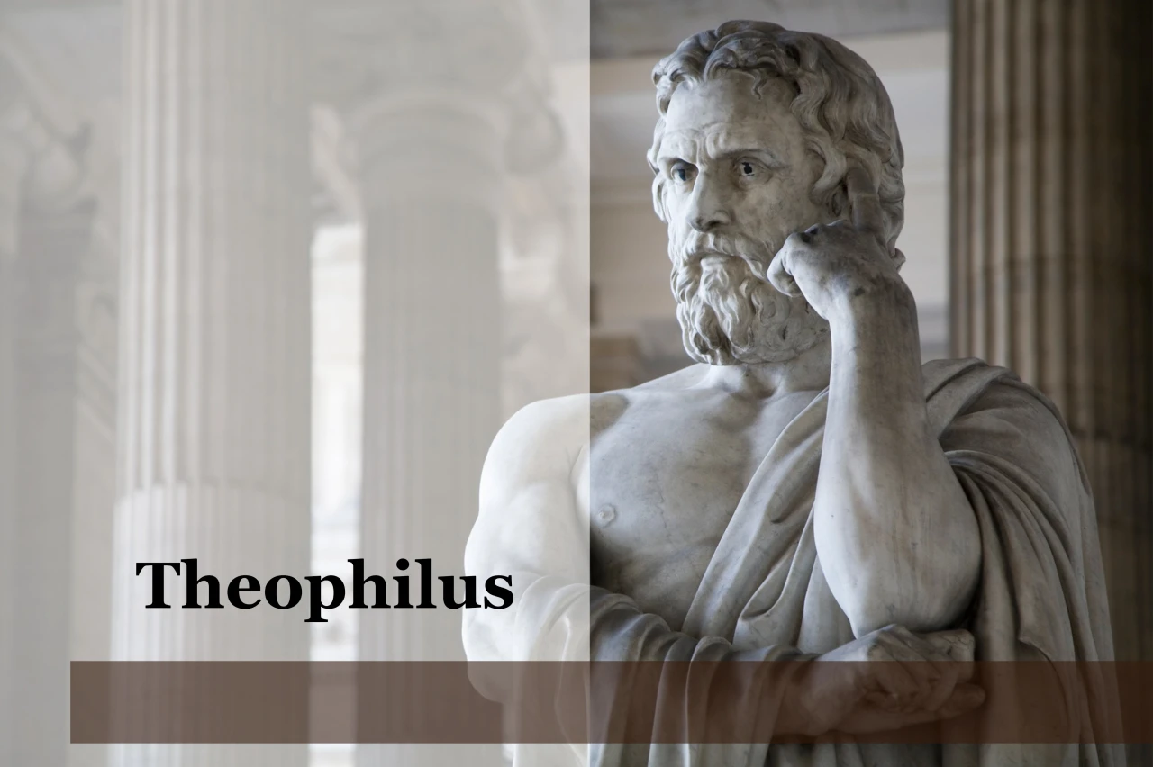
Purpose
  To present Theophilus with an orderly account of the birth and growth of the church so as to affirm him in what he has believed.

Slide 10

Message
  Birth and growth of the church numerically, geographically, ethnically.
  Components
  Numerically (progress reports)
  Geographically (From Jerusalem to Rome)
  Ethnically (From Judaism to Gentile domination)

Slide 11
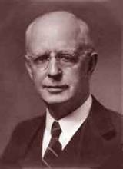
Lewis Sperry Chafer, vol. 7, Systematic Theology
(Grand Rapids, MI: Kregel Publications, 1993), 265-66.
Belief-God’s One Condition for Justification
“…because upwards of 150 passages of Scripture condition salvation upon believing only (cf. John 3:16; Acts 16:31).”

Slide 12
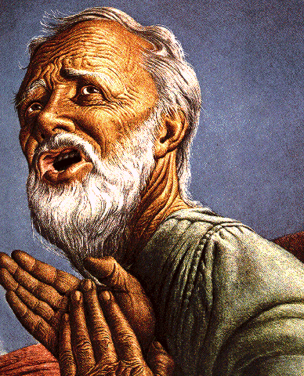
Belief – God’s One Condition for Justification
Gen 15:6
Then he believed in the LORD; and He reckoned it to him as righteousness.
John 3:16
For God so loved the world, that He gave His only begotten Son, that whoever believes in Him shall not perish, but have eternal life.
Acts 16:30-31
"Sirs, what must I do to be saved?" They said, "Believe in the Lord Jesus, and you will be saved..."

Slide 13


1 Corinthians 12:13
“For by one Spirit we were all baptized into one body, whether Jews or Greeks, whether slaves or free, and we were all made to drink of one Spirit.”

Slide 14
Acts 4:32-33
Characteristics of the Church
      Multitude (32a)
      Sharing (32b)
      Apostolic witness (33a)
      Grace (33b)

Slide 15
Activities of the Local Church
(Acts 2:41-47)
Doctrine (Acts 2:42)
Ordinances (Acts 2:41-42, 46)
Prayer (Acts 2:42)
Evangelism (Acts 2:47)
Worship (Acts 2:47)
Benevolence (Acts 2:44-45)
Fellowship (Acts 2:42, 46-47)

Slide 16
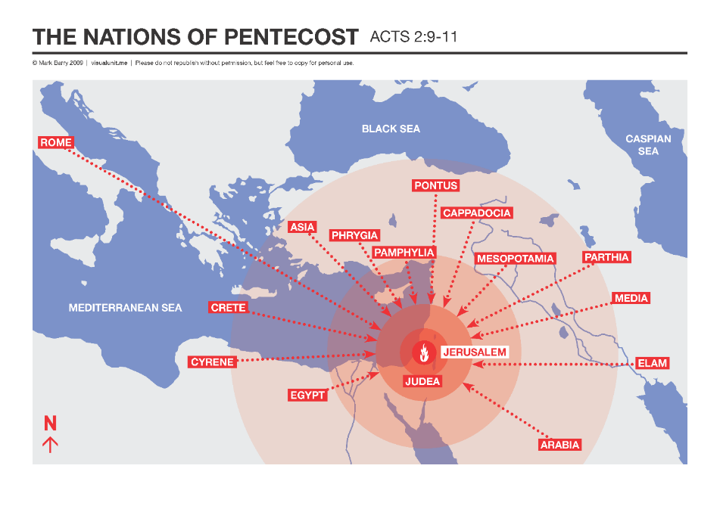

Slide 17
Acts 4:32-33
Characteristics of the Church
      Multitude (32a)
      Sharing (32b)
      Apostolic witness (33a)
      Grace (33b)

Slide 18
Acts 2:15-35
Refutation of the Charge of Drunkenness
      Too early (15)
      Use of Joel 2:28-32 (16-21)
      Christ’s miracles (22)
      Crucifixion (23)
      Resurrection (24)
      Use of Psalm 16:8-11 (25-29)
      Use of Psalm 132:11 (30-32)
      High priestly ministry (33)
      Use of Psalm 110:1 (34-35)

Slide 19
Acts 3:13-15
Israel’s Rejection of Her Messiah
      God sent His Son (13a)
      Delivered to Pilate (13b)
      Rejection of the Holy & Righteous One (14)
      Killed the Prince of Life (15a)
      Messiah was Resurrected (15b)

Slide 20
Acts 4:32-33
Characteristics of the Church
      Multitude (32a)
      Sharing (32b)
      Apostolic witness (33a)
      Grace (33b)

Slide 21
Acts 4:32-35
Community of the Saints
      Characteristics of the Church (32-33)
      Community of the Church (34-35)

Slide 22
Acts 4:34-35
Community of the Church
      Provision (34a)
      Means of provision (34b-35a)
      Communal living (35b)

Slide 23
Acts 4:34-35
Community of the Church
      Provision (34a)
      Means of provision (34b-35a)
      Communal living (35b)

Slide 24

God’s Provision
(Phil. 4:19)
Exodus 16
1 Kings 17:2-6
Psalm 37:25
Matthew 6:25-34

Slide 25
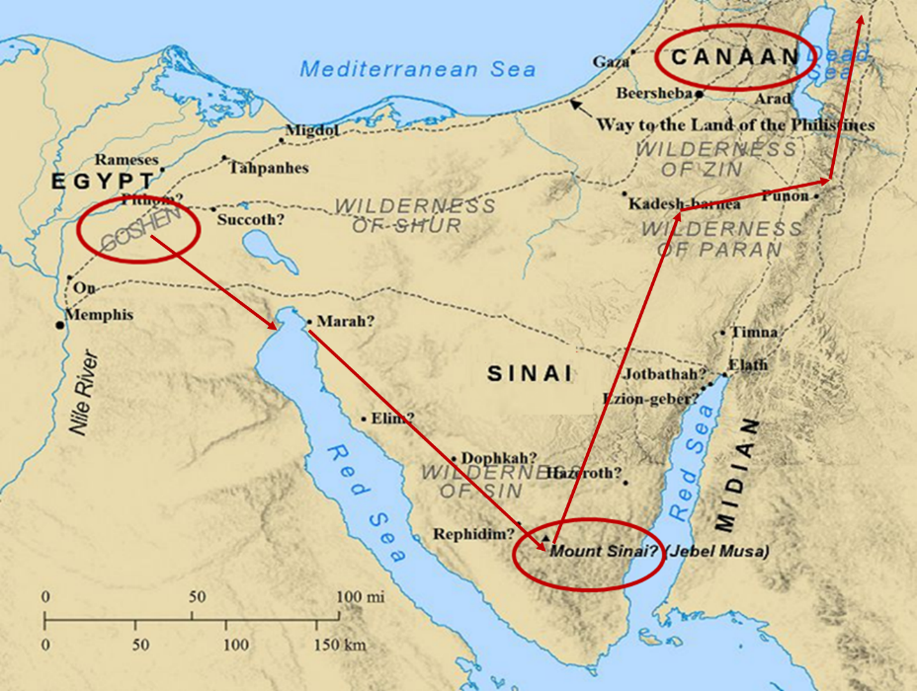

Slide 26
Acts 4:34-35
Community of the Church
      Provision (34a)
      Means of provision (34b-35a)
      Communal living (35b)

Slide 27

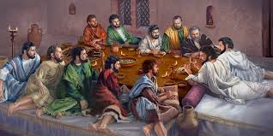
Ephesians 2:20
“having been built on the foundation of the apostles and prophets, Christ Jesus Himself being the corner stone.”

Slide 28

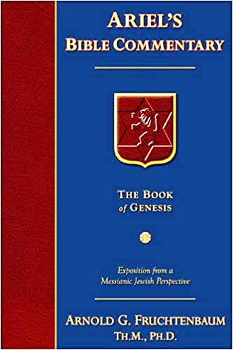
Dr. Arnold G. Fruchtenbaum
The Book of Acts, 118-19
“Wealthier believers sold their possessions, whether they were land holdings or houses, and all of this money was laid at the feet of the apostles. This was a clear recognition of apostolic authority. Nowadays, believers do not lay their financial possessions before the feet of others because there are no apostles anymore. The apostles had a unique authority, and in recognition of this, the saints brought them whatever they made from selling their possessions. The Greek tense allows for the translation to read, ‘Selling, they brought from time to time as it was occasioned by reason of need.’ In other words, the believers did not necessarily lay their entire profits at the apostles’ feet all at once. They would sometimes do it bit by bit as needs arose.”

Slide 29
Acts 4:34-35
Community of the Church
      Provision (34a)
      Means of provision (34b-35a)
      Communal living (35b)

Slide 30
Dr. Arnold G. Fruchtenbaum
The Book of Acts, 119
“Some have tried to base a doctrine of communism using this passage, but this was simply charity built on the teachings of Yeshua. It was not communism for five reasons. First, according to Acts 5:4, this giving was a voluntary act of the believers of Jerusalem. Second, as was pointed out, the Greek tense of verse 34 indicates that varying portions were sold according to the conscience of the individuals; it was not a one-time act. Third, this action was largely based upon a misconception concerning the second coming. The Jewish believers felt strongly that Yeshua would return in their lifetime, although He had clearly indicated that this would not happen.”

Slide 31
Dr. Arnold G. Fruchtenbaum
The Book of Acts, 119
“In fact, Yeshua prophesied in John 21:18-19 that Peter would die before His second coming. Fourth, this practice was limited to the congregation of Jerusalem; it did not spread to the other churches. Fifth, it proved to be a mistake, because it caused the church of Jerusalem to become poverty-stricken; after everything had been sold and distributed, there was nothing left in the common pot. The poverty of the congregation caused the Jewish believers to fall in need of help from Gentile churches that did not follow the procedure of having all things common (Acts 11:27-30; 24:17; Rom. 15:25-27; Gal. 2:10). Thus, there is no basis in this passage for developing the doctrine of communism.”

Slide 32
Dr. Arnold G. Fruchtenbaum
The Book of Acts, 119
“A very important principle of biblical interpretation is to distinguish between what is descriptive and what is prescriptive. Historical accounts are descriptive, simply reporting what has occurred, but there is no command to forward the practice. Only when a specific command is given does it become prescriptive, an imperative to follow.”

Slide 33
Pre-Ananias and Sapphira
Acts 4:32-37
  Community of the Saints (32-35)
  Barnabas’ Positive Example (36-37)

Slide 34
Acts 4:36-37
Barnabas’ Positive Example
      Barnabas’ example (36)
      Barnabas’ work (37)

Slide 35
Acts 4:36-37
Barnabas’ Positive Example
      Barnabas’ example (36)
      Barnabas’ work (37)

Slide 36
Acts 4:36
Barnabas’ Example
      Name (36a)
      Tribe (36b)
      Citizenship (36c)

Slide 37
Acts 4:36
Barnabas’ Example
      Name (36a)
      Tribe (36b)
      Citizenship (36c)

Slide 38
Enumeration of Spiritual Gifts
(Rom 12:6b-8)
      “Prophecy” (6b)
      “Service” (7a)
      “Teaching” (7b)
      “Exhortation” (8a)
      “Giving” (8b)
      “Leading” (8c)
      “Mercy” (8d)

Slide 39
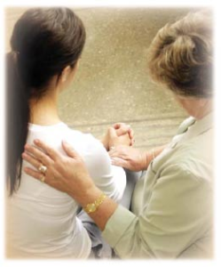
Spiritual Gifts
Exhortation: the ability to encourage others in the body of Christ

Slide 40
12/12/4/4
Romans 12
1 Corinthians 12
1 Peter 4
Ephesians 4

Slide 41
Acts 4:36
Barnabas’ Example
      Name (36a)
      Tribe (36b)
      Citizenship (36c)

Slide 42
ISRAEL'S JUDGMENTS
Division of the kingdom in 931 B.C. (1 Kgs. 12)
Assyrian judgment in 722 B.C. (2 Kgs. 17)
Babylonian captivity in 586 B.C. (2 Kgs. 25)
Rome Diaspora in A.D. 70 (Luke 19:41-44)

Slide 43
Distinctions Between 144,000 & Multitude
144,000 | MULTITUDE
Revelation 7:1-8 | Revelation 7:9-17
Numbered | Innumerable
Jews | All nations
Sealed | Slain
Sealed before the Tribulation | Converted out of the Tribulation
Hitchcock and Ice, The Truth Behind Left Behind, 77

Slide 44
Acts 4:36
Barnabas’ Example
      Name (36a)
      Tribe (36b)
      Citizenship (36c)

Slide 45
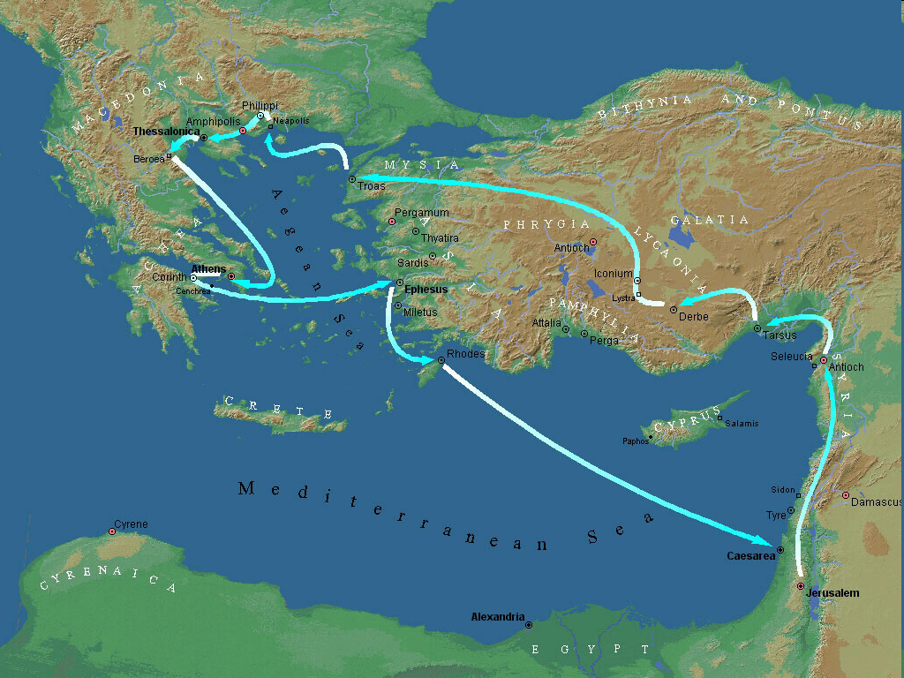

Second Missionary Journey

Slide 46
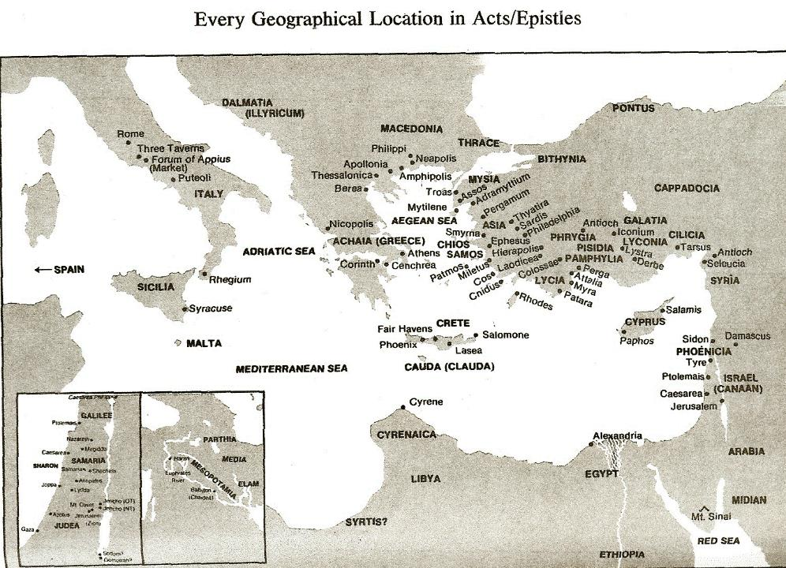

Slide 47
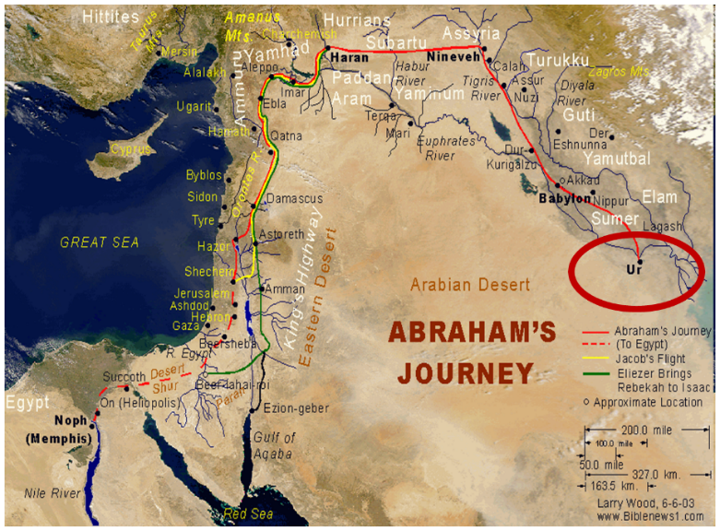

Slide 48
Dr. Arnold G. Fruchtenbaum
The Book of Acts, 120-21
“Additional facts about Barnabas can be gleaned from other passages of Scripture. His name appears 23 times in the book of Acts, and this is the first time he is mentioned. Furthermore, he is mentioned five times elsewhere in the New Testament: I Corinthians 9:6; Galatians 2:1, 9, 13; and Colossians 4:10. He was the cousin of John Mark, who was the author of the Gospel of Mark (Col. 4:10). He was the man who persuaded the church of Jerusalem to receive Paul (Acts 9:27) when Paul returned to Jerusalem from Damascus claiming to have become a believer. Later, Barnabas was sent by the church of Jerusalem to investigate Gentile salvation in Antioch (Acts 11:19-24).”

Slide 49
Dr. Arnold G. Fruchtenbaum
The Book of Acts, 120-21
“He was full of the Holy Spirit (Acts 11:24), which means he was a man who was controlled by the Holy Spirit. He brought Paul from Tarsus to Antioch to begin his ministry there (Acts 11:25-26). According to Acts 14:12, he was of commanding appearance, as he was taken by the people of Lystra to be the god Jupiter or Zeus. Finally, he also had the gift of apostleship (Acts 14:14) and was of that second category of apostles, like Paul or James, the half-brother of Yeshua. The only prerequisite for this category of apostleship was that they had seen the resurrected Messiah. Apparently, Barnabas was among the five hundred who saw Yeshua after His resurrection (I Cor. 15:6).”

Slide 50
Acts 4:36-37
Barnabas’ Positive Example
      Barnabas’ example (36)
      Barnabas’ work (37)

Slide 51
Acts 4:37
Barnabas’ Work
      Owned field (37a)
      Sold field (37b)
      Donation (37c)

Slide 52
Acts 4:37
Barnabas’ Work
      Owned field (37a)
      Sold field (37b)
      Donation (37c)

Slide 53
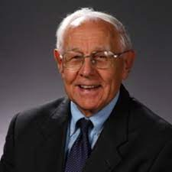
Dr. Stanley Toussaint
The Book of Acts, The Bible Knowledge Commentary, p. 364.
“Whereas the Levites were not to hold land in Israel, they could own land elsewhere. Apparently, Barnabas, being from the island of Cyprus, owned land there. It is also possible that his wife owned land in Israel and that they together sold it.”

Slide 54
Acts 4:37
Barnabas’ Work
      Owned field (37a)
      Sold field (37b)
      Donation (37c)

Slide 55
Acts 4:37
Barnabas’ Work
      Owned field (37a)
      Sold field (37b)
      Donation (37c)

Slide 56
Acts 4:1‒5:11
Summary
  Apostles Arrested (4:1-4)
  Apostles Examined (4:5-12)
  Sanhedrin’s Decision (4:13-22)
  Apostles’ Prayer (4:23-31)
  Pre-Ananias and Sapphira (4:32-37)
  Ananias and Sapphira (5:1-11)

Slide 57
Ananias and Sapphira
Acts 5:1-11
  Ananias’ Discipline (1-6)
  Sapphira’s Discipline (7-10)
  Result (11)

Slide 58
Ananias and Sapphira
Acts 5:1-11
  Ananias’ Discipline (1-6)
  Sapphira’s Discipline (7-10)
  Result (11)

Slide 59
Acts 5:1-6
Ananias’ Discipline
      Deed (1-2)
      Peter’s Accusation (3-4)
      Ananias’ Discipline (5-6)

Slide 60
Acts 5:1-6
Ananias’ Discipline
      Deed (1-2)
      Peter’s Accusation (3-4)
      Ananias’ Discipline (5-6)

Slide 61
Acts 5:1-2
Deed
      Sale (1)
      Conspiracy (2)

Slide 62
Acts 5:1-2
Deed
      Sale (1)
      Conspiracy (2)

Slide 63
Acts 5:1-2
Deed
      Sale (1)
      Conspiracy (2)

Slide 64
Acts 5:1-6
Ananias’ Discipline
      Deed (1-2)
      Peter’s Accusation (3-4)
      Ananias’ Discipline (5-6)

Slide 65
Acts 5:3-4
Peter’s Accusation
      Guilty parties (3)
      Couple’s responsibility (4)

Slide 66
Acts 5:3-4
Peter’s Accusation
      Guilty parties (3)
      Couple’s responsibility (4)

Slide 67
Acts 5:3-4
Peter’s Accusation
      Guilty parties (3)
      Couple’s responsibility (4)

Slide 68
Dr. Stanley Toussaint
The Book of Acts, The Bible Knowledge Commentary, p. 365.
“The fact that believers had the right to keep their money shows that this was not Christian socialism. It was a free-will arrangement for the support of the church, used only temporarily because evidently the early church expected Christ to come in their generation.”

Slide 69
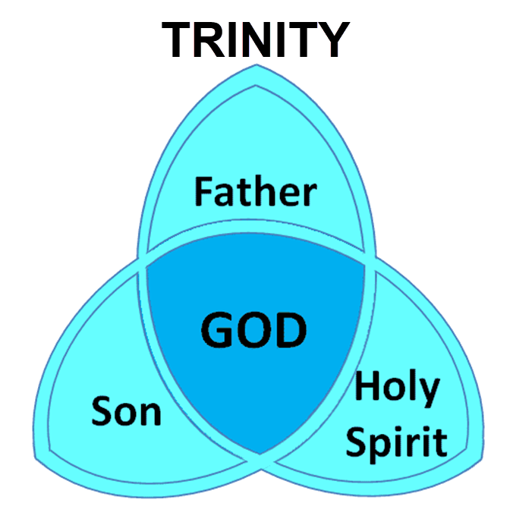

Slide 70
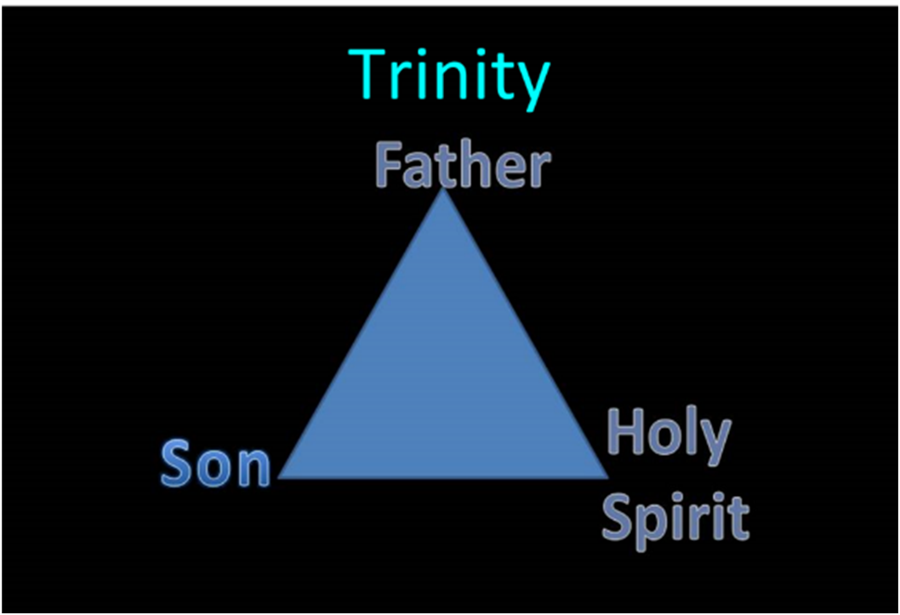

Slide 71
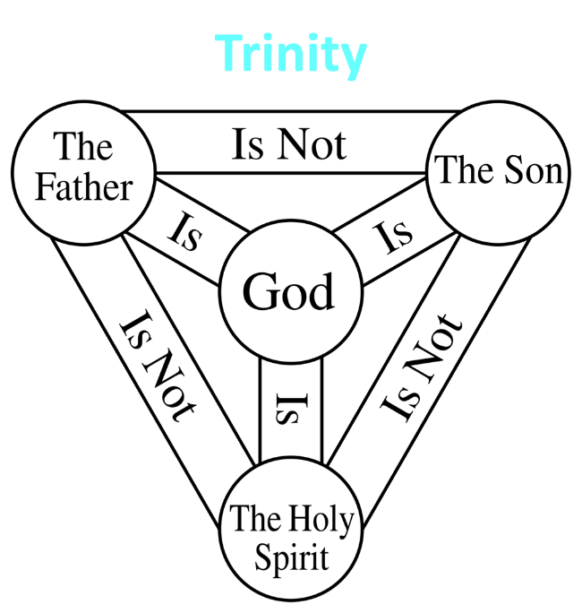

Slide 72
12/12/4/4
Romans 12
1 Corinthians 12
1 Peter 4
Ephesians 4

Slide 73
Acts 5:1-6
Ananias’ Discipline
      Deed (1-2)
      Peter’s Accusation (3-4)
      Ananias’ Discipline (5-6)

Slide 74
Acts 5:5-6
Ananias's Discipline
      Death (5)
      Burial (6)

Slide 75
Acts 5:5-6
Ananias's Discipline
      Death (5)
      Burial (6)

Slide 76
Acts 5:5-6
Ananias's Discipline
      Death (5)
      Burial (6)

Slide 77
Ananias and Sapphira
Acts 5:1-11
  Ananias’ Discipline (1-6)
  Sapphira’s Discipline (7-10)
  Result (11)

Slide 78
Acts 5:7-10
Sapphira's’ Discipline
      Sin (7-8)
      Peter’s confrontation & judgment (9)
      Death and burial (10)

Slide 79
Acts 5:7-10
Sapphira's’ Discipline
      Sin (7-8)
      Peter’s confrontation & judgment (9)
      Death and burial (10)

Slide 80
Acts 5:7-10
Sapphira's’ Discipline
      Sin (7-8)
      Peter’s confrontation & judgment (9)
      Death and burial (10)

Slide 81
Acts 5:7-10
Sapphira's’ Discipline
      Sin (7-8)
      Peter’s confrontation & judgment (9)
      Death and burial (10)

Slide 82
Ananias and Sapphira
Acts 5:1-11
  Ananias’ Discipline (1-6)
  Sapphira’s Discipline (7-10)
  Result (11)

Slide 83
Acts 5:11
Result
      Fear within the congregation (11a)
      Fear outside the congregation (11b)

Slide 84
Acts 5:11
Result
      Fear within the congregation (11a)
      Fear outside the congregation (11b)

Slide 85

Acts 2:47
“praising God and having favor with all the people. And the Lord was adding to their number day by day those who were being saved.” (NASB)
“praising God and having favor with all the people. And the Lord added to the church daily those who were being saved.” (NKJV)

Slide 86
Author | Written | Earliest MSS | Time Span | No. MSS
Cesar | 100 to 44 b.c. | a.d. 900 | 1000 | 10
Plato | 427 to 347 b.c. | a.d. 900 | 1200 | 7
Thucydides | 460 to 400 b.c. | a.d. 900 | 1300 | 8
Tacitus | a.d. 100 | a.d. 1100 | 1000 | 20
Suetonius | a.d. 75 to 160 | a.d. 950 | 800 | 8
Homer (Illiad) | 900 b.c. | a.d. 400 | 500 | 643
New Testament | a.d. 40 to 100 | a.d. 125 | 25 to 50 | 24,000
Cesar | 100 to 44 b.c. | a.d. 900 | 1000 | 10
http://creationrevolution.com/2012/05/should-we-trust-the-bible/

Slide 87
Manuscript Evidence for Ancient Writings
Author | Written | Earliest Fragment/Copy | Time Span in Years | Number of Manuscripts
Cesar | 100 to 44 b.c. | a.d. 900 | 1000 | 10
Plato | 427 to 347 b.c. | a.d. 900 | 1200 | 7
Thucydides | 460 to 400 b.c. | a.d. 900 | 1300 | 8
Tacitus | a.d. 100 | a.d. 1100 | 1000 | 20
Suetonius | a.d. 75 to 160 | a.d. 950 | 800 | 8
Homer (Illiad) | 900 b.c. | a.d. 400 | 500 | 643
New Testament | a.d. 40 to 100 | a.d. 125 | 25 to 50 | 24,000
Information in this chart can be found in various sources. This chart was adapted from: Christian Apologetics, by Norman Geisler, 1976, p. 307; and Evidence That Demands a Verdict, by Josh McDowell, 1979, pp. 42, 43.

Slide 88

Dr. Arnold Fruchtenbaum
Arnold G. Fruchtenbaum, “Israel and the Church,” in Issues in Dispensationalism, ed. Wesley R. Willis and John R. Master (Chicago: Moody, 1994), 118.
“In the book of Acts, both Israel and the church exist simultaneously. The term Israel is used twenty times and ekklēsia (church) nineteen times, yet the two groups are always kept distinct.”

Slide 89
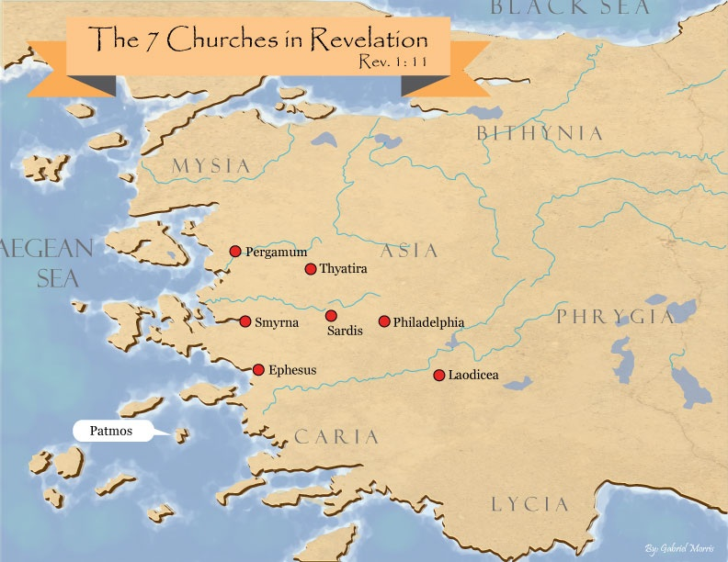
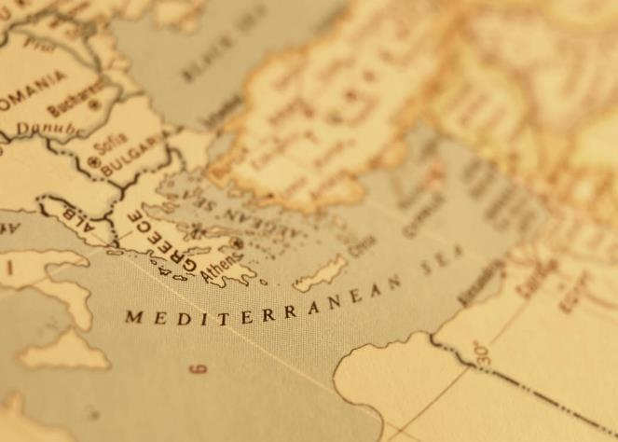

Slide 90
Acts 5:11
Result
      Fear within the congregation (11a)
      Fear outside the congregation (11b)

Slide 91
Conclusion

Slide 92
Acts 4:1‒5:11
Summary
  Apostles Arrested (4:1-4)
  Apostles Examined (4:5-12)
  Sanhedrin’s Decision (4:13-22)
  Apostles’ Prayer (4:23-31)
  Pre-Ananias and Sapphira (4:32-37)
  Ananias and Sapphira (5:1-11)

