Slide 1
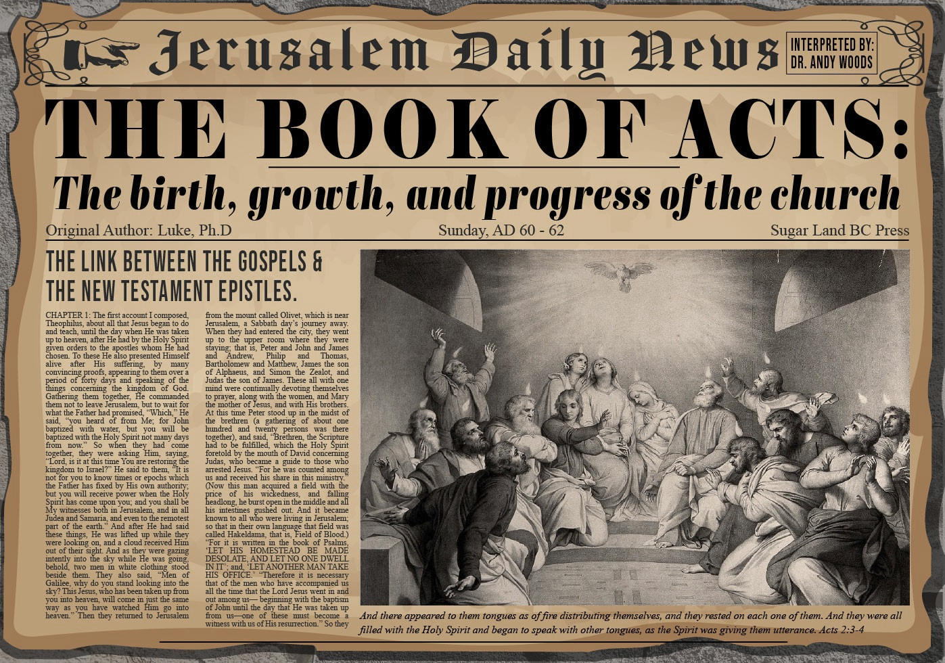


Slide 2
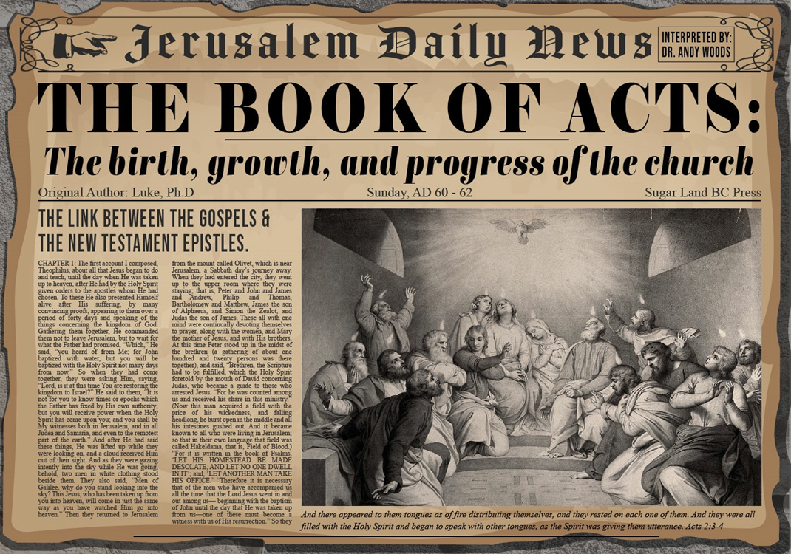
Acts 4:1‒5:11
Summary
  Apostles Arrested (4:1-4)
  Apostles Examined (4:5-12)
  Sanhedrin’s Decision (4:13-22)
  Apostles’ Prayer (4:23-31)
  Pre-Ananias and Sapphira (4:32-37)
  Ananias and Sapphira (5:1-11)

Slide 3
Apostles’ Prayer
Acts 4:23-31
  Report to the Apostles (23)
  Motivation for the Prayer (24)
  Prayer (25-30)
  Answer to the Prayer (31)

Slide 4
Apostles’ Prayer
Acts 4:23-31
  Report to the Apostles (23)
  Motivation for the Prayer (24)
  Prayer (25-30)
  Answer to the Prayer (31)

Slide 5
Apostles’ Prayer
Acts 4:23-31
  Report to the Apostles (23)
  Motivation for the Prayer (24)
  Prayer (25-30)
  Answer to the Prayer (31)

Slide 6
Activities of the Local Church
(Acts 2:41-47)
Doctrine (Acts 2:42)
Ordinances (Acts 2:41-42, 46)
Prayer (Acts 2:42)
Evangelism (Acts 2:47)
Worship (Acts 2:47)
Benevolence (Acts 2:44-45)
Fellowship (Acts 2:42, 46-47)

Slide 7

Exodus 20:8-11
Solar Non-Consecutive Days?
⁸ “Remember the sabbath day, to keep it holy. ⁹ Six days you shall labor and do all your work, ¹⁰ but the seventh day is a sabbath of the Lord your God; in it you shall not do any work, you or your son or your daughter, your male or your female servant or your cattle or your sojourner who stays with you. ¹¹ For in six days the Lord made the heavens and the earth, the sea and all that is in them, and rested on the seventh day; therefore the Lord blessed the sabbath day and made it holy.”

Slide 8

Exodus 31:15-17
Solar Non-Consecutive Days?
¹⁵ ‘For six days work may be done, but on the seventh day there is a sabbath of complete rest, holy to the Lord; whoever does any work on the sabbath day shall surely be put to death. ¹⁶ ‘So the sons of Israel shall observe the sabbath, to celebrate the sabbath throughout their generations as a perpetual covenant.’ ¹⁷ “It is a sign between Me and the sons of Israel forever; for in six days the Lord made heaven and earth, but on the seventh day He ceased from labor, and was refreshed.”

Slide 9

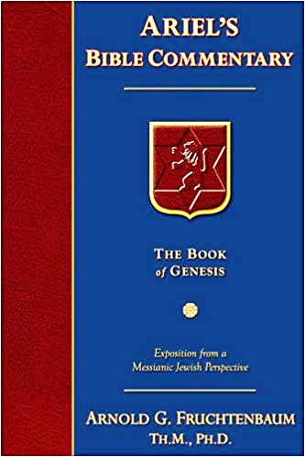
Dr. Arnold G. Fruchtenbaum
The Book of Acts, 113
“The apostles addressed God as ‘Lord,’ or in Greek as despotés. This term is used a total of ten times in the New Testament: four times of a human lord (I Tim. 6:1, 2; Titus 2:9; I Pet. 2:18), three times of God (Lk. 2:29; Acts 4:24; Rev. 6:10), and three times of the Messiah (II Tim. 2:21; II Peter 2:1; Jude 4). In this verse, the apostles used the word in the sense of a master-slave relationship. Thus, they recognized God’s authority. He is the One who made the heavens and the earth and the sea and all life that is in them. This was a recognition of God’s power displayed in the act of creation.”

Slide 10
Apostles’ Prayer
Acts 4:23-31
  Report to the Apostles (23)
  Motivation for the Prayer (24)
  Prayer (25-30)
  Answer to the Prayer (31)

Slide 11
Acts 4:25-30
Prayer
      Citation of Ps. 2:1-2 (25-26)
      Application (27-28)
      Three requests (29-30)

Slide 12
Acts 4:25-30
Prayer
      Citation of Ps. 2:1-2 (25-26)
      Application (27-28)
      Three requests (29-30)

Slide 13

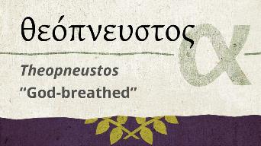
2 Timothy 3:16-17
“All Scripture is inspired by God [theópneustos] and profitable for teaching, for reproof, for correction, for training in righteousness; so that the man of God may be adequate, equipped for every good work.”
Notes:
hapaxlegomena

Slide 14
2 Peter 1:19-21
“¹⁹ So we have the prophetic word made more sure, to which you do well to pay attention as to a lamp shining in a dark place, until the day dawns and the morning star arises in your hearts. ²⁰ But know this first of all, that no prophecy of Scripture is a matter of one’s own interpretation, ²¹ for no prophecy was ever made by an act of human will, but men moved [pherō] by the Holy Spirit spoke from God.”

Slide 15
INSPIRATION OF SCRIPTURE
2 Peter 1:20-21
  Men Wrote as they were inspired by Holy Spirit
    “pherō” = to carry
    Acts 27:15,17
  Opposite of Knowledge of False Teachers
    Which is their own imagination
    Jer. 23:16

Slide 16

Zechariah 12:3
“It will come about in that day that I will make Jerusalem a heavy stone for all the peoples; all who lift it will be severely injured. And all the nations of the earth will be gathered against it.

Slide 17
Zechariah 14:2-3
² For I will gather all the nations against Jerusalem to battle, and the city will be captured, the houses plundered, the women ravished and half of the city exiled, but the rest of the people will not be cut off from the city. ³ Then the Lord will go forth and fight against those nations, as when He fights on a day of battle.

Slide 18
Dr. Arnold G. Fruchtenbaum
The Book of Acts, 113-14
“The literal meaning of the verses in Psalm 2 refers to the Gentiles and the Gentile nations that will come against God and against the Messiah during the Campaign of Armageddon. But the application made here is to the Jewish leaders who have now spoken against God and His Anointed One. The psalmist declared that the Gentiles who in the future will rise up against God will include kings, but these Jewish leaders were not kings. Still, they gathered together against God and against His Anointed. That is the one point of similarity. Just as the Gentiles in Armageddon will come against the Lord and His Messiah, even so, these Jewish leaders have now come against the Lord and His Messiah.”

Slide 19
Acts 4:25-30
Prayer
      Citation of Ps. 2:1-2 (25-26)
      Application (27-28)
      Three requests (29-30)

Slide 20
Acts 4:27-28
Prayer
      Human responsibility (27)
      Divine responsibility (28)

Slide 21
Acts 4:27-28
Prayer
      Human responsibility (27)
      Divine responsibility (28)

Slide 22

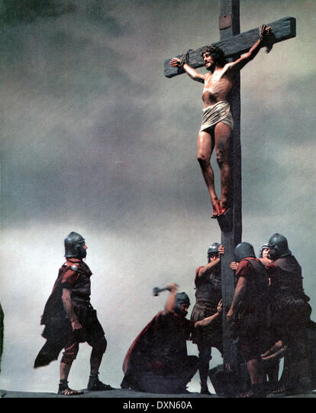
Acts 2:23
“this Man, delivered over by the predetermined plan and foreknowledge of God, you nailed to a cross by the hands of godless men and put Him to death.”

Slide 23
Acts 2:23
“this Man, delivered over by the predetermined plan and foreknowledge of God, you nailed to a cross by the hands of godless men and put Him to death.”

Slide 24
Acts 4:27-28
Prayer
      Human responsibility (27)
      Divine responsibility (28)

Slide 25
Acts 2:23
“this Man, delivered over by the predetermined plan and foreknowledge of God, you nailed to a cross by the hands of godless men and put Him to death.”

Slide 26
Acts 4:25-30
Prayer
      Citation of Ps. 2:1-2 (25-26)
      Application (27-28)
      Three requests (29-30)

Slide 27
Acts 4:29-30
Three Requests
      Consider their threats (29a)
      Boldness (29b)
      Confirmation via signs & wonders (30)

Slide 28
Acts 4:29-30
Three Requests
      Consider their threats (29a)
      Boldness (29b)
      Confirmation via signs & wonders (30)

Slide 29
Acts 4:29-30
Three Requests
      Consider their threats (29a)
      Boldness (29b)
      Confirmation via signs & wonders (30)

Slide 30
Acts 4:29-30
Three Requests
      Consider their threats (29a)
      Boldness (29b)
      Confirmation via signs & wonders (30)

Slide 31

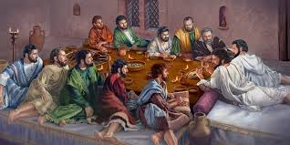
Ephesians 2:20
“having been built on the foundation of the apostles and prophets, Christ Jesus Himself being the corner stone.”

Slide 32
Dr. Arnold G. Fruchtenbaum
The Book of Acts, 114-15
“What they were asking in the third prayer request is the continuous ability to perform these miracles of healing for the purpose of authenticating their message to their audience. Again, throughout the book of Acts, the only ones who performed miracles were the apostles and their delegates, meaning those on whom the apostles laid hands. Believers in general were not performing signs and wonders, as people sometimes teach.”

Slide 33

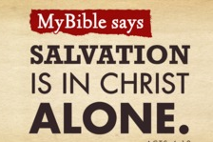
Acts 4:12
“And there is salvation in no one else; for there is no other name under heaven that has been given among men by which we must [dei] be saved.”

Slide 34
Apostles’ Prayer
Acts 4:23-31
  Report to the Apostles (23)
  Motivation for the Prayer (24)
  Prayer (25-30)
  Answer to the Prayer (31)

Slide 35
Acts 4:31
Prayer Answered
      Place shaken (31a)
      Holy Spirit’s filling (31b)
      Bold speaking (31c)

Slide 36
Acts 4:31
Prayer Answered
      Place shaken (31a)
      Holy Spirit’s filling (31b)
      Bold speaking (31c)

Slide 37
Acts 4:31
Prayer Answered
      Place shaken (31a)
      Holy Spirit’s filling (31b)
      Bold speaking (31c)

Slide 38


1 Corinthians 12:13
“For by one Spirit we were all baptized into one body, whether Jews or Greeks, whether slaves or free, and we were all made to drink of one Spirit.”

Slide 39
Acts 4:31
Prayer Answered
      Place shaken (31a)
      Holy Spirit’s filling (31b)
      Bold speaking (31c)

Slide 40

Isaiah 55:10-11
¹⁰ “For as the rain and the snow come down from heaven, And do not return there without watering the earth And making it bear and sprout, And furnishing seed to the sower and bread to the eater; ¹¹ So will My word be which goes forth from My mouth; It will not return to Me empty, Without accomplishing what I desire, And without succeeding in the matter for which I sent it.”

Slide 41
Acts 4:1‒5:11
Summary
  Apostles Arrested (4:1-4)
  Apostles Examined (4:5-12)
  Sanhedrin’s Decision (4:13-22)
  Apostles’ Prayer (4:23-31)
  Pre-Ananias and Sapphira (4:32-37)
  Ananias and Sapphira (5:1-11)

Slide 42
Pre-Ananias and Sapphira
Acts 4:32-37
  Community of the Saints (32-35)
  Barnabas’ Positive Example (36-37)

Slide 43
Pre-Ananias and Sapphira
Acts 4:32-37
  Community of the Saints (32-35)
  Barnabas’ Positive Example (36-37)

Slide 44
Acts 4:32-35
Community of the Saints
      Characteristics of the Church (32-33)
      Community of the Church (34-35)

Slide 45
Acts 4:32-35
Community of the Saints
      Characteristics of the Church (32-33)
      Community of the Church (34-35)

Slide 46
Acts 4:32-33
Characteristics of the Church
      Multitude (32a)
      Sharing (32b)
      Apostolic witness (33a)
      Grace (33b)

Slide 47
Acts 4:32-33
Characteristics of the Church
      Multitude (32a)
      Sharing (32b)
      Apostolic witness (33a)
      Grace (33b)

Slide 48
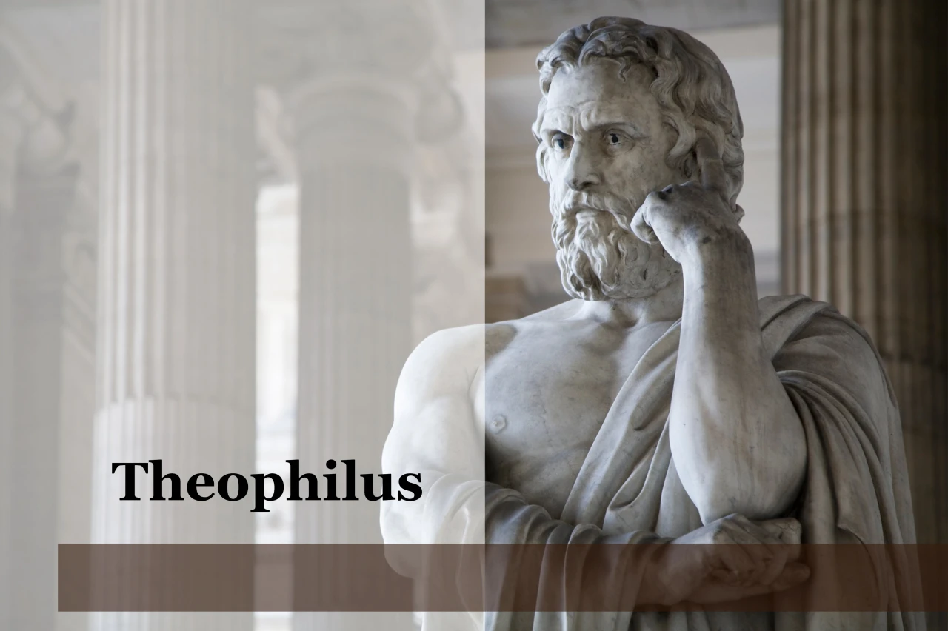
Purpose
  To present Theophilus with an orderly account of the birth and growth of the church so as to affirm him in what he has believed.

Slide 49

Message
  Birth and growth of the church numerically, geographically, ethnically.
  Components
  Numerically (progress reports)
  Geographically (From Jerusalem to Rome)
  Ethnically (From Judaism to Gentile domination)

Slide 50
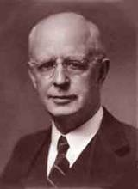
Lewis Sperry Chafer, vol. 7, Systematic Theology
(Grand Rapids, MI: Kregel Publications, 1993), 265-66.
Belief-God’s One Condition for Justification
“…because upwards of 150 passages of Scripture condition salvation upon believing only (cf. John 3:16; Acts 16:31).”

Slide 51
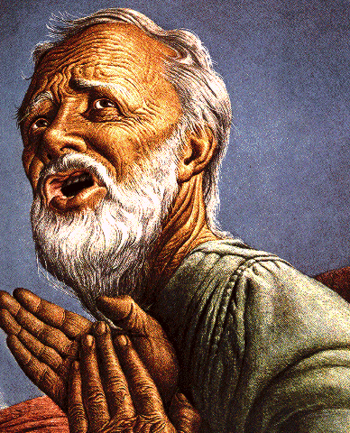
Belief – God’s One Condition for Justification
Gen 15:6
Then he believed in the LORD; and He reckoned it to him as righteousness.
John 3:16
For God so loved the world, that He gave His only begotten Son, that whoever believes in Him shall not perish, but have eternal life.
Acts 16:30-31
"Sirs, what must I do to be saved?" They said, "Believe in the Lord Jesus, and you will be saved..."

Slide 52
Acts 4:32-33
Characteristics of the Church
      Multitude (32a)
      Sharing (32b)
      Apostolic witness (33a)
      Grace (33b)

Slide 53
Activities of the Local Church
(Acts 2:41-47)
Doctrine (Acts 2:42)
Ordinances (Acts 2:41-42, 46)
Prayer (Acts 2:42)
Evangelism (Acts 2:47)
Worship (Acts 2:47)
Benevolence (Acts 2:44-45)
Fellowship (Acts 2:42, 46-47)

Slide 54
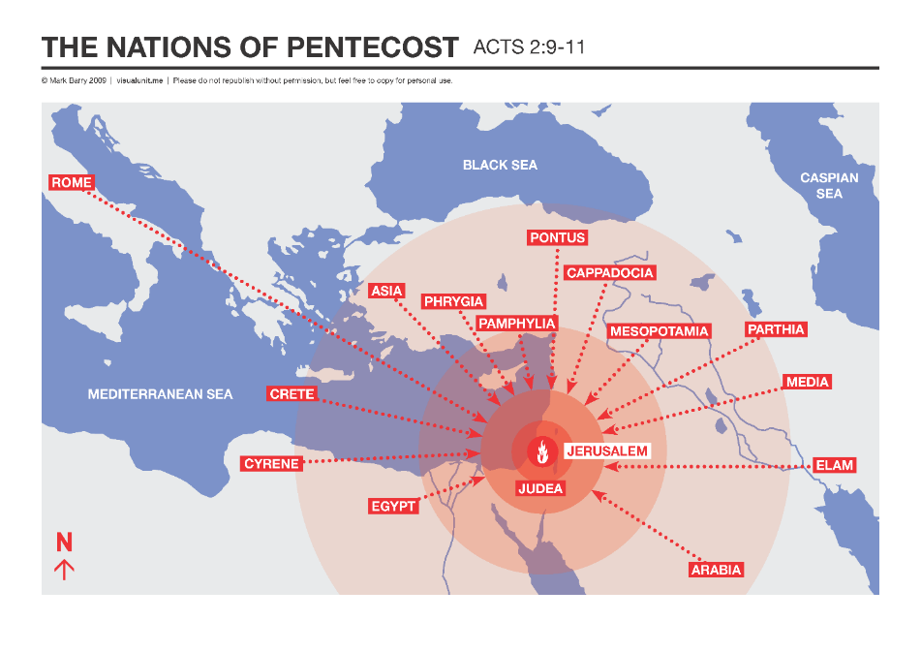

Slide 55
Acts 4:32-33
Characteristics of the Church
      Multitude (32a)
      Sharing (32b)
      Apostolic witness (33a)
      Grace (33b)

Slide 56
Acts 2:15-35
Refutation of the Charge of Drunkenness
      Too early (15)
      Use of Joel 2:28-32 (16-21)
      Christ’s miracles (22)
      Crucifixion (23)
      Resurrection (24)
      Use of Psalm 16:8-11 (25-29)
      Use of Psalm 132:11 (30-32)
      High priestly ministry (33)
      Use of Psalm 110:1 (34-35)

Slide 57
Acts 3:13-15
Israel’s Rejection of Her Messiah
      God sent His Son (13a)
      Delivered to Pilate (13b)
      Rejection of the Holy & Righteous One (14)
      Killed the Prince of Life (15a)
      Messiah was Resurrected (15b)

Slide 58
Acts 4:32-33
Characteristics of the Church
      Multitude (32a)
      Sharing (32b)
      Apostolic witness (33a)
      Grace (33b)

Slide 59
Acts 4:32-35
Community of the Saints
      Characteristics of the Church (32-33)
      Community of the Church (34-35)

Slide 60
Acts 4:34-35
Community of the Church
      Provision (34a)
      Means of provision (34b-35a)
      Communal living (35b)

Slide 61
Acts 4:34-35
Community of the Church
      Provision (34a)
      Means of provision (34b-35a)
      Communal living (35b)

Slide 62

God’s Provision for the Giver
(Phil. 4:19)
Exodus 16
1 Kings 17:2-6
Psalm 37:25
Matthew 6:25-34

Slide 63
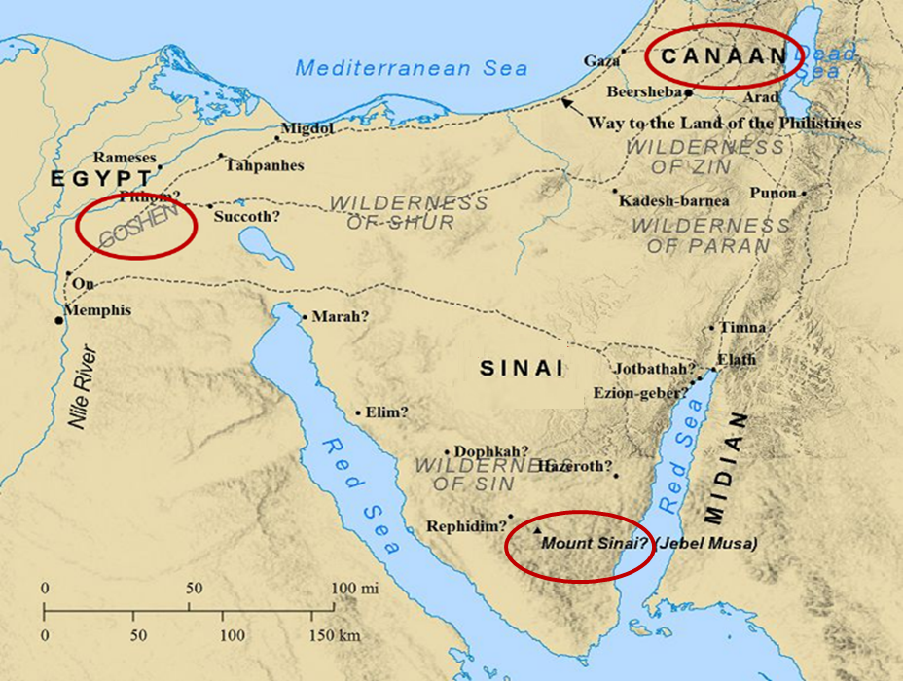

Slide 64
Acts 4:34-35
Community of the Church
      Provision (34a)
      Means of provision (34b-35a)
      Communal living (35b)

Slide 65
Ephesians 2:20
“having been built on the foundation of the apostles and prophets, Christ Jesus Himself being the corner stone.”

Slide 66
Dr. Arnold G. Fruchtenbaum
The Book of Acts, 118-19
“Wealthier believers sold their possessions, whether they were land holdings or houses, and all of this money was laid at the feet of the apostles. This was a clear recognition of apostolic authority. Nowadays, believers do not lay their financial possessions before the feet of others because there are no apostles anymore. The apostles had a unique authority, and in recognition of this, the saints brought them whatever they made from selling their possessions. The Greek tense allows for the translation to read, ‘Selling, they brought from time to time as it was occasioned by reason of need.’ In other words, the believers did not necessarily lay their entire profits at the apostles’ feet all at once. They would sometimes do it bit by bit as needs arose.”

Slide 67
Acts 4:34-35
Community of the Church
      Provision (34a)
      Means of provision (34b-35a)
      Communal living (35b)

Slide 68
Dr. Arnold G. Fruchtenbaum
The Book of Acts, 119
“Some have tried to base a doctrine of communism using this passage, but this was simply charity built on the teachings of Yeshua. It was not communism for five reasons. First, according to Acts 5:4, this giving was a voluntary act of the believers of Jerusalem. Second, as was pointed out, the Greek tense of verse 34 indicates that varying portions were sold according to the conscience of the individuals; it was not a one-time act. Third, this action was largely based upon a misconception concerning the second coming. The Jewish believers felt strongly that Yeshua would return in their lifetime, although He had clearly indicated that this would not happen.”

Slide 69
Dr. Arnold G. Fruchtenbaum
The Book of Acts, 119
“In fact, Yeshua prophesied in John 21:18-19 that Peter would die before His second coming. Fourth, this practice was limited to the congregation of Jerusalem; it did not spread to the other churches. Fifth, it proved to be a mistake, because it caused the church of Jerusalem to become poverty-stricken; after everything had been sold and distributed, there was nothing left in the common pot. The poverty of the congregation caused the Jewish believers to fall in need of help from Gentile churches that did not follow the procedure of having all things common (Acts 11:27-30; 24:17; Rom. 15:25-27; Gal. 2:10). Thus, there is no basis in this passage for developing the doctrine of communism.”

Slide 70
Dr. Arnold G. Fruchtenbaum
The Book of Acts, 119
“A very important principle of biblical interpretation is to distinguish between what is descriptive and what is prescriptive. Historical accounts are descriptive, simply reporting what has occurred, but there is no command to forward the practice. Only when a specific command is given does it become prescriptive, an imperative to follow.”

Slide 71
Pre-Ananias and Sapphira
Acts 4:32-37
  Community of the Saints (32-35)
  Barnabas’ Positive Example (36-37)

Slide 72
Acts 4:36-37
Barnabas’ Positive Example
      Barnabas’ example (36)
      Barnabas’ work (37)

Slide 73
Acts 4:36-37
Barnabas’ Positive Example
      Barnabas’ example (36)
      Barnabas’ work (37)

Slide 74
Acts 4:36
Barnabas’ Example
      Name (36a)
      Tribe (36b)
      Citizenship (36c)

Slide 75
Acts 4:36
Barnabas’ Example
      Name (36a)
      Tribe (36b)
      Citizenship (36c)

Slide 76
Enumeration of Spiritual Gifts
(Rom 12:6b-8)
      “Prophecy” (6b)
      “Service” (7a)
      “Teaching” (7b)
      “Exhortation” (8a)
      “Giving” (8b)
      “Leading” (8c)
      “Mercy” (8d)

Slide 77
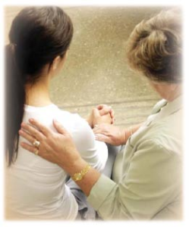
Spiritual Gifts
Exhortation: the ability to encourage others in the body of Christ

Slide 78
12/12/4/4
Romans 12
1 Corinthians 12
1 Peter 4
Ephesians 4

Slide 79
Acts 4:36
Barnabas’ Example
      Name (36a)
      Tribe (36b)
      Citizenship (36c)

Slide 80
ISRAEL'S JUDGMENTS
Division of the kingdom in 931 B.C. (1 Kgs. 12)
Assyrian judgment in 722 B.C. (2 Kgs. 17)
Babylonian captivity in 586 B.C. (2 Kgs. 25)
Rome Diaspora in A.D. 70 (Luke 19:41-44)

Slide 81
Distinctions Between 144,000 & Multitude
144,000 | MULTITUDE
Revelation 7:1-8 | Revelation 7:9-17
Numbered | Innumerable
Jews | All nations
Sealed | Slain
Sealed before the Tribulation | Converted out of the Tribulation
Hitchcock and Ice, The Truth Behind Left Behind, 77

Slide 82
Acts 4:36
Barnabas’ Example
      Name (36a)
      Tribe (36b)
      Citizenship (36c)

Slide 83
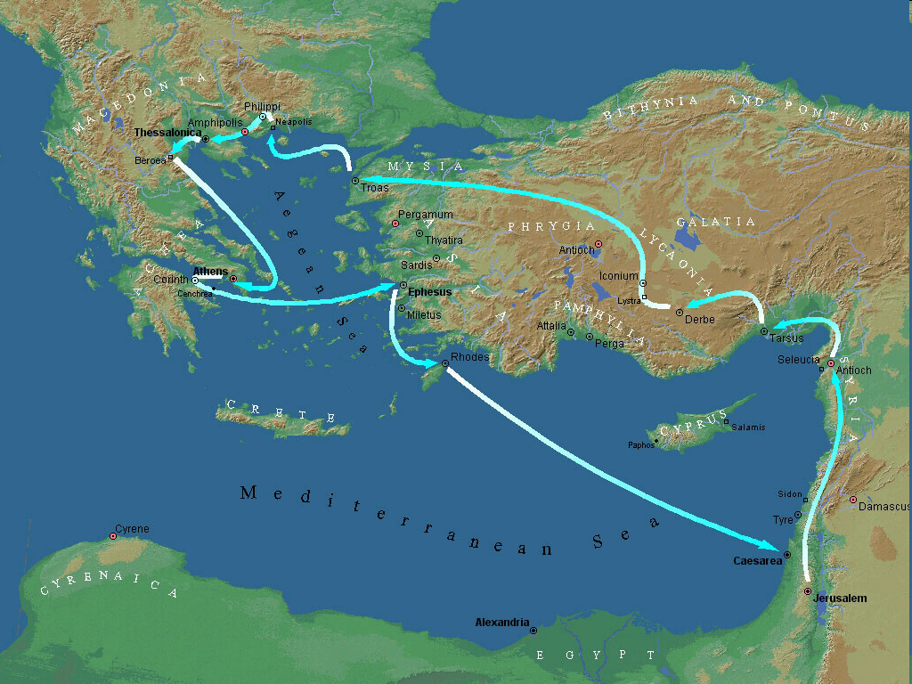

Second Missionary Journey

Slide 84
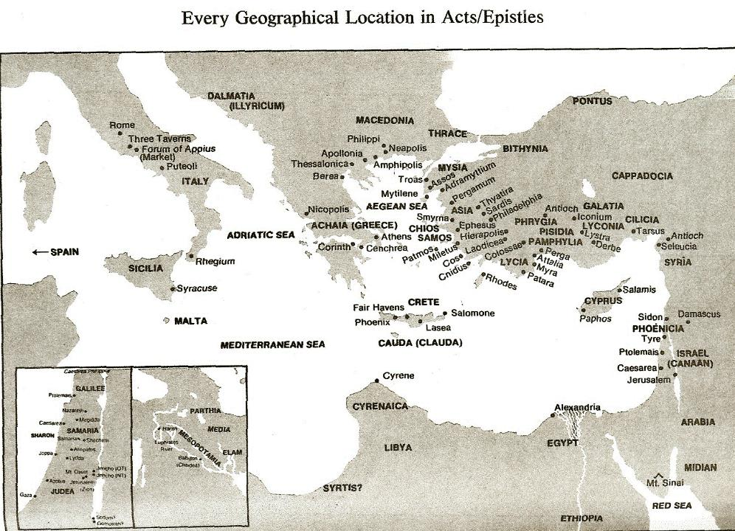

Slide 85
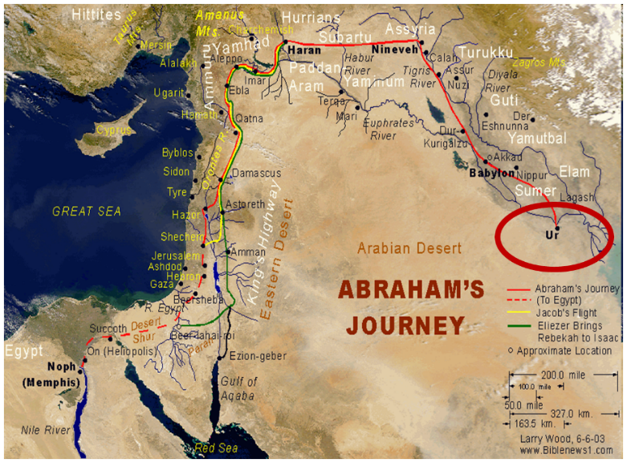

Slide 86
Dr. Arnold G. Fruchtenbaum
The Book of Acts, 120-21
“Additional facts about Barnabas can be gleaned from other passages of Scripture. His name appears 23 times in the book of Acts, and this is the first time he is mentioned. Furthermore, he is mentioned five times elsewhere in the New Testament: I Corinthians 9:6; Galatians 2:1, 9, 13; and Colossians 4:10. He was the cousin of John Mark, who was the author of the Gospel of Mark (Col. 4:10). He was the man who persuaded the church of Jerusalem to receive Paul (Acts 9:27) when Paul returned to Jerusalem from Damascus claiming to have become a believer. Later, Barnabas was sent by the church of Jerusalem to investigate Gentile salvation in Antioch (Acts 11:19-24).”

Slide 87
Dr. Arnold G. Fruchtenbaum
The Book of Acts, 120-21
“He was full of the Holy Spirit (Acts 11:24), which means he was a man who was controlled by the Holy Spirit. He brought Paul from Tarsus to Antioch to begin his ministry there (Acts 11:25-26). According to Acts 14:12, he was of commanding appearance, as he was taken by the people of Lystra to be the god Jupiter or Zeus. Finally, he also had the gift of apostleship (Acts 14:14) and was of that second category of apostles, like Paul or James, the half-brother of Yeshua. The only prerequisite for this category of apostleship was that they had seen the resurrected Messiah. Apparently, Barnabas was among the five hundred who saw Yeshua after His resurrection (I Cor. 15:6).”

Slide 88
Acts 4:36-37
Barnabas’ Positive Example
      Barnabas’ example (36)
      Barnabas’ work (37)

Slide 89
Acts 4:37
Barnabas’ Work
      Owned field (37a)
      Sold field (37b)
      Donation (37c)

Slide 90
Acts 4:37
Barnabas’ Work
      Owned field (37a)
      Sold field (37b)
      Donation (37c)

Slide 91
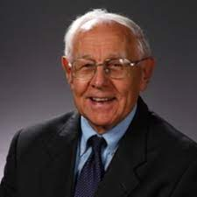
Dr. Stanley Toussaint
The Book of Acts, The Bible Knowledge Commentary, p. 364.
“Whereas the Levites were not to hold land in Israel, they could own land elsewhere. Apparently, Barnabas, being from the island of Cyprus, owned land there. It is also possible that his wife owned land in Israel and that they together sold it.”

Slide 92
Acts 4:37
Barnabas’ Work
      Owned field (37a)
      Sold field (37b)
      Donation (37c)

Slide 93
Acts 4:37
Barnabas’ Work
      Owned field (37a)
      Sold field (37b)
      Donation (37c)

Slide 94
Acts 4:1‒5:11
Summary
  Apostles Arrested (4:1-4)
  Apostles Examined (4:5-12)
  Sanhedrin’s Decision (4:13-22)
  Apostles’ Prayer (4:23-31)
  Pre-Ananias and Sapphira (4:32-37)
  Ananias and Sapphira (5:1-11)

Slide 95
Ananias and Sapphira
Acts 5:1-11
  Ananias’ Discipline (1-6)
  Sapphira’s Discipline (7-10)
  Result (11)

Slide 96
Ananias and Sapphira
Acts 5:1-11
  Ananias’ Discipline (1-6)
  Sapphira’s Discipline (7-10)
  Result (11)

Slide 97
Acts 5:1-6
Ananias’ Discipline
      Deed (1-2)
      Peter’s Accusation (3-4)
      Ananias’ Discipline (5-6)

Slide 98
Acts 5:1-6
Ananias’ Discipline
      Deed (1-2)
      Peter’s Accusation (3-4)
      Ananias’ Discipline (5-6)

Slide 99
Acts 5:1-2
Deed
      Sale (1)
      Conspiracy (2)

Slide 100
Acts 5:1-2
Deed
      Sale (1)
      Conspiracy (2)

Slide 101
Acts 5:1-2
Deed
      Sale (1)
      Conspiracy (2)

Slide 102
Acts 5:1-6
Ananias’ Discipline
      Deed (1-2)
      Peter’s Accusation (3-4)
      Ananias’ Discipline (5-6)

Slide 103
Acts 5:3-4
Peter’s Accusation
      Guilty parties (3)
      Couple’s responsibility (4)

Slide 104
Acts 5:3-4
Peter’s Accusation
      Guilty parties (3)
      Couple’s responsibility (4)

Slide 105
Acts 5:3-4
Peter’s Accusation
      Guilty parties (3)
      Couple’s responsibility (4)

Slide 106
Dr. Stanley Toussaint
The Book of Acts, The Bible Knowledge Commentary, p. 365.
“The fact that believers had the right to keep their money shows that this was not Christian socialism. It was a free-will arrangement for the support of the church, used only temporarily because evidently the early church expected Christ to come in their generation.”

Slide 107
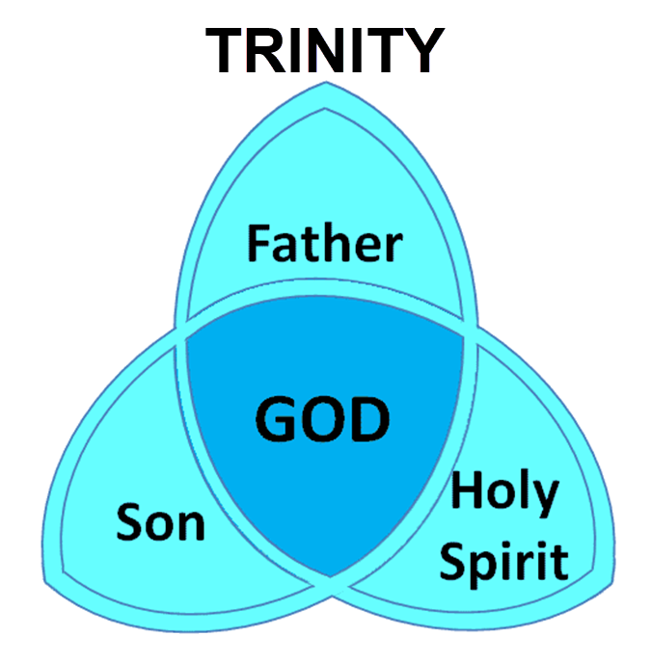

Slide 108
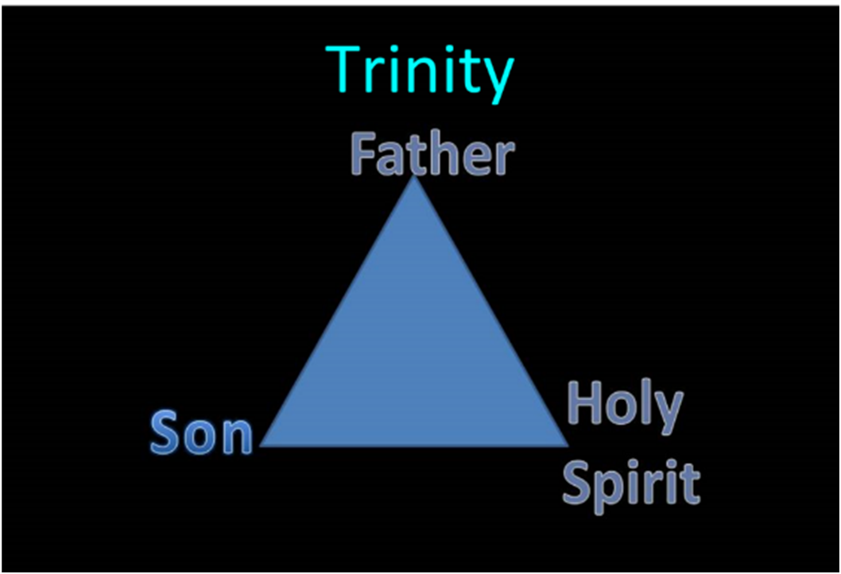

Slide 109
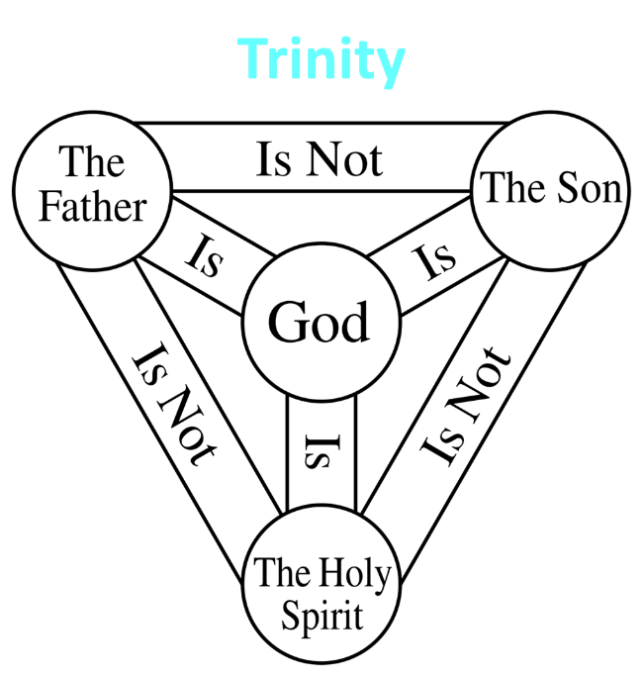

Slide 110
12/12/4/4
Romans 12
1 Corinthians 12
1 Peter 4
Ephesians 4

Slide 111
Acts 5:1-6
Ananias’ Discipline
      Deed (1-2)
      Peter’s Accusation (3-4)
      Ananias’ Discipline (5-6)

Slide 112
Acts 5:5-6
Ananias's Discipline
      Death (5)
      Burial (6)

Slide 113
Acts 5:5-6
Ananias's Discipline
      Death (5)
      Burial (6)

Slide 114
Acts 5:5-6
Ananias's Discipline
      Death (5)
      Burial (6)

Slide 115
Ananias and Sapphira
Acts 5:1-11
  Ananias’ Discipline (1-6)
  Sapphira’s Discipline (7-10)
  Result (11)

Slide 116
Acts 5:7-10
Sapphira's’ Discipline
      Sin (7-8)
      Peter’s confrontation & judgment (9)
      Death and burial (10)

Slide 117
Acts 5:7-10
Sapphira's’ Discipline
      Sin (7-8)
      Peter’s confrontation & judgment (9)
      Death and burial (10)

Slide 118
Acts 5:7-10
Sapphira's’ Discipline
      Sin (7-8)
      Peter’s confrontation & judgment (9)
      Death and burial (10)

Slide 119
Acts 5:7-10
Sapphira's’ Discipline
      Sin (7-8)
      Peter’s confrontation & judgment (9)
      Death and burial (10)

Slide 120
Ananias and Sapphira
Acts 5:1-11
  Ananias’ Discipline (1-6)
  Sapphira’s Discipline (7-10)
  Result (11)

Slide 121
Acts 5:11
Result
      Fear within the congregation (11a)
      Fear outside the congregation (11b)

Slide 122
Acts 5:11
Result
      Fear within the congregation (11a)
      Fear outside the congregation (11b)

Slide 123
Acts 2:47
“praising God and having favor with all the people. And the Lord was adding to their number day by day those who were being saved.” (NASB)
“praising God and having favor with all the people. And the Lord added to the church daily those who were being saved.” (NKJV)

Slide 124
Author | Written | Earliest MSS | Time Span | No. MSS
Cesar | 100 to 44 b.c. | a.d. 900 | 1000 | 10
Plato | 427 to 347 b.c. | a.d. 900 | 1200 | 7
Thucydides | 460 to 400 b.c. | a.d. 900 | 1300 | 8
Tacitus | a.d. 100 | a.d. 1100 | 1000 | 20
Suetonius | a.d. 75 to 160 | a.d. 950 | 800 | 8
Homer (Illiad) | 900 b.c. | a.d. 400 | 500 | 643
New Testament | a.d. 40 to 100 | a.d. 125 | 25 to 50 | 24,000
Cesar | 100 to 44 b.c. | a.d. 900 | 1000 | 10
http://creationrevolution.com/2012/05/should-we-trust-the-bible/

Slide 125
Manuscript Evidence for Ancient Writings
Author | Written | Earliest Fragment/Copy | Time Span in Years | Number of Manuscripts
Cesar | 100 to 44 b.c. | a.d. 900 | 1000 | 10
Plato | 427 to 347 b.c. | a.d. 900 | 1200 | 7
Thucydides | 460 to 400 b.c. | a.d. 900 | 1300 | 8
Tacitus | a.d. 100 | a.d. 1100 | 1000 | 20
Suetonius | a.d. 75 to 160 | a.d. 950 | 800 | 8
Homer (Illiad) | 900 b.c. | a.d. 400 | 500 | 643
New Testament | a.d. 40 to 100 | a.d. 125 | 25 to 50 | 24,000
Information in this chart can be found in various sources. This chart was adapted from: Christian Apologetics, by Norman Geisler, 1976, p. 307; and Evidence That Demands a Verdict, by Josh McDowell, 1979, pp. 42, 43.

Slide 126

Dr. Arnold Fruchtenbaum
Arnold G. Fruchtenbaum, “Israel and the Church,” in Issues in Dispensationalism, ed. Wesley R. Willis and John R. Master (Chicago: Moody, 1994), 118.
“In the book of Acts, both Israel and the church exist simultaneously. The term Israel is used twenty times and ekklēsia (church) nineteen times, yet the two groups are always kept distinct.”

Slide 127
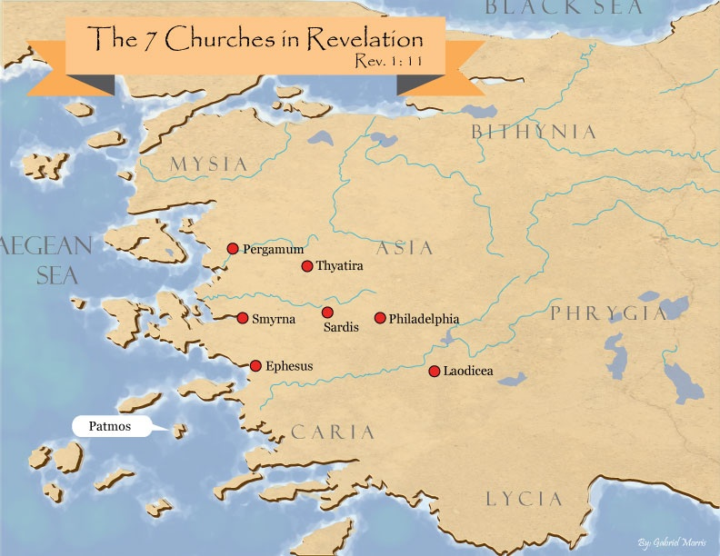
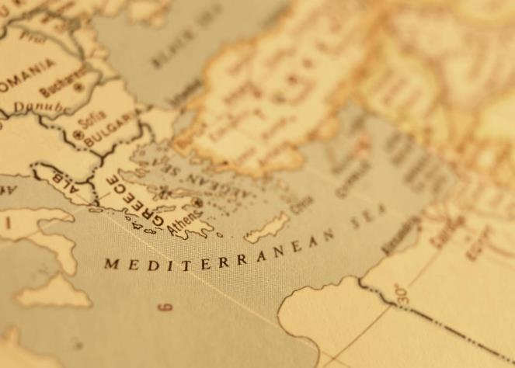

Slide 128
Acts 5:11
Result
      Fear within the congregation (11a)
      Fear outside the congregation (11b)

Slide 129
Conclusion

Slide 130
Acts 4:1‒5:11
Summary
  Apostles Arrested (4:1-4)
  Apostles Examined (4:5-12)
  Sanhedrin’s Decision (4:13-22)
  Apostles’ Prayer (4:23-31)
  Pre-Ananias and Sapphira (4:32-37)
  Ananias and Sapphira (5:1-11)

