Slide 1
Law and Grace: An Overview Jim McGowan, Th.D. Sugar Land Bible Church 10-15-2023
…but grace and truth were realized through Jesus Christ - John 1:17
For the Law was given through Moses…
Special thanks to Dr. Vern Peterman for access to his insights and resources.

Slide 2
Law and Grace: Review The SOM – Matthew 5:1–8:1 (Luke 6:17–49)
Session 40 Outline
Review
Purpose, Aim, and Objective
Session 39
Universal Kingdom vs Earthly Kingdom
Gentiles
Israel
The Church
Concluding Observations

Slide 3
OUR PURPOSE, AIM AND OBJECTIVE
Law and Grace
…is to Compare and Contrast Law and Grace so as to properly understand these two important themes and how they are related to the life of the New Testament Believer.

Slide 4
C. I. Scofield, D. D.
The Grace of God, The Fundamentals Vol. 3, Chapter VII, p. 98
We have, most of us, been reared and now live under the influence of Galatianism. Protestant theology, alas, is for the most part, thoroughly Galatianized, in that neither law nor grace are given their distinct and separated places, as in the counsels of God, but are mingled together in one incoherent system.
The law is no longer, as in the Divine intent, a ministration of death (2 Cor. 3:7), of cursing (Gal. 3:10), of conviction (Rom. 3:19), because we are taught that we must try to keep it, and that by Divine help we may.
Nor, on the other hand, does grace bring us blessed deliverance from the dominion of sin, for we are kept under the law as a rule of life despite the plain declaration, “Sin shall not have dominion over you: for ye are not under the law, but under grace” (Rom. 6:14). (emphasis mine)

Slide 5
William R. Newell
Romans Verse-by-Verse (p. 274).
Grand Rapids, MI: Christian Classics Ethereal Library.
It is because Reformed theology has kept us Gentiles under the Law,—if not as a means of righteousness, then as “a rule of life,” that all the trouble has arisen. The Law is no more a rule of life than it is a means of righteousness. Walking in the Spirit has now taken the place of walking by ordinances. God has another principle under which He has put his saints: “Ye are not under law, but, under grace! (Rom. 6:14)” (italics mine)
PDF Download Here: https://archive.org/details/Romans_Verse_By_Verse-NewellWR

Slide 6
Henry Ironside
The Continual Burnt Offering: Daily Meditations on the Word of God (p. 265). Neptune, NJ: Loizeaux Brothers.
In Romans 7 we have a man renewed by the Spirit of God, but struggling under law, hoping thereby to subdue or find deliverance from the power of the old Adamic nature. In chapter 8 we have God’s way of deliverance through the death and resurrection of Christ with which the believer is identified before God. The chapter begins with “no condemnation” and ends with “no separation.” All who are in Christ Jesus are accepted in the Beloved and as free from every charge of guilt as He is Himself. He paid our penalty on the cross. Now we are linked up with Him in resurrection, not under law but under grace.

Slide 7
Matthew’s 3-Fold Purpose
Law and Grace: Review The SOM – Matthew 5:1–8:1 (Luke 6:17–49)
To explain:
that Jesus in whom they had believed was the long-awaited Jewish Messiah
why the kingdom had been postponed despite the fact that the king had arrived
the interim program of God during the kingdom’s absence

Slide 8
Matthew and the Kingdom
Law and Grace: Review The SOM – Matthew 5:1–8:1 (Luke 6:17–49)
 | offered
 | rejected
 | postponed Interim program
 | ultimately accepted

Slide 9
Matthew’s Message
Law and Grace: Review The SOM – Matthew 5:1–8:1 (Luke 6:17–49)
Jesus is the predicted Jewish king who ushered in an interim program by building the sons of the kingdom into the Church in between Israel’s past rejection and future acceptance of her king.

Slide 10
Law and Grace: Review The SOM – Matthew 5:1–8:1 (Luke 6:17–49)
Session 40 Outline
Review
Purpose, Aim, and Objective
Session 39
Universal Kingdom vs Earthly Kingdom
Gentiles
Israel
The Church
Concluding Observations

Slide 11
Law and Grace: The SOM – Matthew 5:1–8:1 (Luke 6:17–49)
THREE DIFFERENT GROUPS OF PEOPLE
GENTILES
ISRAEL
ISRAEL

Slide 12
Law and Grace: The SOM – Matthew 5:1–8:1 (Luke 6:17–49)
 | GENTILES | ISRAEL | CHURCH
ALSO CALLED | nations, peoples | Hebrews, Jews | body & bride of Christ
BEGAN IN | Genesis 1-11 | Genesis 12-50 | Acts 2-28
PRIMARY STEWARD (S) | Adam, Noah | Moses | Christ
REIGNING PRINCIPLE | Law of Conscience | Law of Moses | Grace
WHOSE WORKS | Self | Self | Christ’s
CHRIST DIED FOR | all | all | all
SAVED | Some, by faith | Some, by faith | All, by faith
IDENTIFICATION, BAPTISM, & PHRASING IN SCRIPTURE | In Adam, with Noah, “among the nations” | Baptized into Moses, “in Israel” | Baptized into Christ, “In Christ”

Slide 13
Law and Grace: The SOM – Matthew 5:1–8:1 (Luke 6:17–49)
 | GENTILES | ISRAEL | CHURCH
NATURE OF BLESSINGS | Initial blessings for Adam & Noah; earthly reproduction | Conditional, earthly | Unconditional, heavenly
EARTHLY DIFFICULTIES | Fall; the limitations are to cause mankind to seek God | Curses for disobedience | Trials for conformity to Christ or for discipline
GRACE | Partial | Partial | Reigning principle
SPIRIT’S ROLE | Will be poured out on all of mankind, in the kingdom | New Covenant promise in the coming kingdom | Indwells each believer all of the time
CHRIST’S KINGDOM TITLE | King of kings & Lord of lords (over the Gentile nations) | King of Israel, Messiah | The Bridegroom, with Whom we reign
GOSPEL (S) | Substitution | Kingdom & substitution | Substitution

Slide 14
Law and Grace: Review The SOM – Matthew 5:1–8:1 (Luke 6:17–49)
Session 40 Outline
Review
Purpose, Aim, and Objective
Session 39
Universal Kingdom vs Earthly Kingdom
Gentiles
Israel
The Church
Concluding Observations

Slide 15
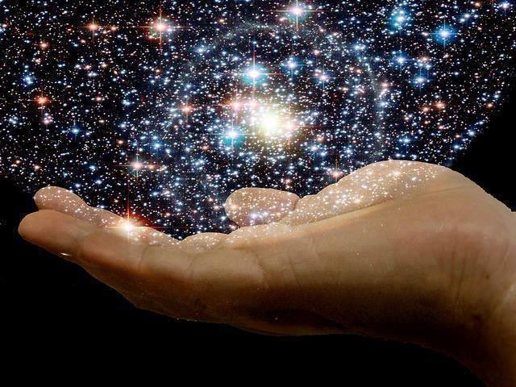
Law and Grace: Grace - Universal kingdom vs earthly kingdom
“He’s got the whole universe in His hands..”

Slide 16
Law and Grace: Grace - Universal kingdom vs earthly kingdom
THE UNIVERSAL KINGDOM OF GOD
God’s rule over, management of, and building of, His creation as King, Administrator, Builder
Psalm 47; 57:11; Jeremiah 23:24; Ephesians 1:10; Hebrews 3:4
Alpha
Omega
Seal Opener
Seated in the heavenlies, and our life on earth
The Messiah, King of Israel, King of kings and Lord of lords over the Gentiles
Creator
The Angel of the Lord
Lamb, Word made flesh
7 year Tribulation
Abraham
Moses
David
Adam
Millennial Kingdom
Noah
Church: Grace
Israel: Mosaic Law
Kingdom Law
Gentiles
World, Flesh, Devil
Flesh

Slide 17
Law and Grace: Grace - Universal kingdom vs earthly kingdom
THE UNIVERSAL KINGDOM OF GOD
God’s rule over, management of, and building of, His creation as King, Administrator, Builder
Psalm 47; 57:11; Jeremiah 23:24; Ephesians 1:10; Hebrews 3:4
Psalm 47:1–4
¹ O clap your hands, all peoples; Shout to God with the voice of joy. ² For the LORD Most High is to be feared, A great King over all the earth. ³ He subdues peoples under us And nations under our feet. ⁴ He chooses our inheritance for us, The glory of Jacob whom He loves. Selah.
Alpha
Omega
Seal Opener
Seated in the heavenlies, and our life on earth
The Messiah, King of Israel, King of kings and Lord of lords over the Gentiles
Creator
The Angel of the Lord
Lamb, Word made flesh
7 year Tribulation
Abraham
Moses
David
Adam
Millennial Kingdom
Noah
Church: Grace
Israel: Mosaic Law
Kingdom Law
Gentiles
World, Flesh, Devil
Flesh

Slide 18
Law and Grace: Grace - Universal kingdom vs earthly kingdom
THE UNIVERSAL KINGDOM OF GOD
God’s rule over, management of, and building of, His creation as King, Administrator, Builder
Psalm 47; 57:11; Jeremiah 23:24; Ephesians 1:10; Hebrews 3:4
Hebrews 3:1-4
¹ Therefore, holy brethren, partakers of a heavenly calling, consider Jesus, the Apostle and High Priest of our confession; ² He was faithful to Him who appointed Him, as Moses also was in all His house. ³ For He has been counted worthy of more glory than Moses, by just so much as the builder of the house has more honor than the house. ⁴ For every house is built by someone, but the builder of all things is God.
Alpha
Omega
Seal Opener
Seated in the heavenlies, and our life on earth
The Messiah, King of Israel, King of kings and Lord of lords over the Gentiles
Creator
The Angel of the Lord
Lamb, Word made flesh
7 year Tribulation
Abraham
Moses
David
Adam
Millennial Kingdom
Noah
Church: Grace
Israel: Mosaic Law
Kingdom Law
Gentiles
World, Flesh, Devil
Flesh

Slide 19
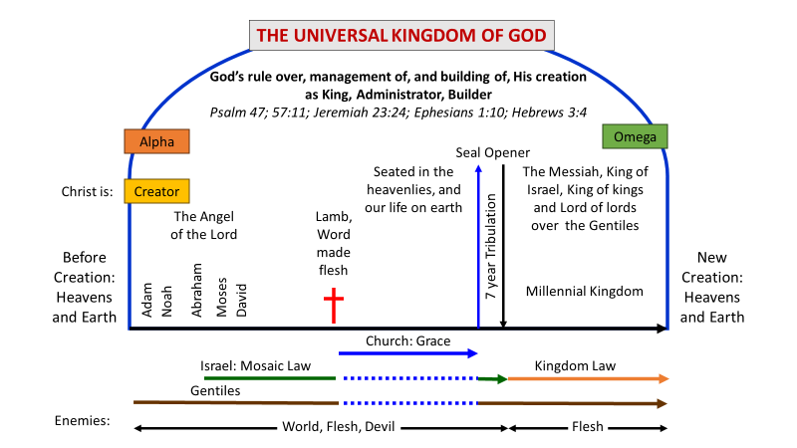
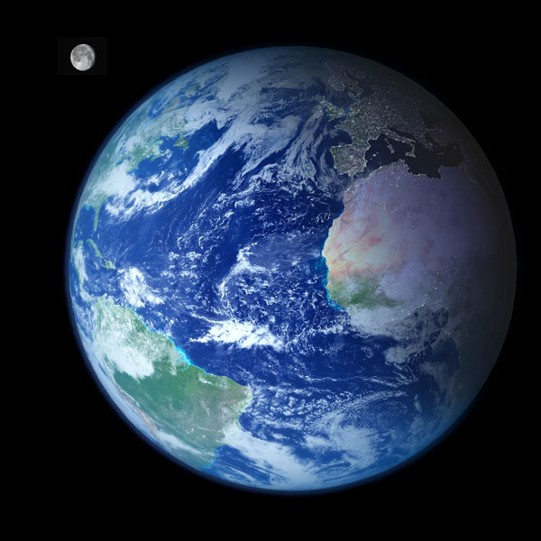
THE UNIVERSAL KINGDOM OF GOD
Law and Grace: Grace - Universal kingdom vs earthly kingdom
The term ‘Universal Kingdom of God’ is God’s rule, building and management of the present heavens and earth (this world).

Slide 20
THE UNIVERSAL KINGDOM OF GOD
Law and Grace: Grace - Universal kingdom vs earthly kingdom
The Kingdom of God on earth (aka kingdom of heaven, or millennial 1000-year kingdom) is the final phase.
1

Slide 21
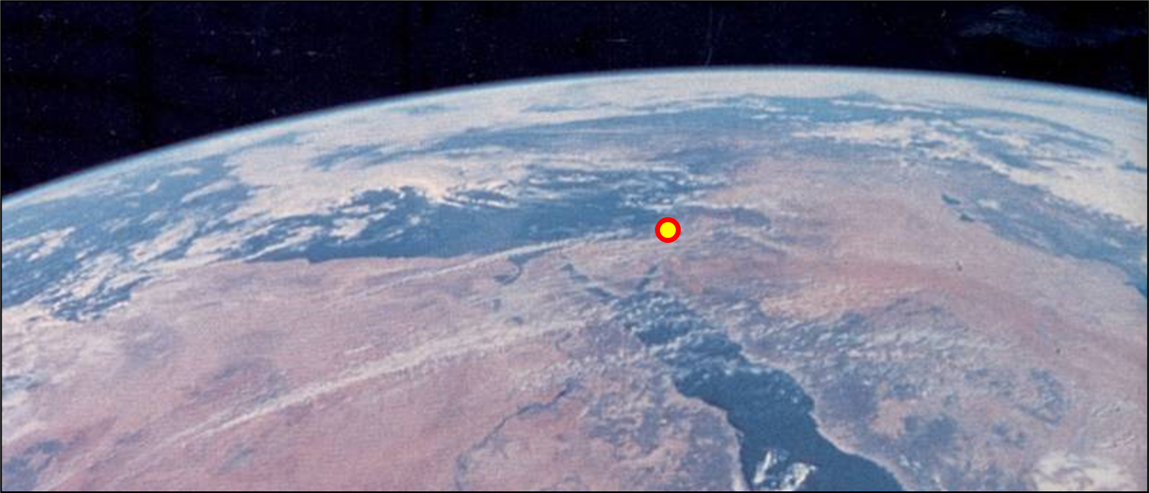
Law and Grace: Grace - Universal kingdom vs earthly kingdom
THE UNIVERSAL KINGDOM OF GOD
In that last and final phase, Christ will reign on earth, on David’s throne, in Jerusalem, as the Messiah, the King of Israel, and the King of kings and the Lord of lords over the Gentiles.

Slide 22
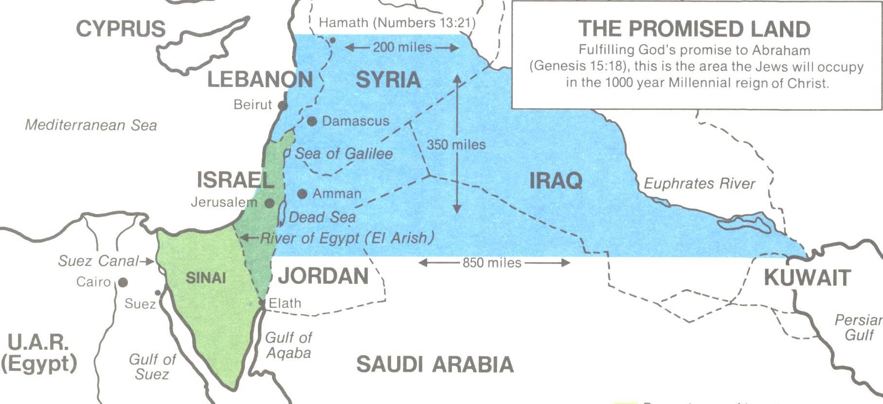
Law and Grace: Grace - Universal kingdom vs earthly kingdom
THE UNIVERSAL KINGDOM OF GOD
The Bible indicates that during the Millennial (1000 year) reign of Christ, Israel’s land will expand well beyond its present small size.

Slide 23
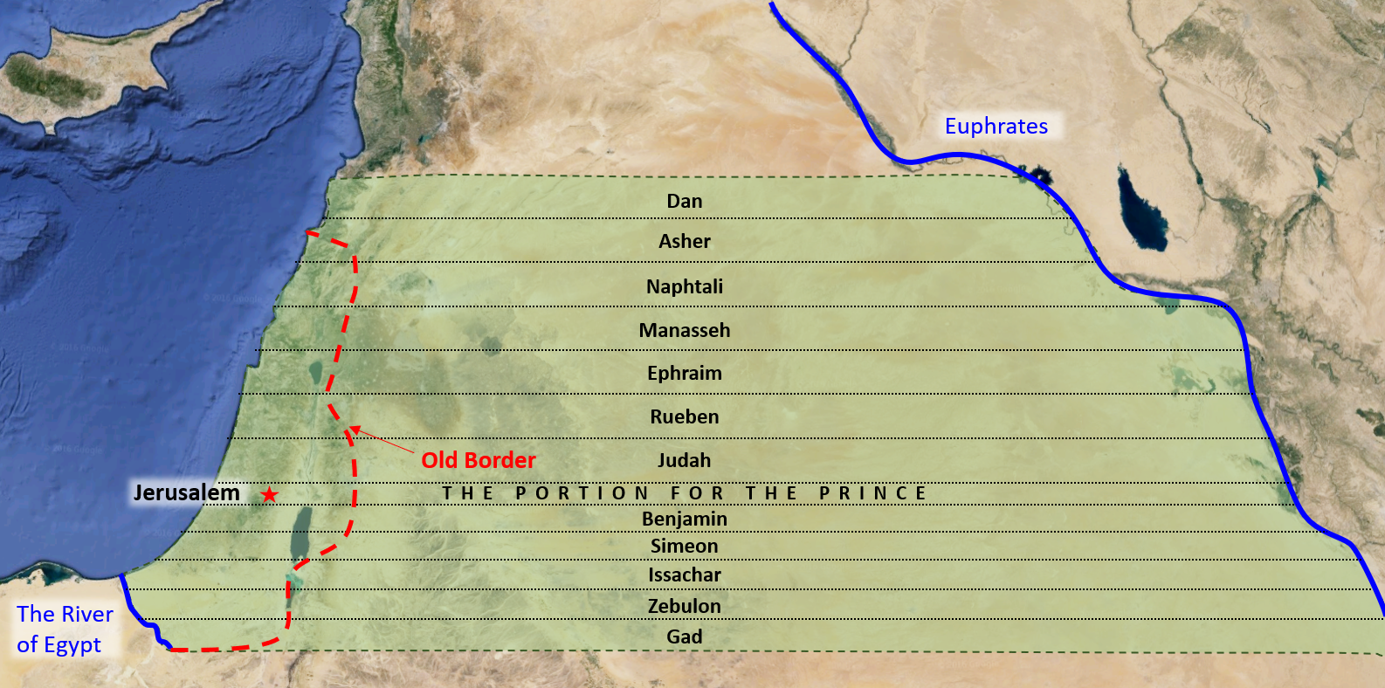
Law and Grace: Grace - Universal kingdom vs earthly kingdom
DIVISION OF THE LAND (EZEKIEL 48)

Slide 24
Law and Grace: Grace - Universal kingdom vs earthly kingdom
THE UNIVERSAL KINGDOM OF GOD
God’s rule over, management of, and building of, His creation as King, Administrator, Builder
Psalm 47; 57:11; Jeremiah 23:24; Ephesians 1:10; Hebrews 3:4
Seal Opener
The Messiah, King of Israel, King of kings and Lord of lords over the Gentiles
Before Creation: Heavens and Earth
New Creation: Heavens and Earth
Millennial Kingdom
Church: Grace
Israel: Mosaic Law
Kingdom Law
Gentiles
World, Flesh, Devil
Flesh

Slide 25
Ephesians 1:9-10
expanded and explained
⁹ He, the Father, made known to us in the Church, through the apostles and prophets, the previously unrevealed mystery of His will, according to His kind intention which He, the Father, purposed in [the] Christ ¹⁰ from the plan and perspective of God’s administration of all things, which we now know includes the Church, toward the full completion and final stage of the earthly times, that is, the summing up and bringing into submission of all things in [the] Christ in the Millennial Kingdom, including all the things in the heavens and things on the earth.

Slide 26
Law and Grace: Grace - Universal kingdom vs earthly kingdom
CHRIST IS…
This excerpt from the chart shows that Christ has varying roles and titles throughout the span of this present heavens and earth.

Slide 27
Law and Grace: Grace - Universal kingdom vs earthly kingdom
CHRIST IS…
But the full chart only has a partial list. Christ is also called:
Prince of Peace
The Bread of Life
The Door
The Good Shepherd
Mediator
Lion of Judah, Etc.
Christ’s roles and titles are not all of equal duration: Christ will be the Lamb forever.

Slide 28
Law and Grace: Grace - Universal kingdom vs earthly kingdom
GOD DOES TIME MANAGEMENT

Slide 29
Law and Grace: Grace - Universal kingdom vs earthly kingdom
GOD DOES TIME MANAGEMENT
An aspect of God’s managing of all things in the heavens and on the earth (the universal kingdom of God) is that God selects spans of time and points of time.
Acts 1:6-7
⁶ So when they had come together, they were asking Him, saying, "Lord, is it at this time You are restoring the kingdom to Israel?" ⁷ He said to them, "It is not for you to know times or epochs which the Father has fixed by His own authority… "

Slide 30
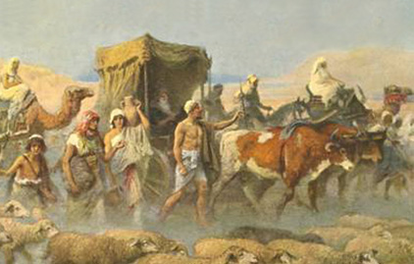
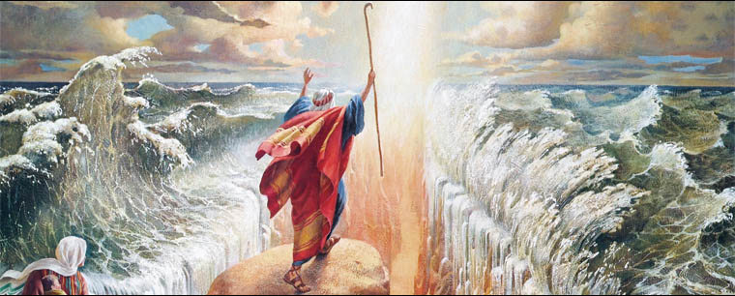
Law and Grace: Grace - Universal kingdom vs earthly kingdom
GOD DOES TIME MANAGEMENT
God would have the Israelites in Egypt for centuries, then select when they would leave Egypt.

Slide 31
Law and Grace: Grace - Universal kingdom vs earthly kingdom
GOD DOES TIME MANAGEMENT
Christ didn’t die at just any time, He died for our sins at the right time.
Romans 5:6
“…at the right time Christ died for the ungodly.”
Galatians 4:4
“But when the fullness of the time came, God sent forth His Son…:

Slide 32
Law and Grace: Review The SOM – Matthew 5:1–8:1 (Luke 6:17–49)
Session 40 Outline
Review
Purpose, Aim, and Objective
Session 39
Universal Kingdom vs Earthly Kingdom
Gentiles
Israel
The Church
Concluding Observations

Slide 33
THE UNIVERSAL KINGDOM OF GOD
God’s rule over, management of, and building of, His creation as King, Administrator, Builder
Psalm 47; 57:11; Jeremiah 23:24; Ephesians 1:10; Hebrews 3:4
Alpha
Omega
Seal Opener
Seated in the heavenlies, and our life on earth
The Messiah, King of Israel, King of kings and Lord of lords over the Gentiles
Christ is:
Creator
The Angel of the Lord
Lamb, Word made flesh
7 year Tribulation
Before Creation: Heavens and Earth
New Creation: Heavens and Earth
Abraham
Moses
David
Adam
Millennial Kingdom
Noah
Church: Grace
Israel: Mosaic Law
Kingdom Law
Gentiles
Enemies:
World, Flesh, Devil
Flesh

Slide 34
Law and Grace: Grace - Universal kingdom vs earthly kingdom
GENTILES: NON-JEWS
The Gentiles, all having begun in Adam, can all be saved by faith, but not all are. Those who are saved by faith between the time of Acts 2 and the Rapture, are part of the Church.

Slide 35
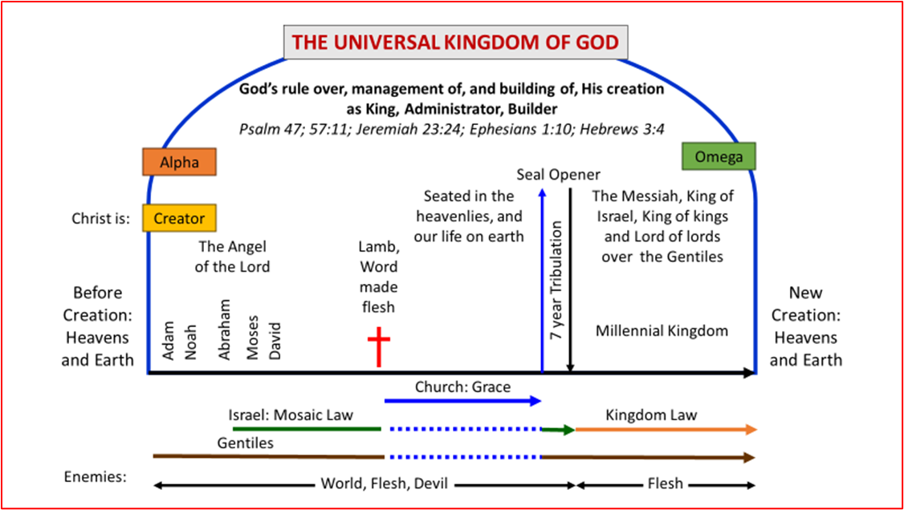
Law and Grace: Grace - Universal kingdom vs earthly kingdom
GENTILES: NON-JEWS
When the Church is raptured, the identification of Gentiles as a critical ethnic distinction will continue until the end of this present heavens and earth and on into the New Heavens and the New Earth.

Slide 36
Law and Grace: Review The SOM – Matthew 5:1–8:1 (Luke 6:17–49)
Session 40 Outline
Review
Purpose, Aim, and Objective
Session 39
Universal Kingdom vs Earthly Kingdom
Gentiles
Israel
The Church
Concluding Observations

Slide 37
THE UNIVERSAL KINGDOM OF GOD
God’s rule over, management of, and building of, His creation as King, Administrator, Builder
Psalm 47; 57:11; Jeremiah 23:24; Ephesians 1:10; Hebrews 3:4
Alpha
Omega
Seal Opener
Seated in the heavenlies, and our life on earth
The Messiah, King of Israel, King of kings and Lord of lords over the Gentiles
Christ is:
Creator
The Angel of the Lord
Lamb, Word made flesh
7 year Tribulation
Before Creation: Heavens and Earth
New Creation: Heavens and Earth
Abraham
Moses
David
Adam
Millennial Kingdom
Noah
Church: Grace
Israel: Mosaic Law
Kingdom Law
Gentiles
Enemies:
World, Flesh, Devil
Flesh

Slide 38
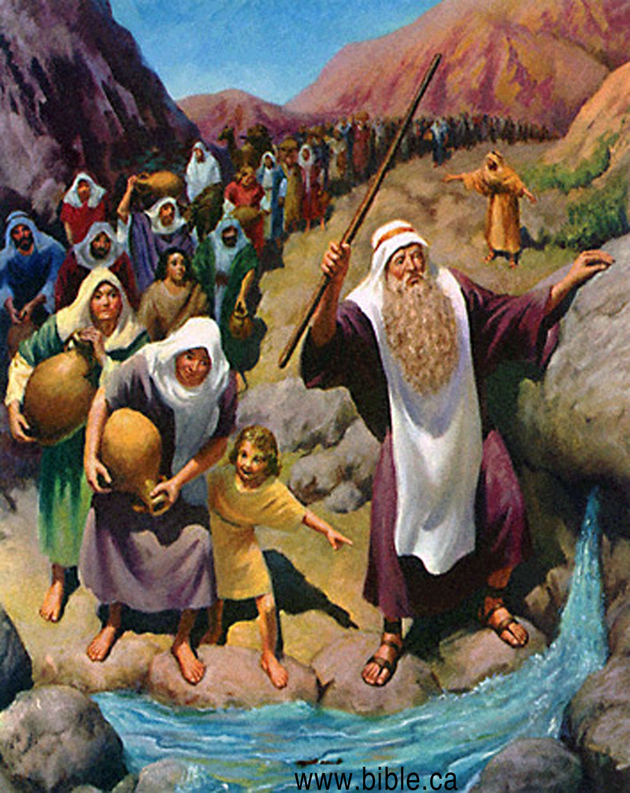
Law and Grace: Grace - Universal kingdom vs earthly kingdom
ISRAEL: HEBREWS OR JEWS
The Israelites, God’s chosen, ethnic, people, could be saved by faith, before the Cross, (Abraham, Isaac, Jacob, Joseph, David, the prophets, etc.) but not all of them were saved.

Slide 39
Law and Grace: Grace - Universal kingdom vs earthly kingdom
ISRAEL: HEBREWS OR JEWS
Between the founding of the Church at Pentecost, in Acts 2 until the Rapture, Israelites saved by faith, are part of the Church.

Slide 40
Law and Grace: Grace - Universal kingdom vs earthly kingdom
ISRAEL: HEBREWS OR JEWS
When the Church is raptured, the identification of Israelites as a critical, ethnic, distinction will continue until the end of this present heavens and earth and on into the New Heavens and the New Earth.

Slide 41
Law and Grace: Review The SOM – Matthew 5:1–8:1 (Luke 6:17–49)
Session 40 Outline
Review
Purpose, Aim, and Objective
Session 39
Universal Kingdom vs Earthly Kingdom
Gentiles
Israel
The Church
Concluding Observations

Slide 42
THE UNIVERSAL KINGDOM OF GOD
God’s rule over, management of, and building of, His creation as King, Administrator, Builder
Psalm 47; 57:11; Jeremiah 23:24; Ephesians 1:10; Hebrews 3:4
Alpha
Omega
Seal Opener
Seated in the heavenlies, and our life on earth
The Messiah, King of Israel, King of kings and Lord of lords over the Gentiles
Christ is:
Creator
The Angel of the Lord
Lamb, Word made flesh
7 year Tribulation
Before Creation: Heavens and Earth
New Creation: Heavens and Earth
Abraham
Moses
David
Adam
Millennial Kingdom
Noah
Church: Grace
Israel: Mosaic Law
Kingdom Law
Gentiles
Enemies:
World, Flesh, Devil
Flesh

Slide 43
Law and Grace: Grace - Universal kingdom vs earthly kingdom
THE CHURCH: A SPIRITUAL BODY
The Church, a spiritual body composed of ethnic Gentiles and Jews, is not under the Law of Moses.
Romans 6:14-15
¹⁴…not under law but under grace. ¹⁵…not under law but under grace…
Galatians 3:27-28
²⁷ For all of you who were baptized into Christ have clothed yourselves with Christ. ²⁸ There is neither Jew nor Greek, there is neither slave nor free man, there is neither male nor female; for you are all one in Christ Jesus.

Slide 44
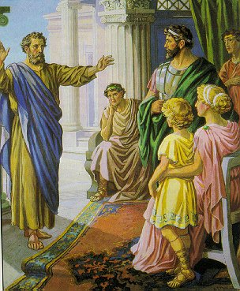
Law and Grace: Grace - Universal kingdom vs earthly kingdom
THE CHURCH: A SPIRITUAL BODY
The Church consists of those Gentiles and Israelites who have believed in Christ, from Acts 2 to the Rapture.
Peter, the Jew, presenting the gospel in the Gentile house of Cornelius!

Slide 45
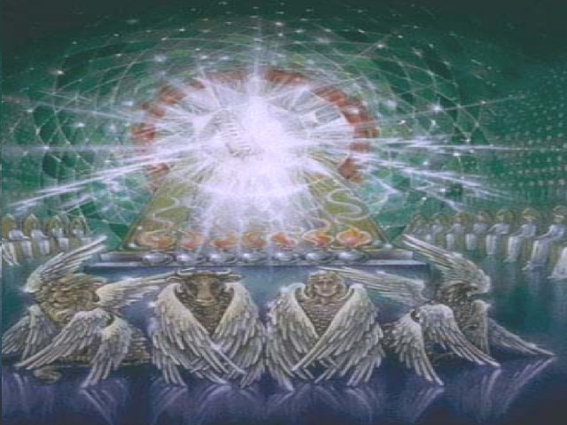
Law and Grace: Grace - Universal kingdom vs earthly kingdom
THE CHURCH: A SPIRITUAL BODY
The Church, even now, has its blessings in the heavenly places in Christ, which include a heavenly seating and citizenship - you can set your mind and hope on that!

Slide 46
THE UNIVERSAL KINGDOM OF GOD
God’s rule over, management of, and building of, His creation as King, Administrator, Builder
Psalm 47; 57:11; Jeremiah 23:24; Ephesians 1:10; Hebrews 3:4
Alpha
Omega
Seal Opener
Seated in the heavenlies, and our life on earth
The Messiah, King of Israel, King of kings and Lord of lords over the Gentiles
Christ is:
Creator
The Angel of the Lord
Lamb, Word made flesh
7 year Tribulation
Before Creation: Heavens and Earth
New Creation: Heavens and Earth
Abraham
Moses
David
Adam
Millennial Kingdom
Noah
Church: Grace
Israel: Mosaic Law
Kingdom Law
Gentiles
Enemies:
World, Flesh, Devil
Flesh

Slide 47
Law and Grace: Grace - Universal kingdom vs earthly kingdom
WHY DOES THE CHURCH DEPART BEFORE THE TRIBULATION?
The Gentiles and Israel can both be shown to be subject to God’s wrath.
Psalm 78:59
When God heard, He was filled with wrath and greatly abhorred Israel.
Jeremiah 10:25
Pour out Your wrath on the nations that do not know You and on the families that do not call Your name; For they have devoured Jacob…

Slide 48
Law and Grace: Grace - Universal kingdom vs earthly kingdom
WHY DOES THE CHURCH DEPART BEFORE THE TRIBULATION?
But the Church is promised to be saved from God’s wrath.
Romans 5:9–10
⁹ Much more then, having now been justified by His blood, we shall be saved from the wrath of God through Him. ¹⁰ For if while we were enemies we were reconciled to God through the death of His Son, much more, having been reconciled, we shall be saved by His life.
1 Thessalonians 1:10; 5:9-10
¹⁰…and to wait for His Son from heaven, whom He raised from the dead, that is Jesus, who rescues us from the wrath to come. ^{5:9-10} For God has not destined us for wrath, but for obtaining salvation through our Lord Jesus Christ…

Slide 49
Law and Grace: Grace - Universal kingdom vs earthly kingdom
WHY DOES THE CHURCH DEPART BEFORE THE TRIBULATION?
The beginning of the seven-year Tribulation period (cf. Revelation 6), begins God’s wrath for those on the earth, so the Church has to have been taken out of the earth prior to that point.
Revelation 6:16-17
¹⁶…and they said to the mountains and to the rocks, "Fall on us and hide us from the presence of Him who sits on the throne, and from the wrath of the Lamb; ¹⁷ for the great day of their wrath has come, and who is able to stand?“

Slide 50
Law and Grace: Grace - Universal kingdom vs earthly kingdom
WHY DOES THE CHURCH DEPART BEFORE THE TRIBULATION?
For us who are in the Church, grace is the one reigning principle (Romans 5:17; 21).

Slide 51
Law and Grace: Grace - Universal kingdom vs earthly kingdom
BUT THERE’S ANOTHER REASON
Once the seven-year Tribulation period begins or perhaps shortly before, Israel will rebuild their Temple, reinstitute the Mosaic Law, and begin offering sacrifices.

Slide 52
Law and Grace: Grace - Universal kingdom vs earthly kingdom
BUT THERE’S ANOTHER REASON
While the mention of the Church on earth ends, once the seven-year Tribulation period begins, the language and focus of the Book of Revelation returns to the 12 Tribes of Israel and the Gentile nations.
Revelation 7:4-5
⁴ And I heard the number of those who were sealed, one hundred and forty-four thousand sealed from every tribe of the sons of Israel: ⁵ from the tribe of Judah, twelve thousand were sealed, from the tribe of Reuben twelve thousand, from the tribe of Gad twelve thousand…

Slide 53
Law and Grace: Review The SOM – Matthew 5:1–8:1 (Luke 6:17–49)
Session 40 Outline
Review
Purpose, Aim, and Objective
Session 39
Universal Kingdom vs Earthly Kingdom
Gentiles
Israel
The Church
Concluding Observations

Slide 54
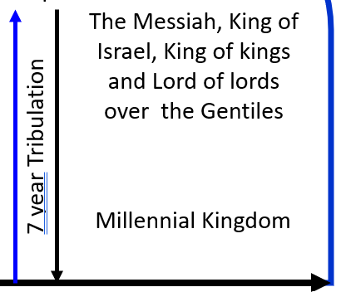
Law and Grace: Grace - Universal kingdom vs earthly kingdom
WHO’S IN AND WHO’S OUT?
Only unbelievers will enter the Tribulation because the Church will have been removed at the Rapture and only believers will enter the Millennial kingdom because no unbelievers will be left on Earth at that point.

Slide 55
Law and Grace: Grace - Universal kingdom vs earthly kingdom
WHO’S IN AND WHO’S OUT?
All those (Gentiles and Jews), who enter the Millennial Kingdom, will have become believers during the Tribulation and will have survived all of its plagues and persecutions.

Slide 56
Law and Grace: An Overview Jim McGowan, Th.D. Sugar Land Bible Church 10-15-2023
…but grace and truth were realized through Jesus Christ - John 1:17
For the Law was given through Moses…
Special thanks to Dr. Vern Peterman for access to his insights and resources.

