Slide 2
ONE
SOMEONE GREATER
MATTHEW 12:38-41
JONAH 1:17

Slide 3
JONAH: AN INTRODUCTION, PART 3
Who wrote it? Jonah
When was it written? 770-750 BC
Who was it written to? Israel
Historicity of the book? Fact!
Genre of the book? Historical Narrative
What is it all about? (Message) To showcase God’s universal love and plan of redemption which extends beyond Israel to include all nations

Slide 4
JONAH: AN INTRODUCTION, PART 3
Why was it written? (Purpose) Expose Israel’s ethnocentrism and encourage national repentance
What’s in it? (Survey) Defiance (1-2) Compliance (3-4)
Christ in Jonah?
What makes this book unique?
Structure of the book?
Outline of book?

Slide 5
JONAH: AN INTRODUCTION, PART 3
Why was it written? (Purpose) Expose Israel’s ethnocentrism and encourage national repentance
What’s in it? (Survey) Defiance (1-2) Compliance (3-4)
Christ in Jonah?
What makes this book unique?
Structure of the book?
Outline of book?

Slide 6
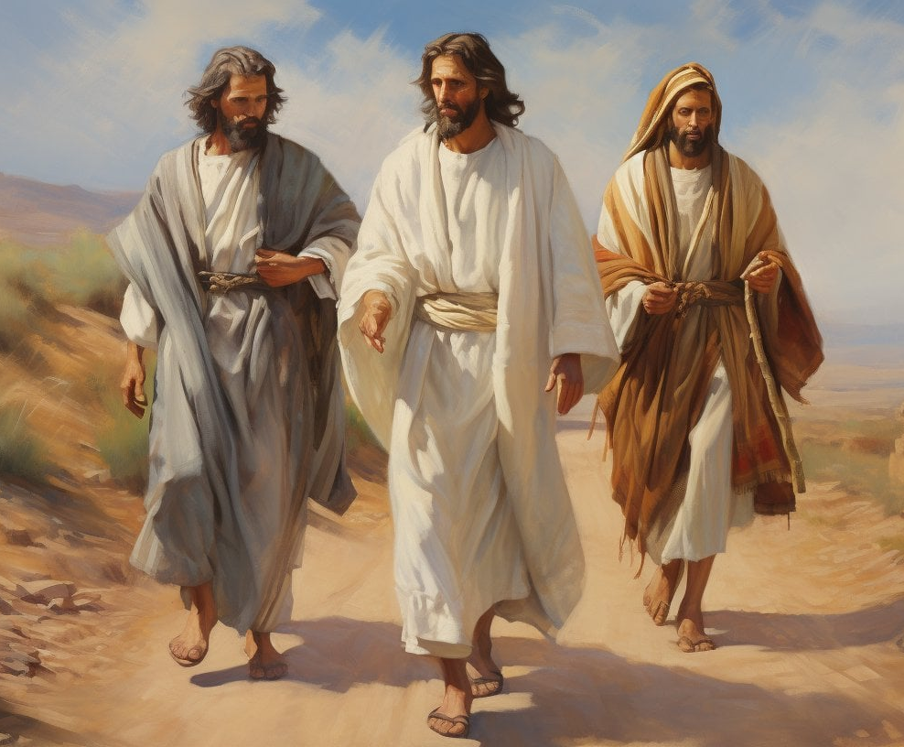
Luke 24:27
“Then beginning with Moses and with all the prophets, He explained to them the things concerning Himself in all the Scriptures.”

Slide 7
CHRIST IN JONAH? YES!
Through Messianic Typology

Slide 8
Who is He? (Matthew 11-12)
John the Baptist: | “Are You the Expected One?” Matthew 11:3-6
The Crowds: | “ This man cannot be the Son of David, can he?” Matthew 12:23
Pharisees: | “This man casts out demons only by Beelzebul the ruler of the demons.” Matthew 12:24
Jesus: | “For the Son of Man is Lord of the Sabbath.” Matthew 12:8
Jesus: Greater than priest | “But I say to you that something greater than the temple is here.” Matthew 12:6
Jesus: Greater than prophet | “…and behold, something greater than Jonah is here.” Matthew 12:41
Jesus: Greater than king | “…and behold, something greater than Solomon is here.” Matthew 12:42

Slide 9
Who is He? (Matthew 11-12)
John the Baptist: | “Are You the Expected One?” Matthew 11:3-6
The Crowds: | “ This man cannot be the Son of David, can he?” Matthew 12:23
Pharisees: | “This man casts out demons only by Beelzebul the ruler of the demons.” Matthew 12:24
Jesus: | “For the Son of Man is Lord of the Sabbath.” Matthew 12:8
Jesus: Greater than priest | “But I say to you that something greater than the temple is here.” Matthew 12:6
Jesus: Greater than prophet | “…and behold, something greater than Jonah is here.” Matthew 12:41
Jesus: Greater than king | “…and behold, something greater than Solomon is here.” Matthew 12:42

Slide 10
Who is He? (Matthew 11-12)
John the Baptist: | “Are You the Expected One?” Matthew 11:3-6
The Crowds: | “ This man cannot be the Son of David, can he?” Matthew 12:23
Pharisees: | “This man casts out demons only by Beelzebul the ruler of the demons.” Matthew 12:24
Jesus: | “For the Son of Man is Lord of the Sabbath.” Matthew 12:8
Jesus: Greater than priest | “But I say to you that something greater than the temple is here.” Matthew 12:6
Jesus: Greater than prophet | “…and behold, something greater than Jonah is here.” Matthew 12:41
Jesus: Greater than king | “…and behold, something greater than Solomon is here.” Matthew 12:42

Slide 11
Who is He? (Matthew 11-12)
John the Baptist: | “Are You the Expected One?” Matthew 11:3-6
The Crowds: | “ This man cannot be the Son of David, can he?” Matthew 12:23
Pharisees: | “This man casts out demons only by Beelzebul the ruler of the demons.” Matthew 12:24
Jesus: | “For the Son of Man is Lord of the Sabbath.” Matthew 12:8
Jesus: Greater than priest | “But I say to you that something greater than the temple is here.” Matthew 12:6
Jesus: Greater than prophet | “…and behold, something greater than Jonah is here.” Matthew 12:41
Jesus: Greater than king | “…and behold, something greater than Solomon is here.” Matthew 12:42

Slide 12
Who is He? (Matthew 11-12)
John the Baptist: | “Are You the Expected One?” Matthew 11:3-6
The Crowds: | “ This man cannot be the Son of David, can he?” Matthew 12:23
Pharisees: | “This man casts out demons only by Beelzebul the ruler of the demons.” Matthew 12:24
Jesus: | “For the Son of Man is Lord of the Sabbath.” Matthew 12:8
Jesus: Greater than priest | “But I say to you that something greater than the temple is here.” Matthew 12:6
Jesus: Greater than prophet | “…and behold, something greater than Jonah is here.” Matthew 12:41
Jesus: Greater than king | “…and behold, something greater than Solomon is here.” Matthew 12:42

Slide 13
Who is He? (Matthew 11-12)
John the Baptist: | “Are You the Expected One?” Matthew 11:3-6
The Crowds: | “ This man cannot be the Son of David, can he?” Matthew 12:23
Pharisees: | “This man casts out demons only by Beelzebul the ruler of the demons.” Matthew 12:24
Jesus: | “For the Son of Man is Lord of the Sabbath.” Matthew 12:8
Jesus: Greater than priest | “But I say to you that something greater than the temple is here.” Matthew 12:6
Jesus: Greater than prophet | “…and behold, something greater than Jonah is here.” Matthew 12:41
Jesus: Greater than king | “…and behold, something greater than Solomon is here.” Matthew 12:42

Slide 14
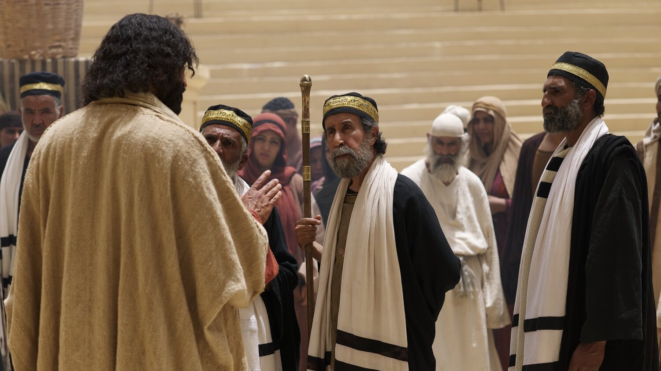
Matthew 12:39-41
39 “But He answered and said to them, ‘An evil and adulterous generation craves for a sign; and yet no sign will be given to it but the sign of Jonah the prophet; 40 for just as JONAH WAS THREE DAYS AND THREE NIGHTS IN THE BELLY OF THE SEA MONSTER, so will the Son of Man be three days and three nights in the heart of the earth. 41 The men of Nineveh will stand up with this generation at the judgment and will condemn it because they repented at the preaching of Jonah; and behold, something greater than Jonah is here.’”

Slide 15
CHRIST IN JONAH? YES!
Through Messianic Typology, such as…
Typifying Jonah’s experience in the whale to Christ’s death and resurrection (Matt 12:40)

Slide 16
Basic Bible Interpretation
“The basis for uniting the Old and New Testaments was typology and predictive prophecy…”

Slide 17
Type - typos, τύπος
“The idols [figures or images] you made to worship” (Acts 7:43)
“The tabernacle … according to the pattern [Moses] had seen” (Acts 7:44)
“Adam, who was a pattern of the One to come” (Rom. 5:14)
“You wholeheartedly obeyed the form of teaching” (6:17)
“Join with others in following my example” (Phil. 3:17)
“And so you became a model to all the believers in Macedonia and Achaia” (1 Thes. 1:7)
“We did this … in order to make ourselves a model for you to follow” (2 Thes. 3:9)
“Set an example for the believers” (1 Tim. 4:12)
“Being examples to the flock” (1 Peter 5:3)

Slide 18
Romans 5:14
“Nevertheless death reigned from Adam until Moses, even over those who had not sinned in the likeness of the offense of Adam, who is a type of Him who was to come.”

Slide 19
Antitype - antitypos, ἀντίτυπος
“Corresponding to that, baptism now saves you—not the removal of dirt from the flesh, but an appeal to God for a good conscience—through the resurrection of Jesus Christ…” (1 Peter 3:21)
“For Christ did not enter a holy place made with hands, a mere copy of the true one, but into heaven itself, now to appear in the presence of God for us…” (Hebrews 9:24)

Slide 20
Basic requisites when observing typology
A notable resemblance or correspondence between the type and antitype
Historical reality in both the type and the antitype
A prefiguring or predictive foreshadowing of the antitype by the type
A heightening in which the antitype is greater than the type
Divine design

Slide 21
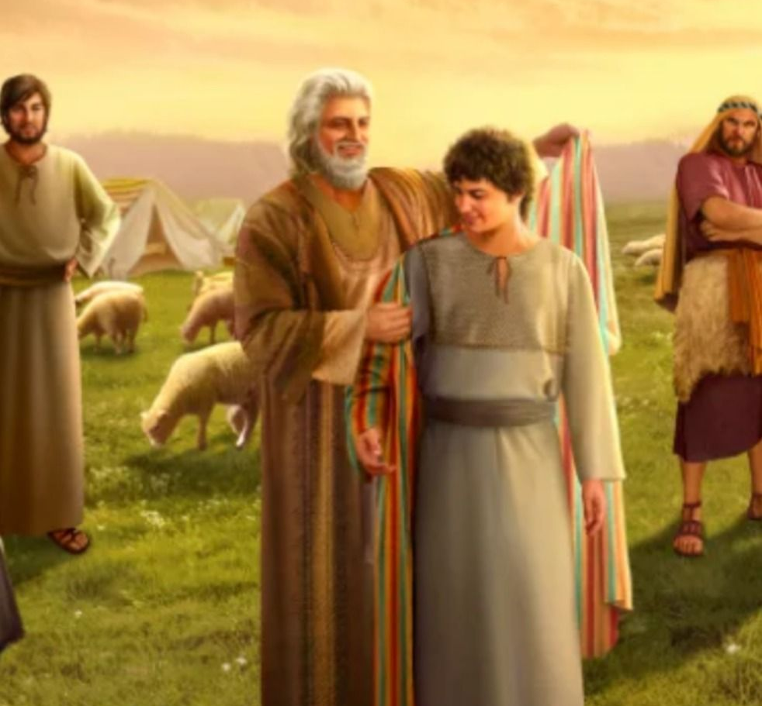
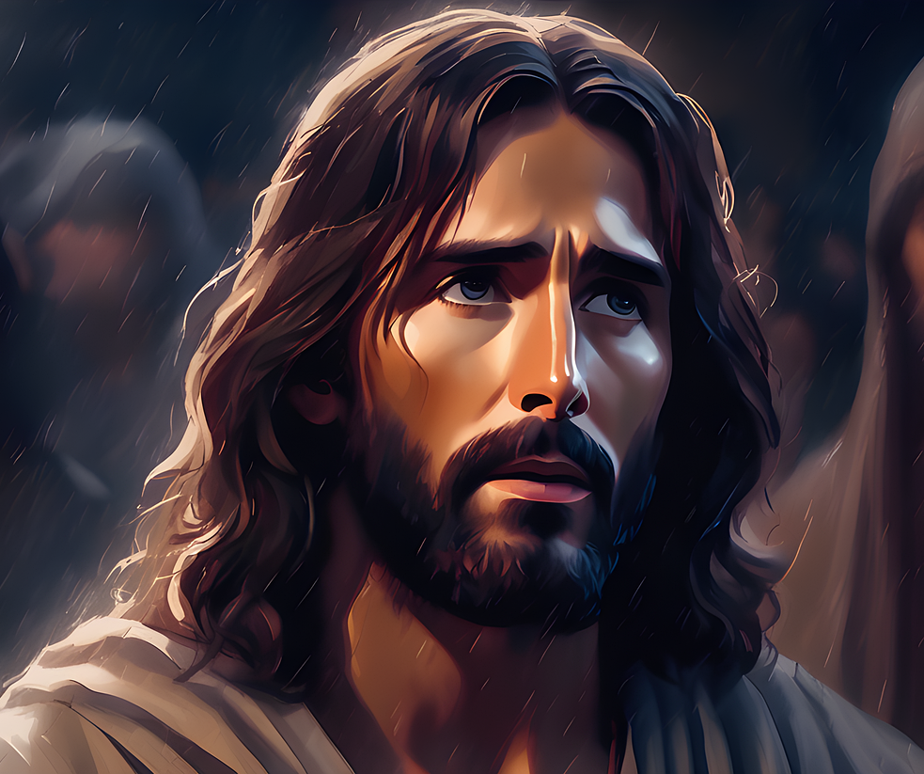
Joseph in Genesis | Jesus of Nazareth
A Shepherd (37:2) | The Good Shepherd (John 10:11)
Beloved of his father (37:3) | Beloved of His Father (Matt 3:17)
Hated by his brothers (37:4, 5, 8) | Jesus was hated by His brothers (John 15:25; Luke 19:14; John 5:18; 7:7; 8:40)
Foretold his future sovereignty (37:7-12) | Foretold His future sovereignty (Matt 26:64; John 18:37)
Sent by his father to his brothers for their welfare (37:13-14) | Jesus was sent to the ‘lost sheep of Israel,’ by His Father (John 4:34; 5:30; 6:38-40; 12:48-50; 17:21) and the world (3:16-17)
Joseph’s brothers plotted to kill Joseph (37:18-20) | The Jews also plotted to kill Christ. (Matt 12:14; 26:4)
A slave, sold for the price of redemption (37:28) | Sold for thirty pieces of silver (the price of a slave - Matt 26:15)
Became a servant (39:1) | Became a servant (Phil 2:6, 7; Luke 22:27; John 13:1-17)
Tempted by Potiphar’s wife and did not sin (39:7-12) | Tempted by Satan and did not sin (Matt 4:1-11; Heb. 2:18; 4:15)
Falsely accused (39:16-18) | Falsely accused (Matthew 26:59-61)
Attempted no defense (39:19) | Attempted no defense at His trials (Isaiah 53:7)

Slide 22
Basic requisites when observing typology
A notable resemblance or correspondence between the type and antitype
Historical reality in both the type and the antitype
A prefiguring or predictive foreshadowing of the antitype by the type
A heightening in which the antitype is greater than the type
Divine design

Slide 23
Basic requisites when observing typology
A notable resemblance or correspondence between the type and antitype
Historical reality in both the type and the antitype
A prefiguring or predictive foreshadowing of the antitype by the type
A heightening in which the antitype is greater than the type
Divine design

Slide 24
Matthew 12:39-41
39 “But He answered and said to them, ‘An evil and adulterous generation craves for a sign; and yet no sign will be given to it but the sign of Jonah the prophet; 40 for just as JONAH WAS THREE DAYS AND THREE NIGHTS IN THE BELLY OF THE SEA MONSTER, so will the Son of Man be three days and three nights in the heart of the earth. 41 The men of Nineveh will stand up with this generation at the judgment and will condemn it because they repented at the preaching of Jonah; and behold, something greater than Jonah is here.’”

Slide 25
Basic requisites when observing typology
A notable resemblance or correspondence between the type and antitype
Historical reality in both the type and the antitype
A prefiguring or predictive foreshadowing of the antitype by the type
A heightening in which the antitype is greater than the type
Divine design

Slide 26
Matthew 12:39-41
39 “But He answered and said to them, ‘An evil and adulterous generation craves for a sign; and yet no sign will be given to it but the sign of Jonah the prophet; 40 for just as JONAH WAS THREE DAYS AND THREE NIGHTS IN THE BELLY OF THE SEA MONSTER, so will the Son of Man be three days and three nights in the heart of the earth. 41 The men of Nineveh will stand up with this generation at the judgment and will condemn it because they repented at the preaching of Jonah; and behold, something greater than Jonah is here.’”

Slide 27
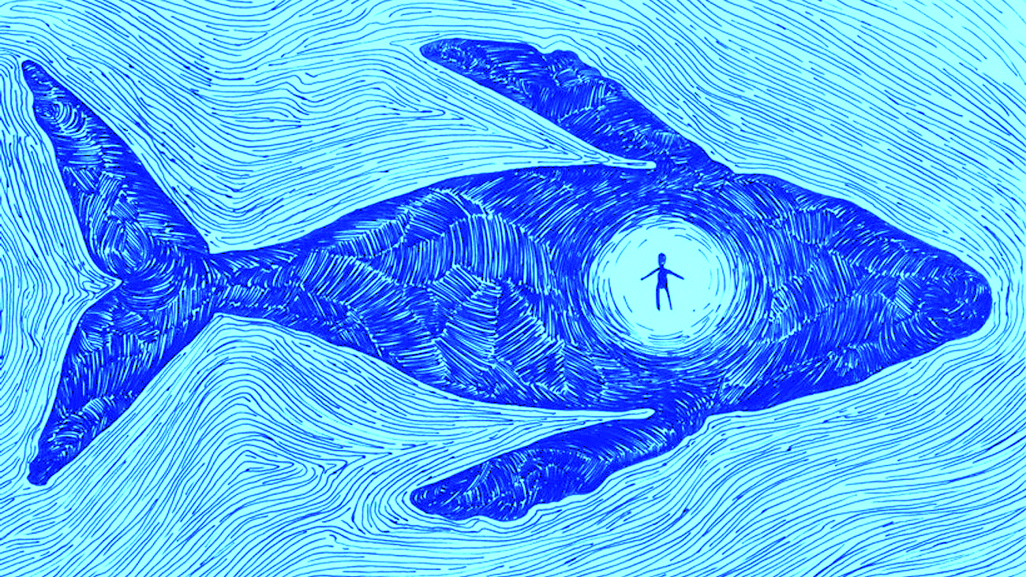
Jonah 1:17
And the LORD appointed a great fish to swallow Jonah, and Jonah was in the stomach of the fish three days and three nights.
ART BY ALMA SHEPPARD-MATSUO

Slide 28
CHRIST IN JONAH? YES!
Through Messianic Typology, such as…
Typifying Jonah’s experience in the whale to Christ’s death and resurrection (Matt 12:40)

Slide 29
Matthew 12:38-41 | Luke 11:29-32
39 - But He answered and said to them, “An evil and adulterous generation craves for a sign; and yet no sign will be given to it but the sign of Jonah the prophet; | 29 - As the crowds were increasing, He began to say, “This generation is a wicked generation; it seeks for a sign, and yet no sign will be given to it but the sign of Jonah.
40 - for just as JONAH WAS THREE DAYS AND THREE NIGHTS IN THE BELLY OF THE SEA MONSTER, | 30 - For just as Jonah became a sign to the Ninevites,
so will the Son of Man be three days and three nights in the heart of the earth. | so will the Son of Man be to this generation.
41 - The men of Nineveh will stand up with this generation at the judgment, and will condemn it because they repented at the preaching of Jonah; and behold, something greater than Jonah is here. | 31 - The Queen of the South will rise up with the men of this generation at the judgment and condemn them, because she came from the ends of the earth to hear the wisdom of Solomon; and behold, something greater than Solomon is here.
42 - The Queen of the South will rise up with this generation at the judgment and will condemn it, because she came from the ends of the earth to hear the wisdom of Solomon; and behold, something greater than Solomon is here. | 32 - The men of Nineveh will stand up with this generation at the judgment and condemn it, because they repented at the preaching of Jonah; and behold, something greater than Jonah is here.

Slide 30
Matthew 12:38-41 | Luke 11:29-32
39 - But He answered and said to them, “An evil and adulterous generation craves for a sign; and yet no sign will be given to it but the sign of Jonah the prophet; | 29 - As the crowds were increasing, He began to say, “This generation is a wicked generation; it seeks for a sign, and yet no sign will be given to it but the sign of Jonah.
40 - for just as JONAH WAS THREE DAYS AND THREE NIGHTS IN THE BELLY OF THE SEA MONSTER, | 30 - For just as Jonah became a sign to the Ninevites,
so will the Son of Man be three days and three nights in the heart of the earth. | so will the Son of Man be to this generation.
41 - The men of Nineveh will stand up with this generation at the judgment, and will condemn it because they repented at the preaching of Jonah; and behold, something greater than Jonah is here. | 31 - The Queen of the South will rise up with the men of this generation at the judgment and condemn them, because she came from the ends of the earth to hear the wisdom of Solomon; and behold, something greater than Solomon is here.
42 - The Queen of the South will rise up with this generation at the judgment and will condemn it, because she came from the ends of the earth to hear the wisdom of Solomon; and behold, something greater than Solomon is here. | 32 - The men of Nineveh will stand up with this generation at the judgment and condemn it, because they repented at the preaching of Jonah; and behold, something greater than Jonah is here.

Slide 31
Matthew 12:38-41 | Luke 11:29-32
39 - But He answered and said to them, “An evil and adulterous generation craves for a sign; and yet no sign will be given to it but the sign of Jonah the prophet; | 29 - As the crowds were increasing, He began to say, “This generation is a wicked generation; it seeks for a sign, and yet no sign will be given to it but the sign of Jonah.
40 - for just as JONAH WAS THREE DAYS AND THREE NIGHTS IN THE BELLY OF THE SEA MONSTER, | 30 - For just as Jonah became a sign to the Ninevites,
so will the Son of Man be three days and three nights in the heart of the earth. | so will the Son of Man be to this generation.
41 - The men of Nineveh will stand up with this generation at the judgment, and will condemn it because they repented at the preaching of Jonah; and behold, something greater than Jonah is here. | 31 - The Queen of the South will rise up with the men of this generation at the judgment and condemn them, because she came from the ends of the earth to hear the wisdom of Solomon; and behold, something greater than Solomon is here.
42 - The Queen of the South will rise up with this generation at the judgment and will condemn it, because she came from the ends of the earth to hear the wisdom of Solomon; and behold, something greater than Solomon is here. | 32 - The men of Nineveh will stand up with this generation at the judgment and condemn it, because they repented at the preaching of Jonah; and behold, something greater than Jonah is here.

Slide 32
Matthew 12:38-41 | Luke 11:29-32
39 - But He answered and said to them, “An evil and adulterous generation craves for a sign; and yet no sign will be given to it but the sign of Jonah the prophet; | 29 - As the crowds were increasing, He began to say, “This generation is a wicked generation; it seeks for a sign, and yet no sign will be given to it but the sign of Jonah.
40 - for just as JONAH WAS THREE DAYS AND THREE NIGHTS IN THE BELLY OF THE SEA MONSTER, | 30 - For just as Jonah became a sign to the Ninevites,
so will the Son of Man be three days and three nights in the heart of the earth. | so will the Son of Man be to this generation.
41 - The men of Nineveh will stand up with this generation at the judgment, and will condemn it because they repented at the preaching of Jonah; and behold, something greater than Jonah is here. | 31 - The Queen of the South will rise up with the men of this generation at the judgment and condemn them, because she came from the ends of the earth to hear the wisdom of Solomon; and behold, something greater than Solomon is here.
42 - The Queen of the South will rise up with this generation at the judgment and will condemn it, because she came from the ends of the earth to hear the wisdom of Solomon; and behold, something greater than Solomon is here. | 32 - The men of Nineveh will stand up with this generation at the judgment and condemn it, because they repented at the preaching of Jonah; and behold, something greater than Jonah is here.

Slide 33
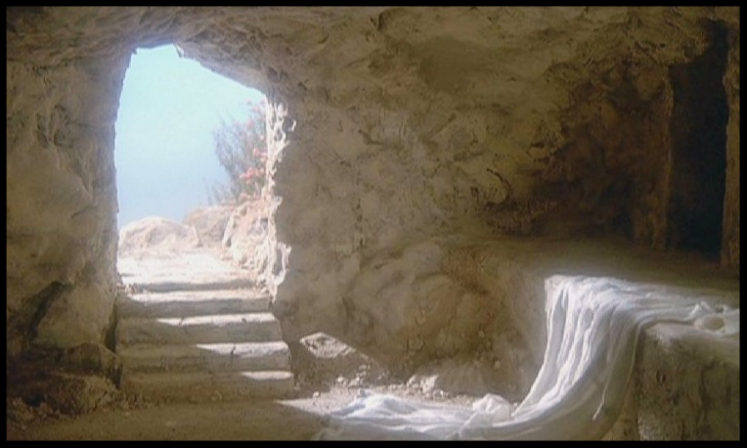
“…raised on the third day…”
Matthew 16:21
17:23
20:19
Luke 9:22
Acts 10:40
1 Corinthians 15:4

Slide 34
Jonah 2:1-2
Then Jonah prayed to the LORD his God from the stomach of the fish, and he said, “I called out of my distress to the LORD, And He answered me. I cried for help from the depth of Sheol; You heard my voice.
ART BY ALMA SHEPPARD-MATSUO

Slide 35
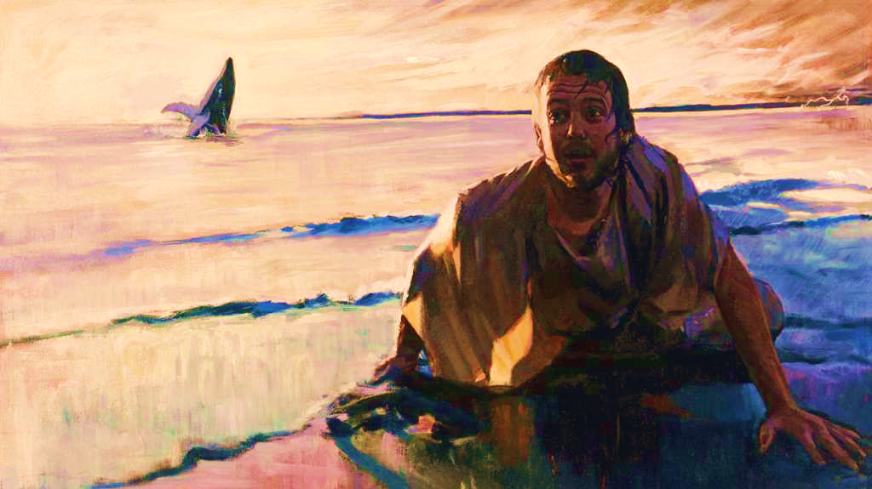
Matt 12:40
“for just as JONAH WAS THREE DAYS AND THREE NIGHTS IN THE BELLY OF THE SEA MONSTER,
so will the Son of Man be three days and three nights in the heart of the earth.”
Luke 11:30-
“For just as Jonah became a sign to the Ninevites,
so will the Son of Man be to this generation.”

Slide 36
Matthew 12:38-41 | Luke 11:29-32
39 - But He answered and said to them, “An evil and adulterous generation craves for a sign; and yet no sign will be given to it but the sign of Jonah the prophet; | 29 - As the crowds were increasing, He began to say, “This generation is a wicked generation; it seeks for a sign, and yet no sign will be given to it but the sign of Jonah.
40 - for just as JONAH WAS THREE DAYS AND THREE NIGHTS IN THE BELLY OF THE SEA MONSTER, | 30 - For just as Jonah became a sign to the Ninevites,
so will the Son of Man be three days and three nights in the heart of the earth. | so will the Son of Man be to this generation.
41 - The men of Nineveh will stand up with this generation at the judgment, and will condemn it because they repented at the preaching of Jonah; and behold, something greater than Jonah is here. | 31 - The Queen of the South will rise up with the men of this generation at the judgment and condemn them, because she came from the ends of the earth to hear the wisdom of Solomon; and behold, something greater than Solomon is here.
42 - The Queen of the South will rise up with this generation at the judgment and will condemn it, because she came from the ends of the earth to hear the wisdom of Solomon; and behold, something greater than Solomon is here. | 32 - The men of Nineveh will stand up with this generation at the judgment and condemn it, because they repented at the preaching of Jonah; and behold, something greater than Jonah is here.

Slide 37
Matthew 12:38-41 | Luke 11:29-32
39 - But He answered and said to them, “An evil and adulterous generation craves for a sign; and yet no sign will be given to it but the sign of Jonah the prophet; | 29 - As the crowds were increasing, He began to say, “This generation is a wicked generation; it seeks for a sign, and yet no sign will be given to it but the sign of Jonah.
40 - for just as JONAH WAS THREE DAYS AND THREE NIGHTS IN THE BELLY OF THE SEA MONSTER, | 30 - For just as Jonah became a sign to the Ninevites,
so will the Son of Man be three days and three nights in the heart of the earth. | so will the Son of Man be to this generation.
41 - The men of Nineveh will stand up with this generation at the judgment, and will condemn it because they repented at the preaching of Jonah; and behold, something greater than Jonah is here. | 31 - The Queen of the South will rise up with the men of this generation at the judgment and condemn them, because she came from the ends of the earth to hear the wisdom of Solomon; and behold, something greater than Solomon is here.
42 - The Queen of the South will rise up with this generation at the judgment and will condemn it, because she came from the ends of the earth to hear the wisdom of Solomon; and behold, something greater than Solomon is here. | 32 - The men of Nineveh will stand up with this generation at the judgment and condemn it, because they repented at the preaching of Jonah; and behold, something greater than Jonah is here.

Slide 38
CHRIST IN JONAH? YES!
Through Messianic Typology, such as…
Typifying Jonah’s experience in the whale to Christ’s death and resurrection (Matt 12:40)

Slide 39
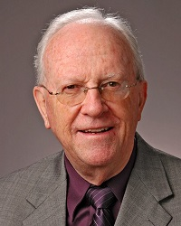
“The Sign of Jonah” by Eugene Merrill
From: The Journal of the Evangelical Theological Society
“Having been cast on the land, Jonah made his way to Nineveh to undertake his mission…it is unlikely that the story of his marvelous transportation and deliverance failed to become known and even to precede him. In any event, the confinement in the stomach of the fish with its attendant and obvious deleterious effects would surely mark Jonah physically and could not fail to make him the object of utmost curiosity. And of course one cannot rule out the possibility of divinely appointed witnesses who not only saw the regurgitation but bore testimony to it in Nineveh and all along the way. But these speculations in the final analysis are unnecessary so long as we recognize that in some manner Jonah became a sign to the Ninevites, his association with the fish being its most plausible source. The sign to which Jesus made reference must have been a major factor in the response of the city of Nineveh to the preaching of Jonah, for the acceptance of his message was apparently immediate and universal.

Slide 40
“The Sign of Jonah” by Eugene Merrill
From: The Journal of the Evangelical Theological Society
“The people, the king, and even the animals were clothed in sackcloth to demonstrate the sincerity of the city’s repentance. Whether the king was Ashur-dan III or not there is no basis in light of the sparse documentation that does exist to deny the historical integrity of the Jonah story and the reality of the sign that brought city-wide repentance to Nineveh. Since the Lord Jesus, according to both Matthew and Luke, spoke of Jonah as constituting in himself a sign to Nineveh, a sign so persuasive that the population from king to peasant repented, something in Jonah’s experience must be found to provide adequate explanation for his effectiveness. In Matthew, attention is drawn to Jonah…in the belly of the fish for three days and three nights, but since Luke specifies that Jonah was a sign to Nineveh that experience in the fish must have been communicated to the Assyrian capital and have become to the Ninevites a sign that Jonah was a divine messenger. Such a sign would be particularly convincing to a people whose aetiology taught them that their city had been founded by a fish-god.

Slide 41
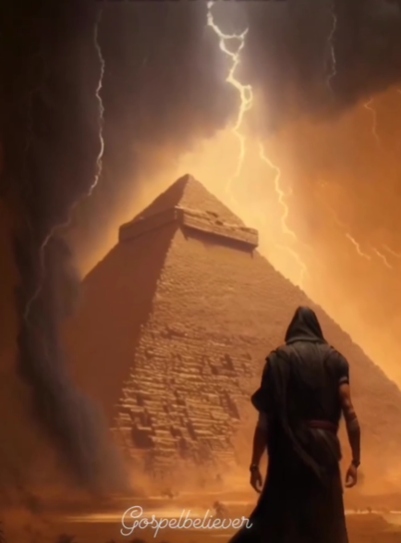
Plague | Reference | Egyptian god Mocked
1. Water into Blood | Exodus 7:17-18 | Apis, the god of Nile; Isis, goddess of Nile; Khnum, guardian of Nile. Nile is bloodstream of Osiris
2. Frogs | Exodus 8:1-4 | Heqet, the frog-headed goddess.
3. Lice, gnats | Exodus 8:16-17 | Set, the god of the desert.
4. Flies | Exodus 8:20-22 | Uatchit, the fly god.
5. Pestilence on livestock | Exodus 9:1-4 | Hathor, cattle goddess
6. Boils, sores | Exodus 9:8-9 | Sekhmet, Sunu, and Isis, gods of health.
7. Hail | Exodus 9:22-23 | Nut, the sky goddess; Osiris, the crop fertility god; and Set, the storm god
8. Locusts | Exodus 10:4-5 | Same as above
9. Darkness | Exodus 10:21-22 | Re, sun god; also symbolized Pharoah himself
10. Death of Egypt’s firstborn | Exodus 11:4-7 | Isis, the protector of children

Slide 42
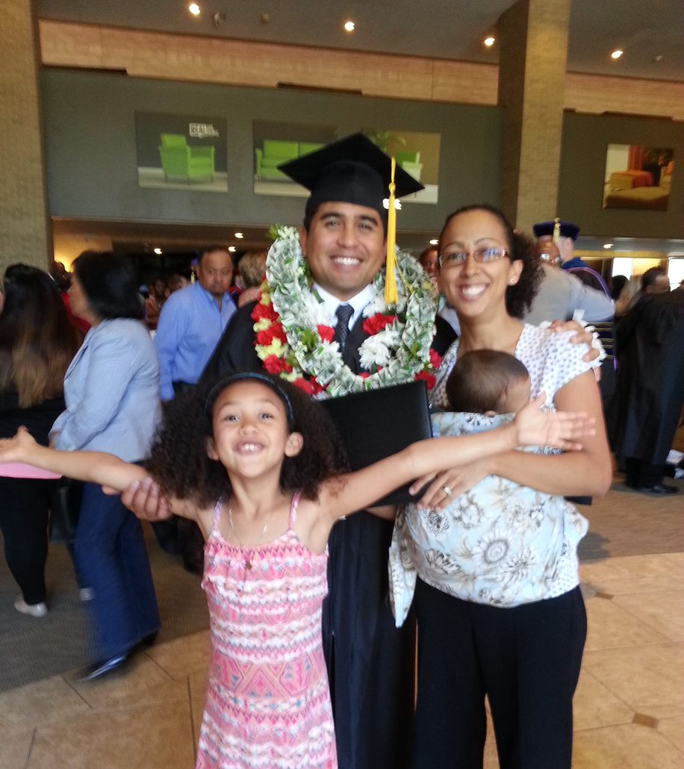

Slide 43
JONAH: AN INTRODUCTION, PART 3
Why was it written? (Purpose) Expose Israel’s ethnocentrism and encourage national repentance
What’s in it? (Survey) Defiance (1-2) Compliance (3-4)
Christ in Jonah? Yes, through Messianic typology
What makes this book unique?
Structure of the book?
Outline of book?

Slide 44
What makes this book unique?
God’s relentless love, grace, and mercy towards man.
God’s sovereignty
Disobedience may bring turmoil in the believer’s life
Israel's missionary purpose
An example of a proper response to God

Slide 45
JONAH: AN INTRODUCTION, PART 3
Why was it written? (Purpose) Expose Israel’s ethnocentrism and encourage national repentance
What’s in it? (Survey) Defiance (1-2) Compliance (3-4)
Christ in Jonah? Yes, through Messianic typology
What makes this book unique?
Structure/Outline of the book?

Slide 46
WHAT’S IN THE BOOK?: A SURVEY
Jonah’s Prideful Defiance (1-2)
Jonah’s Reluctant Compliance (3-4)

Slide 47
Structure & Outline of Jonah
Jonah’s Prideful Defiance (1-2)
God’s commission to Jonah (1:1-2)
Jonah’s flees from God (1:3)
Jonah, the culprit (1:7-9)
Jonah, man overboard (1:10-16)
Jonah saved by the fish (1:17)
Outline adapted from Jonah Argument, by Andy Woods, 2007.

Slide 48
Structure & Outline of Jonah
Jonah’s Prideful Defiance (1-2)
I. Jonah’s Prayer (2)
Jonah’s psalm of thanksgiving (2:2-9)
Call to God (2)
Recalls his dire circumstances (3-6)
Remembers God (7)
Praises God (8-9)
Jonah ejected from the fish (2:10)
Outline adapted from Jonah Argument, by Andy Woods, 2007.

Slide 49
Structure & Outline of Jonah
2. Jonah’s Reluctant Compliance (3-4)
God recommissions Jonah (3:1-2)
Jonah the preacher (3:3-4)
Nineveh’s response (3:5-10)
Outline adapted from Jonah Argument, by Andy Woods, 2007.

Slide 50
Structure & Outline of Jonah
2. Jonah’s Reluctant Compliance (3-4)
Jonah bad attitude (4:1-4)
God rebukes Jonah (4:5-11)
Jonah sulks (5-6)
Jonah’s suicidal (7-8)
Jonah reasons (9)
Jonah learns (10-11)
Outline adapted from Jonah Argument, by Andy Woods, 2007.

Slide 51
JONAH: AN INTRODUCTION, PART 3
Who wrote it? Jonah
When was it written? 770-750 BC
Who was it written to? Israel
Historicity of the book? Fact!
Genre of the book? Historical Narrative
What is it all about? (Message) To showcase God’s universal love and plan of redemption which extends beyond Israel to include all nations

Slide 52
JONAH: AN INTRODUCTION, PART 3
Why was it written? (Purpose) Expose Israel’s ethnocentrism and encourage national repentance
What’s in it? (Survey) Defiance (1-2) Compliance (3-4)
Christ in Jonah? Yes, through Messianic typology
What makes this book unique?
Structure/Outline of the book?

Slide 53
