Slide 1
Law and Grace: An Overview Jim McGowan, Th.D. Sugar Land Bible Church 10-01-2023
…but grace and truth were realized through Jesus Christ - John 1:17
For the Law was given through Moses…
Special thanks to Dr. Vern Peterman for access to his insights and resources.

Slide 2
Session 39 Outline
Review
Purpose, Aim, and Objective
Session 38
Gentiles, Israel, and the Church – Part II
More Information
Charting The Future
Concluding Observations

Slide 3
OUR PURPOSE, AIM AND OBJECTIVE
Law and Grace
…is to Compare and Contrast Law and Grace so as to properly understand these two important themes and how they are related to the life of the New Testament Believer.

Slide 4
C. I. Scofield, D. D.
The Grace of God, The Fundamentals Vol. 3, Chapter VII, p. 98
We have, most of us, been reared and now live under the influence of Galatianism. Protestant theology, alas, is for the most part, thoroughly Galatianized, in that neither law nor grace are given their distinct and separated places, as in the counsels of God, but are mingled together in one incoherent system. The law is no longer, as in the Divine intent, a ministration of death (2 Cor. 3:7), of cursing (Gal. 3:10), of conviction (Rom. 3:19), because we are taught that we must try to keep it, and that by Divine help we may. Nor, on the other hand, does grace bring us blessed deliverance from the dominion of sin, for we are kept under the law as a rule of life despite the plain declaration, “Sin shall not have dominion over you: for ye are not under the law, but under grace” (Rom. 6:14). (emphasis mine)

Slide 5
William R. Newell
Romans Verse-by-Verse (p. 274).
Grand Rapids, MI: Christian Classics Ethereal Library.
It is because Reformed theology has kept us Gentiles under the Law,—if not as a means of righteousness, then as “a rule of life,” that all the trouble has arisen. The Law is no more a rule of life than it is a means of righteousness. Walking in the Spirit has now taken the place of walking by ordinances. God has another principle under which He has put his saints: “Ye are not under law, but, under grace! (Rom. 6:14)” (italics mine)
PDF Download Here: https://archive.org/details/Romans_Verse_By_Verse-NewellWR

Slide 6
Henry Ironside
The Continual Burnt Offering: Daily Meditations on the Word of God (p. 265). Neptune, NJ: Loizeaux Brothers.
There is therefore now no condemnation
to those who are in Christ Jesus. – Romans 8:1
In Romans 7 we have a man renewed by the Spirit of God, but struggling under law, hoping thereby to subdue or find deliverance from the power of the old Adamic nature (sin nature). In chapter 8 we have God’s (only) way of deliverance through the death and resurrection of Christ with which the believer is identified before God. The chapter begins with “no condemnation” and ends with “no separation.” All who are in Christ Jesus are accepted in the Beloved and as free from every charge of guilt as He is Himself. He [Jesus] paid our penalty on the cross. Now we are linked up with Him in resurrection, not under law but under grace.

Slide 7
Matthew’s 3-Fold Purpose
Law and Grace: Review The SOM – Matthew 5:1–8:1 (Luke 6:17–49)
To explain:
that Jesus in whom they had believed was the long-awaited Jewish Messiah
why the kingdom had been postponed despite the fact that the king had arrived
the interim program of God during the kingdom’s absence

Slide 8
Session 39 Outline
Review
Purpose, Aim, and Objective
Session 38
Gentiles, Israel, and the Church – Part II
More Information
Charting The Future
Concluding Observations

Slide 9
Law and Grace: The SOM – Matthew 5:1–8:1 (Luke 6:17–49)
THREE DIFFERENT GROUPS OF PEOPLE
GENTILES
ISRAEL
ISRAEL

Slide 10
Law and Grace: The SOM – Matthew 5:1–8:1 (Luke 6:17–49)
 | GENTILES | ISRAEL | CHURCH
ALSO CALLED | nations, peoples | Hebrews, Jews | body & bride of Christ
BEGAN IN | Genesis 1-11 | Genesis 12-50 | Acts 2-28
PRIMARY STEWARD (S) | Adam, Noah | Moses | Christ
REIGNING PRINCIPLE | Law of Conscience | Law of Moses | Grace
WHOSE WORKS | Self | Self | Christ’s
CHRIST DIED FOR | all | all | all
SAVED | Some, by faith | Some, by faith | All, by faith
IDENTIFICATION, BAPTISM, & PHRASING IN SCRIPTURE | In Adam, with Noah, “among the nations” | Baptized into Moses, “in Israel” | Baptized into Christ, “In Christ”

Slide 11
Law and Grace: The SOM – Matthew 5:1–8:1 (Luke 6:17–49)
 | GENTILES | ISRAEL | CHURCH
NATURE OF BLESSINGS | Initial blessings for Adam & Noah; earthly reproduction | Conditional, earthly | Unconditional, heavenly
EARTHLY DIFFICULTIES | Fall; the limitations are to cause mankind to seek God | Curses for disobedience | Trials for conformity to Christ or for discipline
GRACE | Partial | Partial | Reigning principle
SPIRIT’S ROLE | Will be poured out on all of mankind, in the kingdom | New Covenant promise in the coming kingdom | Indwells each believer all of the time
CHRIST’S KINGDOM TITLE | King of kings & Lord of lords (over the Gentile nations) | King of Israel, Messiah | The Bridegroom, with Whom we reign
GOSPEL (S) | Substitution | Kingdom & substitution | Substitution

Slide 12
Session 39 Outline
Review
Purpose, Aim, and Objective
Session 38
Gentiles, Israel, and the Church – Part II
More Information
Charting The Future
Concluding Observations

Slide 13
Law and Grace: The SOM – Matthew 5:1–8:1 (Luke 6:17–49)
GENTILES, ISRAEL & THE CHURCH - PART II
We could title our message today, “Where are they and where are we?”, because a fundamental and key point we want to make clear is, “Where does God have each of these three groups positioned?”

Slide 14
Law and Grace: The SOM – Matthew 5:1–8:1 (Luke 6:17–49)
BECAUSE LOCATION MATTERS…

Slide 15
Law and Grace: The SOM – Matthew 5:1–8:1 (Luke 6:17–49)
HERE’S THE PATTERN

Slide 16
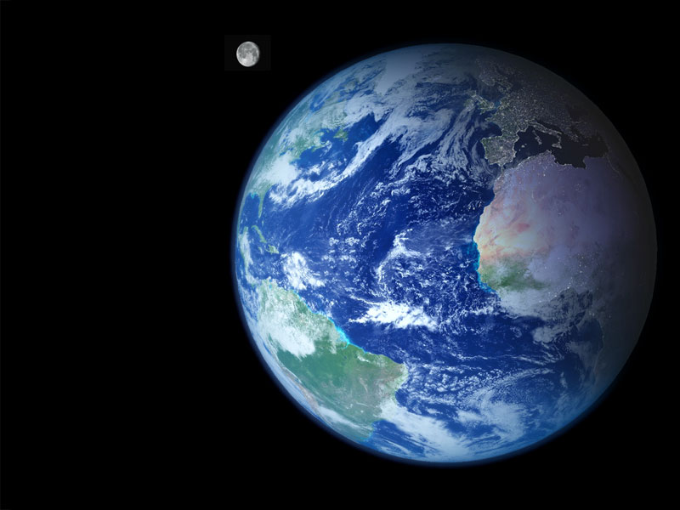
Law and Grace: The SOM – Matthew 5:1–8:1 (Luke 6:17–49)
HERE’S THE PATTERN
Gentiles, who are all of the non-Jews, begun in Adam, are an ethnic distinction whose place was and will be on the earth.

Slide 17
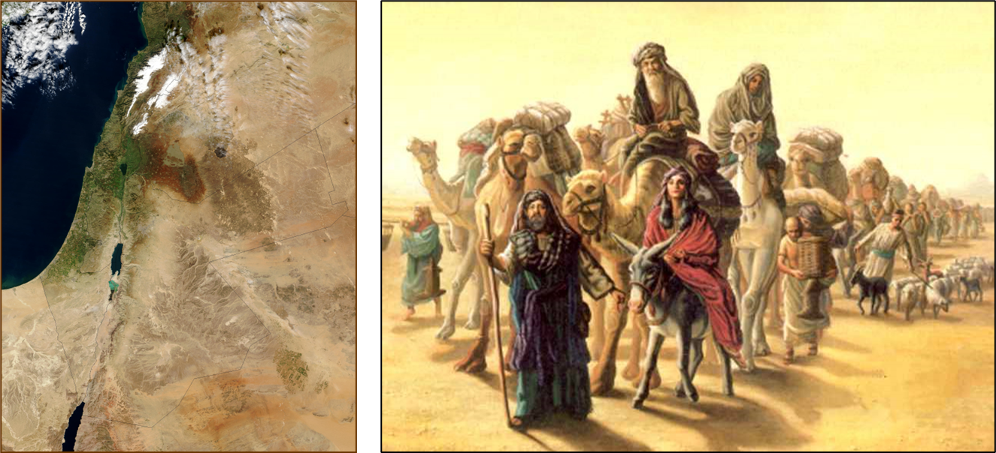
Law and Grace: The SOM – Matthew 5:1–8:1 (Luke 6:17–49)
HERE’S THE PATTERN
Israel, who is all of the Jews, begun in Abraham, Isaac and Jacob, is earthly, and the Gentiles’ access to God, forever.

Slide 18
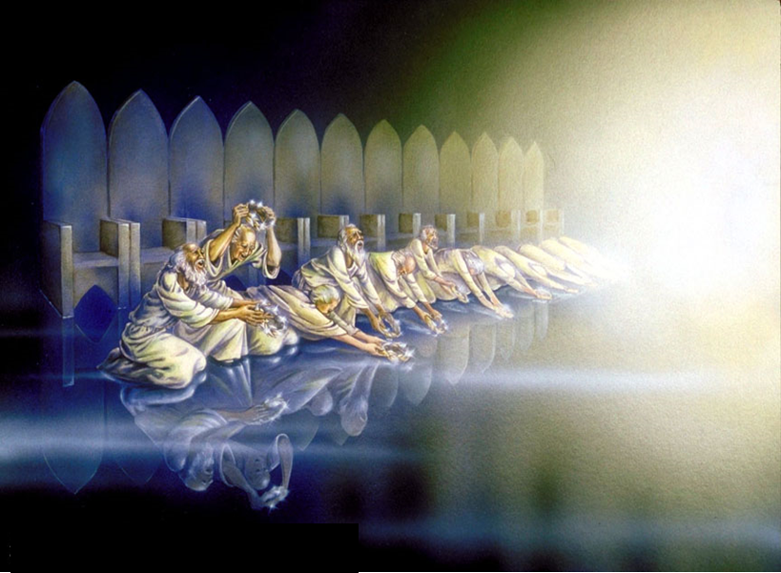
Law and Grace: The SOM – Matthew 5:1–8:1 (Luke 6:17–49)
HERE’S THE PATTERN
We in the body of Christ are a spiritual body, composed of ethnic Gentiles and Jews, whose blessings, spiritual location, and citizenship are heavenly in Christ.

Slide 19
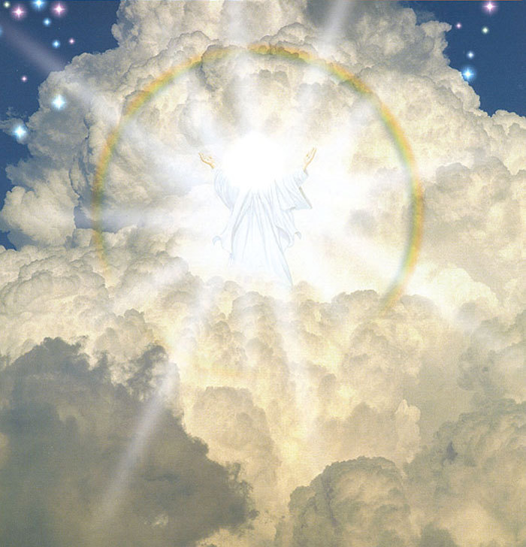
Philippians 3:20
For our citizenship is in heaven, from which also we eagerly wait for a Savior, the Lord Jesus Christ…

Slide 20
Law and Grace: The SOM – Matthew 5:1–8:1 (Luke 6:17–49)
AND THEY’RE OFF – WAY OFF!

Slide 21
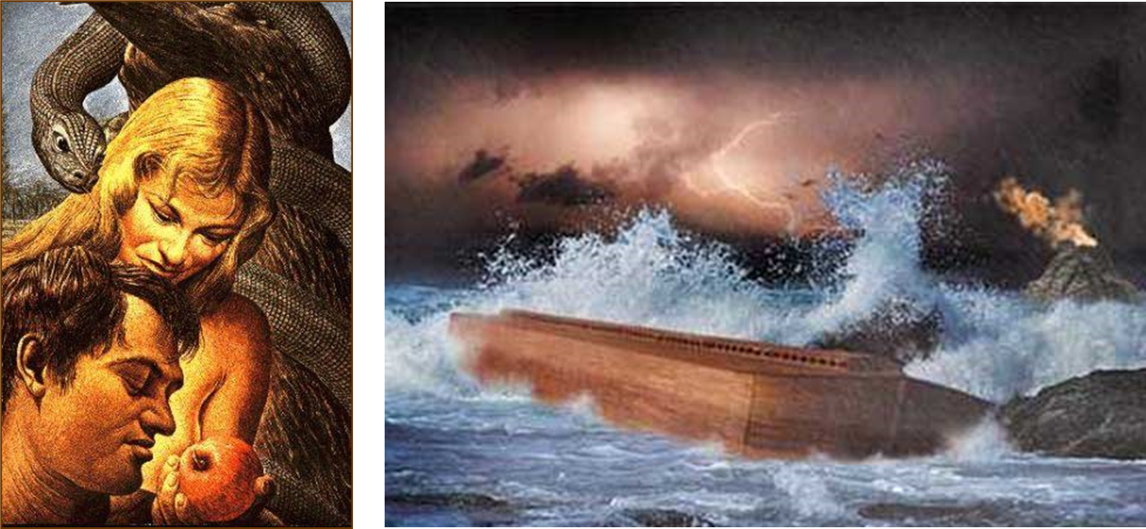
Law and Grace: The SOM – Matthew 5:1–8:1 (Luke 6:17–49)
AND THEY’RE OFF – WAY OFF!
The Gentiles, who all began in fallen Adam, had as their primary stewards Adam and Noah.

Slide 22
Law and Grace: The SOM – Matthew 5:1–8:1 (Luke 6:17–49)
AND THEY’RE OFF – WAY OFF!
Though a very few walked with God, great judgments mark their path: Fall, Flood and Babel.

Slide 23
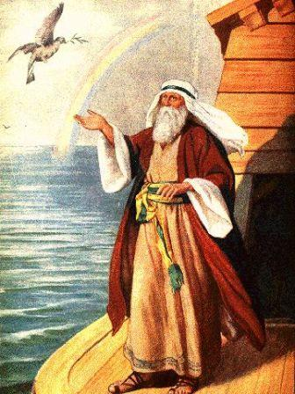
Law and Grace: The SOM – Matthew 5:1–8:1 (Luke 6:17–49)
AND THEY’RE OFF – WAY OFF!
Though a very few walked with God, great judgments mark their path: Fall, Flood and Babel.

Slide 24
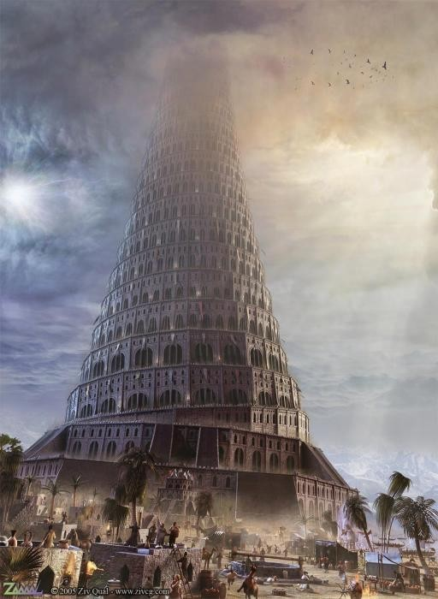
Law and Grace: The SOM – Matthew 5:1–8:1 (Luke 6:17–49)
AND THEY’RE OFF – WAY OFF!
Though a very few walked with God, great judgments mark their path: Fall, Flood and Babel.

Slide 25
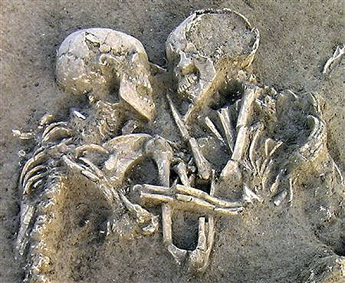
Law and Grace: The SOM – Matthew 5:1–8:1 (Luke 6:17–49)
AND THEY’RE OFF – WAY OFF!
Under the founding Gentiles, the earth was the center of their domain:
Earth cursed.

Slide 26
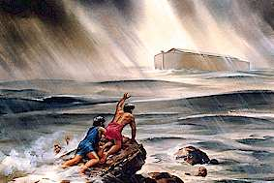
Law and Grace: The SOM – Matthew 5:1–8:1 (Luke 6:17–49)
AND THEY’RE OFF – WAY OFF!
Under the founding Gentiles, the earth was the center of their domain:
Earth flooded.

Slide 27
Law and Grace: The SOM – Matthew 5:1–8:1 (Luke 6:17–49)
AND THEY’RE OFF – WAY OFF!
Under the founding Gentiles, the earth was the center of their domain:
Earth was given a rainbow as a sign that God would not ever flood it again. .

Slide 28
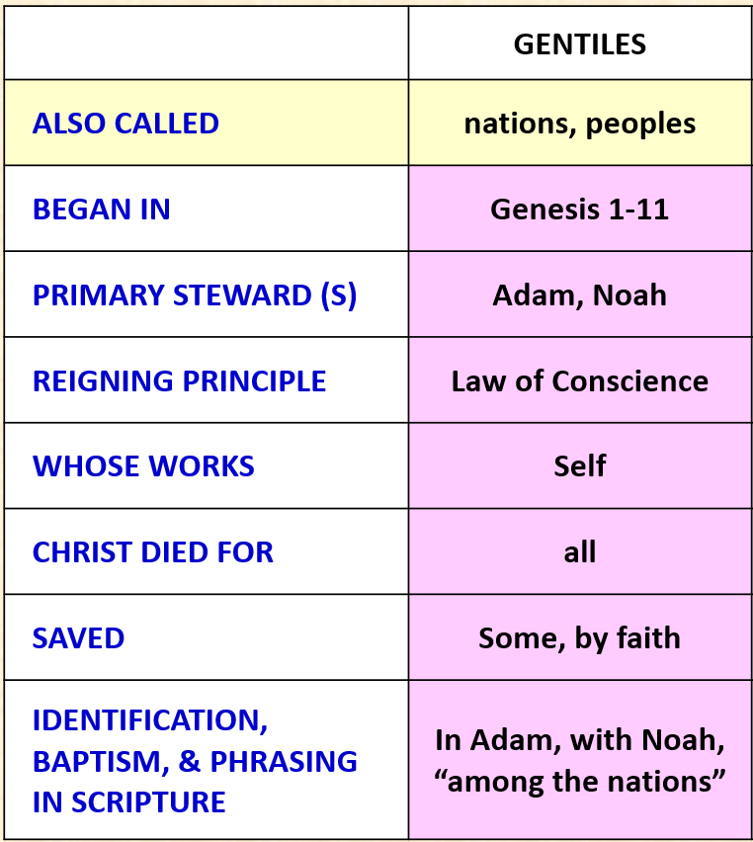
GENTILES, NATIONS, PEOPLES: EARTHLY
Law and Grace: The SOM – Matthew 5:1–8:1 (Luke 6:17–49)
In the chart from our last session, we said that the Gentiles are also called ‘the nations’ and ‘the peoples’ in God’s word.
In the Greek translation of the Old Testament called the Septuagint (LXX) and in the New Testament, the Greek word most often translated Gentile, is ethnos.

Slide 29
GENTILES, NATIONS, PEOPLES: EARTHLY
Law and Grace: The SOM – Matthew 5:1–8:1 (Luke 6:17–49)
Typical terms in the Bible that refer to the Gentiles are:
Nations of the earth
Peoples of the earth
Kings of the earth
These terms all identify and underscore that earth is their home.

Slide 30
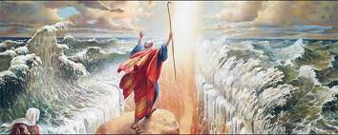
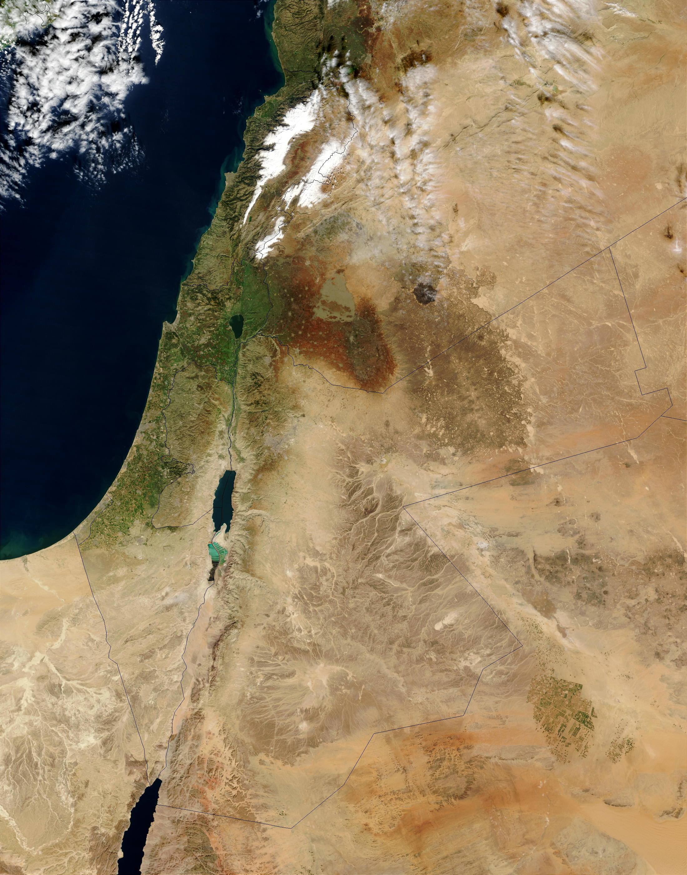
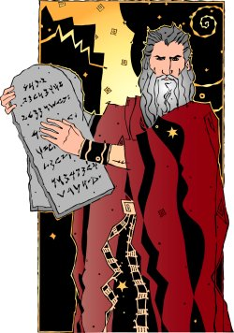
Law and Grace: The SOM – Matthew 5:1–8:1 (Luke 6:17–49)
ISRAEL, HEBREWS, JEWS: EARTHLY FOR THE SAKE OF BLESSING AND ACCESS
Abraham, and then Isaac and Jacob were promised an earthly land, and Moses led the Israelites to it, also giving them the Law (all 613!).

Slide 31
Law and Grace: The SOM – Matthew 5:1–8:1 (Luke 6:17–49)
ISRAEL, HEBREWS, JEWS: EARTHLY FOR THE SAKE OF BLESSING AND ACCESS
As the Israelites obey the Law of Moses they will be blessed in earthly ways and will have the respect of the Gentiles.

Slide 32
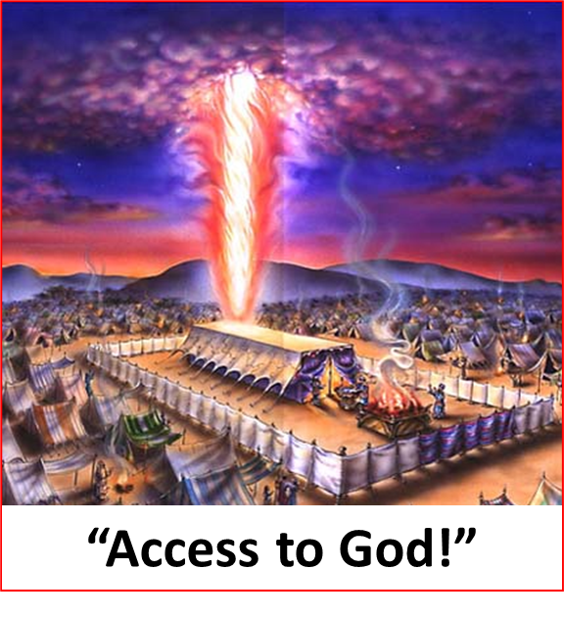
Law and Grace: The SOM – Matthew 5:1–8:1 (Luke 6:17–49)
ISRAEL, HEBREWS, JEWS: EARTHLY FOR THE SAKE OF BLESSING AND ACCESS
The Israelites, from the tabernacle in the wilderness to the four temples in Jerusalem and the New Jerusalem are the Gentiles’ access.

Slide 33
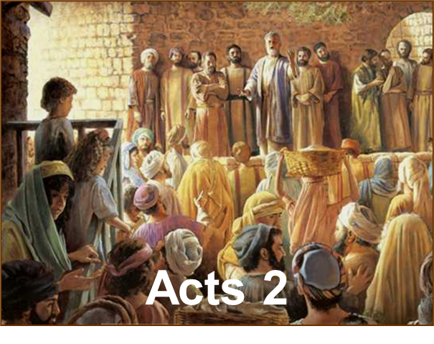
Law and Grace: The SOM – Matthew 5:1–8:1 (Luke 6:17–49)

Slide 34
Session 39 Outline
Review
Purpose, Aim, and Objective
Session 38
Gentiles, Israel, and the Church – Part II
More Information
Charting The Future
Concluding Observations

Slide 35
THE FUTURE TOLD, WELL IN ADVANCE
Law and Grace: The SOM – Matthew 5:1–8:1 (Luke 6:17–49)
Tribulation Millennial Kingdom Eternity
7 years 1000 years timeless
Before the seven-year Tribulation period begins, all Church Age believers will be taken up to be with the Lord (the Rapture) and we, in the Church, will forever be the Bride of Christ, ever to be with Him as His bride.

Slide 36
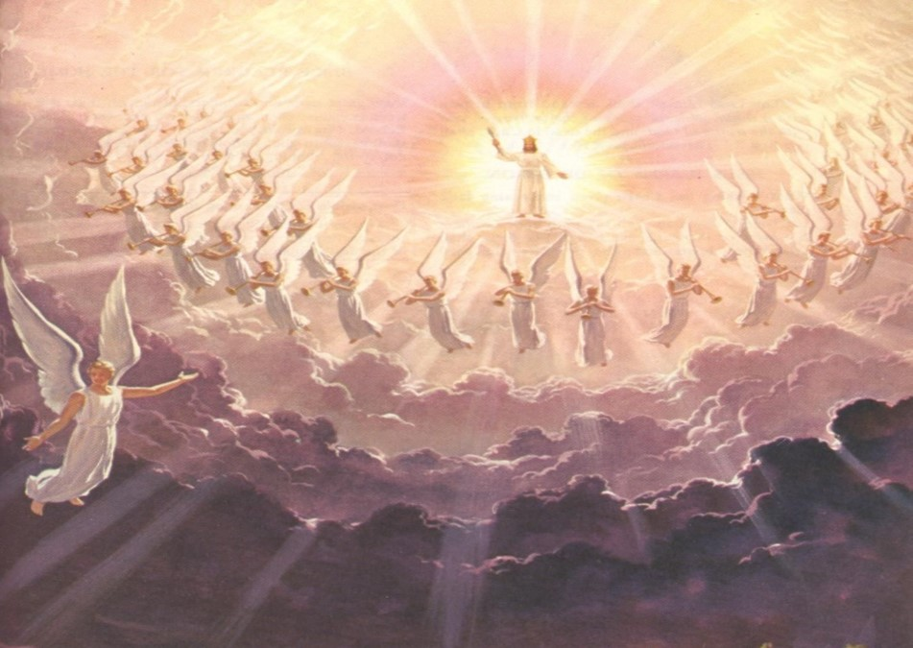
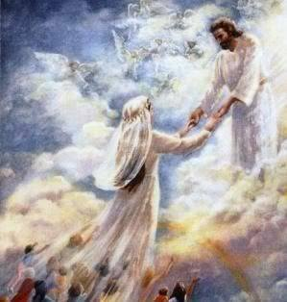
Law and Grace: The SOM – Matthew 5:1–8:1 (Luke 6:17–49)
THE CHURCH, CHRIST’S BRIDE, RAPTURED!

Slide 37
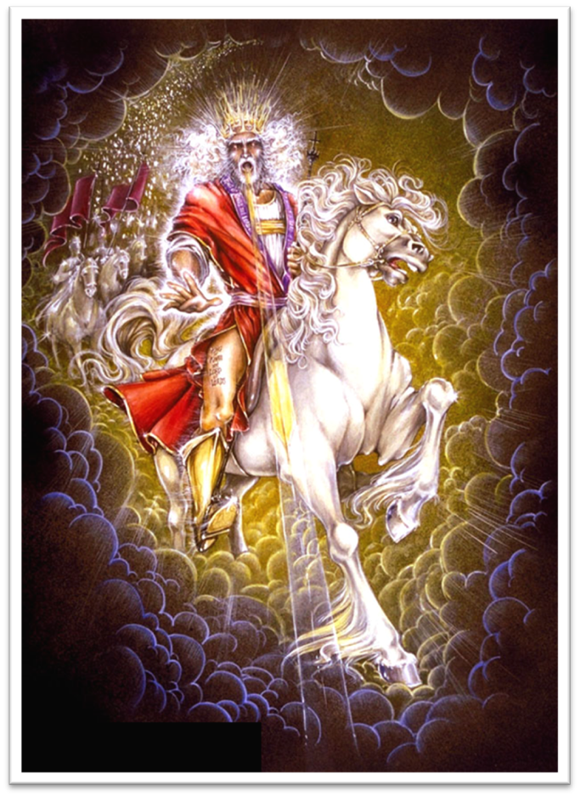
THE FUTURE TOLD, WELL IN ADVANCE
Law and Grace: The SOM – Matthew 5:1–8:1 (Luke 6:17–49)
Tribulation Millennial Kingdom Eternity
7 years 1000 years timeless
After the seven-year Tribulation period, Jesus Christ will return to earth to reign during the Millennial Kingdom and when He comes, He will come with angels, Old Testament saints, Martyred Tribulation saints… AND US!

Slide 38
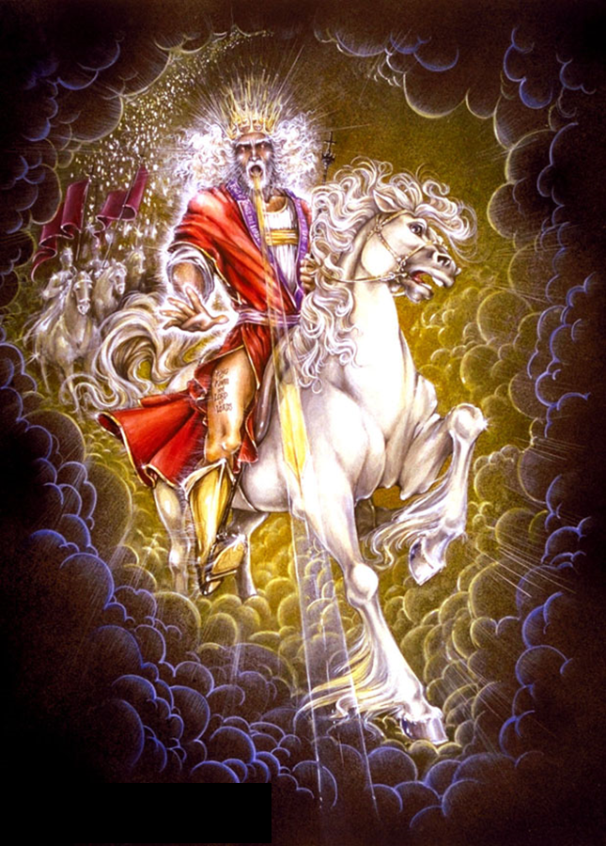
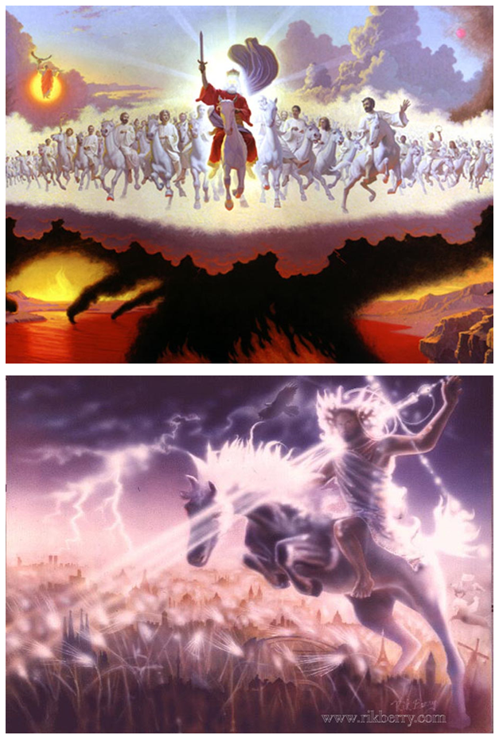
Law and Grace: The SOM – Matthew 5:1–8:1 (Luke 6:17–49)

Slide 39
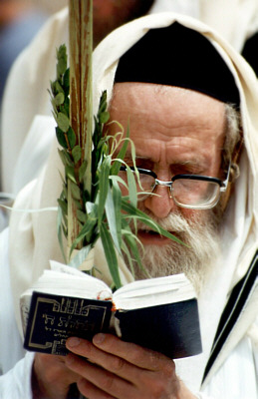
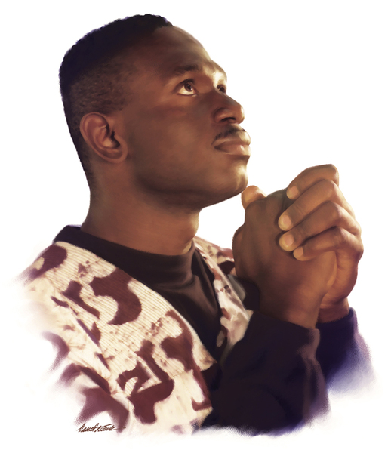
THE FUTURE TOLD, WELL IN ADVANCE
Law and Grace: The SOM – Matthew 5:1–8:1 (Luke 6:17–49)
Tribulation Millennial Kingdom Eternity
During the Millennial Kingdom the earth will be repopulated by both Jews and Gentiles who have come to faith in Jesus and also survived, the seven-year Tribulation period.

Slide 40
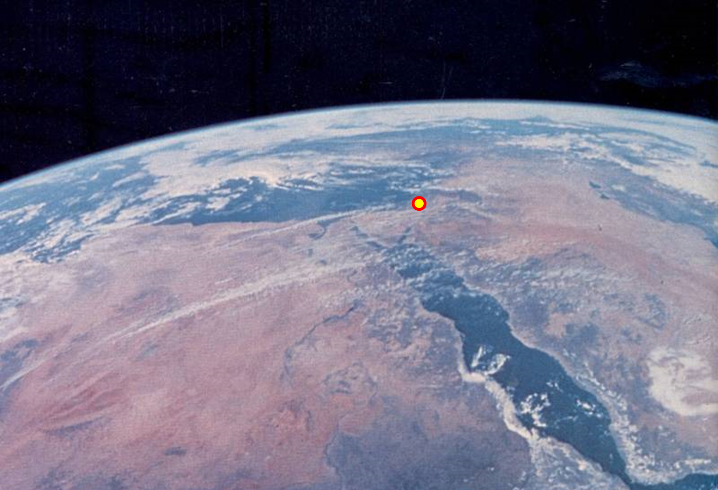
Law and Grace: The SOM – Matthew 5:1–8:1 (Luke 6:17–49)
THE FUTURE TOLD, WELL IN ADVANCE
During the Millennial Kingdom Christ will reign from Jerusalem as:
the King of Israel, and as
the King of kings and Lord of lords over the Gentiles.
Christ will not reign over the Church as He will over Israel and the Gentiles, rather, we in the Church will reign with Christ as His bride.

Slide 41
THE FUTURE TOLD, WELL IN ADVANCE
Law and Grace: The SOM – Matthew 5:1–8:1 (Luke 6:17–49)
Tribulation Millennial Kingdom Eternity
7 years 1000 years timeless
After the Millennial Kingdom we will transition into the Eternal State, where God will create New Heavens and a New Earth.
The New Jerusalem will be relocated from Heaven to the New Earth and both will be populated by believers of all dispensations, who will all have new, resurrected, bodies.

Slide 42
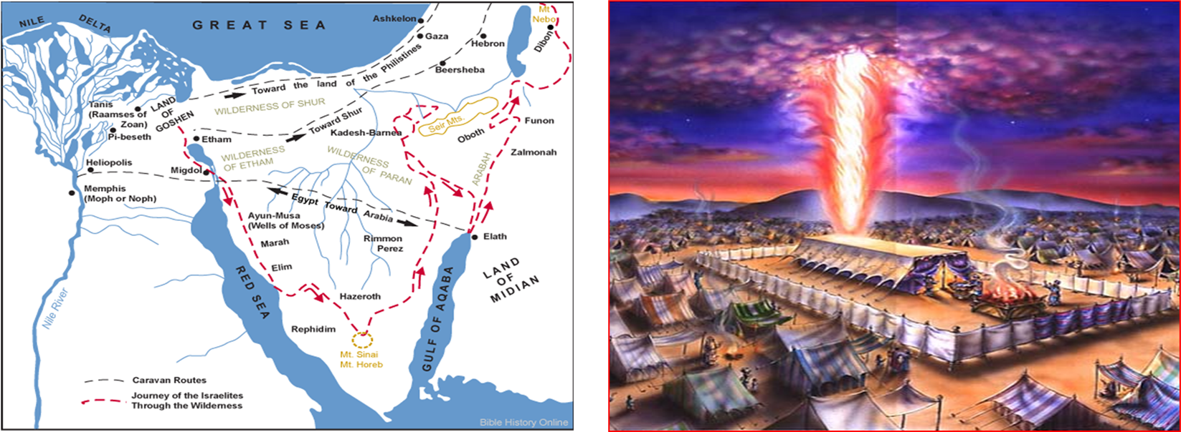
Law and Grace: The SOM – Matthew 5:1–8:1 (Luke 6:17–49)
ISRAEL, HEBREWS, JEWS: EARTHLY FOR THE SAKE OF BLESSING AND ACCESS
The Israelites, from the tabernacle in the wilderness to the four temples in Jerusalem and the New Jerusalem are the Gentiles’ access.

Slide 43
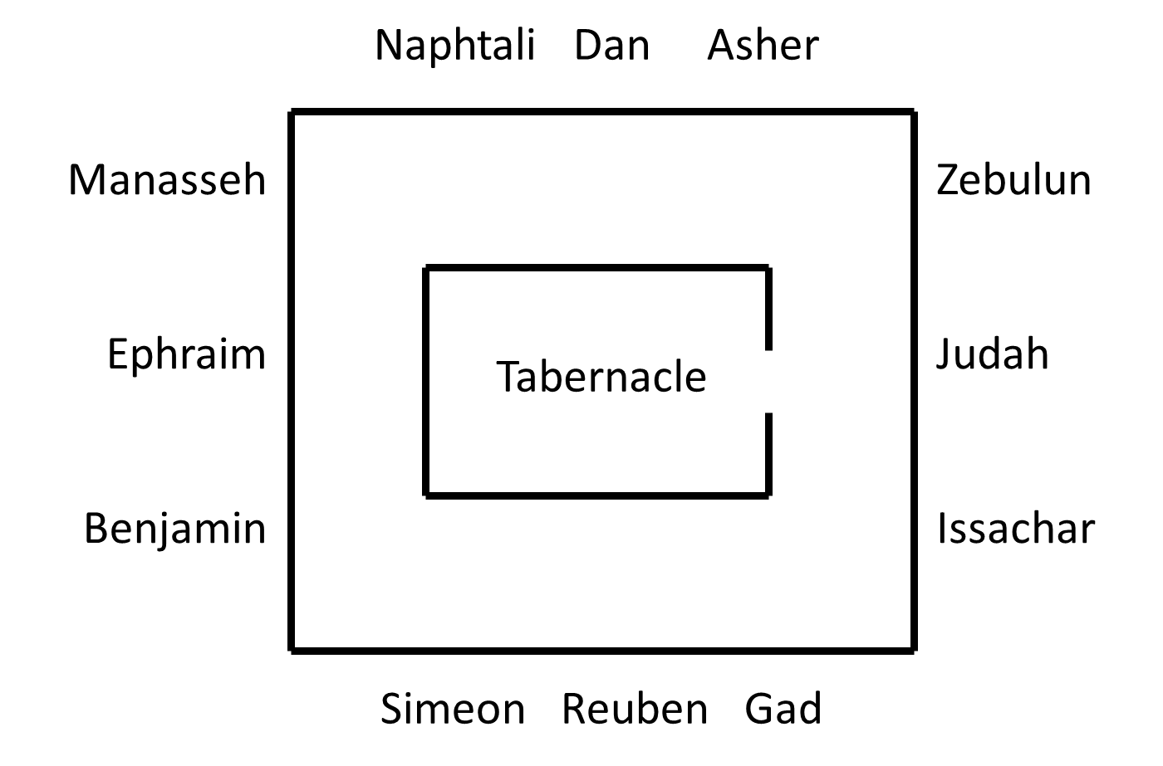
Law and Grace: The SOM – Matthew 5:1–8:1 (Luke 6:17–49)
THE CAMP OF ISRAEL IN THE WILDERNESS ~1400 BC

Slide 44
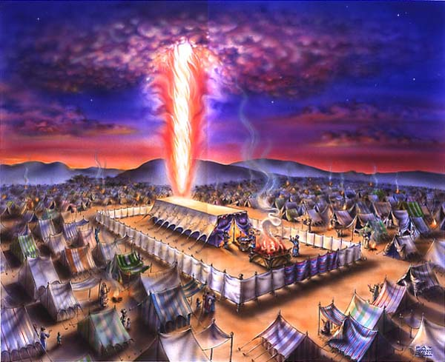
Law and Grace: The SOM – Matthew 5:1–8:1 (Luke 6:17–49)
THE CAMP OF ISRAEL IN THE WILDERNESS ~1400 BC

Slide 45
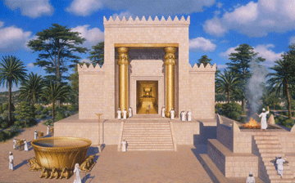
Law and Grace: The SOM – Matthew 5:1–8:1 (Luke 6:17–49)
KING SOLOMON’S TEMPLE BUILT IN JERUSALEM (971-931 BC).

Slide 46
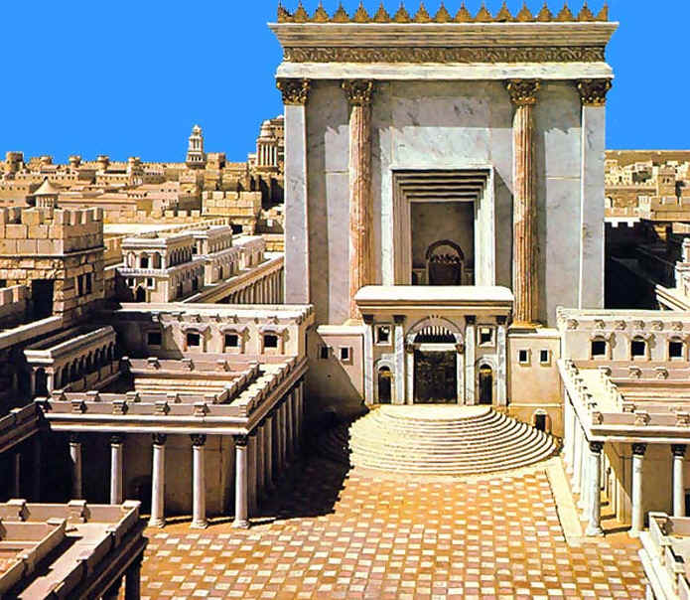
Law and Grace: The SOM – Matthew 5:1–8:1 (Luke 6:17–49)
HEROD’S TEMPLE WAS DESTROYED BY THE ROMANS IN 70 AD,

Slide 47
THE FUTURE TOLD, WELL IN ADVANCE
Law and Grace: The SOM – Matthew 5:1–8:1 (Luke 6:17–49)
Tribulation Millennial Kingdom Eternity
7 years 1000 years timeless

Slide 48
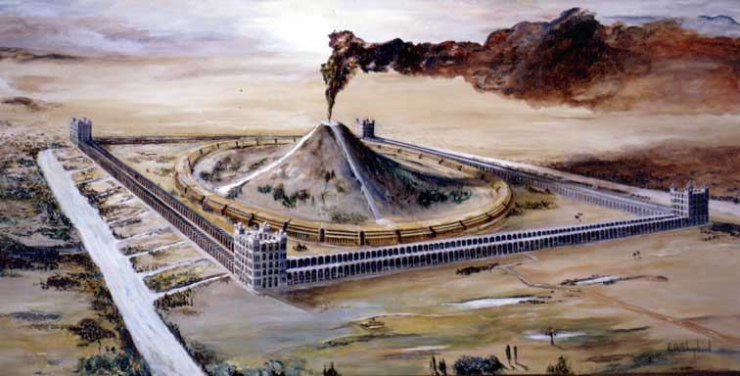
THE FUTURE TOLD, WELL IN ADVANCE
Law and Grace: The SOM – Matthew 5:1–8:1 (Luke 6:17–49)
Tribulation Millennial Kingdom Eternity
7 years 1000 years timeless

Slide 49
Isaiah 49:22-23
gentiles and israel - their relationship during christ’s reign on earth
²² Thus says the Lord God, "Behold, I will lift up My hand to the nations and set up My standard to the peoples; and they will bring your sons in their bosom, and your daughters will be carried on their shoulders. ²³ Kings will be your guardians, and their princesses your nurses. They will bow down to you with their faces to the earth and lick the dust of your feet; and you will know that I am the Lord; those who hopefully wait for Me will not be put to shame."

Slide 50
Zechariah 8:20-23
the gentiles will come to christ through the jews, during christ’s reign on earth
²⁰ “Thus says the Lord of hosts, ‘It will yet be that peoples will come, even the inhabitants of many cities. ²¹ The inhabitants of one will go to another, saying, “Let us go at once to entreat the favor of the Lord, and to seek the Lord of hosts; I will also go.” ²² ‘So many peoples and mighty nations will come to seek the Lord of hosts in Jerusalem and to entreat the favor of the Lord.’ ²³ “Thus says the Lord of hosts, ‘In those days ten men from all the nations will grasp the garment of a Jew, saying, “Let us go with you, for we have heard that God is with you.”

Slide 51
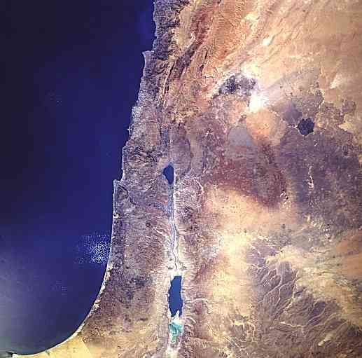
Law and Grace: The SOM – Matthew 5:1–8:1 (Luke 6:17–49)
WHEN CHRIST REIGNS, THE PEOPLE OF ISRAEL WILL BE HIGHLY REGARDED BECAUSE CHRIST WILL BE HIGHLY REGARDED
When Christ reigns, the nations (i.e., the Gentiles) they will truly uphold, support and even regard highly the people of Israel.
This is an aspect of the Gentiles’ part in fulfilling God’s eternal purpose – What eternal purpose is that?
To declare, reveal, and share God’s glory so that He will be glorified.

Slide 52
Law and Grace: The SOM – Matthew 5:1–8:1 (Luke 6:17–49)
WHEN CHRIST REIGNS, THE PEOPLE OF ISRAEL WILL BE HIGHLY REGARDED BECAUSE CHRIST WILL BE HIGHLY REGARDED
The Lord has seen fit to set saved Jews, Gentiles and we in the Church in different relationship with Himself, but all three groups will fulfill God’s eternal purpose in their appointed role.

Slide 53
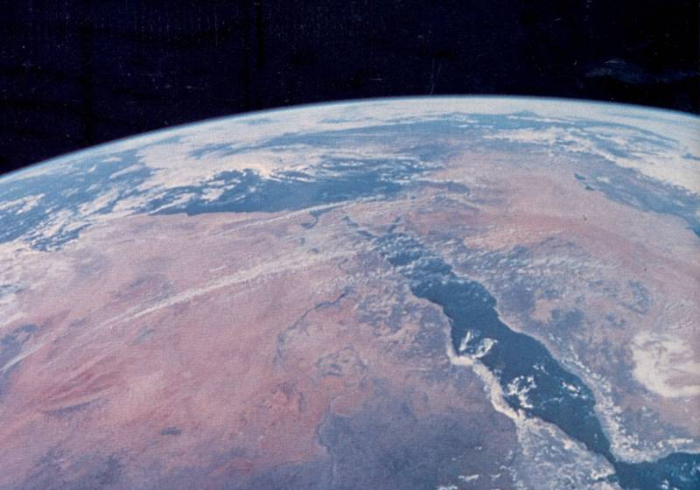
THE FUTURE TOLD, WELL IN ADVANCE
Law and Grace: The SOM – Matthew 5:1–8:1 (Luke 6:17–49)
Tribulation Millennial Kingdom Eternity
7 years 1000 years timeless

Slide 54
Law and Grace: The SOM – Matthew 5:1–8:1 (Luke 6:17–49)

Slide 55
THE FUTURE TOLD, WELL IN ADVANCE
Law and Grace: The SOM – Matthew 5:1–8:1 (Luke 6:17–49)
Tribulation Millennial Kingdom Eternity
7 years 1000 years timeless
God will create a new heavens and a new earth, the center of which will be in a New Jerusalem.

Slide 56
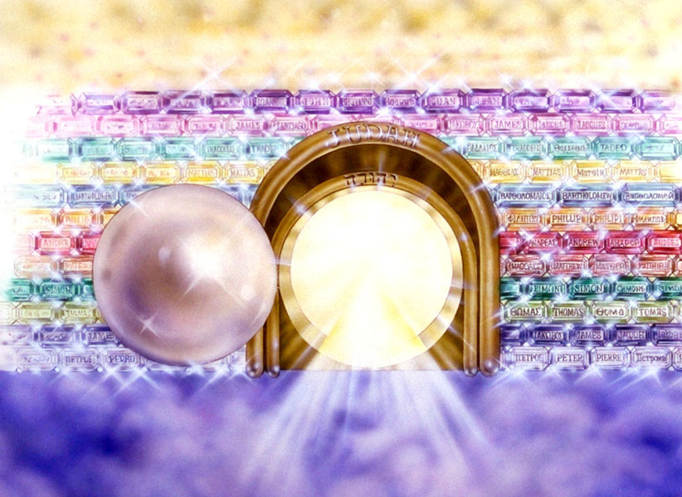
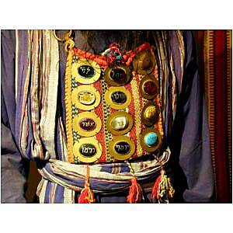
Law and Grace: The SOM – Matthew 5:1–8:1 (Luke 6:17–49)
THE FUTURE TOLD, WELL IN ADVANCE
The New Jerusalem will have 12 gates, 3 on each side, one for each of the 12 tribes of Israel.

Slide 57
Law and Grace: The SOM – Matthew 5:1–8:1 (Luke 6:17–49)
ISRAEL WAS AND WILL BE THE GENTILES’ ACCESS TO GOD
Just as Israel once became the means of access to God for the Gentiles, the Gentiles will have their access to God through Israel in both the coming earthly kingdom and in the new heavens and the new earth.

Slide 58
Law and Grace: The SOM – Matthew 5:1–8:1 (Luke 6:17–49)
ISRAEL WAS AND WILL BE THE GENTILES’ ACCESS TO GOD
The gates of access into the New Jerusalem will be named for each of the tribes of Israel but will also consist of the same precious stones that were on the breastplate of the High Priest, and the kings of the earth will bring in the glory of nations (cf. Rev. 21:4-6).

Slide 59
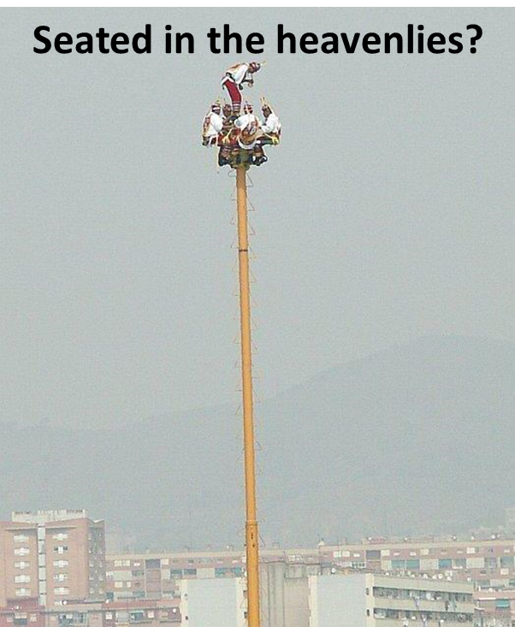
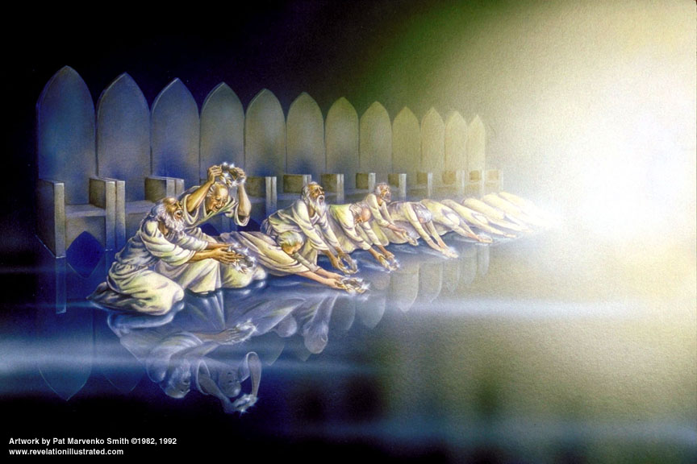
Law and Grace: The SOM – Matthew 5:1–8:1 (Luke 6:17–49)
WE IN THE CHURCH HAVE A DIFFERENT CALLING & LOCATION
We in the Church, the body of Christ, the bride of Christ, have a different location and standing, now and forever, that is distinct from both the Gentiles and Israel!

Slide 60
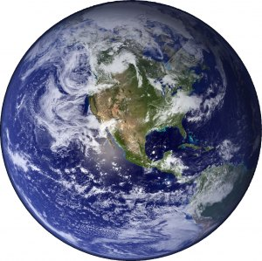
Law and Grace: The SOM – Matthew 5:1–8:1 (Luke 6:17–49)
WE IN THE CHURCH HAVE A DIFFERENT CALLING & LOCATION
Gentiles are those ‘among the nations’ and according to 1 Corinthians 10:1-2, Israel is those who were all ‘baptized into Moses’. But…

Slide 61
Law and Grace: The SOM – Matthew 5:1–8:1 (Luke 6:17–49)
WE IN THE CHURCH HAVE A DIFFERENT CALLING & LOCATION
…only Church Age believers are baptized into Christ – made to be ‘in Christ’.

Slide 62
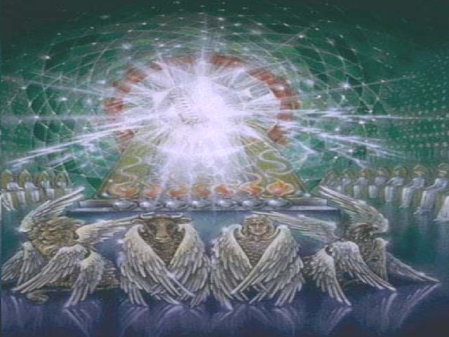
Law and Grace: The SOM – Matthew 5:1–8:1 (Luke 6:17–49)
HEAVEN IS WHERE WE’RE AT!
There in the heavenlies in Christ is:
where we are blessed;
where we are seated with Him;
where we have our citizenship; and
where we breathe in pure grace
This is the unique calling and location of the Church, the Body and Bride of Christ alone!

Slide 63
Session 39 Outline
Review
Purpose, Aim, and Objective
Session 38
Gentiles, Israel, and the Church – Part II
More Information
Charting The Future
Concluding Observations

Slide 64
Ephesians 2:4-7
expanded and explained
⁴ But the one true God, being wealthy in mercy, so as to withhold punishment that was justly due us, because of His great love with which He loved us, ⁵ even when we were dead, so as to be spiritually separated from God in our transgressions, made us alive together with the Christ - the Messiah! (by grace, which is God’s unmerited favor, you have been permanently and irreversibly saved – forever) ⁶ and raised us up with Him, and seated us with Him in the heavenly places in Christ Jesus - the full and final consequence of having been baptized into Him, ⁷ so that in the ages to come He will show, so as to visibly demonstrate, the awesome wealth of His grace in kindness to us who are in Christ Jesus.

Slide 65
Law and Grace: The SOM – Matthew 5:1–8:1 (Luke 6:17–49)
Infinite grace of such magnitude that it will take ABBA, Father all eternity to fully, explicitly, and graphicly demonstrate it to us!

Slide 66
Law and Grace: An Overview Jim McGowan, Th.D. Sugar Land Bible Church 10-01-2023
…but grace and truth were realized through Jesus Christ - John 1:17
For the Law was given through Moses…
Special thanks to Dr. Vern Peterman for access to his insights and resources.

