Slide 1
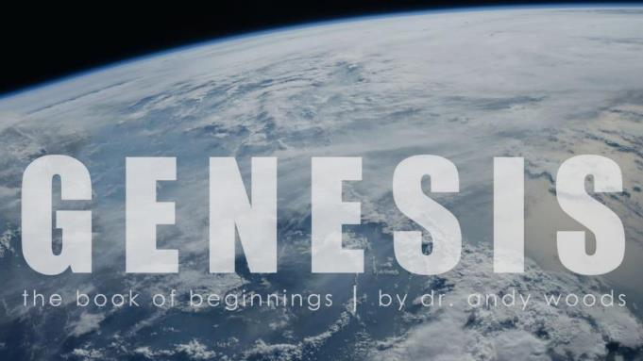
Genesis 12‒50
Israel’s Birth & Preservation

Slide 2
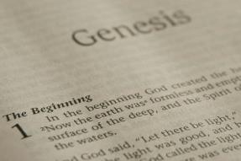
GENESIS STRUCTURE
Genesis 12-50 (four people)
Abraham (12:1–25:11)
Isaac (25:12–26:35)
Jacob (27–36)
Joseph (37–50)

Slide 3
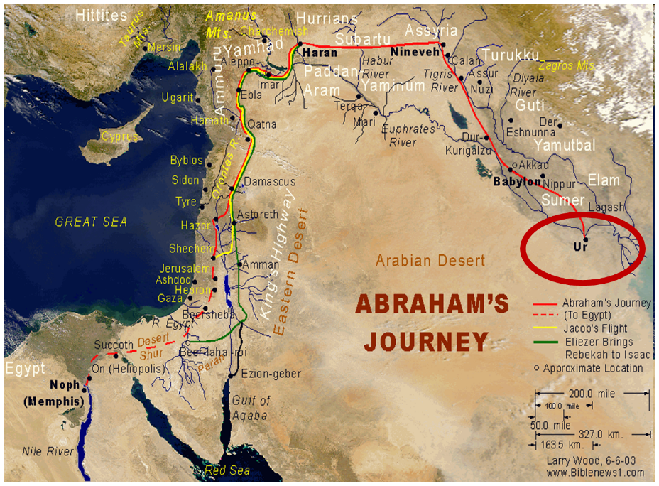

Slide 4
Genesis 33:18‒34:31 The Dinah Incident
Jacob’s Arrival in Shechem (33:18-20)
Rape of Dinah (34:1-7)
Negotiations for Dinah (34:8-17)
Circumcision of the City (34:18-24)
Slaughter of the City (34:25-29)
Jacob’s Regret (34:30-31)

Slide 5
Genesis 33:18‒34:31 The Dinah Incident
Jacob’s Arrival in Shechem (33:18-20)
Rape of Dinah (34:1-7)
Negotiations for Dinah (34:8-17)
Circumcision of the City (34:18-24)
Slaughter of the City (34:25-29)
Jacob’s Regret (34:30-31)

Slide 6
I. Genesis 33:18-20 Jacob’s Arrival in Shechem
Jacob returns to Canaan (18)
Jacob purchases the field (19)
Jacob builds an altar (20)

Slide 7
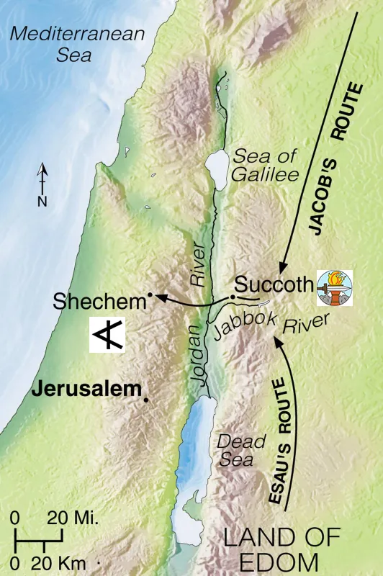

Slide 8
Genesis 33:18‒34:31 The Dinah Incident
Jacob’s Arrival in Shechem (33:18-20)
Rape of Dinah (34:1-7)
Negotiations for Dinah (34:8-17)
Circumcision of the City (34:18-24)
Slaughter of the City (34:25-29)
Jacob’s Regret (34:30-31)

Slide 9
II. Genesis 34:1-7 Rape of Dinah
Occasion (1)
Rapist and rape (2)
Rapist’s “love” for Dinah (3-4)
Jacob’s discovery (5)
Hamor approaches Jacob (6)
Brothers’ response (7)

Slide 10
II. Genesis 34:1-7 Rape of Dinah
Occasion (1)
Rapist and rape (2)
Rapist’s “love” for Dinah (3-4)
Jacob’s discovery (5)
Hamor approaches Jacob (6)
Brothers’ response (7)

Slide 12
II. Genesis 34:1-7 Rape of Dinah
Occasion (1)
Rapist and rape (2)
Rapist’s “love” for Dinah (3-4)
Jacob’s discovery (5)
Hamor approaches Jacob (6)
Brothers’ response (7)

Slide 13
Genesis 34:2 Rapist and Rape
Rapist (2a)
Rape (2b-e)

Slide 14
Genesis 34:2 Rapist and Rape
Rapist (2a)
Rape (2b-e)

Slide 15
Canaan’s Sons (vs. 15-18)
Sidon
Heth
Jebusite
Amorite
Girgashite
Hivite
Arkite
Sinite
Arvadite
Zemarite
Hamathite
Perrizite

Slide 16
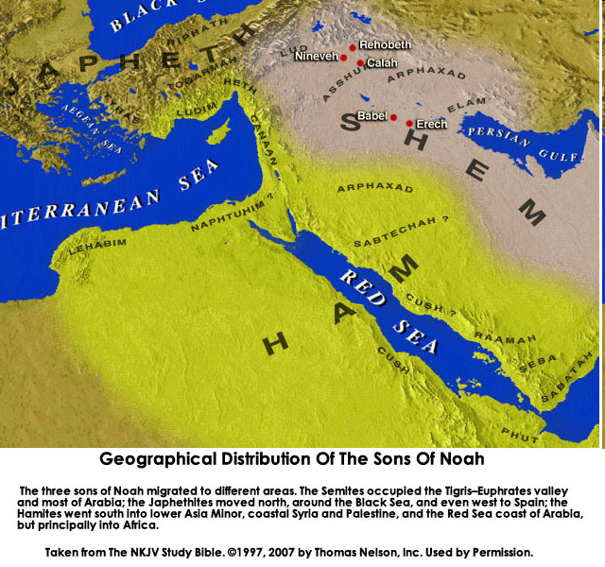
CANNAN

Slide 18
Genesis 34:2 Rapist and Rape
Rapist (2a)
Rape (2b-e)

Slide 19
Genesis 34:2b-e Rape
Saw (2b)
Took (2c)
Lay (2d)
Humbled (2e)

Slide 20
Genesis 34:2b-e Rape
Saw (2b)
Took (2c)
Lay (2d)
Humbled (2e)

Slide 21
Genesis 34:2b-e Rape
Saw (2b)
Took (2c)
Lay (2d)
Humbled (2e)

Slide 22
Genesis 34:2b-e Rape
Saw (2b)
Took (2c)
Lay (2d)
Humbled (2e)

Slide 23
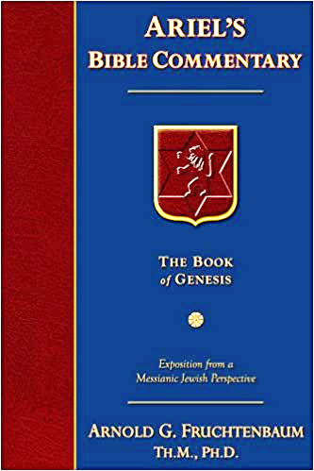
Dr. Arnold G. Fruchtenbaum
The Book of Genesis, 491
“He took her. Second: [He] lay with her. The Hebrew text does not use the indirect object for her, which shows that Dinah was violated by force and not by consent. The indirect form is also used in 39:7, where Potiphar’s wife wanted intercourse with Joseph by consent.”

Slide 24
Genesis 34:2b-e Rape
Saw (2b)
Took (2c)
Lay (2d)
Humbled (2e)

Slide 25
Dr. Arnold G. Fruchtenbaum
The Book of Genesis, 491
“He humbled her. The Hebrew word here means ‘to humble,’ ‘to defile,’ and ‘to afflict.’ The same was used in Genesis 15:13; but here it has the meaning ‘to rape’; and she was raped.”

Slide 26
II. Genesis 34:1-7 Rape of Dinah
Occasion (1)
Rapist and rape (2)
Rapist’s “love” for Dinah (3-4)
Jacob’s discovery (5)
Hamor approaches Jacob (6)
Brothers’ response (7)

Slide 27
Genesis 34:3-4 Rapist’s “Love” for Dinah
“Love” for Dinah (3)
Intention to marry Dinah (4)

Slide 28
Genesis 34:3-4 Rapist’s “Love” for Dinah
“Love” for Dinah (3)
Intention to marry Dinah (4)

Slide 29
Genesis 34:3-4 Rapist’s “Love” for Dinah
“Love” for Dinah (3)
Intention to marry Dinah (4)

Slide 30
II. Genesis 34:1-7 Rape of Dinah
Occasion (1)
Rapist and rape (2)
Rapist’s “love” for Dinah (3-4)
Jacob’s discovery (5)
Hamor approaches Jacob (6)
Brothers’ response (7)

Slide 31
Genesis 34:5 Jacob’s Discovery
Discovery (5a)
Circumstances (5b)
Response (5c)

Slide 32
Genesis 34:5 Jacob’s Discovery
Discovery (5a)
Circumstances (5b)
Response (5c)

Slide 33
Genesis 34:5 Jacob’s Discovery
Discovery (5a)
Circumstances (5b)
Response (5c)

Slide 34
Genesis 34:5 Jacob’s Discovery
Discovery (5a)
Circumstances (5b)
Response (5c)

Slide 35
II. Genesis 34:1-7 Rape of Dinah
Occasion (1)
Rapist and rape (2)
Rapist’s “love” for Dinah (3-4)
Jacob’s discovery (5)
Hamor approaches Jacob (6)
Brothers’ response (7)

Slide 36
II. Genesis 34:1-7 Rape of Dinah
Occasion (1)
Rapist and rape (2)
Rapist’s “love” for Dinah (3-4)
Jacob’s discovery (5)
Hamor approaches Jacob (6)
Brothers’ response (7)

Slide 37
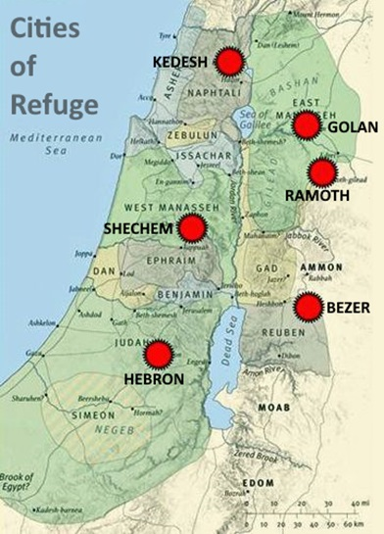

Slide 38
Dr. Arnold G. Fruchtenbaum
The Book of Genesis, 492
“He had done folly in Israel. First, the word for folly refers to a godless act that polluted the family, and eventually results in the breakup of existing relationships between tribes and between family members and between God and man. The word used is nevalah, which appears thirteen times in the Hebrew text, and eight of those times it is used of sexual crimes (Gen. 34:7; Deut. 22:21; Judg. 19:23, 19:24, 20:6, 20:10; II Sam. 13:12; Jer. 29:23). The means of this crime was: in lying with Jacob’s daughter.”

Slide 40
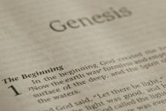
Beginning Themes
Universe Life Man Marriage Evil Clothing | Religion Salvation Language Government Nations Israel
Morris, Genesis Record, 18-20

Slide 41
Genesis 33:18‒34:31 The Dinah Incident
Jacob’s Arrival in Shechem (33:18-20)
Rape of Dinah (34:1-7)
Negotiations for Dinah (34:8-17)
Circumcision of the City (34:18-24)
Slaughter of the City (34:25-29)
Jacob’s Regret (34:30-31)

Slide 42
III. Genesis 34:8-17 Negotiations for Dinah
Hamor’s offers (8-10)
Shechem’s request (11-12)
Response of brothers (13-17)

Slide 43
III. Genesis 34:8-17 Negotiations for Dinah
Hamor’s offers (8-10)
Shechem’s request (11-12)
Response of brothers (13-17)

Slide 44
Genesis 34:8-10 Hamor’s Offers
Marriage (8)
Intermarriage (9)
Citizenship (10)

Slide 45
Genesis 34:8-10 Hamor’s Offers
Marriage (8)
Intermarriage (9)
Citizenship (10)

Slide 46
Genesis 34:8-10 Hamor’s Offers
Marriage (8)
Intermarriage (9)
Citizenship (10)

Slide 47
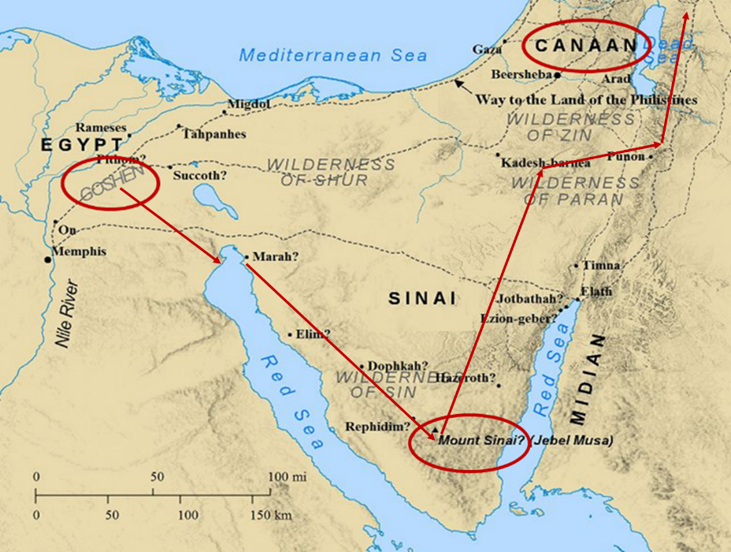

Slide 48
Genesis 34:8-10 Hamor’s Offers
Marriage (8)
Intermarriage (9)
Citizenship (10)

Slide 49
III. Genesis 34:8-17 Negotiations for Dinah
Hamor’s offers (8-10)
Shechem’s request (11-12)
Response of brothers (13-17)

Slide 50
Genesis 34:11-12 Shechem’s Request
No dowry (11-12a)
Dinah only (12b)

Slide 51
Genesis 34:11-12 Shechem’s Request
No dowry (11-12a)
Dinah only (12b)

Slide 52
Genesis 34:11-12 Shechem’s Request
No dowry (11-12a)
Dinah only (12b)

Slide 53
III. Genesis 34:8-17 Negotiations for Dinah
Hamor’s offers (8-10)
Shechem’s request (11-12)
Response of brothers (13-17)

Slide 54
Genesis 34:13-17 Response of Brothers
Setting the stage (13)
Demand (14-17)

Slide 55
Genesis 34:13-17 Response of Brothers
Setting the stage (13)
Demand (14-17)

Slide 56
Dr. Arnold G. Fruchtenbaum
The Book of Genesis, 498-99
“The third observation is to note a contrast between chapters 34 and 35 of Genesis. In chapter 34 there is absolutely no mention of God, no reference to God whatsoever. But in chapter 35, the word God will be mentioned eleven times by itself, and God’s Name will be found eleven more times in connection with specific names.”

Slide 57
Genesis 34:13-17 Response of Brothers
Setting the stage (13)
Demand (14-17)

Slide 58
Genesis 34:14-17 Demand
Rule (14)
Condition (15)
Contingency (16-17)

Slide 59
Genesis 34:14-17 Demand
Rule (14)
Condition (15)
Contingency (16-17)

Slide 60
Genesis 12‒25 Abraham’s Early Journeys
Unconditional promises (Gen. 12:1-3) From Haran to Canaan (Gen. 12:4-5) In Canaan (Gen. 12:6-9) In Egypt (Gen. 12:10-20) Abram and Lot Separate (Gen. 13:1-13) Reaffirmation of Abram’s promises (Gen. 13:14-18) Abram Rescues Lot (14:1-24) Abrahamic Covenant (15:1-21) Hagar & Ishmael (16:1-16) Circumcision (Gen. 17:1-27) | Sodom & Gomorrah (Gen. 18‒19) Abraham & Abimelech (Gen. 20) Isaac’s birth (Gen. 21:1-7) Ishmael’s expulsion (21:8-21) Abraham & Abimelech’s covenant (21:22-34) Abraham sacrifices Isaac (22) Sarah’s death (23) Isaac’s marriage (24) Abraham & Keturah (25:1-6) Abraham’s death (25:7-11)

Slide 61
Genesis 34:14-17 Demand
Rule (14)
Condition (15)
Contingency (16-17)

Slide 62
Genesis 34:14-17 Demand
Rule (14)
Condition (15)
Contingency (16-17)

Slide 63
Genesis 34:16-17 Contingnecy
If accepted (16)
If rejected (17)

Slide 64
Genesis 34:16-17 Contingnecy
If accepted (16)
If rejected (17)

Slide 65
Genesis 34:16-17 Contingnecy
If accepted (16)
If rejected (17)

Slide 66
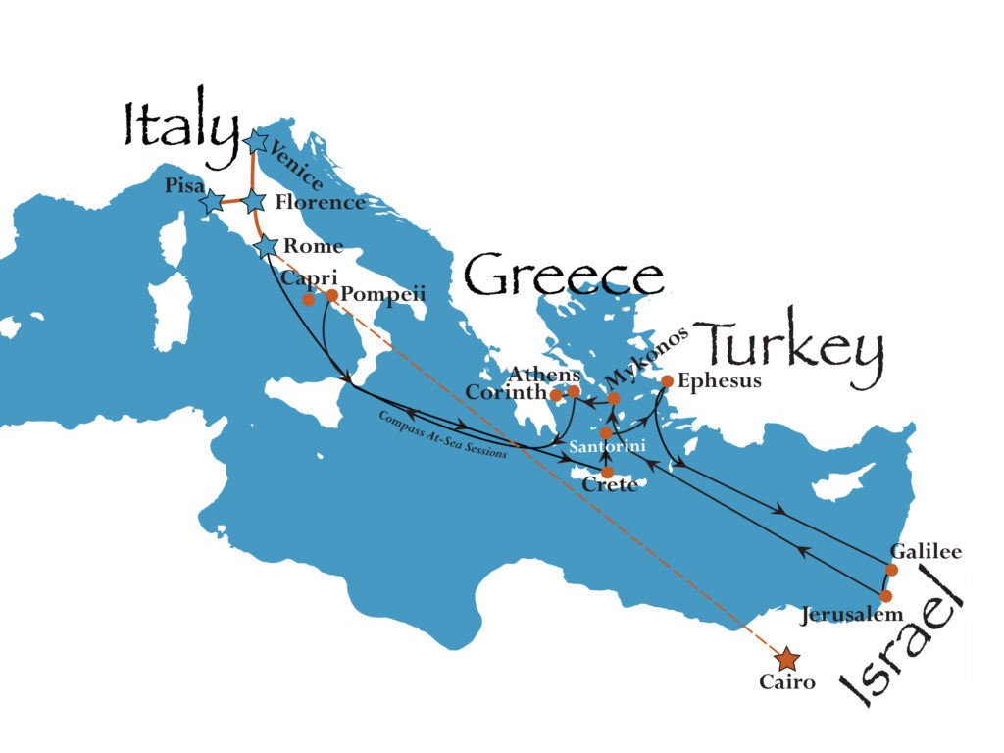
Compass Cruise (9-26 to 10-12, 2023)
Questions? - 1-800-977-2177 https://compass.org/tours/compass-biblelands-cruise-2023/
66

Slide 67
Genesis 33:18‒34:31 The Dinah Incident
Jacob’s Arrival in Shechem (33:18-20)
Rape of Dinah (34:1-7)
Negotiations for Dinah (34:8-17)
Circumcision of the City (34:18-24)
Slaughter of the City (34:25-29)
Jacob’s Regret (34:30-31)

Slide 68
IV. Genesis 34:18-24 Circumcision of the City
Hamor & Shechem’s agreement (18-19)
Report to the City (20-23)
Agreement (24)

Slide 69
IV. Genesis 34:18-24 Circumcision of the City
Hamor & Shechem’s agreement (18-19)
Report to the City (20-23)
Agreement (24)

Slide 70
Genesis 34:18-19 Circumcision of the City
Consent (18)
Reason (19)

Slide 71
Genesis 34:18-19 Circumcision of the City
Consent (18)
Reason (19)

Slide 72
Genesis 34:18-19 Circumcision of the City
Consent (18)
Reason (19)

Slide 73
Genesis 34:19 Reason
For Shechem (19a)
For Shechem’s people (19b)

Slide 74
Genesis 34:19 Reason
For Shechem (19a)
For Shechem’s people (19b)

Slide 75
Genesis 34:19 Reason
For Shechem (19a)
For Shechem’s people (19b)

Slide 76
IV. Genesis 34:18-24 Circumcision of the City
Hamor & Shechem’s agreement (18-19)
Report to the City (20-23)
Agreement (24)

Slide 77
Genesis 34:20-23 Report to the City
Report (20)
Benefits (21)
Condition (22)
Incentive (23)

Slide 78
Genesis 34:20-23 Report to the City
Report (20)
Benefits (21)
Condition (22)
Incentive (23)

Slide 79
Charles Ryrie
The Ryrie Study Bible, p. 45
Genesis 34:20 (RSB:NASB1995U): “The gate of the city was the center of public activity (cf. 19:1). Here Hamor and Shechem persuaded the others to be circumcised.”

Slide 80
Genesis 34:20-23 Report to the City
Report (20)
Benefits (21)
Condition (22)
Incentive (23)

Slide 81
Genesis 34:21 Benefits
Nothing negative (21a)
Let them dwell (21b)
Land big enough (21c)
Intermarriage (21d)

Slide 82
Genesis 34:21 Benefits
Nothing negative (21a)
Let them dwell (21b)
Land big enough (21c)
Intermarriage (21d)

Slide 83
Genesis 34:21 Benefits
Nothing negative (21a)
Let them dwell (21b)
Land big enough (21c)
Intermarriage (21d)

Slide 84
Genesis 34:21 Benefits
Nothing negative (21a)
Let them dwell (21b)
Land big enough (21c)
Intermarriage (21d)

Slide 85
Genesis 34:21 Benefits
Nothing negative (21a)
Let them dwell (21b)
Land big enough (21c)
Intermarriage (21d)

Slide 86
Genesis 34:20-23 Report to the City
Report (20)
Benefits (21)
Condition (22)
Incentive (23)

Slide 87
Genesis 34:20-23 Report to the City
Report (20)
Benefits (21)
Condition (22)
Incentive (23)

Slide 88
IV. Genesis 34:18-24 Circumcision of the City
Hamor & Shechem’s agreement (18-19)
Report to the City (20-23)
Agreement (24)

Slide 89
Genesis 34:24 Agreement
Consent (24a)
Circumcision (24b)

Slide 90
Genesis 34:24 Agreement
Consent (24a)
Circumcision (24b)

Slide 91
Genesis 34:24 Agreement
Consent (24a)
Circumcision (24b)

Slide 92
Genesis 33:18‒34:31 The Dinah Incident
Jacob’s Arrival in Shechem (33:18-20)
Rape of Dinah (34:1-7)
Negotiations for Dinah (34:8-17)
Circumcision of the City (34:18-24)
Slaughter of the City (34:25-29)
Jacob’s Regret (34:30-31)

Slide 93
V. Genesis 34:25-29 Slaughter of the City
Slaughter of Shechem (25)
Dinah’s rescue (26)
Spoiling of the city (27-29)

Slide 94
V. Genesis 34:25-29 Slaughter of the City
Slaughter of Shechem (25)
Dinah’s rescue (26)
Spoiling of the city (27-29)

Slide 95
Genesis 34:25 Slaughter of Shechem
Timing (25a)
Perpetrators (25b)
Slaughter (25c)

Slide 96
Genesis 34:25 Slaughter of Shechem
Timing (25a)
Perpetrators (25b)
Slaughter (25c)

Slide 97
Genesis 34:25 Slaughter of Shechem
Timing (25a)
Perpetrators (25b)
Slaughter (25c)

Slide 99
Genesis 34:25 Slaughter of Shechem
Timing (25a)
Perpetrators (25b)
Slaughter (25c)

Slide 100
Ezekiel 38:8, 11
“⁸ After many days you will be summoned; in the latter years you will come into the land that is restored from the sword, whose inhabitants have been gathered from many nations to the mountains of Israel which had been a continual waste; but its people were brought out from the nations, and they are living securely [batach], all of them….¹¹ and you will say, ‘I will go up against the land of unwalled villages. I will go against those who are at rest [shacat], that live securely [batach], all of them living without walls and having no bars or gates.”

Slide 101
Dr. Arnold G. Fruchtenbaum
The Book of Genesis, 497
“Third, Dinah’s brothers carried out the slaughter: they took each man his sword, and came upon the city unawares. The Hebrew root for came upon is batach from which the word ‘security’ comes. It means they came upon the city boldly, without fail, with full ‘security,’ knowing that the male population had been incapacitated. So although there were just two of them, they were fully secure in what they were about to do, and what they did was: [They] slew all the males.”

Slide 102
Beginning Themes
Universe Life Man Marriage Evil Clothing | Religion Salvation Language Government Nations Israel
Morris, Genesis Record, 18-20

Slide 103
V. Genesis 34:25-29 Slaughter of the City
Slaughter of Shechem (25)
Dinah’s rescue (26)
Spoiling of the city (27-29)

Slide 104
Genesis 34:26 Dinah’s Rescue
Hamor’s death (26a)
Shechem’s death (26b)
Dinah’s rescue (26c)

Slide 105
Genesis 34:26 Dinah’s Rescue
Hamor’s death (26a)
Shechem’s death (26b)
Dinah’s rescue (26c)

Slide 106
Genesis 34:26 Dinah’s Rescue
Hamor’s death (26a)
Shechem’s death (26b)
Dinah’s rescue (26c)

Slide 107
Genesis 34:26 Dinah’s Rescue
Hamor’s death (26a)
Shechem’s death (26b)
Dinah’s rescue (26c)

Slide 108
V. Genesis 34:25-29 Slaughter of the City
Slaughter of Shechem (25)
Dinah’s rescue (26)
Spoiling of the city (27-29)

Slide 109
Genesis 34:27-29 Spoiling of the City
Plunder (27)
Spoils (28-29)

Slide 110
Genesis 34:27-29 Spoiling of the City
Plunder (27)
Spoils (28-29)

Slide 111
Dr. Arnold G. Fruchtenbaum
The Book of Genesis, 497
“The sons of Jacob came upon the slain. After all were dead, after Dinah was rescued, came the act of the sons of Jacob: they plundered the city. The reasons was: because they had defiled their sister. The pronoun is plural, they defiled. The whole town was held responsible for Dinah’s rape, since the whole town failed to act responsibly. Verses 28–29 list the spoils, which included both animals and people...”

Slide 112
Genesis 34:27-29 Spoiling of the City
Plunder (27)
Spoils (28-29)

Slide 113
Genesis 33:18‒34:31 The Dinah Incident
Jacob’s Arrival in Shechem (33:18-20)
Rape of Dinah (34:1-7)
Negotiations for Dinah (34:8-17)
Circumcision of the City (34:18-24)
Slaughter of the City (34:25-29)
Jacob’s Regret (34:30-31)

Slide 114
VI. Genesis 34:30-31 Jacob’s Regret
Jacob’s complaint (30)
Brothers’ defense (31)

Slide 115
VI. Genesis 34:30-31 Jacob’s Regret
Jacob’s complaint (30)
Brothers’ defense (31)

Slide 116
CANNAN

Slide 117
Canaan’s Sons (vs. 15-18)
Sidon
Heth
Jebusite
Amorite
Girgashite
Hivite
Arkite
Sinite
Arvadite
Zemarite
Hamathite
Perrizite

Slide 120
VI. Genesis 34:30-31 Jacob’s Regret
Jacob’s complaint (30)
Brothers’ defense (31)

Slide 122
1 Corinthians 3:10-15
¹⁰ According to the grace of God which was given to me, like a wise master builder I laid a foundation, and another is building on it. But each man must be careful how he builds on it. ¹¹ For no man can lay a foundation other than the one which is laid, which is Jesus Christ. ¹² Now if any man builds on the foundation with gold, silver, precious stones, wood, hay, straw, ¹³ each man’s work will become evident; for the day will show it because it is to be revealed with fire, and the fire itself will test the quality of . . .

Slide 123
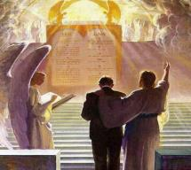
1 Corinthians 3:10-15
. . . each man’s work. ¹⁴ If any man’s work which he has built on it remains, he will receive a reward. ¹⁵ If any man’s work is burned up, he will suffer loss; but he himself will be saved, yet so as through fire.

Slide 124
Conclusion

Slide 125
Genesis 33:18‒34:31 The Dinah Incident
Jacob’s Arrival in Shechem (33:18-20)
Rape of Dinah (34:1-7)
Negotiations for Dinah (34:8-17)
Circumcision of the City (34:18-24)
Slaughter of the City (34:25-29)
Jacob’s Regret (34:30-31)

Slide 126
²⁴ The Lord bless you, and keep you; ²⁵ The Lord make His face shine on you, And be gracious to you; ²⁶ The Lord lift up His countenance on you, And give you peace.
Numbers 6:24–26 (NASB95)

