Slide 1
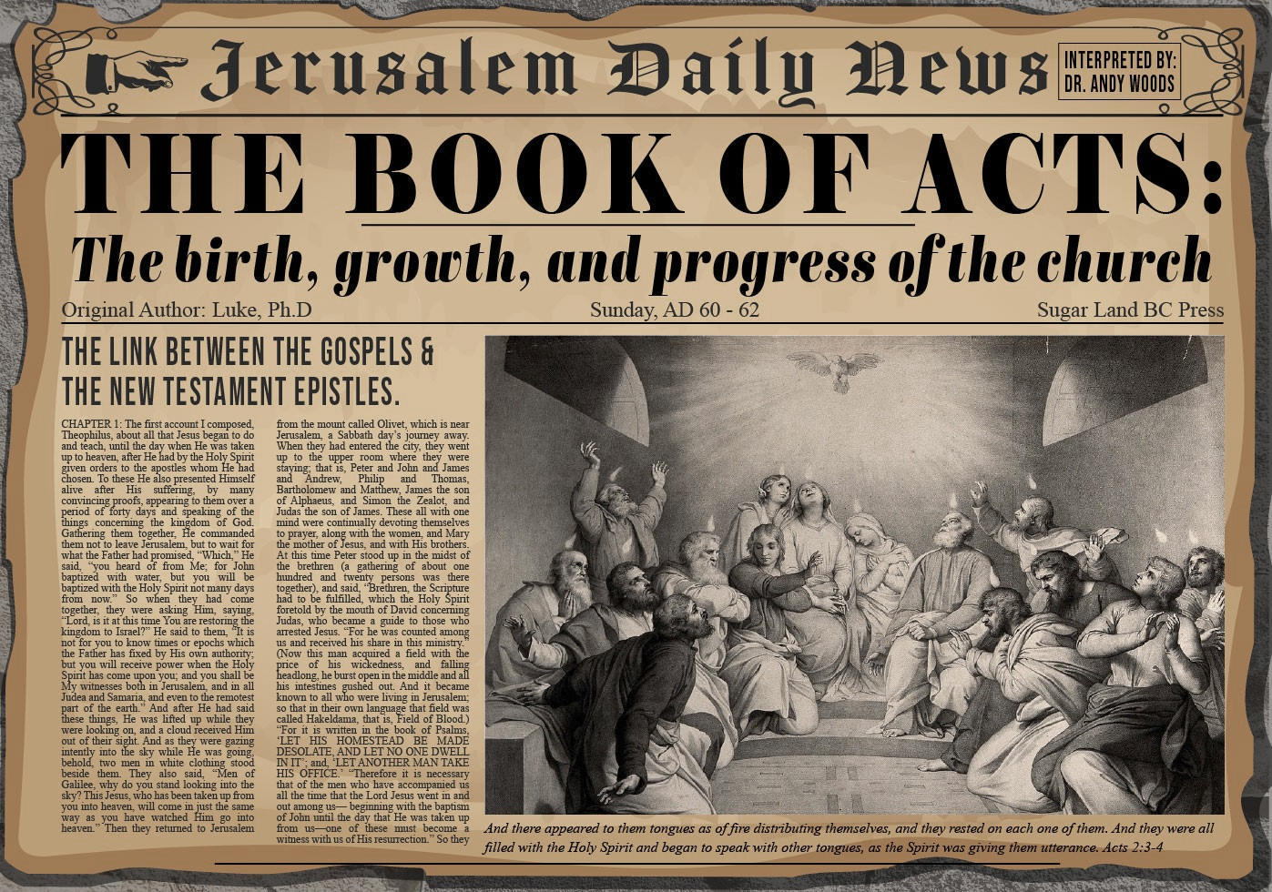


Slide 2
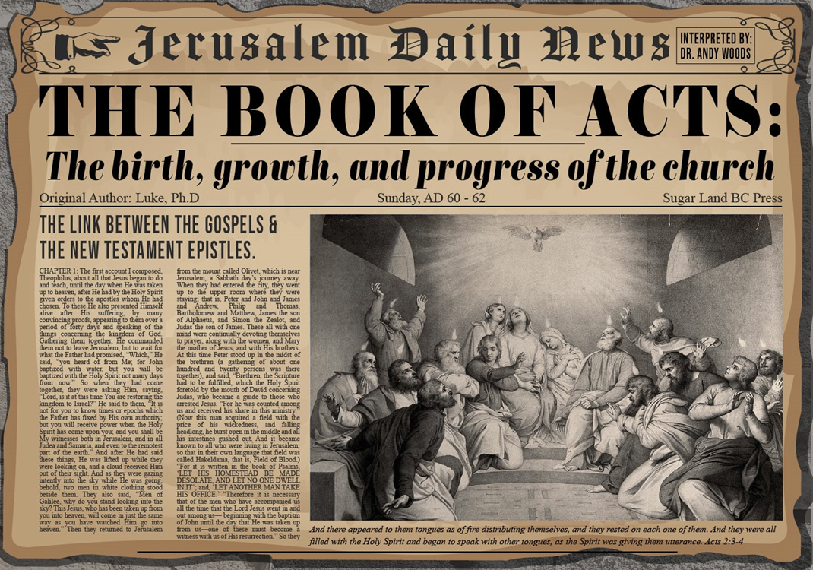
Acts 4:1‒5:11
Summary
  Apostles Arrested (4:1-4)
  Apostles Examined (4:5-12)
  Sanhedrin’s Decision (4:13-22)
  Apostles’ Prayer (4:23-31)
  Pre-Ananias and Sapphira (4:32-37)
  Ananias and Sapphira (5:1-11)

Slide 3
Apostles Examined
Acts 4:5-12
  Sanhedrin’s Questions (5-7)
  Peter Addresses Sanhedrin (8-12)

Slide 4
Acts 4:8-12
Peter Addresses Sanhedrin
      Miracle’s source (8-10)
      Israel’s rejection of Messiah (11)
      Only way of Salvation (12)

Slide 5

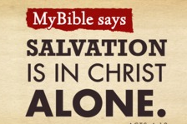
Acts 4:12
“And there is salvation in no one else; for there is no other name under heaven that has been given among men by which we must [dei] be saved.”

Slide 6
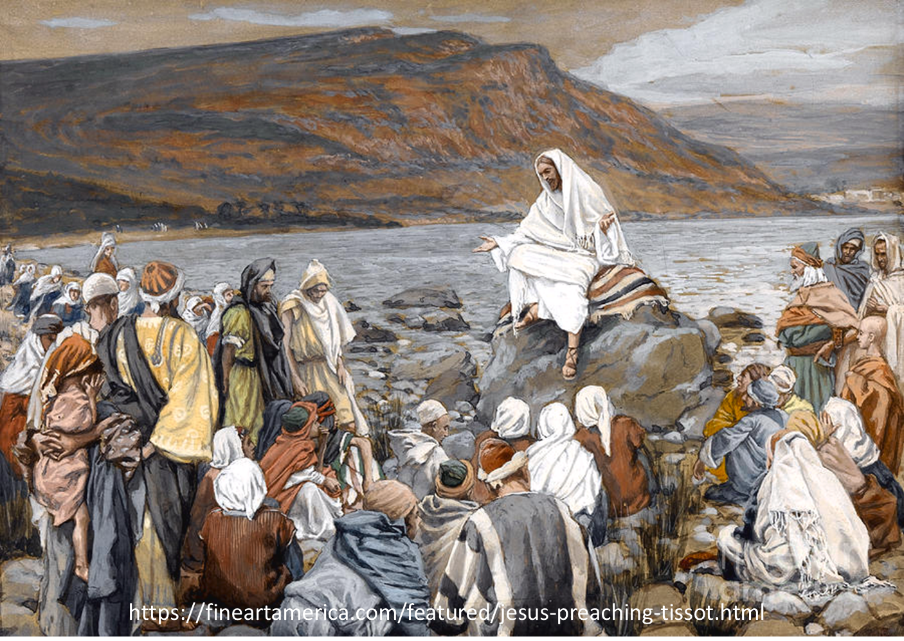
Luke 4:43
“But He said to them, “I must [dei] preach the kingdom of God to the other cities also, for I was sent for this purpose.”

Slide 7
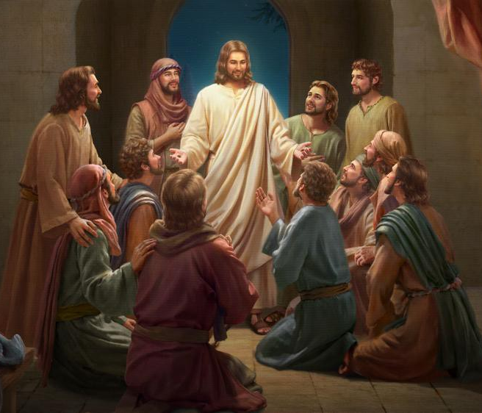
Luke 24:44
“Now He said to them, “These are My words which I spoke to you while I was still with you, that all things which are written about Me in the Law of Moses and the Prophets and the Psalms must [dei] be fulfilled.”

Slide 8

“…one of the mistakes that human beings make is believing that there is only one way…We don’t accept that there are diverse ways of being in the world; that there are millions of ways to be a human being. And many ways…many paths to what you call God. That her path might be something else and when she gets there she might call it the light. But her loving, and her kindness, and her generosity brings her to the…same point that it brings you…
www.youtube.com/watch?v=Lb2RUpMDk34

Slide 9
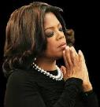
…It doesn’t matter whether she called it ‘God’ along the way or not…There couldn’t possibly be just one way!…There couldn’t possibly be only one way with millions of people in the world!...You think…if you are somewhere on the planet and you never hear the name of Jesus but yet you live with a loving heart. You lived as Jesus would have had you to live. You lived for the same purpose as Jesus came to the planet to teach us all, but you are in some remote part of the earth and you never heard the name of Jesus. You cannot get to Heaven…?”
www.youtube.com/watch?v=Lb2RUpMDk34

Slide 10
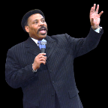
Tony Evans
Totally Saved: Understanding, Experiencing and Enjoying the
Greatness of Your Salvation (Chicago: Moody, 2002), 355, 359.
“In a class I once taught at Dallas Seminary, I inadvertently asked an exam question on material I had not covered in class. One of the students brought this discrepancy to my attention. To be fair, I had to rescore all of the test papers because I could not hold the students liable for information they had never been given…So the premise is that God will not hold people accountable for a decision they cannot make, based on information they have not received…And people in faraway lands who have never heard the gospel still have their own sins to answer for. This means we need to talk about the provision God has made for those who cannot believe….Here's the spiritual principle at work: When people respond to what they do know of God, He takes personal responsibility for giving them more information about Himself.... In the case of a person…

Slide 11
Tony Evans
Totally Saved: Understanding, Experiencing and Enjoying the
Greatness of Your Salvation (Chicago: Moody, 2002), 355, 359.
…who never hears the gospel and never knows the name of Jesus, but who responds to the light he has, God, treats that person like an Old Testament saint, if you will. That is, if the person trusts in what God has revealed, God deals with that person based on the knowledge he has, not the information he never received. I call this trans-dispensationalism...By this I mean if a person is sincerely seeking God and desiring to know Him, and is responding to the truth he knows, if there is no missionary or direct manifestation of God, then God judges that person based on his faith in the light he has received. And as in the case of Abraham, God will retroactively count this person as righteous by applying the death of Christ from the dispensation of grace.”

Slide 12
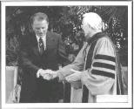
Hl9Aps://www.youtube.com/watch?v=hrf60-zHl9A
Dr. Schuller: "Tell me, what is the future of Christianity?"
Dr. Graham: "Well, Christianity and being a true believer, you know, I think there's the body of Christ which comes from all the Christian groups around the world, or outside the Christian groups. I think that everybody that loves Christ or knows Christ, whether they're conscious of it or not, they're members of the body of Christ. And I don't think that we're going to see a great sweeping revival that will turn the whole world to Christ at any time…and that’s what God is doing today. He is calling people out of the world for His name. Whether they come from the Muslim world, or the Buddhist world, or the Christian world, or the non-believing world, they are members of the body of Christ because they've been called . . .

Slide 13
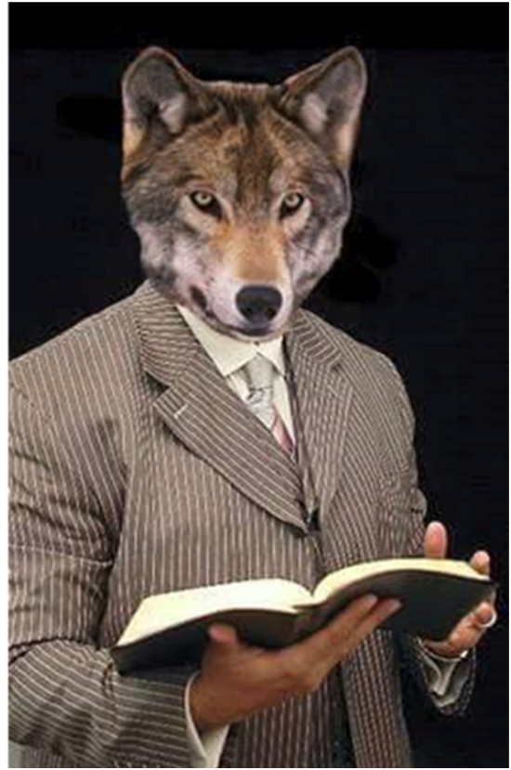
Hl9Aps://www.youtube.com/watch?v=hrf60-zHl9A
…by God. They may not even know the name of Jesus, but they know in their hearts they need something that they don't have and they turn to the only light that they have and I think they're saved and they're going to be with us in heaven.”
Dr. Schuller: "This is fantastic. I'm so thrilled to hear you say that. There's a wideness in God's mercy.”
Dr. Graham: “There is."

Slide 14
Acts 4:1‒5:11
Summary
  Apostles Arrested (4:1-4)
  Apostles Examined (4:5-12)
  Sanhedrin’s Decision (4:13-22)
  Apostles’ Prayer (4:23-31)
  Pre-Ananias and Sapphira (4:32-37)
  Ananias and Sapphira (5:1-11)

Slide 15
Sanhedrin’s Decision
Acts 4:13-22
  Observation (13-14)
  Private counsel (15-16)
  Decision (17-18)
  Apostles’ response (19-20)
  Sanhedrin’s response (21-22)

Slide 16
Sanhedrin’s Decision
Acts 4:13-22
  Observation (13-14)
  Private counsel (15-16)
  Decision (17-18)
  Apostles’ response (19-20)
  Sanhedrin’s response (21-22)

Slide 17
Acts 4:13-14
Observations
      Apostles (13)
      Lame man (14)

Slide 18
Acts 4:13-14
Observations
      Apostles (13)
      Lame man (14)

Slide 19
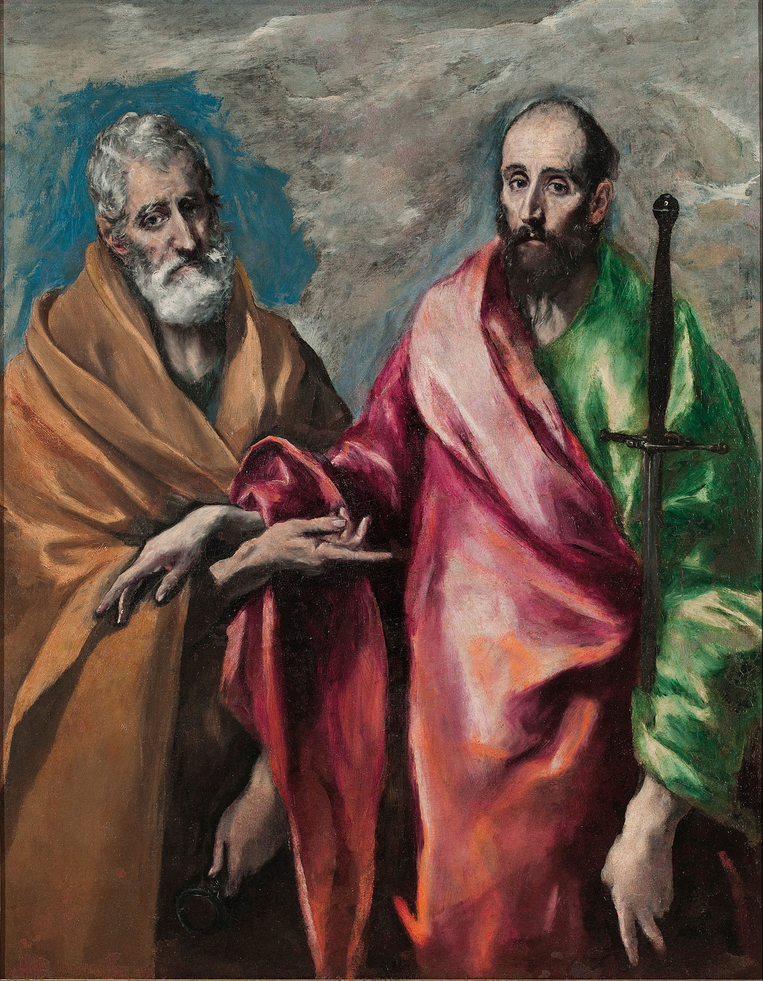
Title
Acts of the Apostles
Misleading?
  Acts of the Holy Spirit
  Geographical expansion
  Two apostles: Peter and Paul

Slide 20
From Peter to Paul
Reference | Center | Person | Place | Outreach
Acts 1–12 | Jerusalem | Peter | Jerusalem, Judea, Samaria | Jewish
Acts 13–28 | Antioch | Paul | Uttermost parts | Gentiles

Slide 21
From Peter to Paul
Peter | Paul
Heals a man lame from birth (3:1-11) | Heals a man lame from birth (14:8-18)
Heals by shadow (3:15-16) | Heals by handkerchief (19:11-12)
Success is a cause of jealousy (5:17) | Success is a cause of jealousy (13:45)
Confronts a sorcerer (8:9-24) | Confronts a sorcerer (13:6-11)
Raises Dorcas (9:36-41) | Raises Eutychus (20:9-12)
Jailed and miraculously freed (12:3-19) | Jailed and miraculously freed (16:25-34)

Slide 22
Acts 4:13-14
Observations
      Apostles (13)
      Lame man (14)

Slide 23
Sanhedrin’s Decision
Acts 4:13-22
  Observation (13-14)
  Private counsel (15-16)
  Decision (17-18)
  Apostles’ response (19-20)
  Sanhedrin’s response (21-22)

Slide 24
Sanhedrin’s Decision
Acts 4:13-22
  Observation (13-14)
  Private counsel (15-16)
  Decision (17-18)
  Apostles’ response (19-20)
  Sanhedrin’s response (21-22)

Slide 25
Acts 4:17-18
Decision
      Goal (17)
      Command (18)

Slide 26
Acts 4:17-18
Decision
      Goal (17)
      Command (18)

Slide 27
Acts 4:12
“And there is salvation in no one else; for there is no other name under heaven that has been given among men by which we must [dei] be saved.”

Slide 28

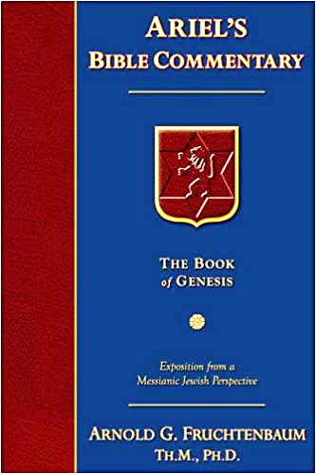
Dr. Arnold G. Fruchtenbaum
The Book of Acts, 110
“One should note the contemptuous use of the phrase ‘in this name,’ for the religious leaders did not even want to say the name ‘Yeshua.’ Rabbinic writings often refer to Yeshua as ‘that man.’…In Matthew 27:63, the Pharisees called Yeshua ‘that deceiver,’ as was typical in Pharisaic Judaism. When the rabbis had an issue with someone, they substituted an epithet, title, or derogatory term for that person’s proper name. Even today, Yeshua is still called Yeshu, which in Hebrew forms a three-letter acronym meaning ‘May his name and memory be blotted out.’ He is also referred to as Ha-Ish Ha-Hu, meaning ‘that man,’ and Ha-Taloui, meaning ‘the hanged one.’”

Slide 29
Acts 4:17-18
Decision
      Goal (17)
      Command (18)

Slide 30

Emphasis of 2 Timothy
“By my count, there are twenty-seven explicit commands given in the body of this letter. In 27 words Paul tells pastors what to focus on. You have to be blind to miss the thrust of Paul's instructions here, because eighteen of those commands--fully two-thirds--have to do with the ministry of the Word.”
Daniel Wallace, “Crisis of the Word: A Message to Pastors or Would-be Pastors,”
Conservative Theological Journal 1, no. 2 (August 1997): 108.

Slide 31
Sanhedrin’s Decision
Acts 4:13-22
  Observation (13-14)
  Private counsel (15-16)
  Decision (17-18)
  Apostles’ response (19-20)
  Sanhedrin’s response (21-22)

Slide 32
Acts 4:19-20
Apostles’ Response
      Rhetorical Question (19)
      Commitment (20)

Slide 33
Acts 4:19-20
Apostles’ Response
      Rhetorical Question (19)
      Commitment (20)

Slide 34
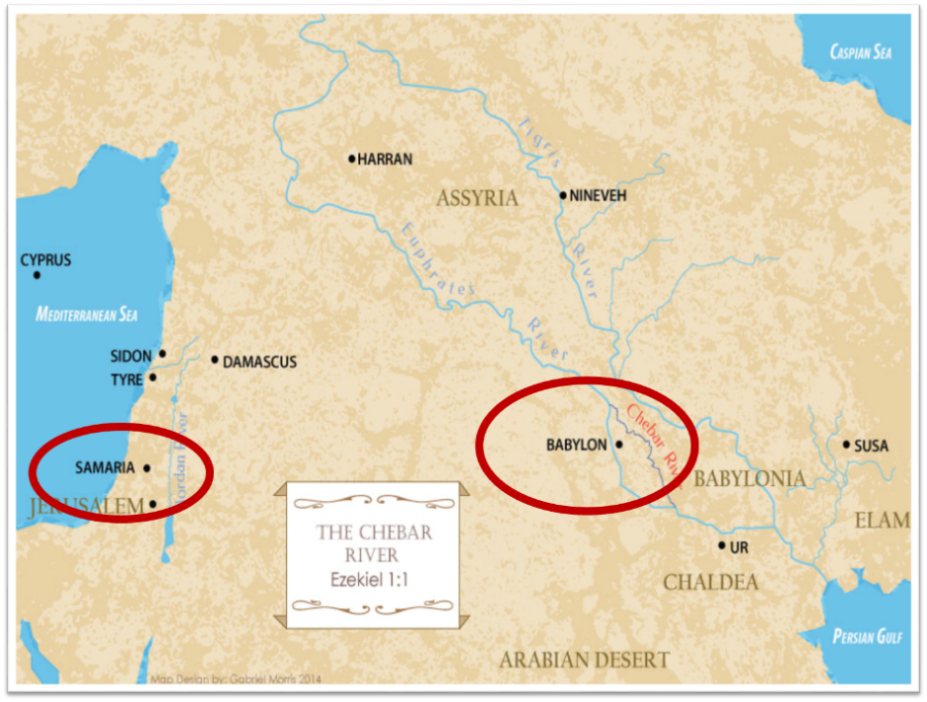

Slide 35
Daniel Outline
  Chiasm “Aramaic” ( 2-7)
1. Gentile History (2)
  2. Protection (3)
    3. Revelation to a gentile king (4)
    3. Revelation to a gentile king (5)
  2. Protection (6)
1. Gentile history (7)

Slide 36
Daniel Outline
  Chiasm “Aramaic” ( 2-7)
1. Gentile History (2)
  2. Protection (3)
    3. Revelation to a gentile king (4)
    3. Revelation to a gentile king (5)
  2. Protection (6)
1. Gentile history (7)

Slide 37
Acts 4:19-20
Apostles’ Response
      Rhetorical Question (19)
      Commitment (20)

Slide 38
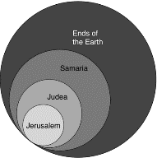
Acts 1:8
“but you will receive power when the Holy Spirit has come upon you; and you shall be My witnesses both in Jerusalem, and in all Judea and Samaria, and even to the remotest part of the earth.”

Slide 39
Sanhedrin’s Decision
Acts 4:13-22
  Observation (13-14)
  Private counsel (15-16)
  Decision (17-18)
  Apostles’ response (19-20)
  Sanhedrin’s response (21-22)

Slide 40
Acts 4:21-22
Sanhedrin’s Response
      Decision (21)
      Observation about the Lame Man (22)

Slide 41
Acts 4:21-22
Sanhedrin’s Response
      Decision (21)
      Observation about the Lame Man (22)

Slide 42
Acts 4:21-22
Sanhedrin’s Response
      Decision (21)
      Observation about the Lame Man (22)

Slide 43

Acts 2:22
“Men of Israel, listen to these words: Jesus the Nazarene, a man attested to you by God with miracles and wonders and signs which God performed through Him in your midst, just as you yourselves know.”

Slide 44
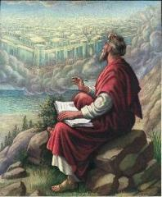
John 20:30-31
“Therefore many other signs Jesus also performed in the presence of the disciples, which are not written in this book; but these have been written so that you may believe that Jesus is the Christ, the Son of God; and that believing you may have life in His name.”

Slide 45
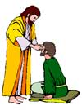
“SEVEN SIGNS” in Gospel of John
1. Changing Water into Wine | 2:11
2. Healing official’s son | 4:46-54
3. Healing an invalid at the Pool of Bethesda | 5:1-18
4. Feeding the 5,000 | 6:5-14
5. Walking on water | 6:16-21
6. Healing a blind man | 9:1-7
7. Raising dead Lazarus | 11:1-45

Slide 46
Acts 4:1‒5:11
Summary
  Apostles Arrested (4:1-4)
  Apostles Examined (4:5-12)
  Sanhedrin’s Decision (4:13-22)
  Apostles’ Prayer (4:23-31)
  Pre-Ananias and Sapphira (4:32-37)
  Ananias and Sapphira (5:1-11)

Slide 47
Apostles’ Prayer
Acts 4:23-31
  Report to the Apostles (23)
  Motivation for the Prayer (24)
  Prayer (25-30)
  Answer to the Prayer (31)

Slide 48
Apostles’ Prayer
Acts 4:23-31
  Report to the Apostles (23)
  Motivation for the Prayer (24)
  Prayer (25-30)
  Answer to the Prayer (31)

Slide 49
Apostles’ Prayer
Acts 4:23-31
  Report to the Apostles (23)
  Motivation for the Prayer (24)
  Prayer (25-30)
  Answer to the Prayer (31)

Slide 50
Activities of the Local Church
(Acts 2:41-47)
Doctrine (Acts 2:42)
Ordinances (Acts 2:41-42, 46)
Prayer (Acts 2:42)
Evangelism (Acts 2:47)
Worship (Acts 2:47)
Benevolence (Acts 2:44-45)
Fellowship (Acts 2:42, 46-47)

Slide 51

Exodus 20:8-11
Solar Non-Consecutive Days?
⁸ “Remember the sabbath day, to keep it holy. ⁹ Six days you shall labor and do all your work, ¹⁰ but the seventh day is a sabbath of the Lord your God; in it you shall not do any work, you or your son or your daughter, your male or your female servant or your cattle or your sojourner who stays with you. ¹¹ For in six days the Lord made the heavens and the earth, the sea and all that is in them, and rested on the seventh day; therefore the Lord blessed the sabbath day and made it holy.”

Slide 52

Exodus 31:15-17
Solar Non-Consecutive Days?
¹⁵ ‘For six days work may be done, but on the seventh day there is a sabbath of complete rest, holy to the Lord; whoever does any work on the sabbath day shall surely be put to death. ¹⁶ ‘So the sons of Israel shall observe the sabbath, to celebrate the sabbath throughout their generations as a perpetual covenant.’ ¹⁷ “It is a sign between Me and the sons of Israel forever; for in six days the Lord made heaven and earth, but on the seventh day He ceased from labor, and was refreshed.”

Slide 53
Dr. Arnold G. Fruchtenbaum
The Book of Acts, 113
“The apostles addressed God as ‘Lord,’ or in Greek as despotés. This term is used a total of ten times in the New Testament: four times of a human lord (I Tim. 6:1, 2; Titus 2:9; I Pet. 2:18), three times of God (Lk. 2:29; Acts 4:24; Rev. 6:10), and three times of the Messiah (II Tim. 2:21; II Peter 2:1; Jude 4). In this verse, the apostles used the word in the sense of a master-slave relationship. Thus, they recognized God’s authority. He is the One who made the heavens and the earth and the sea and all life that is in them. This was a recognition of God’s power displayed in the act of creation.”

Slide 54
Apostles’ Prayer
Acts 4:23-31
  Report to the Apostles (23)
  Motivation for the Prayer (24)
  Prayer (25-30)
  Answer to the Prayer (31)

Slide 55
Acts 4:25-30
Prayer
      Citation of Ps. 2:1-2 (25-26)
      Application (27-28)
      Three requests (29-30)

Slide 56
Acts 4:25-30
Prayer
      Citation of Ps. 2:1-2 (25-26)
      Application (27-28)
      Three requests (29-30)

Slide 57

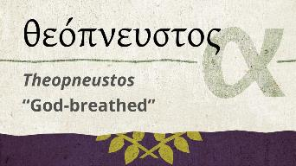
2 Timothy 3:16-17
“All Scripture is inspired by God [theópneustos] and profitable for teaching, for reproof, for correction, for training in righteousness; so that the man of God may be adequate, equipped for every good work.”
Notes:
hapaxlegomena

Slide 58
2 Peter 1:19-21
“¹⁹ So we have the prophetic word made more sure, to which you do well to pay attention as to a lamp shining in a dark place, until the day dawns and the morning star arises in your hearts. ²⁰ But know this first of all, that no prophecy of Scripture is a matter of one’s own interpretation, ²¹ for no prophecy was ever made by an act of human will, but men moved [pherō] by the Holy Spirit spoke from God.”

Slide 59
INSPIRATION OF SCRIPTURE
V. 20-21
  Men Wrote as they were inspired by Holy Spirit
    “pherō” = to carry
    Acts 27:15,17
  Opposite of Knowledge of False Teachers
    Which is their own imagination
    Jer. 23:16

Slide 60

Zechariah 12:3
“It will come about in that day that I will make Jerusalem a heavy stone for all the peoples; all who lift it will be severely injured. And all the nations of the earth will be gathered against it.

Slide 61
Zechariah 14:2-3
² For I will gather all the nations against Jerusalem to battle, and the city will be captured, the houses plundered, the women ravished and half of the city exiled, but the rest of the people will not be cut off from the city. ³ Then the Lord will go forth and fight against those nations, as when He fights on a day of battle.

Slide 62
Dr. Arnold G. Fruchtenbaum
The Book of Acts, 113-14
“The literal meaning of the verses in Psalm 2 refers to the Gentiles and the Gentile nations that will come against God and against the Messiah during the Campaign of Armageddon. But the application made here is to the Jewish leaders who have now spoken against God and His Anointed One. The psalmist declared that the Gentiles who in the future will rise up against God will include kings, but these Jewish leaders were not kings. Still, they gathered together against God and against His Anointed. That is the one point of similarity. Just as the Gentiles in Armageddon will come against the Lord and His Messiah, even so, these Jewish leaders have now come against the Lord and His Messiah.”

Slide 63
Acts 4:25-30
Prayer
      Citation of Ps. 2:1-2 (25-26)
      Application (27-28)
      Three requests (29-30)

Slide 64
Acts 4:27-28
Prayer
      Human responsibility (27)
      Divine responsibility (28)

Slide 65
Acts 4:27-28
Prayer
      Human responsibility (27)
      Divine responsibility (28)

Slide 66
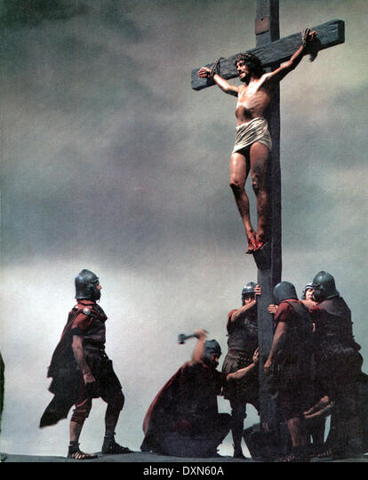
Acts 2:23
“this Man, delivered over by the predetermined plan and foreknowledge of God, you nailed to a cross by the hands of godless men and put Him to death.”

Slide 67
Acts 2:23
“this Man, delivered over by the predetermined plan and foreknowledge of God, you nailed to a cross by the hands of godless men and put Him to death.”

Slide 68
Acts 4:27-28
Prayer
      Human responsibility (27)
      Divine responsibility (28)

Slide 69
Acts 2:23
“this Man, delivered over by the predetermined plan and foreknowledge of God, you nailed to a cross by the hands of godless men and put Him to death.”

Slide 70
Acts 4:25-30
Prayer
      Citation of Ps. 2:1-2 (25-26)
      Application (27-28)
      Three requests (29-30)

Slide 71
Acts 4:29-30
Three Requests
      Consider their threats (29a)
      Boldness (29b)
      Confirmation via signs & wonders (30)

Slide 72
Acts 4:29-30
Three Requests
      Consider their threats (29a)
      Boldness (29b)
      Confirmation via signs & wonders (30)

Slide 73
Acts 4:29-30
Three Requests
      Consider their threats (29a)
      Boldness (29b)
      Confirmation via signs & wonders (30)

Slide 74
Acts 4:29-30
Three Requests
      Consider their threats (29a)
      Boldness (29b)
      Confirmation via signs & wonders (30)

Slide 75
Dr. Arnold G. Fruchtenbaum
The Book of Acts, 114-15
“What they were asking in the third prayer request is the continuous ability to perform these miracles of healing for the purpose of authenticating their message to their audience. Again, throughout the book of Acts, the only ones who performed miracles were the apostles and their delegates, meaning those on whom the apostles laid hands. Believers in general were not performing signs and wonders, as people sometimes teach.”

Slide 76
Apostles’ Prayer
Acts 4:23-31
  Report to the Apostles (23)
  Motivation for the Prayer (24)
  Prayer (25-30)
  Answer to the Prayer (31)

Slide 77
Acts 4:31
Prayer Answered
      Place shaken (31a)
      Holy Spirit’s filling (31b)
      Bold speaking (31c)

Slide 78
Acts 4:31
Prayer Answered
      Place shaken (31a)
      Holy Spirit’s filling (31b)
      Bold speaking (31c)

Slide 79
Acts 4:31
Prayer Answered
      Place shaken (31a)
      Holy Spirit’s filling (31b)
      Bold speaking (31c)

Slide 80


1 Corinthians 12:13
“For by one Spirit we were all baptized into one body, whether Jews or Greeks, whether slaves or free, and we were all made to drink of one Spirit.”

Slide 81
Acts 4:31
Prayer Answered
      Place shaken (31a)
      Holy Spirit’s filling (31b)
      Bold speaking (31c)

Slide 82
Acts 4:1‒5:11
Summary
  Apostles Arrested (4:1-4)
  Apostles Examined (4:5-12)
  Sanhedrin’s Decision (4:13-22)
  Apostles’ Prayer (4:23-31)
  Pre-Ananias and Sapphira (4:32-37)
  Ananias and Sapphira (5:1-11)

Slide 83
Pre-Ananias and Sapphira
Acts 4:32-37
  Community of the Saints (32-35)
  Barnabas’ Positive Example (36-37)

Slide 84
Pre-Ananias and Sapphira
Acts 4:32-37
  Community of the Saints (32-35)
  Barnabas’ Positive Example (36-37)

Slide 85
Acts 4:32-35
Community of the Saints
      Characteristics of the Church (32-33)
      Community of the Church (34-35)

Slide 86
Acts 4:32-35
Community of the Saints
      Characteristics of the Church (32-33)
      Community of the Church (34-35)

Slide 87
Acts 4:32-33
Characteristics of the Church
      Multitude (32a)
      Sharing (32b)
      Apostolic witness (33a)
      Grace (33b)

Slide 88
Acts 4:32-33
Characteristics of the Church
      Multitude (32a)
      Sharing (32b)
      Apostolic witness (33a)
      Grace (33b)

Slide 89
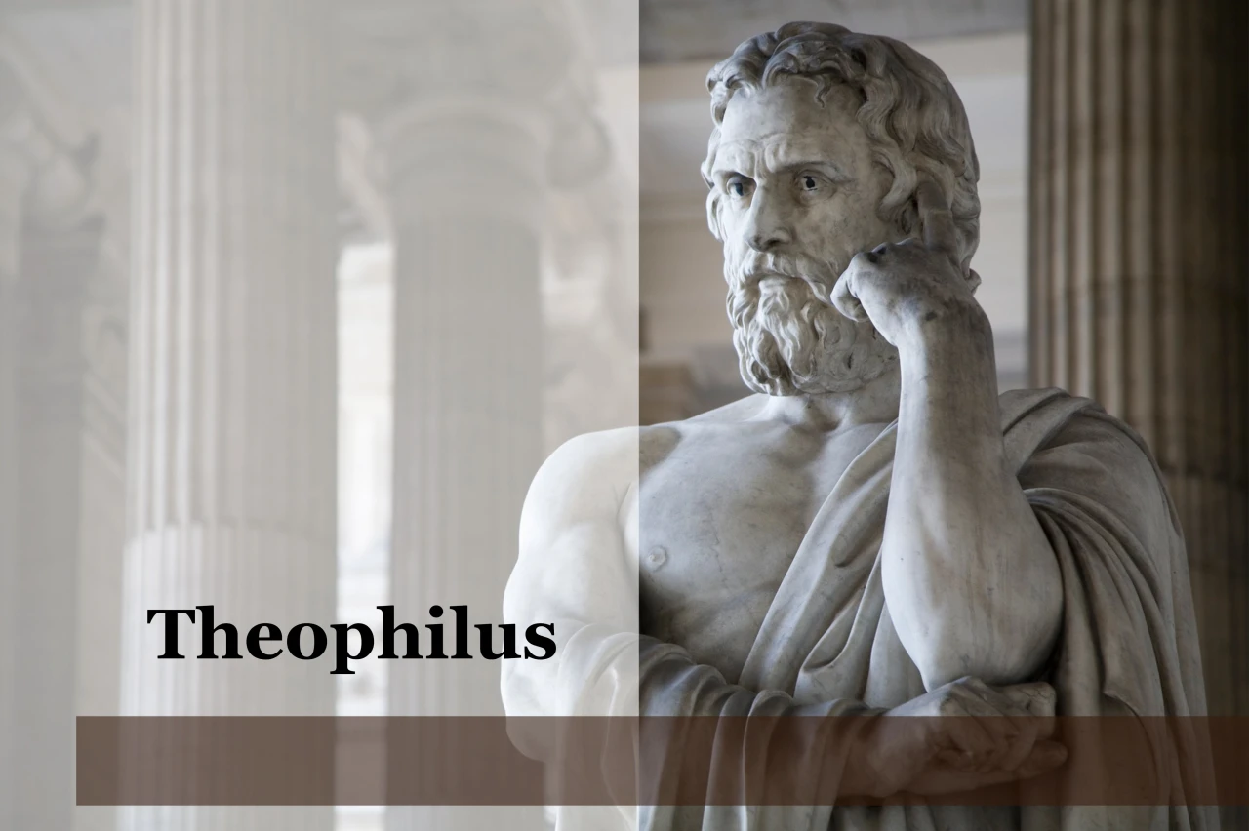
Purpose
  To present Theophilus with an orderly account of the birth and growth of the church so as to affirm him in what he has believed.

Slide 90

Message
  Birth and growth of the church numerically, geographically, ethnically.
  Components
  Numerically (progress reports)
  Geographically (From Jerusalem to Rome)
  Ethnically (From Judaism to Gentile domination)

Slide 91
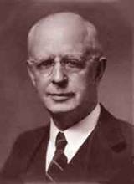
Lewis Sperry Chafer, vol. 7, Systematic Theology
(Grand Rapids, MI: Kregel Publications, 1993), 265-66.
Belief-God’s One Condition for Justification
“…because upwards of 150 passages of Scripture condition salvation upon believing only (cf. John 3:16; Acts 16:31).”

Slide 92
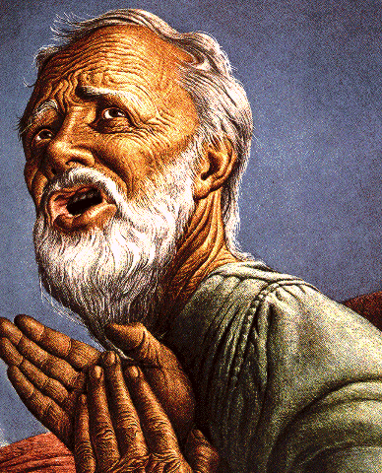
Belief – God’s One Condition for Justification
Gen 15:6
Then he believed in the LORD; and He reckoned it to him as righteousness.
John 3:16
For God so loved the world, that He gave His only begotten Son, that whoever believes in Him shall not perish, but have eternal life.
Acts 16:30-31
"Sirs, what must I do to be saved?" They said, "Believe in the Lord Jesus, and you will be saved..."

Slide 93
Acts 4:32-33
Characteristics of the Church
      Multitude (32a)
      Sharing (32b)
      Apostolic witness (33a)
      Grace (33b)

Slide 94
Activities of the Local Church
(Acts 2:41-47)
Doctrine (Acts 2:42)
Ordinances (Acts 2:41-42, 46)
Prayer (Acts 2:42)
Evangelism (Acts 2:47)
Worship (Acts 2:47)
Benevolence (Acts 2:44-45)
Fellowship (Acts 2:42, 46-47)

Slide 95
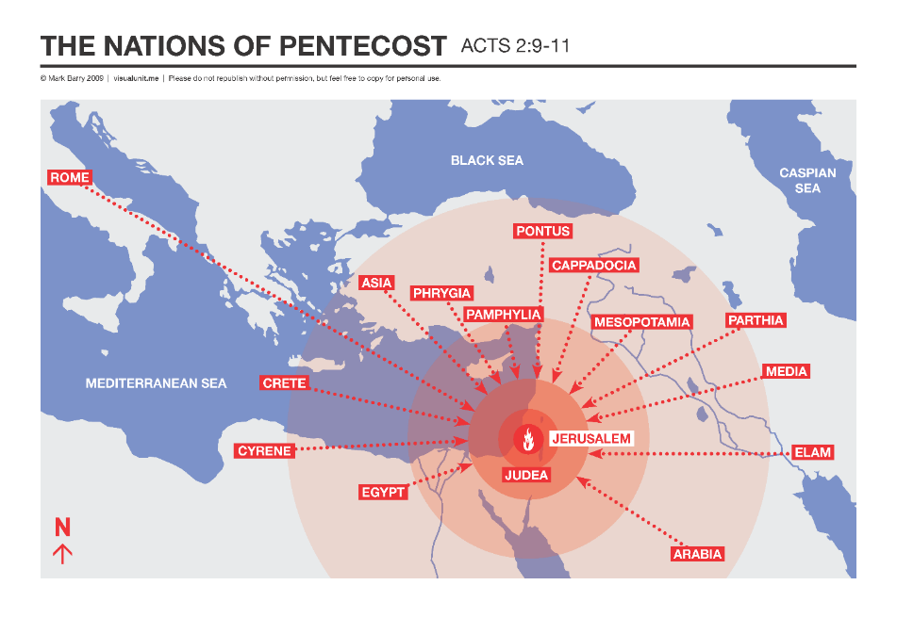

Slide 96
Acts 4:32-33
Characteristics of the Church
      Multitude (32a)
      Sharing (32b)
      Apostolic witness (33a)
      Grace (33b)

Slide 97
Acts 2:15-35
Refutation of the Charge of Drunkenness
      Too early (15)
      Use of Joel 2:28-32 (16-21)
      Christ’s miracles (22)
      Crucifixion (23)
      Resurrection (24)
      Use of Psalm 16:8-11 (25-29)
      Use of Psalm 132:11 (30-32)
      High priestly ministry (33)
      Use of Psalm 110:1 (34-35)

Slide 98
Acts 3:13-15
Israel’s Rejection of Her Messiah
      God sent His Son (13a)
      Delivered to Pilate (13b)
      Rejection of the Holy & Righteous One (14)
      Killed the Prince of Life (15a)
      Messiah was Resurrected (15b)

Slide 99
Acts 4:32-33
Characteristics of the Church
      Multitude (32a)
      Sharing (32b)
      Apostolic witness (33a)
      Grace (33b)

Slide 100
Acts 4:32-35
Community of the Saints
      Characteristics of the Church (32-33)
      Community of the Church (34-35)

Slide 101
Acts 4:34-35
Community of the Church
      Provision (34a)
      Means of provision (34b-35a)
      Communal living (35b)

Slide 102
Acts 4:34-35
Community of the Church
      Provision (34a)
      Means of provision (34b-35a)
      Communal living (35b)

Slide 103

God’s Provision for the Giver
(Phil. 4:19)
Exodus 16
1 Kings 17:2-6
Psalm 37:25
Matthew 6:25-34

Slide 104
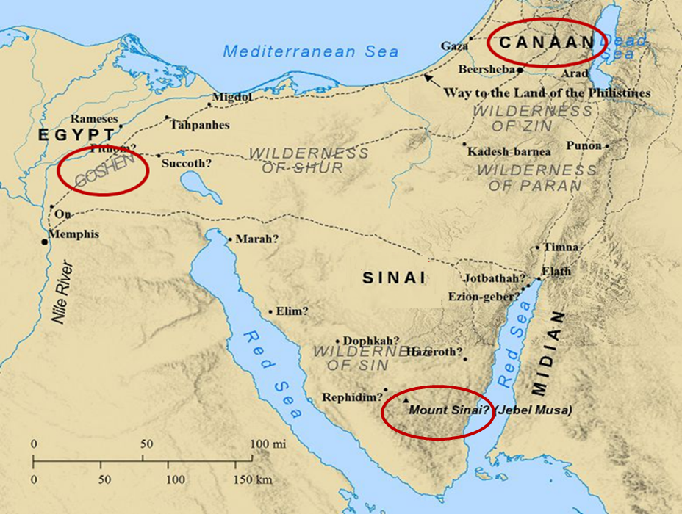

Slide 105
Acts 4:34-35
Community of the Church
      Provision (34a)
      Means of provision (34b-35a)
      Communal living (35b)

Slide 106

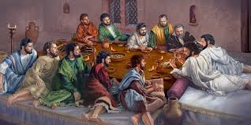
Ephesians 2:20
“having been built on the foundation of the apostles and prophets, Christ Jesus Himself being the corner stone.”

Slide 107
Dr. Arnold G. Fruchtenbaum
The Book of Acts, 118-19
“Wealthier believers sold their possessions, whether they were land holdings or houses, and all of this money was laid at the feet of the apostles. This was a clear recognition of apostolic authority. Nowadays, believers do not lay their financial possessions before the feet of others because there are no apostles anymore. The apostles had a unique authority, and in recognition of this, the saints brought them whatever they made from selling their possessions. The Greek tense allows for the translation to read, ‘Selling, they brought from time to time as it was occasioned by reason of need.’ In other words, the believers did not necessarily lay their entire profits at the apostles’ feet all at once. They would sometimes do it bit by bit as needs arose.”

Slide 108
Acts 4:34-35
Community of the Church
      Provision (34a)
      Means of provision (34b-35a)
      Communal living (35b)

Slide 109
Dr. Arnold G. Fruchtenbaum
The Book of Acts, 119
“Some have tried to base a doctrine of communism using this passage, but this was simply charity built on the teachings of Yeshua. It was not communism for five reasons. First, according to Acts 5:4, this giving was a voluntary act of the believers of Jerusalem. Second, as was pointed out, the Greek tense of verse 34 indicates that varying portions were sold according to the conscience of the individuals; it was not a one-time act. Third, this action was largely based upon a misconception concerning the second coming. The Jewish believers felt strongly that Yeshua would return in their lifetime, although He had clearly indicated that this would not happen.”

Slide 110
Dr. Arnold G. Fruchtenbaum
The Book of Acts, 119
“In fact, Yeshua prophesied in John 21:18-19 that Peter would die before His second coming. Fourth, this practice was limited to the congregation of Jerusalem; it did not spread to the other churches. Fifth, it proved to be a mistake, because it caused the church of Jerusalem to become poverty-stricken; after everything had been sold and distributed, there was nothing left in the common pot. The poverty of the congregation caused the Jewish believers to fall in need of help from Gentile churches that did not follow the procedure of having all things common (Acts 11:27-30; 24:17; Rom. 15:25-27; Gal. 2:10). Thus, there is no basis in this passage for developing the doctrine of communism.”

Slide 111
Dr. Arnold G. Fruchtenbaum
The Book of Acts, 119
“A very important principle of biblical interpretation is to distinguish between what is descriptive and what is prescriptive. Historical accounts are descriptive, simply reporting what has occurred, but there is no command to forward the practice. Only when a specific command is given does it become prescriptive, an imperative to follow.”

Slide 112
Pre-Ananias and Sapphira
Acts 4:32-37
  Community of the Saints (32-35)
  Barnabas’ Positive Example (36-37)

Slide 113
Acts 4:36-37
Barnabas’ Positive Example
      Barnabas’ example (36)
      Barnabas’ work (37)

Slide 114
Acts 4:36-37
Barnabas’ Positive Example
      Barnabas’ example (36)
      Barnabas’ work (37)

Slide 115
Acts 4:36
Barnabas’ Example
      Name (36a)
      Tribe (36b)
      Citizenship (36c)

Slide 116
Acts 4:36
Barnabas’ Example
      Name (36a)
      Tribe (36b)
      Citizenship (36c)

Slide 117
Enumeration of Spiritual Gifts
(Rom 12:6b-8)
      “Prophecy” (6b)
      “Service” (7a)
      “Teaching” (7b)
      “Exhortation” (8a)
      “Giving” (8b)
      “Leading” (8c)
      “Mercy” (8d)

Slide 118
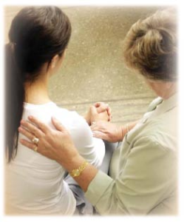
Spiritual Gifts
Exhortation: the ability to encourage others in the body of Christ

Slide 119
12/12/4/4
Romans 12
1 Corinthians 12
1 Peter 4
Ephesians 4

Slide 120
Acts 4:36
Barnabas’ Example
      Name (36a)
      Tribe (36b)
      Citizenship (36c)

Slide 121
ISRAEL'S JUDGMENTS
Division of the kingdom in 931 B.C. (1 Kgs. 12)
Assyrian judgment in 722 B.C. (2 Kgs. 17)
Babylonian captivity in 586 B.C. (2 Kgs. 25)
Rome Diaspora in A.D. 70 (Luke 19:41-44)

Slide 122
Distinctions Between 144,000 & Multitude
144,000 | MULTITUDE
Revelation 7:1-8 | Revelation 7:9-17
Numbered | Innumerable
Jews | All nations
Sealed | Slain
Sealed before the Tribulation | Converted out of the Tribulation
Hitchcock and Ice, The Truth Behind Left Behind, 77

Slide 123
Acts 4:36
Barnabas’ Example
      Name (36a)
      Tribe (36b)
      Citizenship (36c)

Slide 124
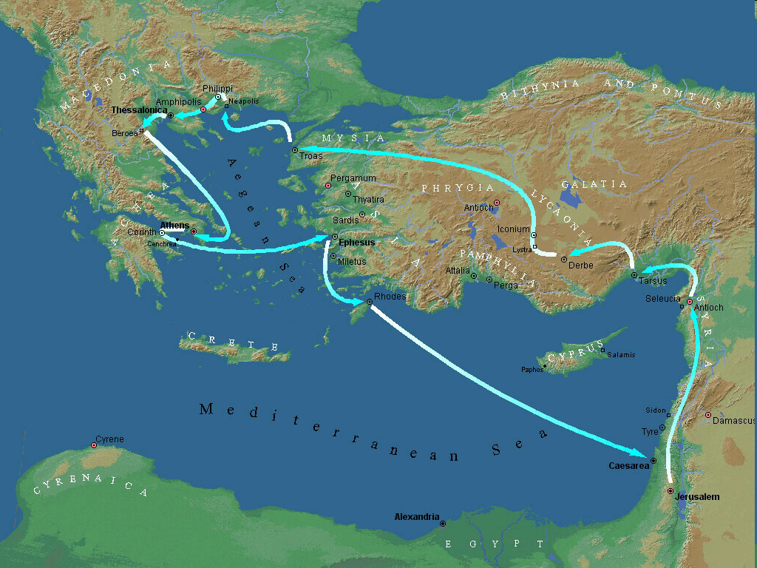

Second Missionary Journey

Slide 125
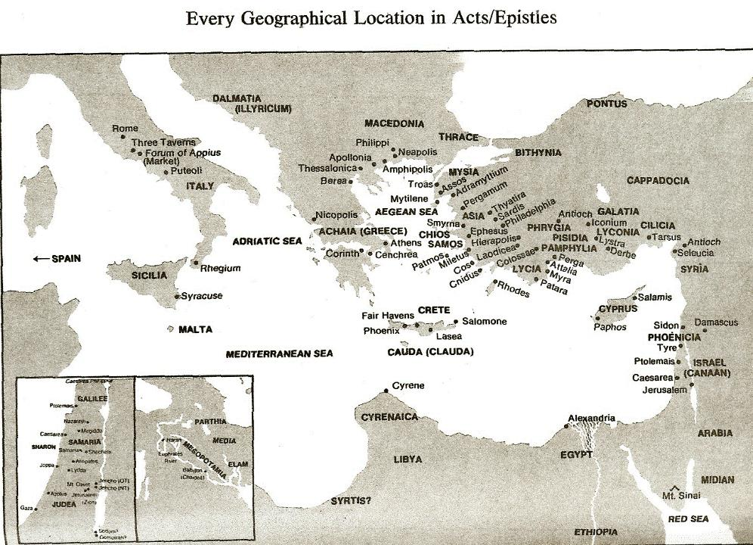

Slide 126
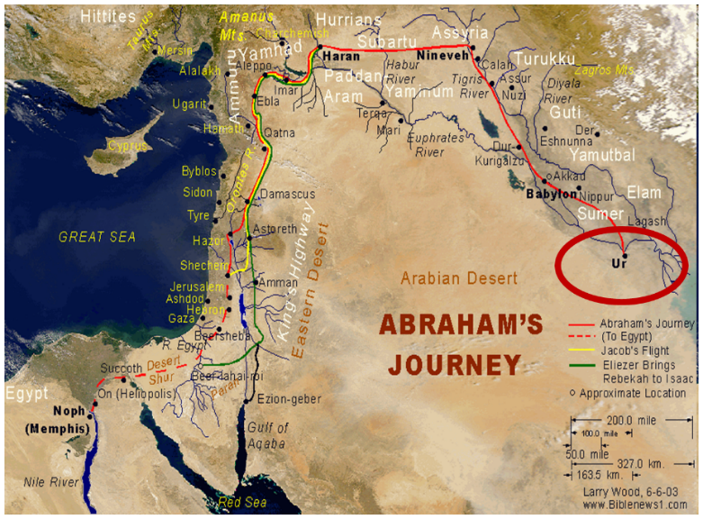

Slide 127
Dr. Arnold G. Fruchtenbaum
The Book of Acts, 120-21
“Additional facts about Barnabas can be gleaned from other passages of Scripture. His name appears 23 times in the book of Acts, and this is the first time he is mentioned. Furthermore, he is mentioned five times elsewhere in the New Testament: I Corinthians 9:6; Galatians 2:1, 9, 13; and Colossians 4:10. He was the cousin of John Mark, who was the author of the Gospel of Mark (Col. 4:10). He was the man who persuaded the church of Jerusalem to receive Paul (Acts 9:27) when Paul returned to Jerusalem from Damascus claiming to have become a believer. Later, Barnabas was sent by the church of Jerusalem to investigate Gentile salvation in Antioch (Acts 11:19-24).”

Slide 128
Dr. Arnold G. Fruchtenbaum
The Book of Acts, 120-21
“He was full of the Holy Spirit (Acts 11:24), which means he was a man who was controlled by the Holy Spirit. He brought Paul from Tarsus to Antioch to begin his ministry there (Acts 11:25-26). According to Acts 14:12, he was of commanding appearance, as he was taken by the people of Lystra to be the god Jupiter or Zeus. Finally, he also had the gift of apostleship (Acts 14:14) and was of that second category of apostles, like Paul or James, the half-brother of Yeshua. The only prerequisite for this category of apostleship was that they had seen the resurrected Messiah. Apparently, Barnabas was among the five hundred who saw Yeshua after His resurrection (I Cor. 15:6).”

Slide 129
Acts 4:36-37
Barnabas’ Positive Example
      Barnabas’ example (36)
      Barnabas’ work (37)

Slide 130
Acts 4:37
Barnabas’ Work
      Owned field (37a)
      Sold field (37b)
      Donation (37c)

Slide 131
Acts 4:37
Barnabas’ Work
      Owned field (37a)
      Sold field (37b)
      Donation (37c)

Slide 132
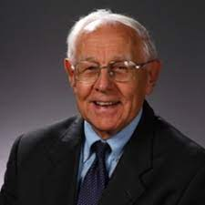
Dr. Stanley Toussaint
The Book of Acts, The Bible Knowledge Commentary, p. 364.
“Whereas the Levites were not to hold land in Israel, they could own land elsewhere. Apparently, Barnabas, being from the island of Cyprus, owned land there. It is also possible that his wife owned land in Israel and that they together sold it.”

Slide 133
Acts 4:37
Barnabas’ Work
      Owned field (37a)
      Sold field (37b)
      Donation (37c)

Slide 134
Acts 4:37
Barnabas’ Work
      Owned field (37a)
      Sold field (37b)
      Donation (37c)

Slide 135
Acts 4:1‒5:11
Summary
  Apostles Arrested (4:1-4)
  Apostles Examined (4:5-12)
  Sanhedrin’s Decision (4:13-22)
  Apostles’ Prayer (4:23-31)
  Pre-Ananias and Sapphira (4:32-37)
  Ananias and Sapphira (5:1-11)

Slide 136
Ananias and Sapphira
Acts 5:1-11
  Ananias’ Discipline (1-6)
  Sapphira’s Discipline (7-10)
  Result (11)

Slide 137
Ananias and Sapphira
Acts 5:1-11
  Ananias’ Discipline (1-6)
  Sapphira’s Discipline (7-10)
  Result (11)

Slide 138
Acts 5:1-6
Ananias’ Discipline
      Deed (1-2)
      Peter’s Accusation (3-4)
      Ananias’ Discipline (5-6)

Slide 139
Acts 5:1-6
Ananias’ Discipline
      Deed (1-2)
      Peter’s Accusation (3-4)
      Ananias’ Discipline (5-6)

Slide 140
Acts 5:1-2
Deed
      Sale (1)
      Conspiracy (2)

Slide 141
Acts 5:1-2
Deed
      Sale (1)
      Conspiracy (2)

Slide 142
Acts 5:1-2
Deed
      Sale (1)
      Conspiracy (2)

Slide 143
Acts 5:1-6
Ananias’ Discipline
      Deed (1-2)
      Peter’s Accusation (3-4)
      Ananias’ Discipline (5-6)

Slide 144
Acts 5:3-4
Peter’s Accusation
      Guilty parties (3)
      Couple’s responsibility (4)

Slide 145
Acts 5:3-4
Peter’s Accusation
      Guilty parties (3)
      Couple’s responsibility (4)

Slide 146
Acts 5:3-4
Peter’s Accusation
      Guilty parties (3)
      Couple’s responsibility (4)

Slide 147
Dr. Stanley Toussaint
The Book of Acts, The Bible Knowledge Commentary, p. 365.
“The fact that believers had the right to keep their money shows that this was not Christian socialism. It was a free-will arrangement for the support of the church, used only temporarily because evidently the early church expected Christ to come in their generation.”

Slide 148
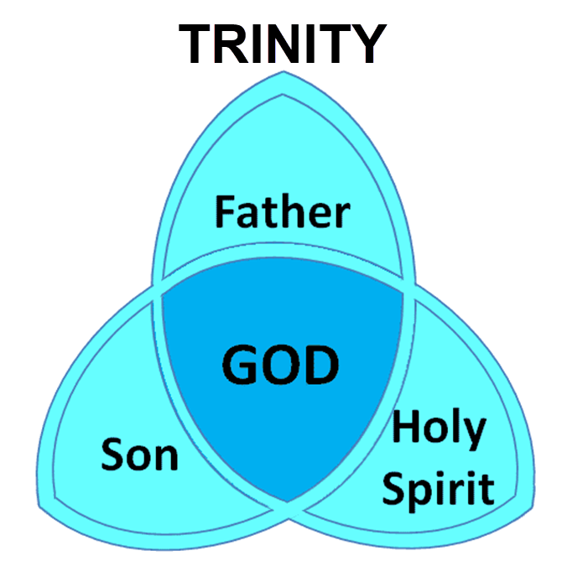

Slide 149
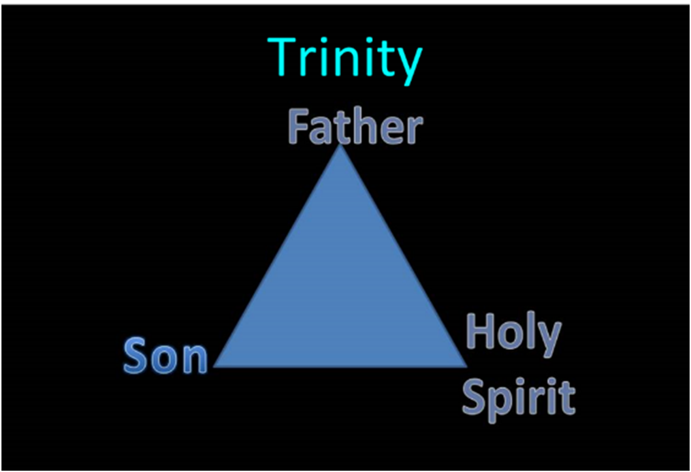

Slide 150
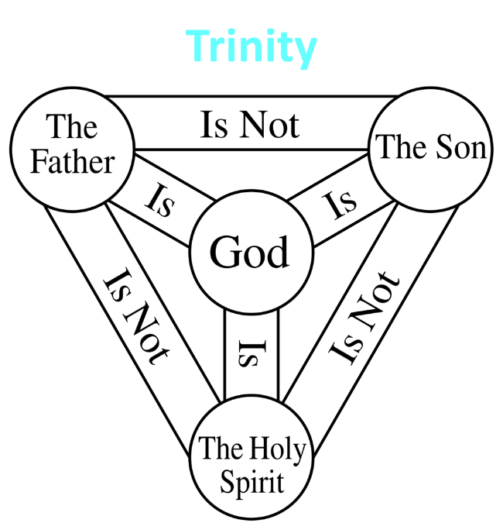

Slide 151
12/12/4/4
Romans 12
1 Corinthians 12
1 Peter 4
Ephesians 4

Slide 152
Acts 5:1-6
Ananias’ Discipline
      Deed (1-2)
      Peter’s Accusation (3-4)
      Ananias’ Discipline (5-6)

Slide 153
Acts 5:5-6
Ananias's Discipline
      Death (5)
      Burial (6)

Slide 154
Acts 5:5-6
Ananias's Discipline
      Death (5)
      Burial (6)

Slide 155
Acts 5:5-6
Ananias's Discipline
      Death (5)
      Burial (6)

Slide 156
Ananias and Sapphira
Acts 5:1-11
  Ananias’ Discipline (1-6)
  Sapphira’s Discipline (7-10)
  Result (11)

Slide 157
Acts 5:7-10
Sapphira's’ Discipline
      Sin (7-8)
      Peter’s confrontation & judgment (9)
      Death and burial (10)

Slide 158
Acts 5:7-10
Sapphira's’ Discipline
      Sin (7-8)
      Peter’s confrontation & judgment (9)
      Death and burial (10)

Slide 159
Acts 5:7-10
Sapphira's’ Discipline
      Sin (7-8)
      Peter’s confrontation & judgment (9)
      Death and burial (10)

Slide 160
Acts 5:7-10
Sapphira's’ Discipline
      Sin (7-8)
      Peter’s confrontation & judgment (9)
      Death and burial (10)

Slide 161
Ananias and Sapphira
Acts 5:1-11
  Ananias’ Discipline (1-6)
  Sapphira’s Discipline (7-10)
  Result (11)

Slide 162
Acts 5:11
Result
      Fear within the congregation (11a)
      Fear outside the congregation (11b)

Slide 163
Acts 5:11
Result
      Fear within the congregation (11a)
      Fear outside the congregation (11b)

Slide 164
Acts 2:47
“praising God and having favor with all the people. And the Lord was adding to their number day by day those who were being saved.” (NASB)
“praising God and having favor with all the people. And the Lord added to the church daily those who were being saved.” (NKJV)

Slide 165
Author | Written | Earliest MSS | Time Span | No. MSS
Cesar | 100 to 44 b.c. | a.d. 900 | 1000 | 10
Plato | 427 to 347 b.c. | a.d. 900 | 1200 | 7
Thucydides | 460 to 400 b.c. | a.d. 900 | 1300 | 8
Tacitus | a.d. 100 | a.d. 1100 | 1000 | 20
Suetonius | a.d. 75 to 160 | a.d. 950 | 800 | 8
Homer (Illiad) | 900 b.c. | a.d. 400 | 500 | 643
New Testament | a.d. 40 to 100 | a.d. 125 | 25 to 50 | 24,000
Cesar | 100 to 44 b.c. | a.d. 900 | 1000 | 10
http://creationrevolution.com/2012/05/should-we-trust-the-bible/

Slide 166
Manuscript Evidence for Ancient Writings
Author | Written | Earliest Fragment/Copy | Time Span in Years | Number of Manuscripts
Cesar | 100 to 44 b.c. | a.d. 900 | 1000 | 10
Plato | 427 to 347 b.c. | a.d. 900 | 1200 | 7
Thucydides | 460 to 400 b.c. | a.d. 900 | 1300 | 8
Tacitus | a.d. 100 | a.d. 1100 | 1000 | 20
Suetonius | a.d. 75 to 160 | a.d. 950 | 800 | 8
Homer (Illiad) | 900 b.c. | a.d. 400 | 500 | 643
New Testament | a.d. 40 to 100 | a.d. 125 | 25 to 50 | 24,000
Information in this chart can be found in various sources. This chart was adapted from: Christian Apologetics, by Norman Geisler, 1976, p. 307; and Evidence That Demands a Verdict, by Josh McDowell, 1979, pp. 42, 43.

Slide 167

Dr. Arnold Fruchtenbaum
Arnold G. Fruchtenbaum, “Israel and the Church,” in Issues in Dispensationalism, ed. Wesley R. Willis and John R. Master (Chicago: Moody, 1994), 118.
“In the book of Acts, both Israel and the church exist simultaneously. The term Israel is used twenty times and ekklēsia (church) nineteen times, yet the two groups are always kept distinct.”

Slide 168
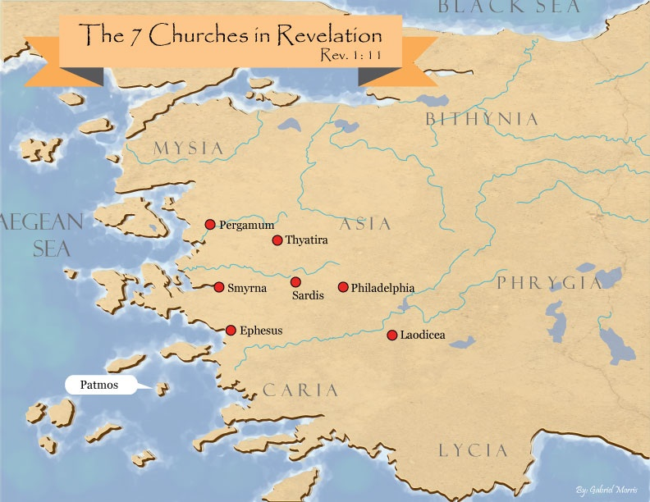
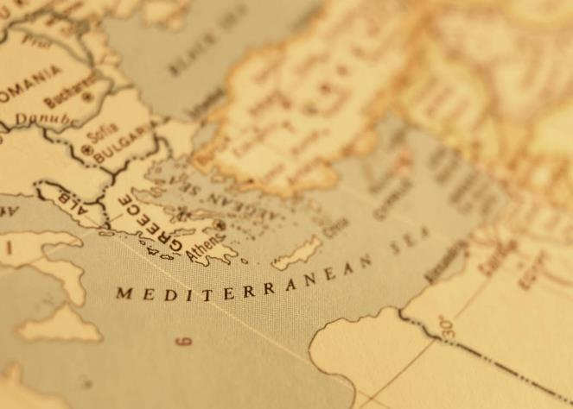

Slide 169
Acts 5:11
Result
      Fear within the congregation (11a)
      Fear outside the congregation (11b)

Slide 170
Conclusion

Slide 171
Acts 4:1‒5:11
Summary
  Apostles Arrested (4:1-4)
  Apostles Examined (4:5-12)
  Sanhedrin’s Decision (4:13-22)
  Apostles’ Prayer (4:23-31)
  Pre-Ananias and Sapphira (4:32-37)
  Ananias and Sapphira (5:1-11)

