Slide 2
JONAH: AN INTRODUCTION, PART 2
Who wrote it? (Authorship)
When was it written? (Date)
Who was it written to? (Audience)
Historicity of the book? (fact of fiction?)
Genre of the book?
What is it all about? (Message)

Slide 3
JONAH: AN INTRODUCTION, PART 2
Why was it written? (Purpose)
What’s in it? (Survey)
Christ in Jonah?
What makes this book unique?
Structure of the book?
Outline of book?

Slide 4
JONAH: AN INTRODUCTION, PART 2
Who wrote it? Jonah
When was it written? 770-750 BC
Who was it written to? Israel
Historicity of the book? Fact!
Genre of the book?
What is it all about? (Message)

Slide 5
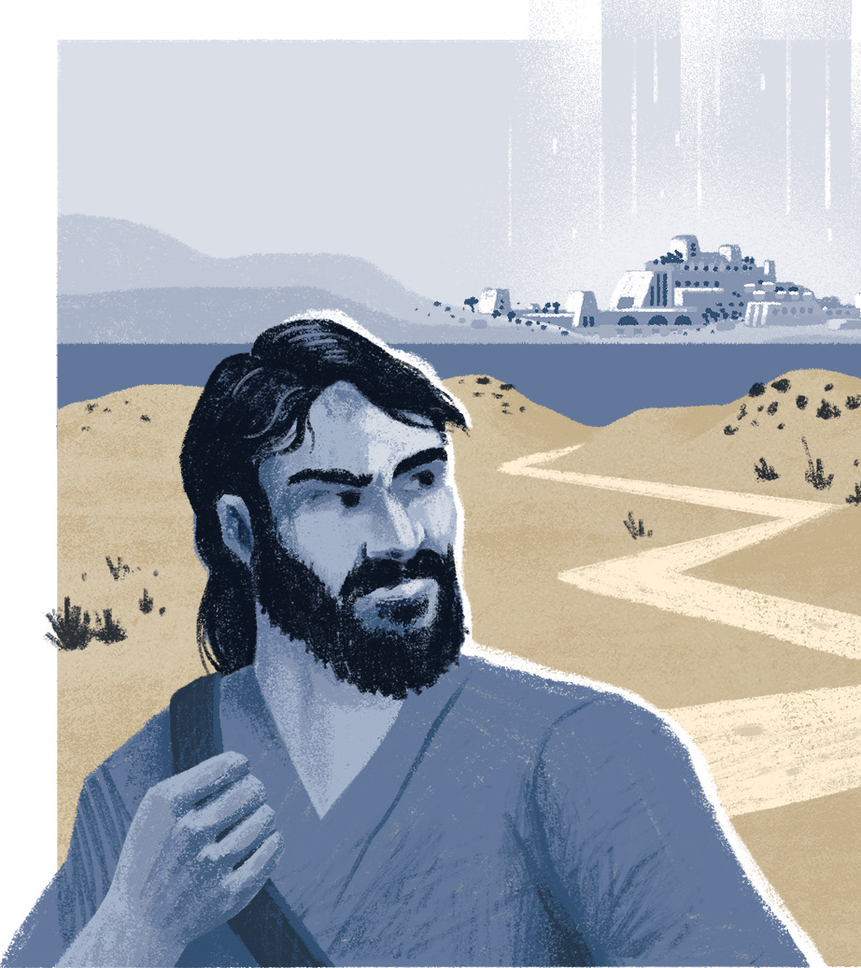
WHO WAS JONAH?
Son of Amittai (Jonah 1:1)
Yonah means dove (see Gen 8:8; Lev 1:14
Comes from the root אנה (‘nh – lament) see Is. 3:26; 2 Kings 5:7)
Prophet from Gath-Hepher (2 Kings 14:25) during the reign of Jeroboam II (793-753 BC).
Tribe of Zebulun

Slide 6
JONAH: AN INTRODUCTION, PART 2
Who wrote it? Jonah
When was it written? 770-750 BC
Who was it written to? Israel
Historicity of the book? Fact!
Genre of the book?
What is it all about? (Message)

Slide 7
THE KINGS OF ISRAEL, NORTHERN KINGDOM | APPROXIMATE DATE | FATHER | HOW ACCESSION WAS GAINED
Jeroboam I Nadab | 931-910 910-909 | Nebat Jeroboam | Chosen by the people Inherited
Baasha | 909-886 | Common | Assassinated
Elah Zimri | 886-885 885 | Baasha Common | Inherited
Omri | 885-874 | Common | Declared so by army
Ahab Ahazia | 874-853 853-852 | Omri Ahab | Inherited Inherited
Jehoram | 852-841 | Ahab | Inherited
Jehu | 841-814 | Nimshi | Assassinated
Jehoahaz | 814-798 | Jehu | Inherited
Jehoash | 798-782 | Jehoahaz | Inherited
Jeroboam II | 793-753 | Jehoash | Inherited
Zechariah | 753-752 | Jeroboam II | Inherited
Shallum Menahem | 752 752-742 | Jabesh Gadi | Assassinated Assassinated
Pekahiah | 742-740 | Menahem | Inherited
Pekah Hoshea | 752-732 732-722 | Remaliah Elah | Coup d’etat Assassinated

Slide 8
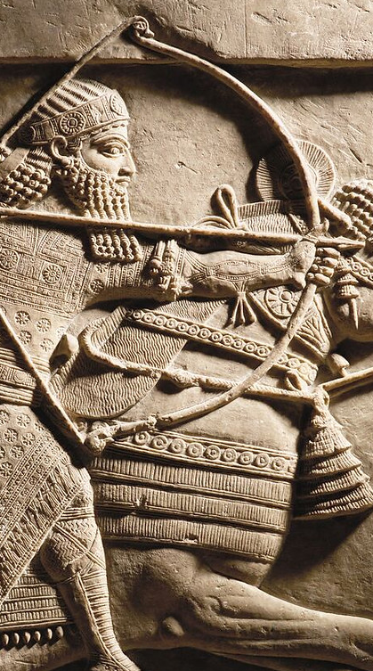
KINGS OF ASSYRIA
KING | REIGN | KING | REIGN
Ashur-uballit I | 1365–1330 | Shamsi-Adad V | 824–810
Adad-nirari I | 1307–1275 | Adad-nirari III | 810–782
Shalmaneser I | 1274–1245 | Shalmaneser IV | 782–773
Tukulti-Ninurta I | 1244–1208 | Ashur-dan III | 773–754
Ashur-dan I | 1179–1133 | Ashur-nirari V | 754–745
Tiglath-pileser I | 1115–1076 | Tiglath-pileser III | 745–727
Ashur-rabi II | 1012–972 | Shalmaneser V | 727–722
Ashur-resh-ishi II | 972–967 | Sargon II | 721–705
Tiglath-pileser II | 967–935 | Sennacherib | 704–681
Ashur-dan II | 935–912 | Esarhaddon | 681–669
Adad-nirari II | 912–889 | Ashur-banipal | 669–633
Tukulti-Ninurta II | 889–884 | Ashur-etil-ilani | 633–622
Ashur-nasir-apal II | 884–858 | Sin-shur-ishkun | 621–612
Shalmaneser III | 858–824 | Ashur-uballit | 612–608

Slide 9
JONAH: AN INTRODUCTION, PART 2
Who wrote it? Jonah
When was it written? 770-750 BC
Who was it written to? Israel
Historicity of the book? Fact!
Genre of the book?
What is it all about? (Message)

Slide 10
Arguments for the historicity of Jonah…
Presented as normative history
Jewish tradition embraced the historicity of Jonah, book canonized in the OT minor prophets.
Jonah 1:1 is historically linked to 2 Kings 14:25
Jesus took Jonah as historically accurate

Slide 11
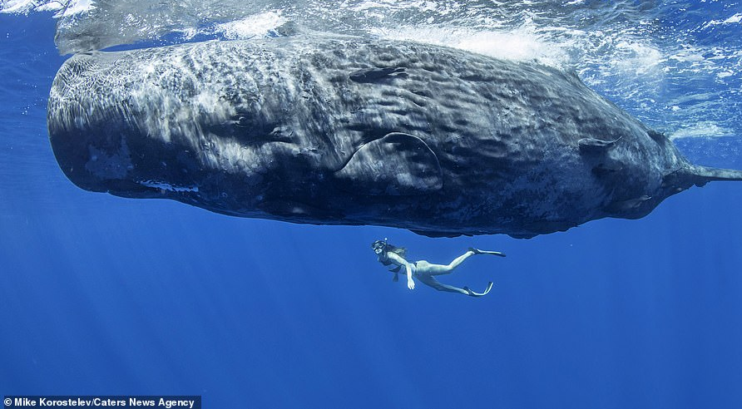

Slide 14
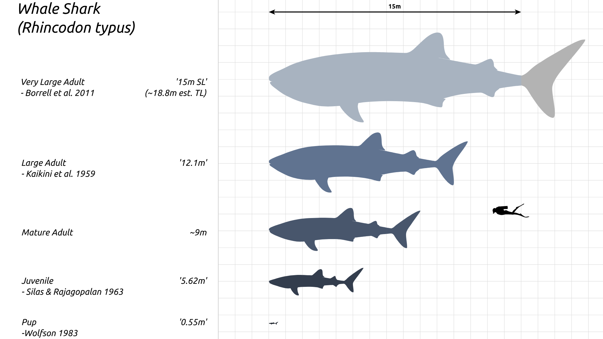

Slide 15
Jonah 1:17
And the LORD appointed a great fish to swallow Jonah, and Jonah was in the stomach of the fish three days and three nights.

Slide 16
JONAH: AN INTRODUCTION, PART 2
Who wrote it? Jonah
When was it written? 770-750 BC
Who was it written to? Israel
Historicity of the book? Fact!
Genre of the book?
What is it all about? (Message)

Slide 17
JONAH: AN INTRODUCTION, PART 2
Who wrote it? Jonah
When was it written? 770-750 BC
Who was it written to? Israel
Historicity of the book? Fact!
Genre of the book?
What is it all about? (Message)

Slide 18
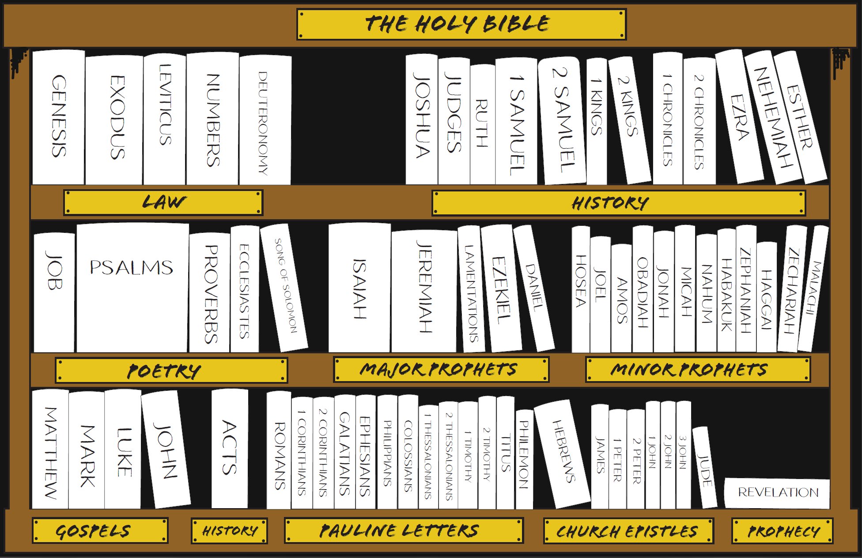

Slide 19
JONAH: Genres proposed
(Journalistic) history: an account of events as they were experienced or witnessed
Epic: a glamorized story recounting noteworthy events
Heroic/anti-heroic: a story honoring or vilifying individual deeds
Satire: a story ridiculing folly, vice, or incompetence
Legend: a fanciful story about a historical character
Midrash: an expansive, paradigmatic story
Parable: a teaching story
Allegory: a symbolic story
Parody: a comical imitation of a serious work
Farce: a story of comical exaggeration
Novella: short & compact, story that uses a limited number of events and includes surprises.

Slide 20
JONAH: Genres proposed
“The book is probably a sensational didactic prophetic historical narrative in its literary style.” (Thomas Constable, Online notes, Jonah)
“The Book is a simple narrative, with the exception of (ch. 2) a prayer or thanksgiving.” James Wolfendale, Minor Prophets, The Preacher’s Complete Homiletic Commentary (New York; London; Toronto: Funk & Wagnalls Company, 1892), 345.
The book clearly has a didactic purpose to teach about God’s redemptive concern for the Assyrian people, but no literary clues within the book itself suggest that the book of Jonah should be read as anything other than a straightforward historical narrative. (Ed Hindson and Gary Yates, eds., The Essence of the Old Testament: A Survey (Nashville, TN: B&H Publishing Group, 2012), 397.)

Slide 21
JONAH: AN INTRODUCTION, PART 2
Who wrote it? Jonah
When was it written? 770-750 BC
Who was it written to? Israel
Historicity of the book? Fact!
Genre of the book? Historical Narrative
What is it all about? (Message)

Slide 22
JONAH: AN INTRODUCTION, PART 2
Who wrote it? Jonah
When was it written? 770-750 BC
Who was it written to? Israel
Historicity of the book? Fact!
Genre of the book? Historical Narrative
What is it all about? (Message)

Slide 23
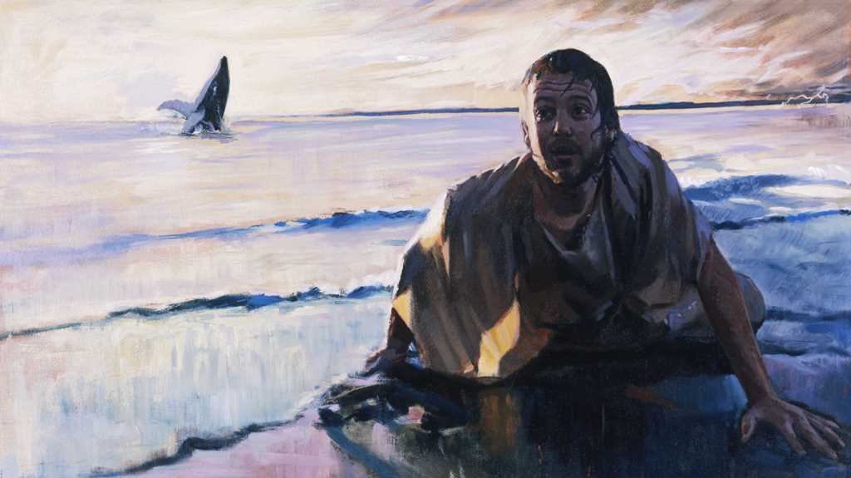

Slide 24
GENESIS 12:3
“And I will bless those who bless you, And the one who curses you I will curse. And in you all the families of the earth will be blessed.”

Slide 25
THE MESSAGE OF JONAH
To showcase God’s universal love and plan of redemption which extends beyond Israel to include all nations.

Slide 26
Romans 5:8
But God demonstrates His own love toward us, in that while we were yet sinners, Christ died for us.

Slide 27
Romans 5:7-8
7 For one will hardly die for a righteous man; though perhaps for the good man someone would dare even to die.
8 But God demonstrates His own love toward us, in that while we were yet sinners, Christ died for us.

Slide 28
JONAH: AN INTRODUCTION, PART 2
Who wrote it? Jonah
When was it written? 770-750 BC
Who was it written to? Israel
Historicity of the book? Fact!
Genre of the book? Historical Narrative
What is it all about? (Message) To showcase God’s universal love and plan of redemption which extends beyond Israel to include all nations

Slide 29
JONAH: AN INTRODUCTION, PART 2
Why was it written? (Purpose)
What’s in it? (Survey)
Christ in Jonah?
What makes this book unique?
Structure of the book?
Outline of book?

Slide 30
THE PURPOSE OF JONAH
Expose Israel’s ethnocentrism

Slide 31
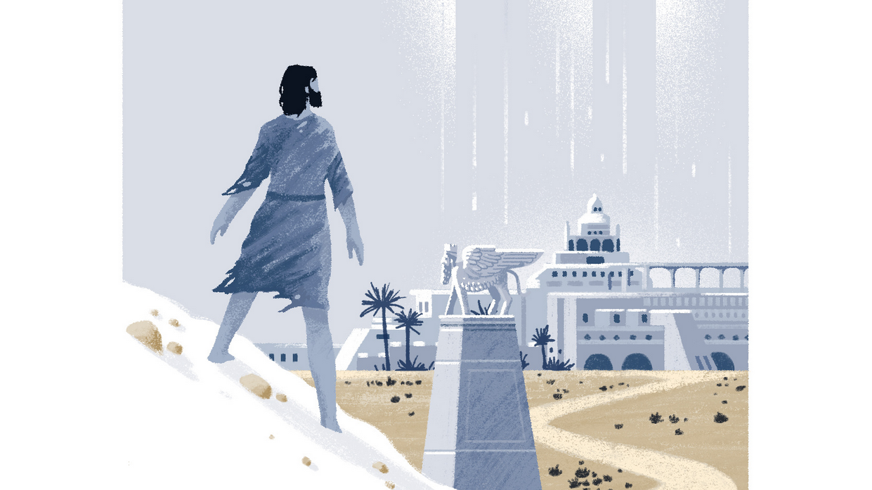
2 Kings 14:25
Jonah 1:1
“He restored the border of Israel from the entrance of Hamath as far as the Sea of the Arabah, according to the word of the LORD, the God of Israel, which He spoke through His servant Jonah the son of Amittai, the prophet, who was of Gath-hepher.”
“The word of the Lord came to Jonah the son of Amittai saying…”

Slide 32
Jonah 4:2
He prayed to the LORD and said, “Please LORD, was not this what I said while I was still in my own country? Therefore, in order to forestall this I fled to Tarshish, for I knew that You are a gracious and compassionate God, slow to anger and abundant in lovingkindness, and one who relents concerning calamity.

Slide 33
Israel’s Judgments
Division of the kingdom in 931 B.C.
North: Assyrian judgment in 722 B.C.
South: Babylonian captivity in 586 B.C.

Slide 34
KINGS OF ASSYRIA
KING | REIGN | KING | REIGN
Ashur-uballit I | 1365–1330 | Shamsi-Adad V | 824–810
Adad-nirari I | 1307–1275 | Adad-nirari III | 810–782
Shalmaneser I | 1274–1245 | Shalmaneser IV | 782–773
Tukulti-Ninurta I | 1244–1208 | Ashur-dan III | 773–754
Ashur-dan I | 1179–1133 | Ashur-nirari V | 754–745
Tiglath-pileser I | 1115–1076 | Tiglath-pileser III | 745–727
Ashur-rabi II | 1012–972 | Shalmaneser V | 727–722
Ashur-resh-ishi II | 972–967 | Sargon II | 721–705
Tiglath-pileser II | 967–935 | Sennacherib | 704–681
Ashur-dan II | 935–912 | Esarhaddon | 681–669
Adad-nirari II | 912–889 | Ashur-banipal | 669–633
Tukulti-Ninurta II | 889–884 | Ashur-etil-ilani | 633–622
Ashur-nasir-apal II | 884–858 | Sin-shur-ishkun | 621–612
Shalmaneser III | 858–824 | Ashur-uballit | 612–608

Slide 35
THE PURPOSE OF JONAH
Expose Israel’s ethnocentrism
Encourage national repentance

Slide 36
JONAH: AN INTRODUCTION, PART 2
Why was it written? (Purpose) Expose Israel’s ethnocentrism and encourage national repentance
What’s in it? (Survey)
Christ in Jonah?
What makes this book unique?
Structure of the book?
Outline of book?

Slide 37
JONAH: AN INTRODUCTION, PART 2
Why was it written? (Purpose) Expose Israel’s ethnocentrism and encourage national repentance
What’s in it? (Survey)
Christ in Jonah?
What makes this book unique?
Structure of the book?
Outline of book?

Slide 38
WHAT’S IN THE BOOK?: A SURVEY
Jonah’s Prideful Defiance (1-2)
Jonah’s Reluctant Compliance (3-4)

Slide 39
JONAH: AN INTRODUCTION, PART 2
Why was it written? (Purpose) Expose Israel’s ethnocentrism and encourage national repentance
What’s in it? (Survey) Defiance (1-2) Compliance (3-4)
Christ in Jonah?
What makes this book unique?
Structure of the book?
Outline of book?

Slide 40
JONAH: AN INTRODUCTION, PART 2
Why was it written? (Purpose) Expose Israel’s ethnocentrism and encourage national repentance
What’s in it? (Survey) Defiance (1-2) Compliance (3-4)
Christ in Jonah?
What makes this book unique?
Structure of the book?
Outline of book?

