Slide 1
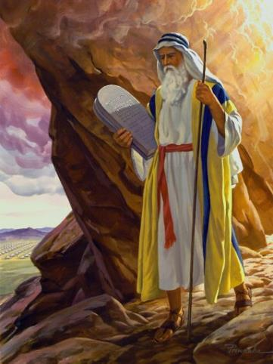
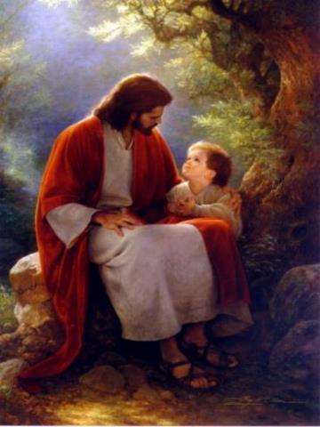
Law and Grace: An Overview
Jim McGowan, Th.D.
Sugar Land Bible Church
09-10-2023
…but grace and truth were realized through Jesus Christ - John 1:17
For the Law was given through Moses…
Special thanks to Dr. Vern Peterman for access to his insights and resources.

Slide 2
Session 38 Outline
  REVIEW
    PURPOSE, AIM, AND OBJECTIVE
  GENTILES, ISRAEL, & THE CHURCH – Part 1
    SCRIPTURES (Gal. 2:19-20; Matt. 10:5-8; Acts 14:26-27)
    GENERAL INFORMATION
    CHART - THE THREE DIFFERENT GROUPS
  CONCLUDING OBSERVATIONS

Slide 3

OUR PURPOSE, AIM AND OBJECTIVE
Law and Grace
…is to Compare and Contrast Law and Grace so as to properly understand these two important themes and how they are related to the life of the New Testament Believer.

Slide 4

C. I. Scofield, D. D.
The Grace of God, The Fundamentals Vol. 3, Chapter VII, p. 98
We have, most of us, been reared and now live under the influence of Galatianism. Protestant theology, alas, is for the most part, thoroughly Galatianized, in that neither law nor grace are given their distinct and separated places, as in the counsels of God, but are mingled together in one incoherent system. The law is no longer, as in the Divine intent, a ministration of death (2 Cor. 3:7), of cursing (Gal. 3:10), of conviction (Rom. 3:19), because we are taught that we must try to keep it, and that by Divine help we may. Nor, on the other hand, does grace bring us blessed deliverance from the dominion of sin, for we are kept under the law as a rule of life despite the plain declaration, “Sin shall not have dominion over you: for ye are not under the law, but under grace” (Rom. 6:14). (emphasis mine)

Slide 5
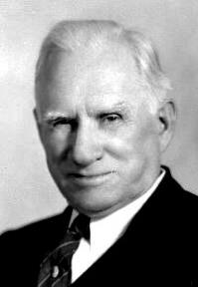
William R. Newell
Romans Verse-by-Verse (p. 274).
Grand Rapids, MI: Christian Classics Ethereal Library.
It is because Reformed theology has kept us Gentiles under the Law,—if not as a means of righteousness, then as “a rule of life,” that all the trouble has arisen. The Law is no more a rule of life than it is a means of righteousness. Walking in the Spirit has now taken the place of walking by ordinances. God has another principle under which He has put his saints: “Ye are not under law, but, under grace! (Rom. 6:14)” (italics mine)
PDF Download Here: https://archive.org/details/Romans_Verse_By_Verse-NewellWR

Slide 6

Henry Ironside
The Continual Burnt Offering: Daily Meditations on the Word of God (p. 265). Neptune, NJ: Loizeaux Brothers.
There is therefore now no condemnation
to those who are in Christ Jesus. – Romans 8:1
In Romans 7 we have a man renewed by the Spirit of God, but struggling under law, hoping thereby to subdue or find deliverance from the power of the old Adamic nature (sin nature). In chapter 8 we have God’s (only) way of deliverance through the death and resurrection of Christ with which the believer is identified before God. The chapter begins with “no condemnation” and ends with “no separation.” All who are in Christ Jesus are accepted in the Beloved and as free from every charge of guilt as He is Himself. He [Jesus] paid our penalty on the cross. Now we are linked up with Him in resurrection, not under law but under grace.

Slide 7
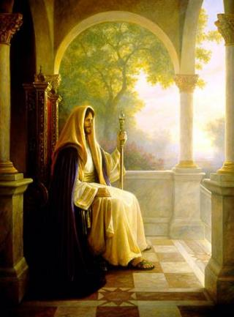
Matthew’s 3-Fold Purpose
Law and Grace: Review The SOM – Matthew 5:1–8:1 (Luke 6:17–49)
To explain:
  that Jesus, in whom Matthew’s Israelite audience had believed, was indeed the long-awaited Jewish Messiah;
  why the promised, messianic kingdom had been postponed despite the fact that the king had arrived; and,
  the interim program of God during the messianic kingdom’s absence.

Slide 8
Session 38 Outline
  REVIEW
    PURPOSE, AIM, AND OBJECTIVE
  GENTILES, ISRAEL, & THE CHURCH – Part 1
    SCRIPTURES (Gal. 2:19-20; Matt. 10:5-8; Acts 14:26-27)
    GENERAL INFORMATION
    CHART - THE THREE DIFFERENT GROUPS
  CONCLUDING OBSERVATIONS

Slide 9

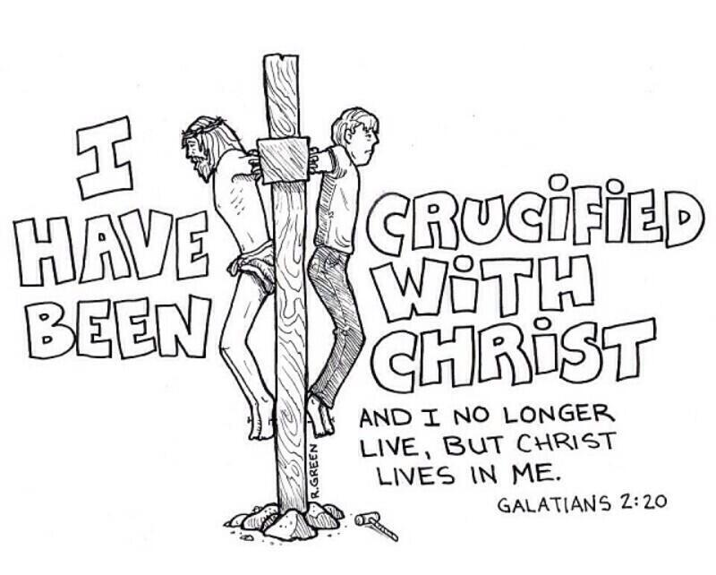
Galatians 2:19-20
¹⁹ "For through the Law I died to the Law, so that I might live to God. ²⁰ I have been crucified with Christ; and it is no longer I who live, but Christ lives in me; and the life which I now live in the flesh I live by faith in the Son of God, who loved me and gave Himself up for me."

Slide 10
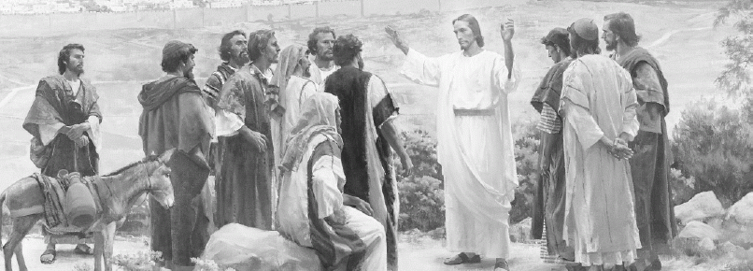
Matthew 10:5-8
⁵ These twelve Jesus sent out after instructing them: "Do not go in the way of the Gentiles, and do not enter any city of the Samaritans; ⁶ but rather go to the lost sheep of the house of Israel. ⁷ And as you go, preach, saying, 'The kingdom of heaven is at hand.'"

Slide 11
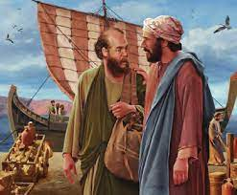
Acts 14:26-27
²⁶ From there they [Paul & Barnabas] sailed to Antioch, from which they had been commended to the grace of God for the work that they had accomplished. ²⁷ When they had arrived and gathered the church together, they began to report all things that God had done with them and how He [God] had opened a door of faith to the Gentiles.

Slide 12
Session 38 Outline
  REVIEW
    PURPOSE, AIM, AND OBJECTIVE
  GENTILES, ISRAEL, & THE CHURCH – Part 1
    SCRIPTURES (Gal. 2:19-20; Matt. 10:5-8; Acts 14:26-27)
    GENERAL INFORMATION
    CHART - THE THREE DIFFERENT GROUPS
  CONCLUDING OBSERVATIONS

Slide 13

GENERAL REVIEW TO CLARIFY TERMS AND DISTINCTIONS
Law and Grace: The SOM – Matthew 5:1–8:1 (Luke 6:17–49)
In this Law & Grace series, we have had 37 sessions so, this would be a good time to review terms and important distinctions for those who may not have been following along with us from the beginning.

Slide 14
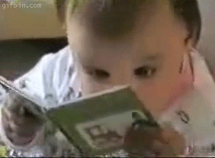
GENERAL REVIEW TO CLARIFY TERMS AND DISTINCTIONS
Law and Grace: The SOM – Matthew 5:1–8:1 (Luke 6:17–49)
In this session we’ll endeavor to clarify some terms and key distinctions, so that when we use those terms their meaning is clearly and appropriately understood.

Slide 15

ARE WE JUST BEING PICKY, OR…?
Law and Grace: The SOM – Matthew 5:1–8:1 (Luke 6:17–49)
In seeking to be clear and making distinctions, we need to address the question, “Are we just being really persnickety or are there indeed legitimate reasons for doing so?

Slide 16
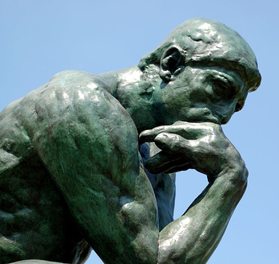
ARE WE JUST BEING PICKY, OR…?
Law and Grace: The SOM – Matthew 5:1–8:1 (Luke 6:17–49)
In seeking to be clear we are wanting to have a good understanding of the answers to questions like:
  Who am I?
  Where did I come from?
  Where am I going?
  What is God doing?

Slide 17
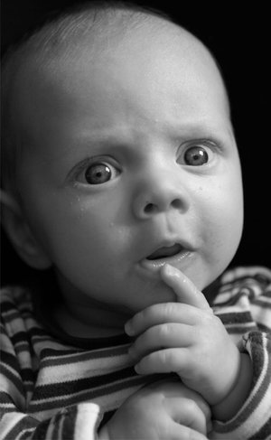
AND SOME OTHER QUESTIONS, TOO!
Law and Grace: The SOM – Matthew 5:1–8:1 (Luke 6:17–49)
Why is “the gospel of the kingdom” not the same as “the gospel of salvation” that we present to unbelievers currently?

Slide 18
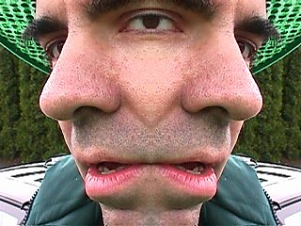
AND SOME OTHER QUESTIONS, TOO!
Law and Grace: The SOM – Matthew 5:1–8:1 (Luke 6:17–49)
Why is there more than one meaning in the Bible for the word, “kingdom”, depending on the context in which it is used?
Doesn’t God just treat everybody the same, throughout all time and beyond?

Slide 19

ALL SALVATIONS AREN’T THE SAME?
Law and Grace: The SOM – Matthew 5:1–8:1 (Luke 6:17–49)
Some are shocked and surprised to learn that the words ‘salvation’ and ‘saved’ and ‘blessing’ and ‘blessed’ do not have the same meaning nor do mean the same throughout the Bible.

Slide 20
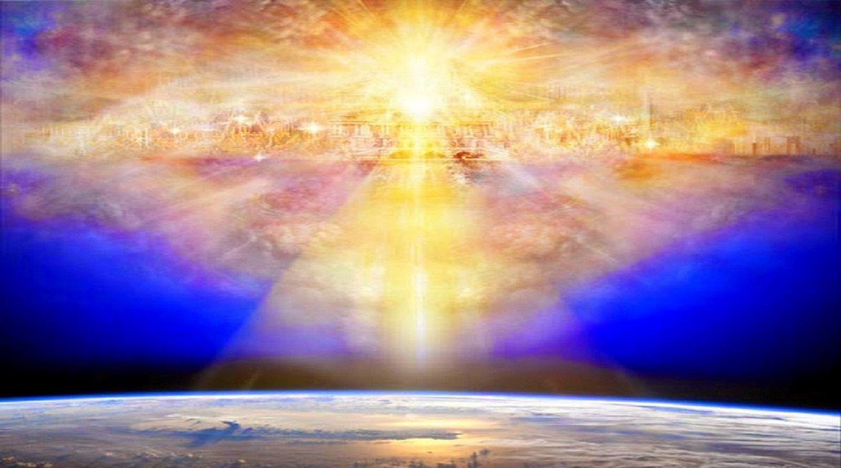
Deuteronomy 28:1-2
“¹ …if you [Israel] diligently obey the Lord your God… ² [Then] All these blessings will come upon you [Israel]…”
Ephesians 1:3
“Blessed be the God and Father of our Lord Jesus Christ, who has blessed us [Church Age Believers] with every spiritual blessing in the heavenly places in Christ”

Slide 21
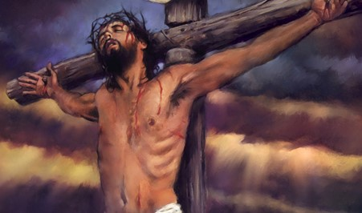
ALL ‘SALVATIONS’ AREN’T THE SAME?
Law and Grace: The SOM – Matthew 5:1–8:1 (Luke 6:17–49)
Though Christ died for all the sins of all humans for all of time, not everyone who believes and is saved of all time is positionally ‘in Christ’.

Slide 22
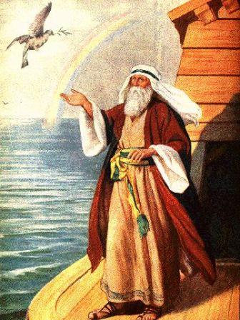
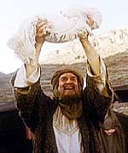
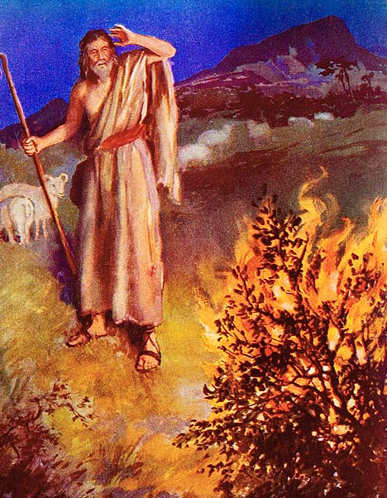
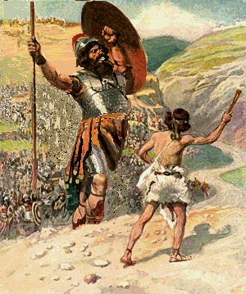
ALL ‘SALVATIONS’ AREN’T THE SAME?
Law and Grace: The SOM – Matthew 5:1–8:1 (Luke 6:17–49)
Noah was not ‘in Christ’, Abraham was not ‘in Christ’, Moses was not ‘in Christ’, nor was David ‘in Christ’.

Slide 23
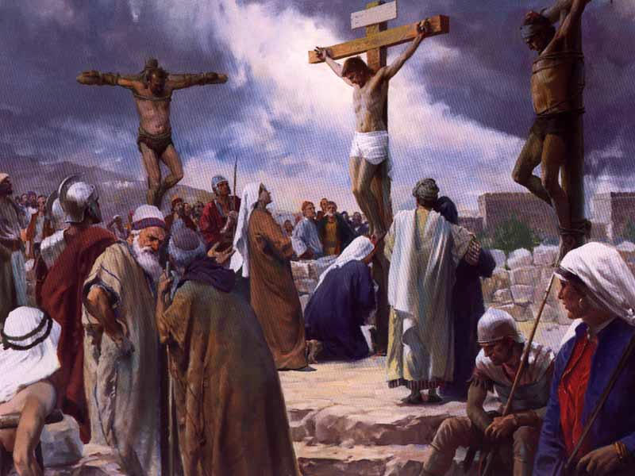
ALL ‘SALVATIONS’ AREN’T THE SAME?
Law and Grace: The SOM – Matthew 5:1–8:1 (Luke 6:17–49)
… nor even the saved thief on the Cross!

Slide 24

Law and Grace: The SOM – Matthew 5:1–8:1 (Luke 6:17–49)
THREE DIFFERENT GROUPS OF PEOPLE
The three different groups of people in the Bible are the Gentiles, Israel and the Church:

Slide 25
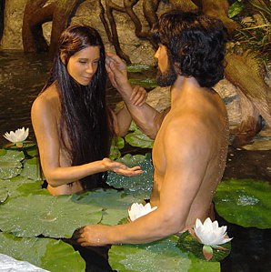

Law and Grace: The SOM – Matthew 5:1–8:1 (Luke 6:17–49)
THREE DIFFERENT GROUPS OF PEOPLE – GENTILES
The Gentiles are all peoples descended from Adam, who are not ethnically Jewish.

Slide 26
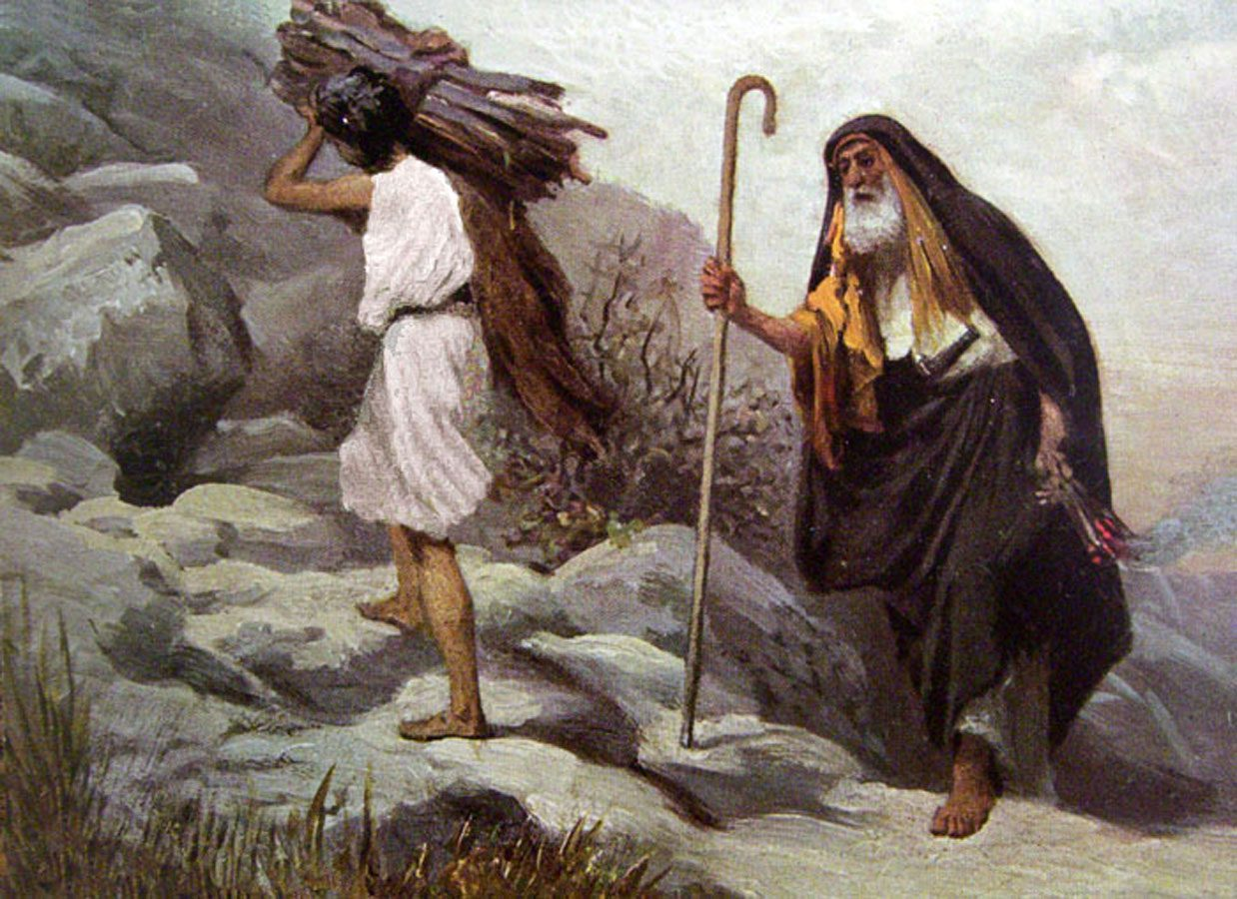
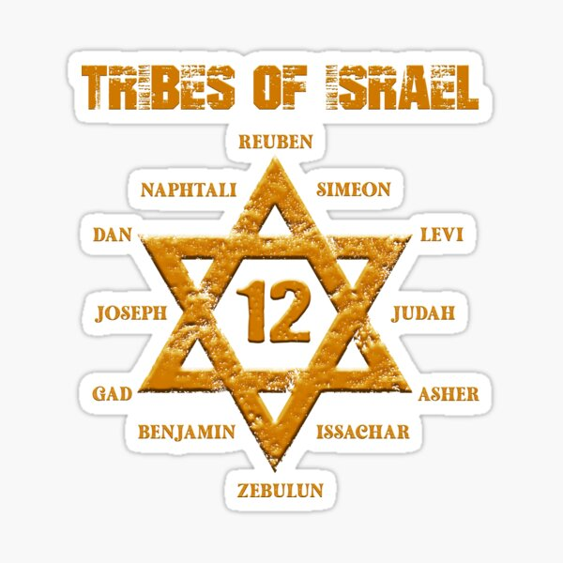
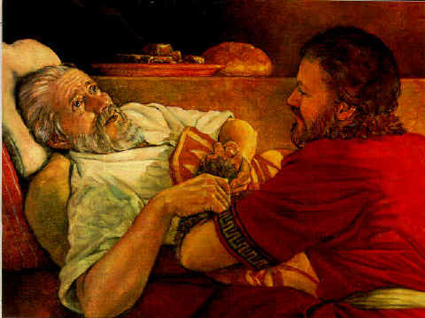
Law and Grace: The SOM – Matthew 5:1–8:1 (Luke 6:17–49)
THREE DIFFERENT GROUPS OF PEOPLE – ISRAEL
The Jews are all those who trace both their physical lineage and ethnicity through Abraham, Isaac and Jacob.

Slide 27
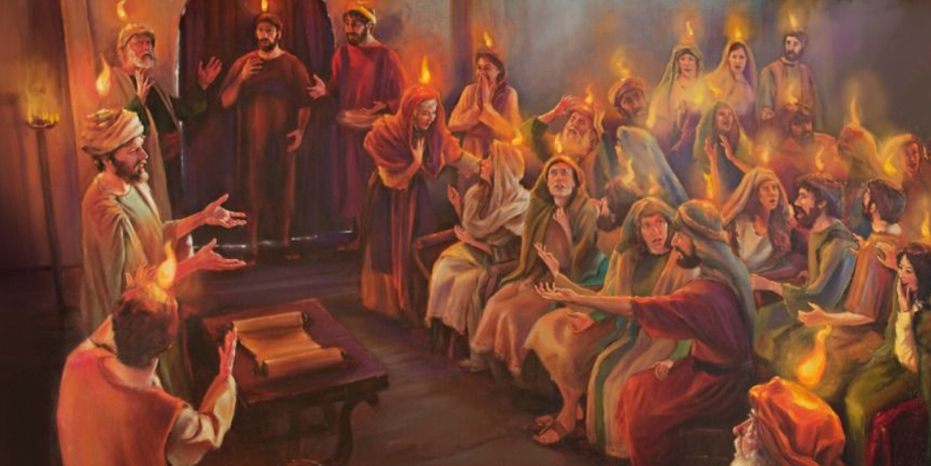
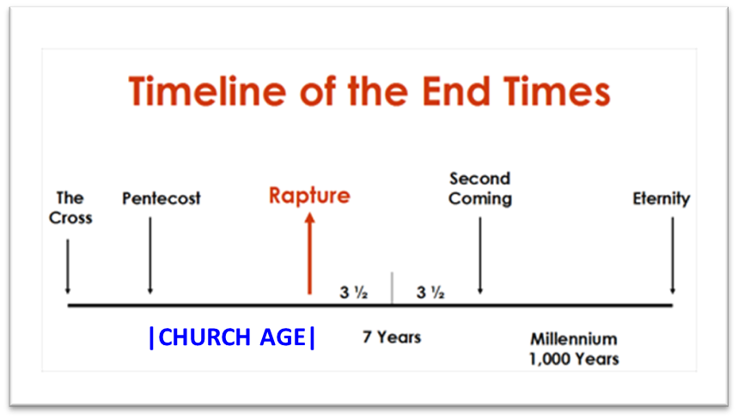
Law and Grace: The SOM – Matthew 5:1–8:1 (Luke 6:17–49)
THREE DIFFERENT GROUPS OF PEOPLE – THE CHURCH
The Church is all those, regardless of ethnic distinction, who are saved by faith from the beginning of the Church on the day of Pentecost (Acts 2) until the catching away of the Church at the Rapture.

Slide 28
Session 38 Outline
  REVIEW
    PURPOSE, AIM, AND OBJECTIVE
  GENTILES, ISRAEL, & THE CHURCH – Part 1
    SCRIPTURES (Gal. 2:19-20; Matt. 10:5-8; Acts 14:26-27)
    GENERAL INFORMATION
    CHART - THE THREE DIFFERENT GROUPS
  CONCLUDING OBSERVATIONS

Slide 29
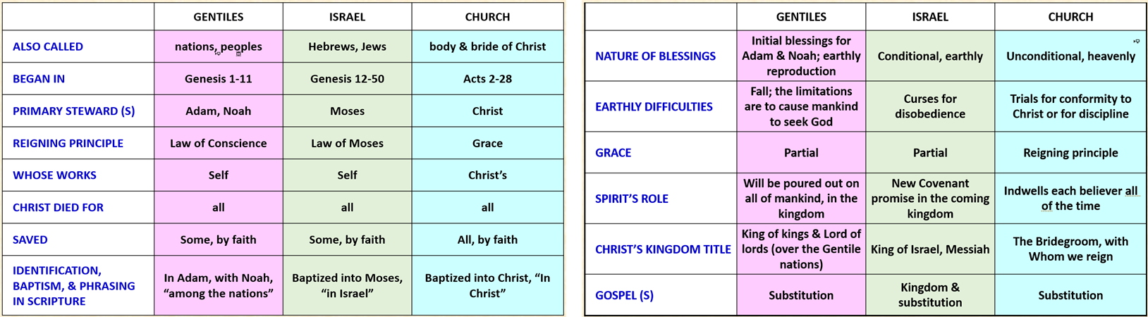
Law and Grace: The SOM – Matthew 5:1–8:1 (Luke 6:17–49)
CHARTING THE THREE DIFFERENT GROUPS OF PEOPLE

Slide 30
Law and Grace: The SOM – Matthew 5:1–8:1 (Luke 6:17–49)
 | GENTILES | ISRAEL | CHURCH
ALSO CALLED | nations, peoples | Hebrews, Jews | Body & Bride of Christ
BEGAN IN | Genesis 1-11 | Genesis 12-50 | Acts 2-28
PRIMARY STEWARD (S) | Adam, Noah | Moses | Christ
REIGNING PRINCIPLE | Law of Conscience | Law of Moses | Grace
WHOSE WORKS | Self | Self | Christ’s
CHRIST DIED FOR | all | all | all
SAVED | Some, by faith | Some, by faith | All, by faith
IDENTIFICATION, BAPTISM, & PHRASING IN SCRIPTURE | In Adam, with Noah, “among the nations” | Baptized into Moses, “in Israel” | Baptized into Christ, “In Christ”

Slide 31
Law and Grace: The SOM – Matthew 5:1–8:1 (Luke 6:17–49)
 | GENTILES | ISRAEL | CHURCH
ALSO CALLED | nations, peoples | Hebrews, Jews | Body & Bride of Christ
BEGAN IN | Genesis 1-11 | Genesis 12-50 | Acts 2-28
PRIMARY STEWARD (S) | Adam, Noah | Moses | Christ
REIGNING PRINCIPLE | Law of Conscience | Law of Moses | Grace
WHOSE WORKS | Self | Self | Christ’s
CHRIST DIED FOR | all | all | all
SAVED | Some, by faith | Some, by faith | All, by faith
IDENTIFICATION, BAPTISM, & PHRASING IN SCRIPTURE | In Adam, with Noah, “among the nations” | Baptized into Moses, “in Israel” | Baptized into Christ, “In Christ”

Slide 32
Law and Grace: The SOM – Matthew 5:1–8:1 (Luke 6:17–49)
 | GENTILES | ISRAEL | CHURCH
ALSO CALLED | nations, peoples | Hebrews, Jews | Body & Bride of Christ
BEGAN IN | Genesis 1-11 | Genesis 12-50 | Acts 2-28
PRIMARY STEWARD (S) | Adam, Noah | Moses | Christ
REIGNING PRINCIPLE | Law of Conscience | Law of Moses | Grace
WHOSE WORKS | Self | Self | Christ’s
CHRIST DIED FOR | all | all | all
SAVED | Some, by faith | Some, by faith | All, by faith
IDENTIFICATION, BAPTISM, & PHRASING IN SCRIPTURE | In Adam, with Noah, “among the nations” | Baptized into Moses, “in Israel” | Baptized into Christ, “In Christ”

Slide 33
Law and Grace: The SOM – Matthew 5:1–8:1 (Luke 6:17–49)
 | GENTILES | ISRAEL | CHURCH
ALSO CALLED | nations, peoples | Hebrews, Jews | Body & Bride of Christ
BEGAN IN | Genesis 1-11 | Genesis 12-50 | Acts 2-28
PRIMARY STEWARD (S) | Adam, Noah | Moses | Christ
REIGNING PRINCIPLE | Law of Conscience | Law of Moses | Grace
WHOSE WORKS | Self | Self | Christ’s
CHRIST DIED FOR | all | all | all
SAVED | Some, by faith | Some, by faith | All, by faith
IDENTIFICATION, BAPTISM, & PHRASING IN SCRIPTURE | In Adam, with Noah, “among the nations” | Baptized into Moses, “in Israel” | Baptized into Christ, “In Christ”

Slide 34
Law and Grace: The SOM – Matthew 5:1–8:1 (Luke 6:17–49)
 | GENTILES | ISRAEL | CHURCH
ALSO CALLED | nations, peoples | Hebrews, Jews | Body & Bride of Christ
BEGAN IN | Genesis 1-11 | Genesis 12-50 | Acts 2-28
PRIMARY STEWARD (S) | Adam, Noah | Moses | Christ
REIGNING PRINCIPLE | Law of Conscience | Law of Moses | Grace
WHOSE WORKS | Self | Self | Christ’s
CHRIST DIED FOR | ALL | ALL | ALL
SAVED | Some, by faith | Some, by faith | All, by faith
IDENTIFICATION, BAPTISM, & PHRASING IN SCRIPTURE | In Adam, with Noah, “among the nations” | Baptized into Moses, “in Israel” | Baptized into Christ, “In Christ”

Slide 35
Law and Grace: The SOM – Matthew 5:1–8:1 (Luke 6:17–49)
 | GENTILES | ISRAEL | CHURCH
ALSO CALLED | nations, peoples | Hebrews, Jews | Body & Bride of Christ
BEGAN IN | Genesis 1-11 | Genesis 12-50 | Acts 2-28
PRIMARY STEWARD (S) | Adam, Noah | Moses | Christ
REIGNING PRINCIPLE | Law of Conscience | Law of Moses | Grace
WHOSE WORKS | Self | Self | Christ’s
CHRIST DIED FOR | all | all | all
SAVED | Some, by faith | Some, by faith | All, by faith
IDENTIFICATION, BAPTISM, & PHRASING IN SCRIPTURE | In Adam, with Noah, “among the nations” | Baptized into Moses, “in Israel” | Baptized into Christ, “In Christ”

Slide 36
Law and Grace: The SOM – Matthew 5:1–8:1 (Luke 6:17–49)
 | GENTILES | ISRAEL | CHURCH
ALSO CALLED | nations, peoples | Hebrews, Jews | Body & Bride of Christ
BEGAN IN | Genesis 1-11 | Genesis 12-50 | Acts 2-28
PRIMARY STEWARD (S) | Adam, Noah | Moses | Christ
REIGNING PRINCIPLE | Law of Conscience | Law of Moses | Grace
WHOSE WORKS | Self | Self | Christ’s
CHRIST DIED FOR | all | all | all
SAVED | Some, by faith | Some, by faith | All, by faith
IDENTIFICATION, BAPTISM, & PHRASING IN SCRIPTURE | IN ADAM, WITH NOAH, “AMONG THE NATIONS” | BAPTIZED INTO MOSES, “IN ISRAEL” | BAPTIZED INTO CHRIST, “IN CHRIST”

Slide 37
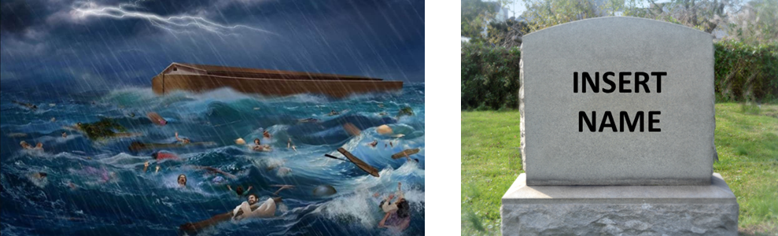
Hebrews 11:7
By faith Noah, being warned by God about things not yet seen, in reverence prepared an ark…by which he condemned the world…
1 Corinthians 15:21-22
²¹ For…by a man came death,… ²² For as in Adam all die...”

Slide 38
Law and Grace: The SOM – Matthew 5:1–8:1 (Luke 6:17–49)
 | GENTILES | ISRAEL | CHURCH
ALSO CALLED | nations, peoples | Hebrews, Jews | Body & Bride of Christ
BEGAN IN | Genesis 1-11 | Genesis 12-50 | Acts 2-28
PRIMARY STEWARD (S) | Adam, Noah | Moses | Christ
REIGNING PRINCIPLE | Law of Conscience | Law of Moses | Grace
WHOSE WORKS | Self | Self | Christ’s
CHRIST DIED FOR | all | all | all
SAVED | Some, by faith | Some, by faith | All, by faith
IDENTIFICATION, BAPTISM, & PHRASING IN SCRIPTURE | IN ADAM, WITH NOAH, “AMONG THE NATIONS” | BAPTIZED INTO MOSES, “IN ISRAEL” | BAPTIZED INTO CHRIST, “IN CHRIST”

Slide 39
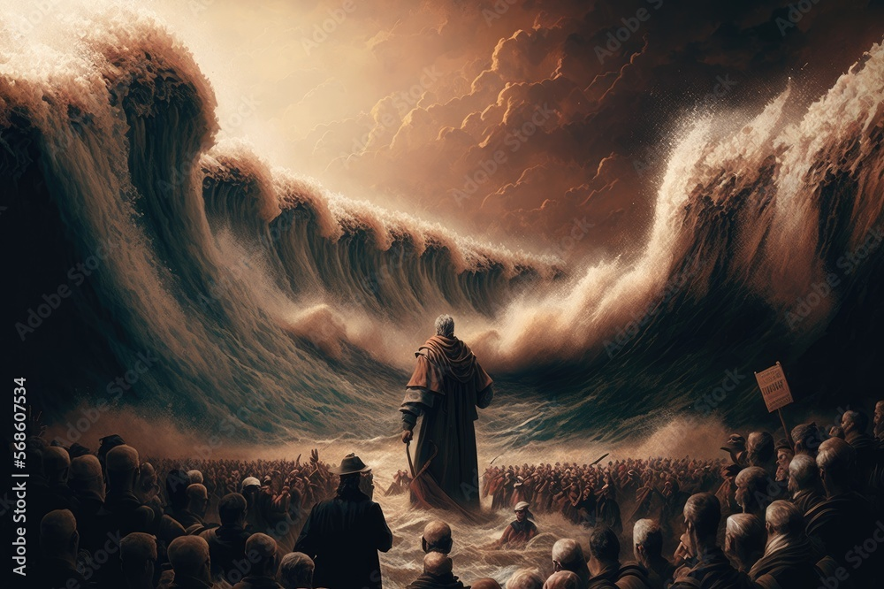
1 Corinthians 10:1-2
¹ For I do not want you to be unaware, brethren, that our fathers were all under the cloud and all passed through the sea; ² and all were baptized into Moses in the cloud and in the sea…

Slide 40
Law and Grace: The SOM – Matthew 5:1–8:1 (Luke 6:17–49)
 | GENTILES | ISRAEL | CHURCH
ALSO CALLED | nations, peoples | Hebrews, Jews | Body & Bride of Christ
BEGAN IN | Genesis 1-11 | Genesis 12-50 | Acts 2-28
PRIMARY STEWARD (S) | Adam, Noah | Moses | Christ
REIGNING PRINCIPLE | Law of Conscience | Law of Moses | Grace
WHOSE WORKS | Self | Self | Christ’s
CHRIST DIED FOR | all | all | all
SAVED | Some, by faith | Some, by faith | All, by faith
IDENTIFICATION, BAPTISM, & PHRASING IN SCRIPTURE | IN ADAM, WITH NOAH, “AMONG THE NATIONS” | BAPTIZED INTO MOSES, “IN ISRAEL” | BAPTIZED INTO CHRIST, “IN CHRIST”

Slide 41
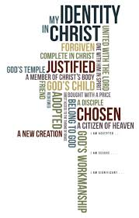
Romans 6:3
Or do you not know that all of us who have been baptized into Christ Jesus have been baptized into His death?
Galatians 3:27
For all of you who were baptized into Christ have clothed yourselves with Christ.

Slide 42
Law and Grace: The SOM – Matthew 5:1–8:1 (Luke 6:17–49)
 | GENTILES | ISRAEL | CHURCH
ALSO CALLED | nations, peoples | Hebrews, Jews | Body & Bride of Christ
BEGAN IN | Genesis 1-11 | Genesis 12-50 | Acts 2-28
PRIMARY STEWARD (S) | Adam, Noah | Moses | Christ
REIGNING PRINCIPLE | Law of Conscience | Law of Moses | Grace
WHOSE WORKS | Self | Self | Christ’s
CHRIST DIED FOR | all | all | all
SAVED | Some, by faith | Some, by faith | All, by faith
IDENTIFICATION, BAPTISM, & PHRASING IN SCRIPTURE | IN ADAM, WITH NOAH, “AMONG THE NATIONS” | BAPTIZED INTO MOSES, “IN ISRAEL” | BAPTIZED INTO CHRIST, “IN CHRIST”

Slide 43
Law and Grace: The SOM – Matthew 5:1–8:1 (Luke 6:17–49)
 | GENTILES | ISRAEL | CHURCH
NATURE OF BLESSINGS | INITIAL BLESSINGS FOR ADAM & NOAH; EARTHLY REPRODUCTION | CONDITIONAL, EARTHLY | UNCONDITIONAL, HEAVENLY
EARTHLY DIFFICULTIES | Fall; the limitations are to cause mankind to seek God | Curses for disobedience | Trials for conformity to Christ or for discipline
GRACE | Partial | Partial | Reigning principle
SPIRIT’S ROLE | Will be poured out on all of mankind, in the kingdom | New Covenant promise in the coming kingdom | Indwells each believer all of the time
CHRIST’S KINGDOM TITLE | King of kings & Lord of lords (over the Gentile nations) | King of Israel, Messiah | The Bridegroom, with Whom we reign
GOSPEL (S) | Substitution | Kingdom & substitution | Substitution

Slide 44
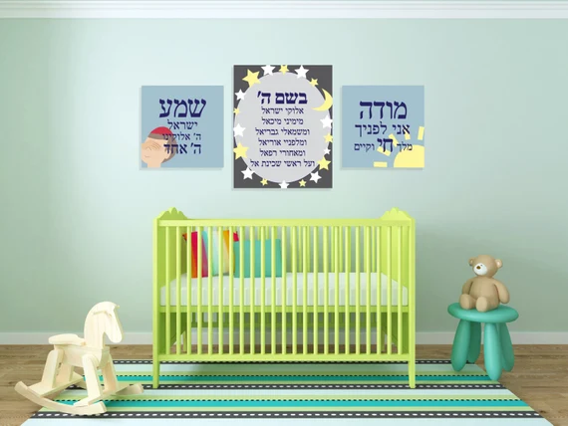
Leviticus 26:3, 9
³ ‘If you walk in My statutes and keep My commandments so as to carry them out,…⁹…I will turn toward you and make you fruitful and multiply you,…
Deuteronomy 28:4, 11
⁴ “Blessed shall be the offspring of your body…¹¹ “The LORD will make you abound in prosperity, in the offspring of your body…

Slide 45
Law and Grace: The SOM – Matthew 5:1–8:1 (Luke 6:17–49)
 | GENTILES | ISRAEL | CHURCH
NATURE OF BLESSINGS | INITIAL BLESSINGS FOR ADAM & NOAH; EARTHLY REPRODUCTION | CONDITIONAL, EARTHLY | UNCONDITIONAL, HEAVENLY
EARTHLY DIFFICULTIES | Fall; the limitations are to cause mankind to seek God | Curses for disobedience | Trials for conformity to Christ or for discipline
GRACE | Partial | Partial | Reigning principle
SPIRIT’S ROLE | Will be poured out on all of mankind, in the kingdom | New Covenant promise in the coming kingdom | Indwells each believer all of the time
CHRIST’S KINGDOM TITLE | King of kings & Lord of lords (over the Gentile nations) | King of Israel, Messiah | The Bridegroom, with Whom we reign
GOSPEL (S) | Substitution | Kingdom & substitution | Substitution

Slide 46

Ephesians 1:3
“Blessed be the God and Father of our Lord Jesus Christ, who has blessed us [Church Age Believers] with every spiritual blessing in the heavenly places in Christ”
Instantly
Eternally
Absolutely

Slide 47
Law and Grace: The SOM – Matthew 5:1–8:1 (Luke 6:17–49)
 | GENTILES | ISRAEL | CHURCH
NATURE OF BLESSINGS | Initial blessings for Adam & Noah; earthly reproduction | Conditional, earthly | Unconditional, heavenly
EARTHLY DIFFICULTIES | FALL; THE LIMITATIONS ARE TO CAUSE MANKIND TO SEEK GOD | CURSES FOR DISOBEDIENCE | TRIALS FOR CONFORMITY TO CHRIST OR FOR DISCIPLINE
GRACE | Partial | Partial | Reigning principle
SPIRIT’S ROLE | Will be poured out on all of mankind, in the kingdom | New Covenant promise in the coming kingdom | Indwells each believer all of the time
CHRIST’S KINGDOM TITLE | King of kings & Lord of lords (over the Gentile nations) | King of Israel, Messiah | The Bridegroom, with Whom we reign
GOSPEL (S) | Substitution | Kingdom & substitution | Substitution

Slide 48
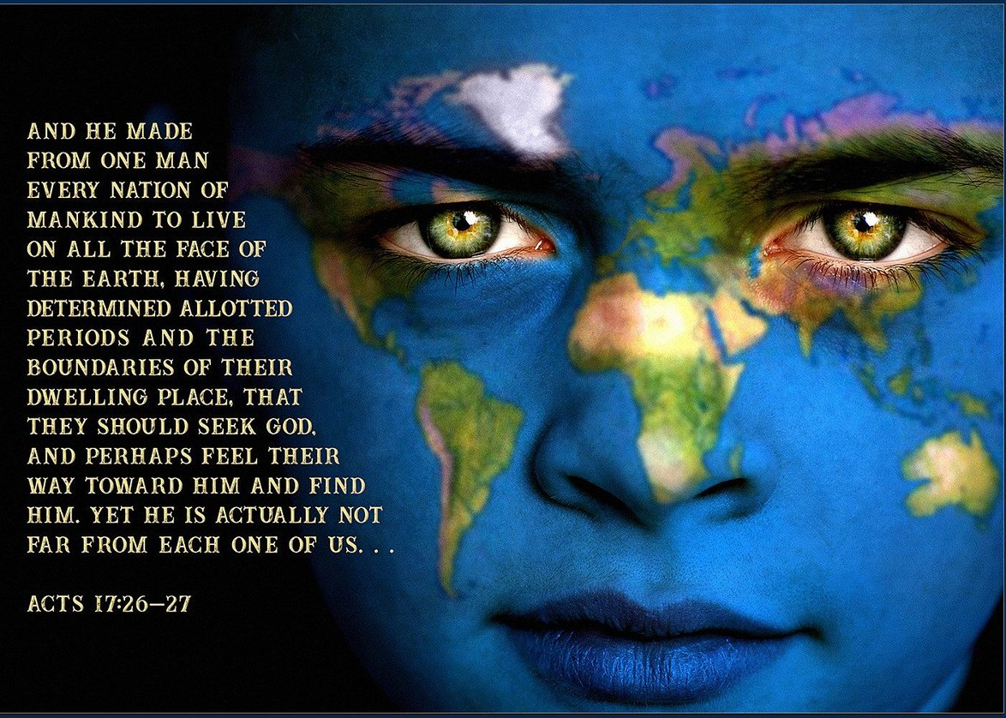
Acts 17:26–27
²⁶ … [God] made from one man [Adam] every nation of mankind [Gentiles] to live on all the face of the earth, having determined their appointed times and the boundaries of their habitation, ²⁷ that they would seek God, if perhaps they might grope for Him and find Him, though He is not far from each one of us;

Slide 49
Law and Grace: The SOM – Matthew 5:1–8:1 (Luke 6:17–49)
 | GENTILES | ISRAEL | CHURCH
NATURE OF BLESSINGS | Initial blessings for Adam & Noah; earthly reproduction | Conditional, earthly | Unconditional, heavenly
EARTHLY DIFFICULTIES | FALL; THE LIMITATIONS ARE TO CAUSE MANKIND TO SEEK GOD | CURSES FOR DISOBEDIENCE | TRIALS FOR CONFORMITY TO CHRIST OR FOR DISCIPLINE
GRACE | Partial | Partial | Reigning principle
SPIRIT’S ROLE | Will be poured out on all of mankind, in the kingdom | New Covenant promise in the coming kingdom | Indwells each believer all of the time
CHRIST’S KINGDOM TITLE | King of kings & Lord of lords (over the Gentile nations) | King of Israel, Messiah | The Bridegroom, with Whom we reign
GOSPEL (S) | Substitution | Kingdom & substitution | Substitution

Slide 50
Law and Grace: The SOM – Matthew 5:1–8:1 (Luke 6:17–49)
 | GENTILES | ISRAEL | CHURCH
NATURE OF BLESSINGS | Initial blessings for Adam & Noah; earthly reproduction | Conditional, earthly | Unconditional, heavenly
EARTHLY DIFFICULTIES | Fall; the limitations are to cause mankind to seek God | Curses for disobedience | Trials for conformity to Christ or for discipline
GRACE | PARTIAL | PARTIAL | REIGNING PRINCIPLE
SPIRIT’S ROLE | Will be poured out on all of mankind, in the kingdom | New Covenant promise in the coming kingdom | Indwells each believer all of the time
CHRIST’S KINGDOM TITLE | King of kings & Lord of lords (over the Gentile nations) | King of Israel, Messiah | The Bridegroom, with Whom we reign
GOSPEL (S) | Substitution | Kingdom & substitution | Substitution

Slide 51
Galatians 3:10–12
¹⁰ For as many as are of the works of the Law are under a curse; for it is written, “Cursed is everyone who does not abide by all things written in the book of the law, to perform them.” ¹¹ Now that no one is justified by the Law before God is evident; for, “The righteous man shall live by faith.” ¹² However, the Law is not of faith; on the contrary, “He who practices them shall live by them.” (cf. Deu. 27:26)
James 2:10
¹⁰ For whoever keeps the whole law and yet stumbles in one point, he has become guilty of all.

Slide 52
Law and Grace: The SOM – Matthew 5:1–8:1 (Luke 6:17–49)
 | GENTILES | ISRAEL | CHURCH
NATURE OF BLESSINGS | Initial blessings for Adam & Noah; earthly reproduction | Conditional, earthly | Unconditional, heavenly
EARTHLY DIFFICULTIES | Fall; the limitations are to cause mankind to seek God | Curses for disobedience | Trials for conformity to Christ or for discipline
GRACE | Partial | Partial | Reigning principle
SPIRIT’S ROLE | WILL BE POURED OUT ON ALL OF MANKIND, IN THE KINGDOM | NEW COVENANT PROMISE IN THE COMING KINGDOM | INDWELLS EACH BELIEVER ALL OF THE TIME
CHRIST’S KINGDOM TITLE | King of kings & Lord of lords (over the Gentile nations) | King of Israel, Messiah | The Bridegroom, with Whom we reign
GOSPEL (S) | Substitution | Kingdom & substitution | Substitution

Slide 53
Genesis 6:3
Then the Lord said, “My Spirit shall not strive with man forever, because he also is flesh; nevertheless his days shall be one hundred and twenty years.”
Joel 2:28a
“It will come about…That I will pour out My Spirit on all mankind…”

Slide 54
Law and Grace: The SOM – Matthew 5:1–8:1 (Luke 6:17–49)
 | GENTILES | ISRAEL | CHURCH
NATURE OF BLESSINGS | Initial blessings for Adam & Noah; earthly reproduction | Conditional, earthly | Unconditional, heavenly
EARTHLY DIFFICULTIES | Fall; the limitations are to cause mankind to seek God | Curses for disobedience | Trials for conformity to Christ or for discipline
GRACE | Partial | Partial | Reigning principle
SPIRIT’S ROLE | WILL BE POURED OUT ON ALL OF MANKIND, IN THE KINGDOM | NEW COVENANT PROMISE IN THE COMING KINGDOM | INDWELLS EACH BELIEVER ALL OF THE TIME
CHRIST’S KINGDOM TITLE | King of kings & Lord of lords (over the Gentile nations) | King of Israel, Messiah | The Bridegroom, with Whom we reign
GOSPEL (S) | Substitution | Kingdom & substitution | Substitution

Slide 55
Jeremiah 31:31–34
³¹ “Behold, days are coming,” declares the Lord, “when I will make a new covenant with the house of Israel and with the house of Judah, ³² not like the covenant which I made with their fathers…³³ “But this is the covenant which I will make…declares the Lord, “I will put My law within them and on their heart I will write it;…³⁴ “They will not teach again, each man his neighbor and each man his brother, saying, ‘Know the Lord,’ for they will all know Me,…declares the Lord…

Slide 56
Ezekiel 11:19–20; 36:26
¹⁹ “And I will give them one heart, and put a new spirit within them. And I will take the heart of stone out of their flesh and give them a heart of flesh, ²⁰ that they may walk in My statutes and keep My ordinances and do them. Then they will be My people, and I shall be their God.
^{36:26} “Moreover, I will give you a new heart and put a new spirit within you; and I will remove the heart of stone from your flesh and give you a heart of flesh. ²⁷ “I will put My Spirit within you and cause you to walk in My statutes, and you will be careful to observe My ordinances.

Slide 57
Law and Grace: The SOM – Matthew 5:1–8:1 (Luke 6:17–49)
 | GENTILES | ISRAEL | CHURCH
NATURE OF BLESSINGS | Initial blessings for Adam & Noah; earthly reproduction | Conditional, earthly | Unconditional, heavenly
EARTHLY DIFFICULTIES | Fall; the limitations are to cause mankind to seek God | Curses for disobedience | Trials for conformity to Christ or for discipline
GRACE | Partial | Partial | Reigning principle
SPIRIT’S ROLE | WILL BE POURED OUT ON ALL OF MANKIND, IN THE KINGDOM | NEW COVENANT PROMISE IN THE COMING KINGDOM | INDWELLS EACH BELIEVER ALL OF THE TIME
CHRIST’S KINGDOM TITLE | King of kings & Lord of lords (over the Gentile nations) | King of Israel, Messiah | The Bridegroom, with Whom we reign
GOSPEL (S) | Substitution | Kingdom & substitution | Substitution

Slide 58
Law and Grace: The SOM – Matthew 5:1–8:1 (Luke 6:17–49)
 | GENTILES | ISRAEL | CHURCH
NATURE OF BLESSINGS | Initial blessings for Adam & Noah; earthly reproduction | Conditional, earthly | Unconditional, heavenly
EARTHLY DIFFICULTIES | Fall; the limitations are to cause mankind to seek God | Curses for disobedience | Trials for conformity to Christ or for discipline
GRACE | Partial | Partial | Reigning principle
SPIRIT’S ROLE | Will be poured out on all of mankind, in the kingdom | New Covenant promise in the coming kingdom | Indwells each believer all of the time
CHRIST’S KINGDOM TITLE | KING OF KINGS & LORD OF LORDS (OVER THE GENTILE NATIONS) | KING OF ISRAEL, MESSIAH | THE BRIDEGROOM, WITH WHOM WE REIGN
GOSPEL (S) | Substitution | Kingdom & substitution | Substitution

Slide 59
Matthew 27:11
¹¹ Now Jesus stood before the governor, and the governor questioned Him, saying, “Are You the King of the Jews?” And Jesus said to him, “It is as you say.”
John 18:37
³⁷ Therefore Pilate said to Him, “So You are a king?” Jesus answered, “You say correctly that I am a king. For this I have been born, and for this I have come into the world, to testify to the truth. Everyone who is of the truth hears My voice.”

Slide 60
Law and Grace: The SOM – Matthew 5:1–8:1 (Luke 6:17–49)
 | GENTILES | ISRAEL | CHURCH
NATURE OF BLESSINGS | Initial blessings for Adam & Noah; earthly reproduction | Conditional, earthly | Unconditional, heavenly
EARTHLY DIFFICULTIES | Fall; the limitations are to cause mankind to seek God | Curses for disobedience | Trials for conformity to Christ or for discipline
GRACE | Partial | Partial | Reigning principle
SPIRIT’S ROLE | Will be poured out on all of mankind, in the kingdom | New Covenant promise in the coming kingdom | Indwells each believer all of the time
CHRIST’S KINGDOM TITLE | KING OF KINGS & LORD OF LORDS (OVER THE GENTILE NATIONS) | KING OF ISRAEL, MESSIAH | THE BRIDEGROOM, WITH WHOM WE REIGN
GOSPEL (S) | Substitution | Kingdom & substitution | Substitution

Slide 61
Law and Grace: The SOM – Matthew 5:1–8:1 (Luke 6:17–49)
 | GENTILES | ISRAEL | CHURCH
NATURE OF BLESSINGS | Initial blessings for Adam & Noah; earthly reproduction | Conditional, earthly | Unconditional, heavenly
EARTHLY DIFFICULTIES | Fall; the limitations are to cause mankind to seek God | Curses for disobedience | Trials for conformity to Christ or for discipline
GRACE | Partial | Partial | Reigning principle
SPIRIT’S ROLE | Will be poured out on all of mankind, in the kingdom | New Covenant promise in the coming kingdom | Indwells each believer all of the time
CHRIST’S KINGDOM TITLE | King of kings & Lord of lords (over the Gentile nations) | King of Israel, Messiah | The Bridegroom, with Whom we reign
GOSPEL (S) | SUBSTITUTION | KINGDOM & SUBSTITUTION | SUBSTITUTION

Slide 62
Session 38 Outline
  REVIEW
    PURPOSE, AIM, AND OBJECTIVE
  GENTILES, ISRAEL, & THE CHURCH – Part 1
    SCRIPTURES (Gal. 2:19-20; Matt. 10:5-8; Acts 14:26-27)
    GENERAL INFORMATION
    CHART - THE THREE DIFFERENT GROUPS
  CONCLUDING OBSERVATIONS

Slide 63
Law and Grace: The SOM – Matthew 5:1–8:1 (Luke 6:17–49)
WHY WOULD WE GO THROUGH ALL OF THIS?
Since Christians have not always understood these truths clearly, they haven’t known what God intends therefore:
  Some have thought themselves under some or all of the Law of Moses.
  Some have seen themselves as an earthly people with conditional earthly blessings.
  Some have seen Christ as their King and the Church as the Kingdom, ultimately leading to antisemitism.

Slide 64
BUT WAIT! THERE’S MORE!
Law and Grace: The SOM – Matthew 5:1–8:1 (Luke 6:17–49)
  Some Christians mistakenly see it as their godly responsibility to take dominion over the earth politically, and economically and militarily, for Christ.
  Some have not fully understood what actually took place on the cross.

Slide 65
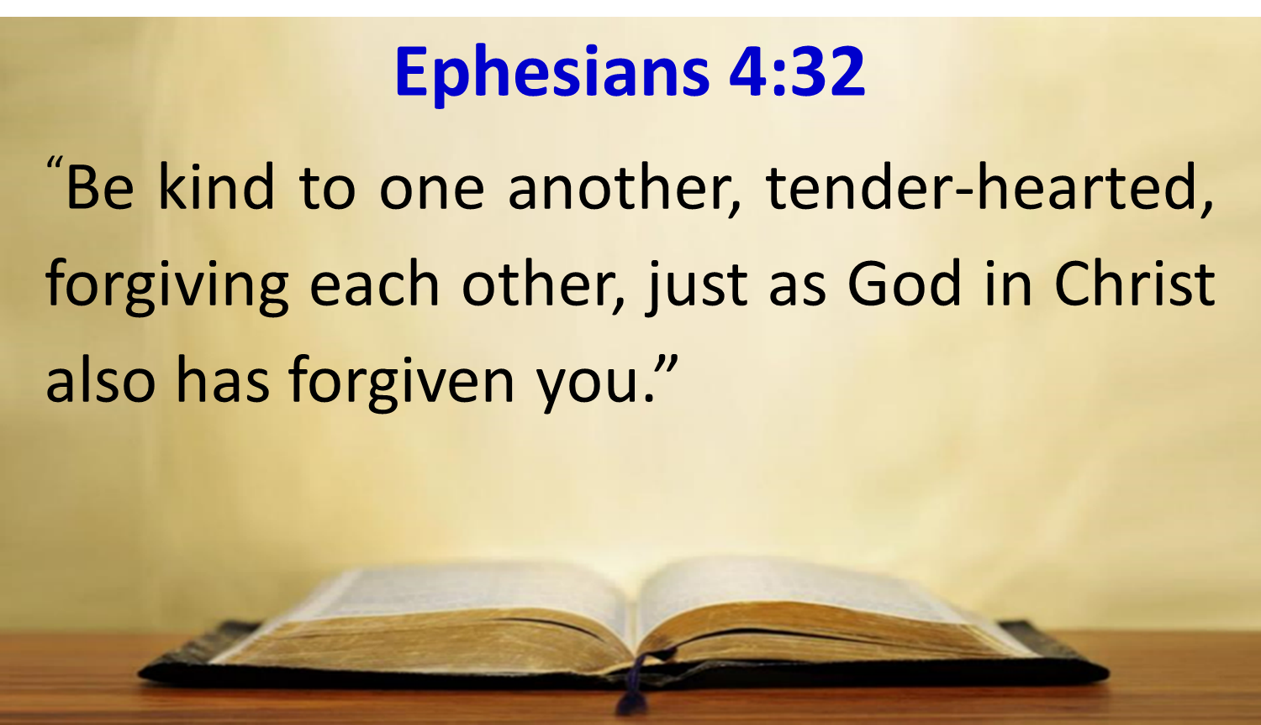
MOTIVE, MEANS & OPPORTUNITY
Law and Grace: The SOM – Matthew 5:1–8:1 (Luke 6:17–49)
In the Body of Christ our motive for how we live is distinct:
  Grace and mercy are to be our motives (cf. Eph. 4:32).

Slide 66

MOTIVE, MEANS & OPPORTUNITY
Law and Grace: The SOM – Matthew 5:1–8:1 (Luke 6:17–49)
In the Body of Christ we have a means of living that is from the life of Christ and the indwelling Holy Spirit.

Slide 67
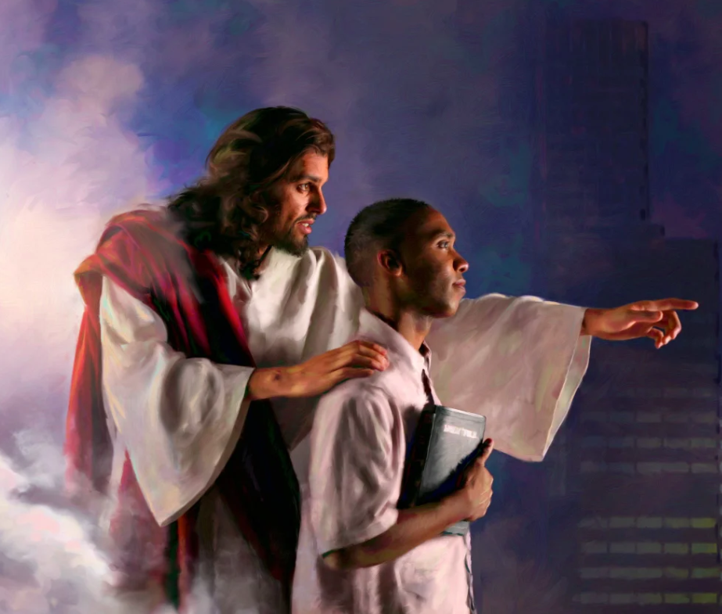
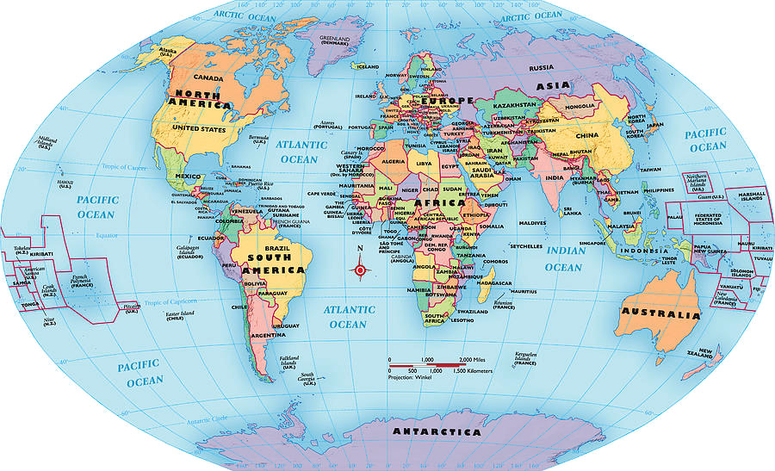
MOTIVE, MEANS & OPPORTUNITY
Law and Grace: The SOM – Matthew 5:1–8:1 (Luke 6:17–49)
Our opportunity is not to be conditionally blessed or cursed in earthly ways like Israel under the Law, but rather to walk as children of light, as ambassadors of the Lord Jesus Christ, and living out the life of Christ before a lost and dying world.

Slide 68
Law and Grace: An Overview
Jim McGowan, Th.D.
Sugar Land Bible Church
09-10-2023
…but grace and truth were realized through Jesus Christ - John 1:17
For the Law was given through Moses…
Special thanks to Dr. Vern Peterman for access to his insights and resources.

