Slide 1
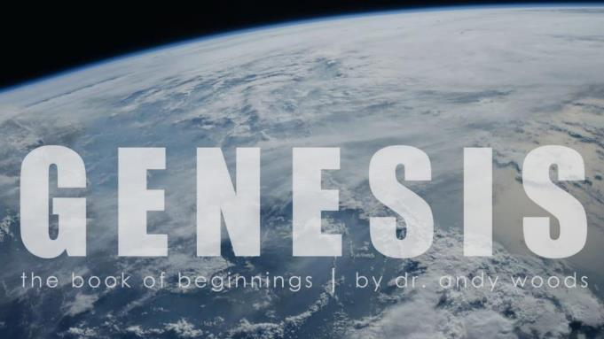
Genesis 12‒50
Israel’s Birth & Preservation

Slide 2
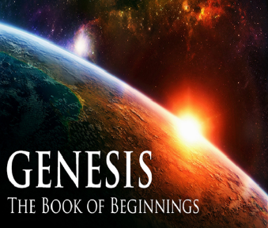
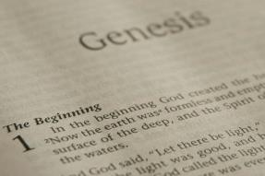
GENESIS STRUCTURE
Genesis 12-50 (four people)
Abraham (12:1–25:11)
Isaac (25:12–26:35)
Jacob (27–36)
Joseph (37–50)

Slide 3
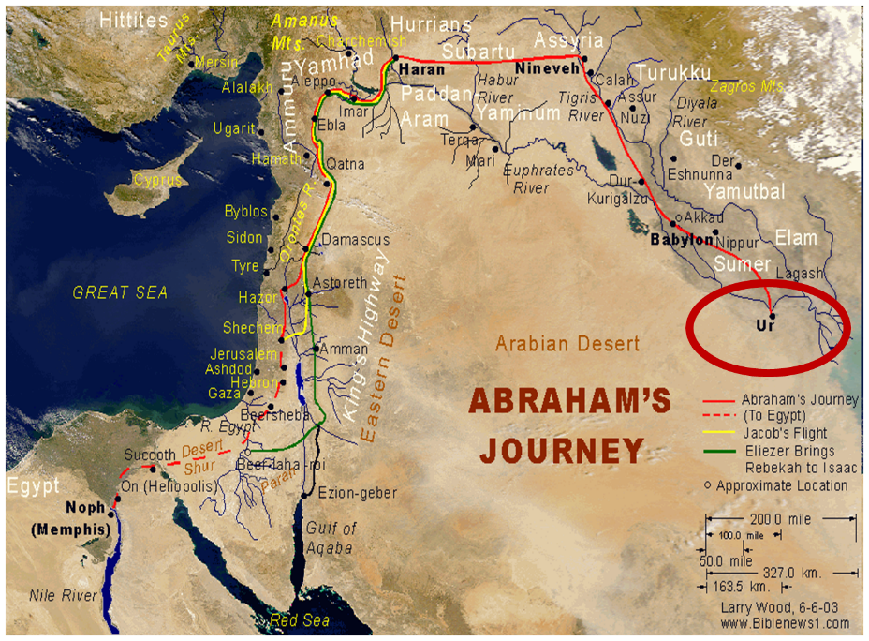

Slide 4
Genesis 32:1‒33:17 Jacob and Esau
Mahanaim (32:1-2)
Jacob’s Message to Esau (32:3-21)
Peniel (32:22-32)
Jacob’s Meeting with Esau (33:1-17)

Slide 5
III. Genesis 32:22-32 Peniel
Family sent away (22-23)
Jacob wrestles with the Angel of the Lord (24)
Jacob’s thigh dislocated (25)
Struggle for blessing (26-28)
Angel of the Lord’s identity (29)
Results of the encounter (30-32)

Slide 6
Genesis 32:29 Angel of the Lord’s Identity
Jacob’s question (29a)
Angel’s answer (29b)
Angel blesses Jacob (29c)

Slide 7
Genesis 32:29 Angel of the Lord’s Identity
Jacob’s question (29a)
Angel’s answer (29b)
Angel blesses Jacob (29c)

Slide 10
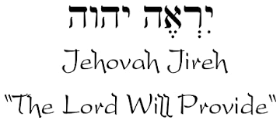

Slide 11
Names for God in Genesis
Elohim (1:1) - Power
Yahweh (2:4) - Relational
El Roi (Gen. 16:13) – Aware
El Olam (21:33) – Eternal
Jehovah Jireh (22:14) - Provision
God Isaac Feared (31:42, 53) - Reverenced

Slide 12
Genesis 32:29 Angel of the Lord’s Identity
Jacob’s question (29a)
Angel’s answer (29b)
Angel blesses Jacob (29c)

Slide 13
Charles Ryrie
The Ryrie Study Bible, p. 43
“Genesis 32:29 (RSB:NASB1995U): 32:29 “Jacob’s question had already been answered in the name bestowed on him, since the el in Israel means ‘god.’”

Slide 14
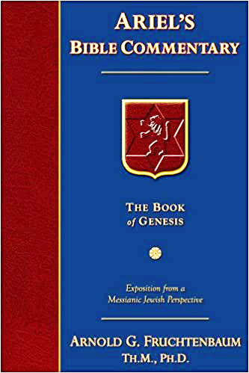
Dr. Arnold G. Fruchtenbaum
The Book of Genesis, 484
“In verse 29a is the Angel’s identification, beginning with Jacob’s question: Jacob asked him, and said, Tell me, I pray you, your name. However, the Angel answered the question with a question: Why is it that you do ask after my name? The point was: ‘Think on it, and you will know what My Name is.’ And His Name is YHVH. This was very similar to Manoah’s question. Manoah was the father of Samson. When Manoah had an encounter with the Angel of Jehovah, the Angel of God, he asked the same question that Jacob did: What is your name? (Judg. 13:17–18). In that passage the Angel also answered, ‘Why do you seek after My Name?’”

Slide 15
Dr. Arnold G. Fruchtenbaum
The Book of Genesis, 484
“However, in the Judges passage, the Angel did not stop there but added: seeing it is wonderful. Moreover, the Hebrew word for wonderful is pele, one of those words in the Hebrew text used only of God and never used of a man. In this way, the Angel answered Manoah’s question. By combining the two passages, there is the same question on the part of man and the same answer with another similar question on the part of the Angel. The additional answer given by the Angel in Judges indicates this was clearly God Himself. In verse 29b, Jacob received the blessing: And he blessed him there. Hosea 12:4 states: Yea he had power over the angel and prevailed.”

Slide 16
Isaiah 9:6-7
⁶ For a child will be born to us, a son will be given to us; And the government will rest on His shoulders; And His name will be called Wonderful Counselor, Mighty God, Eternal Father, Prince of Peace.⁷ There will be no end to the increase of His government or of peace, On the throne of David and over his kingdom, To establish it and to uphold it with justice and righteousness From then on and forevermore. The zeal of the Lord of hosts will accomplish this.

Slide 17
Genesis 32:29 Angel of the Lord’s Identity
Jacob’s question (29a)
Angel’s answer (29b)
Angel blesses Jacob (29c)

Slide 18
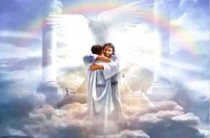
Ephesians 1:3
“Blessed be the God and Father of our Lord Jesus Christ, who has blessed us with every spiritual blessing in the heavenly places in Christ.”

Slide 19
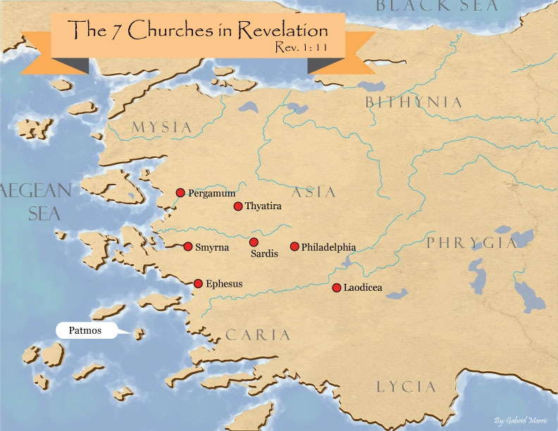

Slide 20
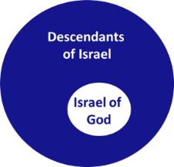
Revelation 2:9
“I know your tribulation and your poverty (but you are rich), and the blasphemy by those who say they are Jews and are not, but are a synagogue of Satan.”

Slide 21
III. Genesis 32:22-32 Peniel
Family sent away (22-23)
Jacob wrestles with the Angel of the Lord (24)
Jacob’s thigh dislocated (25)
Struggle for blessing (26-28)
Angel of the Lord’s identity (29)
Results of the encounter (30-32)

Slide 22
Genesis 32:30-32 Results of the Encounter
Naming of the place (30)
Jacob’s limp (31)
Source of Hebrew tradition (32)

Slide 23
Genesis 32:30-32 Results of the Encounter
Naming of the place (30)
Jacob’s limp (31)
Source of Hebrew tradition (32)

Slide 24
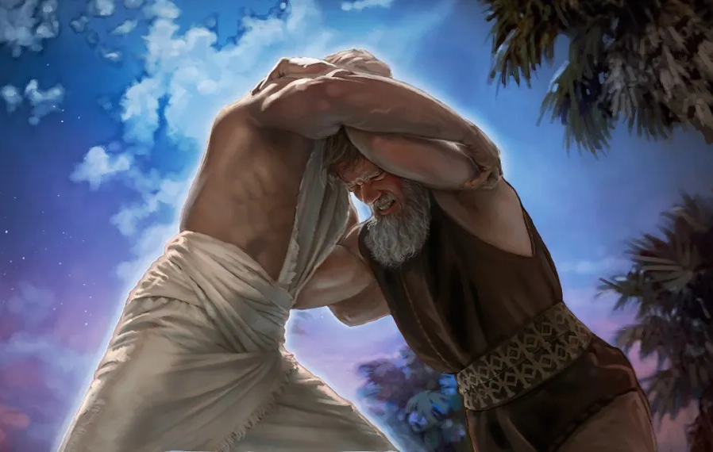
Charles Ryrie
The Ryrie Study Bible, p. 43
“Genesis 32:30 (RSB:NASB1995U): 32:30 “Peniel means ‘the face of God.’”

Slide 25
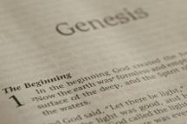
Beginning Themes
Universe Life Man Marriage Evil Clothing | Religion Salvation Language Government Nations Israel
Morris, Genesis Record, 18-20

Slide 26
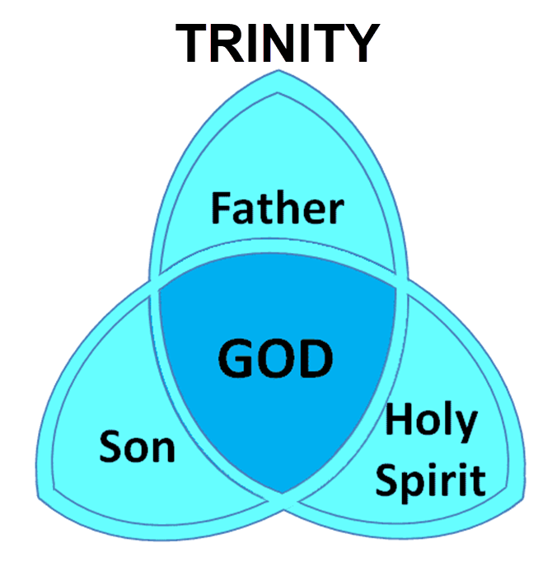

Slide 27
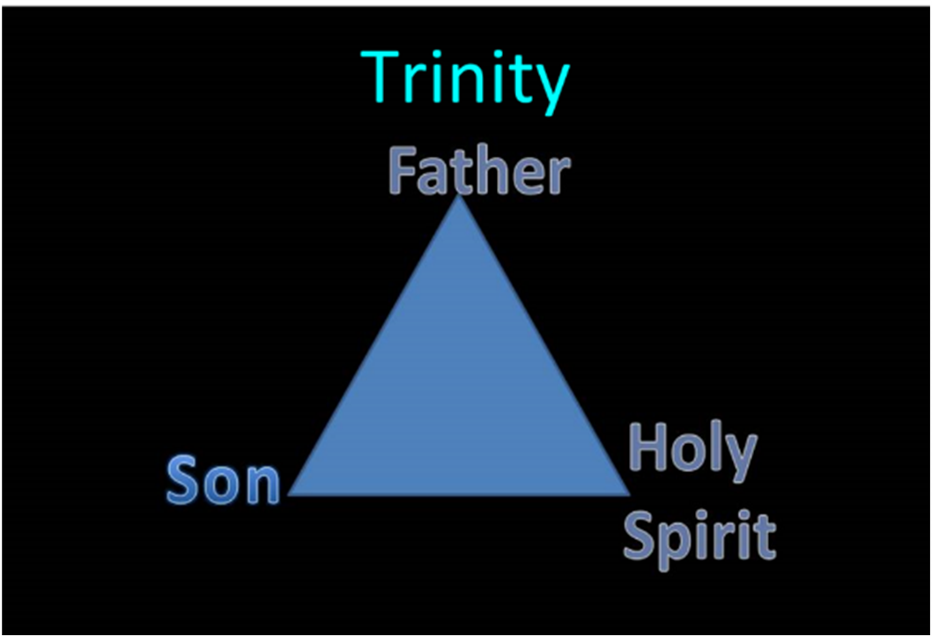

Slide 28
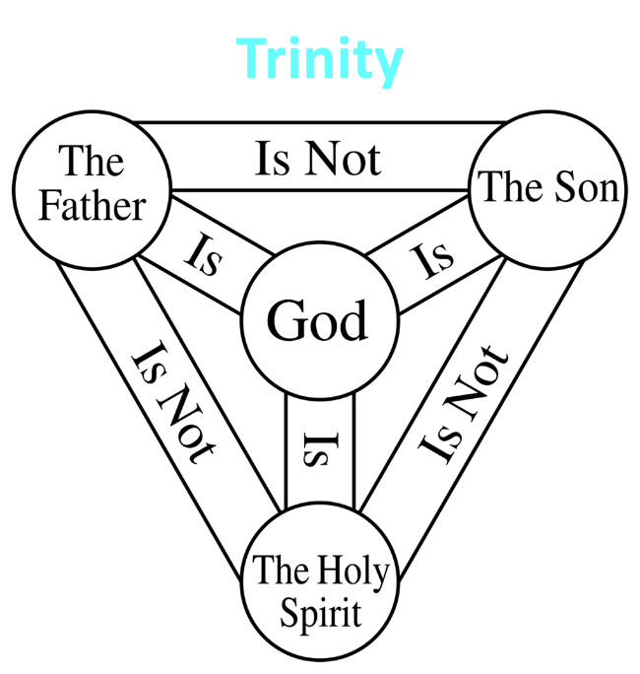

Slide 29
Three Tenses of Salvation
Phase | Justification | Sanctification | Glorification
Tense | Past | Present | Future
Saved from sin’s: | Penalty | Power | Presence
Scripture | Eph 2:8-9; Titus 3:5 | Philip 2:12 | Rom 5:10

Slide 30
Genesis 32:30-32 Results of the Encounter
Naming of the place (30)
Jacob’s limp (31)
Source of Hebrew tradition (32)

Slide 31
Genesis 32:30-32 Results of the Encounter
Naming of the place (30)
Jacob’s limp (31)
Source of Hebrew tradition (32)

Slide 32
Dr. Arnold G. Fruchtenbaum
The Book of Genesis, 484-85
“The account ends in verse 32 spelling out that this was the source of a Jewish eating tradition: Therefore, the children of Israel eat not the sinew of the hip which is upon the hollow of the thigh, unto this day. This refers to the sciatic nerve; and so, unto this day, the arteries and the tendons were removed before the meat was ritually prepared for Jewish consumption. However, this practice eventually was not incorporated into rabbinic Jewish law, and it is not considered part of kosher law today. However, this was the original practice, and the reason given for this practice was: because he touched the hollow of Jacob’s thigh in the sinew of the hip.”

Slide 33
Charles Ryrie
The Ryrie Study Bible, p. 44
“Genesis 32:30 (RSB:NASB1995U): 32:30 “Though the practice is not forbidden in Scripture, Jews have traditionally avoided eating the sciatic nerve (sinew) of the hind quarter of animals.”

Slide 34
Beginning Themes
Universe Life Man Marriage Evil Clothing | Religion Salvation Language Government Nations Israel
Morris, Genesis Record, 18-20

Slide 35
Conclusion

Slide 36
III. Genesis 32:22-32 Peniel
Family sent away (22-23)
Jacob wrestles with the Angel of the Lord (24)
Jacob’s thigh dislocated (25)
Struggle for blessing (26-28)
Angel of the Lord’s identity (29)
Results of the encounter (30-32)

Slide 37
Genesis 32:1‒33:17 Jacob and Esau
Mahanaim (32:1-2)
Jacob’s Message to Esau (32:3-21)
Peniel (32:22-32)
Jacob’s Meeting with Esau (33:1-17)

Slide 38
²⁴ The Lord bless you, and keep you; ²⁵ The Lord make His face shine on you, And be gracious to you; ²⁶ The Lord lift up His countenance on you, And give you peace.
Numbers 6:24–26 (NASB95)

