Slide 1


Apostasy or Rapture?
(2 Thessalonians 2:3A)
Dr. Andy Woods
Senior Pastor – Sugar Land Bible Church
President – Chafer Theological Seminary

Slide 2


2 Thessalonians 2:3
“Let no one in any way deceive you, for it will not come unless the apostasy [apostasia] comes first, and the man of lawlessness is revealed, the son of destruction.”

Slide 3
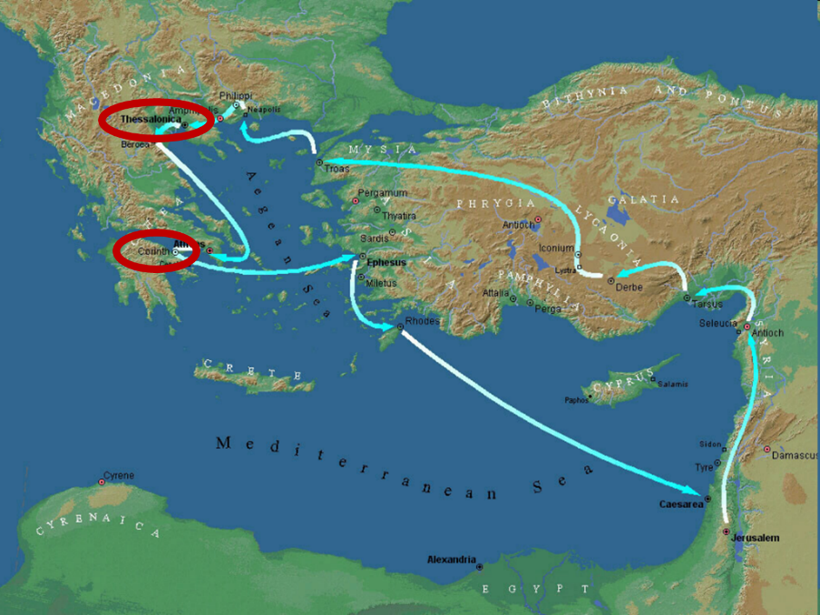

Slide 4
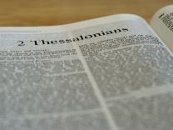
2 Thessalonians 2:1-12
Problem (2:1-2)
Prerequisites for the Day of the Lord (2:3-12)
  The apostasy (2:3a)
  Advent of the lawless one (2:3b-4)
  Removal of the restrainer (2:5-7)
  Destruction of the lawless one (2:8-9)
  Destruction of lawless one’s followers (2:10-12)

Slide 5
2 Thessalonians 2:1-12
Problem (2:1-2)
Prerequisites for the Day of the Lord (2:3-12)
  The apostasy (2:3a)
  Advent of the lawless one (2:3b-4)
  Removal of the restrainer (2:5-7)
  Destruction of the lawless one (2:8-9)
  Destruction of lawless one’s followers (2:10-12)

Slide 6

2 Thessalonians 2:2
“that you not be quickly shaken from your composure or be disturbed either by a spirit or a message or a letter as if from us, to the effect that the day of the Lord has come.”

Slide 7
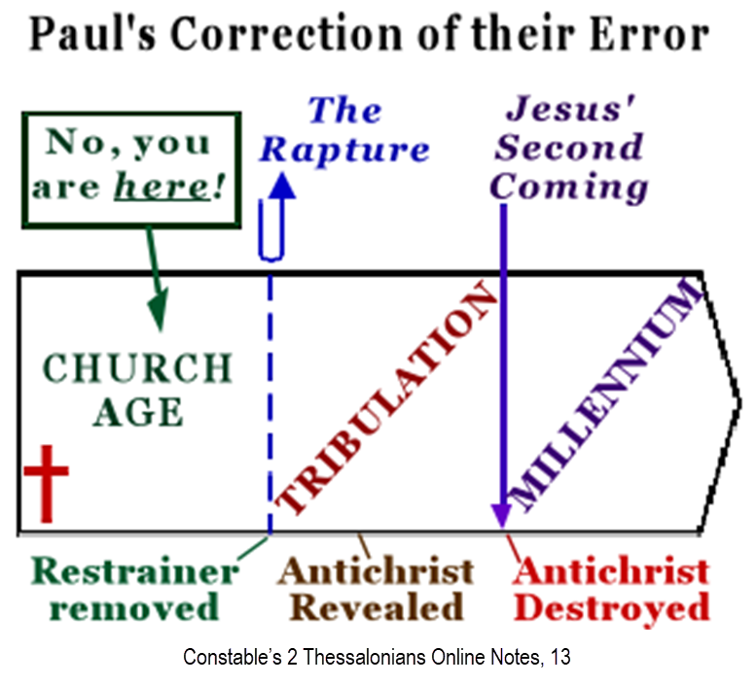

Slide 8
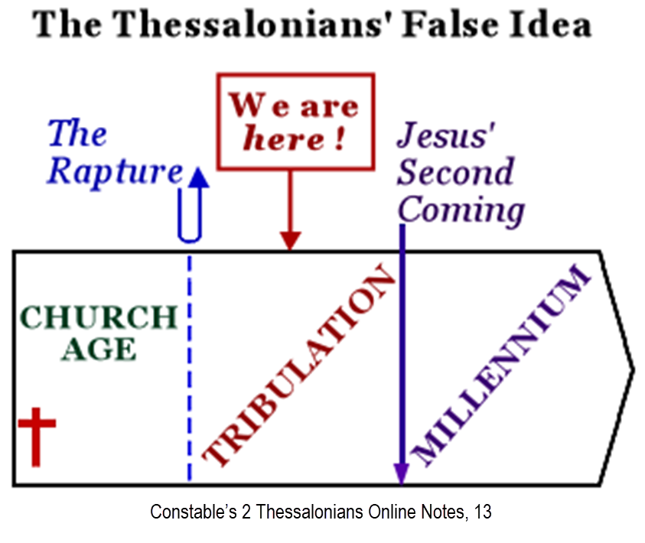

Slide 9
2 Thessalonians 2:1-12
Problem (2:1-2)
Prerequisites for the Day of the Lord (2:3-12)
  The apostasy (2:3a)
  Advent of the lawless one (2:3b-4)
  Removal of the restrainer (2:5-7)
  Destruction of the lawless one (2:8-9)
  Destruction of lawless one’s followers (2:10-12)

Slide 10
2 Thessalonians 2:1-12
Problem (2:1-2)
Prerequisites for the Day of the Lord (2:3-12)
  The apostasy (2:3a)
  Advent of the lawless one (2:3b-4)
  Removal of the restrainer (2:5-7)
  Destruction of the lawless one (2:8-9)
  Destruction of lawless one’s followers (2:10-12)

Slide 11

Apostasy? (2:3a)
Spiritual departure (Acts 21:21) – Unbelieving world embracing the antichrist
Physical departure (Acts 12:10; 2 Cor. 12:8) – Rapture

Slide 12
Apostasy? (2:3a)
Spiritual departure (Acts 21:21) – Unbelieving world embracing the antichrist
Physical departure (Acts 12:10; 2 Cor. 12:8) – Rapture

Slide 13
Spiritual Departure Options
Apostasy of the Church (pre-rapture)
Apostasy of the World (post-rapture)
Apostasy of Israel (Dan. 9:27)

Slide 14
Spiritual Departure Options
Apostasy of the Church (pre-rapture)
Apostasy of the World (post-rapture)
Apostasy of Israel (Dan. 9:27)

Slide 15
Order of Paul’s Letters
Galatians (A.D. 49)
1‒2 Thessalonians (A.D. 51)
1‒2 Corinthians (A.D. 56)
Romans (A.D. 57)
Ephesians, Colossians, Philemon, Philippians (A.D. 60‒62)
1 Timothy, Titus (A.D. 62‒66)
2 Timothy (A.D. 67)

Slide 16
Unique Characteristics of 1 Thessalonians
Every chapter ends with a reference to the Second Advent
Small amount of time in between planting of the church and the first letter to the church

Slide 17
2 Thessalonians 2:3
“Let no one in any way deceive you, for it will not come unless the apostasy [apostasia] comes first [prōton], and the man of lawlessness is revealed, the son of destruction.”

Slide 18
C. Gordon Olson
C. Gordon Olson, The Resurrection New Testament (Lynchburg, VA: Global Gospel Publishers, 2017), 261, n. B.
“‘Let no one deceive you in anyway, for that day will not come unless the departure comes first and the man of lawlessness is revealed, the man doomed to destruction.’….The Greek Apostasy means a departure, as does its verb aphistēmi. It can refer to a physical departure, a spiritual departure, or a rebellion. The rapture of Christians would be a physical departure, which is supported by his announced subject in 2:1, ‘our gathering together unto him’ (cf. 1 Th. 4:13-18). Otherwise, Paul never returned to his declared topic in a lapse of thought, which raises questions. Only two other versions so render it: GNV & WEB.”

Slide 19
Spiritual Departure Options
Apostasy of the Church (pre-rapture)
Apostasy of the World (post-rapture)
Apostasy of Israel (Dan. 9:27)

Slide 20
God’s Estimate of the Lost
Lightner, Salvation, Class notes of Andy Woods
Lost (Luke 19:10)
Perishing (John 3:16)
Condemned (John 3:18)
Lovers of darkness/evil (John 3:19-21)
Under divine wrath (John 3:36)
Without spiritual life (John 3:36)
Of their father the devil (John 8:44)
Dead (Eph 2:1)
Demonically energized (Eph 2:2)

Slide 21
God’s Estimate of the Lost
Lightner, Salvation, Class notes of Andy Woods
Depraved (Eph 2:3a)
Doomed (Eph 2:3b)
Held captive (Col 1:13; 2 Tim. 26; Acts 26:17-18)
Unable to receive truth (1 Cor. 2:14; 2 Cor. 4:3-4)
Under the control of Satan’s world system (1 John 5:19)
Filled with all unrighteousness (Rom 1:29-32)
Unable to seek God (Rom 3:10-18)
Conceived in iniquity (Ps 51:5)
Desperately wicked (Jer. 17:9)

Slide 22
Spiritual Departure Options
Apostasy of the Church (pre-rapture)
Apostasy of the World (post-rapture)
Apostasy of Israel (Dan. 9:27)

Slide 23


Slide 24

Matthew 12:24
“But when the Pharisees heard this, they said, “‘This man casts out demons only by Beelzebul the ruler of the demons.’”

Slide 25
Apostasy? (2:3a)
Spiritual departure (Acts 21:21) – Unbelieving world embracing the antichrist
Physical departure (Acts 12:10; 2 Cor. 12:8) – Rapture

Slide 26
When Will the Rapture Take Place Relative to the Tribulation Period?
Pre-tribulation rapture theory
Mid-tribulation rapture theory
Post-tribulation rapture theory
Pre-wrath rapture theory
Partial rapture theory

Slide 27
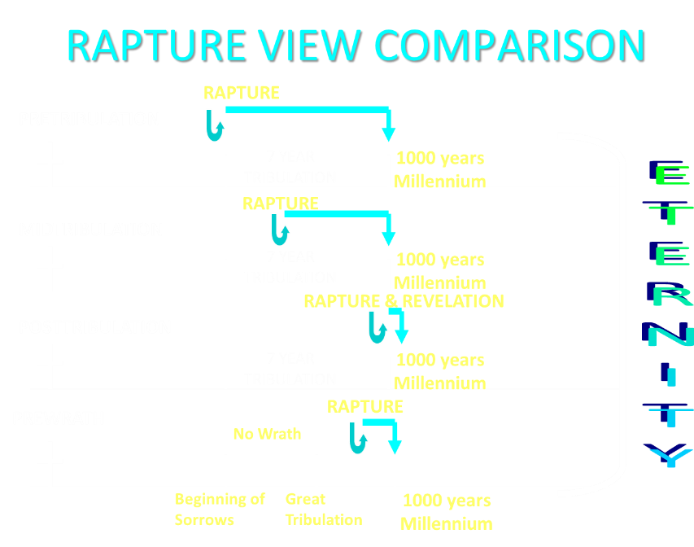

Slide 28
Apostasy? (2:3a)
Spiritual departure (Acts 21:21) – Unbelieving world embracing the antichrist
Physical departure (Acts 12:10; 2 Cor. 12:8) – Rapture

Slide 29
2 Thessalonians 2:3
“Let no one in any way deceive you, for it will not come unless the apostasy [apostasia] comes first [prōton], and the man of lawlessness is revealed, the son of destruction.”

Slide 30
2 Thessalonians 2:1-12
Problem (2:1-2)
Prerequisites for the Day of the Lord (2:3-12)
  The apostasy (2:3a)
  Advent of the lawless one (2:3b-4)
  Removal of the restrainer (2:5-7)
  Destruction of the lawless one (2:8-9)
  Destruction of lawless one’s followers (2:10-12)

Slide 32

Mark Hitchcock
Mark and Jeff Kinley Hitchcock, The Coming Apostasy: Exposing the Sabatoge of Christianity from Within (Carol Stream, Ill: Tyndale, 2017), 191
“Since the word apostasia means ‘departure,’ some have understood the term ‘the apostasy’ to be the physical departure of the church itself—that is, the Rapture, since the Rapture will be a physical departure of believers from the earth. If this view were correct, it would definitely place the Rapture before the Tribulation, which would be a slam dunk for the pre-Tribulation Rapture position.”

Slide 33

10 Reasons Favoring Physical Departure
There have always been doctrinal departures
2 Thess. was an early letter
The definite article before apostasia
Noun apostasia can refer to physical departure
Verb aphistēmi can refer to physical departure

Slide 34
10 Reasons Favoring Physical Departure
Extended context favors physical departure
Immediate context favors physical departure
2 Thess. 2:2 is a review course
Early Bible translations favor physical departure
Physical departure is held by credible scholars

Slide 35


Slide 36
10 Reasons Favoring Physical Departure
There have always been doctrinal departures
2 Thess. was an early letter
The definite article before apostasia
Noun apostasia can refer to physical departure
Verb aphistēmi can refer to physical departure

Slide 37
Acts 20:29-31
“For I know this, that after my departure savage wolves will come in among you, not sparing the flock.”Also from among yourselves men will rise up, speaking perverse things, to draw away the disciples after themselves. Therefore be on the alert, remembering that night and day for a period of three years I did not cease to admonish each one with tears.” (Italics added).

Slide 38

Acts 19:10
“This took place for two years, so that all who lived in Asia heard the word of the Lord, both Jews and Greeks.”

Slide 39
2 Timothy 1:15
“You are aware of the fact that all who are in Asia turned away from me, among whom are Phygelus and Hermogenes.”

Slide 40



Slide 41
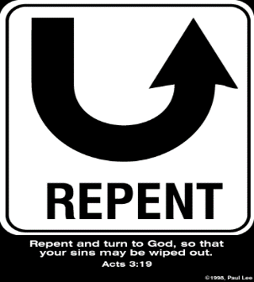
Rev 2:4-5
Apostasy
“⁴ But I have this against you, that you have left your first love. ⁵ Therefore remember from where you have fallen, and repent and do the deeds you did at first; or else I am coming to you and will remove your lampstand out of its place—unless you repent.”

Slide 42
2 Thessalonians 2:7
“For the mystery of lawlessness is already at work; only he who now restrains will do so until he is taken out of the way.”

Slide 43
1 John 4:3
“and every spirit that does not confess Jesus is not from God; this is the spirit of the antichrist, of which you have heard that it is coming, and now it is already in the world.”

Slide 44

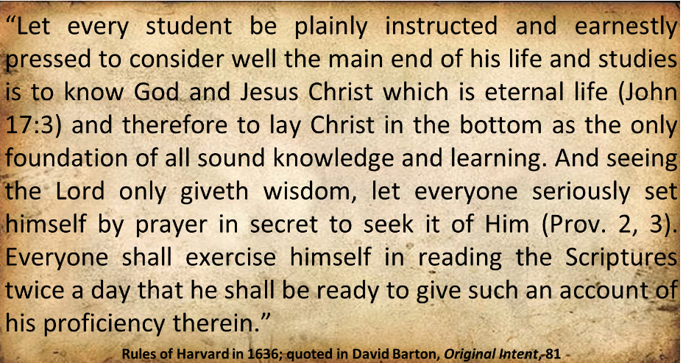
Harvard University

Slide 45
Henry M. Morris
The Defender's Study Bible: King James Version (Iowa Falls, IA: World Bible Publishers, 1995), 1338.
“2:3 falling away…The entire context, before and after, fits this understanding of the text better than the idea of the apostasy from the faith. Over the 1950 years since Paul wrote these lines, there have been numerous great apostasies from the faith, and none of these introduced the day of the Lord, although the persecuted believers in each case might easily have so interpreted them.”

Slide 46
Jimmy De Young
Prophetic Prospective – Daily Devotional
“If the word ‘apostasia’ was communicating that ‘apostasy’ was what it was talking about then the Rapture and the coming of the Antichrist would have happened during the writing of II Thessalonians. Apostasy had infiltrated the early church by the time Paul wrote this passage. What Paul is saying here is that the Antichrist, the ‘Son of Perdition’, would not come until the Church departs from one place and goes to another. That is what happens at the Rapture. The scenario for the future according to all prophetic passages is that the Rapture takes all Christians into Heaven and then the Antichrist appears on earth. Let me . . .

Slide 47
Jimmy De Young
Prophetic Prospective – Daily Devotional
. . . remind you that all preparations have been made for the temple to be built in Jerusalem. False teachers and deception presently are a part of our society today, which indicates that Antichrist is nearing his appearance on earth. Remember, before the appearance of Antichrist and the temple is built, the Rapture happens. Actually the Rapture could happen at any moment. Be ready!”

Slide 48
10 Reasons Favoring Physical Departure
There have always been doctrinal departures
2 Thess. was an early letter
The definite article before apostasia
Noun apostasia can refer to physical departure
Verb aphistēmi can refer to physical departure

Slide 49
Order of Paul’s Letters
Galatians (A.D. 49)
1‒2 Thessalonians (A.D. 51)
1‒2 Corinthians (A.D. 56)
Romans (A.D. 57)
Ephesians, Colossians, Philemon, Philippians (A.D. 60‒62)
1 Timothy, Titus (A.D. 62‒66)
2 Timothy (A.D. 67)

Slide 50
Unique Characteristics of 1-2 Thessalonians
Every chapter ends with a reference to the Second Advent
Small amount of time in between planting of the church and the first letter to the church

Slide 51
Acts 20:29-31
“For I know this, that after my departure savage wolves will come in among you, not sparing the flock.”Also from among yourselves men will rise up, speaking perverse things, to draw away the disciples after themselves. Therefore be on the alert, remembering that night and day for a period of three years I did not cease to admonish each one with tears.” (Italics added).

Slide 52
Order of Paul’s Letters
Galatians (A.D. 49)
1‒2 Thessalonians (A.D. 51)
1‒2 Corinthians (A.D. 56)
Romans (A.D. 57)
Ephesians, Colossians, Philemon, Philippians (A.D. 60‒62)
1 Timothy, Titus (A.D. 62‒66)
2 Timothy (A.D. 67)

Slide 53
1 Timothy 4:1
“But the Spirit explicitly says that in later times some will fall away [aphistēmi] from the faith, paying attention to deceitful spirits and doctrines of demons.”

Slide 54
10 Reasons Favoring Physical Departure
There have always been doctrinal departures
2 Thess. was an early letter
The definite article before apostasia
Noun apostasia can refer to physical departure
Verb aphistēmi can refer to physical departure

Slide 55
2 Thessalonians 2:3
“Let no one in any way deceive you, for it will not come unless the apostasy [apostasia] comes first, and the man of lawlessness is revealed, the son of destruction.”

Slide 56
2 Thessalonians 2:3
“Let no one in any way deceive you, for it will not come unless the apostasy [apostasia] comes first, and the man of lawlessness is revealed, the son of destruction.”

Slide 58


Slide 60
Rev 2:4-5
Apostasy
“⁴ But I have this against you, that you have left your first love. ⁵ Therefore remember from where you have fallen, and repent and do the deeds you did at first; or else I am coming to you and will remove your lampstand out of its place—unless you repent.”

Slide 61

1 Corinthians 15:52
“in a moment, in the twinkling of an eye, at the last trumpet; for the trumpet will sound, and the dead will be raised imperishable, and we will be changed.”

Slide 62
1 Corinthians 15:52
“in a moment [atomos], in the twinkling of an eye, at the last trumpet; for the trumpet will sound, and the dead will be raised imperishable, and we will be changed.”

Slide 63

Instantaneous
(1 Cor 15:52)
Twinkling of an eye
Flash or moment
Split second
Atomos (Greek) = atom (English)

Slide 64
10 Reasons Favoring Physical Departure
There have always been doctrinal departures
2 Thess. was an early letter
The definite article before apostasia
Noun apostasia can refer to physical departure
Verb aphistēmi can refer to physical departure

Slide 65
Apostasy? (2:3a)
Spiritual departure (Acts 21:21) – Unbelieving world embracing the antichrist
Physical departure (Acts 12:10; 2 Cor. 12:8) – Rapture

Slide 66
Acts 21:21
“and they have been told about you, that you are teaching all the Jews who are among the Gentiles to forsake [apostasia] Moses, telling them not to circumcise their children nor to walk according to the customs.”

Slide 67
Apostasy? (2:3a)
Spiritual departure (Acts 21:21) – Unbelieving world embracing the antichrist
Physical departure (Acts 12:10; 2 Cor. 12:8) – Rapture

Slide 68

Entries for Apostasia in Liddell & Scott
Rebellion against God
Apostasy
Departure
Disappearance
Distance
Henry Liddell & Henry Scott, A Greek English Lexicon (Oxford: Oxford University Press, 1940), 218.

Slide 69
Entries for Apostasia in Lampe’s A Patristic Greek Lexicon
Revolt
Defection
Apostasy from paganism, Judaism, Christianity, orthodoxy
Divorce
Departure
Standing aloof
G. W. H. Lampe, A Patristic Greek Lexicon (Oxford: Clarnedon Press, 1961), 208.

Slide 70
H. Wayne House
"Apostasia in 2 Thessalonians 2:3: Apostasy of Rapture?," in When the Trumpet Sounds: Today's Foremost Authorities Speak out on End-Time Controversies, ed. Thomas Ice and Timothy Demy (Eugene, OR: Harvest House, 1995), 273.
“The noun form allows for apostasia as a simple departure in the classical period, proved by examples from Liddell and Scott...If one says that this is not important because the meaning is only classical or ancient and thus lost its meaning by the time of the New Testament, then I may turn to the same root meaning of apostasia in the patristic era immediately following the New Testament period, as indicated in the definitions for the noun form in Lampe's Patristic Greek Lexicon. Although the noun used in the sense of spatial departure is not the normal meaning…during New Testament times, the word is found with this meaning in time periods before and after the New Testament era, and it is likely to have been understood this way at least sometimes.”

Slide 71
Matthew 5:32
“It was said, ‘Whoever sends his wife away, let him give her a certificate of divorce [apostosion]’”

Slide 72
Definition of “Apostasy”
apos = away from
histēmi = to stand
Apostasy = to stand away from
Apostasy = a departure
A departure from what?
  From previously known truth
  Physically from something

Slide 73
10 Reasons Favoring Physical Departure
There have always been doctrinal departures
2 Thess. was an early letter
The definite article before apostasia
Noun apostasia can refer to physical departure
Verb aphistēmi can refer to physical departure

Slide 74
New Testament Meanings of Aphistēmi
15 New Testament uses
Spiritual departure – Luke 8:13; 1 Tim. 4:1; Heb. 3:12
Physical departure – Luke 2:37; 4:13; 13:27; Acts 5:37-38; 12:10; 13:13; 15:38; 19:9; 22:29; 2 Cor. 12:8; 2 Tim. 2:19

Slide 75
New Testament Meanings of Aphistēmi
15 New Testament uses
Spiritual departure – Luke 8:13; 1 Tim. 4:1; Heb. 3:12
Physical departure – Luke 2:37; 4:13; 13:27; Acts 5:37-38; 12:10; 13:13; 15:38; 19:9; 22:29; 2 Cor. 12:8; 2 Tim. 2:19

Slide 76
New Testament Meanings of Aphistēmi
15 New Testament uses
Spiritual departure – Luke 8:13; 1 Tim. 4:1; Heb. 3:12
Physical departure – Luke 2:37; 4:13; 13:27; Acts 5:37-38; 12:10; 13:13; 15:38; 19:9; 22:29; 2 Cor. 12:8; 2 Tim. 2:19

Slide 77
1 Timothy 4:1
“But the Spirit explicitly says that in later times some will fall away [aphistēmi] from the faith, paying attention to deceitful spirits and doctrines of demons.”

Slide 78
New Testament Meanings of Aphistēmi
15 New Testament uses
Spiritual departure – Luke 8:13; 1 Tim. 4:1; Heb. 3:12
Physical departure – Luke 2:37; 4:13; 13:27; Acts 5:37-38; 12:10; 13:13; 15:38; 19:9; 22:29; 2 Cor. 12:8; 2 Tim. 2:19

Slide 79
George Gunn
John 14:1-3 – The Father’s House: Are We There Yet?, 30. www.pre-trib.org
“I ran out of ingredients for the salad, so I decided to make a quick run down to the store. While at the store, I left the car engine running while I made my purchase, thinking that I would be right out again. However, while I was in the store, I ran into my good friend Edward who was running for county supervisor. This resulted in my having to endure a somewhat long-winded rundown on how his campaign was running. Finally, fearing that my car would run out of gas, I ran with great haste out to the parking lot and returned home with the car surely running only on fumes.”

Slide 80
Illegitimate Totality Transfer
D. A. Carson, Exegetical Fallacies, 2nd ed. (Grand Rapids, MI: Baker Academic, 1996), 60-61.
“Unwarranted adoption of an expanded semantic field: The fallacy in this instance lies in the supposition that the meaning of a word in a specific context is much broader than the context itself allows and may bring with it the word’s entire semantic range. This step is sometimes called illegitimate totality transfer.”

Slide 81
Acts 21:21
“and they have been told about you, that you are teaching all the Jews who are among the Gentiles to forsake [apostasia] Moses, telling them not to circumcise their children nor to walk according to the customs.”

Slide 82
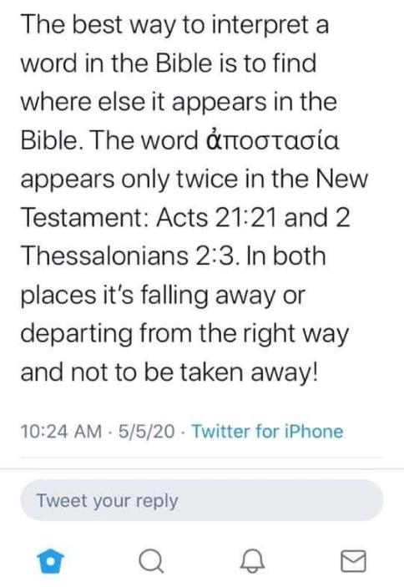

Slide 83
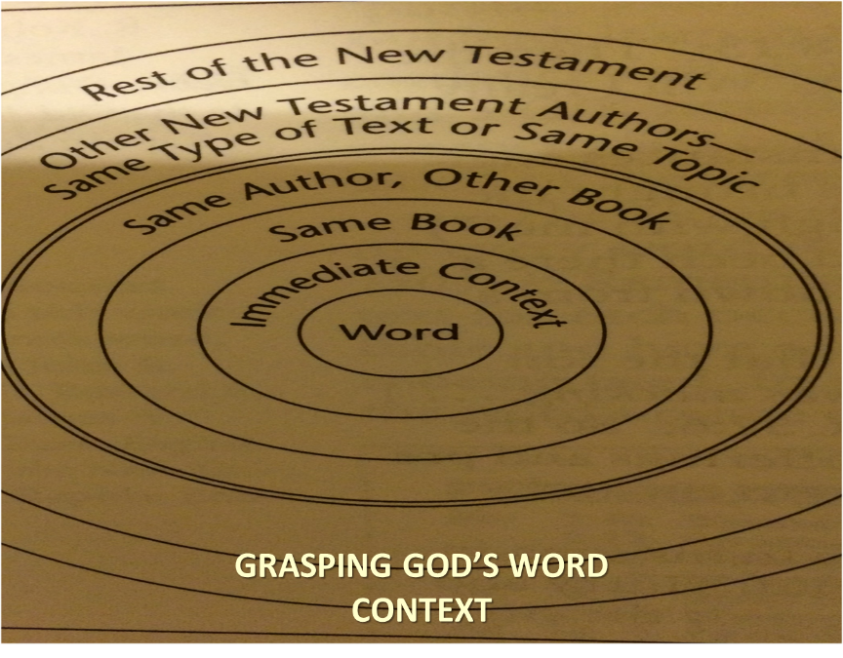

Slide 84
Acts 21:21
“and they have been told about you, that you are teaching all the Jews who are among the Gentiles to forsake [apostasia] Moses, telling them not to circumcise their children nor to walk according to the customs.”

Slide 85
2 Thessalonians 2:3
“Let no one in any way deceive you, for it will not come unless the apostasy [apostasia] comes first, and the man of lawlessness is revealed, the son of destruction.”

Slide 86
THE APOSTASIA
2 Thessalonians 2:3a | Acts 21:21
Pauline authorship | Lukan authorship
Paul speaking | Paul not speaking (v. 20)
Mosaic Law not mentioned | Departure from the Mosaic Law
Epistolary genre | Narrative genre
Definite article | No definite article

Slide 87
10 Reasons Favoring Physical Departure
Extended context favors physical departure
Immediate context favors physical departure
2 Thess. 2:2 is a review course
Early Bible translations favor physical departure
Physical departure is held by credible scholars

Slide 88
Unique Characteristics of 1 Thessalonians
Every chapter ends with a reference to the Second Advent
Small amount of time in between planting of the church and the first letter to the church

Slide 89

1 Thessalonians 1:10
“and to wait for His Son from heaven, whom He raised from the dead, that is Jesus, who rescues (rhyomai) us from (ek) the wrath (orgē) to come..”

Slide 90

1 Thessalonians 4:13-18
¹³ "But we do not want you to be uninformed, brethren, about those who are asleep, so that you will not grieve as do the rest who have no hope. ¹⁴ For if we believe that Jesus died and rose again, even so God will bring with Him those who have fallen asleep in Jesus. ¹⁵ For this we say to you by the word of the Lord, that we who are alive and remain until the coming of the Lord, will not precede those who have fallen asleep. ¹⁶ For the Lord Himself will descend from . . .

Slide 91
1 Thessalonians 4:13-18
. . .heaven with a shout, with the voice of the archangel and with the trumpet of God, and the dead in Christ will rise first. ¹⁷ Then we who are alive and remain will be caught up together with them in the clouds to meet the Lord in the air, and so we shall always be with the Lord. ¹⁸ Therefore comfort one another with these words."

Slide 92
10 Reasons Favoring Physical Departure
Extended context favors physical departure
Immediate context favors physical departure
2 Thess. 2:2 is a review course
Early Bible translations favor physical departure
Physical departure is held by credible scholars

Slide 93
2 Thessalonians 2:1
“Now we request you, brethren, with regard to the coming of our Lord Jesus Christ and our gathering together to Him.”

Slide 94
2 Thessalonians 2:1-12
Problem (2:1-2)
Prerequisites for the Day of the Lord (2:3-12)
  The apostasy (2:3a)
  Advent of the lawless one (2:3b-4)
  Removal of the restrainer (2:5-7)
  Destruction of the lawless one (2:8-9)
  Destruction of lawless one’s followers (2:10-12)

Slide 95

2 Thessalonians 2:6-7
⁶And you know what restrains [katechō; neuter] him now, so that in his time he will be revealed. ⁷For the mystery of lawlessness is already at work; only he who now restrains [katechō; masculine] will do so until he is taken out of the way.

Slide 96

Restrainer? (2:6-7)
Rome?
Satan?
Government?
Michael?
Spirit?

Slide 97
Restrainer? (2:6-7)
Rome?
Satan?
Government?
Michael?
Spirit?

Slide 98
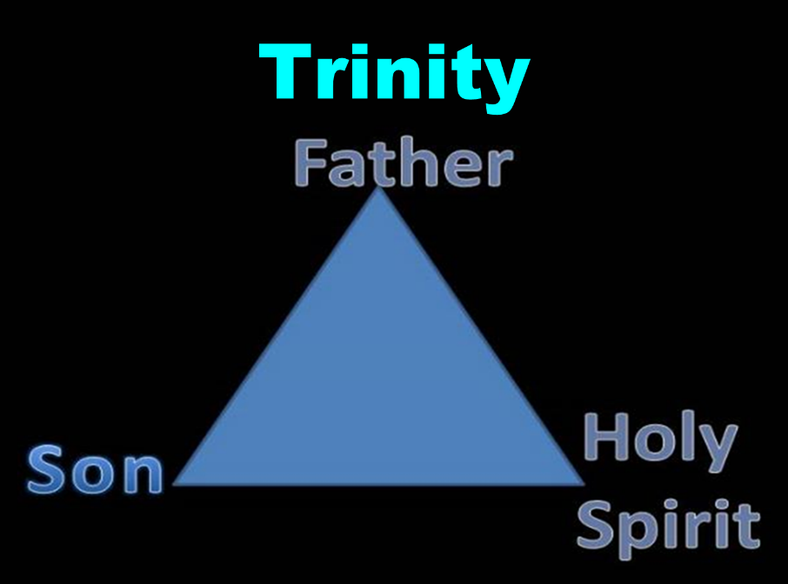

Slide 99


Slide 100

3 Reasons Why the Restrainer is the Holy Spirit
(2 Thessalonians 2:6-7)
The Holy Spirit is omnipotent (2 Thess. 2:9)
The Holy Spirit is active in the world (Gen. 6:3; John 16:7-11)
The Holy Spirit view handles well the switch in gender from the neuter (vs. 6) to the masculine (vs. 7)

Slide 101
3 Reasons Why the Restrainer is the Holy Spirit
(2 Thessalonians 2:6-7)
The Holy Spirit is omnipotent (2 Thess. 2:9)
The Holy Spirit is active in the world (Gen. 6:3; John 16:7-11)
The Holy Spirit view handles well the switch in gender from the neuter (vs. 6) to the masculine (vs. 7)

Slide 102
2 Thessalonians 2:9
“that is, the one whose coming is in accord with the activity of Satan, with all power and signs and false wonders.”

Slide 103
3 Reasons Why the Restrainer is the Holy Spirit
(2 Thessalonians 2:6-7)
The Holy Spirit is omnipotent (2 Thess. 2:9)
The Holy Spirit is active in the world (Gen. 6:3; John 16:7-11)
The Holy Spirit view handles well the switch in gender from the neuter (vs. 6) to the masculine (vs. 7)

Slide 104
3 Reasons Why the Restrainer is the Holy Spirit
(2 Thessalonians 2:6-7)
The Holy Spirit is omnipotent (2 Thess. 2:9)
The Holy Spirit is active in the world (Gen. 6:3; John 16:7-11)
The Holy Spirit view handles well the switch in gender from the neuter (vs. 6) to the masculine (vs. 7)

Slide 105
Genesis 6:1-3
“¹ Now it came about, when men began to multiply on the face of the land, and daughters were born to them, ² that the sons of God saw that the daughters of men were beautiful; and they took wives for themselves, whomever they chose. ³ Then the Lord said, “My Spirit shall not strive with man forever, because he also is flesh; nevertheless his days shall be one hundred and twenty years.”

Slide 106
John 16:7-11
“⁷ But I tell you the truth, it is to your advantage that I go away; for if I do not go away, the Helper will not come to you; but if I go, I will send Him to you. ⁸ And He, when He comes, will convict the world concerning sin and righteousness and judgment; ⁹ concerning sin, because they do not believe in Me; ¹⁰ and concerning righteousness, because I go to the Father and you no longer see Me; ¹¹ and concerning judgment, because the ruler of this world has been judged.”

Slide 107
3 Reasons Why the Restrainer is the Holy Spirit
(2 Thessalonians 2:6-7)
The Holy Spirit is omnipotent (2 Thess. 2:9)
The Holy Spirit is active in the world (Gen. 6:3; John 16:7-11)
The Holy Spirit view handles well the switch in gender from the neuter (vs. 6) to the masculine (vs. 7)

Slide 108
2 Thessalonians 2:6-7
⁶And you know what restrains [katechō; neuter] him now, so that in his time he will be revealed. ⁷For the mystery of lawlessness is already at work; only he who now restrains [katechō; masculine] will do so until he is taken out of the way.

Slide 109
John 14:16-17
¹⁶ I will ask the Father, and He will give you another Helper, that He may be with you forever; ¹⁷ that is the Spirit of truth, whom the world cannot receive, because it does not see Him or know Him, but you know Him because He abides with you and will be in you.

Slide 110
John 16:7-11
“⁷ But I tell you the truth, it is to your advantage that I go away; for if I do not go away, the Helper will not come to you; but if I go, I will send Him to you. ⁸ And He, when He comes, will convict the world concerning sin and righteousness and judgment; ⁹ concerning sin, because they do not believe in Me; ¹⁰ and concerning righteousness, because I go to the Father and you no longer see Me; ¹¹ and concerning judgment, because the ruler of this world has been judged.”

Slide 111
Restrainer Must First be Removed
Restrainer holds back the Antichrist (2 Thess 2:6-7)
Restrainer = the omnipotent Holy Spirit (2 Thess 2:9)
Holy Spirit permanently indwells all Christians (John 14:16; Rom 8:9)
Sprit indwelt Christians must first be removed prior to the Antichrist's advent

Slide 112
1 Samuel 16:13-14
“¹³ Then Samuel took the horn of oil and anointed him in the midst of his brothers; and the Spirit of the Lord came mightily upon David from that day forward. And Samuel arose and went to Ramah. ¹⁴ Now the Spirit of the Lord departed from Saul, and an evil spirit from the Lord terrorized him.”

Slide 113

John 14:16-17
¹⁶ I will ask the Father, and He will give you another Helper, that He may be with you forever; ¹⁷ that is the Spirit of truth, whom the world cannot receive, because it does not see Him or know Him, but you know Him because He abides with you and will be in you.

Slide 114

Guessing the Identity of the Antichrist?
Irenaeus Against Heresies 5.30.3
“We will not, however, incur the risk of pronouncing positively as to the name of Antichrist. But if it had been necessary to announce his name plainly at the present time, it would have been spoken by him who saw the apocalypse. For it was not seen long ago, but almost in our own time, at the end of the reign of Domitian.”

Slide 115

Psalm 50:10
“For every beast of the forest is Mine, The cattle on a thousand hills.”

Slide 116
10 Reasons Favoring Physical Departure
Extended context favors physical departure
Immediate context favors physical departure
2 Thess. 2:2 is a review course
Early Bible translations favor physical departure
Physical departure is held by credible scholars

Slide 117
1 Thessalonians 4:16-18
¹⁶ For the Lord Himself will descend from heaven with a shout, with the voice of the archangel and with the trumpet of God, and the dead in Christ will rise first. ¹⁷ Then we who are alive and remain will be caught up [harpazō] together with them in the clouds to meet the Lord in the air, and so we shall always be with the Lord. ¹⁸ Therefore comfort one another with these words.

Slide 118
2 Thessalonians 2:3
“Let no one in any way deceive you, for it will not come unless the apostasy [apostasia] comes first, and the man of lawlessness is revealed, the son of destruction.”

Slide 119

Paul’s Various Rapture Terms
parousia | 2 Thess. 2:1
episynagōgē | 2 Thess. 2:1
apokalypsis | 1 Cor. 1:7
epiphaneia | Titus 2:13
rhyomai | 1 Thess. 1:10
harpazō | 1 Thess. 4:17
apostasia | 2 Thess. 2:3a

Slide 120
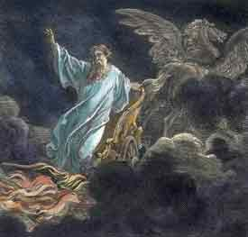
Exemption from Death
(1 Cor 15:54-56)
Enoch (Gen 5:24)
Elijah (2 Kings 2)
Christ (Acts 1:11; Rev 12:5)
Philip (Acts 8:39)
Paul (2 Cor 12:2, 4)
John (Rev 4:1-2)
Two witnesses (Rev 11:12)

Slide 121

2 Thessalonians 2:5
“Do you not remember that while I was still with you, I was telling you these things?”

Slide 122
10 Reasons Favoring Physical Departure
Extended context favors physical departure
Immediate context favors physical departure
2 Thess. 2:2 is a review course
Early Bible translations favor physical departure
Physical departure is held by credible scholars

Slide 123
“Departing First” or “Falling Away”
Year | Bible | Translation
1384 | Wycliffe Bible | Departynge First
1526 | Tyndale Bible | Departynge First
1535 | Coverdale Bible | Departynge First
1539 | Crammer Bible | Departing First
1576 | Breeches Bible | Departing First
1583 | Beeza Bible | Departing First
1608 | Geneva Bible | Departing First
1576 | Rheims Bible | The Protestant “Revolt”
1611 | King James V. | Falling Away
House, When the Trumpet Sounds, p. 270.

Slide 124
2 Thessalonians 2:3
Rheims Bible 1576
“Let no man deceive you by any means, for unless there come a revolt [apostasia] first, and the man of sin be revealed, the son of perdition.”

Slide 125
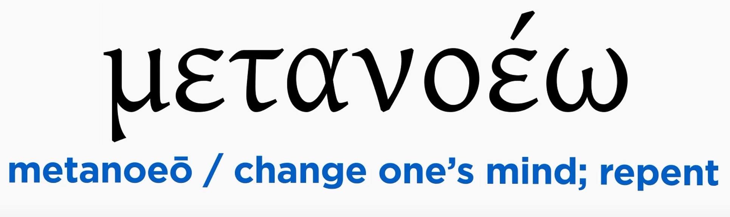
Matthew 3:1-2
“Now in those days John the Baptist came, preaching in the wilderness of Judea, saying, ‘Repent [metanoeō], for the kingdom of heaven is at hand.”

Slide 126
Matthew 3:1-2
Rheims Bible 1576
“AND in those days cometh John the Baptist preaching in the desert of Judea. And saying: Do penance: for the kingdom of heaven is at hand.”

Slide 127
Acts 2:38
“Peter said to them, “Repent [metanoeō], and each of you be baptized in the name of Jesus Christ for (eis) the forgiveness of your sins; and you will receive the gift of the Holy Spirit.”

Slide 128

Acts 2:38
Douay-Rheims 1899 American Edition (DRA)
“But Peter said to them: Do penance, and be baptized every one of you in the name of Jesus Christ, for the remission of your sins: and you shall receive the gift of the Holy Ghost.”

Slide 129
2 Peter 3:9
“The Lord is not slow about His promise, as some count slowness, but is patient toward you, not wishing for any to perish but for all to come to repentance.”

Slide 130
2 Peter 3:9
Douay-Rheims 1899 American Edition (DRA)
“The Lord delayeth not his promise, as some imagine, but dealeth patiently for your sake, not willing that any should perish, but that all should return to penance.”

Slide 131
“Departing First” or “Falling Away”
Year | Bible | Translation
1384 | Wycliffe Bible | Departynge First
1526 | Tyndale Bible | Departynge First
1535 | Coverdale Bible | Departynge First
1539 | Crammer Bible | Departing First
1576 | Breeches Bible | Departing First
1583 | Beeza Bible | Departing First
1608 | Geneva Bible | Departing First
1576 | Rheims Bible | The Protestant “Revolt”
1611 | King James V. | Falling Away
House, When the Trumpet Sounds, p. 270.

Slide 132
Thomas Ice
“The ‘Departure’ in 2 Thessalonians 2:3,” online: www.pre-trib.org, accessed 7 May 2017, 2.
“Most scholars say that no one knows the reason for the translation shift. However, a plausible theory has been put forth by Martin Butalla in his Master of Theology thesis produced at Dallas Theology Seminary in 1998. It appears that the Catholic translation into English from Jerome’s Latin Vulgate known as the Rheims Bible (1576) was the first to break the translation trend. “Apostasia was revised from ‘the departure’ to ‘the Protestant Revolt,’” explains Butalla. “Revolution is the terminology still in use today when Catholicism teaches the history of the Protestant Reformation. Under this guise, apostasia would refer to a departure of Protestants from the Catholic Church.” The Catholic translators appear eager to engage in polemics against the Reformation by even allowing it to impact Bible translation.”

Slide 133

NKJV, NIV, RSV, ASV, JB, NASB
“apostasy”
“falling away”
“revolt”
“rejection”
“rebellion”

Slide 134
10 Reasons Favoring Physical Departure
Extended context favors physical departure
Immediate context favors physical departure
2 Thess. 2:2 is a review course
Early Bible translations favor physical departure
Physical departure is held by credible scholars

Slide 135

Physical Departure Adherents
Kenneth Wuest |  | Paul Lee Tan*
E. Schuyler English |  | Arnold Fruchtenbaum*
J. Dwight Pentecost |  | Tim LaHaye
H. Wayne House |  | Thomas Ice
Stanley Ellison |  | Don Stewart
J.S. Mabie |  | Robert Thieme
Allen McRae |  | Gordon Olson*
Gordon Lewis |  | J. Vernon McGee*
Henry Morris* |  | Jimmy DeYoung*
John. R. Rice |  | J.D. Farag
David Olander* |  | David Hocking
J. Carl Laney*

Slide 136

Arnold Fruchtenbaum
Arnold G. Fruchtenbaum, Footsteps of the Messiah: A Study of the Sequence of Prophetic Events, rev. ed. (San Antonio, TX: Ariel, 2020), xviii.
“The 2020 revision primarily focuses on correcting some formatting and spelling inconsistencies of the 2003‒edition of this work as well as the editing of the text to improve its readability. Furthermore, it includes a new topical index as well as my altered view of II Thessalonians 2:3, which I developed after additional research of new scholarly work, such as Dr. Andy Woods’ The Falling Away – Spiritual Departure or Physical Rapture?, published in 2018 by Dispensational Publishing House.”

Slide 137
Arnold Fruchtenbaum
Arnold G. Fruchtenbaum, Footsteps of the Messiah: A Study of the Sequence of Prophetic Events, rev. ed. (San Antonio, TX: Ariel, 2020), 546-47.
“In previous editions of this work, I presented a different viewpoint: that the term apostasia was referring to the apostasy of the church. The fact that in the last days, the church will depart from the faith is clearly taught in other passages, such as I Timothy 4:1-3. But is that true also of II Thessalonians 2:3? That was my assumption for many years, but at one point I began questioning this conclusion. One reason I held this position was based on viewing II Thessalonians 2:3 from the perspective of systematic theology where conclusions are drawn from all sources. My conclusions on the II Thessalonian passage were drawn from the I Timothy passage.”

Slide 138
Arnold Fruchtenbaum
Arnold G. Fruchtenbaum, Footsteps of the Messiah: A Study of the Sequence of Prophetic Events, rev. ed. (San Antonio, TX: Ariel, 2020), 546-47.
“The second reason was based on another fact. I already knew that the Greek term apostasia could refer to a physical departure as well as a moral, ethical, or spiritual departure. In the vast majority of appearances, the term is used in the latter sense. Hence, the vast majority of theologians, including me, interpret II Thessalonians 2:3 according to this meaning of the term. Rather than continuing to interpret the verse primarily from the viewpoint of systematic theology, I decided to research it from the perspective of biblical theology, which focuses more on a specific biblical writer and/or book.”

Slide 139
Arnold Fruchtenbaum
Arnold G. Fruchtenbaum, Footsteps of the Messiah: A Study of the Sequence of Prophetic Events, rev. ed. (San Antonio, TX: Ariel, 2020), 546-47.
“In this case, the focus was on both epistles to the Thessalonians before interpreting one verse in one of the epistles through a verse from a different book by the same author, but addressed to a different audience and written in a different context. Paul wrote I and II Thessalonians to the same church responding to questions they had written to him. In the first epistle, Paul dealt with the rapture of the church (4:13-18) and the day of the Lord (5:1-11). He clearly taught that the day of the Lord will not overtake the believer, but only the unbeliever, since believers are not appointed to wrath (v. 9) and the antecedent to wrath is the day of the Lord (v. 2).”

Slide 140
Arnold Fruchtenbaum
Arnold G. Fruchtenbaum, Footsteps of the Messiah: A Study of the Sequence of Prophetic Events, rev. ed. (San Antonio, TX: Ariel, 2020), 546-47.
“The verses show a pre-tribulational rapture. Between the two epistles, false teachers had come into the church announcing that the day of the Lord had begun. The news troubled the Thessalonians greatly, since it was the opposite of what Paul had taught them both in person and in writing (in the first epistle). So, Paul wrote them the second epistle to let them know that it was not possible for them to be in the day of the Lord since two things had to precede this time, the first of which was the apostasia. This fact raised a question in my mind: Is it possible that Paul mentioned the apostasia in II Thessalonians 2:3 in order to reaffirm what he had written in the first epistle, namely, that the believers would not enter the day of the Lord?”

Slide 141
Arnold Fruchtenbaum
Arnold G. Fruchtenbaum, Footsteps of the Messiah: A Study of the Sequence of Prophetic Events, rev. ed. (San Antonio, TX: Ariel, 2020), 546-47.
“What finally helped to convince me is Dr. Andy Woods’ booklet The Falling Away: Spiritual Departure or Physical Departure?, published by Dispensational Publishing House in 2018. Among the points Woods makes are the following: 1. There have always been doctrinal departures, even in the first century (p. 6-8). 2. There is a definite article before the noun apostasia, just as there is a definite article before ‘man of sin’ in the same verse. Woods states: ‘By providing these two definite articles essentially Paul is indicating that the apostasy will be something that has specific, time-bound qualities just like the man of sin’s coming has such qualities.’”

Slide 142
Arnold Fruchtenbaum
Arnold G. Fruchtenbaum, Footsteps of the Messiah: A Study of the Sequence of Prophetic Events, rev. ed. (San Antonio, TX: Ariel, 2020), 546-47.
“‘In other words, just like the advent of the man of sin will be specific and an instantaneous event in future history, the coming apostasia, or departure, will similarly be specific and time bound . . . [It] will also take place instantaneously.’ (p. 15-16). 3. The Greek noun apostasia can refer to a physical departure, and examples include Matthew 5:31, 19:7; and Mark 10:4 (p. 17-20). 4. The verbal form of apostasia is aphistēmi. Woods states: ‘Only three times does the verb aphistēmi mean a spiritual departure [Lk. 8:13; I Tim. 4:1; Heb. 3:12] . . . However, the majority of times, or a full seventy-five percent of instances where aphistēmi is used in the Greek New Testament, it does not refer to a spiritual departure, but rather to a physical departure.’”

Slide 143
Arnold Fruchtenbaum
Arnold G. Fruchtenbaum, Footsteps of the Messiah: A Study of the Sequence of Prophetic Events, rev. ed. (San Antonio, TX: Ariel, 2020), 546-47.
“‘Thus, while this verb is used 15 times, only three times does it mean a spiritual departure. The remaining twelve times it clearly means a physical departure.’” (p. 21). Woods made additional observations in his booklet, but these four were the main points that finally convinced me that II Thessalonians 2:3 is speaking of a physical departure, which will be the rapture of the church. Hence, the verse provides additional evidence for a pre-tribulational rapture.”

Slide 144
C. Gordon Olson
C. Gordon Olson, The Resurrection New Testament (Lynchburg, VA: Global Gospel Publishers, 2017), 261, n. B.
“‘Let no one deceive you in anyway, for that day will not come unless the departure comes first and the man of lawlessness is revealed, the man doomed to destruction.’….The Greek Apostasy means a departure, as does its verb aphistēmi. It can refer to a physical departure, a spiritual departure, or a rebellion. The rapture of Christians would be a physical departure, which is supported by his announced subject in 2:1, ‘our gathering together unto him’ (cf. 1 Th. 4:13-18). Otherwise, Paul never returned to his declared topic in a lapse of thought, which raises questions. Only two other versions so render it: GNV & WEB.”

Slide 145
Henry M. Morris
The Defender's Study Bible: King James Version (Iowa Falls, IA: World Bible Publishers, 1995), 1337-38.
“2:3 falling away. The ‘falling away’ (Greek apostasia) has commonly been translated as the apostasy (the definite article in the Greek indicates Paul had already told them about it), and then assumed to apply to the final, great religious apostasy at the end of the age. The context, however, as well as the etymology of the word itself, makes this interpretation unlikely. In this precise form, it is used nowhere else in the New Testament, so its meaning must be defined by its context here. It is derived from two Greek words, apo (meaning ‘away from’) and stasis (meaning ‘standing’). It could properly be rendered ‘standing away’ instead of ‘falling away.’”

Slide 146
Henry M. Morris
The Defender's Study Bible: King James Version (Iowa Falls, IA: World Bible Publishers, 1995), 1337-38.
“In Paul’s previous letter, he made no reference to a coming departure from the faith, but he had discussed, at length, a coming departure from the earth by all believers when Christ returns to meet them in the air (1 Thessalonians 4:13-18). This standing away from, in context, seems to refer to all the raptured believers standing away from the earth, as they stand before their returning Lord when they meet Him in the heavens. Here, Paul is reminding them that the ‘sudden destruction’ that would come upon unbelievers when the day of the Lord begins could not happen until the rapture - the standing away from the earth before Christ (Romans 14:10) - had taken place.”

Slide 147
Henry M. Morris
The Defender's Study Bible: King James Version (Iowa Falls, IA: World Bible Publishers, 1995), 1337-38.
“The entire context, before and after, fits this understanding of the text better than the idea of the apostasy from the faith. Over the 1950 years since Paul wrote these lines, there have been numerous great apostasies from the faith, and none of these introduced the day of the Lord, although the persecuted believers in each case might easily have so interpreted them.”

Slide 148
J. Carl Laney
J. Carl Laney, Answers to Tough Questions: A Survey of Problem Passages and Issues from Every Book of the Bible (Kregel: Grand Rapids, 1997), 289.
“The Greek word apostasia it is derived from a verb meaning ‘depart from’ (aphistēmi). The most basic root meaning of apostasia is ‘departure.’ While the word can be used metaphorically of departure from doctrine (Acts 21:21), the context of the passage must ultimately determine its meaning. It is significant that in 2:1 Paul is writing about ‘the coming of our Lord Jesus’ and particularly about the aspect of the event, which relates to ‘our gathering to Him.’ A comparison of 1 Thessalonians 4:17 suggests that this is a clear reference to the Rapture. Two events, then, must precede the Day of the Lord‒the rapture of the church and the revelation of the Antichrist. Believers who have not experienced these events can be assumed that they are not suffering Tribulation judgments.”

Slide 149
J. Vernon McGee
Thru the Bible with J. Vernon McGee. 5 vols. Pasadena, Calif.: Thru The Bible Radio; and Nashville: Thomas Nelson, Inc., 1983. 5:413.
“Paul says that before the Day of the Lord begins there must first come a removing. There are two kinds of removing that are going to take place. First, the organized church will depart from the faith‒that is what we call apostasy. But there will be total apostasy when the Lord comes, and that cannot take place until the true church is removed. The Lord asked… ‘when the Son of man cometh [to the earth], shall He find faith...?’ (Luke 18:8). When He says, ‘the faith,’ He means that body of truth which He left here. The answer to His question is no, He will not find faith here when He returns.”

Slide 150
J. Vernon McGee
Thru the Bible with J. Vernon McGee. 5 vols. Pasadena, Calif.: Thru The Bible Radio; and Nashville: Thomas Nelson, Inc., 1983. 5:413.
“There will be total apostasy because of two things: (1) the organization of the church has separated from the faith—it has apostatized and (2) there has been another departure, the departure of the true church from the earth. The departure of the true church leads into the total apostatizing of the organized church. The Day of The Lord cannot begin‒nor the Great Tribulation period‒until the departure of the true church has taken place.”

Slide 151
David Olander
David Olander, The Greatness of the Rapture (Fort Worth, TX: Tyndale Seminary Press, 2015). 100-101.
“Apostasy has a basic root meaning of departure, departure from, or standing apart from. The question in Second Thessalonians is a departure from what? Context is the key for understanding many words in the text. Scripture uses the term apostasy in several ways…Paul had written to the Thessalonians about another departure of the church (1 Thessalonians 4:13–18) and her gathering together unto Him (2 Thessalonians 2:1). This is the rapture and a legitimate use of the word departure, stand apart, or apostasy. Historically the word can easily mean this. Once the church has departed. (been raptured) there is not one believer left on the planet. This would be a total complete apostasy in several ways. In essence, one departure, or an apostasy causes the other and Paul could have easily used the word he did, referring to the secondary part (those left behind on the planet) in total.”

Slide 152
Jimmy De Young
Prophetic Prospective – Daily Devotional
“Our key verse for this devotional, verse 3, has become somewhat controversial. There are those that believe that the Antichrist will come when the ‘falling away’ of the church, apostasy in the Church, has happened. This then seems to be saying that the church will be here when the Antichrist appears. This belief comes from a wrong understanding of the Greek word used in the passage and translated, ‘a falling away’…A close and careful word study of the Greek word apostasia will conclude that the true meaning of the word is found in the phrase, ‘departing from one place and going to another’, not a falling away from the doctrines of the church.”

Slide 153
Jimmy De Young
Prophetic Prospective – Daily Devotional
“If the word ‘apostasia’ was communicating that ‘apostasy’ was what it was talking about then the Rapture and the coming of the Antichrist would have happened during the writing of II Thessalonians. Apostasy had infiltrated the early church by the time Paul wrote this passage. What Paul is saying here is that the Antichrist, the ‘Son of Perdition’, would not come until the Church departs from one place and goes to another. That is what happens at the Rapture. The scenario for the future according to all prophetic passages is that the Rapture takes all Christians into Heaven and then the Antichrist appears on earth…Let me remind you that all preparations have been made for the temple to be built in . . .

Slide 154
Jimmy De Young
Prophetic Prospective – Daily Devotional
. . . Jerusalem. False teachers and deception presently are a part of our society today, which indicates that Antichrist is nearing his appearance on earth. Remember, before the appearance of Antichrist and the temple is built, the Rapture happens. Actually the Rapture could happen at any moment. Be ready!”

Slide 155
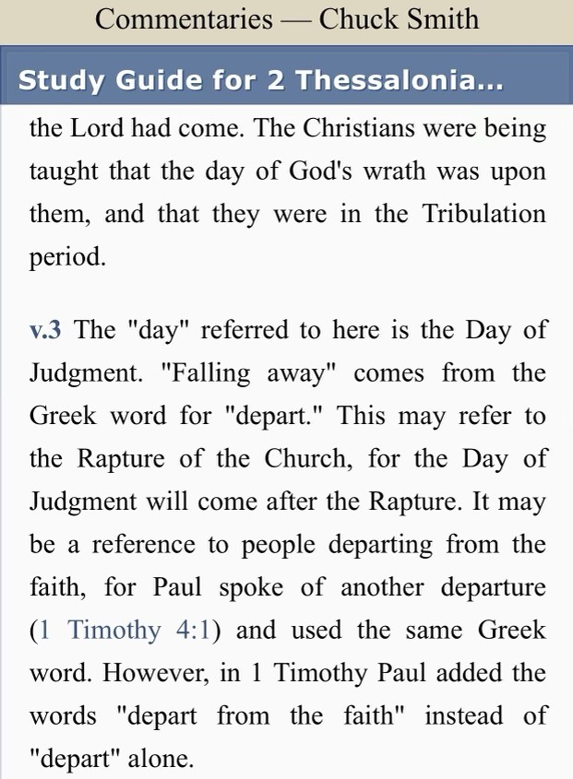

Slide 156
Paul Lee Tan
Paul Lee Tan, The Interpretation of Prophecy (Dallas, TX: Paul Lee Tan Prophetic Ministries, 2015; reprint, Dallas, TX: Paul Lee Tan Prophetic Ministries, 2015). 341.
“What precisely does Paul mean when he says that ‘the falling away’ (2:3) must come before the tribulation? The definite article ‘the’ denotes that this will be a definitive event, an event distinct from the appearance of the Man of Sin. The Greek word for ‘falling away’, taken by itself, does not mean religious apostasy or defection. Neither does the word mean ‘to fall,’ as the Greeks have another word for that. The best translation of the word is ‘to depart.’ The apostle Paul refers here to a definitive event, which he calls ‘the departure,’ and which will occur just before the start of the tribulation. This is the rapture of the church.”

Slide 157
Paul Lee Tan
Paul Lee Tan, The Interpretation of Prophecy (Dallas, TX: Paul Lee Tan Prophetic Ministries, 2015; reprint, Dallas, TX: Paul Lee Tan Prophetic Ministries, 2015). 341, n. 2.
“The apostle Paul uses this word in 1 Timothy 4:1, ‘some shall depart from the faith.’ The necessity for qualifying the word with the phrase “from the faith“ shows of the word taken by itself has no such connotation.”

Slide 158

Answering Objections to the Physical Departure View
Greek from the Koine period?
Subtraction from the Last Days will be characterized by continual apostasy?
Rapture is passive and apostasy is active?
Incongruence with verse 1?
Paul is re-assuring the Thessalonians that they had not already missed the rapture; therefore, it would be incomprehensible to read, “the rapture cannot have happened unless the rapture happens first”

Slide 159
Answering Objections to the Physical Departure View
Greek from the Koine period?
Subtraction from the Last Days will be characterized by continual apostasy?
Rapture is passive and apostasy is active?
Incongruence with verse 1?
Paul is re-assuring the Thessalonians that they had not already missed the rapture; therefore, it would be incomprehensible to read, “the rapture cannot have happened unless the rapture happens first”

Slide 160
H. Wayne House
"Apostasia in 2 Thessalonians 2:3: Apostasy of Rapture?," in When the Trumpet Sounds: Today's Foremost Authorities Speak out on End-Time Controversies, ed. Thomas Ice and Timothy Demy (Eugene, OR: Harvest House, 1995), 273.
“The noun form allows for apostasia as a simple departure in the classical period, proved by examples from Liddell and Scott...If one says that this is not important because the meaning is only classical or ancient and thus lost its meaning by the time of the New Testament, then I may turn to the same root meaning of apostasia in the patristic era immediately following the New Testament period, as indicated in the definitions for the noun form in Lampe's Patristic Greek Lexicon. Although the noun used in the sense of spatial departure is not the normal meaning…during New Testament times, the word is found with this meaning in time periods before and after the New Testament era, and it is likely to have been understood this way at least sometimes.”

Slide 161
Answering Objections to the Physical Departure View
Greek from the Koine period?
Subtraction from the Last Days will be characterized by continual apostasy?
Rapture is passive and apostasy is active?
Incongruence with verse 1?
Paul is re-assuring the Thessalonians that they had not already missed the rapture; therefore, it would be incomprehensible to read, “the rapture cannot have happened unless the rapture happens first”

Slide 162
Order of Paul’s Letters
Galatians (A.D. 49)
1‒2 Thessalonians (A.D. 51)
1‒2 Corinthians (A.D. 56)
Romans (A.D. 57)
Ephesians, Colossians, Philemon, Philippians (A.D. 60‒62)
1 Timothy, Titus (A.D. 62‒66)
2 Timothy (A.D. 67)

Slide 163
1 Timothy 4:1
“But the Spirit explicitly says that in later times some will fall away [aphistēmi] from the faith, paying attention to deceitful spirits and doctrines of demons.”

Slide 164
2 Thessalonians 2:3
“Let no one in any way deceive you, for it will not come unless the apostasy [apostasia] comes first [prōton], and the man of lawlessness is revealed, the son of destruction.”

Slide 165
Answering Objections to the Physical Departure View
Greek from the Koine period?
Subtraction from the Last Days will be characterized by continual apostasy?
Rapture is passive and apostasy is active?
Incongruence with verse 1?
Paul is re-assuring the Thessalonians that they had not already missed the rapture; therefore, it would be incomprehensible to read, “the rapture cannot have happened unless the rapture happens first”

Slide 166
Mark Hitchcock
Mark and Jeff Kinley Hitchcock, The Coming Apostasy: Exposing the Sabatoge of Christianity from Within (Carol Stream, Ill: Tyndale, 2017), 191
“Since the word apostasia means ‘departure,’ some have understood the term ‘the apostasy’ to be the physical departure of the church itself—that is, the Rapture, since the Rapture will be a physical departure of believers from the earth. If this view were correct, it would definitely place the Rapture before the Tribulation, which would be a slam dunk for the pre-Tribulation Rapture position. While this is attractive to pretribulationalists, there are six main reasons to reject a physical departure as the meaning of apostasia in this context:”

Slide 167
Mark Hitchcock
Mark and Jeff Kinley Hitchcock, The Coming Apostasy: Exposing the Sabatoge of Christianity from Within (Carol Stream, Ill: Tyndale, 2017), 191
“(1) In classical Greek, hē apostasia (‘the apostasy’) was used to denote a political or military rebellion. (2) In the Septuagint (the Greek translation of the Old Testament), this term was used of rebellion against God (see Joshua 22:22; Jeremiah 2:19). (3) In 2 Maccabees 2:15 (a noncanonical book written in the time between the Old and New Testaments), it is used of apostasy to paganism. (4) In Acts 21:21, the only other use of the noun in the New Testament, it refers to apostasy or spiritual departure from Moses.”

Slide 168
Mark Hitchcock
Mark and Jeff Kinley Hitchcock, The Coming Apostasy: Exposing the Sabatoge of Christianity from Within (Carol Stream, Ill: Tyndale, 2017), 191
“(5) The Rapture is not an act of departure by the saints; the saints are passive not active participants. (6) In 2 Thessalonians 2:1, Paul refers to the Rapture as ‘our gathering together to Him.’ It seems strange to use this unlikely term (‘the apostasy’) for the same thing in the immediate context. (These six points are from D. Edmond Hiebert, 1 & 2 Thessalonians [Chicago: Moody Press, 1971], 331.) For these reasons, most expositors have understood ‘the rebellion’ (apostasy) not as the physical departure of the church at the Rapture but rather as doctrinal, theological, and moral departure from the truth.”

Slide 169
D. Edmond Hiebert
The Thessalonian Epistles. Chicago: Moody Press, 1971. Page 306
"Nowhere else does the Scripture speak of the rapture as 'the departure.' A departure denotes an act on the part of the individual or company departing. But the rapture is not an act of departure on the part of the saints. In the rapture the church is passive, not active. At the rapture, the church is 'caught up' or 'snatched away,' an event wherein the Lord acts to transport believers from earth into His presence (1 Thess. 4:16-17). Everything that takes place with the believers at the rapture is initiated by the Lord and done by Him.”

Slide 170

Matthew 4:4
“But He answered and said, “It is written, ‘Man shall not live on bread alone, but on every word that proceeds out of the mouth of God.’”

Slide 171
Matthew 5:18
“For truly I say to you, until heaven and earth pass away, not the smallest letter or stroke shall pass from the Law until all is accomplished.”

Slide 172
Answering Objections to the Physical Departure View
Greek from the Koine period?
Subtraction from the Last Days will be characterized by continual apostasy?
Rapture is passive and apostasy is active?
Incongruence with verse 1?
Paul is re-assuring the Thessalonians that they had not already missed the rapture; therefore, it would be incomprehensible to read, “the rapture cannot have happened unless the rapture happens first”

Slide 173
2 Thessalonians 2:1
“Now we request you, brethren, with regard to the coming [parousia] of our Lord Jesus Christ and our gathering [episynagōgē] together to Him.”

Slide 174
2 Thessalonians 2:3
“Let no one in any way deceive you, for it will not come unless the apostasy [apostasia] comes first, and the man of lawlessness is revealed, the son of destruction.”

Slide 175

D. Edmond Hiebert
The Thessalonian Epistles. Chicago: Moody Press, 1971. Page 306
"Paul has just referred to the rapture as 'our gathering together unto him' (v. 1); why then should he now use this unlikely term to mean the same thing?”

Slide 176
Paul’s Various Rapture Terms
parousia | 2 Thess. 2:1
episynagōgē | 2 Thess. 2:1
apokalypsis | 1 Cor. 1:7
epiphaneia | Titus 2:13
rhyomai | 1 Thess. 1:10
harpazō | 1 Thess. 4:17
apostasia | 2 Thess. 2:3a

Slide 177
Answering Objections to the Physical Departure View
Greek from the Koine period?
Subtraction from the Last Days will be characterized by continual apostasy?
Rapture is passive and apostasy is active?
Incongruence with verse 1?
Paul is re-assuring the Thessalonians that they had not already missed the rapture; therefore, it would be incomprehensible to read, “the rapture cannot have happened unless the rapture happens first”

Slide 178
2 Thessalonians 2:2 (NKJV)
“not to be soon shaken in mind or troubled, either by spirit or by word or by letter, as if from us, as though the day of Christ had come.”

Slide 179
2 Thessalonians 2:2 (NASB)
“that you not be quickly shaken from your composure or be disturbed either by a spirit or a message or a letter as if from us, to the effect that the day of the Lord has come.”

Slide 180
2 Thessalonians 2:1-12
Problem (2:1-2)
Prerequisites for the Day of the Lord (2:3-12)
  The apostasy (2:3a)
  Advent of the lawless one (2:3b-4)
  Removal of the restrainer (2:5-7)
  Destruction of the lawless one (2:8-9)
  Destruction of lawless one’s followers (2:10-12)

Slide 181
2 Thessalonians 2:1-12
Problem (2:1-2)
Prerequisites for the Day of the Lord (2:3-12)
  The apostasy (2:3a)
  Advent of the lawless one (2:3b-4)
  Removal of the restrainer (2:5-7)
  Destruction of the lawless one (2:8-9)
  Destruction of lawless one’s followers (2:10-12)

Slide 182
Conclusion

Slide 183
10 Reasons Favoring Physical Departure
There have always been doctrinal departures
2 Thess. was an early letter
The definite article before apostasia
Noun apostasia can refer to physical departure
Verb aphistēmi can refer to physical departure

Slide 184
10 Reasons Favoring Physical Departure
Extended context favors physical departure
Immediate context favors physical departure
2 Thess. 2:2 is a review course
Early Bible translations favor physical departure
Physical departure is held by credible scholars

Slide 186
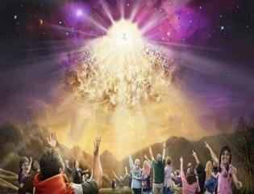
Titus 2:13
“Looking for the blessed hope and the appearing of the glory of our great God and Savior, Christ Jesus.”

Slide 187
2 Thessalonians 2:1-12
Problem (2:1-2)
Prerequisites for the Day of the Lord (2:3-12)
  The apostasy (2:3a)
  Advent of the lawless one (2:3b-4)
  Removal of the restrainer (2:5-7)
  Destruction of the lawless one (2:8-9)
  Destruction of lawless one’s followers (2:10-12)

