Slide 1
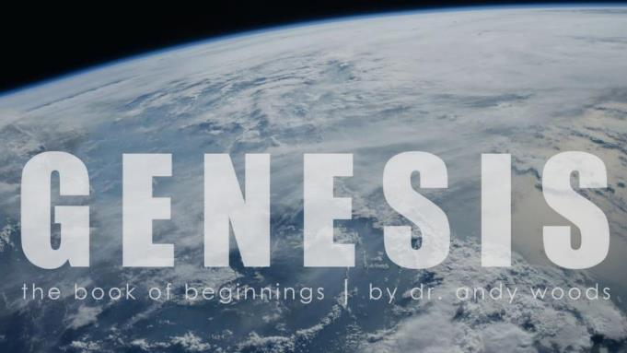
Genesis 12‒50
Israel’s Birth & Preservation

Slide 2
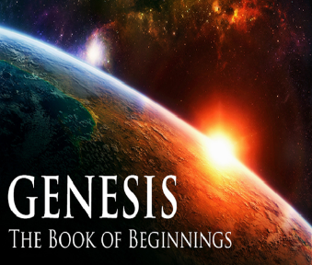
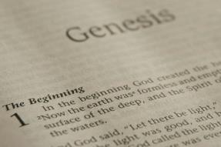
GENESIS STRUCTURE
Genesis 12-50 (four people)
Abraham (12:1–25:11)
Isaac (25:12–26:35)
Jacob (27–36)
Joseph (37–50)

Slide 3
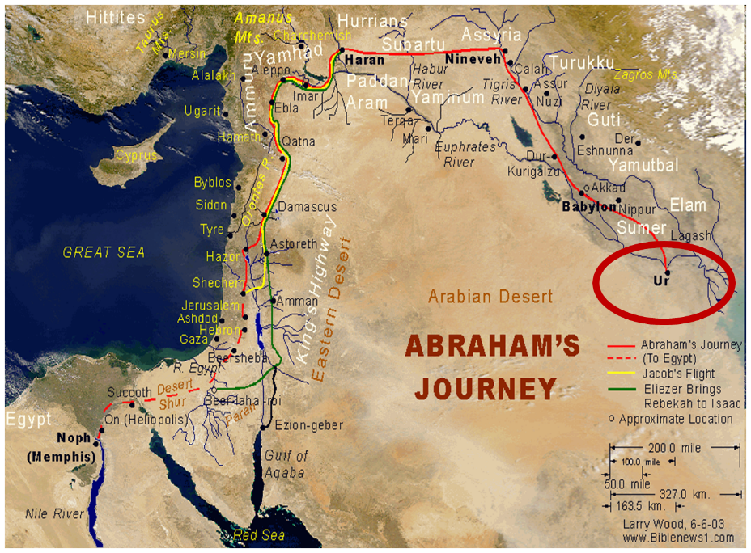

Slide 4
Genesis 32:1‒33:17 Jacob and Esau
Mahanaim (32:1-2)
Jacob’s Message to Esau (32:3-21)
Peniel (32:22-32)
Jacob’s Meeting with Esau (33:1-17)

Slide 5
III. Genesis 32:22-32 Peniel
Family sent away (22-23)
Jacob wrestles with the Angel of the Lord (24)
Jacob’s thigh dislocated (25)
Struggle for blessing (26-28)
Angel of the Lord’s identity (29)
Results of the encounter (30-32)

Slide 6
III. Genesis 32:22-32 Peniel
Family sent away (22-23)
Jacob wrestles with the Angel of the Lord (24)
Jacob’s thigh dislocated (25)
Struggle for blessing (26-28)
Angel of the Lord’s identity (29)
Results of the encounter (30-32)

Slide 7
Genesis 32:22-23 Family Sent Away
Timing (22a)
Family (22b)
Jabbok crossing (22c)
New encampment (23)

Slide 8
Genesis 32:22-23 Family Sent Away
Timing (22a)
Family (22b)
Jabbok crossing (22c)
New encampment (23)

Slide 9
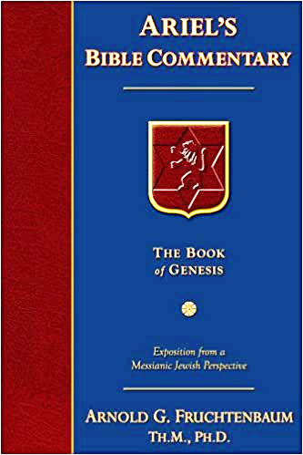
Dr. Arnold G. Fruchtenbaum
The Book of Genesis, 481
“In the previous section, in the Hebrew text, the word face appeared five times: that I may cover his face, to appease him; gifts that go before my face, gifts that precede me; when I see his face, when I face him; he will raise my face, he will forgive me; and the gifts went on ahead of his face, went ahead of him. This sets the stage for this next division about Peniel, the Face of God.”

Slide 10
Genesis 32:22-23 Family Sent Away
Timing (22a)
Family (22b)
Jabbok crossing (22c)
New encampment (23)

Slide 12
Genesis 32:22-23 Family Sent Away
Timing (22a)
Family (22b)
Jabbok crossing (22c)
New encampment (23)

Slide 13
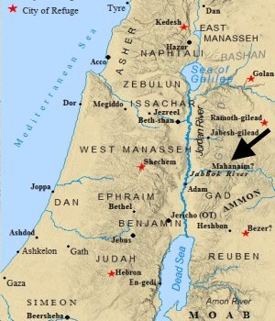

Slide 14
Charles Ryrie
The Ryrie Study Bible, p. 43
“Genesis 32:22 (RSB:NASB1995U): 32:22 “The Jabbok is a tributary of the Jordan, flowing into it about 24 mi. (38 km) N of the Dead Sea. The name is related to the Hebrew word for ‘wrestled’ (see v. 24).”

Slide 15
Genesis 32:22-23 Family Sent Away
Timing (22a)
Family (22b)
Jabbok crossing (22c)
New encampment (23)

Slide 17
III. Genesis 32:22-32 Peniel
Family sent away (22-23)
Jacob wrestles with the Angel of the Lord (24)
Jacob’s thigh dislocated (25)
Struggle for blessing (26-28)
Angel of the Lord’s identity (29)
Results of the encounter (30-32)

Slide 18
Genesis 32:24 Jacob’s Wrestles with the Angel of the Lord
Solitude (24a)
Wrestling (24b)

Slide 19
Genesis 32:24 Jacob’s Wrestles with the Angel of the Lord
Solitude (24a)
Wrestling (24b)

Slide 20
Genesis 32:24 Jacob’s Wrestles with the Angel of the Lord
Solitude (24a)
Wrestling (24b)

Slide 21
Dr. Arnold G. Fruchtenbaum
The Book of Genesis, 482
“In verse 24b is the account of the wrestling: and there wrestled a man with him. The Hebrew word for wrestled is a word play based on the name of the river, which would forever serve as a reminder. The Hebrew word for ‘wrestling’ is found only here and in verse 25 and nowhere else in the Hebrew Bible. The word itself comes from the root avak, which means ‘dust.’ The basic meaning of this word for wrestling is ‘to get dusty in wrestling’ or ‘to get dusty while wrestling.’ Altogether, there are three similar-sounding words in Hebrew: Jacob; Jabbok; and ‘he wrestled,’ yaaveik.”

Slide 22
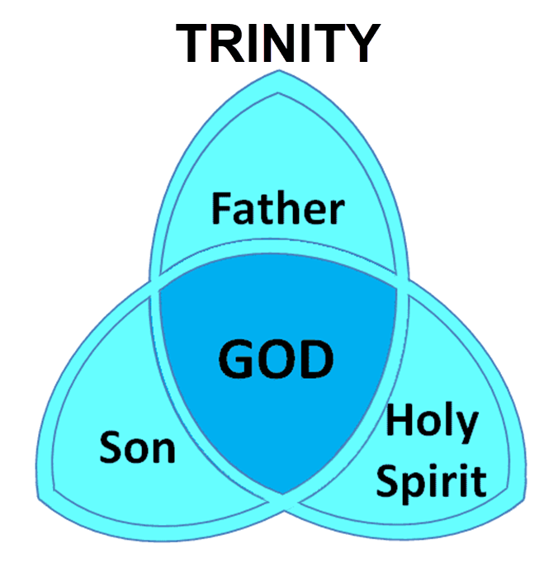

Slide 23
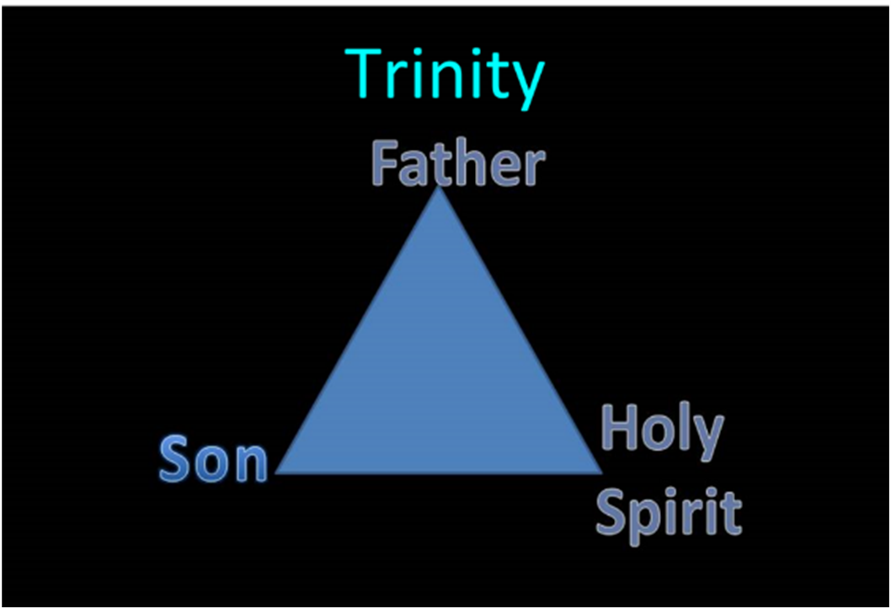

Slide 24
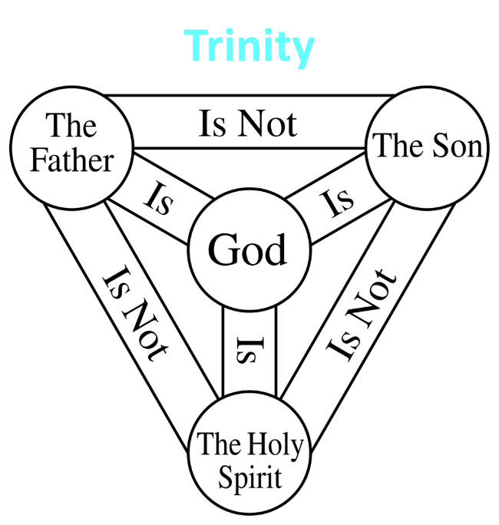

Slide 25
Charles Ryrie
The Ryrie Study Bible, p. 43
“Genesis 32:24 (RSB:NASB1995U): 32:24 “The man who wrestled Jacob is called an angel in Hos. 12:4 and was evidently the preincarnate Christ. Jacob’s wrestling involved agonizing prayer (Hos. 12:4).”

Slide 26
III. Genesis 32:22-32 Peniel
Family sent away (22-23)
Jacob wrestles with the Angel of the Lord (24)
Jacob’s thigh dislocated (25)
Struggle for blessing (26-28)
Angel of the Lord’s identity (29)
Results of the encounter (30-32)

Slide 27
Genesis 32:25 Jacob’s Thigh Dislocated
Situation (25a)
Action (25b)
Result (25c)
Occasion (25d)

Slide 28
Genesis 32:25 Jacob’s Thigh Dislocated
Situation (25a)
Action (25b)
Result (25c)
Occasion (25d)

Slide 29
Evidence of Abrahamic Covenant’s Unconditional Nature
ANE covenant ratification ceremony (Gen 15)
Lack of stated conditions for Israel’s obedience (Gen 15)
Covenant's eternality (Gen 17:7, 13, 19; Ps. 90:2)
Covenant's immutability (Heb 6:13-18; Mal. 3:6)
Trans-generational reaffirmation despite perpetual national disobedience (Jer 31:35-37)
Walvoord, The Millennial Kingdom, 149-52

Slide 30
Genesis 32:25 Jacob’s Thigh Dislocated
Situation (25a)
Action (25b)
Result (25c)
Occasion (25d)

Slide 31
Genesis 32:25 Jacob’s Thigh Dislocated
Situation (25a)
Action (25b)
Result (25c)
Occasion (25d)

Slide 32
Genesis 32:25 Jacob’s Thigh Dislocated
Situation (25a)
Action (25b)
Result (25c)
Occasion (25d)

Slide 33
III. Genesis 32:22-32 Peniel
Family sent away (22-23)
Jacob wrestles with the Angel of the Lord (24)
Jacob’s thigh dislocated (25)
Struggle for blessing (26-28)
Angel of the Lord’s identity (29)
Results of the encounter (30-32)

Slide 34
Genesis 32:26-28 Struggle for Blessing
Angel’s demand (26)
Change of names (27-28)

Slide 35
Genesis 32:26-28 Struggle for Blessing
Angel’s demand (26)
Change of names (27-28)

Slide 36
Genesis 32:26 Angel of the Lord’s Demand
Demand (26a)
Reason (26b)
Jacob’s response (26c)

Slide 37
Genesis 32:26 Angel of the Lord’s Demand
Demand (26a)
Reason (26b)
Jacob’s response (26c)

Slide 38
Genesis 32:26 Angel of the Lord’s Demand
Demand (26a)
Reason (26b)
Jacob’s response (26c)

Slide 39
Genesis 32:26 Angel of the Lord’s Demand
Demand (26a)
Reason (26b)
Jacob’s response (26c)

Slide 40
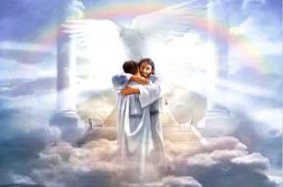
Ephesians 1:3
“Blessed be the God and Father of our Lord Jesus Christ, who has blessed us with every spiritual blessing in the heavenly places in Christ.”

Slide 41
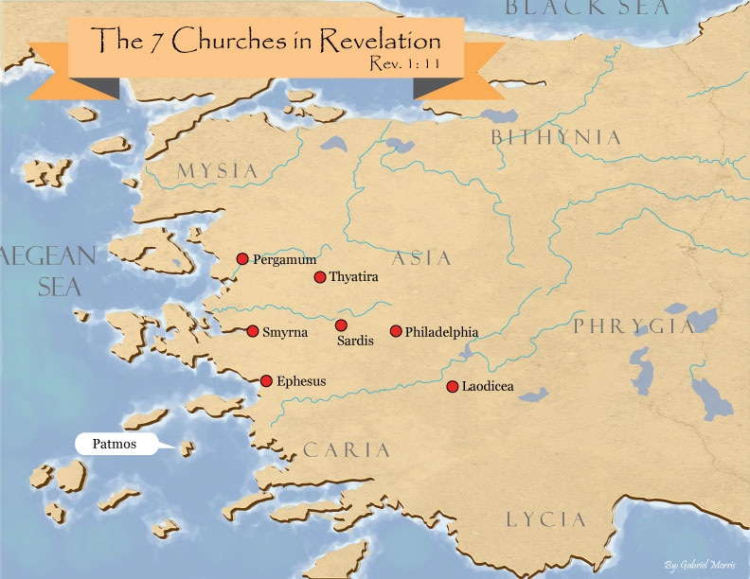

Slide 42
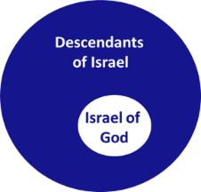
Revelation 2:9
“I know your tribulation and your poverty (but you are rich), and the blasphemy by those who say they are Jews and are not, but are a synagogue of Satan.”

Slide 43
Genesis 32:26-28 Struggle for Blessing
Angel’s demand (26)
Change of names (27-28)

Slide 44
Genesis 32:27-28 Change of Names
Old name (27)
New name (28)

Slide 45
Genesis 32:27-28 Change of Names
Old name (27)
New name (28)

Slide 46
Genesis 32:27-28 Change of Names
Old name (27)
New name (28)

Slide 47
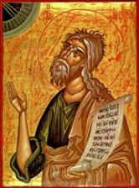
Jeremiah 30:7
“ Alas! for that day is great, There is none like it; And it is the time of Jacob’s distress, But he will be saved from it.”

Slide 48
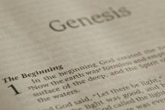
Beginning Themes
Universe Life Man Marriage Evil Clothing | Religion Salvation Language Government Nations Israel
Morris, Genesis Record, 18-20

Slide 50
Dr. Arnold G. Fruchtenbaum
The Book of Genesis, 483
“He answered: Jacob. In verse 28 is the new name: Your name shall be called no more Jacob, but Israel. In Hebrew, it is Yisrael, a combination of two Hebrew words: sarah and el, and it literally means ‘he who strives with God.’ Corollary interpretations include ‘God strives,’ ‘God fights,’ ‘God contends.’ A third alternative is: ‘May God contend.’ However, the basic meaning is this: God has fought for Jacob, now God will fight for Israel. The reason for the change of name was: for you have striven. The Hebrew is used only here and in Hosea 12:3, which speaks of the same event and literally means: ‘You have striven,’ and this is the first part of the name Israel-Sars.”

Slide 51
Dr. Arnold G. Fruchtenbaum
The Book of Genesis, 483
“Furthermore, Jacob has striven with two categories: with God, to gain the blessing; and with men, such as Esau and Laban, and has prevailed. Even after his loss of strength by the dislocated hip, he has still prevailed in that he received the blessing of God. That was what he had striven for; that is what he received.”

Slide 52
Zechariah 14:2-3
² For I will gather all the nations against Jerusalem to battle, and the city will be captured, the houses plundered, the women ravished and half of the city exiled, but the rest of the people will not be cut off from the city. ³ Then the LORD will go forth and fight against those nations, as when He fights on a day of battle.

Slide 53
Genesis 12‒25 Abraham’s Early Journeys
Unconditional promises (Gen. 12:1-3) From Haran to Canaan (Gen. 12:4-5) In Canaan (Gen. 12:6-9) In Egypt (Gen. 12:10-20) Abram and Lot Separate (Gen. 13:1-13) Reaffirmation of Abram’s promises (Gen. 13:14-18) Abram Rescues Lot (14:1-24) Abrahamic Covenant (15:1-21) Hagar & Ishmael (16:1-16) Circumcision (Gen. 17:1-27) | Sodom & Gomorrah (Gen. 18‒19) Abraham & Abimelech (Gen. 20) Isaac’s birth (Gen. 21:1-7) Ishmael’s expulsion (21:8-21) Abraham & Abimelech’s covenant (21:22-34) Abraham sacrifices Isaac (22) Sarah’s death (23) Isaac’s marriage (24) Abraham & Keturah (25:1-6) Abraham’s death (25:7-11)

Slide 54
Matthew 16:18
I also say to you that you are Peter, and upon this rock I will build [oikodomeō] My church; and the gates of Hades will not overpower it.

Slide 56
III. Genesis 32:22-32 Peniel
Family sent away (22-23)
Jacob wrestles with the Angel of the Lord (24)
Jacob’s thigh dislocated (25)
Struggle for blessing (26-28)
Angel of the Lord’s identity (29)
Results of the encounter (30-32)

Slide 57
Genesis 32:29 Angel of the Lord’s Identity
Jacob’s question (29a)
Angel’s answer (29b)
Angel blesses Jacob (29c)

Slide 58
Genesis 32:29 Angel of the Lord’s Identity
Jacob’s question (29a)
Angel’s answer (29b)
Angel blesses Jacob (29c)

Slide 61
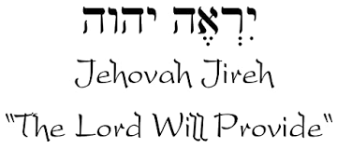

Slide 62
Names for God in Genesis
Elohim (1:1) - Power
Yahweh (2:4) - Relational
El Roi (Gen. 16:13) – Aware
El Olam (21:33) – Eternal
Jehovah Jireh (22:14) - Provision
God Isaac Feared (31:42, 53) - Reverenced

Slide 63
Genesis 32:29 Angel of the Lord’s Identity
Jacob’s question (29a)
Angel’s answer (29b)
Angel blesses Jacob (29c)

Slide 64
Charles Ryrie
The Ryrie Study Bible, p. 43
“Genesis 32:29 (RSB:NASB1995U): 32:29 “Jacob’s question had already been answered in the name bestowed on him, since the el in Israel means ‘god.’”

Slide 65
Dr. Arnold G. Fruchtenbaum
The Book of Genesis, 484
“In verse 29a is the Angel’s identification, beginning with Jacob’s question: Jacob asked him, and said, Tell me, I pray you, your name. However, the Angel answered the question with a question: Why is it that you do ask after my name? The point was: ‘Think on it, and you will know what My Name is.’ And His Name is YHVH. This was very similar to Manoah’s question. Manoah was the father of Samson. When Manoah had an encounter with the Angel of Jehovah, the Angel of God, he asked the same question that Jacob did: What is your name? (Judg. 13:17–18). In that passage the Angel also answered, ‘Why do you seek after My Name?’”

Slide 66
Dr. Arnold G. Fruchtenbaum
The Book of Genesis, 484
“However, in the Judges passage, the Angel did not stop there but added: seeing it is wonderful. Moreover, the Hebrew word for wonderful is pele, one of those words in the Hebrew text used only of God and never used of a man. In this way, the Angel answered Manoah’s question. By combining the two passages, there is the same question on the part of man and the same answer with another similar question on the part of the Angel. The additional answer given by the Angel in Judges indicates this was clearly God Himself. In verse 29b, Jacob received the blessing: And he blessed him there. Hosea 12:4 states: Yea he had power over the angel and prevailed.”

Slide 67
Genesis 32:29 Angel of the Lord’s Identity
Jacob’s question (29a)
Angel’s answer (29b)
Angel blesses Jacob (29c)

Slide 68
Ephesians 1:3
“Blessed be the God and Father of our Lord Jesus Christ, who has blessed us with every spiritual blessing in the heavenly places in Christ.”

Slide 70
Revelation 2:9
“I know your tribulation and your poverty (but you are rich), and the blasphemy by those who say they are Jews and are not, but are a synagogue of Satan.”

Slide 71
III. Genesis 32:22-32 Peniel
Family sent away (22-23)
Jacob wrestles with the Angel of the Lord (24)
Jacob’s thigh dislocated (25)
Struggle for blessing (26-28)
Angel of the Lord’s identity (29)
Results of the encounter (30-32)

Slide 72
Genesis 32:30-32 Results of the Encounter
Naming of the place (30)
Jacob’s limp (31)
Source of Hebrew tradition (32)

Slide 73
Genesis 32:30-32 Results of the Encounter
Naming of the place (30)
Jacob’s limp (31)
Source of Hebrew tradition (32)

Slide 74
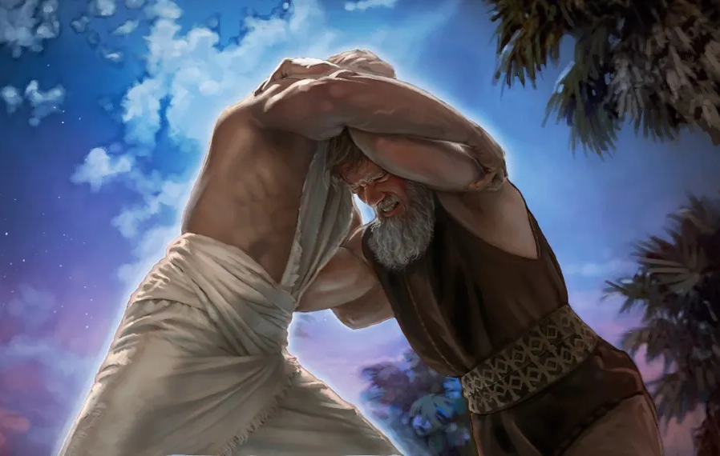
Charles Ryrie
The Ryrie Study Bible, p. 43
“Genesis 32:30 (RSB:NASB1995U): 32:30 “Peniel means ‘the face of God.’”

Slide 78
Three Tenses of Salvation
Phase | Justification | Sanctification | Glorification
Tense | Past | Present | Future
Saved from sin’s: | Penalty | Power | Presence
Scripture | Eph 2:8-9; Titus 3:5 | Philip 2:12 | Rom 5:10

Slide 79
Genesis 32:30-32 Results of the Encounter
Naming of the place (30)
Jacob’s limp (31)
Source of Hebrew tradition (32)

Slide 80
Genesis 32:30-32 Results of the Encounter
Naming of the place (30)
Jacob’s limp (31)
Source of Hebrew tradition (32)

Slide 81
Dr. Arnold G. Fruchtenbaum
The Book of Genesis, 484-85
“The account ends in verse 32 spelling out that this was the source of a Jewish eating tradition: Therefore, the children of Israel eat not the sinew of the hip which is upon the hollow of the thigh, unto this day. This refers to the sciatic nerve; and so, unto this day, the arteries and the tendons were removed before the meat was ritually prepared for Jewish consumption. However, this practice eventually was not incorporated into rabbinic Jewish law, and it is not considered part of kosher law today. However, this was the original practice, and the reason given for this practice was: because he touched the hollow of Jacob’s thigh in the sinew of the hip.”

Slide 82
Charles Ryrie
The Ryrie Study Bible, p. 44
“Genesis 32:30 (RSB:NASB1995U): 32:30 “Though the practice is not forbidden in Scripture, Jews have traditionally avoided eating the sciatic nerve (sinew) of the hind quarter of animals.”

Slide 83
Beginning Themes
Universe Life Man Marriage Evil Clothing | Religion Salvation Language Government Nations Israel
Morris, Genesis Record, 18-20

Slide 84
Conclusion

Slide 85
III. Genesis 32:22-32 Peniel
Family sent away (22-23)
Jacob wrestles with the Angel of the Lord (24)
Jacob’s thigh dislocated (25)
Struggle for blessing (26-28)
Angel of the Lord’s identity (29)
Results of the encounter (30-32)

Slide 86
²⁴ The Lord bless you, and keep you; ²⁵ The Lord make His face shine on you, And be gracious to you; ²⁶ The Lord lift up His countenance on you, And give you peace.
Numbers 6:24–26 (NASB95)

