Slide 1


Dr. Andy Woods
Senior Pastor – Sugar Land Bible Church
President – Chafer Theological Seminary

Slide 2

Introductory Matters
Authorship: Paul
Audience: Thessalonians
Place of writing: Corinth
Date: AD 51
Occasion: Forgery
Structure: 3 Parts
Message: working & waiting
Purpose: Correction of orthodoxy & orthopraxy

Slide 3
Structure
1 – Commendation
2 – Correction
3 – Consequences

Slide 4
Commendation (1)
Reminder of grace (1:1-2)
Thanksgiving (1:3-4)
Kingdom (1:5)
Destiny of their persecutors (1:6-9)
Our contrasting fate (10)
Prayer for continued progress (1:11-12)

Slide 5
Dispensational Theology is a System of Theology
Traditional-normative dispensational theology is a system that embodies three essential, fundamental concepts called the sine qua non (lit. “without which is not”):
The consistent use of a plain, normal, literal, grammatical-historical method of interpretation;
Which reveals that the Church is distinct from Israel;
God’s overall purpose is to bring glory to Himself (Eph. 1:6, 12, 14).
Dr. Charles Ryrie, Dispensationalism, pp. 38-41

Slide 6
Dispensational Theology: Doxological Purpose
God’s ultimate purpose for the ages is to glorify Himself. Scripture is not human-centered, as though salvation were the principle point, but God-centered, because His glory is at the center.
The glory of God is the primary principle that unifies all dispensations, the program of salvation being just one of the means by which God glorifies Himself. Each successive revelation of God’s plan for the ages, as well as His dealing with the elect, non-elect, angels, and nations all manifest His glory.
Dictionary of Premillennial Theology, Charles Ryrie, p. 94

Slide 7
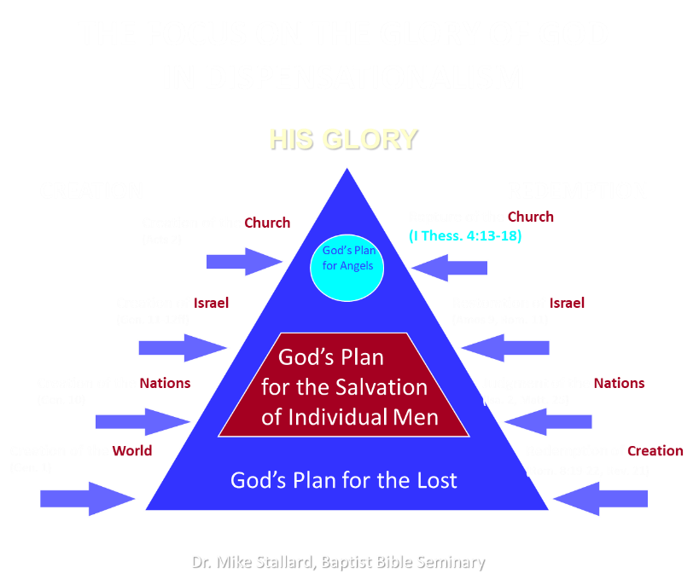

Slide 8


Galatians 3:3
“Are you so foolish? Having begun by the Spirit, are you now being perfected by the flesh?”

Slide 9
Structure
1 – Commendation
2 – Correction
3 – Consequences

Slide 10
2 Thessalonians 2:1-12
Problem (2:1-2)
Prerequisites for the Day of the Lord (2:3-12)
  The apostasy (2:3a)
  Advent of the lawless one (2:3b-4)
  Removal of the restrainer (2:5-7)
  Destruction of the lawless one (2:8-9)
  Destruction of lawless one’s followers (2:10-12)

Slide 11
2 Thessalonians 2:1-12
Problem (2:1-2)
Prerequisites for the Day of the Lord (2:3-12)
  The apostasy (2:3a)
  Advent of the lawless one (2:3b-4)
  Removal of the restrainer (2:5-7)
  Destruction of the lawless one (2:8-9)
  Destruction of lawless one’s followers (2:10-12)

Slide 12
Commendation (1)
Reminder of grace (1:1-2)
Thanksgiving (1:3-4)
Kingdom (1:5)
Destiny of their persecutors (1:6-9)
Our contrasting fate (10)
Prayer for continued progress (1:11-12)

Slide 13
RAPTURE DISTINCT FROM SECOND ADVENT
RAPTURE (1 Thess 4:13-17; 1 Cor 15:51-57) | SECOND COMING (Rev 19:11-16)
Christ comes in the air (1 Thess 4:16) | Christ comes to the earth (Zech 14:4)
For His saints (1 Thess 4:15-17) | With His saints (Rev 19:14)
Blessing (1 Thess 4:18) | Judgment (Rev 19:15)
Effects only believers (1 Thess 4:16) | Effects both believers and unbelievers (Rev 19:15)
Invisible (1 Thess 4:16) | Visible to all (Rev 1:7)
Announced only by an archangel (1 Thess 4:16) | Involves myriads of angels (Jude 14)
Resurrection (1 Cor 15: 51) | No resurrection
Rescue of the Church (1 Thess 1:10) | Rescue of Israel (Matt 23:37-39)

Slide 14


1 Thessalonians 1:10
“and to wait for His Son from heaven, whom He raised from the dead, that is Jesus, who rescues (rhyomai) us from (ek) the wrath (orgē) to come.”

Slide 15

1 Thessalonians 4:13-18
¹³ "But we do not want you to be uninformed, brethren, about those who are asleep, so that you will not grieve as do the rest who have no hope. ¹⁴ For if we believe that Jesus died and rose again, even so God will bring with Him those who have fallen asleep in Jesus. ¹⁵ For this we say to you by the word of the Lord, that we who are alive and remain until the coming of the Lord, will not precede those who have fallen asleep. ¹⁶ For the Lord Himself will descend from . . .

Slide 16
1 Thessalonians 4:13-18
. . .heaven with a shout, with the voice of the archangel and with the trumpet of God, and the dead in Christ will rise first. ¹⁷ Then we who are alive and remain will be caught up together with them in the clouds to meet the Lord in the air, and so we shall always be with the Lord. ¹⁸ Therefore comfort one another with these words."

Slide 17

Matthew 23:37-39
³⁷ “Jerusalem, Jerusalem, who kills the prophets and stones those who are sent to her! How often I wanted to gather [episynagō] your children together, the way a hen gathers [episynagō] her chicks under her wings, and you were unwilling. ³⁸ Behold, your house is being left to you desolate! ³⁹ For I say to you, from now on you will not see Me until you say, ‘Blessed is He who comes in the name of the Lord!’”

Slide 18
Matthew 24:31
“And He will send forth His angels with a great trumpet and they will gather together [episynagō] His elect from the four winds, from one end of the sky to the other.”

Slide 19

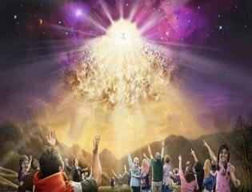

Titus 2:13
“Looking for the blessed hope and the appearing of the glory of our great God and Savior, Christ Jesus.”

Slide 20
1 Thessalonians 4:13-18
. . .heaven with a shout, with the voice of the archangel and with the trumpet of God, and the dead in Christ will rise first. ¹⁷ Then we who are alive and remain will be caught up together with them in the clouds to meet the Lord in the air, and so we shall always be with the Lord. ¹⁸ Therefore comfort one another with these words."

Slide 21


Slide 22

Daniel 9:27
“And he will make a firm covenant with the many for one week, but in the middle of the week he will put a stop to sacrifice and grain offering; and on the wing of abominations will come one who makes desolate, even until a complete destruction, one that is decreed, is poured out on the one who makes desolate.”

Slide 23


Slide 24


Slide 25
1 Thessalonians 1:10
“and to wait for His Son from heaven, whom He raised from the dead, that is Jesus, who rescues (rhyomai) us from (ek) the wrath (orgē) to come.”

Slide 26
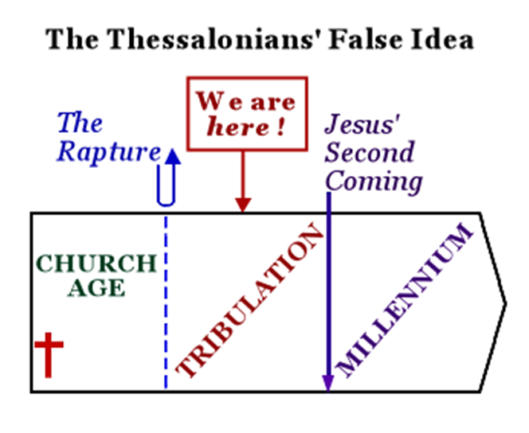
Constable’s 2 Thessalonians Online Notes, 13

Slide 27
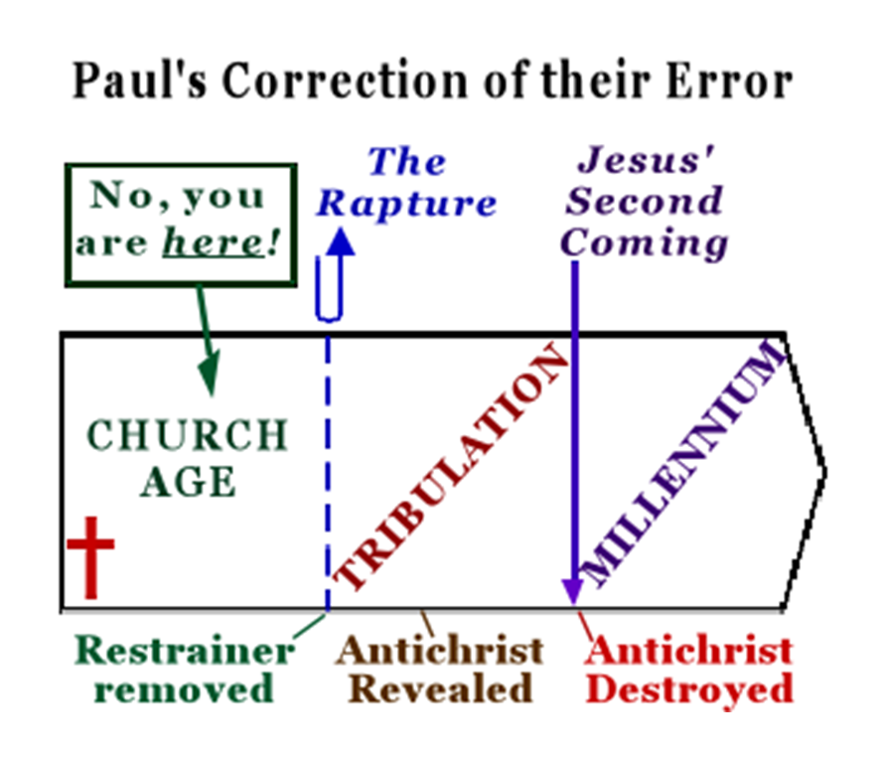
Constable’s 2 Thessalonians Online Notes, 13

Slide 28
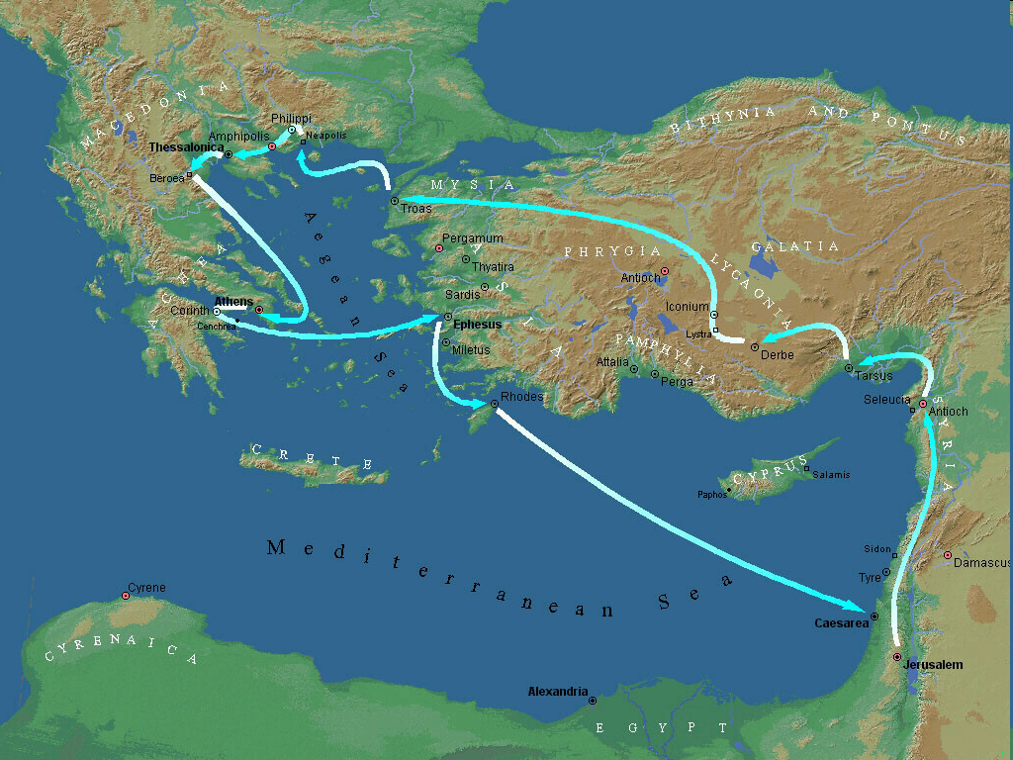
Second Missionary Journey

Slide 29
1 Thessalonians 4:13-18
¹³ "But we do not want you to be uninformed, brethren, about those who are asleep, so that you will not grieve as do the rest who have no hope. ¹⁴ For if we believe that Jesus died and rose again, even so God will bring with Him those who have fallen asleep in Jesus. ¹⁵ For this we say to you by the word of the Lord, that we who are alive and remain until the coming of the Lord, will not precede those who have fallen asleep. ¹⁶ For the Lord Himself will descend from . . .

Slide 30
Order of Paul’s Letters
Galatians (A.D. 49)
1‒2 Thessalonians (A.D. 51)
1‒2 Corinthians (A.D. 56)
Romans (A.D. 57)
Ephesians, Colossians, Philemon, Philippians (A.D. 60‒62)
1 Timothy, Titus (A.D. 62‒66)
2 Timothy (A.D. 67)

Slide 31
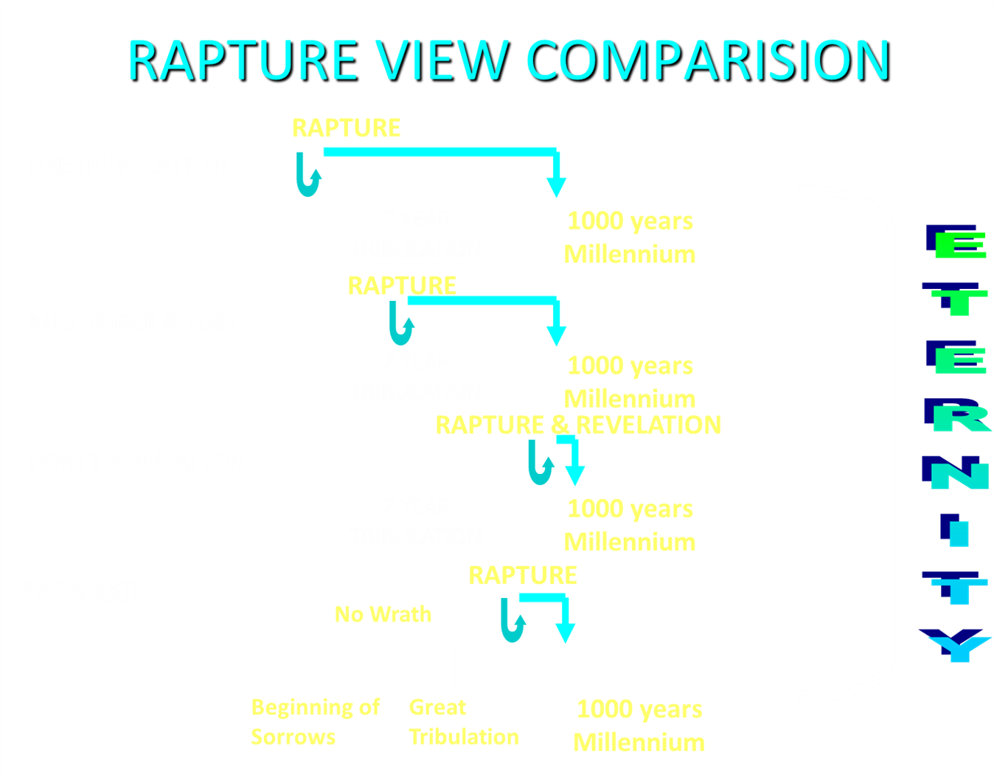

Slide 32
2 Thessalonians 2:1-12
Problem (2:1-2)
Prerequisites for the Day of the Lord (2:3-12)
  The apostasy (2:3a)
  Advent of the lawless one (2:3b-4)
  Removal of the restrainer (2:5-7)
  Destruction of the lawless one (2:8-9)
  Destruction of lawless one’s followers (2:10-12)

Slide 33
2 Thessalonians 2:1-12
Problem (2:1-2)
Prerequisites for the Day of the Lord (2:3-12)
  The apostasy (2:3a)
  Advent of the lawless one (2:3b-4)
  Removal of the restrainer (2:5-7)
  Destruction of the lawless one (2:8-9)
  Destruction of lawless one’s followers (2:10-12)

Slide 34
2 Thessalonians 2:1-12
Problem (2:1-2)
Prerequisites for the Day of the Lord (2:3-12)
  The apostasy (2:3a)
  Advent of the lawless one (2:3b-4)
  Removal of the restrainer (2:5-7)
  Destruction of the lawless one (2:8-9)
  Destruction of lawless one’s followers (2:10-12)

Slide 35
2 Thessalonians 2:1-12
Problem (2:1-2)
Prerequisites for the Day of the Lord (2:3-12)
  The apostasy (2:3a)
  Advent of the lawless one (2:3b-4)
  Removal of the restrainer (2:5-7)
  Destruction of the lawless one (2:8-9)
  Destruction of lawless one’s followers (2:10-12)

Slide 36
2 Thessalonians 2:1-12
Problem (2:1-2)
Prerequisites for the Day of the Lord (2:3-12)
  The apostasy (2:3a)
  Advent of the lawless one (2:3b-4)
  Removal of the restrainer (2:5-7)
  Destruction of the lawless one (2:8-9)
  Destruction of lawless one’s followers (2:10-12)

Slide 37
2 Thessalonians 2:1-12
Problem (2:1-2)
Prerequisites for the Day of the Lord (2:3-12)
  The apostasy (2:3a)
  Advent of the lawless one (2:3b-4)
  Removal of the restrainer (2:5-7)
  Destruction of the lawless one (2:8-9)
  Destruction of lawless one’s followers (2:10-12)

Slide 38
Conclusion

Slide 39
Commendation (1)
Reminder of grace (1:1-2)
Thanksgiving (1:3-4)
Kingdom (1:5)
Destiny of their persecutors (1:6-9)
Our contrasting fate (10)
Prayer for continued progress (1:11-12)

Slide 40
2 Thessalonians 2:1-12
Problem (2:1-2)
Prerequisites for the Day of the Lord (2:3-12)
  The apostasy (2:3a)
  Advent of the lawless one (2:3b-4)
  Removal of the restrainer (2:5-7)
  Destruction of the lawless one (2:8-9)
  Destruction of lawless one’s followers (2:10-12)

Slide 41
2 Thessalonians 2:1-12
Problem (2:1-2)
Prerequisites for the Day of the Lord (2:3-12)
  The apostasy (2:3a)
  Advent of the lawless one (2:3b-4)
  Removal of the restrainer (2:5-7)
  Destruction of the lawless one (2:8-9)
  Destruction of lawless one’s followers (2:10-12)

