Slide 1
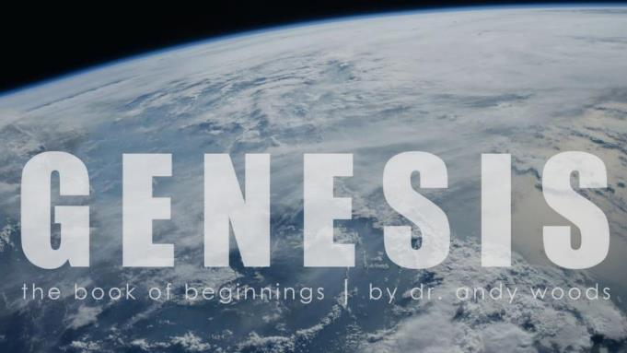
Genesis 12‒50
Israel’s Birth & Preservation

Slide 2
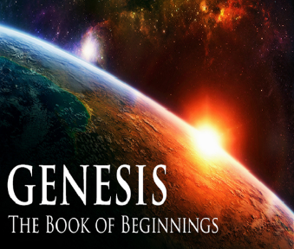
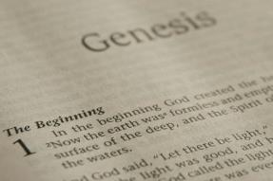
GENESIS STRUCTURE
Genesis 12-50 (four people)
Abraham (12:1–25:11)
Isaac (25:12–26:35)
Jacob (27–36)
Joseph (37–50)

Slide 3
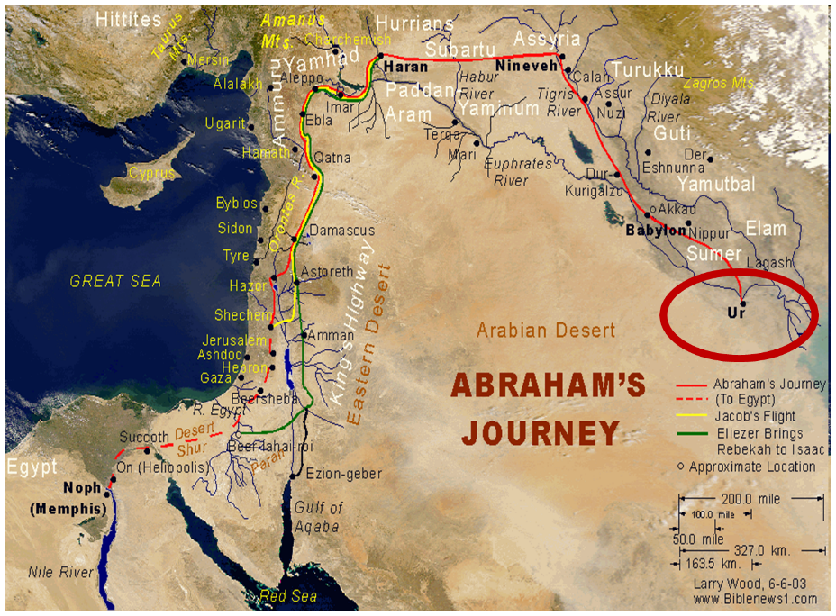

Slide 4
Genesis 32:1‒33:17 Jacob and Esau
Mahanaim (32:1-2)
Jacob’s Message to Esau (32:3-21)
Peniel (32:22-32)
Jacob’s Meeting with Esau (33:1-17)

Slide 5
II. Genesis 32:3-21 Jacob’s Response
Messengers sent to Esau (3-6)
Jacob’s response (7-12)
Offer of appeasement (13-16)
Instructions (17-20a)
Jacob’s desire to appease Esau (20b)
Concluding circumstances (21)

Slide 6
Genesis 32:13-16 Offer of Appeasement
Setting aside (13)
Enumerated (14-15)
Division (16)

Slide 7
Genesis 32:13-16 Offer of Appeasement
Setting aside (13)
Enumerated (14-15)
Division (16)

Slide 8
Genesis 32:13-16 Offer of Appeasement
Setting aside (13)
Enumerated (14-15)
Division (16)

Slide 9
Genesis 32:14-15 Enumerated
Goats (14a)
Rams (14b)
Camels (15a)
Cows (15b)
Bulls (15c)
Donkeys (15d)

Slide 10
Genesis 32:14-15 Enumerated
Goats (14a)
Rams (14b)
Camels (15a)
Cows (15b)
Bulls (15c)
Donkeys (15d)

Slide 11
Genesis 32:14-15 Enumerated
Goats (14a)
Rams (14b)
Camels (15a)
Cows (15b)
Bulls (15c)
Donkeys (15d)

Slide 12
Genesis 32:14-15 Enumerated
Goats (14a)
Rams (14b)
Camels (15a)
Cows (15b)
Bulls (15c)
Donkeys (15d)

Slide 13
Genesis 32:14-15 Enumerated
Goats (14a)
Rams (14b)
Camels (15a)
Cows (15b)
Bulls (15c)
Donkeys (15d)

Slide 14
Genesis 32:14-15 Enumerated
Goats (14a)
Rams (14b)
Camels (15a)
Cows (15b)
Bulls (15c)
Donkeys (15d)

Slide 15
Genesis 32:14-15 Enumerated
Goats (14a)
Rams (14b)
Camels (15a)
Cows (15b)
Bulls (15c)
Donkeys (15d)

Slide 16
8 New Promises Genesis 12:1-3
Land (Gen. 12:1b)
Great nation (Gen. 12:2a)
Personal blessing (Gen. 12:2b)
Great name (Gen. 12:2c)
Blessing to others (Gen. 12:2d)
Blessing to blessers (Gen. 12:3a)
Cursing to cursers (Gen. 12:3b)
Blessing to the world (Gen. 12:3c)

Slide 17
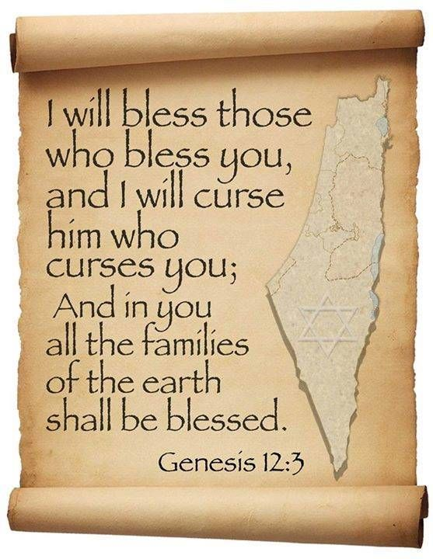
Genesis 12:2
“And I will make you a great nation, And I will bless you, And make your name great; And so you shall be a blessing.”

Slide 18
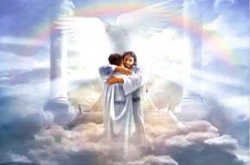
Ephesians 1:3
“Blessed be the God and Father of our Lord Jesus Christ, who has blessed us with every spiritual blessing in the heavenly places in Christ.”

Slide 19
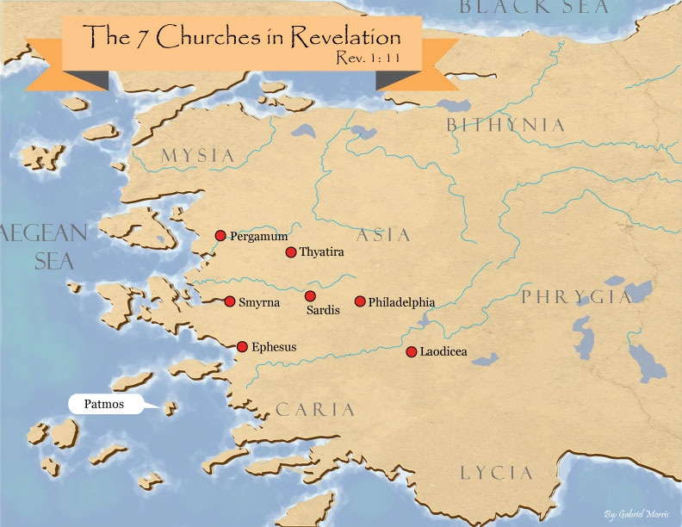

Slide 20
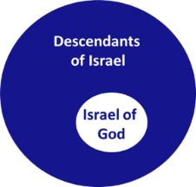
Revelation 2:9
“I know your tribulation and your poverty (but you are rich), and the blasphemy by those who say they are Jews and are not, but are a synagogue of Satan.”

Slide 21
Genesis 32:13-16 Offer of Appeasement
Setting aside (13)
Enumerated (14-15)
Division (16)

Slide 22
II. Genesis 32:3-21 Jacob’s Response
Messengers sent to Esau (3-6)
Jacob’s response (7-12)
Offer of appeasement (13-16)
Instructions (17-20a)
Jacob’s desire to appease Esau (20b)
Concluding circumstances (21)

Slide 23
Genesis 32:17-20a Jacob’s Response
1st group (17-18)
Remaining 4 groups (19-20a)

Slide 24
Genesis 32:17-20a Jacob’s Response
1st group (17-18)
Remaining 4 groups (19-20a)

Slide 25
Genesis 32:17-18 First Group
Esau’s anticipated questions (17)
Answers (18)

Slide 26
Genesis 32:17-18 First Group
Esau’s anticipated questions (17)
Answers (18)

Slide 27
Genesis 32:17 Esau’s Anticipated Questions
Whose are you? (17a)
Where are you going? (17b)
Whose are these behind you? (17c)

Slide 28
Genesis 32:17 Esau’s Anticipated Questions
Whose are you? (17a)
Where are you going? (17b)
Whose are these behind you? (17c)

Slide 29
Genesis 32:17 Esau’s Anticipated Questions
Whose are you? (17a)
Where are you going? (17b)
Whose are these behind you? (17c)

Slide 30
Genesis 32:17 Esau’s Anticipated Questions
Whose are you? (17a)
Where are you going? (17b)
Whose are these behind you? (17c)

Slide 31
Genesis 32:17-18 First Group
Esau’s anticipated questions (17)
Answers (18)

Slide 32
Genesis 32:18 Answers
They belong to Jacob (18a)
Present sent to Esau (18b)
Jacob is behind us (18c)

Slide 33
Genesis 32:18 Answers
They belong to Jacob (18a)
Present sent to Esau (18b)
Jacob is behind us (18c)

Slide 34
Genesis 32:18 Answers
They belong to Jacob (18a)
Present sent to Esau (18b)
Jacob is behind us (18c)

Slide 35
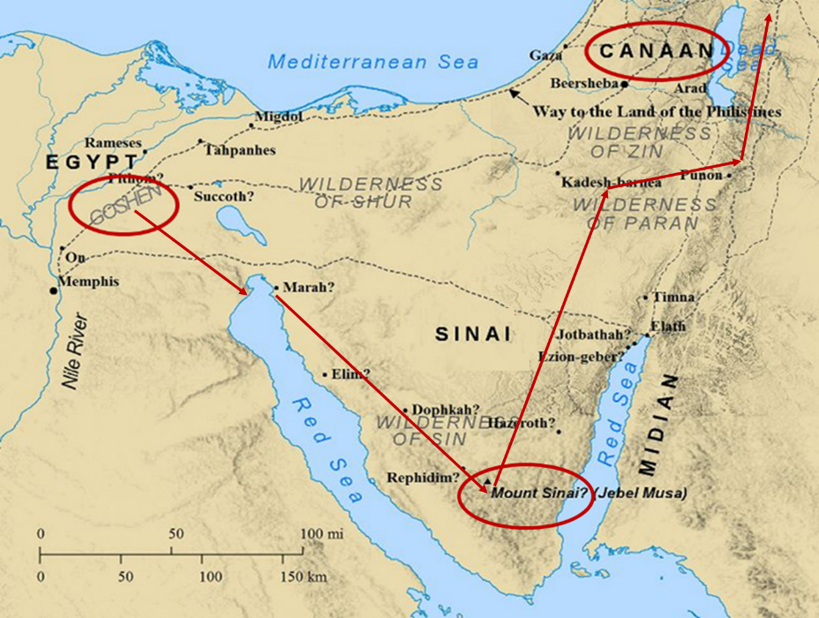

Slide 36
Numbers 13:32-33
³² So they gave out to the sons of Israel a bad report of the land which they had spied out, saying, “The land through which we have gone, in spying it out, is a land that devours its inhabitants; and all the people whom we saw in it are men of great size. ³³ There also we saw the Nephilim (the sons of Anak are part of the Nephilim); and we became like grasshoppers in our own sight, and so we were in their sight.”

Slide 37
Genesis 32:18 Answers
They belong to Jacob (18a)
Present sent to Esau (18b)
Jacob is behind us (18c)

Slide 38
Genesis 32:17-20a Jacob’s Response
1st group (17-18)
Remaining 4 groups (19-20a)

Slide 39
Genesis 32:19-20a First Group
Instructions (19a)
Answer (19b-20a)

Slide 40
Genesis 32:19-20a First Group
Instructions (19a)
Answer (19b-20a)

Slide 41
Genesis 32:19-20a First Group
Instructions (19a)
Answer (19b-20a)

Slide 42
II. Genesis 32:3-21 Jacob’s Response
Messengers sent to Esau (3-6)
Jacob’s response (7-12)
Offer of appeasement (13-16)
Instructions (17-20a)
Jacob’s desire to appease Esau (20b)
Concluding circumstances (21)

Slide 43
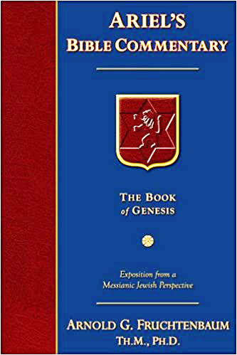
Dr. Arnold G. Fruchtenbaum
The Book of Genesis, 480-81
“For he said, I will appease him with the present that goes before me. The Hebrew word for appease has the same Hebrew root as ‘atonement.’ What this means is that Jacob was seeking Esau’s forgiveness: Afterward I will see his face; peradventure he will accept me.”

Slide 44
Isaiah 53:3–6
³ “He was despised and forsaken of men, A man of sorrows and acquainted with grief; And like one from whom men hide their face He was despised, and we did not esteem Him. ⁴ Surely our griefs He Himself bore, And our sorrows He carried; Yet we ourselves esteemed Him stricken, Smitten of God, and afflicted. ⁵ But He was pierced through for our transgressions, He was crushed for our iniquities; The chastening for our well-being fell upon Him, And by His scourging we are healed. ⁶ All of us like sheep have gone astray, Each of us has turned to his own way; But the Lord has caused the iniquity of us all To fall on Him.”

Slide 45
False Views of the Atonement
Ransom to Satan – Christ’s death is a ransom to Satan and not the Father (A.D. 185‒54)
Moral influence – Christ’s death is an expression of God’s love (A.D. 1079‒1142)
Moral example – Christ’s death inspires us to be sacrificial (A.D. 1539‒1604)
Governmental – Christ’s death promotes respect for God’s Law (A.D. 1583‒1645)
Accidental – Fate accidently ended Christ’s life

Slide 46
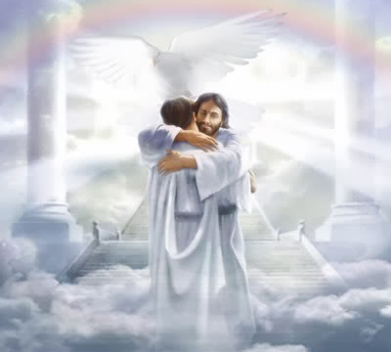
John 5:24
“Truly, truly, I say to you, he who hears My word, and believes Him who sent Me, has eternal life, and does not come into judgment, but has passed out of death into life.”

Slide 47
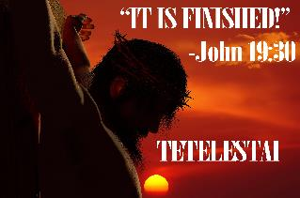
John 19:30
“Therefore, when Jesus had received the sour wine, He said, ‘It is finished!’ [tetelestai] And He bowed His head and gave up His spirit.”

Slide 48
II. Genesis 32:3-21 Jacob’s Response
Messengers sent to Esau (3-6)
Jacob’s response (7-12)
Offer of appeasement (13-16)
Instructions (17-20a)
Jacob’s desire to appease Esau (20b)
Concluding circumstances (21)

Slide 49
Genesis 32:21 Concluding Circumstances
Presents pass before Jacob (21a)
Jacob lodged that night (21b)

Slide 50
Genesis 32:21 Concluding Circumstances
Presents pass before Jacob (21a)
Jacob lodged that night (21b)

Slide 51
Genesis 32:21 Concluding Circumstances
Presents pass before Jacob (21a)
Jacob lodged that night (21b)

Slide 52
Conclusion

Slide 53
II. Genesis 32:3-21 Jacob’s Response
Messengers sent to Esau (3-6)
Jacob’s response (7-12)
Offer of appeasement (13-16)
Instructions (17-20a)
Jacob’s desire to appease Esau (20b)
Concluding circumstances (21)

Slide 54
²⁴ The Lord bless you, and keep you; ²⁵ The Lord make His face shine on you, And be gracious to you; ²⁶ The Lord lift up His countenance on you, And give you peace.
Numbers 6:24–26 (NASB95)

