Slide 1
Dr. Andy Woods
Senior Pastor – Sugar Land Bible Church
President – Chafer Theological Seminary

Slide 2
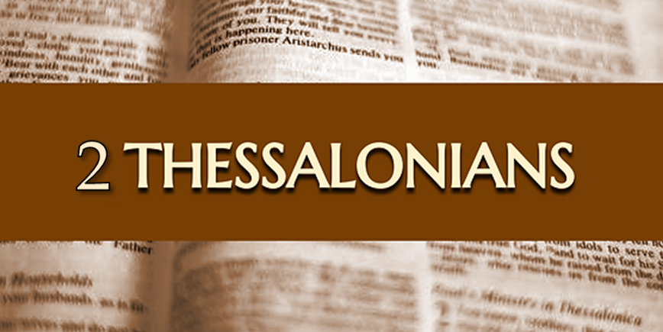
Introductory Matters
Authorship: Paul
Audience: Thessalonians
Place of writing: Corinth
Date: AD 51
Occasion: Forgery
Structure: 3 Parts
Message: working & waiting
Purpose: Correction of orthodoxy & orthopraxy

Slide 3
Structure
1 – Commendation
2 – Correction
3 – Consequences

Slide 4
Commendation (1)
Reminder of grace (1:1-2)
Thanksgiving (1:3-4)
Kingdom (1:5)
Destiny of their persecutors (1:6-9)
Our contrasting fate (10)
Prayer for continued progress (1:11-12)

Slide 5
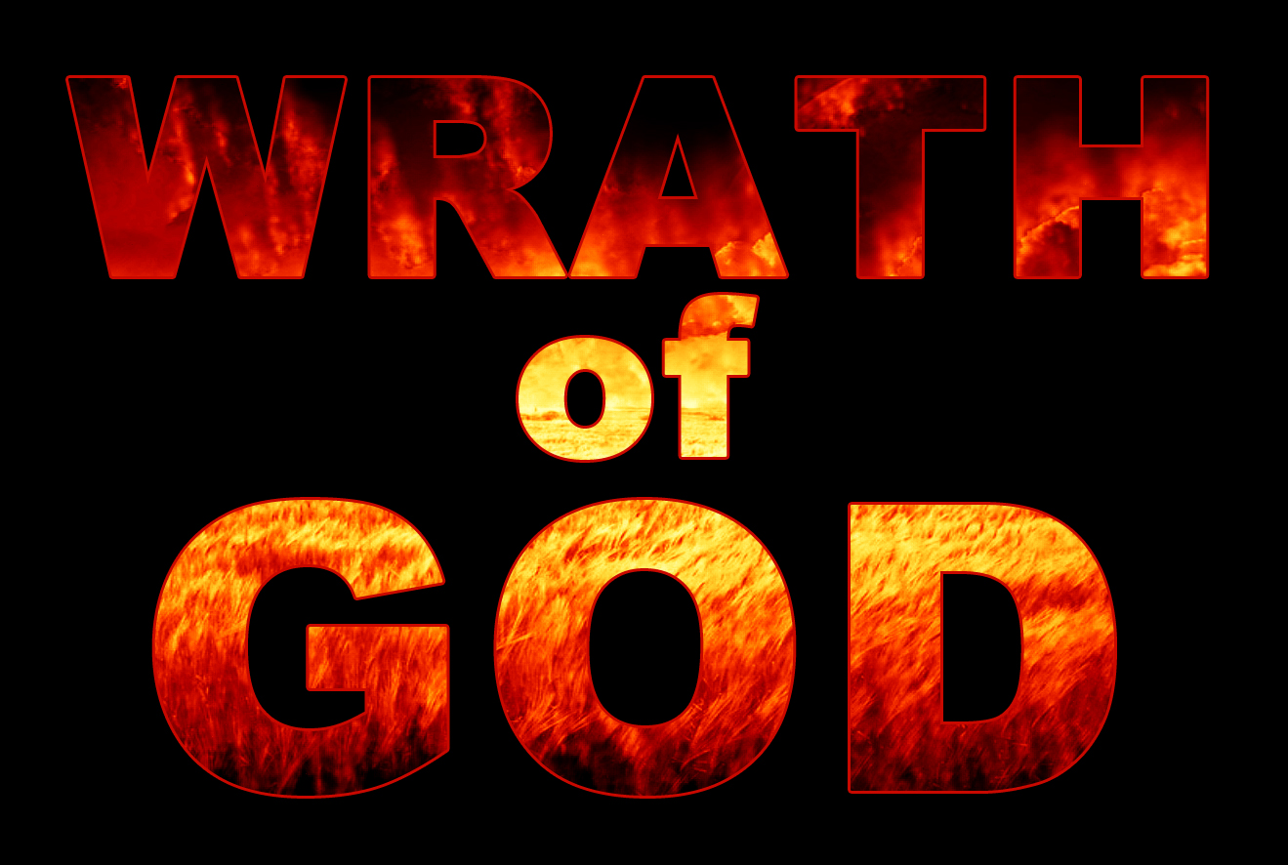
John 3:36
“He who believes in the Son has eternal life; but he who does not obey the Son will not see life, but the wrath of God abides on him.”

Slide 6
Commendation (1)
Reminder of grace (1:1-2)
Thanksgiving (1:3-4)
Kingdom (1:5)
Destiny of their persecutors (1:6-9)
Our contrasting fate (10)
Prayer for continued progress (1:11-12)

Slide 7
Three Tenses of Salvation
Phase | Justification | Sanctification | Glorification
Tense | Past | Present | Future
Saved from sin’s: | Penalty | Power | Presence
Scripture | Eph 2:8-9; Titus 3:5 | Philip 2:12 | Rom 5:10

Slide 8
RAPTURE DISTINCT FROM SECOND ADVENT
RAPTURE (1 Thess 4:13-17; 1 Cor 15:51-57) | SECOND COMING (Rev 19:11-16)
Christ comes in the air (1 Thess 4:16) | Christ comes to the earth (Zech 14:4)
For His saints (1 Thess 4:15-17) | With His saints (Rev 19:14)
Blessing (1 Thess 4:18) | Judgment (Rev 19:15)
Effects only believers (1 Thess 4:16) | Effects both believers and unbelievers (Rev 19:15)
Invisible (1 Thess 4:16) | Visible to all (Rev 1:7)
Announced only by an archangel (1 Thess 4:16) | Involves myriads of angels (Jude 14)
Resurrection (1 Cor 15: 51) | No resurrection
Rescue of the church (1 Thess 1:10) | Rescue of Israel (Matt 23:37-39)

Slide 10
Isaiah 53:3–6
³ “He was despised and forsaken of men, A man of sorrows and acquainted with grief; And like one from whom men hide their face He was despised, and we did not esteem Him. ⁴ Surely our griefs He Himself bore, And our sorrows He carried; Yet we ourselves esteemed Him stricken, Smitten of God, and afflicted. ⁵ But He was pierced through for our transgressions, He was crushed for our iniquities; The chastening for our well-being fell upon Him, And by His scourging we are healed. ⁶ All of us like sheep have gone astray, Each of us has turned to his own way; But the Lord has caused the iniquity of us all To fall on Him.”

Slide 11
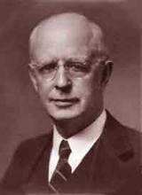
Lewis Sperry Chafer, vol. 7, Systematic Theology (Grand Rapids, MI: Kregel Publications, 1993), 265-66.
Belief – God’s One Condition for Justification
“…because upwards of 150 passages of Scripture condition salvation upon believing only (cf. John 3:16; Acts 16:31).”

Slide 12
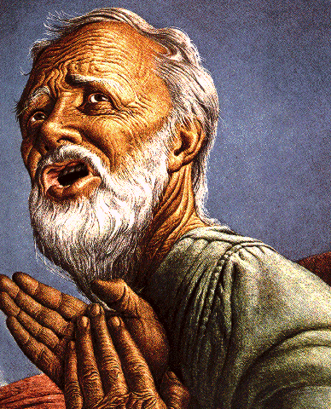
Belief – God’s One Condition for Justification
Gen 15:6
Then he believed in the LORD; and He reckoned it to him as righteousness.
John 3:16
For God so loved the world, that He gave His only begotten Son, that whoever believes in Him shall not perish, but have eternal life.
Acts 16:30-31
"Sirs, what must I do to be saved?" They said, "Believe in the Lord Jesus, and you will be saved..."

Slide 13
John 3:36
“He who believes in the Son has eternal life; but he who does not obey the Son will not see life, but the wrath of God abides on him.”

Slide 14
Commendation (1)
Reminder of grace (1:1-2)
Thanksgiving (1:3-4)
Kingdom (1:5)
Destiny of their persecutors (1:6-9)
Our contrasting fate (10)
Prayer for continued progress (1:11-12)

Slide 15
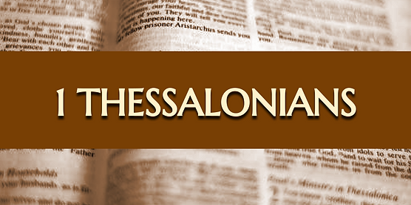
Three Positive Commands (5:16-18)
Rejoice always (5:16)
Pray without ceasing (5:17)
Give thanks in all things (5:18)

Slide 17
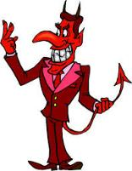
Names & Titles Demonstrating Satan’s Post-Fall, Earthly Authority (Job 1:7; 2:2; Luke 4:5-8; Rom. 8:19-22)
Prince of this world (John 12:31; 14:30; 16:11)
God of this age (2 Cor. 4:4)
Prince and power of the air (Eph. 2:2)
Who the believer wrestles with (Eph. 6:12)
Roaring lion (1 Pet. 5:8)
Whole world lies in his power (1 John 5:19)

Slide 18
2 Peter 1:5-7
⁵ Now for this very reason also, applying all diligence, in your faith supply moral excellence, and in your moral excellence, knowledge, ⁶ and in your knowledge, self-control, and in your self-control, perseverance, and in your perseverance, godliness, ⁷ and in your godliness, brotherly kindness, and in your brotherly kindness, love.

Slide 19
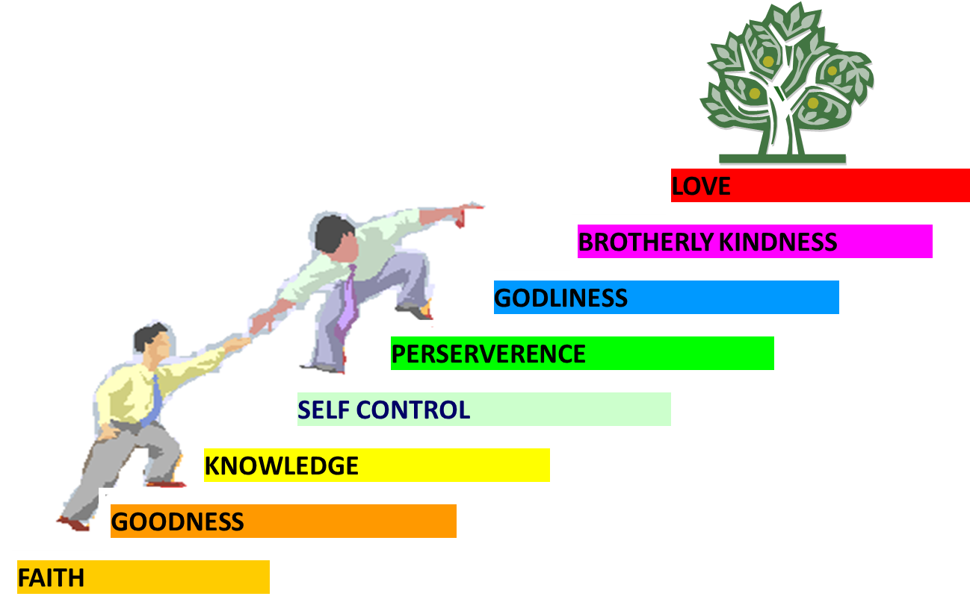
PORTRAIT OF GROWTH 1:5-7

Slide 20
Dispensational Theology is a System of Theology
Traditional-normative dispensational theology is a system that embodies three essential, fundamental concepts called the sine qua non (lit. “without which is not”):
The consistent use of a plain, normal, literal, grammatical-historical method of interpretation;
Which reveals that the Church is distinct from Israel;
God’s overall purpose is to bring glory to Himself (Eph. 1:6, 12, 14).
Dr. Charles Ryrie, Dispensationalism, pp. 38-41

Slide 21
Dispensational Theology: Doxological Purpose
God’s ultimate purpose for the ages is to glorify Himself. Scripture is not human-centered, as though salvation were the principle point, but God-centered, because His glory is at the center.
The glory of God is the primary principle that unifies all dispensations, the program of salvation being just one of the means by which God glorifies Himself. Each successive revelation of God’s plan for the ages, as well as His dealing with the elect, non-elect, angels, and nations all manifest His glory.
Dictionary of Premillennial Theology, Charles Ryrie, p. 94

Slide 23
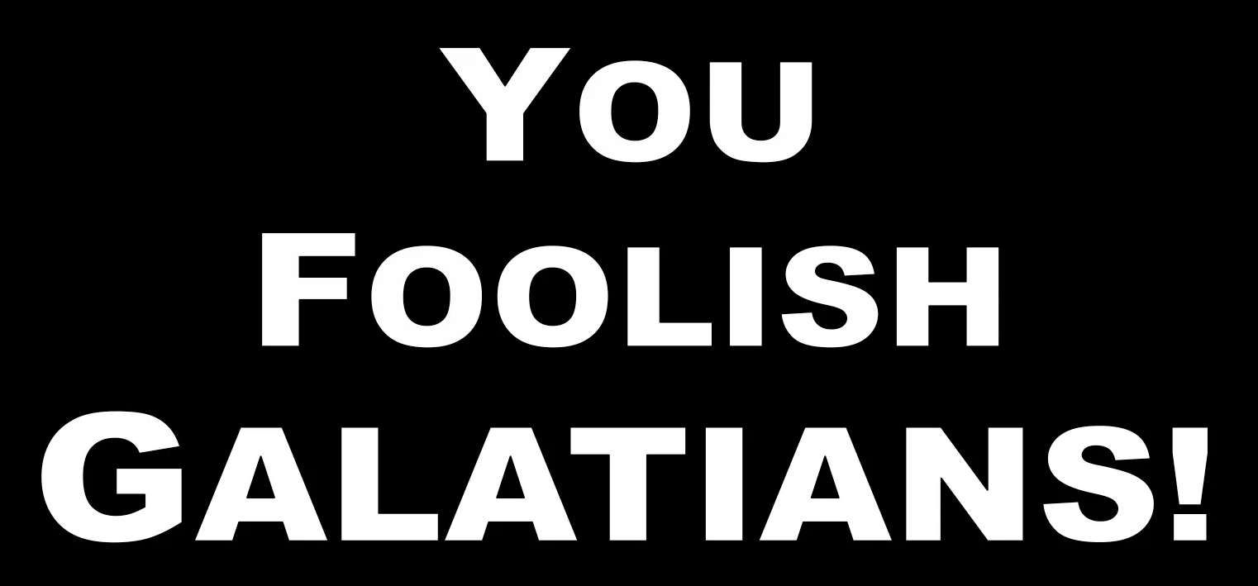
Galatians 3:3
“Are you so foolish? Having begun by the Spirit, are you now being perfected by the flesh?”

Slide 24
Conclusion

Slide 25
Commendation (1)
Reminder of grace (1:1-2)
Thanksgiving (1:3-4)
Kingdom (1:5)
Destiny of their persecutors (1:6-9)
Our contrasting fate (10)
Prayer for continued progress (1:11-12)

Slide 26
Structure
1 – Commendation
2 – Correction
3 – Consequences

