Slide 1
Dr. Andy Woods
Senior Pastor – Sugar Land Bible Church
President – Chafer Theological Seminary

Slide 2
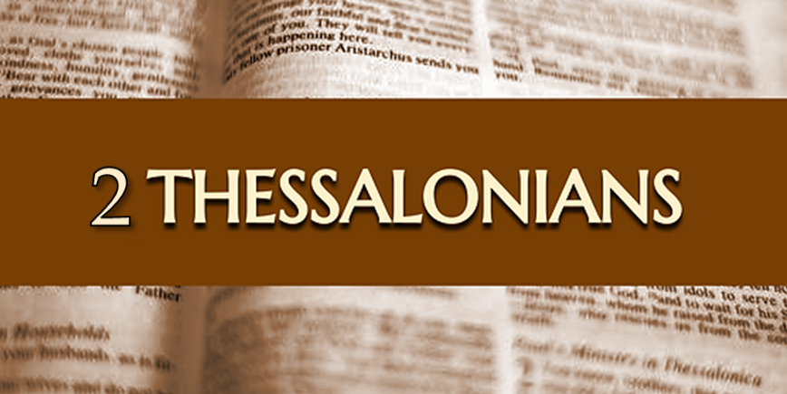
Introductory Matters
Authorship: Paul
Audience: Thessalonians
Place of writing: Corinth
Date: AD 51
Occasion: Forgery
Structure: 3 Parts
Message: working & waiting
Purpose: Correction of orthodoxy & orthopraxy

Slide 3
Structure
1 – Commendation
2 – Correction
3 – Consequences

Slide 4
Commendation (1)
Reminder of grace (1:1-2)
Thanksgiving (1:3-4)
Kingdom (1:5)
Destiny of their persecutors (1:6-10)
Prayer for continued progress (1:11-12)

Slide 5
Revelation 6:9-11
“⁹ When the Lamb broke the fifth seal, I saw underneath the altar the souls of those who had been slain because of the word of God, and because of the testimony which they had maintained; ¹⁰ and they cried out with a loud voice, saying, “How long, O Lord, holy and true, will You refrain from judging and avenging our blood on those who dwell on the earth?” ¹¹ And there was given to each of them a white robe; and they were told that they should rest for a little while longer, until the number of their fellow servants and their brethren who were to be killed even as they had been, would be completed also.”

Slide 6
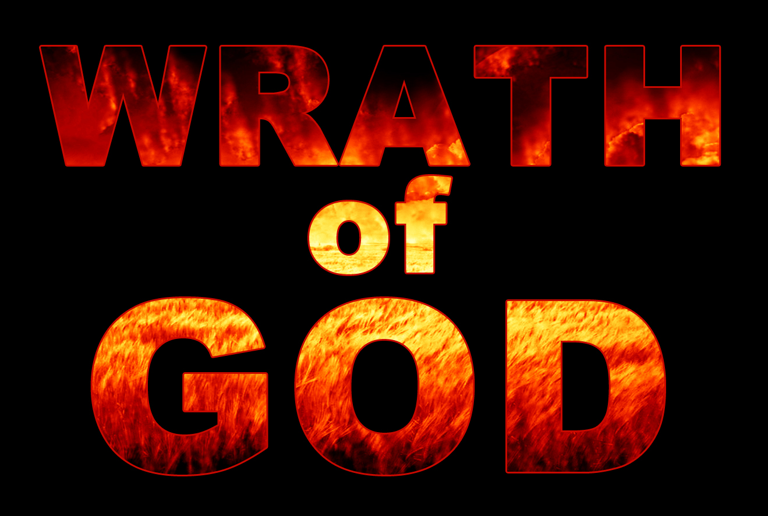
John 3:36
“He who believes in the Son has eternal life; but he who does not obey the Son will not see life, but the wrath of God abides on him.”

Slide 7
John 3:36
“He who believes in the Son has eternal life; but he who does not obey the Son will not see life, but the wrath of God abides on him.”

Slide 8
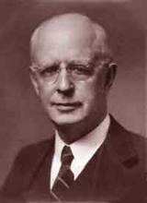
Lewis Sperry Chafer, vol. 7, Systematic Theology (Grand Rapids, MI: Kregel Publications, 1993), 265-66.
Belief-God’s One Condition for Justification
“…because upwards of 150 passages of Scripture condition salvation upon believing only (cf. John 3:16; Acts 16:31).”

Slide 9
Belief – God’s One Condition for Justification
Gen 15:6
Then he believed in the LORD; and He reckoned it to him as righteousness.
John 3:16
For God so loved the world, that He gave His only begotten Son, that whoever believes in Him shall not perish, but have eternal life.
Acts 16:30-31
"Sirs, what must I do to be saved?" They said, "Believe in the Lord Jesus, and you will be saved..."

Slide 10
Matthew 25:46
“These will go away into eternal (aiōnios) punishment, but the righteous into eternal (aiōnios) life.

Slide 11
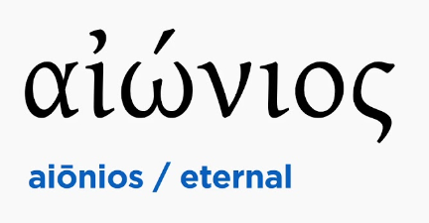
Romans 16:26
“but now is manifested, and by the Scriptures of the prophets, according to the commandment of the eternal (aiōnios) God, has been made known to all the nations, leading to obedience of faith.”

Slide 12
Revelation 14:11
“And the smoke of their torment goes up forever (aiōn) and ever (aiōn); they have no rest day and night, those who worship the beast and his image, and whoever receives the mark of his name.”

Slide 13
Daniel 12:1-2
“¹ Now at that time Michael, the great prince who stands guard over the sons of your people, will arise. And there will be a time of distress such as never occurred since there was a nation until that time; and at that time your people, everyone who is found written in the book, will be rescued. ² Many of those who sleep in the dust of the ground will awake, these to everlasting (olam) life, but the others to disgrace and everlasting (olam) contempt.”

Slide 14
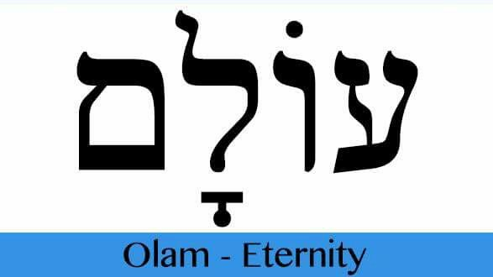
Psalm 90:2
“Before the mountains were born Or You gave birth to the earth and the world, Even from everlasting (olam) to everlasting (olam), You are God.”

Slide 15
Dominoes in a Row

Slide 18
Lewis Sperry Chafer, vol. 7, Systematic Theology (Grand Rapids, MI: Kregel Publications, 1993), 265-66.
Belief-God’s One Condition for Justification
“…because upwards of 150 passages of Scripture condition salvation upon believing only (cf. John 3:16; Acts 16:31).”

Slide 19
Belief – God’s One Condition for Justification
Gen 15:6
Then he believed in the LORD; and He reckoned it to him as righteousness.
John 3:16
For God so loved the world, that He gave His only begotten Son, that whoever believes in Him shall not perish, but have eternal life.
Acts 16:30-31
"Sirs, what must I do to be saved?" They said, "Believe in the Lord Jesus, and you will be saved..."

Slide 20
Commendation (1)
Reminder of grace (1:1-2)
Thanksgiving (1:3-4)
Kingdom (1:5)
Destiny of their persecutors (1:6-10)
Prayer for continued progress (1:11-12)

Slide 21
2 Peter 1:5-7
⁵ Now for this very reason also, applying all diligence, in your faith supply moral excellence, and in your moral excellence, knowledge, ⁶ and in your knowledge, self-control, and in your self-control, perseverance, and in your perseverance, godliness, ⁷ and in your godliness, brotherly kindness, and in your brotherly kindness, love.

Slide 22
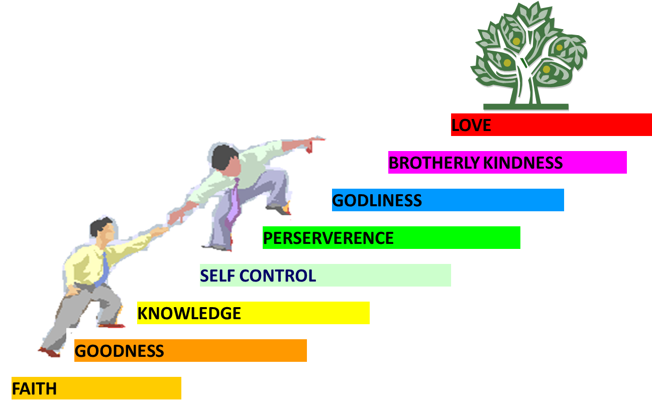
PORTRAIT OF GROWTH 1:5-7

Slide 23
Dispensational Theology is a System of Theology
Traditional-normative dispensational theology is a system that embodies three essential, fundamental concepts called the sine qua non (lit. “without which is not”):
The consistent use of a plain, normal, literal, grammatical-historical method of interpretation;
Which reveals that the Church is distinct from Israel;
God’s overall purpose is to bring glory to Himself (Eph. 1:6, 12, 14).
Dr. Charles Ryrie, Dispensationalism, pp. 38-41

Slide 24
Dispensational Theology: Doxological Purpose
God’s ultimate purpose for the ages is to glorify Himself. Scripture is not human-centered, as though salvation were the principle point, but God-centered, because His glory is at the center.
The glory of God is the primary principle that unifies all dispensations, the program of salvation being just one of the means by which God glorifies Himself. Each successive revelation of God’s plan for the ages, as well as His dealing with the elect, non-elect, angels, and nations all manifest His glory.
Dictionary of Premillennial Theology, Charles Ryrie, p. 94

Slide 26
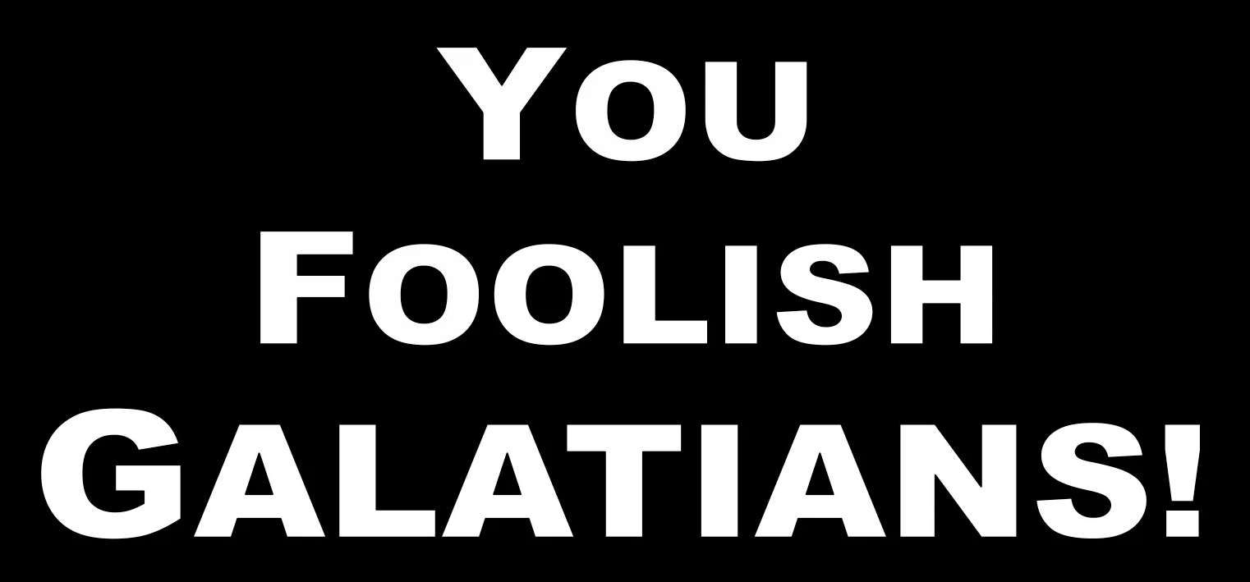
Galatians 3:3
“Are you so foolish? Having begun by the Spirit, are you now being perfected by the flesh?”

Slide 27
Conclusion

Slide 28
Commendation (1)
Reminder of grace (1:1-2)
Thanksgiving (1:3-4)
Kingdom (1:5)
Destiny of their persecutors (1:6-10)
Prayer for continued progress (1:11-12)

