Slide 1
Dr. Andy Woods
Senior Pastor – Sugar Land Bible Church
President – Chafer Theological Seminary

Slide 2
Introductory Matters
Authorship: Paul
Audience: Thessalonians
Place of writing: Corinth
Date: AD 51
Occasion: Forgery
Structure: 3 Parts
Message: working & waiting
Purpose: Correction of orthodoxy & orthopraxy

Slide 3
Structure
1 – Commendation
2 – Correction
3 – Consequences

Slide 4
Commendation (1)
Reminder of grace (1:1-2)
Thanksgiving (1:3-4)
Kingdom (1:5)
Destiny of their persecutors (1:6-10)
Prayer for continued progress (1:11-12)

Slide 5
OT PROPHETS DESCRIBE THE KINGDOM
Established by God (Dan. 2:44)
Eternal (Dan. 7:27)
Christ’s direct rule (Zech. 9:9-10)
Earthly (Zech. 14:9)
Land promises realized (Gen. 15:18-21)
Israel’s preeminence (Isa. 49:22-23)
Millennial Temple (Ezek. 40‒46)

Slide 6
OT PROPHETS DESCRIBE THE KINGDOM
Millennial David (Jer. 30:9)
Righteousness (Isa. 9:6-7)
Curse curtailed (Isa. 65:20, 22)
Peace (Isa. 2:4)
Prosperity (Amos 9:13-14; Isa 65:22)
Topographical changes (Ezek. 47:1-12)
Immediate answers to prayer (Isa. 65:24)

Slide 7
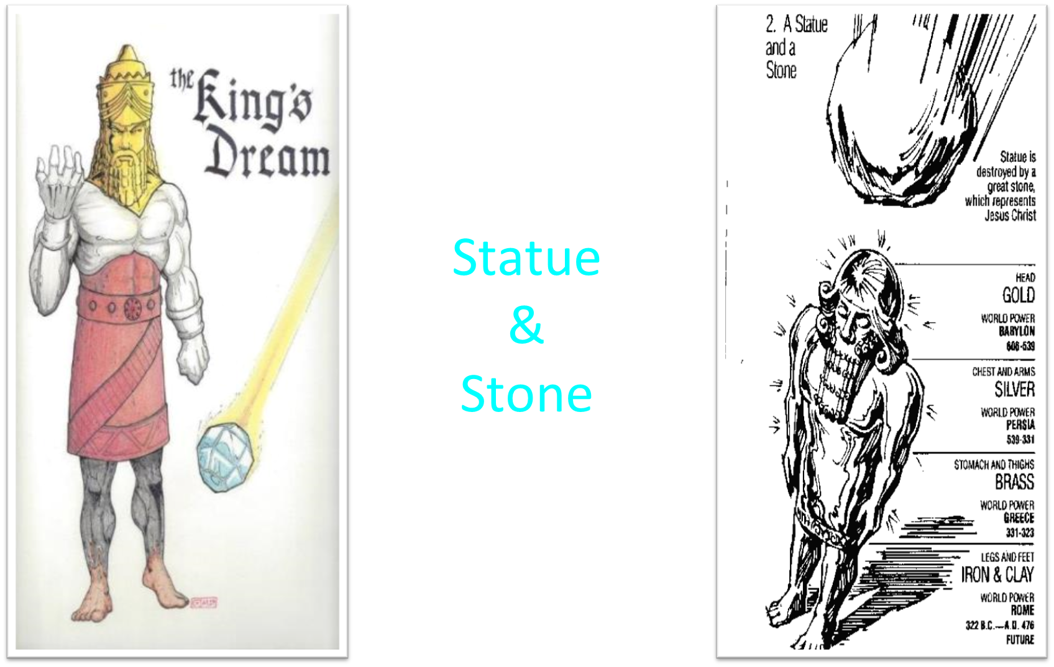

Slide 8
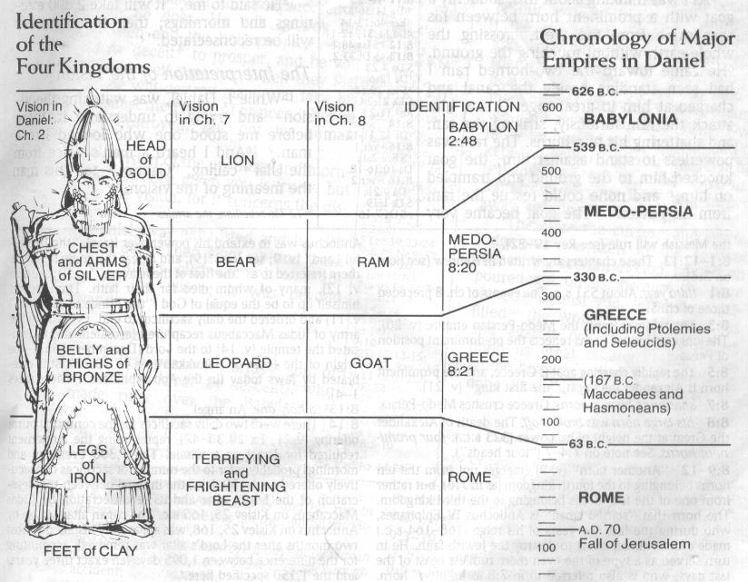

Slide 10
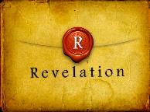
Revelation 1:6
“and He has made us to be a kingdom, priests to His God and Father—to Him be the glory and the dominion forever and ever. Amen.”

Slide 11
Revelation 5:10
“You have made them to be a kingdom and priests to our God; and they will reign [basileuō] upon the earth [gē].”

Slide 12
Commendation (1)
Reminder of grace (1:1-2)
Thanksgiving (1:3-4)
Kingdom (1:5)
Destiny of their persecutors (1:6-10)
Prayer for continued progress (1:11-12)

Slide 13
Genesis 15:16
“Then in the fourth generation they will return here, for the wrongdoing of the Amorite is not yet complete.”

Slide 14
RAPTURE DISTINCT FROM SECOND ADVENT
RAPTURE (1 Thess 4:13-17; 1 Cor 15:51-57) | SECOND COMING (Rev 19:11-16)
Christ comes in the air (1 Thess 4:16) | Christ comes to the earth (Zech 14:4)
For His saints (1 Thess 4:15-17) | With His saints (Rev 19:14)
Blessing (1 Thess 4:18) | Judgment (Rev 19:15)
Effects only believers (1 Thess 4:16) | Effects both believers and unbelievers (Rev 19:15)
Invisible (1 Thess 4:16) | Visible to all (Rev 1:7)
Announced only by an archangel (1 Thess 4:16) | Involves myriads of angels (Jude 14)
Resurrection (1 Cor 15: 51) | No resurrection
Rescue of the church (1 Thess 1:10) | Rescue of Israel (Matt 23:37-39)

Slide 16
Douglas Moo Douglas Moo, “The Case for the Posttribulation Rapture Position” in The Rapture: Pre-, Mid-, or Post- Tribulational? (Grand Rapids: Zondervan, 1984): 187
“In 2 Thessalonians 1:5-7 Paul appears to provide strong support for the view that believers will not be raptured until the Parousia of Christ at the end of the Tribulation. For there can be no doubt that in verses 7-8 Paul depicts this coming in glory, which he characterizes as ‘the revelation of the Lord Jesus from Heaven in blazing fire with His powerful angels.’ Yet it is at…this time that the believers who are suffering tribulation are given ‘rest.’ In other words, it is only at the posttribulational Advent that believers experience deliverance from the sufferings of this age.”

Slide 17
William Bell William E. Bell, Jr., A Critical Evaluation of the Pretribulation Rapture Doctrine in Christian Eschatology (Unpublished Ph.D. dissertation, New York University, 1967), 275.
“This passage would seem to be fatal to any view of a pretribulational rapture. Paul explicitly states that the hope of the Thessalonian believers is the glorious second advent of Christ, at which time they will receive rest from their afflictions. If the rapture, as a separate event, is indeed the ‘blessed hope’ (Titus 2:13) of the Christian, rather than the second advent, this passage becomes inexplicable.”

Slide 18
Robert Gundry Robert H. Gundry, The Church and the Tribulation (Grand Rapids: Zondervan, 1973), 113.
“The resultant difficulty for pretribulationalism is that Paul places the release of Christians from persecution at the posttribulational return of Christ to judge unbelievers, whereas according to pretribulationalism this release will occur seven years earlier.”

Slide 19
Acts 3:19-21
“¹⁹ Therefore repent and return, so that your sins may be wiped away, in order that times of refreshing may come from the presence of the Lord; ²⁰ and that He may send Jesus, the Christ appointed for you,²¹ whom heaven must receive until the period of restoration of all things about which God spoke by the mouth of His holy prophets from ancient time.”

Slide 24
1st Six Seals (Revelation 6)
SEAL 1 – 6:1-2 – Advent of antichrist
SEAL 2 – 6:3-4 – War
SEAL 3 – 6:5-6 – Famine
SEAL 4 – 6:7-8 – Death
SEAL 5 – 6:9-11 – Martyrdoms
SEAL 6 – 6:12-17 – Cosmic disturbances

Slide 25
Acts 3:19-21
“¹⁹ Therefore repent and return, so that your sins may be wiped away, in order that times of refreshing may come from the presence of the Lord; ²⁰ and that He may send Jesus, the Christ appointed for you,²¹ whom heaven must receive until the period of restoration of all things about which God spoke by the mouth of His holy prophets from ancient time.”

Slide 26
Revelation 6:9-11
“⁹ When the Lamb broke the fifth seal, I saw underneath the altar the souls of those who had been slain because of the word of God, and because of the testimony which they had maintained; ¹⁰ and they cried out with a loud voice, saying, “How long, O Lord, holy and true, will You refrain from judging and avenging our blood on those who dwell on the earth?” ¹¹ And there was given to each of them a white robe; and they were told that they should rest for a little while longer, until the number of their fellow servants and their brethren who were to be killed even as they had been, would be completed also.”

Slide 27
Charles Ryrie Charles Ryrie, What You Should Know About the Rapture (Chicago: Moody, 1981). 55-56.
“If death or the rapture brings release from personal persecution, why should believers be concerned with this future vindication? Because the case against persecutors cannot be closed until Christ is vindicated and righteousness prevails. Persecution may cease when death occurs, but the case against the persecutors is not closed until they are judged. And believers are concerned not only about relief but about vindication. Notice a biblical example of that principle. Hear the Tribulation martyrs in heaven, before the end of the Tribulation, crying out to God for vindication (Revelation 6:9–11)…”

Slide 28
Charles Ryrie Charles Ryrie, What You Should Know About the Rapture (Chicago: Moody, 1981). 55-56.
“…When will You settle the score against those who killed us? they ask. Of course, they have already obtained release through physical death and are in heaven; yet they are concerned about vindication. And the Lord replies that they will have to wait a little longer for that vindication until others are also martyred on earth.”

Slide 29
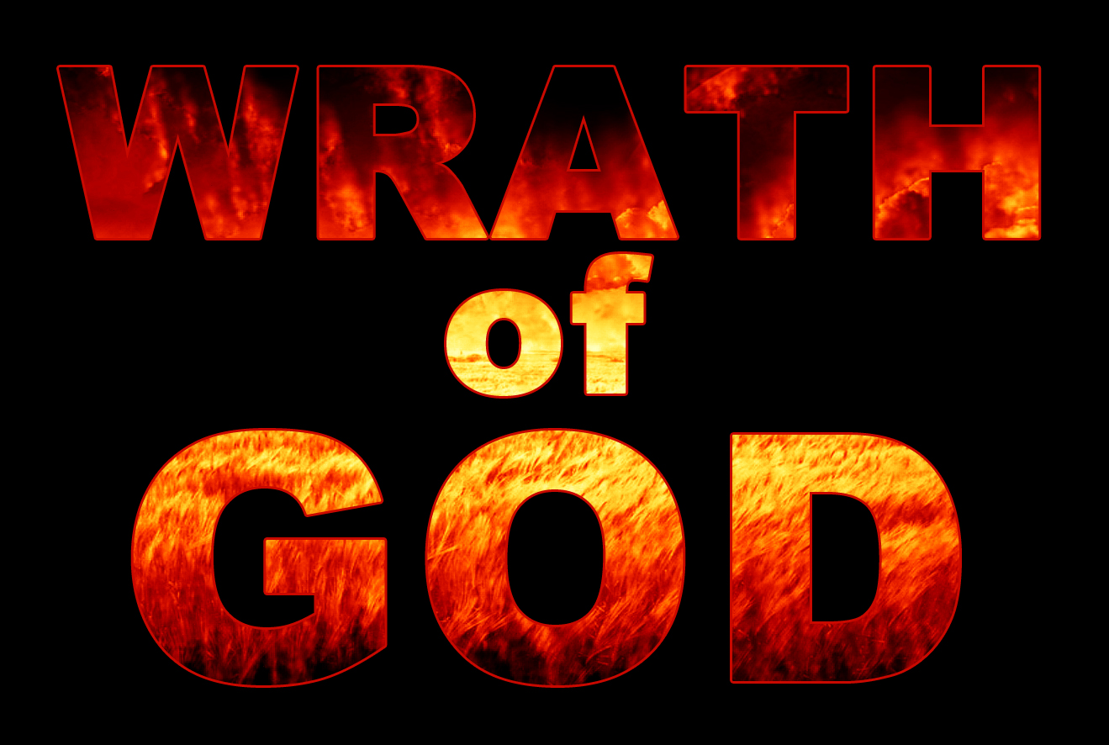
John 3:36
“He who believes in the Son has eternal life; but he who does not obey the Son will not see life, but the wrath of God abides on him.”

Slide 30
John 3:36
“He who believes in the Son has eternal life; but he who does not obey the Son will not see life, but the wrath of God abides on him.”

Slide 31
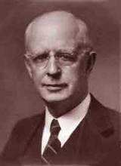
Lewis Sperry Chafer, vol. 7, Systematic Theology (Grand Rapids, MI: Kregel Publications, 1993), 265-66.
Belief-God’s One Condition for Justification
“…because upwards of 150 passages of Scripture condition salvation upon believing only (cf. John 3:16; Acts 16:31).”

Slide 32
Belief – God’s One Condition for Justification
Gen 15:6
Then he believed in the LORD; and He reckoned it to him as righteousness.
John 3:16
For God so loved the world, that He gave His only begotten Son, that whoever believes in Him shall not perish, but have eternal life.
Acts 16:30-31
"Sirs, what must I do to be saved?" They said, "Believe in the Lord Jesus, and you will be saved..."

Slide 33
Matthew 25:46
“These will go away into eternal (aiōnios) punishment, but the righteous into eternal (aiōnios) life.

Slide 34
Romans 16:26
“but now is manifested, and by the Scriptures of the prophets, according to the commandment of the eternal (aiōnios) God, has been made known to all the nations, leading to obedience of faith.”

Slide 35
Revelation 14:11
“And the smoke of their torment goes up forever (aiōn) and ever (aiōn); they have no rest day and night, those who worship the beast and his image, and whoever receives the mark of his name.”

Slide 36
Daniel 12:1-2
“¹ Now at that time Michael, the great prince who stands guard over the sons of your people, will arise. And there will be a time of distress such as never occurred since there was a nation until that time; and at that time your people, everyone who is found written in the book, will be rescued. ² Many of those who sleep in the dust of the ground will awake, these to everlasting (olam) life, but the others to disgrace and everlasting (olam) contempt.”

Slide 37
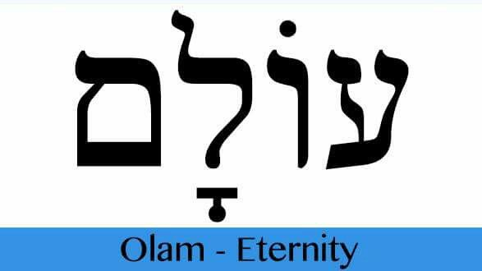
Psalm 90:2
“Before the mountains were born Or You gave birth to the earth and the world, Even from everlasting (olam) to everlasting (olam), You are God.”

Slide 38
Dominoes in a Row

Slide 41
Lewis Sperry Chafer, vol. 7, Systematic Theology (Grand Rapids, MI: Kregel Publications, 1993), 265-66.
Belief-God’s One Condition for Justification
“…because upwards of 150 passages of Scripture condition salvation upon believing only (cf. John 3:16; Acts 16:31).”

Slide 42
Belief – God’s One Condition for Justification
Gen 15:6
Then he believed in the LORD; and He reckoned it to him as righteousness.
John 3:16
For God so loved the world, that He gave His only begotten Son, that whoever believes in Him shall not perish, but have eternal life.
Acts 16:30-31
"Sirs, what must I do to be saved?" They said, "Believe in the Lord Jesus, and you will be saved..."

Slide 43
Commendation (1)
Reminder of grace (1:1-2)
Thanksgiving (1:3-4)
Kingdom (1:5)
Destiny of their persecutors (1:6-10)
Prayer for continued progress (1:11-12)

Slide 44
2 Peter 1:5-7
⁵ Now for this very reason also, applying all diligence, in your faith supply moral excellence, and in your moral excellence, knowledge, ⁶ and in your knowledge, self-control, and in your self-control, perseverance, and in your perseverance, godliness, ⁷ and in your godliness, brotherly kindness, and in your brotherly kindness, love.

Slide 45
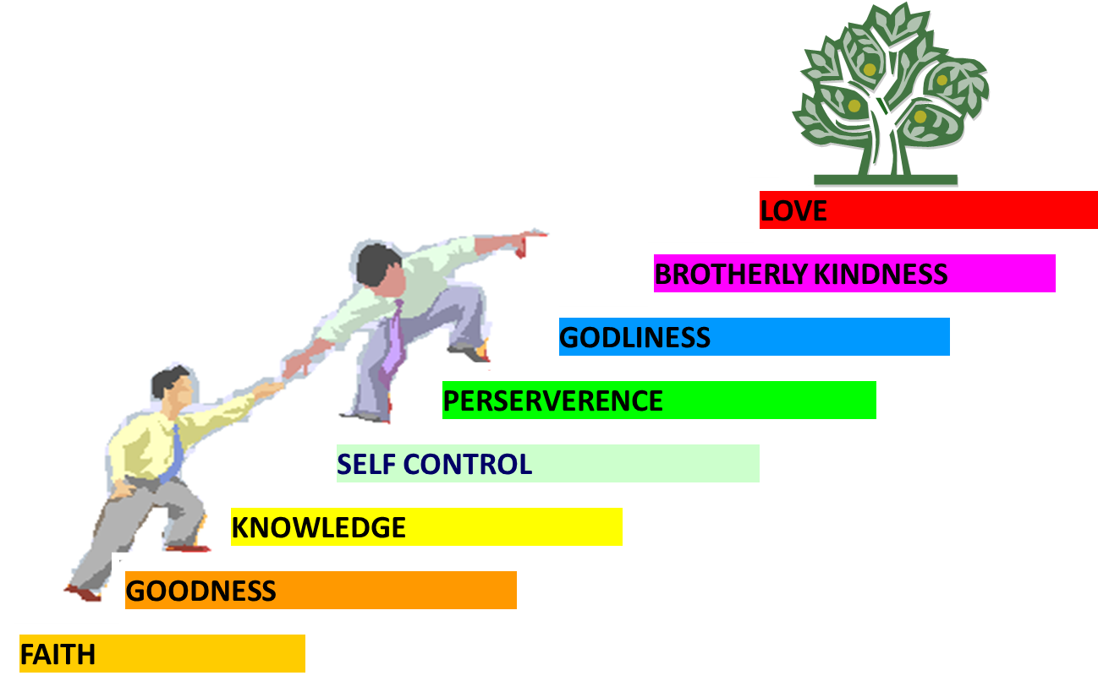
PORTRAIT OF GROWTH 1:5-7

Slide 46
Dispensational Theology is a System of Theology
Traditional-normative dispensational theology is a system that embodies three essential, fundamental concepts called the sine qua non (lit. “without which is not”):
The consistent use of a plain, normal, literal, grammatical-historical method of interpretation;
Which reveals that the Church is distinct from Israel;
God’s overall purpose is to bring glory to Himself (Eph. 1:6, 12, 14).
Dr. Charles Ryrie, Dispensationalism, pp. 38-41

Slide 47
Dispensational Theology: Doxological Purpose
God’s ultimate purpose for the ages is to glorify Himself. Scripture is not human-centered, as though salvation were the principle point, but God-centered, because His glory is at the center.
The glory of God is the primary principle that unifies all dispensations, the program of salvation being just one of the means by which God glorifies Himself. Each successive revelation of God’s plan for the ages, as well as His dealing with the elect, non-elect, angels, and nations all manifest His glory.
Dictionary of Premillennial Theology, Charles Ryrie, p. 94

Slide 49
Galatians 3:3
“Are you so foolish? Having begun by the Spirit, are you now being perfected by the flesh?”

Slide 50
Conclusion

Slide 51
Commendation (1)
Reminder of grace (1:1-2)
Thanksgiving (1:3-4)
Kingdom (1:5)
Destiny of their persecutors (1:6-10)
Prayer for continued progress (1:11-12)

