Slide 1
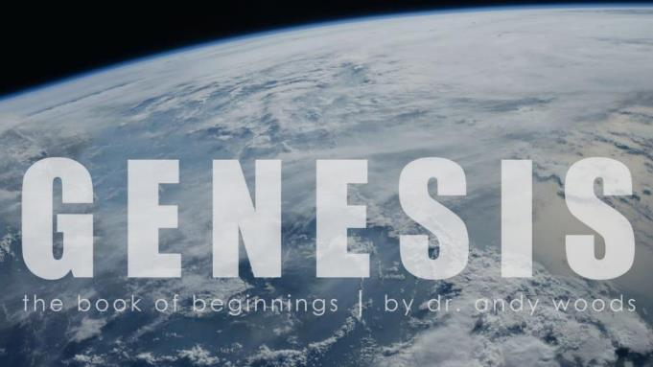
Genesis 12‒50
Israel’s Birth & Preservation

Slide 2
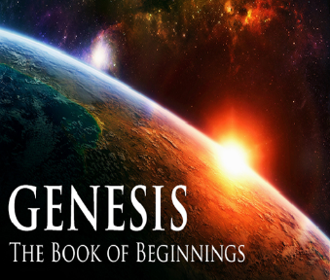
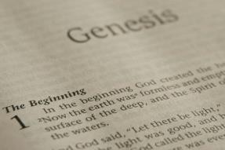
GENESIS STRUCTURE
Genesis 12-50 (four people)
Abraham (12:1–25:11)
Isaac (25:12–26:35)
Jacob (27–36)
Joseph (37–50)

Slide 3
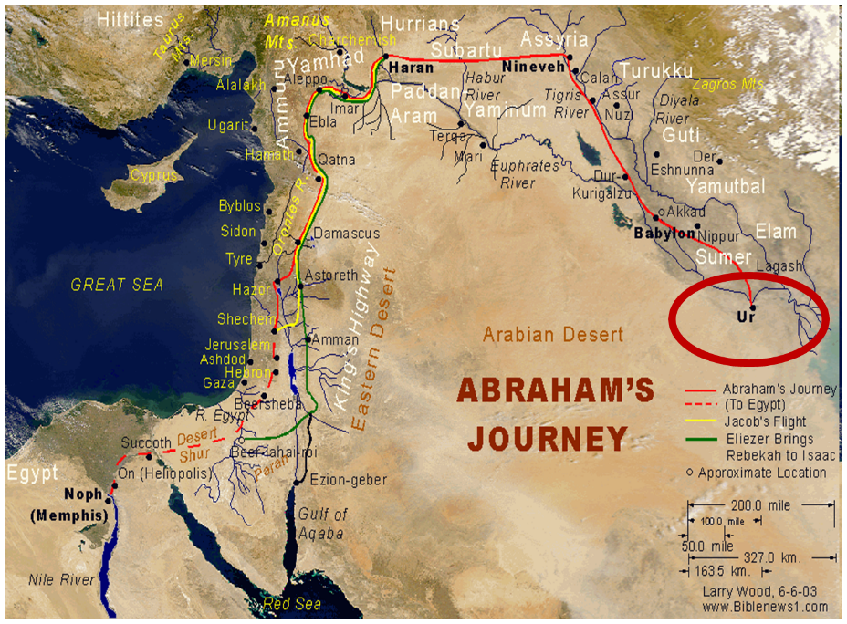

Slide 4
Genesis 32:1‒33:17 Jacob and Esau
Mahanaim (32:1-2)
Jacob’s Message to Esau (32:3-21)
Peniel (32:22-32)
Jacob’s Meeting with Esau (33:1-17)

Slide 5
Genesis 32:1‒33:17 Jacob and Esau
Mahanaim (32:1-2)
Jacob’s Message to Esau (32:3-21)
Peniel (32:22-32)
Jacob’s Meeting with Esau (33:1-17)

Slide 6
I. Genesis 32:1-2 Mahanaim
Background to the naming (1)
The naming (2)

Slide 7
I. Genesis 32:1-2 Mahanaim
Background to the naming (1)
The naming (2)

Slide 9
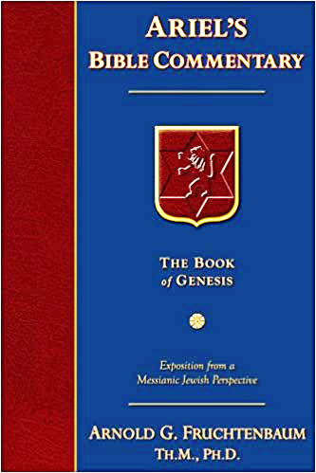
Dr. Arnold G. Fruchtenbaum
The Book of Genesis, 437
“Furthermore: And behold, the angels of God. In the Book of Genesis, the phrase the angels of God is found only twice, here and in 32:1; and it is significant as to the circumstances when it appears. Here in verse 12, the angels of God are mentioned as Jacob departs from the Land. In 32:1, they appear again as Jacob is returning to the Land.”

Slide 10
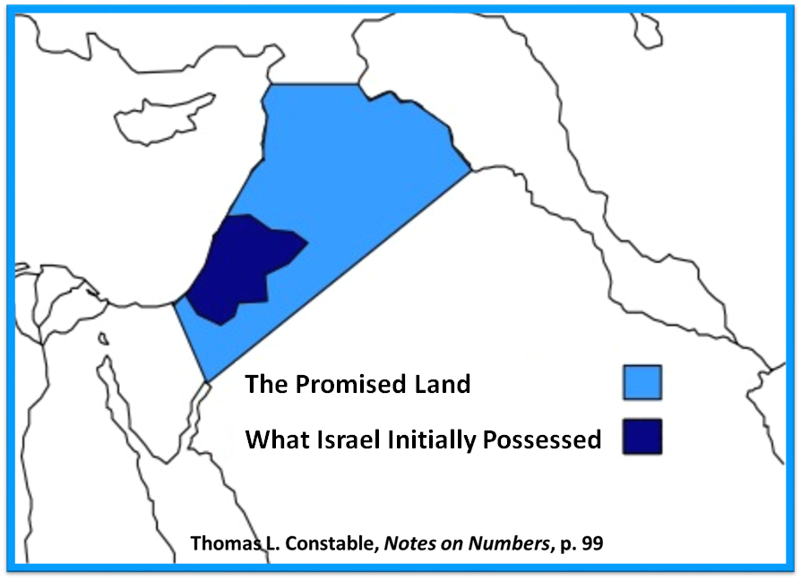

Slide 11
I. Genesis 32:1-2 Mahanaim
Background to the naming (1)
The naming (2)

Slide 12
Dr. Arnold G. Fruchtenbaum
The Book of Genesis, 475
“Genesis 32:2 records Jacob’s response: And Jacob said when he saw them, This is God’s host. In Hebrew, the word host is machaneh, and what he was saying was that this was God’s ‘camp.’ This is not the normal Hebrew word for host, but rather it is God’s ‘camp.’ That led to the naming of the place: and he called the name of the place Mahanaim, a dual form of machaneh, literally meaning ‘two camps.’ The two camps were Jacob’s camp and God’s camp, where the angels were.”

Slide 13
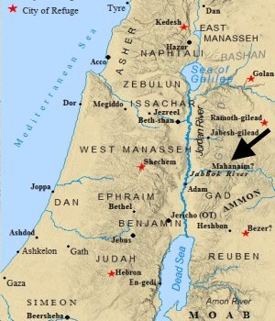

Slide 14
Dr. Arnold G. Fruchtenbaum
The Book of Genesis, 475
“In later history, Mahanaim became a border town between the tribes of Manasseh and Gad (Josh. 13:26, 13:30), and it became a capital of Israel under Ishbosheth (II Sam. 2:8). Mahanaim was the city to which David fled from Absalom (II Sam. 17:24, 17:27), and it was made a district capital under Solomon (I Kings 4:14).”

Slide 15
Genesis 32:1‒33:17 Jacob and Esau
Mahanaim (32:1-2)
Jacob’s Message to Esau (32:3-21)
Peniel (32:22-32)
Jacob’s Meeting with Esau (33:1-17)

Slide 16
II. Genesis 32:3-21 Jacob’s Response
Messengers sent to Esau (3-6)
Jacob’s response (7-12)
Offer of appeasement (13-16)
Instructions (17-20a)
Jacob’s desire to appease Esau (20b)
Concluding circumstances (21)

Slide 17
II. Genesis 32:3-21 Jacob’s Response
Messengers sent to Esau (3-6)
Jacob’s response (7-12)
Offer of appeasement (13-16)
Instructions (17-20a)
Jacob’s desire to appease Esau (20b)
Concluding circumstances (21)

Slide 18
Genesis 32:3-6 Messengers Sent to Esau
Sending (3)
Message (4-5)
Messengers return (6)

Slide 19
Genesis 32:3-6 Messengers Sent to Esau
Sending (3)
Message (4-5)
Messengers return (6)

Slide 20
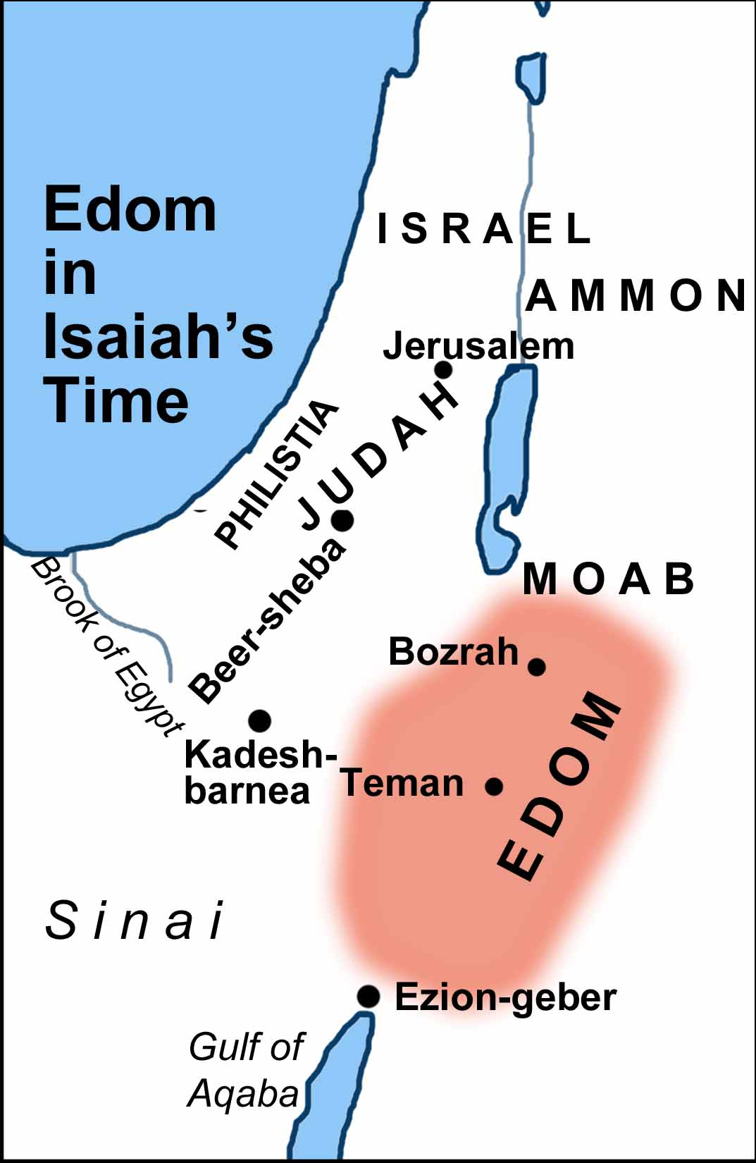

Slide 21
Genesis 32:3-6 Messengers Sent to Esau
Sending (3)
Message (4-5)
Messengers return (6)

Slide 22
Genesis 32:4-5 Message
Declaration (4a)
Servant (4b)
Sojourn (4c)
Wealth (5a)
Purpose (5b)

Slide 23
Genesis 32:4-5 Message
Declaration (4a)
Servant (4b)
Sojourn (4c)
Wealth (5a)
Purpose (5b)

Slide 24
Genesis 32:4-5 Message
Declaration (4a)
Servant (4b)
Sojourn (4c)
Wealth (5a)
Purpose (5b)

Slide 25
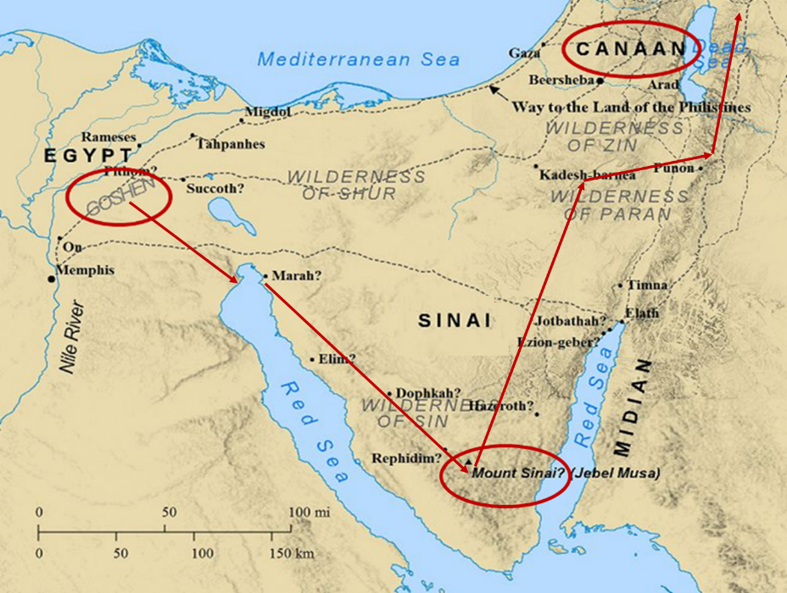

Slide 26
Numbers 13:32-33
³² So they gave out to the sons of Israel a bad report of the land which they had spied out, saying, “The land through which we have gone, in spying it out, is a land that devours its inhabitants; and all the people whom we saw in it are men of great size. ³³ There also we saw the Nephilim (the sons of Anak are part of the Nephilim); and we became like grasshoppers in our own sight, and so we were in their sight.”

Slide 27
Genesis 32:4-5 Message
Declaration (4a)
Servant (4b)
Sojourn (4c)
Wealth (5a)
Purpose (5b)

Slide 30
Genesis 32:4-5 Message
Declaration (4a)
Servant (4b)
Sojourn (4c)
Wealth (5a)
Purpose (5b)

Slide 31
8 New Promises Genesis 12:1-3
Land (Gen. 12:1b)
Great nation (Gen. 12:2a)
Personal blessing (Gen. 12:2b)
Great name (Gen. 12:2c)
Blessing to others (Gen. 12:2d)
Blessing to blessers (Gen. 12:3a)
Cursing to cursers (Gen. 12:3b)
Blessing to the world (Gen. 12:3c)

Slide 32
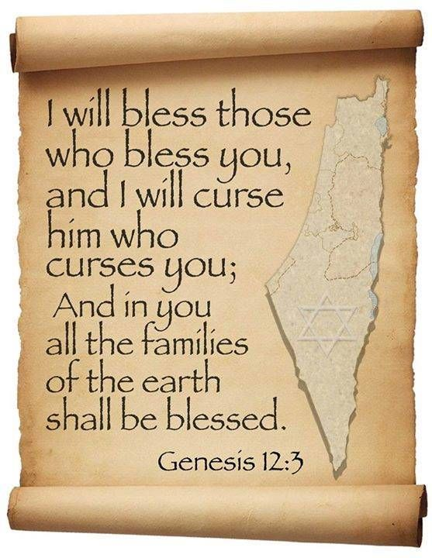
Genesis 12:2
“And I will make you a great nation, And I will bless you, And make your name great; And so you shall be a blessing.”

Slide 33
Genesis 32:4-5 Message
Declaration (4a)
Servant (4b)
Sojourn (4c)
Wealth (5a)
Purpose (5b)

Slide 34
Genesis 32:3-6 Messengers Sent to Esau
Sending (3)
Message (4-5)
Messengers return (6)

Slide 35
II. Genesis 32:3-21 Jacob’s Response
Messengers sent to Esau (3-6)
Jacob’s response (7-12)
Offer of appeasement (13-16)
Instructions (17-20a)
Jacob’s desire to appease Esau (20b)
Concluding circumstances (21)

Slide 36
Genesis 32:7-12 Jacob’s Response
1st response: division (7-8)
2nd response: prayer (9-12)

Slide 37
Genesis 32:7-12 Jacob’s Response
1st response: division (7-8)
2nd response: prayer (9-12)

Slide 38
Genesis 32:7-8 First Response: Division
Fear (7a)
Division (7b)
Reason (8)

Slide 39
Genesis 32:7-8 First Response: Division
Fear (7a)
Division (7b)
Reason (8)

Slide 40
Revelation 21:8
“But for the cowardly and unbelieving and abominable and murderers and immoral persons and sorcerers and idolaters and all liars, their part will be in the lake that burns with fire and brimstone, which is the second death.”

Slide 41
Genesis 32:7-8 First Response: Division
Fear (7a)
Division (7b)
Reason (8)

Slide 42
8 New Promises Genesis 12:1-3
Land (Gen. 12:1b)
Great nation (Gen. 12:2a)
Personal blessing (Gen. 12:2b)
Great name (Gen. 12:2c)
Blessing to others (Gen. 12:2d)
Blessing to blessers (Gen. 12:3a)
Cursing to cursers (Gen. 12:3b)
Blessing to the world (Gen. 12:3c)

Slide 43
Genesis 12:2
“And I will make you a great nation, And I will bless you, And make your name great; And so you shall be a blessing.”

Slide 44
Genesis 32:7-8 First Response: Division
Fear (7a)
Division (7b)
Reason (8)

Slide 45
Genesis 32:7-12 Jacob’s Response
1st response: division (7-8)
2nd response: prayer (9-12)

Slide 46
Genesis 32:9-12 Second Response: Prayer
Addressee (9)
Past blessing (10)
Petition (11)
Basis (12)

Slide 47
Genesis 32:9-12 Second Response: Prayer
Addressee (9)
Past blessing (10)
Petition (11)
Basis (12)

Slide 48
Genesis 32:9-12 Second Response: Prayer
Addressee (9)
Past blessing (10)
Petition (11)
Basis (12)

Slide 51
8 New Promises Genesis 12:1-3
Land (Gen. 12:1b)
Great nation (Gen. 12:2a)
Personal blessing (Gen. 12:2b)
Great name (Gen. 12:2c)
Blessing to others (Gen. 12:2d)
Blessing to blessers (Gen. 12:3a)
Cursing to cursers (Gen. 12:3b)
Blessing to the world (Gen. 12:3c)

Slide 52
Genesis 12:2
“And I will make you a great nation, And I will bless you, And make your name great; And so you shall be a blessing.”

Slide 53
Genesis 32:9-12 Second Response: Prayer
Addressee (9)
Past blessing (10)
Petition (11)
Basis (12)

Slide 54
Three Tenses of Salvation
Phase | Justification | Sanctification | Glorification
Tense | Past | Present | Future
Saved from sin’s: | Penalty | Power | Presence
Scripture | Eph 2:8-9; Titus 3:5 | Philip 2:12 | Rom 5:10

Slide 55
Genesis 32:9-12 Second Response: Prayer
Addressee (9)
Past blessing (10)
Petition (11)
Basis (12)

Slide 57
II. Genesis 32:3-21 Jacob’s Response
Messengers sent to Esau (3-6)
Jacob’s response (7-12)
Offer of appeasement (13-16)
Instructions (17-20a)
Jacob’s desire to appease Esau (20b)
Concluding circumstances (21)

Slide 58
Genesis 32:13-16 Offer of Appeasement
Setting aside (13)
Enumerated (14-15)
Division (16)

Slide 59
Genesis 32:13-16 Offer of Appeasement
Setting aside (13)
Enumerated (14-15)
Division (16)

Slide 60
Genesis 32:13-16 Offer of Appeasement
Setting aside (13)
Enumerated (14-15)
Division (16)

Slide 61
Genesis 32:14-15 Enumerated
Goats (14a)
Rams (14b)
Camels (15a)
Cows (15b)
Bulls (15c)
Donkeys (15d)

Slide 62
Genesis 32:14-15 Enumerated
Goats (14a)
Rams (14b)
Camels (15a)
Cows (15b)
Bulls (15c)
Donkeys (15d)

Slide 63
Genesis 32:14-15 Enumerated
Goats (14a)
Rams (14b)
Camels (15a)
Cows (15b)
Bulls (15c)
Donkeys (15d)

Slide 64
Genesis 32:14-15 Enumerated
Goats (14a)
Rams (14b)
Camels (15a)
Cows (15b)
Bulls (15c)
Donkeys (15d)

Slide 65
Genesis 32:14-15 Enumerated
Goats (14a)
Rams (14b)
Camels (15a)
Cows (15b)
Bulls (15c)
Donkeys (15d)

Slide 66
Genesis 32:14-15 Enumerated
Goats (14a)
Rams (14b)
Camels (15a)
Cows (15b)
Bulls (15c)
Donkeys (15d)

Slide 67
Genesis 32:14-15 Enumerated
Goats (14a)
Rams (14b)
Camels (15a)
Cows (15b)
Bulls (15c)
Donkeys (15d)

Slide 68
8 New Promises Genesis 12:1-3
Land (Gen. 12:1b)
Great nation (Gen. 12:2a)
Personal blessing (Gen. 12:2b)
Great name (Gen. 12:2c)
Blessing to others (Gen. 12:2d)
Blessing to blessers (Gen. 12:3a)
Cursing to cursers (Gen. 12:3b)
Blessing to the world (Gen. 12:3c)

Slide 69
Genesis 12:2
“And I will make you a great nation, And I will bless you, And make your name great; And so you shall be a blessing.”

Slide 70
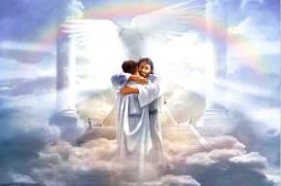
Ephesians 1:3
“Blessed be the God and Father of our Lord Jesus Christ, who has blessed us with every spiritual blessing in the heavenly places in Christ.”

Slide 71
Genesis 32:13-16 Offer of Appeasement
Setting aside (13)
Enumerated (14-15)
Division (16)

Slide 72
II. Genesis 32:3-21 Jacob’s Response
Messengers sent to Esau (3-6)
Jacob’s response (7-12)
Offer of appeasement (13-16)
Instructions (17-20a)
Jacob’s desire to appease Esau (20b)
Concluding circumstances (21)

Slide 73
Genesis 32:17-20a Jacob’s Response
1st group (17-18)
Remaining 4 groups (19-20a)

Slide 74
Genesis 32:17-20a Jacob’s Response
1st group (17-18)
Remaining 4 groups (19-20a)

Slide 75
Genesis 32:17-18 First Group
Esau’s anticipated questions (17)
Answers (18)

Slide 76
Genesis 32:17-18 First Group
Esau’s anticipated questions (17)
Answers (18)

Slide 77
Genesis 32:17 Esau’s Anticipated Questions
Whose are you? (17a)
Where are you going? (17b)
Whose are these behind you? (17c)

Slide 78
Genesis 32:17 Esau’s Anticipated Questions
Whose are you? (17a)
Where are you going? (17b)
Whose are these behind you? (17c)

Slide 79
Genesis 32:17 Esau’s Anticipated Questions
Whose are you? (17a)
Where are you going? (17b)
Whose are these behind you? (17c)

Slide 80
Genesis 32:17 Esau’s Anticipated Questions
Whose are you? (17a)
Where are you going? (17b)
Whose are these behind you? (17c)

Slide 81
Genesis 32:17-18 First Group
Esau’s anticipated questions (17)
Answers (18)

Slide 82
Genesis 32:18 Answers
They belong to Jacob (18a)
Present sent to Esau (18b)
Jacob is behind us (18c)

Slide 83
Genesis 32:18 Answers
They belong to Jacob (18a)
Present sent to Esau (18b)
Jacob is behind us (18c)

Slide 84
Genesis 32:18 Answers
They belong to Jacob (18a)
Present sent to Esau (18b)
Jacob is behind us (18c)

Slide 85
Genesis 32:18 Answers
They belong to Jacob (18a)
Present sent to Esau (18b)
Jacob is behind us (18c)

Slide 86
Genesis 32:17-20a Jacob’s Response
1st group (17-18)
Remaining 4 groups (19-20a)

Slide 87
Genesis 32:19-20a First Group
Instructions (19a)
Answer (19b-20a)

Slide 88
Genesis 32:19-20a First Group
Instructions (19a)
Answer (19b-20a)

Slide 89
Genesis 32:19-20a First Group
Instructions (19a)
Answer (19b-20a)

Slide 90
II. Genesis 32:3-21 Jacob’s Response
Messengers sent to Esau (3-6)
Jacob’s response (7-12)
Offer of appeasement (13-16)
Instructions (17-20a)
Jacob’s desire to appease Esau (20b)
Concluding circumstances (21)

Slide 91
Dr. Arnold G. Fruchtenbaum
The Book of Genesis, 480-81
“For he said, I will appease him with the present that goes before me. The Hebrew word for appease has the same Hebrew root as “atonement.” What this means is that Jacob was seeking Esau’s forgiveness: Afterward I will see his face; peradventure he will accept me.”

Slide 92
Isaiah 53:3–6
³ “He was despised and forsaken of men, A man of sorrows and acquainted with grief; And like one from whom men hide their face He was despised, and we did not esteem Him. ⁴ Surely our griefs He Himself bore, And our sorrows He carried; Yet we ourselves esteemed Him stricken, Smitten of God, and afflicted. ⁵ But He was pierced through for our transgressions, He was crushed for our iniquities; The chastening for our well-being fell upon Him, And by His scourging we are healed. ⁶ All of us like sheep have gone astray, Each of us has turned to his own way; But the Lord has caused the iniquity of us all To fall on Him.”

Slide 93
False Views of the Atonement
Ransom to Satan – Christ’s death is a ransom to Satan and not the Father (A.D. 185‒54)
Moral influence – Christ’s death is an expression of God’s love (A.D. 1079‒1142)
Moral example – Christ’s death inspires us to be sacrificial (A.D. 1539‒1604)
Governmental – Christ’s death promotes respect for God’s Law (A.D. 1583‒1645)
Accidental – Fate accidently ended Christ’s life

Slide 94
II. Genesis 32:3-21 Jacob’s Response
Messengers sent to Esau (3-6)
Jacob’s response (7-12)
Offer of appeasement (13-16)
Instructions (17-20a)
Jacob’s desire to appease Esau (20b)
Concluding circumstances (21)

Slide 95
Genesis 32:21 Concluding Circumstances
Presents pass before Jacob (21a)
Jacob lodged that night (21b)

Slide 96
Genesis 32:21 Concluding Circumstances
Presents pass before Jacob (21a)
Jacob lodged that night (21b)

Slide 97
Genesis 32:21 Concluding Circumstances
Presents pass before Jacob (21a)
Jacob lodged that night (21b)

Slide 98
Conclusion

Slide 99
II. Genesis 32:3-21 Jacob’s Response
Messengers sent to Esau (3-6)
Jacob’s response (7-12)
Offer of appeasement (13-16)
Instructions (17-20a)
Jacob’s desire to appease Esau (20b)
Concluding circumstances (21)

Slide 100
²⁴ The Lord bless you, and keep you; ²⁵ The Lord make His face shine on you, And be gracious to you; ²⁶ The Lord lift up His countenance on you, And give you peace.
Numbers 6:24–26 (NASB95)

