Slide 1
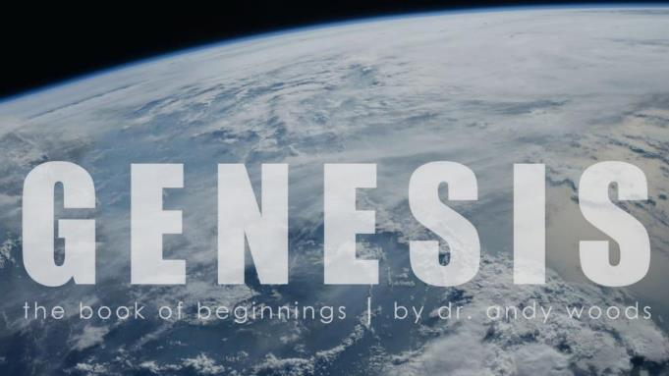
Genesis 12‒50
Israel’s Birth & Preservation

Slide 2
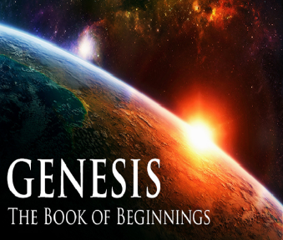
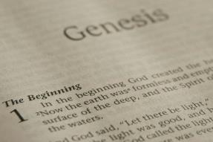
GENESIS STRUCTURE
Genesis 12-50 (four people)
Abraham (12:1–25:11)
Isaac (25:12–26:35)
Jacob (27–36)
Joseph (37–50)

Slide 3
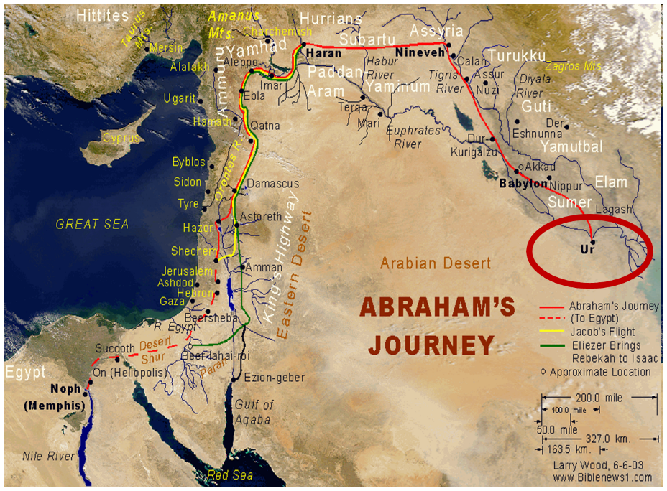

Slide 4
Genesis 31:43-55 Jacob and Laban’s Covenant
Covenant Proposal (43-44)
Covenant Witnesses (45-50)
Laban’s Perspective (51-53a)
Jacob’s Response (53b-54)
Laban’s Departure (55)

Slide 5
IV. Genesis 31:53b-54 Jacob’s Response
Swore (53b)
Sacrifice (54a)
Meal (54b)
Duration (54c)

Slide 6
IV. Genesis 31:53b-54 Jacob’s Response
Swore (53b)
Sacrifice (54a)
Meal (54b)
Duration (54c)

Slide 7
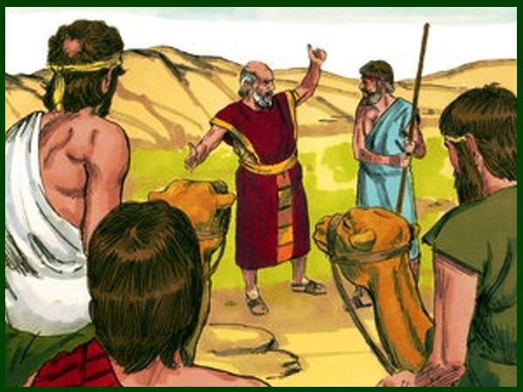
Charles Ryrie The Ryrie Study Bible, page 42
Genesis 31:42 (RSBEE:NASB1995U): “31:42 the fear of Isaac means ‘the God Isaac feared.’”

Slide 8
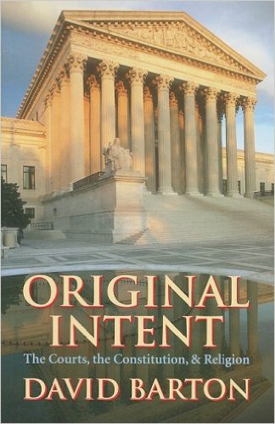
David Barton, Original Intent, p. 245

Slide 11
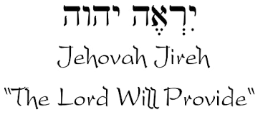

Slide 12
Names for God in Genesis
Elohim (1:1) - Power
Yahweh (2:4) - Relational
El Roi (Gen. 16:13) – Aware
El Olam (21:33) – Eternal
Jehovah Jireh (22:14) - Provision
God Isaac Feared (31:42, 53) - Reverenced

Slide 13
Colossians 2:8
“See to it that no one takes you captive through philosophy and empty deception, according to the tradition of men, according to the elementary principles of the world, rather than according to Christ.”

Slide 14
AUTHORSHIP
Charles Darwin
Karl Marx
Julius Wellhausen
John Dewey
Sigmund Freud
John Maynard Keynes
Soren Kierkegaard

Slide 15
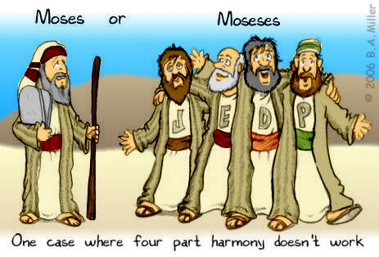
DOCUMENTARY HYPOTHESIS
J – Yahwist (850 B.C.)
E – Elohist (750 B.C.)
D – Deuteronomist (621 B.C.)
P – Priestly code (525 B.C.)

Slide 16
Arguments Favoring the Documentary Hypothesis
Writing unknown at the time of Moses
Different names for God
Differing styles
Editorial insertions (Gen. 36:31)
Assumption of polytheism to monotheism

Slide 17
Problems with the Documentary Hypothesis
JEDP Documents never discovered
Writing prior to 1500 B.C. (Code of Hamurabi)
Different names for God used for different literary purposes
Editorial insertions added after Moses completed the bulk of the work
Polytheism to monotheism trajectory never proven
Moses relied upon other sources (Gen. 5:1)

Slide 18
IV. Genesis 31:53b-54 Jacob’s Response
Swore (53b)
Sacrifice (54a)
Meal (54b)
Duration (54c)

Slide 20
Romans 12:1
¹ Therefore I urge you, brethren, by the mercies of God, to present your bodies a living and holy sacrifice, acceptable to God, which is your spiritual service of worship.

Slide 21
IV. Genesis 31:53b-54 Jacob’s Response
Swore (53b)
Sacrifice (54a)
Meal (54b)
Duration (54c)

Slide 24
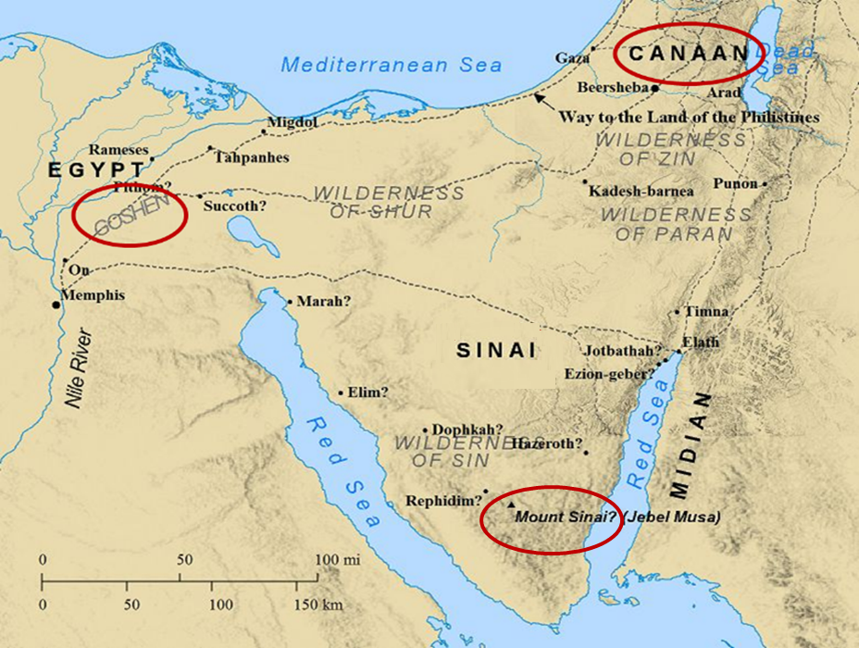

Slide 25
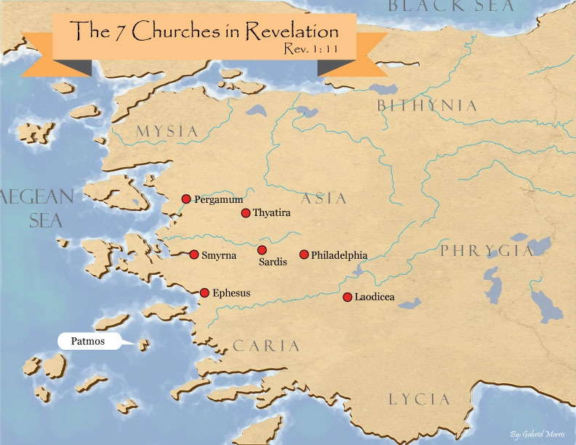

Slide 26
IV. Genesis 31:53b-54 Jacob’s Response
Swore (53b)
Sacrifice (54a)
Meal (54b)
Duration (54c)

Slide 27
Genesis 31:43-55 Jacob and Laban’s Covenant
Covenant Proposal (43-44)
Covenant Witnesses (45-50)
Laban’s Perspective (51-53a)
Jacob’s Response (53b-54)
Laban’s Departure (55)

Slide 28
V. Genesis 31:55 Laban’s Departure
Blessing (55a)
Departure (55b)

Slide 29
V. Genesis 31:55 Laban’s Departure
Blessing (55a)
Departure (55b)

Slide 31
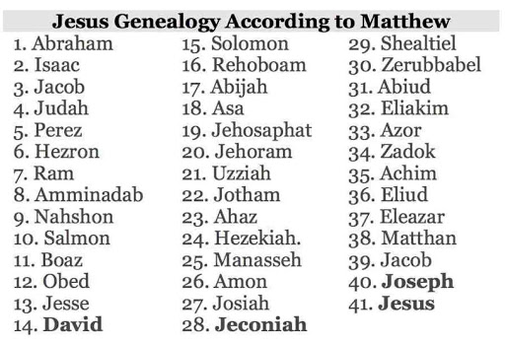

Slide 32
V. Genesis 31:55 Laban’s Departure
Blessing (55a)
Departure (55b)

Slide 34
Genesis 32:1‒33:17 Jacob and Esau
Mahanaim (32:1-2)
Jacob’s Message to Esau (32:3-21)
Peniel (32:22-32)
Jacob’s Meeting with Esau (33:1-17)

Slide 35
Genesis 32:1‒33:17 Jacob and Esau
Mahanaim (32:1-2)
Jacob’s Message to Esau (32:3-21)
Peniel (32:22-32)
Jacob’s Meeting with Esau (33:1-17)

Slide 36
I. Genesis 32:1-2 Mahanaim
Background to the naming (1)
The naming (2)

Slide 37
I. Genesis 32:1-2 Mahanaim
Background to the naming (1)
The naming (2)

Slide 38
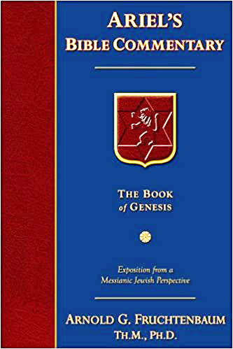
Dr. Arnold G. Fruchtenbaum
The Book of Genesis, 437
“Furthermore: And behold, the angels of God. In the Book of Genesis, the phrase the angels of God is found only twice, here and in 32:1; and it is significant as to the circumstances when it appears. Here in verse 12, the angels of God are mentioned as Jacob departs from the Land. In 32:1, they appear again as Jacob is returning to the Land.”

Slide 39
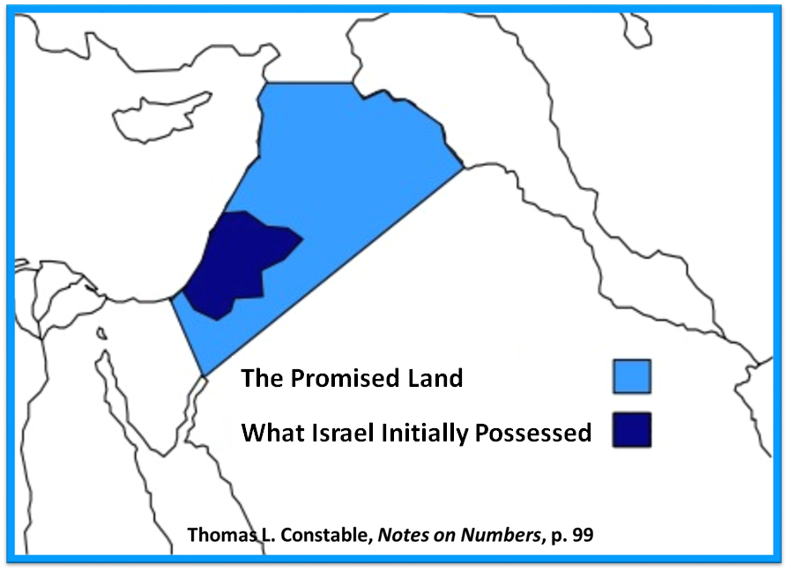

Slide 40
I. Genesis 32:1-2 Mahanaim
Background to the naming (1)
The naming (2)

Slide 41
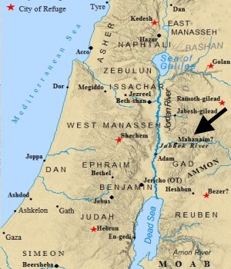

Slide 42
Dr. Arnold G. Fruchtenbaum
The Book of Genesis, 475
“In later history, Mahanaim became a border town between the tribes of Manasseh and Gad (Josh. 13:26, 13:30), and it became a capital of Israel under Ishbosheth (II Sam. 2:8). Mahanaim was the city to which David fled from Absalom (II Sam. 17:24, 17:27), and it was made a district capital under Solomon (I Kings 4:14).”

Slide 43
Conclusion

Slide 44
Genesis 31:43-55 Jacob and Laban’s Covenant
Covenant Proposal (43-44)
Covenant Witnesses (45-50)
Laban’s Perspective (51-53a)
Jacob’s Response (53b-54)
Laban’s Departure (55)

Slide 45
²⁴ The Lord bless you, and keep you; ²⁵ The Lord make His face shine on you, And be gracious to you; ²⁶ The Lord lift up His countenance on you, And give you peace.
Numbers 6:24–26 (NASB95)

