Slide 1


Dr. Andy Woods
Senior Pastor – Sugar Land Bible Church
President – Chafer Theological Seminary

Slide 2

Introductory Matters
Authorship: Paul
Audience: Thessalonians
Place of writing: Corinth
Date: AD 51
Occasion: Forgery
Structure: 3 Parts
Message: working & waiting
Purpose: Correction of orthodoxy & orthopraxy

Slide 3
Structure
1 – Commendation
2 – Correction
3 – Consequences

Slide 4
Commendation (1)
Reminder of grace (1:1-2)
Thanksgiving (1:3-4)
Kingdom (1:5)
Destiny of their persecutors (1:6-10)
Prayer for continued progress (1:11-12)

Slide 5
Commendation (1)
Reminder of grace (1:1-2)
Thanksgiving (1:3-4)
Kingdom (1:5)
Destiny of their persecutors (1:6-10)
Prayer for continued progress (1:11-12)

Slide 6
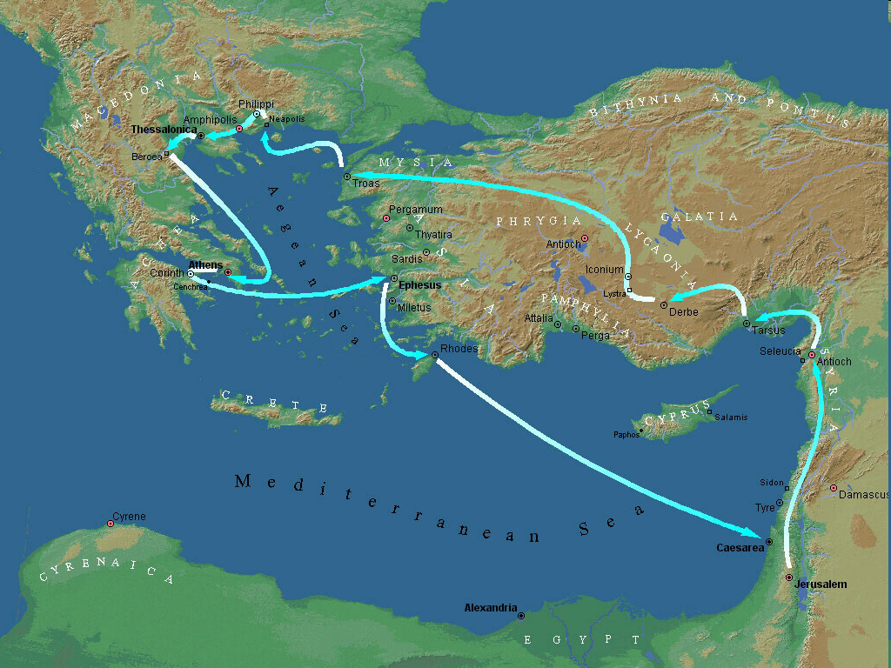

Second Missionary Journey

Slide 7
Second Missionary Journey

Slide 8
Second Missionary Journey

Slide 9
Three Tenses of Salvation
Phase | Justification | Sanctification | Glorification
Tense | Past | Present | Future
Saved from sin’s: | Penalty | Power | Presence
Scripture | Eph 2:8-9; Titus 3:5 | Philip 2:12 | Rom 5:10

Slide 10
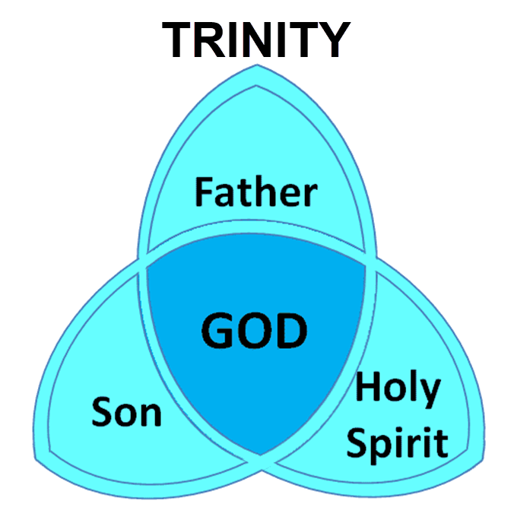

Slide 11
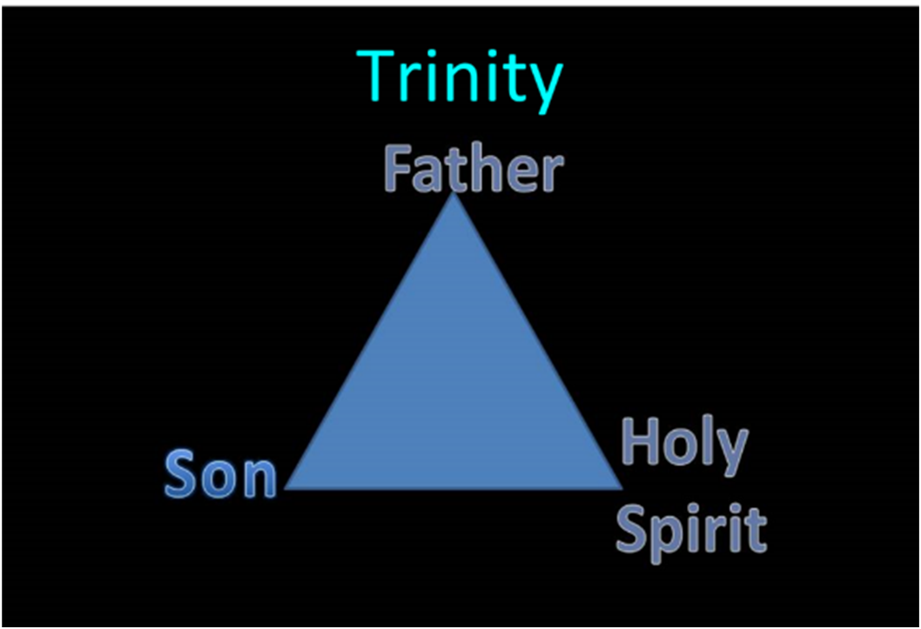

Slide 12
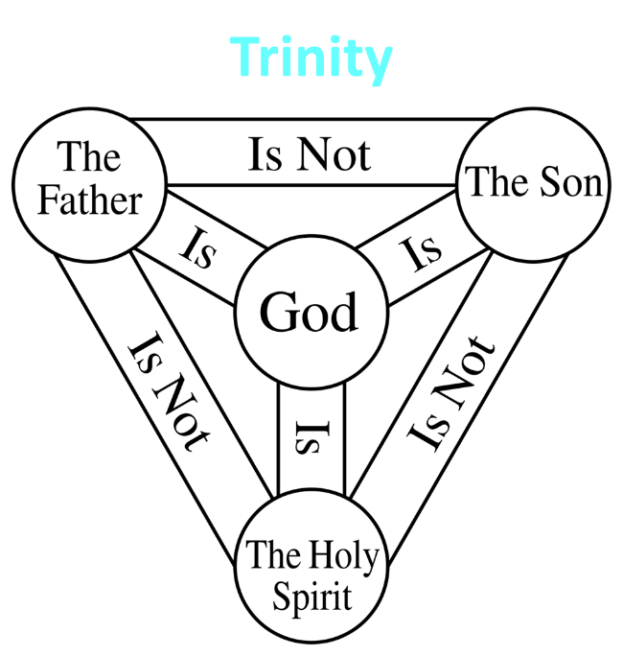

Slide 13
Commendation (1)
Reminder of grace (1:1-2)
Thanksgiving (1:3-4)
Kingdom (1:5)
Destiny of their persecutors (1:6-10)
Prayer for continued progress (1:11-12)

Slide 14
Commendation (1)
Reminder of grace (1:1-2)
Thanksgiving (1:3-4)
Kingdom (1:5)
Destiny of their persecutors (1:6-10)
Prayer for continued progress (1:11-12)

Slide 15
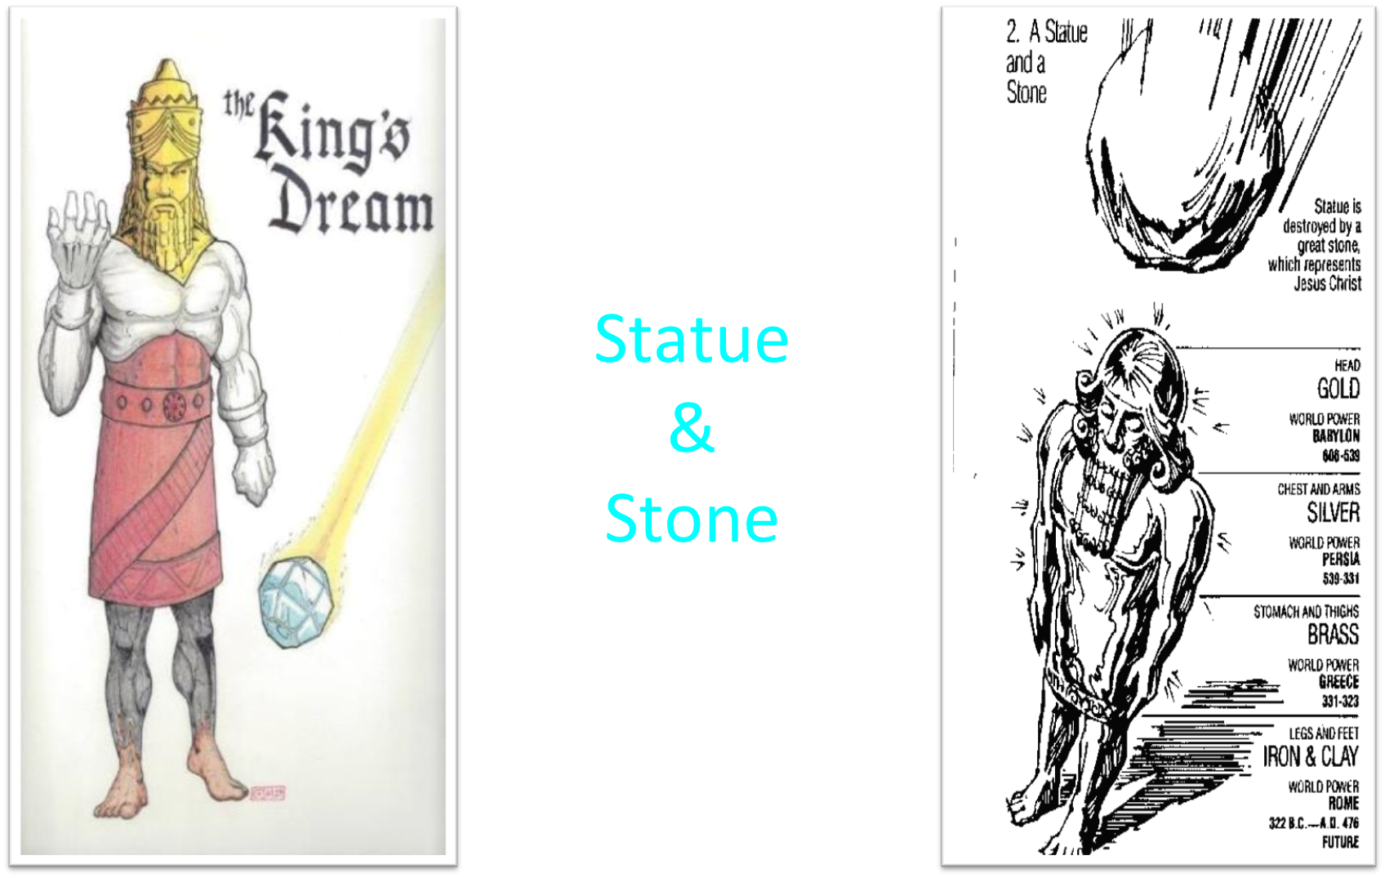

Slide 16
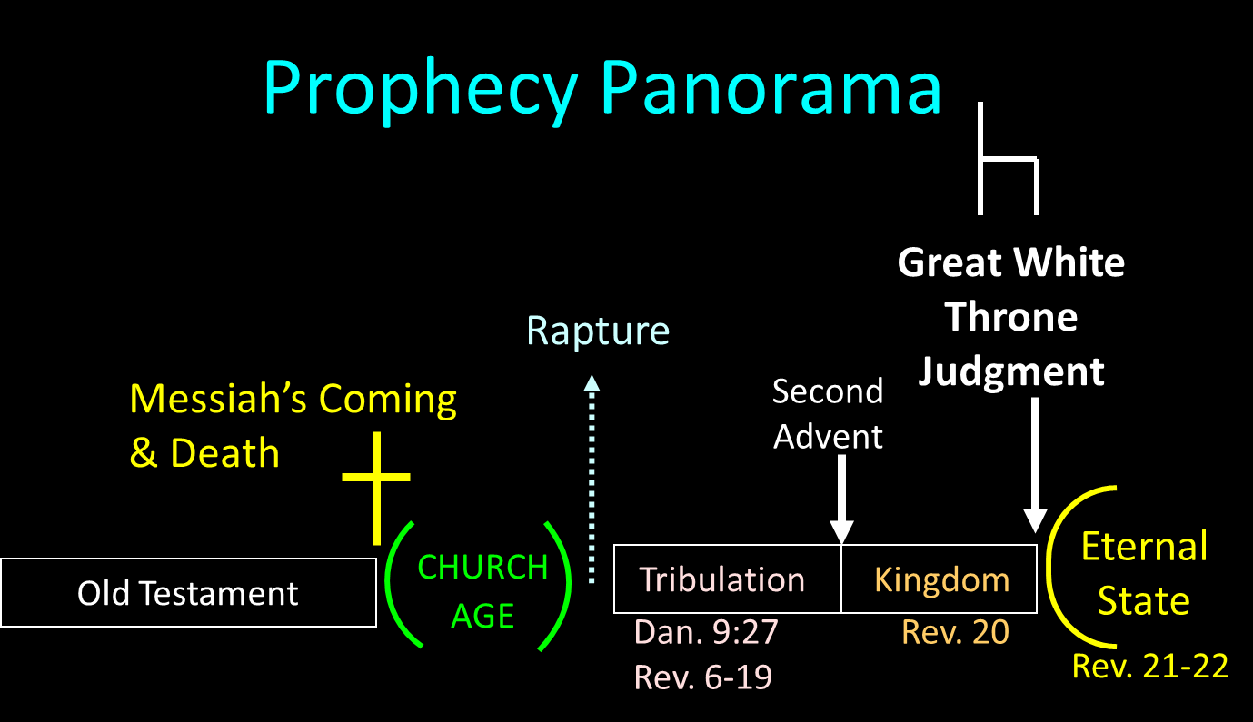

Slide 17
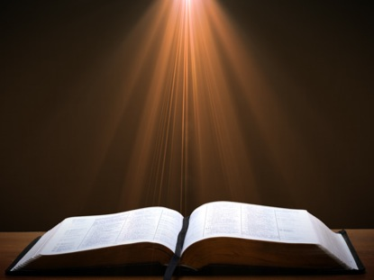
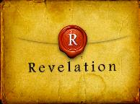
Revelation 5:10
“You have made them to be a kingdom and priests to our God; and they will reign [basileuō] upon the earth [gē].”

Slide 18
Commendation (1)
Reminder of grace (1:1-2)
Thanksgiving (1:3-4)
Kingdom (1:5)
Destiny of their persecutors (1:6-10)
Prayer for continued progress (1:11-12)

Slide 19


Genesis 15:16
“Then in the fourth generation they will return here, for the wrongdoing of the Amorite is not yet complete.”

Slide 20
RAPTURE DISTINCT FROM SECOND ADVENT
RAPTURE (1 Thess 4:13-17; 1 Cor 15:51-57) | SECOND COMING (Rev 19:11-16)
Christ comes in the air (1 Thess 4:16) | Christ comes to the earth (Zech 14:4)
For His saints (1 Thess 4:15-17) | With His saints (Rev 19:14)
Blessing (1 Thess 4:18) | Judgment (Rev 19:15)
Effects only believers (1 Thess 4:16) | Effects both believers and unbelievers (Rev 19:15)
Invisible (1 Thess 4:16) | Visible to all (Rev 1:7)
Announced only by an archangel (1 Thess 4:16) | Involves myriads of angels (Jude 14)
Resurrection (1 Cor 15: 51) | No resurrection
Rescue of the church (1 Thess 1:10) | Rescue of Israel (Matt 23:37-39)

Slide 21
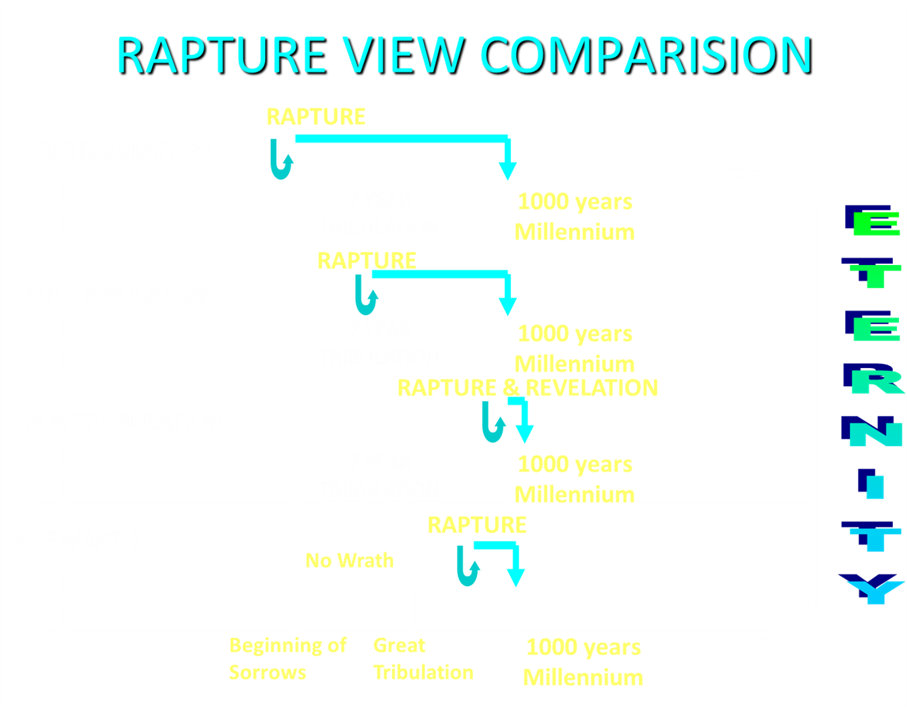

Slide 22
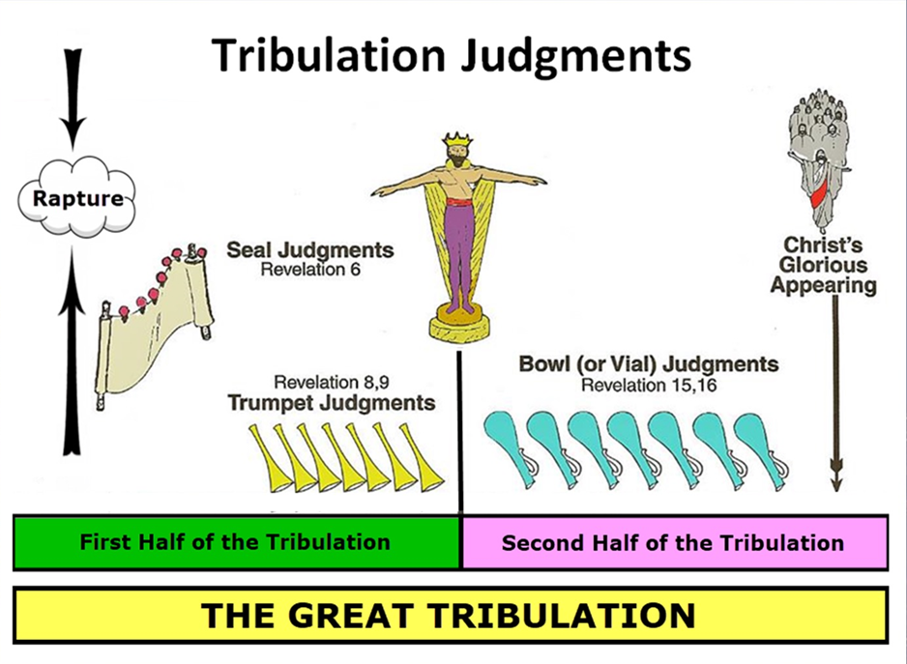

Slide 23
1st Six Seals (Revelation 6)
SEAL 1 – 6:1-2 – Advent of antichrist
SEAL 2 – 6:3-4 – War
SEAL 3 – 6:5-6 – Famine
SEAL 4 – 6:7-8 – Death
SEAL 5 – 6:9-11 – Martyrdoms
SEAL 6 – 6:12-17 – Cosmic disturbances

Slide 24
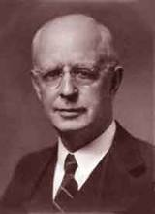
Lewis Sperry Chafer, vol. 7, Systematic Theology
(Grand Rapids, MI: Kregel Publications, 1993), 265-66.
Belief-God’s One Condition for Justification
“…because upwards of 150 passages of Scripture condition salvation upon believing only (cf. John 3:16; Acts 16:31).”

Slide 25
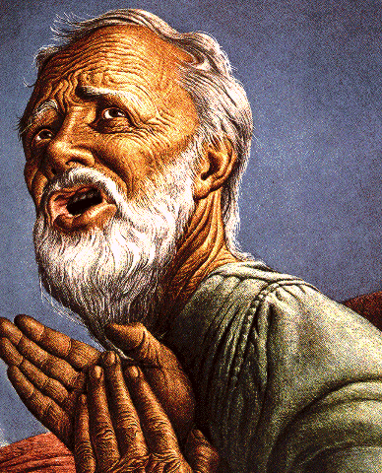
Belief – God’s One Condition for Justification
Gen 15:6
Then he believed in the LORD; and He reckoned it to him as righteousness.
John 3:16
For God so loved the world, that He gave His only begotten Son, that whoever believes in Him shall not perish, but have eternal life.
Acts 16:30-31
"Sirs, what must I do to be saved?" They said, "Believe in the Lord Jesus, and you will be saved..."

Slide 26
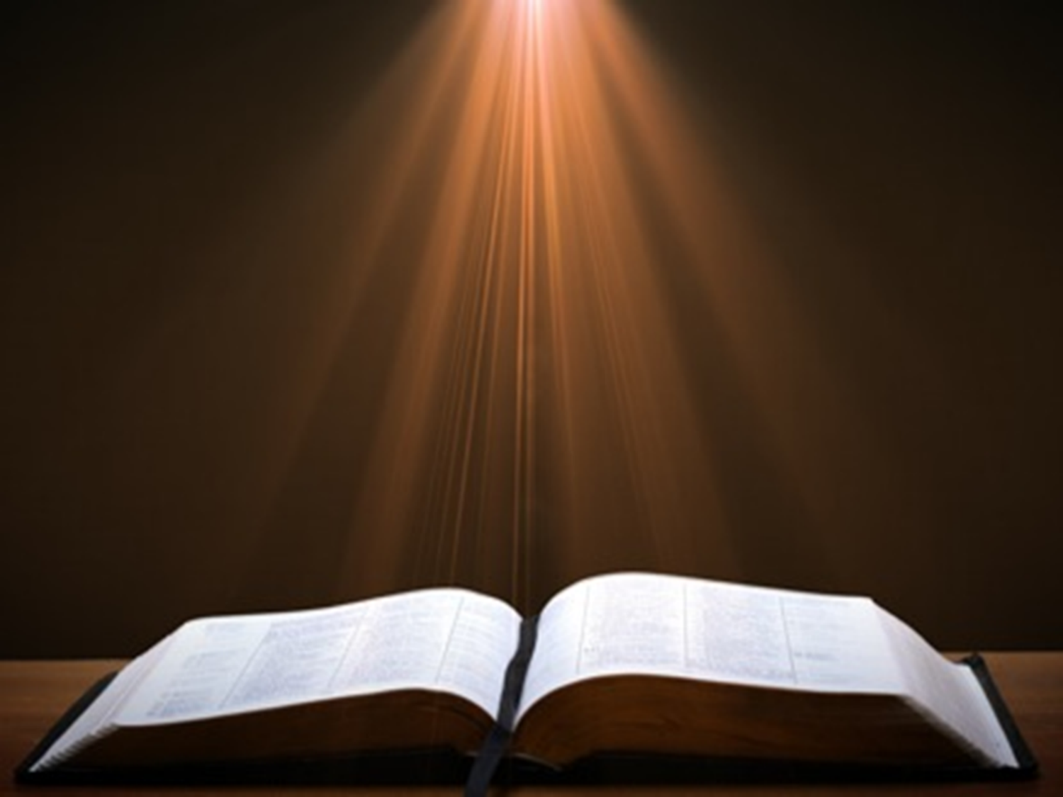
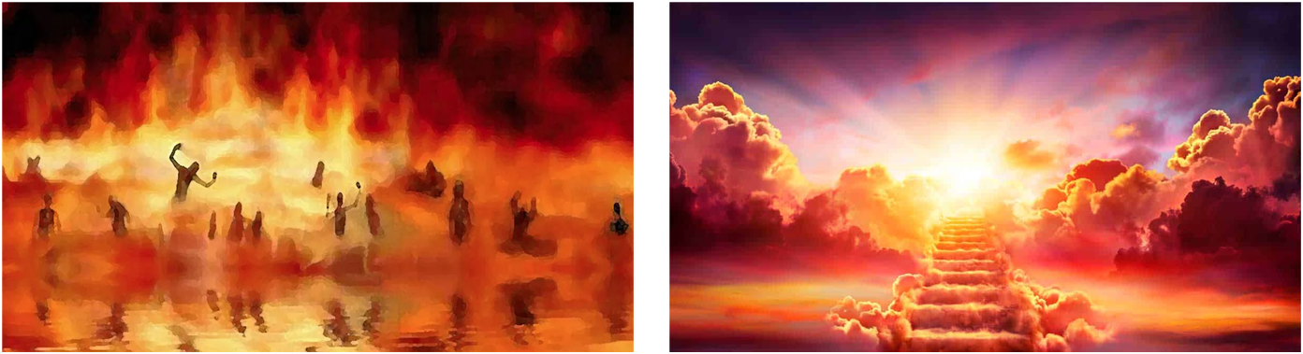
Matthew 25:46
“These will go away into eternal (aiōnios) punishment, but the righteous into eternal (aiōnios) life.

Slide 27

Romans 16:26
“but now is manifested, and by the Scriptures of the prophets, according to the commandment of the eternal (aiōnios) God, has been made known to all the nations, leading to obedience of faith.”

Slide 28
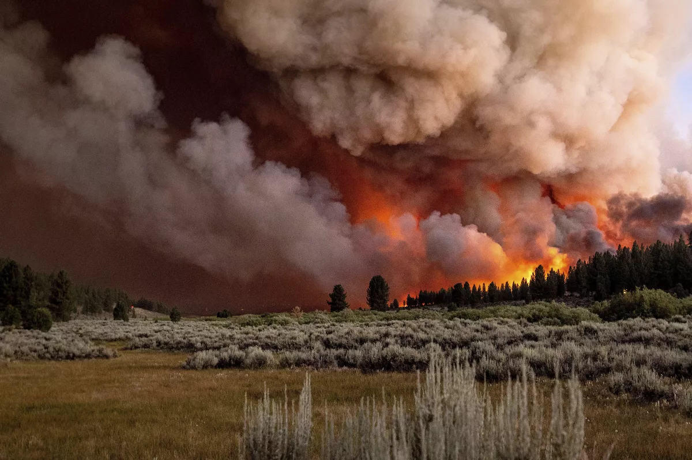
Revelation 14:11
“And the smoke of their torment goes up forever (aiōn) and ever (aiōn); they have no rest day and night, those who worship the beast and his image, and whoever receives the mark of his name.”

Slide 29

Daniel 12:1-2
“¹ Now at that time Michael, the great prince who stands guard over the sons of your people, will arise. And there will be a time of distress such as never occurred since there was a nation until that time; and at that time your people, everyone who is found written in the book, will be rescued. ² Many of those who sleep in the dust of the ground will awake, these to everlasting (olam) life, but the others to disgrace and everlasting (olam) contempt.”

Slide 30
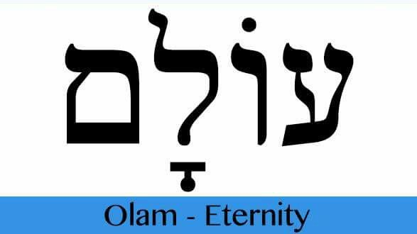
Psalm 90:2
“Before the mountains were born Or You gave birth to the earth and the world, Even from everlasting (olam) to everlasting (olam), You are God.”

Slide 31

Dominoes in a Row

Slide 34
Lewis Sperry Chafer, vol. 7, Systematic Theology
(Grand Rapids, MI: Kregel Publications, 1993), 265-66.
Belief-God’s One Condition for Justification
“…because upwards of 150 passages of Scripture condition salvation upon believing only (cf. John 3:16; Acts 16:31).”

Slide 35
Belief – God’s One Condition for Justification
Gen 15:6
Then he believed in the LORD; and He reckoned it to him as righteousness.
John 3:16
For God so loved the world, that He gave His only begotten Son, that whoever believes in Him shall not perish, but have eternal life.
Acts 16:30-31
"Sirs, what must I do to be saved?" They said, "Believe in the Lord Jesus, and you will be saved..."

Slide 36
Commendation (1)
Reminder of grace (1:1-2)
Thanksgiving (1:3-4)
Kingdom (1:5)
Destiny of their persecutors (1:6-10)
Prayer for continued progress (1:11-12)

Slide 37

2 Peter 1:5-7
⁵ Now for this very reason also, applying all diligence, in your faith supply moral excellence, and in your moral excellence, knowledge, ⁶ and in your knowledge, self-control, and in your self-control, perseverance, and in your perseverance, godliness, ⁷ and in your godliness, brotherly kindness, and in your brotherly kindness, love.

Slide 38
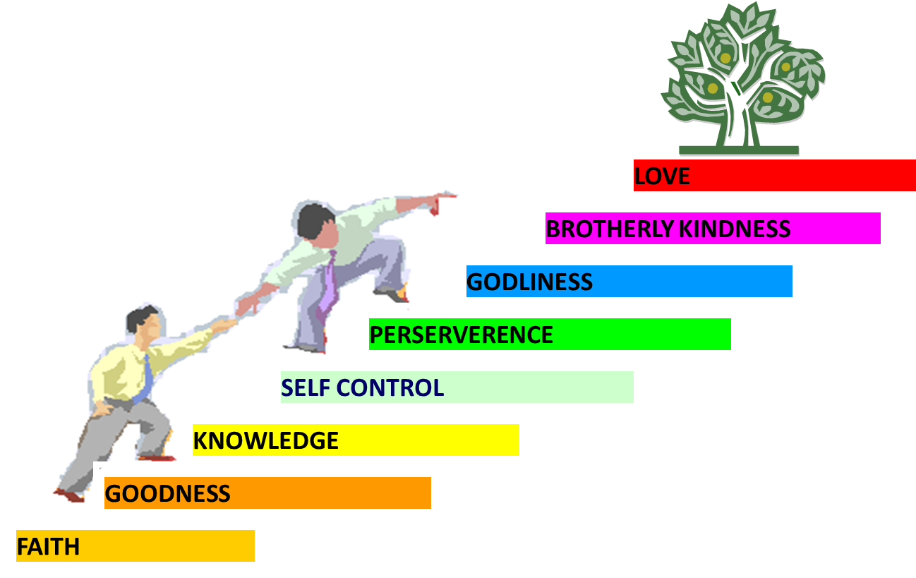
PORTRAIT OF GROWTH
1:5-7

Slide 39
Dispensational Theology is a
System of Theology
Traditional-normative dispensational theology is a system that embodies three essential, fundamental concepts called the sine qua non (lit. “without which is not”):
The consistent use of a plain, normal, literal, grammatical-historical method of interpretation;
Which reveals that the Church is distinct from Israel;
God’s overall purpose is to bring glory to Himself (Eph. 1:6, 12, 14).
Dr. Charles Ryrie, Dispensationalism, pp. 38-41

Slide 40
Dispensational Theology:
Doxological Purpose
God’s ultimate purpose for the ages is to glorify Himself. Scripture is not human-centered, as though salvation were the principle point, but God-centered, because His glory is at the center.
The glory of God is the primary principle that unifies all dispensations, the program of salvation being just one of the means by which God glorifies Himself. Each successive revelation of God’s plan for the ages, as well as His dealing with the elect, non-elect, angels, and nations all manifest His glory.
Dictionary of Premillennial Theology, Charles Ryrie, p. 94

Slide 41
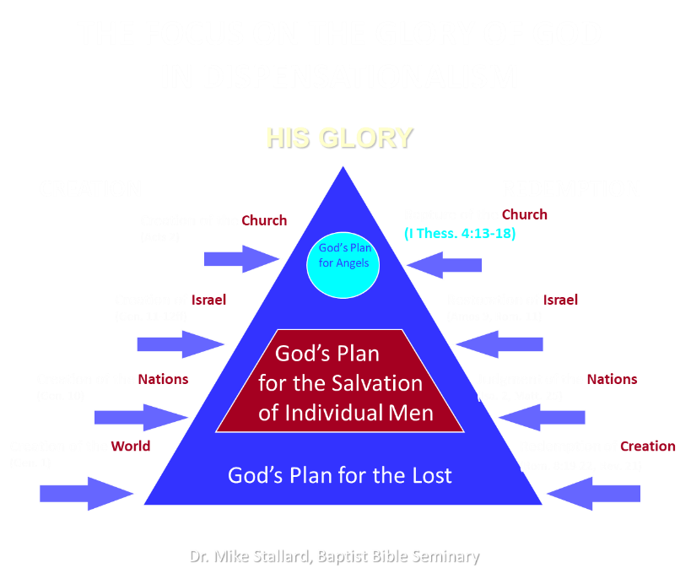

Slide 42

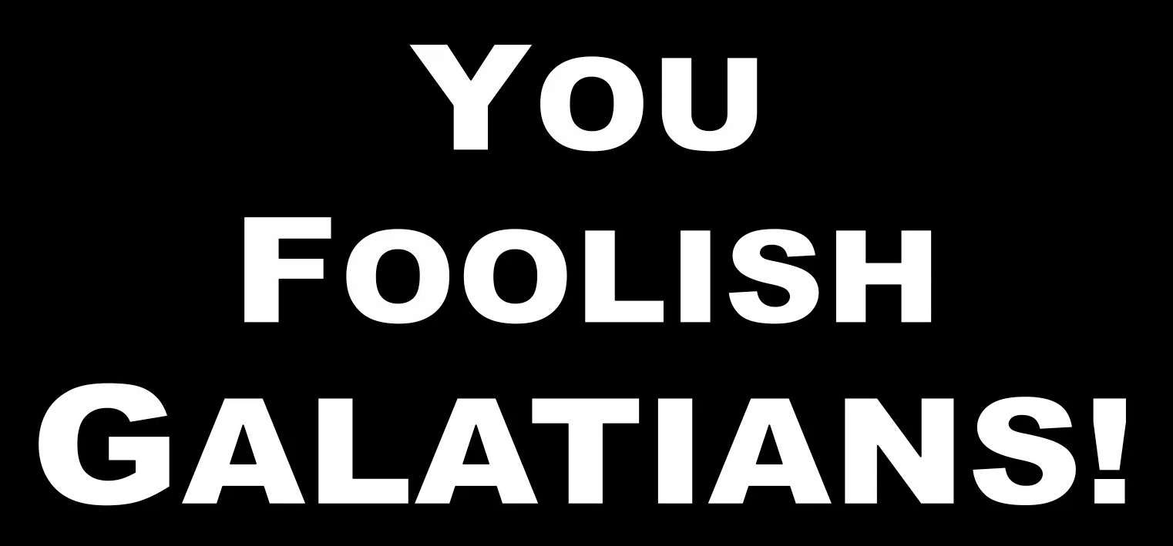
Galatians 3:3
“Are you so foolish? Having begun by the Spirit, are you now being perfected by the flesh?”

Slide 43
Conclusion

Slide 44
Commendation (1)
Reminder of grace (1:1-2)
Thanksgiving (1:3-4)
Kingdom (1:5)
Destiny of their persecutors (1:6-10)
Prayer for continued progress (1:11-12)

