Slide 1


Slide 2


Second Thessalonians
Balance: Waiting and Working
Dr. Andy Woods
Senior Pastor – Sugar Land Bible Church
President – Chafer Theological Seminary

Slide 3
Introductory Matters
Authorship | Occasion
Audience | Structure
Place of writing | Message
Date | Purpose

Slide 4
Introductory Matters
Authorship | Occasion
Audience | Structure
Place of writing | Message
Date | Purpose

Slide 5
Pauline Authorship
1:1; 3:17
Strong external support
Not challenged until the 19th century

Slide 6
Introductory Matters
Authorship | Occasion
Audience | Structure
Place of writing | Message
Date | Purpose

Slide 7
Audience
Thessalonians
1:1

Slide 8
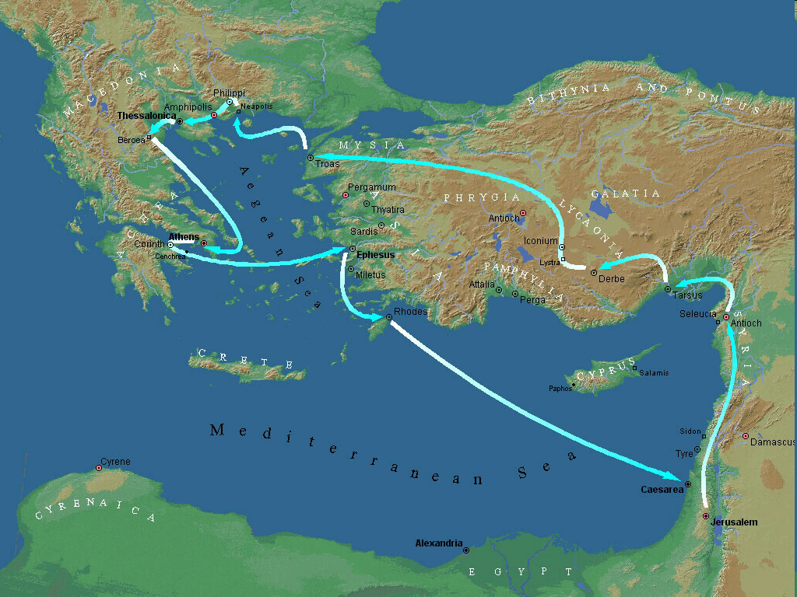

Second Missionary Journey

Slide 9
Introductory Matters
Authorship | Occasion
Audience | Structure
Place of writing | Message
Date | Purpose

Slide 10
Place of Writing
Corinth
1:1
Acts 18:5

Slide 11
Second Missionary Journey

Slide 12
Second Missionary Journey

Slide 13
Introductory Matters
Authorship | Occasion
Audience | Structure
Place of writing | Message
Date | Purpose

Slide 14
Date
Arose out of concerns raised in the 1st letter
6-12 months later
Late 51 or early 52 AD
3rd letter

Slide 15
Paul’s Ministry Chronology
# of books | Journey | Acts | Date | Books
1 | 1 | 13–14 | 48–49 | Gal
2 | 2 | 15:36–18:22 | 50–52 | 1–2 Thess
3 | 3 | 18:23–21:17 | 53–57 | 1–2 Cor, Rom
4 | 4 | 28:16-31 | 60–62 | Eph, Col, Phlm, Phlp
2 | Between Imprisonments | Post Acts | 62–66 | 1 Tim, Titus
1 | 2nd Imprisonment | Post Acts | 67 | 2 Tim

Slide 16
Order of Paul’s Letters
Galatians (A.D. 49)
1‒2 Thessalonians (A.D. 51)
1‒2 Corinthians (A.D. 56)
Romans (A.D. 57)
Ephesians, Colossians, Philemon, Philippians (A.D. 60‒62)
1 Timothy, Titus (A.D. 62‒66)
2 Timothy (A.D. 67)

Slide 17
Introductory Matters
Authorship | Occasion
Audience | Structure
Place of writing | Message
Date | Purpose

Slide 18
Occasion
Good news: continued growth despite persecution
Bad news:
  Forgery (2:2)
  Day of the Lord has begun
  Quit their jobs
  Attack on Paul’s credibility (1 Thess 1:10; 5:9)

Slide 19
Occasion
Good news: continued growth despite persecution
Bad news:
  Forgery (2:2)
  Day of the Lord has begun
  Quit their jobs
  Attack on Paul’s credibility (1 Thess 1:10; 5:9)

Slide 20
Occasion
Good news: continued growth despite persecution
Bad news:
  Forgery (2:2)
  Day of the Lord has begun
  Quit their jobs
  Attack on Paul’s credibility (1 Thess 1:10; 5:9)

Slide 21
Occasion
Good news: continued growth despite persecution
Bad news:
  Forgery (2:2)
  Day of the Lord has begun
  Quit their jobs
  Attack on Paul’s credibility (1 Thess 1:10; 5:9)

Slide 22
Occasion
Good news: continued growth despite persecution
Bad news:
  Forgery (2:2)
  Day of the Lord has begun
  Quit their jobs
  Attack on Paul’s credibility (1 Thess 1:10; 5:9)

Slide 23

Daniel 9:27
“And he will make a firm covenant with the many for one week, but in the middle of the week he will put a stop to sacrifice and grain offering; and on the wing of abominations will come one who makes desolate, even until a complete destruction, one that is decreed, is poured out on the one who makes desolate.”

Slide 24


Slide 25
Occasion
Good news: continued growth despite persecution
Bad news:
  Forgery (2:2)
  Day of the Lord has begun
  Quit their jobs
  Attack on Paul’s credibility (1 Thess 1:10; 5:9)

Slide 26
Occasion
Good news: continued growth despite persecution
Bad news:
  Forgery (2:2)
  Day of the Lord has begun
  Quit their jobs
  Attack on Paul’s credibility (1 Thess 1:10; 5:9)

Slide 27
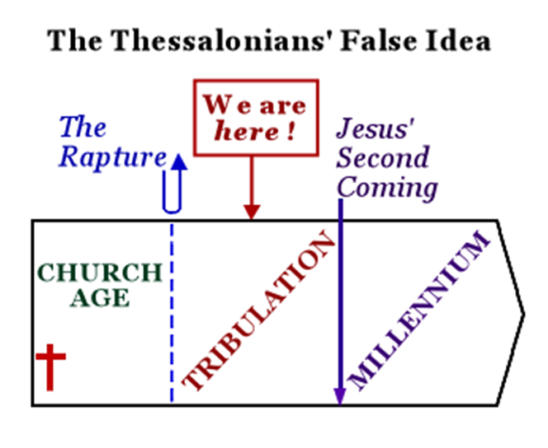
Constable’s 2 Thessalonians Online Notes, 13

Slide 28
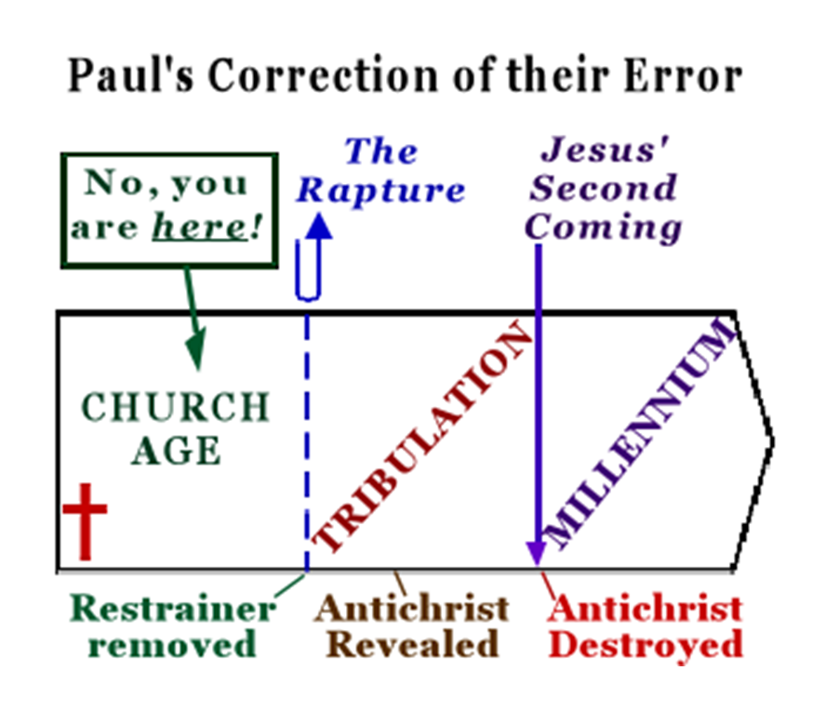
Constable’s 2 Thessalonians Online Notes, 13

Slide 29


1 Thessalonians 1:10
“and to wait for His Son from heaven, whom He raised from the dead, that is Jesus, who rescues (rhyomai) us from (ek) the wrath (orgē) to come.”

Slide 30
Introductory Matters
Authorship | Occasion
Audience | Structure
Place of writing | Message
Date | Purpose

Slide 31
Structure
1 – Commendation
2 – Correction
3 – Consequences

Slide 32
Introductory Matters
Authorship | Occasion
Audience | Structure
Place of writing | Message
Date | Purpose

Slide 33
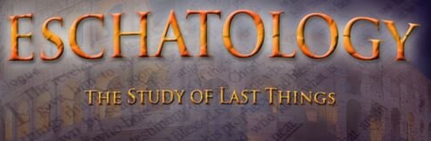
Message
A correct understanding of eschatology (2) leads to encouragement (1) and a proper balance between waiting and working (3)

Slide 34
Introductory Matters
Authorship | Occasion
Audience | Structure
Place of writing | Message
Date | Purpose

Slide 35
Purpose
To exhort the Thessalonians to adhere to a correct eschatology and thus live rightly

Slide 36
Conclusion

Slide 37
Introductory Matters
Authorship: Paul
Audience: Thessalonians
Place of writing: Corinth
Date: AD 51
Occasion: Forgery
Structure: 3 Parts
Message: working & waiting
Purpose: Correction of orthodoxy & orthopraxy

