Slide 1
Genesis 12‒50
Israel’s Birth & Preservation

Slide 2
GENESIS STRUCTURE
Genesis 12-50 (four people)
Abraham (12:1–25:11)
Isaac (25:12–26:35)
Jacob (27–36)
Joseph (37–50)

Slide 3
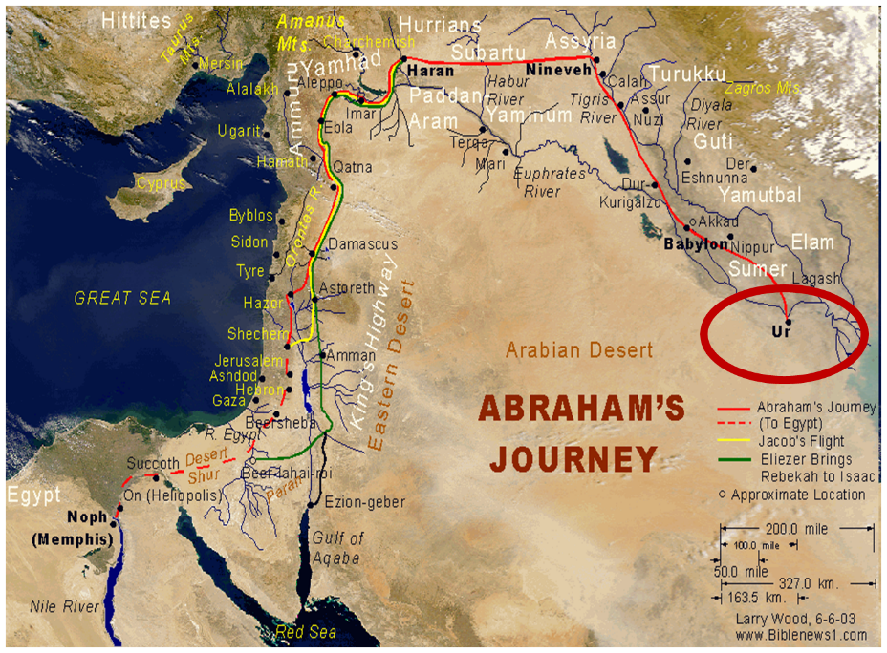

Slide 4
Genesis 31:43-55 Jacob and Laban’s Covenant
Covenant Proposal (43-44)
Covenant Witnesses (45-50)
Laban’s Perspective (51-53a)
Jacob’s Response (53b-54)
Laban’s Departure (55)

Slide 5
Genesis 31:43-55 Jacob and Laban’s Covenant
Covenant Proposal (43-44)
Covenant Witnesses (45-50)
Laban’s Perspective (51-53a)
Jacob’s Response (53b-54)
Laban’s Departure (55)

Slide 6
I. Genesis 31:43-44 Covenant Proposal
Claim of ownership (43a)
Claim of power (43b)
Covenant offer (44a)
Covenant purpose (44b)

Slide 7
I. Genesis 31:43-44 Covenant Proposal
Claim of ownership (43a)
Claim of power (43b)
Covenant offer (44a)
Covenant purpose (44b)

Slide 9
I. Genesis 31:43-44 Covenant Proposal
Claim of ownership (43a)
Claim of power (43b)
Covenant offer (44a)
Covenant purpose (44b)

Slide 10
I. Genesis 31:43-44 Covenant Proposal
Claim of ownership (43a)
Claim of power (43b)
Covenant offer (44a)
Covenant purpose (44b)

Slide 12
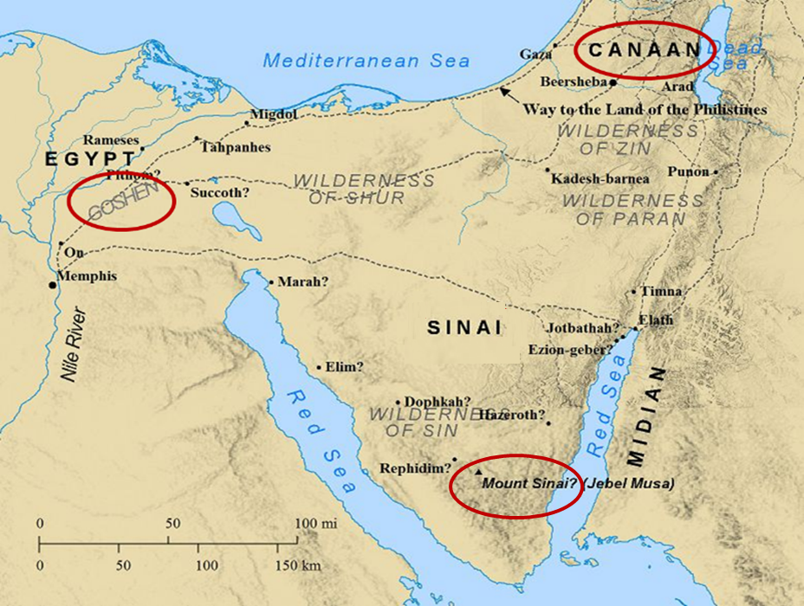

Slide 13
Psalm 147:19-20
“He declares His words to Jacob, His statutes and His ordinances to Israel. He has not dealt thus with any nation; And as for His ordinances, they have not known them. Praise the Lord!”

Slide 14
John 10:27-29
“²⁷ My sheep hear My voice, and I know them, and they follow Me; ²⁸ and I give eternal life to them, and they will never perish [ou mē; aiōnia]; and no one will snatch them out of My hand. ²⁹ My Father, who has given them to Me, is greater than all; and no one is able to snatch them out of the Father’s hand.”

Slide 15
2 Timothy 2:11-13
“It is a trustworthy statement: For if we died with Him, we will also live with Him; ¹² If we endure, we will also reign with Him; If we deny Him, He also will deny us; ¹³ If we are faithless, He remains faithful, for He cannot deny Himself.”

Slide 16
I. Genesis 31:43-44 Covenant Proposal
Claim of ownership (43a)
Claim of power (43b)
Covenant offer (44a)
Covenant purpose (44b)

Slide 17
Genesis 31:43-55 Jacob and Laban’s Covenant
Covenant Proposal (43-44)
Covenant Witnesses (45-50)
Laban’s Perspective (51-53a)
Jacob’s Response (53b-54)
Laban’s Departure (55)

Slide 18
II. Genesis 31:45-50 Covenant Witnesses
Stone (45)
Heap (46a)
Meal (46b)
Marker’s name (47-50)

Slide 19
II. Genesis 31:45-50 Covenant Witnesses
Stone (45)
Heap (46a)
Meal (46b)
Marker’s name (47-50)

Slide 20
II. Genesis 31:45-50 Covenant Witnesses
Stone (45)
Heap (46a)
Meal (46b)
Marker’s name (47-50)

Slide 22
II. Genesis 31:45-50 Covenant Witnesses
Stone (45)
Heap (46a)
Meal (46b)
Marker’s name (47-50)

Slide 25
II. Genesis 31:45-50 Covenant Witnesses
Stone (45)
Heap (46a)
Meal (46b)
Marker’s name (47-50)

Slide 26
Genesis 31:47-50 Marker’s Name
Aramaic name (47a)
Hebrew name (47b)
Name’s meaning (48a)
Final name (48b-49a)
Final name’s meaning (49b-50)

Slide 27
Genesis 31:47-50 Marker’s Name
Aramaic name (47a)
Hebrew name (47b)
Name’s meaning (48a)
Final name (48b-49a)
Final name’s meaning (49b-50)

Slide 28
Genesis 31:47-50 Marker’s Name
Aramaic name (47a)
Hebrew name (47b)
Name’s meaning (48a)
Final name (48b-49a)
Final name’s meaning (49b-50)

Slide 29
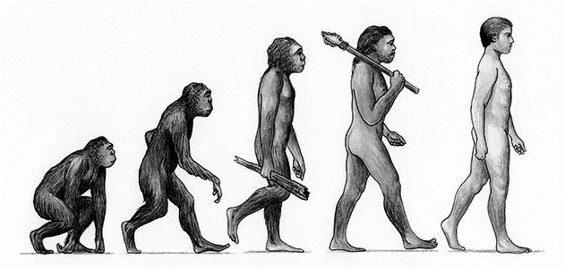

Slide 30
Genesis 31:47-50 Marker’s Name
Aramaic name (47a)
Hebrew name (47b)
Name’s meaning (48a)
Final name (48b-49a)
Final name’s meaning (49b-50)

Slide 31
Genesis 31:47-50 Marker’s Name
Aramaic name (47a)
Hebrew name (47b)
Name’s meaning (48a)
Final name (48b-49a)
Final name’s meaning (49b-50)

Slide 32
Genesis 31:47-50 Marker’s Name
Aramaic name (47a)
Hebrew name (47b)
Name’s meaning (48a)
Final name (48b-49a)
Final name’s meaning (49b-50)

Slide 33
Dr. Arnold G. Fruchtenbaum
The Book of Genesis, 473
“The reason was: For he said, Jehovah watch between me and you, when we are absent one from another. Many have taken this to be a benediction to be applied to oneself when separated from a girlfriend, boyfriend, husband, or wife, etc. However, in the original meaning in context, this was not a benediction but a warning, a warning between two men who could not trust each other. The pillar and the heap now erected were to mark a border over which neither one was to cross over. Laban did not want Jacob to cross back over to Paddan-Aram with the teraphim and claim his property. That was the real meaning of the actions here. Verse 50 spells out the meaning of the heap of witness.”

Slide 34
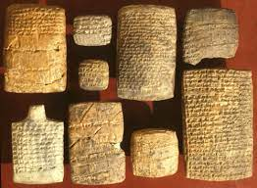
Dr. Arnold G. Fruchtenbaum
The Book of Genesis, 473-74
“Here again there is documentation from the Nuzi Tablets, which states that Wullu would lose the property of Nashwi if he took a wife besides Nashwi’s daughter.”

Slide 36
Names for God in Genesis
Elohim (1:1) - Power
Yahweh (2:4) - Relational
El Roi (Gen. 16:13) – Aware
El Olam (21:33) – Eternal
Jehovah Jireh (22:14) - Provision
God Isaac Feared (31:42, 53) - Reverenced

Slide 37
Genesis 31:43-55 Jacob and Laban’s Covenant
Covenant Proposal (43-44)
Covenant Witnesses (45-50)
Laban’s Perspective (51-53a)
Jacob’s Response (53b-54)
Laban’s Departure (55)

Slide 38
III. Genesis 31:51-53a Laban’s Perspective
Witnesses (51)
Meaning (52)
Divine witness (53a)

Slide 39
III. Genesis 31:51-53a Laban’s Perspective
Witnesses (51)
Meaning (52)
Divine witness (53a)

Slide 40
III. Genesis 31:51-53a Laban’s Perspective
Witnesses (51)
Meaning (52)
Divine witness (53a)

Slide 42
Dr. Arnold G. Fruchtenbaum
The Book of Genesis, 465
“The Code of Hammurabi states that whoever has the household gods owns the property. The Nuzi Tablets record an incident of the person mentioned earlier and states: ‘If Nashwi has a son of his own, he shall divide the estate equally with Wullu, (adopted son), but the son of Nashwi shall take the gods of Nashwi. However, if Nashwi does not have a son of his own, the Wullu shall take the gods.’ So owning the household gods meant the owner could claim the property. Rachel was not worshipping idols, but rather it was her attempt to gain the property of Laban for her husband.”

Slide 43
Joseph P. Free
Joseph P. Free. “Archaeology and the Bible.“ HIS Magazine. 9 (May 1949). Page 20.
The following, from J. P. Free’s Archaeology and the Bible gives a good explanation of not only the episode, but also the background of the Nuzi tablets: “Over 1000 clay tablets were found in 1925 in the excavation of a Mesopotamian site known today as Yorgan Tepe. Subsequent work brought forth another 3000 tablets and revealed the ancient site as ‘Nuzi.’ The tablets, written about 1500 B.C., illuminate the background of the biblical patriarchs, Abraham, Isaac, and Jacob. One instance will be cited: When Jacob and Rachel left the home of Laban, . . .

Slide 44
Joseph P. Free
Joseph P. Free. “Archaeology and the Bible.“ HIS Magazine. 9 (May 1949). Page 20.
…Rachel stole Laban’s family images or ‘teraphim.’ When Laban discovered the theft, he pursued his daughter and son-in-law, and after a long journey overtook them (Genesis 31:19-23). Commentators have long wondered why he would go to such pains to recover images he could have replaced easily in the local shops. The Nuzi tablets record one instance of a son-in-law who possessed the family images having the right to lay legal claim to his father-in-law’s property, a fact which explains Laban’s anxiety.”

Slide 45
III. Genesis 31:51-53a Laban’s Perspective
Witnesses (51)
Meaning (52)
Divine witness (53a)

Slide 46
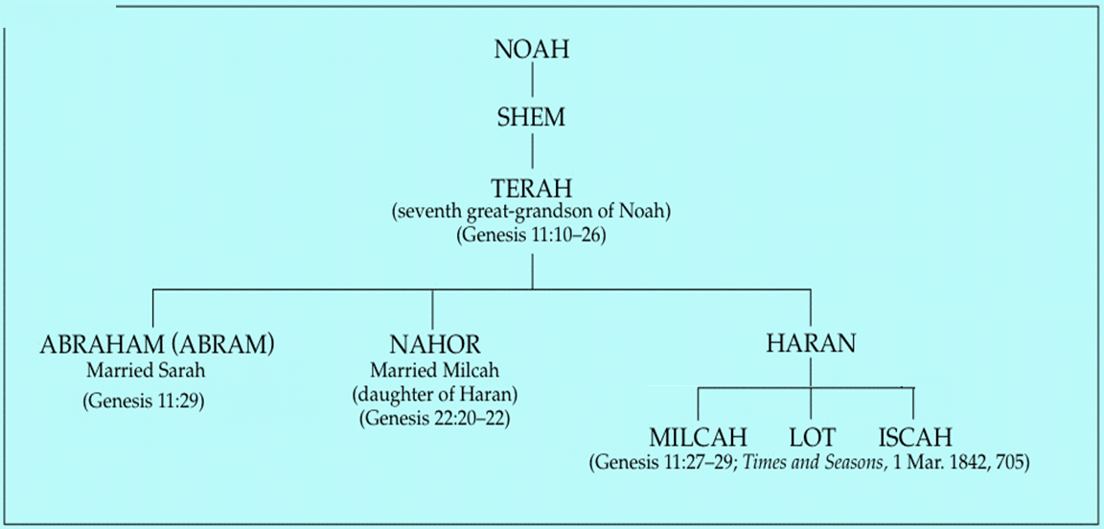

Slide 47
Dr. Arnold G. Fruchtenbaum
The Book of Genesis, 455
“The request Laban made was: If now I have found favor in your eyes, tarry [stay]. He wanted Jacob to stay there. The reason was: for I have divined that Jehovah has blessed me for your sake. The Hebrew word for ‘divine’ has the same root as the word ‘serpent’ and literally means ‘to divine through a serpent.’ Laban was a pagan who practiced such occult divination; and through occult practice, Laban, the pagan, recognized that Jacob’s God, Whoever He might be, was blessing Laban because of his relationship to Jacob.”

Slide 48
Genesis 31:43-55 Jacob and Laban’s Covenant
Covenant Proposal (43-44)
Covenant Witnesses (45-50)
Laban’s Perspective (51-53a)
Jacob’s Response (53b-54)
Laban’s Departure (55)

Slide 49
IV. Genesis 31:53b-54 Jacob’s Response
Swore (53b)
Sacrifice (54a)
Meal (54b)
Duration (54c)

Slide 50
IV. Genesis 31:53b-54 Jacob’s Response
Swore (53b)
Sacrifice (54a)
Meal (54b)
Duration (54c)

Slide 51
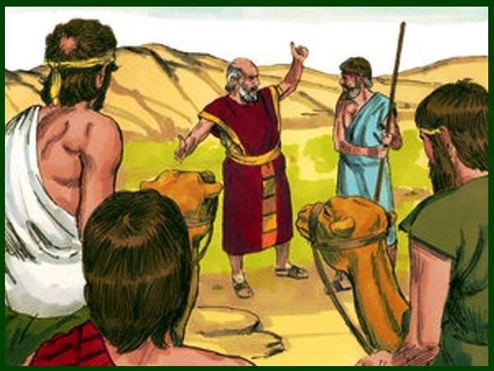
Charles Ryrie The Ryrie Study Bible, page 42
Genesis 31:42 (RSBEE:NASB1995U): “31:42 the fear of Isaac means ‘the God Isaac feared.’”

Slide 52
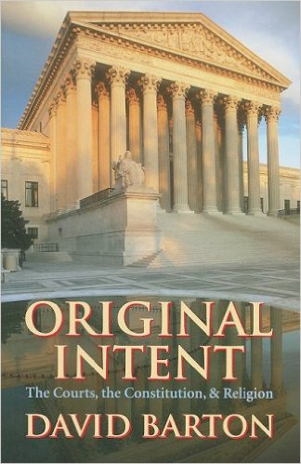
David Barton, Original Intent, p. 245

Slide 55
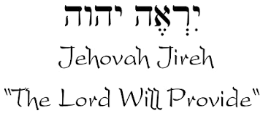

Slide 56
Names for God in Genesis
Elohim (1:1) - Power
Yahweh (2:4) - Relational
El Roi (Gen. 16:13) – Aware
El Olam (21:33) – Eternal
Jehovah Jireh (22:14) - Provision
God Isaac Feared (31:42, 53) - Reverenced

Slide 57
Colossians 2:8
“See to it that no one takes you captive through philosophy and empty deception, according to the tradition of men, according to the elementary principles of the world, rather than according to Christ.”

Slide 58
AUTHORSHIP
Charles Darwin
Karl Marx
Julius Wellhausen
John Dewey
Sigmund Freud
John Maynard Keynes
Soren Kierkegaard

Slide 59
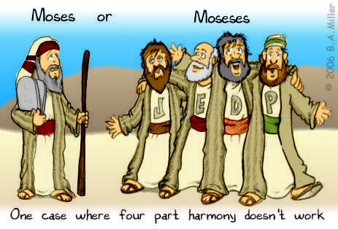
DOCUMENTARY HYPOTHESIS
J – Yahwist (850 B.C.)
E – Elohist (750 B.C.)
D – Deuteronomist (621 B.C.)
P – Priestly code (525 B.C.)

Slide 60
Arguments Favoring the Documentary Hypothesis
Writing unknown at the time of Moses
Different names for God
Differing styles
Editorial insertions (Gen. 36:31)
Assumption of polytheism to monotheism

Slide 61
Problems with the Documentary Hypothesis
JEDP Documents never discovered
Writing prior to 1500 B.C. (Code of Hamurabi)
Different names for God used for different literary purposes
Editorial insertions added after Moses completed the bulk of the work
Polytheism to monotheism trajectory never proven
Moses relied upon other sources (Gen. 5:1)

Slide 62
IV. Genesis 31:53b-54 Jacob’s Response
Swore (53b)
Sacrifice (54a)
Meal (54b)
Duration (54c)

Slide 64
Romans 12:1
¹ Therefore I urge you, brethren, by the mercies of God, to present your bodies a living and holy sacrifice, acceptable to God, which is your spiritual service of worship.

Slide 65
IV. Genesis 31:53b-54 Jacob’s Response
Swore (53b)
Sacrifice (54a)
Meal (54b)
Duration (54c)

Slide 69
IV. Genesis 31:53b-54 Jacob’s Response
Swore (53b)
Sacrifice (54a)
Meal (54b)
Duration (54c)

Slide 70
Genesis 31:43-55 Jacob and Laban’s Covenant
Covenant Proposal (43-44)
Covenant Witnesses (45-50)
Laban’s Perspective (51-53a)
Jacob’s Response (53b-54)
Laban’s Departure (55)

Slide 71
V. Genesis 31:55 Laban’s Departure
Blessing (55a)
Departure (55b)

Slide 72
V. Genesis 31:55 Laban’s Departure
Blessing (55a)
Departure (55b)

Slide 74
V. Genesis 31:55 Laban’s Departure
Blessing (55a)
Departure (55b)

Slide 76
Conclusion

Slide 77
Genesis 31:43-55 Jacob and Laban’s Covenant
Covenant Proposal (43-44)
Covenant Witnesses (45-50)
Laban’s Perspective (51-53a)
Jacob’s Response (53b-54)
Laban’s Departure (55)

Slide 78
²⁴ The Lord bless you, and keep you; ²⁵ The Lord make His face shine on you, And be gracious to you; ²⁶ The Lord lift up His countenance on you, And give you peace.
Numbers 6:24–26 (NASB95)

