Slide 1
Dr. Andy Woods
Senior Pastor – Sugar Land Bible Church
President – Chafer Theological Seminary

Slide 2
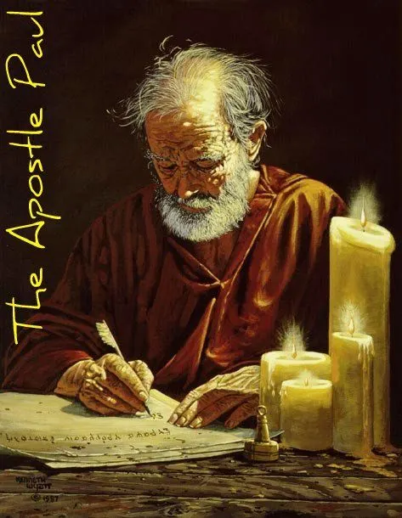
Structure
1 THESSALONIANS 1-3 | 1 THESSALONIANS 4-5
Personal Experience | Practical Exhortation
Looking Back | Looking Forward

Slide 3
Structure
Personal (1–3)
Genuine conversion (1)
Impure motives (2:1-16)
Lack of concern (2:17–3:13)
Practical (4–5)
Immorality (4:1-8)
Laziness (4:9-12)
Eschatology (4:13–5:11)
Ministry imbalances (5:12-15)
Progressive sanctification (5:16-28)

Slide 4
Structure
Personal (1–3)
Genuine conversion (1)
Impure motives (2:1-16)
Lack of concern (2:17–3:13)
Practical (4–5)
Immorality (4:1-8)
Laziness (4:9-12)
Eschatology (4:13–5:11)
Ministry imbalances (5:12-15)
Progressive sanctification (5:16-28)

Slide 5
Church Life
5:12-13 – Attitude toward leaders
5:14-15 – Ministry toward one another

Slide 6
Structure
Personal (1–3)
Genuine conversion (1)
Impure motives (2:1-16)
Lack of concern (2:17–3:13)
Practical (4–5)
Immorality (4:1-8)
Laziness (4:9-12)
Eschatology (4:13–5:11)
Ministry imbalances (5:12-15)
Progressive sanctification (5:16-28)

Slide 7
Practical Sanctification (5:16-24)
Three positive commands (5:16-18)
Three negative commands (5:19-22)
Divine enablement (5:23-24)

Slide 8
Three Positive Commands (5:16-18)
Rejoice always (5:16)
Pray without ceasing (5:17)
Give thanks in all things (5:18)

Slide 9
Practical Sanctification (5:16-24)
Three positive commands (5:16-18)
Three negative commands (5:19-22)
Divine enablement (5:23-24)

Slide 10
Three Negative Commands (5:19-22)
Do not quench the Spirit (5:19)
Do not despise prophetic utterances (5:20-21)
Abstain from evil (5:22)

Slide 11
Practical Sanctification (5:16-24)
Three positive commands (5:16-18)
Three negative commands (5:19-22)
Divine enablement (5:23-24)

Slide 12
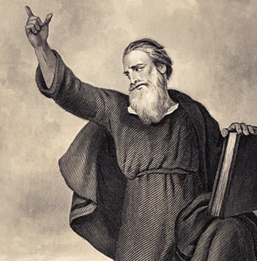
Conclusion (5:25-28)
Three personal requests (5:25-27)
Benediction (5:28)

Slide 13
Conclusion (5:25-28)
Three personal requests (5:25-27)
Benediction (5:28)

Slide 14
Three Personal Requests (5:25-27)
Prayer (5:25)
Greet the brethren (5:26)
Read the letter aloud (5:27)

Slide 15
Three Personal Requests (5:25-27)
Prayer (5:25)
Greet the brethren (5:26)
Read the letter aloud (5:27)

Slide 16
Three Personal Requests (5:25-27)
Prayer (5:25)
Greet the brethren (5:26)
Read the letter aloud (5:27)

Slide 17
Three Personal Requests (5:25-27)
Prayer (5:25)
Greet the brethren (5:26)
Read the letter aloud (5:27)

Slide 18
1 Timothy 4:13
“Until I come, give your attention to the public reading, to exhortation, and teaching.”

Slide 19
2 Timothy 3:16-17
“¹⁶ All Scripture is inspired by God [theopneustos] and profitable for teaching, for reproof, for correction, for training in righteousness; ¹⁷ so that the man of God may be adequate, equipped for every good work.”

Slide 20
Emphasis of 2 Timothy
“By my count, there are twenty-seven explicit commands given in the body of this letter. In 27 words Paul tells pastors what to focus on. You have to be blind to miss the thrust of Paul's instructions here, because eighteen of those commands--fully two-thirds--have to do with the ministry of the Word.”
Daniel Wallace, “Crisis of the Word: A Message to Pastors or Would-be Pastors,”
Conservative Theological Journal 1, no. 2 (August 1997): 108.

Slide 21
Conclusion (5:25-28)
Three personal requests (5:25-27)
Benediction (5:28)

Slide 22
2 Peter 3:18
“ but grow in the grace and knowledge of our Lord and Savior Jesus Christ. To Him be the glory, both now and to the day of eternity. Amen.”

Slide 23
Conclusion

Slide 24
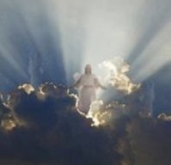
Message
Continued growth in faith, hope, and love in view of the Lord’s imminent return

Slide 25
Structure
Personal (1–3)
Genuine conversion (1)
Impure motives (2:1-16)
Lack of concern (2:17–3:13)
Practical (4–5)
Immorality (4:1-8)
Laziness (4:9-12)
Eschatology (4:13–5:11)
Ministry imbalances (5:12-15)
Progressive sanctification (5:16-28)

