Slide 1

Is America Under The Judgment of God?
Andrew Marshall Woods, Th.M., JD., PhD.
Sr. Pastor, Sugar Land Bible Church

Slide 2

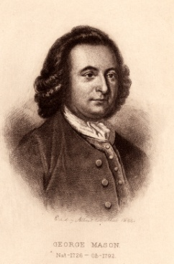
George Mason
“As nations cannot be rewarded or punished in the next world, so they must be in this. By an inevitable chain of causes and effects, providence punishes national sins by national calamites.” [italics added]
James Madison, The Papers of James Madison, ed. Henry Gilpin, vol. 3 (Washington: Langtree and O'Sullivan, 1840), 1391, August 22, 1787.

Slide 3

Kinds of Wrath/Discipline
Historical (Gen. 7‒8; 19)
Eschatological (Rev. 6‒19)
Discipline (Heb. 12:5-11)
Sowing and reaping (Gal. 6:7-8)
Abandonment (Judges 16:20; 1 Sam. 16:14)

Slide 4
Kinds of Wrath/Discipline
Historical (Gen. 7‒8; 19)
Eschatological (Rev. 6‒19)
Discipline (Heb. 12:5-11)
Sowing and reaping (Gal. 6:7-8)
Abandonment (Judges 16:20; 1 Sam. 16:14)

Slide 5
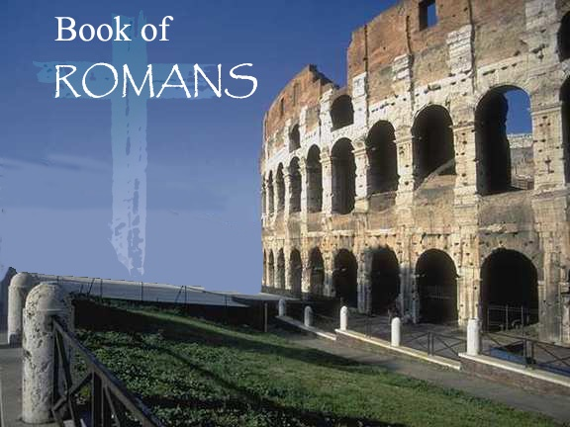

Slide 6

Divine Righteousness
Revealed!

Slide 7
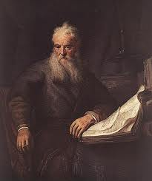
Structure
Salutation (1:1-17)
Sin (1:18–3:20)
Salvation (3:21–5:21)
Sanctification (6–8)
Sovereignty (9–11)
Service (12:1–15:13)
Summation (15:14–16:27)

Slide 8
Structure
Salutation (1:1-17)
Sin (1:18–3:20)
Salvation (3:21–5:21)
Sanctification (6–8)
Sovereignty (9–11)
Service (12:1–15:13)
Summation (15:14–16:27)

Slide 9
Sin
(1:18–3:20)
Condemnation of the Gentile (1:18-32)
Condemnation of the moralist (2:1-16)
Condemnation of the Jew (2:17–3:8)
Condemnation of the world (3:9-20)

Slide 10
Sin
(1:18–3:20)
Condemnation of the Gentile (1:18-32)
Condemnation of the moralist (2:1-16)
Condemnation of the Jew (2:17–3:8)
Condemnation of the world (3:9-20)

Slide 11
Preview
Bad News
Good News

Slide 12
Preview
Bad News
Good News

Slide 13
Condemnation of the Gentile (1:18-32)
Revelation of and reason for God’s wrath (18)
God’s self-revelation in creation renders mankind inexcusable (19-20)
Results of mankind’s rejection of God (21-23)
God abandons mankind to passion and consequences (24-32)

Slide 14
Condemnation of the Gentile (1:18-32)
Revelation of and reason for God’s wrath (18)
God’s self-revelation in creation renders mankind inexcusable (19-20)
Results of mankind’s rejection of God (21-23)
God abandons mankind to passion and consequences (24-32)

Slide 15
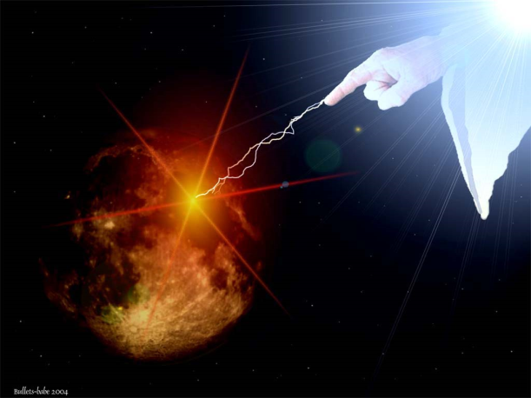
Revelation of and Reason for God’s Wrath (18)
Revelation of God’s wrath (18a)
  Apokalypsis
  Orgē
Reason for God’s wrath (18b)
  Ungodliness; unrighteousness
  Suppressing truth

Slide 16
Revelation of and Reason for God’s Wrath (18)
Revelation of God’s wrath (18a)
  Apokalypsis
  Orgē
Reason for God’s wrath (18b)
  Ungodliness; unrighteousness
  Suppressing truth

Slide 17


Revelation 1:1
“The Revelation [apokalypsis] of Jesus Christ, which God gave Him to show to His bond-servants, the things which must soon take place; and He sent and communicated it by His angel to His bond-servant John.”

Slide 18
Revelation of and Reason for God’s Wrath (18)
Revelation of God’s wrath (18a)
  Apokalypsis
  Orgē
Reason for God’s wrath (18b)
  Ungodliness; unrighteousness
  Suppressing truth

Slide 19
Condemnation of the Gentile (1:18-32)
Revelation of and reason for God’s wrath (18)
God’s self-revelation in creation renders mankind inexcusable (19-20)
Results of mankind’s rejection of God (21-23)
God abandons mankind to passion and consequences (24-32)

Slide 20
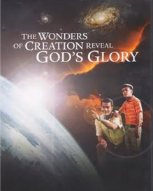
God’s Self-Revelation in Creation Renders
Mankind Inexcusable (19-20)
God’s self disclosure in creation (19-20a)
God’s self disclosure renders mankind accountable (20b)

Slide 21
God’s Self-Revelation in Creation Renders
Mankind Inexcusable (19-20)
God’s self disclosure in creation (19-20a)
God’s self disclosure renders mankind accountable (20b)

Slide 22
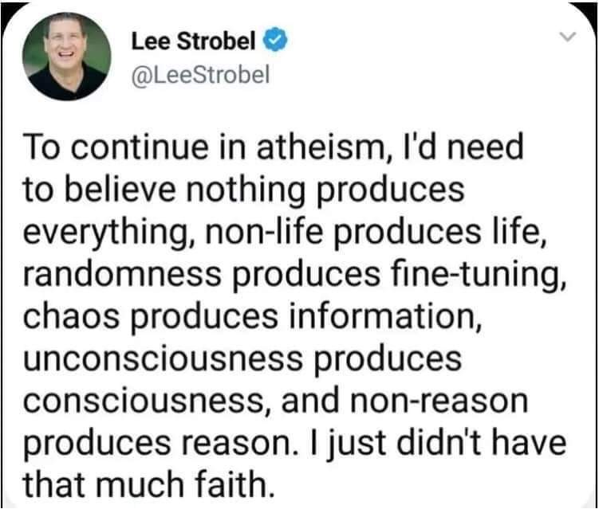

Slide 23

General vs. Special Revelation
 | General | Special
Examples | Nature, conscience (Rom 1–2) | Incarnation, Scripture, miracles
Availability | All | Some
Accomplishment | Accountability (Rom 1) | Salvation (Acts 4:12; 2 Tim 3:15)
Form | Non-written or non-verbal | Written
Quality | Natural | Supernatural, miraculous

Slide 24
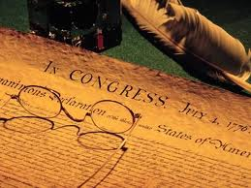
Declaration of Independence
“the Laws of Nature and of Nature’s God,”
“we hold these truths to be self evident, that all men are created equal,”
“they are endowed by their Creator with certain unalienable Rights,”
“appealing to the Supreme Judge of the world for the rectitude of our intentions,”
“with firm reliance on the protection of Divine Providence.”
Church of the Holy Trinity v. U.S., 143 U.S. 457, 467-68 (1892)

Slide 25
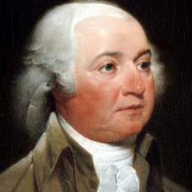
John Adams
John Adams - America's second President "Rights [are] antecedent to all earthly government; Rights... cannot be repealed or restrained by human laws; Rights [are] derived from the great Legislature of the universe."
John Adams, The Works of John Adams, Second President of the United States,
ed. Charles Francis Adams, 10 vols. (Boston: Little, Brown, 1856), 3:449.

Slide 26
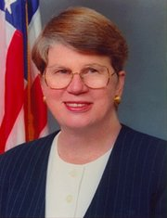
Speech by Attorney General Janet Reno, Newark, New Jersey, May 5, 1995.
Quoted in James Bovard, “Waco Must Get a Hearing,” Wall Street Journal, May 15, 1995.
Former Attorney General Janet Reno
“You are part of a government that has given its people more freedom... than any other government in the history of the world.”

Slide 27
God’s Self-Revelation in Creation Renders
Mankind Inexcusable (19-20)
God’s self disclosure in creation (19-20a)
God’s self disclosure renders mankind accountable (20b)

Slide 28
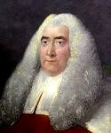
Sir William Blackstone
“Thus, when the Supreme Being formed the universe, and created matter out of nothing, he imposed certain principles upon that matter, from which it can never depart, and without which it would cease to be…If we farther advance, from mere inactive matter to vegetable and animal life, we shall find them still governed by laws, more numerous indeed, but equally fixed and invariable…Man, considered as a creature, must necessarily be subject to the laws of his creator, for he is entirely a dependent being.… no human laws should be suffered to contradict the laws of nature and the law of revelation.”
Sir William Blackstone, Commentaries on the Laws of New England, 5 vols. (Philadelphia: Robert Bell Union Library, 1771; reprint, NY: Layston, 1967), 1:38-39, 42.

Slide 29

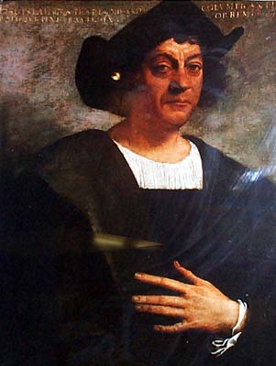
Christopher Columbus
“Our Lord opened to my understanding (I could sense his hand upon me) so it became clear to me that the voyage was feasible…All those who heard of my enterprise rejected it with laughter, scoffing at me…Who doubts this illumination was from the Holy Spirit? I attest that He, with marvelous rays of light, consoled me with the holy and sacred Scriptures…“they inflame me with a sense of great urgency…No one should be afraid to take on any enterprise in the name of the savior if it is right and if the purpose is purely for His holy service…And I say that the sign that convinces me that our Lord is hastening the end of the world is the preaching of the Gospel in so many distant lands.””
Columbus, Book of Prophecies, trans. Kay Brigham, 178-79, 182-83.

Slide 30
Christopher Columbus
…“they inflame me with a sense of great urgency…No one should be afraid to take on any enterprise in the name of the savior if it is right and if the purpose is purely for His holy service…And I say that the sign that convinces me that our Lord is hastening the end of the world is the preaching of the Gospel in so many distant lands.”
Columbus, Book of Prophecies, trans. Kay Brigham, 178-79, 182-83.

Slide 31

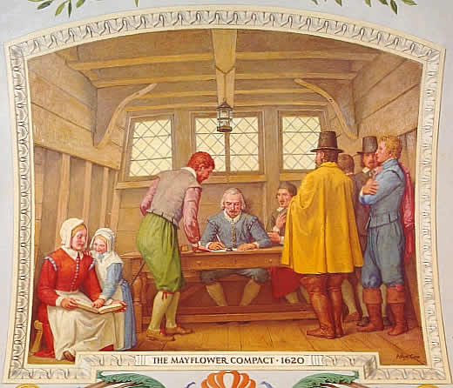
Mayflower Compact (1620)
Mayflower, in 1620, recites: “Having undertaken for the glory of God and advancement of the Christian faith and the honor of our king and country a voyage to plant the first colony in the northern parts of Virginia.”
David Brewer, United States A Christian Nation, 14

Slide 32
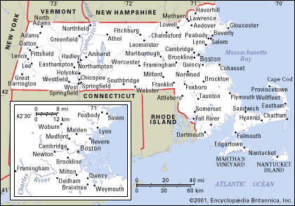
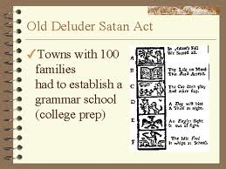
Old Satan Deluder Law: 1642 Massachusetts
“It being one chief project of that old deluder, Satan, to keep men from the knowledge of the Scriptures, as in former time… It is therefore ordered…that after the Lord hath increased the settlement… they shall…appoint one within their town, to teach all such children to read…they shall set up a grammar school to instruct youths…”
Church of the Holy Trinity v. U.S., 143 U.S. 457, 467 (1892)

Slide 33
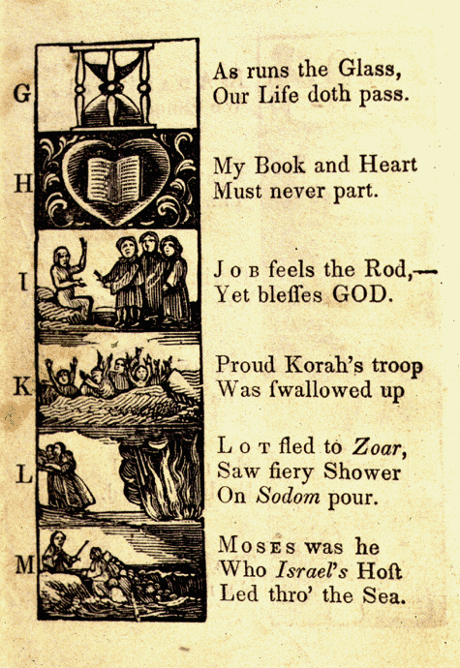
New England Primer
A: “In Adam’s fall we sinned all.”
C: Christ crucify’d for sinners dy’d.”
D: “The deluge drown’d the earth around.”
J: Job feels the rod, yet blesses God
N: “Noah did view the old world & new.”
Z: “Zaccheus he did climb the tree our Lord to see.”
New England Primer, 1737

Slide 34


Harvard University
“Let every student be plainly instructed and earnestly pressed to consider well the main end of his life and studies is to know God and Jesus Christ which is eternal life (John 17:3) and therefore to lay Christ in the bottom as the only foundation of all sound knowledge and learning. And seeing the Lord only giveth wisdom, let everyone seriously set himself by prayer in secret to seek it of Him (Prov. 2, 3). Everyone shall exercise himself in reading the Scriptures twice a day that he shall be ready to give such an account of his proficiency therein.”
Rules of Harvard in 1636; quoted in David Barton, Original Intent, 81

Slide 35
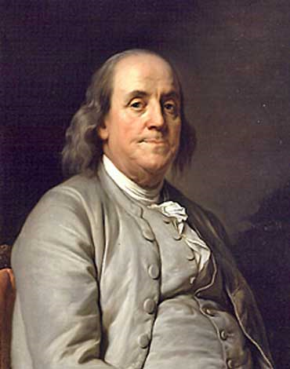
Benjamin Franklin
“Hence bad examples to youth are more rare in America… Atheism is unknown there, Infidelity rare and secret; so that great persons may live to a great age in that country without having their piety shocked by meeting with either Atheist or Infidel.”
Benjamin Franklin, “Advice on Coming to America,” America in Person, ed. George D. Youstra, 109.

Slide 36
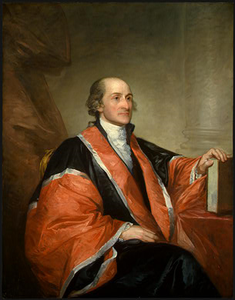
John Jay
“Providence has given to our people the choice of their rulers, and it is the duty, as well as the privilege and interest of our Christian nation to select and prefer Christians for their rulers.” [emphasis added]
Letter of John Jay to John Murray October 12, 1816. Papers of John Jay. http://oll.libertyfund.org/titles/jay-the-correspondence-and-public-papers-of-john-jay-vol-4-1794-1826

Slide 37
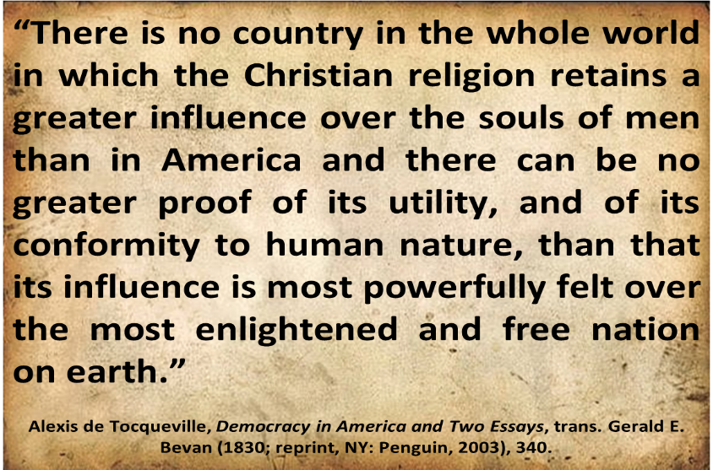
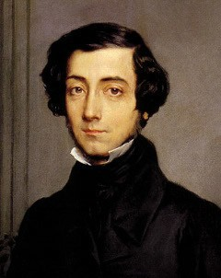
Alexis de Tocqueville

Slide 38
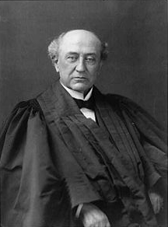
America is a “Christian Nation”
“This is historically true. From the discovery of this continent to the present hour, there is a single voice making this affirmation…These are not the sayings, declarations of private persons: they are organic utterances; they speak the voice of the entire people…These and many other matters which might be noticed, add a volume of unofficial declarations to the mass of organic utterances that this is a Christian nation.”
Church of the Holy Trinity v. U.S., 143 U.S. 457, 465, 470-71 (1892)

Slide 39
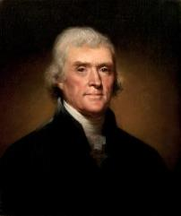
Thomas Jefferson
"I tremble for my country when I reflect that God is just, and that his justice will not sleep forever.”
Thomas Jefferson, Notes on the State of Virginia (1794), 270–272,
“Query XVIII The Particular Customs and Manners that may Happen to be Received in that State?”

Slide 40
Condemnation of the Gentile (1:18-32)
Revelation of and reason for God’s wrath (18)
God’s self-revelation in creation renders mankind inexcusable (19-20)
Results of mankind’s rejection of God (21-23)
God abandons mankind to passion and consequences (24-32)

Slide 41

Mankind's Rejection of God and the Ensuing Results (21-23)
Mankind rejects knowledge of God (21a)
  Knew God
  Yet they did not honor nor thank Him
Two results (21b-23)
  Darkened thinking (21b-22)
  Idolater (23)

Slide 42
Mankind's Rejection of God and the Ensuing Results (21-23)
Mankind rejects knowledge of God (21a)
  Knew God
  Yet they did not honor nor thank Him
Two results (21b-23)
  Darkened thinking (21b-22)
  Idolater (23)

Slide 43
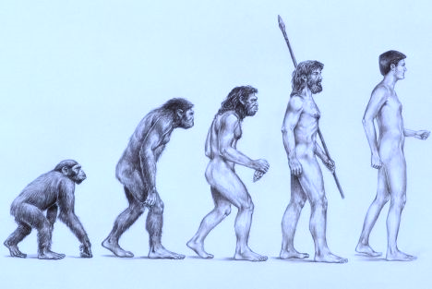
Evolution
Definition – A gradual process in which something changes into a different and usually more complex or better form. Change in the genetic composition of a population during successive generations, as a result of natural selection acting on the genetic variation among individuals, and resulting in the development of new species. – Wikipedia

Slide 44
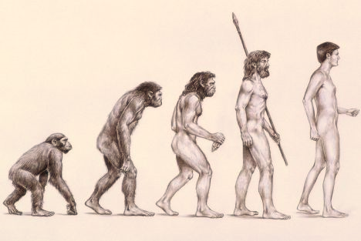
Intelligent Design Resources
Michael Behe-Darwin’s Black Box
Michael Denton-Evolution: A Theory in Crisis
Philip Johnson-Darwin on Trial
William Dembski-Intelligent Design
Marvin Lubenow-Bones of Contention

Slide 45
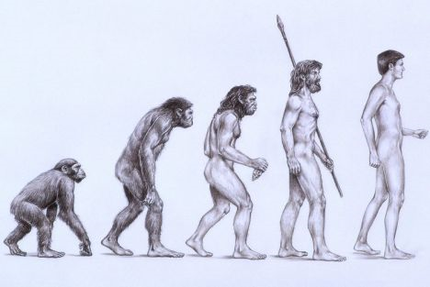
Missing Links
“Links are missing just where we most fervently desire them and its all too probable that many ‘links’ will continue to be missing.”
Alfred S. Romer, Genetics, Evolution, and Paleontology, p. 114

Slide 46
“Gradualism is a concept I believe in…Yet Gould and the American museum people are hard to contradict when they say that there are no transitional fossils. You say that I should show a photo of the fossil from which each type of organism was derived. I will lay it on the line-there is not one such fossil from which one could make an airtight argument…It is easy enough to make up stories of how one form gave rise to another, and to find reasons why the stages should be favoured by natural selection. But such stories are not part of science, for there is no way of putting them to the test.”
Colin Patterson of the British Museum of Natural History, Bible-Science Newsletter (Aug, 1981), p. 8.

Slide 47
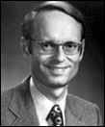
Why Evolution’s Popularity?
“The evolutionary origin of man relieves man of responsibility to a personal Creator outside of himself.”
Ryrie, Survey of Bible Doctrine, 101

Slide 48

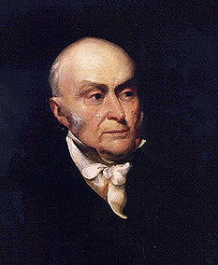
John Quincy Adams
“The birth-day of the nation is indissolubly linked with the birth-day of the Saviour [and] forms a leading event in the progress of the gospel dispensation…the Declaration of Independence first organized the social compact on the foundation of the Redeemer’s mission upon the earth [and] laid the corner stone of human government upon the first precepts of Christianity.”
John Quincy Adams, An Oration Delivered before the Inhabitants of the Town of Newburyport at Their Request on the Sixty-First Anniversary of the Declaration of Independence (Newburyport: Whipple, 1837), 5-6.

Slide 49
Mankind's Rejection of God and the Ensuing Results (21-23)
Mankind rejects knowledge of God (21a)
  Knew God
  Yet they did not honor nor thank Him
Two results (21b-23)
  Darkened thinking (21b-22)
  Idolater (23)

Slide 50
Mankind's Rejection of God and the Ensuing Results (21-23)
Mankind rejects knowledge of God (21a)
  Knew God
  Yet they did not honor nor thank Him
Two results (21b-23)
  Darkened thinking (21b-22)
  Idolater (23)

Slide 51

Original State and First Sin
Ezek. 28:12-17
  Attributes
    Creature (15)
    Angel (14, 16)
    Powerful (14)
    Without sin (15)
    Beautiful (12-13)
    Intelligent (12)
  Nature of 1st sin (17)

Slide 52
Original State and First Sin (cont’d)
Ezek. 28:12-17
  Consequences
    Fell (16-17)
    Retains some access to heaven (Job 1:6; 2:1)
    Some angels fell with him (14)
    Fallen angels confirmed in wickedness (Matt 25:41)
    Darkened thought process (17)

Slide 53
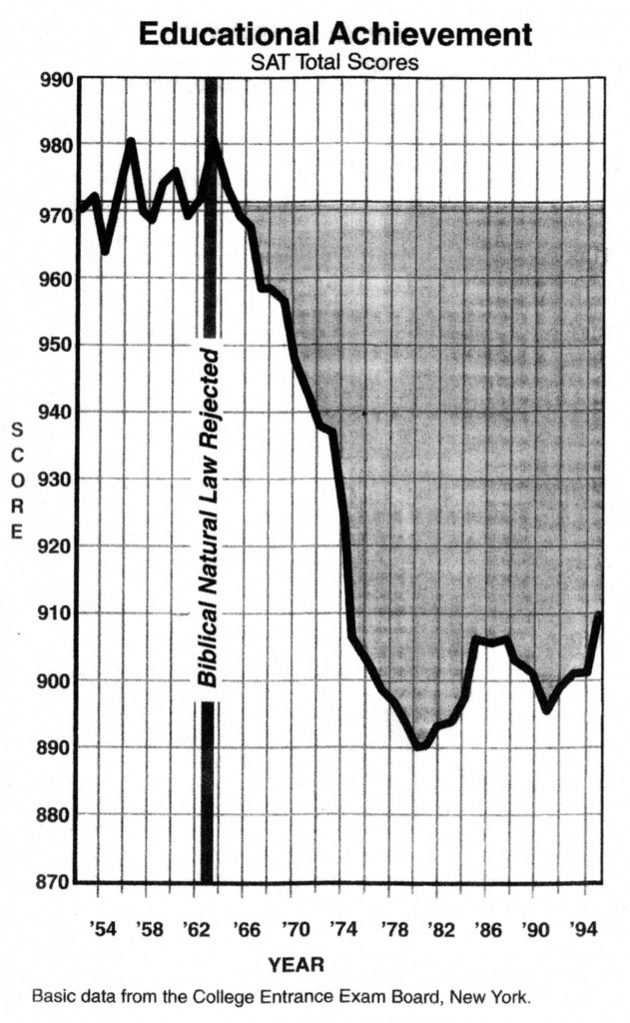
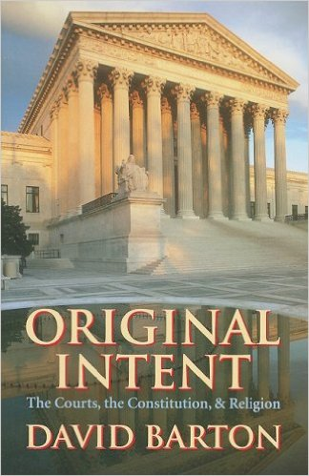
David Barton, Original Intent, p. 245

Slide 54
Mankind's Rejection of God and the Ensuing Results (21-23)
Mankind rejects knowledge of God (21a)
  Knew God
  Yet they did not honor nor thank Him
Two results (21b-23)
  Darkened thinking (21b-22)
  Idolater (23)

Slide 55
Gaia Hypothesis
“According to the Gaia Hypothesis, we are parts of a greater whole. If we endanger her, she will dispense with us in the interest of a higher value–that is, life itself.”
Vaclav Havel, “What the World Needs Now,” New Age Journal (September/October 1994): 162; quoted in William Grigg, Freedom on the Altar (Appleton, WI: American Opinion, 1995), 161.

Slide 56
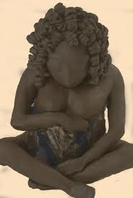
Gaia Hypothesis
“Gaia is Mother Earth. Gaia is immortal. She is the eternal source of life. She does not need to reproduce herself as she is immortal. She is certainly the mother of us all, including Jesus…Gaia is not a tolerant mother. She is rigid and inflexible, ruthless in the destruction of whoever transgresses. Her unconscious objective is that of maintaining a world adapted to life. If we men hinder this objective we will be eliminated without pity.”
James Lovelock, Orion Nature Quart 8, no. 1 (1989): 58; quoted in Coffman, Saviors of the Earth, 145.

Slide 57
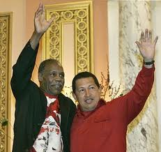
Gaia Hypothesis
"What happened in Haiti could happen to anywhere in the Caribbean because all these island nations are in peril because of global warming," Glover said. "When we see what we did at the climate summit in Copenhagen, this is the response, this is what happens, you know what I'm sayin'?"
www.huffingtonpost.com/.../danny-glover-haiti-earthq_n_425160.html

Slide 58
Condemnation of the Gentile (1:18-32)
Revelation of and reason for God’s wrath (18)
God’s self-revelation in creation renders mankind inexcusable (19-20)
Results of mankind’s rejection of God (21-23)
God abandons mankind to passion and consequences (24-32)

Slide 59

God Abandons Mankind to Passion and Consequences (24-32)
God gives mankind over (24a)
To:
  Impurity (24b)
  Idolatry (25)
  Homosexuality (26-27)
  Depravity (28-32)

Slide 60
God Abandons Mankind to Passion and Consequences (24-32)
God gives mankind over (24a)
To:
  Impurity (24b)
  Idolatry (25)
  Homosexuality (26-27)
  Depravity (28-32)

Slide 61

Genesis 6:1-4
“¹ Now it came about, when men began to multiply on the face of the land, and daughters were born to them, ² that the sons of God saw that the daughters of men were beautiful; and they took wives for themselves, whomever they chose. ³ Then the Lord said, ‘My Spirit shall not strive with man forever, because he also is flesh; nevertheless his days shall be one hundred and twenty years.’ ⁴ The Nephilim were on the earth in those days,...”

Slide 62
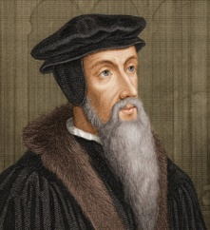
John Calvin
Calvin’s Institutes 4.20.25 and Calvin’s Commentary on Romans (13:3-4).
“Indeed, he says that those who rule for the public benefit are true patterns and evidences of this beneficence of his; that they who rule unjustly and incompetently have been raised up by him to punish the wickedness of the people...Yet, we need not labor to prove that a wicked king is the Lord’s wrath upon the earth [Job 34:30, Vg.; Hos. 13:11; Isa. 3:4; 10:5; Deut. 28:29], for I believe no man will contradict me; and thus nothing more would be said of a king than of a robber who seizes your possessions, of an adulterer who pollutes your marriage bed, or of a murderer who seeks to kill you...For since a wicked prince is the Lord’s scourge to punish the sins of the people, let us remember, that it happens through our fault that this excellent blessing of God is turned into a curse.” [italics added].

Slide 63
God Abandons Mankind to Passion and Consequences (24-32)
God gives mankind over (24a)
To:
  Impurity (24b)
  Idolatry (25)
  Homosexuality (26-27)
  Depravity (28-32)

Slide 64
God Abandons Mankind to Passion and Consequences (24-32)
God gives mankind over (24a)
To:
  Impurity (24b)
  Idolatry (25)
  Homosexuality (26-27)
  Depravity (28-32)

Slide 65
God Abandons Mankind to Passion and Consequences (24-32)
God gives mankind over (24a)
To:
  Impurity (24b)
  Idolatry (25)
  Homosexuality (26-27)
  Depravity (28-32)

Slide 66

The Earth has a Fever

Slide 67


Slide 68
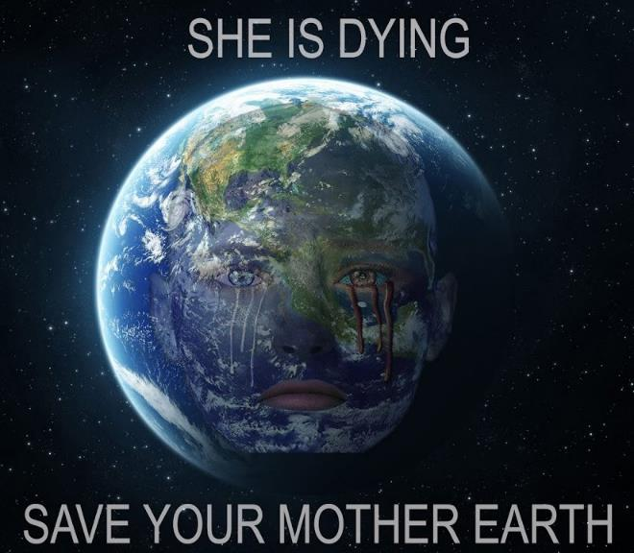
Mother Earth

Slide 69
God Abandons Mankind to Passion and Consequences (24-32)
God gives mankind over (24a)
To:
  Impurity (24b)
  Idolatry (25)
  Homosexuality (26-27)
  Depravity (28-32)

Slide 70


Slide 71
Oregon Declares War on Aaron & Melissa Klein
“In yet another example of gay activist overreach, an Oregon official has not only burdened a Christian couple with a ridiculous fine, he has imposed a gag order on them…In one of the most egregious anti-Christian acts committed by a state official in recent memory, Oregon Labor Commissioner Brad Avakian not only upheld the ridiculous $135,000 fine levied against Aaron and Melissa Klein for declining to bake a cake for a lesbian commitment ceremony, but he ordered the Kleins to ‘cease and desist’ from making any public comments about their religious convictions relative to this case.”
http://www.onenewsnow.com/perspectives/michael-brown/2015/07/06/oregon-declares-war-on-christian-faith

Slide 72
God Abandons Mankind to Passion and Consequences (24-32)
God gives mankind over (24a)
To:
  Impurity (24b)
  Idolatry (25)
  Homosexuality (26-27)
  Depravity (28-32)

Slide 73
Depravity (28-32)
Depraved mind (28)
Depraved sins (29-31)
Depraved attitude (32)

Slide 74
Depravity (28-32)
Depraved mind (28)
Depraved sins (29-31)
Depraved attitude (32)

Slide 75
David Barton, Original Intent, p. 245

Slide 76
Depravity (28-32)
Depraved mind (28)
Depraved sins (29-31)
Depraved attitude (32)

Slide 77


Slide 78
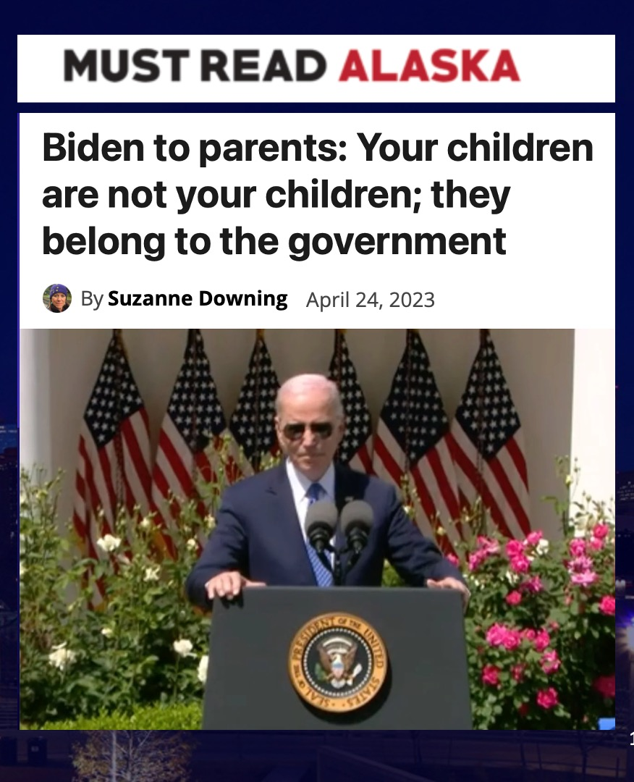

Slide 79

Deuteronomy 6:4–7
⁴ “Hear, O Israel! The Lord is our God, the Lord is one! ⁵ “You shall love the Lord your God with all your heart and with all your soul and with all your might. ⁶ “These words, which I am commanding you today, shall be on your heart. ⁷ “You shall teach them diligently to your sons and shall talk of them when you sit in your house and when you walk by the way and when you lie down and when you rise up.

Slide 80
Depravity (28-32)
Depraved mind (28)
Depraved sins (29-31)
Depraved attitude (32)

Slide 81
Condemnation of the Gentile (1:18-32)
Revelation of and reason for God’s wrath (18)
God’s self-revelation in creation renders mankind inexcusable (19-20)
Results of mankind’s rejection of God (21-23)
God abandons mankind to passion and consequences (24-32)

Slide 82
Preview
Bad News
Good News

Slide 83
The Good News!
Nothing is impossible for God (Gen. 18:14)
God uses the ungodly for His own purposes (Prov. 21:1; Isa. 45:4)
Intercessory prayer still works (Jas. 5:16; 1 Tim. 2:1-4)
Jesus is still building His church (Matt. 16:18)

Slide 84
The Good News!
Nothing is impossible for God (Gen. 18:14)
God uses the ungodly for His own purposes (Prov. 21:1; Isa. 45:4)
Intercessory prayer still works (Jas. 5:16; 1 Tim. 2:1-4)
Jesus is still building His church (Matt. 16:18)

Slide 85
The Good News!
Nothing is impossible for God (Gen. 18:14)
God uses the ungodly for His own purposes (Prov. 21:1; Isa. 45:4)
Intercessory prayer still works (Jas. 5:16; 1 Tim. 2:1-4)
Jesus is still building His church (Matt. 16:18)

Slide 86
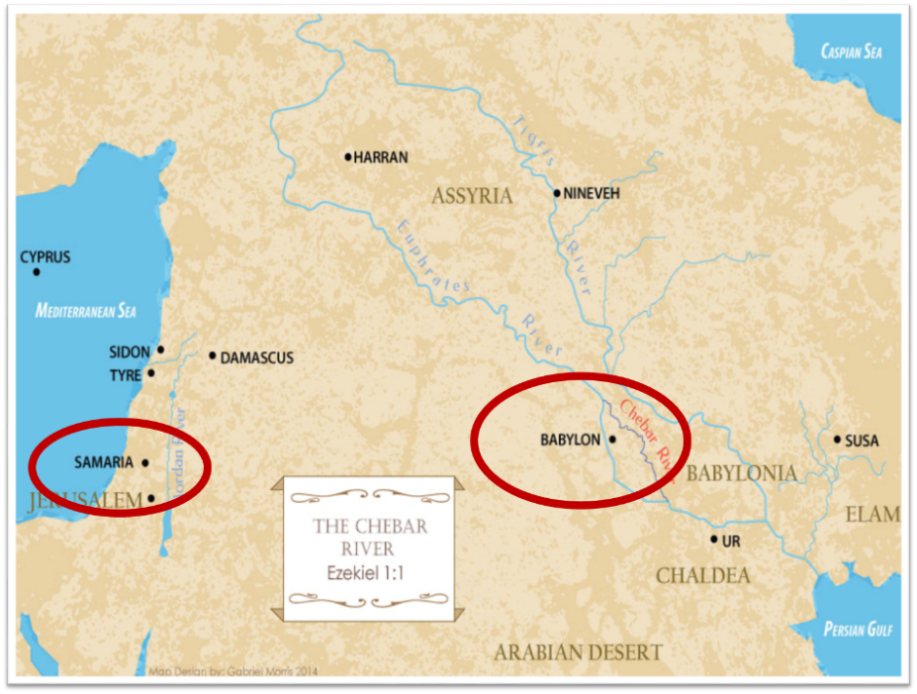

Slide 87
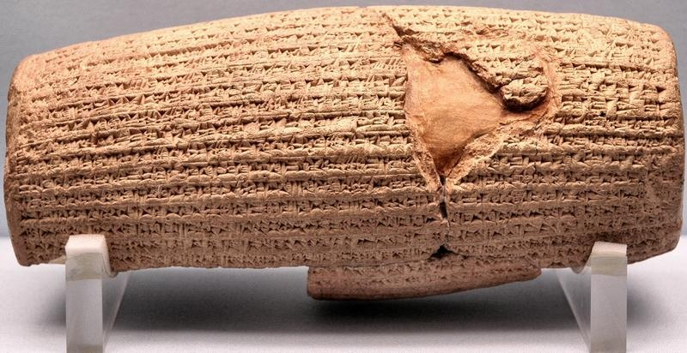
Cyrus Cylinder

Slide 88
The Good News!
Nothing is impossible for God (Gen. 18:14)
God uses the ungodly for His own purposes (Prov. 21:1; Isa. 45:4)
Intercessory prayer still works (Jas. 5:16; 1 Tim. 2:1-4)
Jesus is still building His church (Matt. 16:18)

Slide 89


Slide 90
The Good News!
Nothing is impossible for God (Gen. 18:14)
God uses the ungodly for His own purposes (Prov. 21:1; Isa. 45:4)
Intercessory prayer still works (Jas. 5:16; 1 Tim. 2:1-4)
Jesus is still building His church (Matt. 16:18)

Slide 91


Matthew 16:18
“I also say to you that you are Peter, and upon this rock I will build [oikodomeō] My church; and the gates of Hades WILL NOT overpower it.”

Slide 92
Conclusion

Slide 93
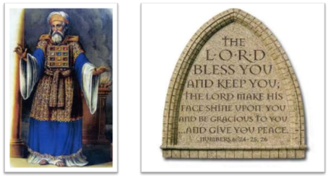
²⁴ The Lord bless you, and keep you; ²⁵ The Lord make His face shine on you, And be gracious to you; ²⁶ The Lord lift up His countenance on you, And give you peace.
Numbers 6:24–26 (NASB95)

