Slide 1
Law and Grace: An Overview Jim McGowan, Th.D. Sugar Land Bible Church 06-25-2023
…but grace and truth were realized through Jesus Christ - John 1:17
For the Law was given through Moses…
Special thanks to Dr. Vern Peterman for access to his insights and resources.

Slide 2
Session 37 Outline
Review
Purpose, Aim, and Objective
Session 36
ENTRY, BEWARE & ENTER – Matthew 7:13-23
General Information
Matthew 7:13-23
Concluding Observations

Slide 3
OUR PURPOSE, AIM AND OBJECTIVE
Law and Grace
…is to Compare and Contrast Law and Grace so as to properly understand these two important themes and how they are related to the life of the New Testament Believer.

Slide 4
C. I. Scofield, D. D.
The Grace of God, The Fundamentals Vol. 3, Chapter VII, p. 98
We have, most of us, been reared and now live under the influence of Galatianism. Protestant theology, alas, is for the most part, thoroughly Galatianized, in that neither law nor grace are given their distinct and separated places, as in the counsels of God, but are mingled together in one incoherent system. The law is no longer, as in the Divine intent, a ministration of death (2 Cor. 3:7), of cursing (Gal. 3:10), of conviction (Rom. 3:19), because we are taught that we must try to keep it, and that by Divine help we may. Nor, on the other hand, does grace bring us blessed deliverance from the dominion of sin, for we are kept under the law as a rule of life despite the plain declaration, “Sin shall not have dominion over you: for ye are not under the law, but under grace” (Rom. 6:14). (emphasis mine)

Slide 5
William R. Newell
Romans Verse-by-Verse (p. 274).
Grand Rapids, MI: Christian Classics Ethereal Library.
It is because Reformed theology has kept us Gentiles under the Law,—if not as a means of righteousness, then as “a rule of life,” that all the trouble has arisen. The Law is no more a rule of life than it is a means of righteousness. Walking in the Spirit has now taken the place of walking by ordinances. God has another principle under which He has put his saints: “Ye are not under law, but, under grace! (Rom. 6:14)” (italics mine)
PDF Download Here: https://archive.org/details/Romans_Verse_By_Verse-NewellWR

Slide 6
Henry Ironside
The Continual Burnt Offering: Daily Meditations on the Word of God (p. 265). Neptune, NJ: Loizeaux Brothers.
There is therefore now no condemnation
to those who are in Christ Jesus. – Romans 8:1
In Romans 7 we have a man renewed by the Spirit of God, but struggling under law, hoping thereby to subdue or find deliverance from the power of the old Adamic nature (sin nature). In chapter 8 we have God’s (only) way of deliverance through the death and resurrection of Christ with which the believer is identified before God. The chapter begins with “no condemnation” and ends with “no separation.” All who are in Christ Jesus are accepted in the Beloved and as free from every charge of guilt as He is Himself. He [Jesus] paid our penalty on the cross. Now we are linked up with Him in resurrection, not under law but under grace.

Slide 7
Matthew’s 3-Fold Purpose
Law and Grace: Review The SOM – Matthew 5:1–8:1 (Luke 6:17–49)
To explain:
that Jesus, in whom Matthew’s Israelite audience had believed, was indeed the long-awaited Jewish Messiah;
why the promised, messianic kingdom had been postponed despite the fact that the king had arrived; and,
the interim program of God during the messianic kingdom’s absence.

Slide 8
Session 37 Outline
Review
Purpose, Aim, and Objective
Session 36
ENTRY, BEWARE & ENTER – Matthew 7:13-23
General Information
Matthew 7:13-23
Concluding Observations

Slide 9
Law and Grace: Review The SOM – Matthew 5:1–8:1 (Luke 6:17–49)
To judge or not to judge, that is the question! Matthew 7:1-2
Jesus tells His Israelite audience that they are not to judge!
Then He says that to the extent that they do judge and in the manner that they judge, they themselves will be judged!

Slide 10
Law and Grace: Review The SOM – Matthew 5:1–8:1 (Luke 6:17–49)
What appears to be a conflict …is a call to look carefully Matthew 7:1-2
…Jesus warns against a particular ‘quality of judging’.
John 7:24
“Do not judge according to appearance, but judge with righteous judgment.”
Deuteronomy 16:18
“…judge the people with righteous judgment.”

Slide 11
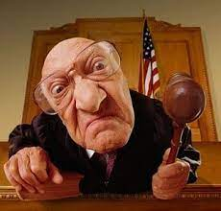
Law and Grace: Review The SOM – Matthew 5:1–8:1 (Luke 6:17–49)
So, what’s the problem with judging? Matthew 7:1-2
The judging that Jesus is warning about is superficial and according to the flesh, being from a human viewpoint, i.e. influenced by:
Anger
Envy
Hatred
Ignorance
Jealousy
Selfish Ambition

Slide 12
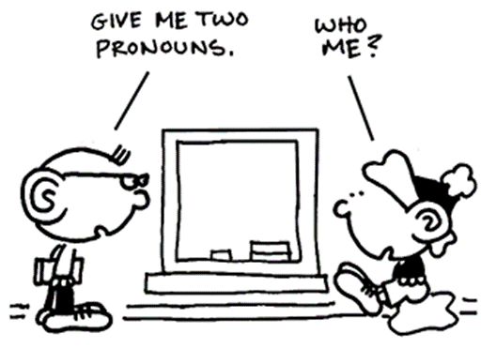
Law and Grace: Review The SOM – Matthew 5:1–8:1 (Luke 6:17–49)
Logs and specks Matthew 7:3-5
The principle of judging oneself under Law is also valid under Grace.
1 Corinthians 11:31
But if we judged ourselves rightly, we would not be judged.

Slide 13
‘Ask, seek and knock’ is also about God’s character! Matthew 7:7-11
Law and Grace: Review The SOM – Matthew 5:1–8:1 (Luke 6:17–49)
God's intention in encouraging us to come to Him in faith, is benevolence.

Slide 14
Law and Grace: Review The SOM – Matthew 5:1–8:1 (Luke 6:17–49)
Ask, Seek and Knock – VIP Privileged Access Matthew 7:7-11
All believers have VIP privileged access to God! (cf. Heb. 4:16; Eph. 3:12; 1 Jn. 3:21; 1 Jn. 5:14)

Slide 15
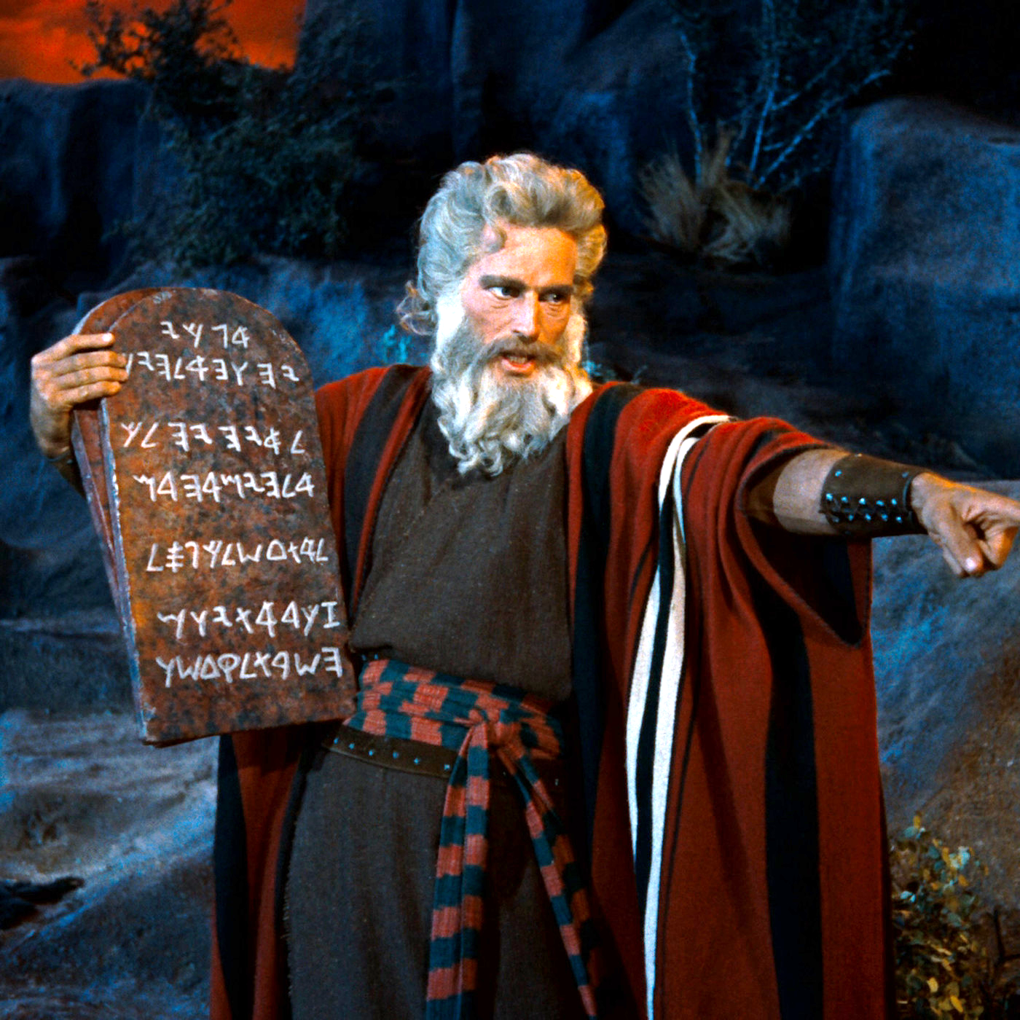
Law and Grace: Review The SOM – Matthew 5:1–8:1 (Luke 6:17–49)
The Golden Rule Matthew 7:12
Jesus takes His Israelite audience once again back to the Law of Moses, which declares, that the Israelite is to love his neighbor as himself (Lev. 19:18). (Remember the Essenes? See Session 31)
Just do it.
Leviticus 19:18
“…you shall love your neighbor as yourself; I am the Lord.”

Slide 16
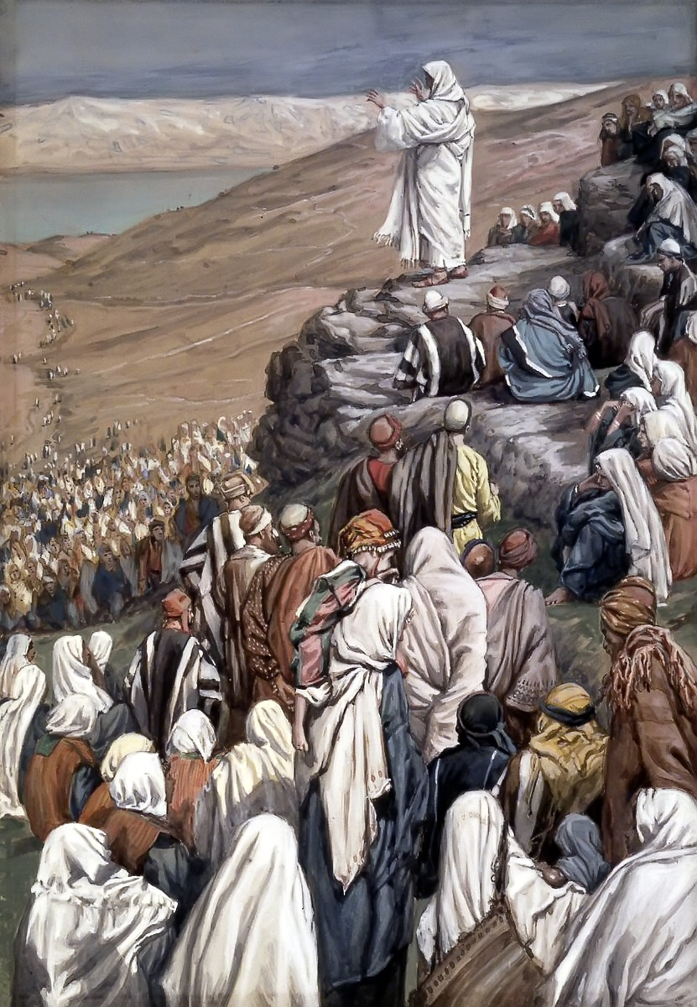
Law and Grace: Review The SOM – Matthew 5:1–8:1 (Luke 6:17–49)
The Golden Rule Matthew 7:12
However, loving one’s neighbor also applies to the Body of Christ as well, but not as being under the principle of the Law of Moses, but as being under the principle of grace.

Slide 17
Session 37 Outline
Review
Purpose, Aim, and Objective
Session 36
ENTRY, BEWARE & ENTER – Matthew 7:13-23
General Information
Matthew 7:13-23
Concluding Observations

Slide 18
Matthew 7:13–23
¹³ “Enter through the narrow gate; for the gate is wide and the way is broad that leads to destruction, and there are many who enter through it. ¹⁴ “For the gate is small and the way is narrow that leads to life, and there are few who find it. ¹⁵ “Beware of the false prophets, who come to you in sheep’s clothing, but inwardly are ravenous wolves. ¹⁶ “You will know them by their fruits. Grapes are not gathered from thorn bushes nor figs from thistles, are they? ¹⁷ “So every good tree bears good fruit, but the bad tree bears bad fruit. ¹⁸ “A good tree cannot produce bad fruit, nor can a bad tree produce good fruit. ¹⁹ “Every tree that does not bear good fruit is cut down and thrown into the fire. ²⁰ “So then, you will know them by their. . .

Slide 19
Matthew 7:13–23
. . .fruits. ²¹ “Not everyone who says to Me, ‘Lord, Lord,’ will enter the kingdom of heaven, but he who does the will of My Father who is in heaven will enter. ²² “Many will say to Me on that day, ‘Lord, Lord, did we not prophesy in Your name, and in Your name cast out demons, and in Your name perform many miracles?’ ²³ “And then I will declare to them, ‘I never knew you; depart from Me, you who practice lawlessness.’

Slide 20
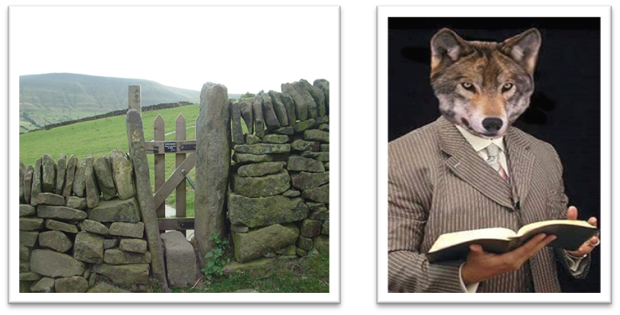
Law and Grace: The SOM – Matthew 5:1–8:1 (Luke 6:17–49)
ENTRY, BEWARE & ENTRY - PASSAGE OVERVIEW
Matthew 7:13-23
Verses 13-14 address the issue of entry into the coming kingdom of heaven.
Verses 15-20 is a warning from Christ about those who are false prophets.

Slide 21
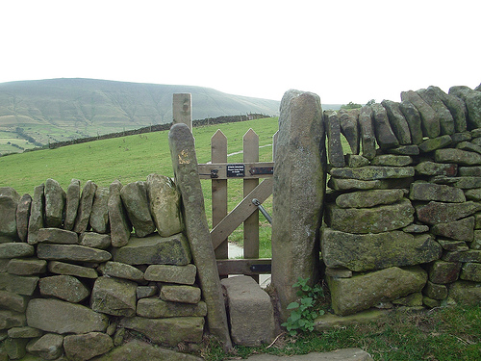
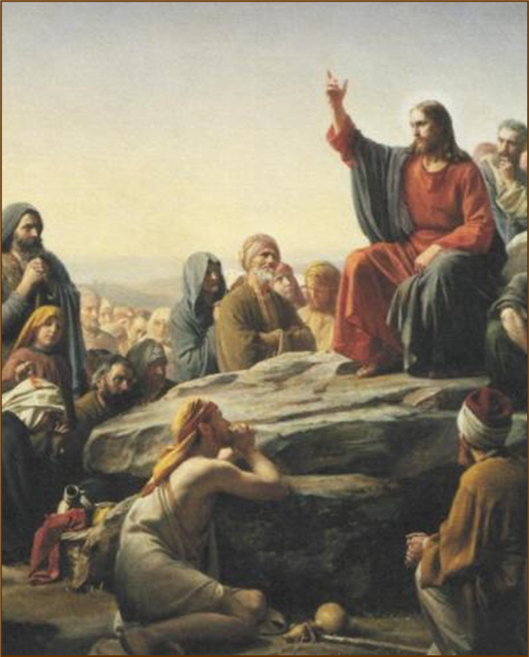
Law and Grace: The SOM – Matthew 5:1–8:1 (Luke 6:17–49)
ENTRY, BEWARE & ENTRY - PASSAGE OVERVIEW
Matthew 7:13-23
Verses 21-23 return to the issue of entry into the coming kingdom of heaven.
It is vitally important that we remember that these verses are spoken to Israelites, in the land of Israel, by their coming King.

Slide 22
Law and Grace: The SOM – Matthew 5:1–8:1 (Luke 6:17–49)
“4 GOSPELS” AND “2 GOSPEL MESSAGES” IN THE N.T.
The word ‘gospel’ literally means ‘good news’ and can refer to the New Testament Books, Matthew, Mark, Luke, and John, and/or the ‘message of good news’, they contain.

Slide 23
Law and Grace: The SOM – Matthew 5:1–8:1 (Luke 6:17–49)
TWO GOSPEL (GOOD NEWS) MESSAGES IN THE N.T.
The two ‘gospel’ messages in the New Testament are:
First, ‘the gospel of the Kingdom’ which was specifically for the Jews and was preached by John the Baptist (Matt. 3:1-12), Jesus, (Matt. 4:14), and The Twelve, (Matt. 10:1-11:1), and . . .

Slide 24
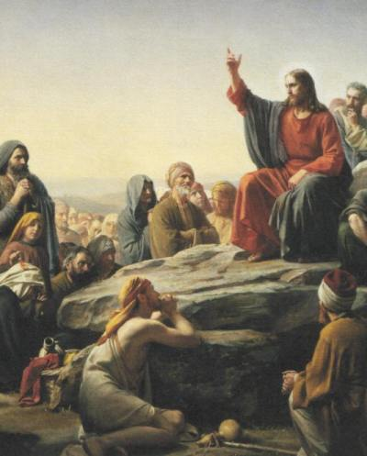
Law and Grace: The SOM – Matthew 5:1–8:1 (Luke 6:17–49)
TWO GOSPEL (GOOD NEWS) MESSAGES IN THE N.T.
Second, ‘the gospel of substitution’ (the Cross), which is for both the Jews and the Gentiles of all time.

Slide 25
Law and Grace: The SOM – Matthew 5:1–8:1 (Luke 6:17–49)
THREE HAZARDS IN THE FIRST OF TWO GOSPELS
Matthew 7:13-23
Jesus is presenting ‘the gospel of the kingdom’ TO THE ISRAELITES, and He sets before them three hazards:
The wide gate (or false gate),
False prophets, and,
False attempts at kingdom entry.

Slide 26
Session 37 Outline
Review
Purpose, Aim, and Objective
Session 36
ENTRY, BEWARE & ENTER – Matthew 7:13-23
General Information
Matthew 7:13-23
Concluding Observations

Slide 27
Matthew 7:13-14
¹³ “Enter through the narrow (στενός stenós) gate; for the gate is wide and the way is broad that leads to [the] destruction, and there are many who enter through it. ¹⁴ “For the gate is small and the way is narrow (θλίβω thlíbō) that leads to [the] life, and there are few who find it.

Slide 28
Law and Grace: The SOM – Matthew 5:1–8:1 (Luke 6:17–49)
The narrow & wide gates
Matthew 7:13-14
The narrow and wide gates are both in reference to the entry of Israelites into the coming kingdom, in which Christ will reign.

Slide 29
Law and Grace: The SOM – Matthew 5:1–8:1 (Luke 6:17–49)
The narrow & wide gates
Matthew 7:13-14
Entry through the *narrow gate is the way to kingdom life - not the broad way.
Entering the *narrow gate is a deliberate, considered decision.
* In v. 14, the Greek word translated ‘narrow’ literally means, “to be pressed by tribulation and affliction”.

Slide 30
Law and Grace: The SOM – Matthew 5:1–8:1 (Luke 6:17–49)
The path to life comes with affliction
Matthew 7:13-14
So, Jesus is warning His Jewish audience that entry by means of the narrow gate while being the only right choice, of necessity brings with it, tribulation and affliction and this is very important!

Slide 31
Law and Grace: The SOM – Matthew 5:1–8:1 (Luke 6:17–49)
The path to life comes with affliction
Matthew 7:13-14
This fits well with the warning about persecution that Christ gave to His Jewish audience earlier.
Matthew 5:10-12
¹⁰ “Blessed are those who have been persecuted for the sake of righteousness, for theirs is the kingdom of heaven....¹² “Rejoice and be glad, for your reward in heaven is great; for in the same way they persecuted the prophets who were before you.

Slide 32
Law and Grace: The SOM – Matthew 5:1–8:1 (Luke 6:17–49)
The path to life comes with affliction
Matthew 7:13-14
We who are in the body of Christ can also suffer persecution, and trials are certain to come, but for God’s purpose. (cf. Phil. 1:29; 1 Thess. 3:3-4)
2 Timothy 3:12
“Indeed, all who desire to live godly in Christ Jesus will be persecuted.”

Slide 33
Matthew 7:13-14
Expanded & Explained
¹³“You must enter into the kingdom through the narrow gate; for the gate is wide and the way is broad that leads to destruction, and there are many who enter through it because it is easy to find, easy to get through, and quite popular – even though in the end it leads to utter disaster. ¹⁴ For the gate is small and the way is constrained by affliction, that leads to the kingdom life of Messiah [Me, Jesus], and there are a relative few who find that small, narrow and constrained gate because of the hard and difficult path that goes with choosing it.”

Slide 34
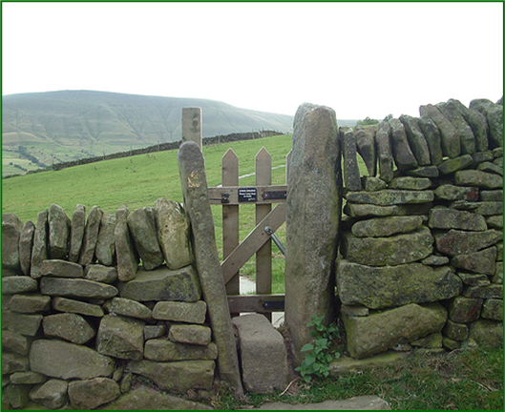
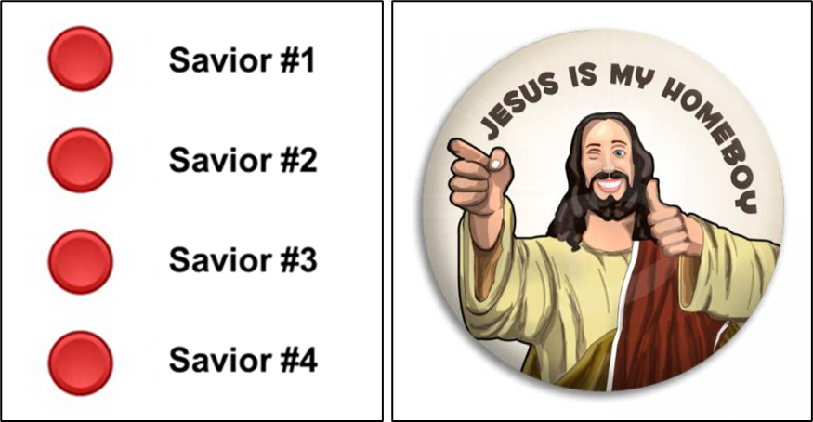
Law and Grace: The SOM – Matthew 5:1–8:1 (Luke 6:17–49)
Jesus is not a ‘Mix & Match’ Messiah
Matthew 7:13-14
Jesus is not a ‘mix and match’ Messiah nor a ‘menu selection’ among Saviors.
He presented Himself to the people of Israel as their one and only Messiah – the path to following Him meant entering the one narrow gate.

Slide 35
Law and Grace: The SOM – Matthew 5:1–8:1 (Luke 6:17–49)
Jesus is not a ‘Mix & Match’ Messiah
Matthew 7:13-14
In John 14:6, Jesus presents Himself to all as the way, the truth, and the life. (This is the ‘gospel of substitution’. Jesus died in our place.)
John 14:6
Expanded & Explained
Jesus said, “I, in contrast and distinction with everything else and everyone else, am the singular way, I am the singular truth, and I am the singular life. No one comes to the father except by me.”

Slide 36
Law and Grace: The SOM – Matthew 5:1–8:1 (Luke 6:17–49)
Jesus is not a ‘Mix & Match’ Messiah
Matthew 7:13-14
There is no other Savior and no other path to the Life!

Slide 37
Law and Grace: The SOM – Matthew 5:1–8:1 (Luke 6:17–49)
The narrow & wide gates
Matthew 7:13-14
The paths are not at all the same and which gate is chosen does make a difference!

Slide 38
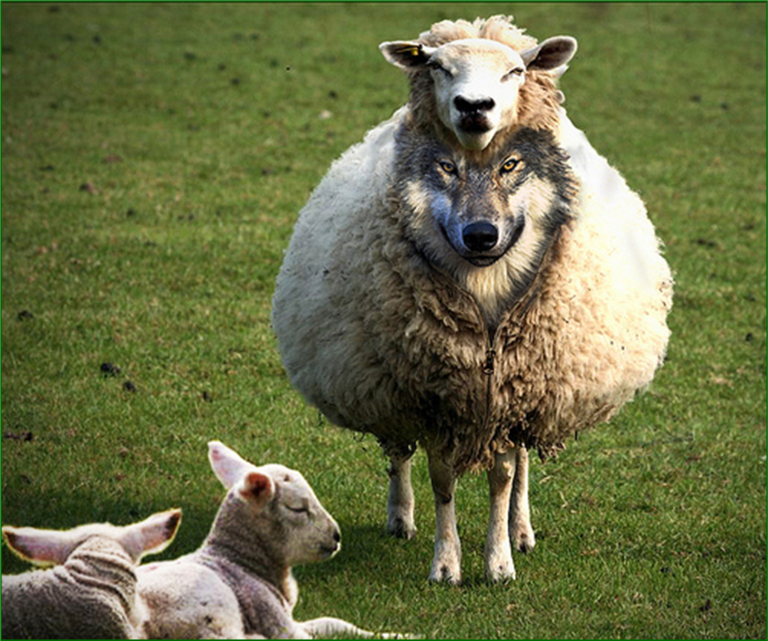
Matthew 7:15-20
¹⁵ “Beware of the false prophets, who come to you in sheep’s clothing, but inwardly are ravenous wolves. ¹⁶ “You will know them by their fruits. Grapes are not gathered from thorn bushes nor figs from thistles, are they? ¹⁷ “So every good tree bears good fruit, but the bad tree bears bad fruit. ¹⁸ “A good tree cannot produce bad fruit, nor can a bad tree produce good fruit. ¹⁹ “Every tree that does not bear good fruit is cut down and thrown into the fire. ²⁰ “So then, you will know them by their fruits. . . .

Slide 39
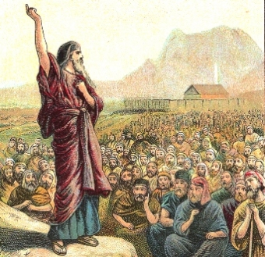
Law and Grace: The SOM – Matthew 5:1–8:1 (Luke 6:17–49)
Do you like to be lied to?
Matthew 7:15-20
In verses 15-20 Jesus warns His Israelite audience about false prophets, just as Moses had done more than 14 centuries before in (cf. Deut. 13; 18) and later, also the O.T. prophets! (cf. Jer. 6:13–15; 8:8–12; Ezek. 13; 22:27; Zeph. 3:4).

Slide 40
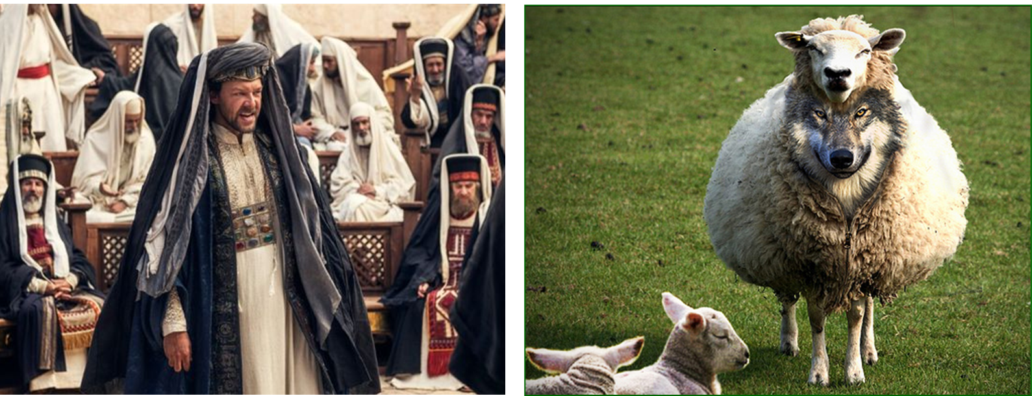
Law and Grace: The SOM – Matthew 5:1–8:1 (Luke 6:17–49)
Do you like to be lied to?
Matthew 7:15-20
In verse 15 Jesus speaks about how the false prophets disguise themselves, and He calls them ‘wolves in sheep’s clothing’.

Slide 41
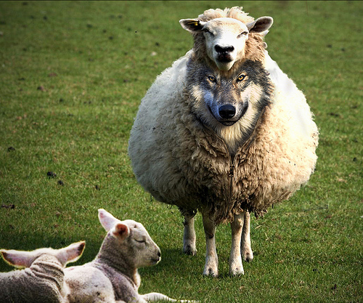
Law and Grace: The SOM – Matthew 5:1–8:1 (Luke 6:17–49)
Do you like to be lied to?
Matthew 7:15-20
In verses 15-20, Jesus also introduces the fruit illustration to metaphorically emphasize an important point.

Slide 42
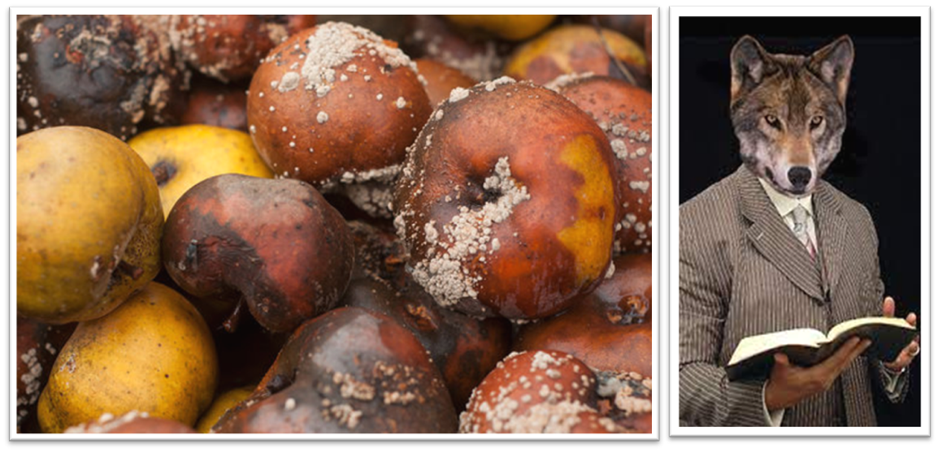
Law and Grace: The SOM – Matthew 5:1–8:1 (Luke 6:17–49)
How can you tell wolves from sheep?
Matthew 7:15-20
So how can one tell the wolves who are disguised as sheep from the real sheep? The way to uncover ‘the wolves’ among the flock is to carefully inspect their ‘wolf fruit’!

Slide 43
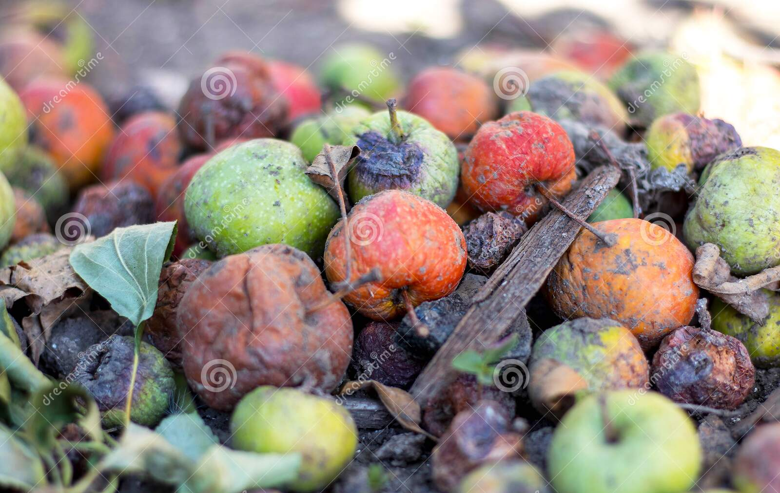
Matthew 7:15-20
¹⁵ “Beware of the false prophets, who come to you in sheep’s clothing, but inwardly are ravenous wolves. ¹⁶ “You will know them by their fruits. Grapes are not gathered from thorn bushes nor figs from thistles, are they? ¹⁷ “So every good tree bears good fruit, but the bad tree bears bad fruit. ¹⁸ “A good tree cannot produce bad fruit, nor can a bad tree produce good fruit. ¹⁹ “Every tree that does not bear good fruit is cut down and thrown into the fire. ²⁰ “So then, you will know them by their fruits. . . .

Slide 44
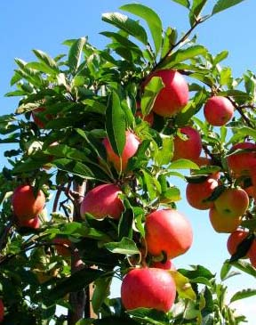
Law and Grace: The SOM – Matthew 5:1–8:1 (Luke 6:17–49)
How can you tell wolves from sheep?
Matthew 7:15-20
Just as good trees produce good fruit, so bad trees will produce bad fruit. Good and bad fruit is determined by the fruit’s source.
BTW, the Law of Moses forbade cutting down good fruit trees, but not non-fruit bearing trees! (cf. Deut. 20:20)

Slide 45
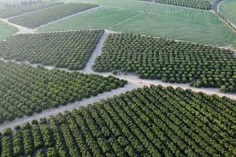
Deuteronomy 20:20
“Only the trees which you know are not fruit trees you shall destroy and cut down, that you may construct siegeworks against the city that is making war with you until it falls.”

Slide 46
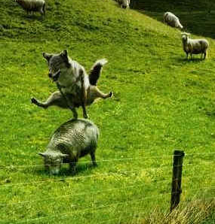
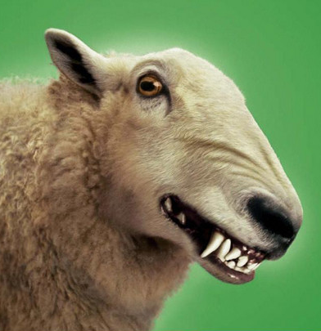
Law and Grace: The SOM – Matthew 5:1–8:1 (Luke 6:17–49)
Gates, wolves, sheep & fruit
Matthew 7:13-20

Slide 47
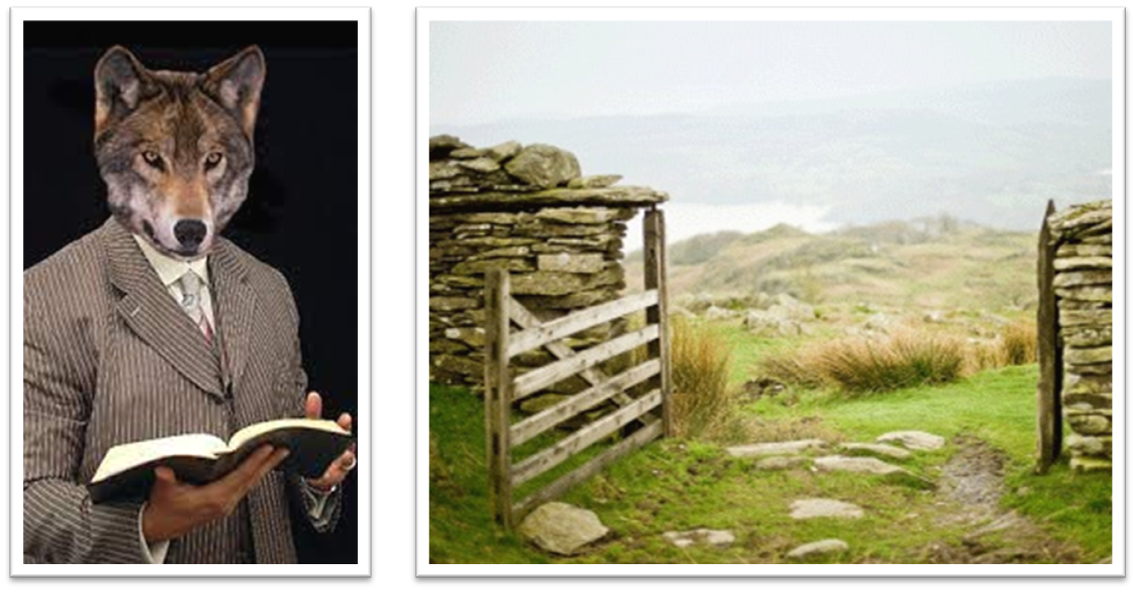
Law and Grace: The SOM – Matthew 5:1–8:1 (Luke 6:17–49)
Gates, wolves, sheep & fruit
Matthew 7:13-20
False prophets, who are the wolves, will point an Israelite to the wrong gate – the wide one. And the wrong way – the broad one!

Slide 48
Matthew 7:13
¹³ “…the gate is wide and the way is broad that leads to [the] destruction, and there are many who enter through it.”

Slide 49
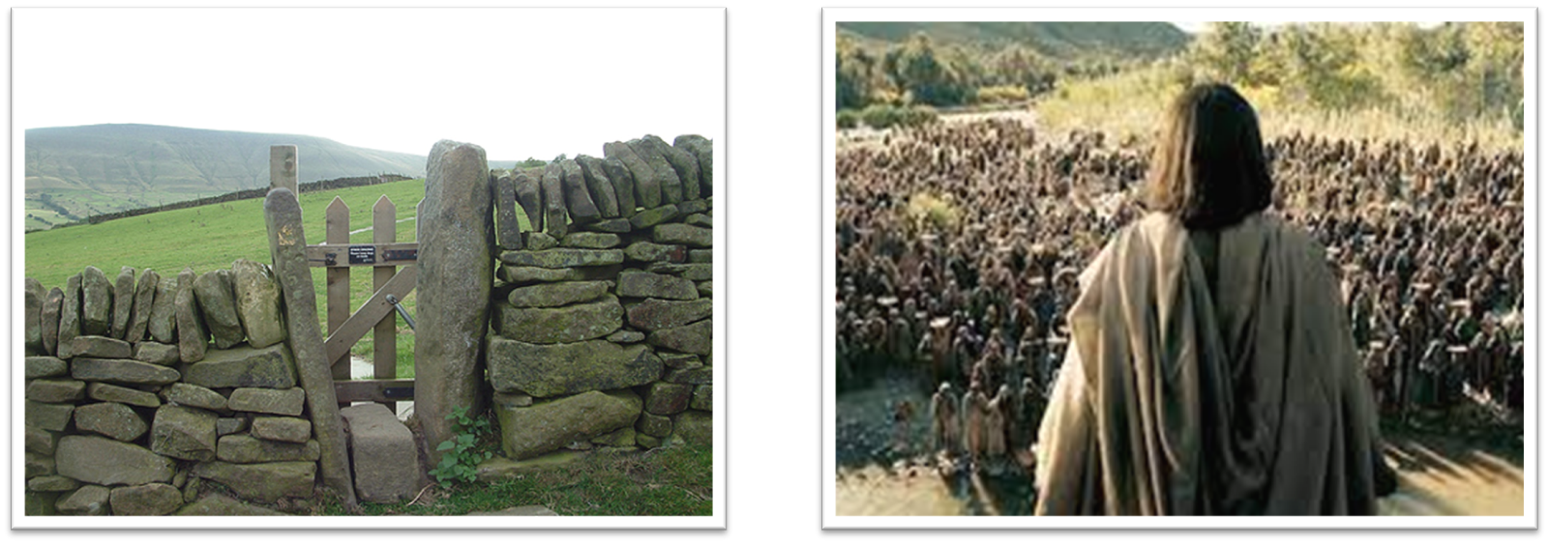
Law and Grace: The SOM – Matthew 5:1–8:1 (Luke 6:17–49)
Gates, wolves, sheep & fruit
Matthew 7:13-20
By contrast, a true prophet among them would point them to the right gate – the narrow one that leads to the Life.

Slide 50
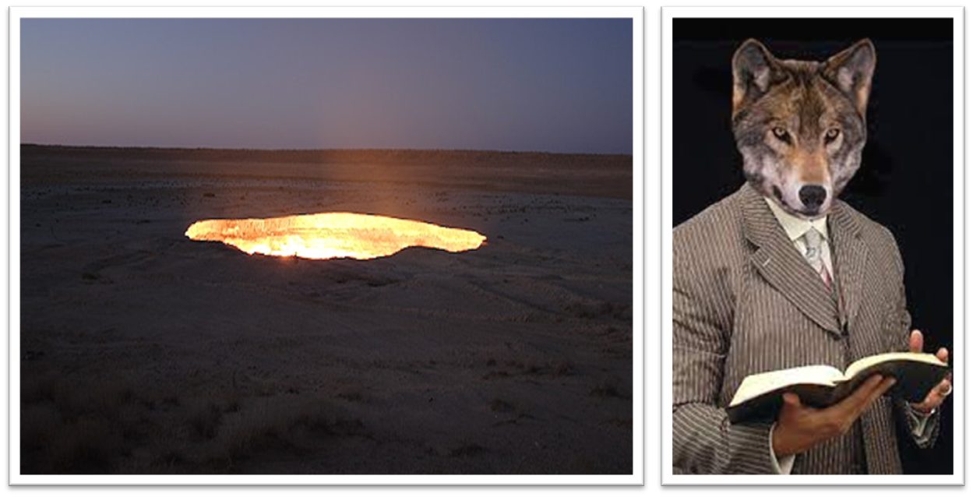
Law and Grace: The SOM – Matthew 5:1–8:1 (Luke 6:17–49)
Gates, wolves, sheep & fruit
Matthew 7:13-20
False prophets will not only point people to the wrong gate, but will end up going in themselves, to their own destruction.

Slide 51
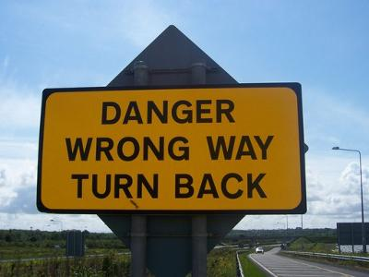
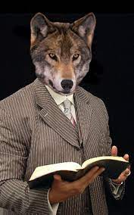
Law and Grace: The SOM – Matthew 5:1–8:1 (Luke 6:17–49)
False Prophets to False Teachers
Matthew 7:15-20
Jesus warned the Israelites, under Law, about false prophets, but for us in the Body of Christ, the primary warning is against false teachers, (cf. 2 Peter 2:1; 3:17-18; Eph. 4:14).

Slide 52
2 Peter 2:1
But false prophets also arose among the people [Israel], just as there will also be false teachers among you [the Body of Christ], who will secretly introduce destructive heresies [divisive teachings], even denying the Master who bought them, bringing swift destruction upon themselves.

Slide 53
2 Peter 3:17-18
¹⁷ You therefore, beloved, knowing this beforehand, be on your guard so that you are not carried away by the error of unprincipled men and fall from your own steadfastness, ¹⁸ but grow in the grace and knowledge of our Lord and Savior Jesus Christ. To Him be the glory, both now and to the day of eternity. Amen.

Slide 54
2 Peter 3:17-18
¹⁷ You therefore, beloved, knowing this beforehand, be on your guard so that you are not carried away by the error of unprincipled men and fall from your own steadfastness, ¹⁸ but grow [an imperative: you must grow] in the grace and knowledge of our Lord and Savior Jesus Christ. To Him be the glory, both now and to the day of eternity. Amen.

Slide 55
Ephesians 4:14
“As a result, we are no longer to be children, tossed here and there by waves and carried about by every wind of doctrine, by the trickery of men, by craftiness in deceitful scheming;”

Slide 56
Law and Grace: The SOM – Matthew 5:1–8:1 (Luke 6:17–49)
False prophets to false teachers
Matthew 7:15-20
The choice is: to be carried away by error or to grow in the grace and knowledge of our Lord and Savior.

Slide 57
Matthew 7:21-23
²¹ “Not everyone who says to Me, ‘Lord, Lord,’ will enter the kingdom of heaven, but he who does the will of My Father who is in heaven will enter. ²² “Many will say to Me on that day, ‘Lord, Lord, did we not prophesy in Your name, and in Your name cast out demons, and in Your name perform many miracles?’ ²³ “And then I will declare to them, ‘I never knew you; depart from Me, you who practice lawlessness.’

Slide 58
Law and Grace: The SOM – Matthew 5:1–8:1 (Luke 6:17–49)
The criteria for kingdom entry
Matthew 7:21-23
While verses 15–20 dealt with false prophets, verses 21–23 deal with false followers.

Slide 59
Law and Grace: The SOM – Matthew 5:1–8:1 (Luke 6:17–49)
The criteria for kingdom entry
Matthew 7:21-23
Verses 21-23 focus on verbs: do, enter, say, know, practice.
We will see as we go through the book of Matthew that there is an ongoing focus on judgment of the Israelites.

Slide 60
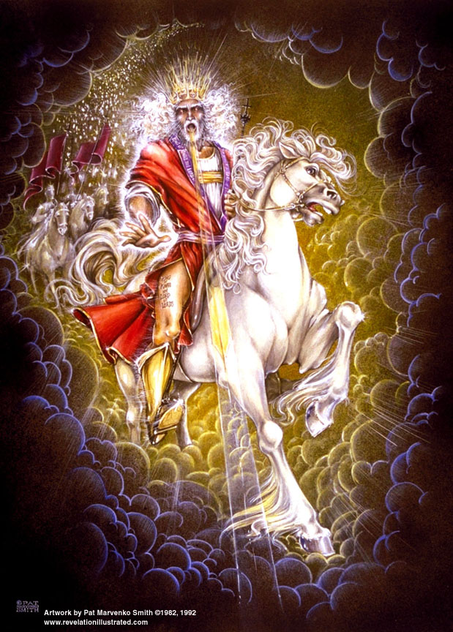
Law and Grace: The SOM – Matthew 5:1–8:1 (Luke 6:17–49)
The criteria for kingdom entry
Matthew 7:21-23
The judgment of the Israelites that Jesus is talking about will take place at the time of His Second Coming.

Slide 61
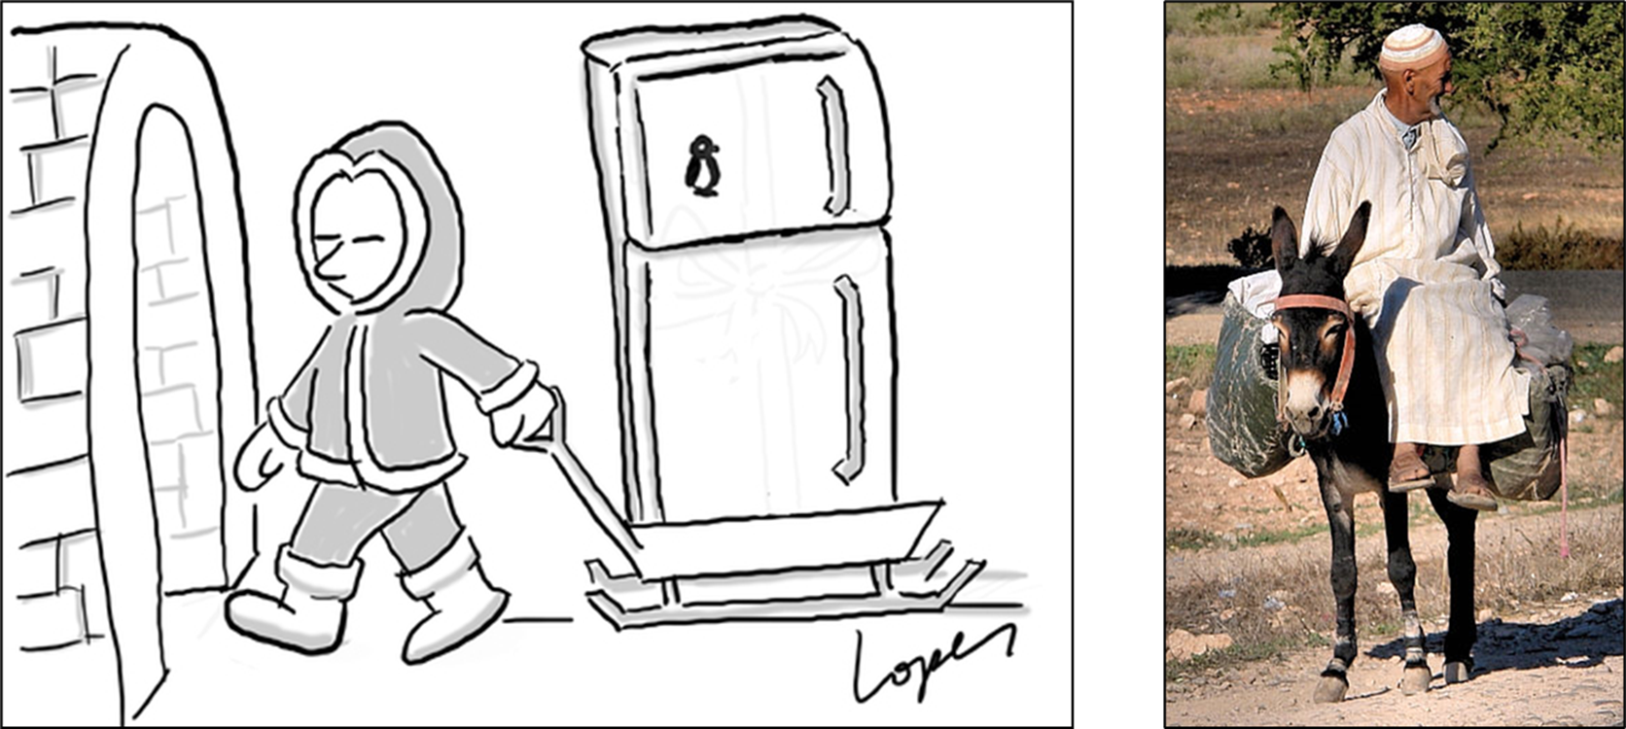
Law and Grace: The SOM – Matthew 5:1–8:1 (Luke 6:17–49)
Ice cubes to eskimos, hind leg off a donkey
Matthew 7:21-23
There are those in this world who are very persuasive – so much so that we have expressions like, “He can sell ice cubes to Eskimos.” or “He can talk the hind leg off of a donkey”.

Slide 62
Matthew 7:21-23
²¹ “Not everyone who says to Me, ‘Lord, Lord,’ will enter the kingdom of heaven, but he who does the will of My Father who is in heaven will enter. ²² “Many will say to Me on that day, ‘Lord, Lord, did we not prophesy in Your name, and in Your name cast out demons, and in Your name perform many miracles?’ ²³ “And then I will declare to them, ‘I never knew you; depart from Me, you who practice lawlessness.’

Slide 63
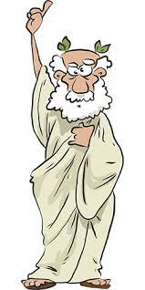
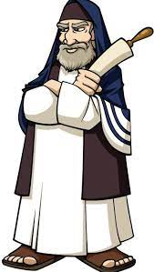
Law and Grace: The SOM – Matthew 5:1–8:1 (Luke 6:17–49)
Ice cubes to eskimos, hind leg off a donkey
Matthew 7:21-23
But we see in this passage that verbal eloquence and the most persuasive speech will not carry any weight in that coming judgment of the Israelites.
For the Israelite hoping to enter the kingdom in which Christ reigns, just talking a good talk will mean nothing.

Slide 64
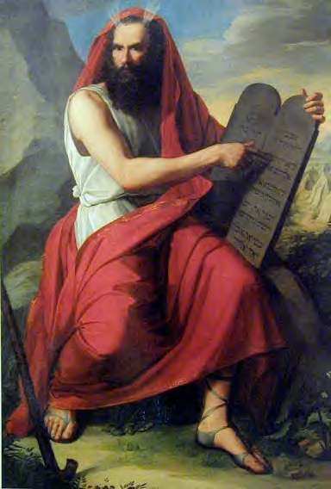
Law and Grace: The SOM – Matthew 5:1–8:1 (Luke 6:17–49)
Kingdom entry is about doing & knowing
Matthew 7:21-23
The Israelite hoping to enter the kingdom must have been doing the Father’s will, which for the Jews means pursuing true righteousness as correctly revealed in Law of Moses as opposed to Pharisaic righteousness.
From God’s viewpoint, the ones who will enter the kingdom of heaven will be those whom Christ actually knows, regardless of what they say.

Slide 65
Law and Grace: The SOM – Matthew 5:1–8:1 (Luke 6:17–49)
Let’s talk about their talk & their walk
Matthew 7:21-23
The deceived Israelites that Jesus is referring to in these 3 verses begin by calling Christ, “Lord, Lord”, which is a Hebrew way of expressing and acknowledging ultimate Lordship.
Matthew 25:11-12
“¹¹…Lord, lord, open up for us.’ ¹² "But he answered, 'Truly I say to you, I do not know you.”

Slide 66
Law and Grace: The SOM – Matthew 5:1–8:1 (Luke 6:17–49)
Let’s talk about their talk & their walk
Matthew 7:21-23
These deceived Israelites even make claims to prophesy, cast out demons and perform miracles – all in Christ’s name! (cf. Acts 19:13–15)

Slide 67
Law and Grace: The SOM – Matthew 5:1–8:1 (Luke 6:17–49)
Dr. Arnold Fruchtenbaum
The Messianic Bible Study Collection (Vol. 94 p. 26 & Vol 102, p. 22). Ariel Ministries. (1983).
“One can be truly saved, and never performed a miracle, yet enter the Kingdom, while many others who have done miracles in the name of a counterfeit Jesus will see themselves left out of the Messianic Kingdom.…Notice what Yeshua said to those people who even did miracles in His name. Jesus does not say, “I used to know you, but you lost your salvation, so I don’t know you any longer.” Rather, He said: I never knew you. Miracles are possible in the name of a counterfeit Yeshua, because Satan can duplicate many of the miracles of Jesus. Just because these people claimed to have done things in the name of Yeshua does not necessarily make it true. They had outward profession, but Jesus said: I never knew you, and that clearly means they were never saved to begin with.”

Slide 68
Law and Grace: The SOM – Matthew 5:1–8:1 (Luke 6:17–49)
Dr. Thomas Constable
Tom Constable’s Expository Notes on the Bible (Mt 7:21). Galaxie Software. (2003).
Obviously, it was possible for unbelieving disciples (e.g., Judas Iscariot) to prophesy, exorcise (cast out) demons, and perform miracles in Jesus’ name. The authority of His name (His person) enabled them to do so, not their own righteousness or their relationship to Him. Many onlookers undoubtedly viewed these works as good fruit and evidence of righteous character. However, these were cases of tares that looked like wheat (cf. 13:24–30).

Slide 69
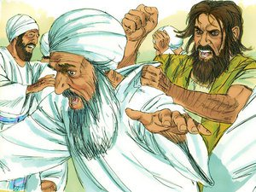
Acts 19:13–15
¹³ But also some of the Jewish exorcists, who went from place to place, attempted to name over those who had the evil spirits the name of the Lord Jesus, saying, “I adjure you by Jesus whom Paul preaches.” ¹⁴ Seven sons of one Sceva, a Jewish chief priest, were doing this. ¹⁵ And the evil spirit answered and said to them, “I recognize Jesus, and I know about Paul, but who are you?”

Slide 70
Session 37 Outline
Review
Purpose, Aim, and Objective
Session 36
ENTRY, BEWARE & ENTER – Matthew 7:13-23
General Information
Matthew 7:13-23
Concluding Observations

Slide 71
Law and Grace: The SOM – Matthew 5:1–8:1 (Luke 6:17–49)
The many & the few
Matthew 7:13-23
Verses 13-14 and 21-23 talk about entry into the Messianic Kingdom, and both passages talk about the many.
Most of those who come to the place of potential entry into the kingdom will be turned away.

Slide 72
Law and Grace: The SOM – Matthew 5:1–8:1 (Luke 6:17–49)
The many & the few
Matthew 7:13-23
Relatively few Israelites will actually be granted entry into Christ’s coming kingdom.
Those few Israelites who will be granted entry will be those whom the Messiah (Christ) actually knows, and He won’t be fooled.

Slide 73
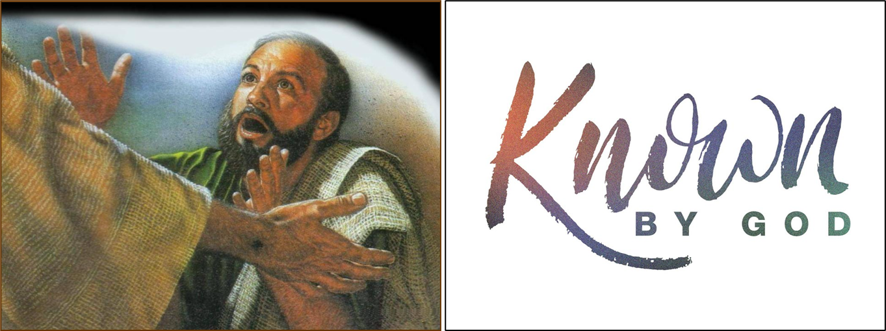
Law and Grace: The SOM – Matthew 5:1–8:1 (Luke 6:17–49)
More than who you know, it’s Who knows you
Matthew 7:21-23
On the other hand, we in the Body of Christ are to grow in the grace and knowledge of the Lord Jesus Christ, and while knowing Christ is of great importance, we must be known by Him to be saved.

Slide 74
Galatians 4:9
“But now that you have come to know God, or rather to be known by God…”
John 10:27
“My sheep hear My voice, and I know them…”

Slide 75
Law and Grace: An Overview Jim McGowan, Th.D. Sugar Land Bible Church 06-25-2023
…but grace and truth were realized through Jesus Christ - John 1:17
For the Law was given through Moses…
Special thanks to Dr. Vern Peterman for access to his insights and resources.

