Slide 1
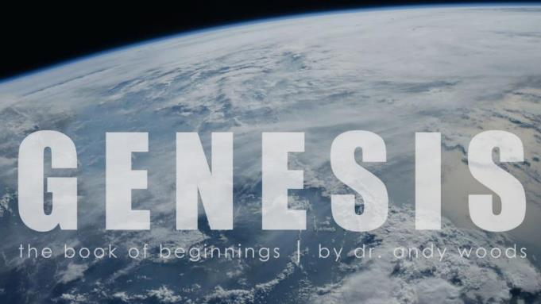
Genesis 12‒50
Israel’s Birth & Preservation

Slide 2
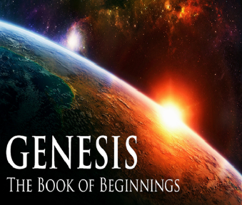
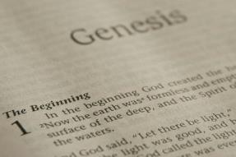
GENESIS STRUCTURE
Genesis 12-50 (four people)
Abraham (12:1–25:11)
Isaac (25:12–26:35)
Jacob (27–36)
Joseph (37–50)

Slide 3
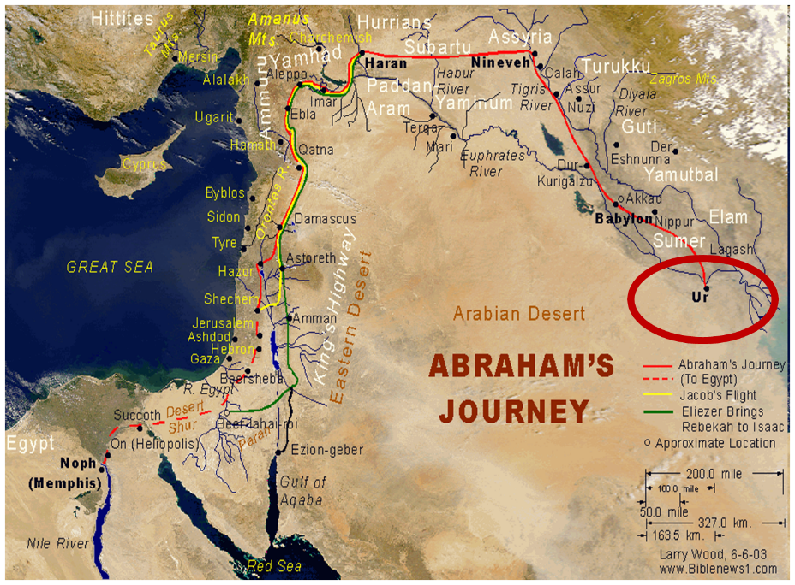

Slide 4
Genesis 31:22-42 Laban’s Pursuit
Report to Laban (22)
Laban’s chase (23)
God’s warning (24)
Laban catches Jacob (25)
Laban’s verbal attack (26-30)
Jacob’s response (31-32)
Laban’s search (33-35)
Jacob’s response (36-42)

Slide 5
VI. Genesis 31:31-32 Jacob’s Response
Jacob’s reasons for flight (31)
Jacob’s offer to Laban (32a)
Jacob’s ignorance (32b)

Slide 6
VI. Genesis 31:31-32 Jacob’s Response
Jacob’s reasons for flight (31)
Jacob’s offer to Laban (32a)
Jacob’s ignorance (32b)

Slide 7
VI. Genesis 31:31-32 Jacob’s Response
Jacob’s reasons for flight (31)
Jacob’s offer to Laban (32a)
Jacob’s ignorance (32b)

Slide 8
VI. Genesis 31:31-32 Jacob’s Response
Jacob’s reasons for flight (31)
Jacob’s offer to Laban (32a)
Jacob’s ignorance (32b)

Slide 9
Genesis 31:22-42 Laban’s Pursuit
Report to Laban (22)
Laban’s chase (23)
God’s warning (24)
Laban catches Jacob (25)
Laban’s verbal attack (26-30)
Jacob’s response (31-32)
Laban’s search (33-35)
Jacob’s response (36-42)

Slide 10
VII. Genesis 31:33-35 Laban’s Search
Laban searches the other tents (33a)
Laban searches Rachel’s tent (33b-34)
Rachel’s excuse (35)

Slide 11
VII. Genesis 31:33-35 Laban’s Search
Laban searches the other tents (33a)
Laban searches Rachel’s tent (33b-34)
Rachel’s excuse (35)

Slide 13
VII. Genesis 31:33-35 Laban’s Search
Laban searches the other tents (33a)
Laban searches Rachel’s tent (33b-34)
Rachel’s excuse (35)

Slide 14
VII. Genesis 31:33-35 Laban’s Search
Laban searches the other tents (33a)
Laban searches Rachel’s tent (33b-34)
Rachel’s excuse (35)

Slide 15
Charles Ryrie The Ryrie Study Bible, page 42
Genesis 31:35 (RSBEE:NASB1995U): “31:35 It was customary for children, regardless of age, to stand in the presence of their parents (cf. Lev. 19:32; 1 Kings 2:19), but Rachel claimed to be menstruating.”

Slide 16
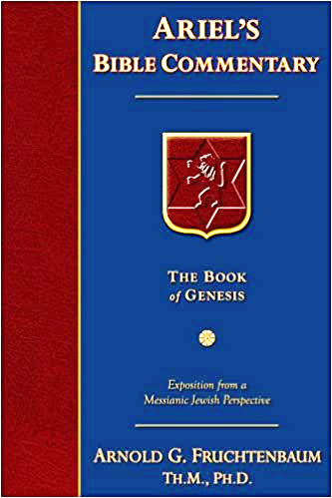
Dr. Arnold G. Fruchtenbaum
The Book of Genesis, 470
“So, verse 35a gives Rachel’s excuse: And she said to her father, Let not my lord be angry that I cannot rise before you; for the manner of woman is upon me. What she claimed was that she was now having her period, so she was in pain and discomfort and could not rise. Now if this was true (it may not have been true since she may have been lying), this would have in effect contaminated these household gods, rendering them unclean because of coming into contact with menstrual blood. A woman in the menstrual state did not need to rise. So Laban was deceived by local custom, just as he once deceived Jacob by local custom (29:26). Here again is curse for curse in kind. This indeed actually may have saved Rachel’s life.”

Slide 17
8 New Promises Genesis 12:1-3
Land (Gen. 12:1b)
Great nation (Gen. 12:2a)
Personal blessing (Gen. 12:2b)
Great name (Gen. 12:2c)
Blessing to others (Gen. 12:2d)
Blessing to blessers (Gen. 12:3a)
Cursing to cursers (Gen. 12:3b)
Blessing to the world (Gen. 12:3c)

Slide 18
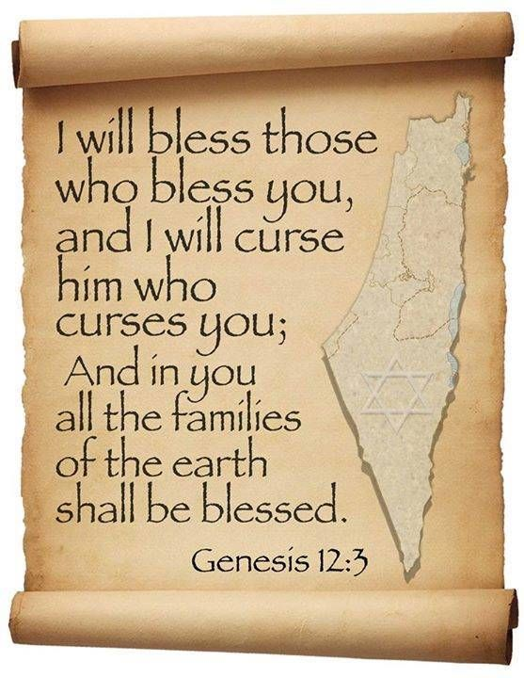
Genesis 12:3
“And I will bless those who bless you, And the one who curses you I will curse. And in you all the families of the earth will be blessed.”

Slide 19
Genesis 31:22-42 Laban’s Pursuit
Report to Laban (22)
Laban’s chase (23)
God’s warning (24)
Laban catches Jacob (25)
Laban’s verbal attack (26-30)
Jacob’s response (31-32)
Laban’s search (33-35)
Jacob’s response (36-42)

Slide 20
VIII. Genesis 31:36-42 Laban’s Search
Emotional response (36a)
Jacob’s challenge (36b-37)
Jacob’s history with Laban (38-42)

Slide 21
VIII. Genesis 31:36-42 Laban’s Search
Emotional response (36a)
Jacob’s challenge (36b-37)
Jacob’s history with Laban (38-42)

Slide 22
VIII. Genesis 31:36-42 Laban’s Search
Emotional response (36a)
Jacob’s challenge (36b-37)
Jacob’s history with Laban (38-42)

Slide 23
VIII. Genesis 31:36-42 Laban’s Search
Emotional response (36a)
Jacob’s challenge (36b-37)
Jacob’s history with Laban (38-42)

Slide 24
Genesis 31:38-42 Jacob’s History with Laban
Jacob’s innocence (38-40)
Laban’s dishonesty (41)
Divine intervention (42)

Slide 25
Genesis 31:38-42 Jacob’s History with Laban
Jacob’s innocence (38-40)
Laban’s dishonesty (41)
Divine intervention (42)

Slide 26
Genesis 31:38-40 Jacob’s Innocence
No flock miscarriages (38a)
No eating of the flock (38b)
Bore loss for torn beasts (39a)
Made good for stolen property (39b)
Endured adverse circumstances (40a)
Severe conditions & sleepless nights (40b)

Slide 27
Genesis 31:38-40 Jacob’s Innocence
No flock miscarriages (38a)
No eating of the flock (38b)
Bore loss for torn beasts (39a)
Made good for stolen property (39b)
Endured adverse circumstances (40a)
Severe conditions & sleepless nights (40b)

Slide 28
Genesis 31:38-40 Jacob’s Innocence
No flock miscarriages (38a)
No eating of the flock (38b)
Bore loss for torn beasts (39a)
Made good for stolen property (39b)
Endured adverse circumstances (40a)
Severe conditions & sleepless nights (40b)

Slide 29
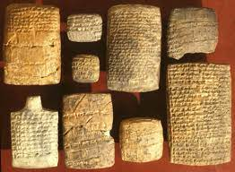
Dr. Arnold G. Fruchtenbaum
The Book of Genesis, 470
“The rams of your flocks have I not eaten; Jacob did not eat of the flocks when he was hungry. According to the Nuzi Tablets, this was a common sin of shepherds, who frequently used the flocks of their masters to feed themselves; but Jacob never did.”

Slide 30
Genesis 31:38-40 Jacob’s Innocence
No flock miscarriages (38a)
No eating of the flock (38b)
Bore loss for torn beasts (39a)
Made good for stolen property (39b)
Endured adverse circumstances (40a)
Severe conditions & sleepless nights (40b)

Slide 31
Genesis 31:38-40 Jacob’s Innocence
No flock miscarriages (38a)
No eating of the flock (38b)
Bore loss for torn beasts (39a)
Made good for stolen property (39b)
Endured adverse circumstances (40a)
Severe conditions & sleepless nights (40b)

Slide 32
Genesis 31:38-40 Jacob’s Innocence
No flock miscarriages (38a)
No eating of the flock (38b)
Bore loss for torn beasts (39a)
Made good for stolen property (39b)
Endured adverse circumstances (40a)
Severe conditions & sleepless nights (40b)

Slide 33
Genesis 31:38-40 Jacob’s Innocence
No flock miscarriages (38a)
No eating of the flock (38b)
Bore loss for torn beasts (39a)
Made good for stolen property (39b)
Endured adverse circumstances (40a)
Severe conditions & sleepless nights (40b)

Slide 34
Dr. Arnold G. Fruchtenbaum
The Book of Genesis, 471
“In the Code of Hammurabi, any charge of negligence could be challenged in court. A shepherd gave a receipt to the owner for the animals he took; he had to return the animals with a reasonable increase, although he was allowed to use some for food. He was not responsible for those killed by lions or by lightning, but any loss due to carelessness had to be repaid tenfold. This shows that Jacob did not demand or make use of his own civil rights under the law in effect in that area of the country. This reveals Jacob’s attitude in that he could have had an even greater gain if he had resorted to the laws of his day to his benefit, but he did not. In 31:41, Jacob spelled out Laban’s unfaithfulness: These twenty years have I been in your house, and he went on to divide the timing.”

Slide 35
Genesis 31:38-42 Jacob’s History with Laban
Jacob’s innocence (38-40)
Laban’s dishonesty (41)
Divine intervention (42)

Slide 36
Genesis 31:41 Laban’s Dishonesty
Twenty-year summation (41a)
First fourteen years (41b)
Remaining six years (41b)

Slide 37
Genesis 31:41 Laban’s Dishonesty
Twenty-year summation (41a)
First fourteen years (41b)
Remaining six years (41b)

Slide 38
Genesis 31:41 Laban’s Dishonesty
Twenty-year summation (41a)
First fourteen years (41b)
Remaining six years (41b)

Slide 39
Genesis 31:41 Laban’s Dishonesty
Twenty-year summation (41a)
First fourteen years (41b)
Remaining six years (41b)

Slide 40
Genesis 31:38-42 Jacob’s History with Laban
Jacob’s innocence (38-40)
Laban’s dishonesty (41)
Divine intervention (42)

Slide 41
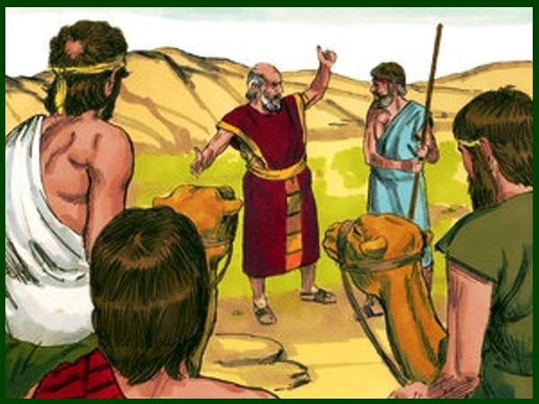
Charles Ryrie The Ryrie Study Bible, page 42
Genesis 31:42 (RSBEE:NASB1995U): “31:42 the fear of Isaac means ‘the God Isaac feared.’”

Slide 42
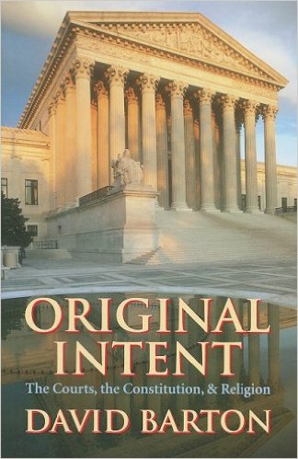
David Barton, Original Intent, p. 245

Slide 45
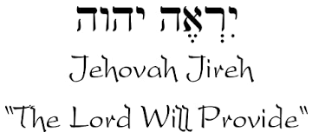

Slide 46
Names for God in Genesis
Elohim (1:1) - Power
Yahweh (2:4) - Relational
El Roi (Gen. 16:13) – Aware
El Olam (21:33) – Eternal
Jehovah Jireh (22:14) - Provision
God Isaac Feared (31:42, 53) - Reverenced

Slide 47
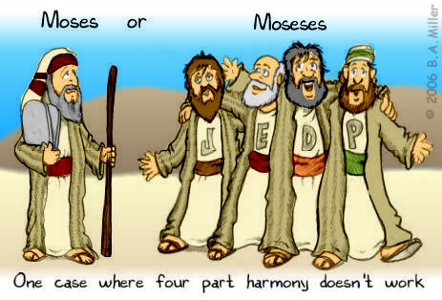
DOCUMENTARY HYPOTHESIS
J – Yahwist (850 B.C.)
E – Elohist (750 B.C.)
D – Deuteronomist (621 B.C.)
P – Priestly code (525 B.C.)

Slide 48
Arguments Favoring the Documentary Hypothesis
Writing unknown at the time of Moses
Different names for God
Differing styles
Editorial insertions (Gen. 36:31)
Assumption of polytheism to monotheism

Slide 49
Problems with the Documentary Hypothesis
JEDP Documents never discovered
Writing prior to 1500 B.C. (Code of Hamurabi)
Different names for God used for different literary purposes
Editorial insertions added after Moses completed the bulk of the work
Polytheism to monotheism trajectory never proven
Moses relied upon other sources (Gen. 5:1)

Slide 50
Conclusion

Slide 51
Genesis 31:22-42 Laban’s Pursuit
Report to Laban (22)
Laban’s chase (23)
God’s warning (24)
Laban catches Jacob (25)
Laban’s verbal attack (26-30)
Jacob’s response (31-32)
Laban’s search (33-35)
Jacob’s response (36-42)

Slide 52
²⁴ The Lord bless you, and keep you; ²⁵ The Lord make His face shine on you, And be gracious to you; ²⁶ The Lord lift up His countenance on you, And give you peace.
Numbers 6:24–26 (NASB95)

