Slide 1
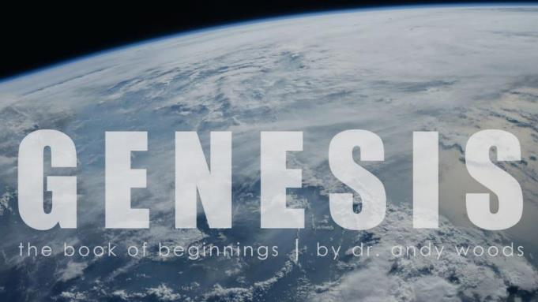
Genesis 12‒50
Israel’s Birth & Preservation

Slide 2
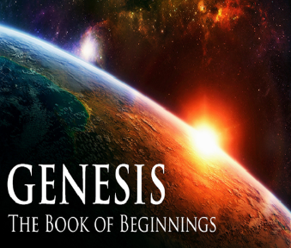
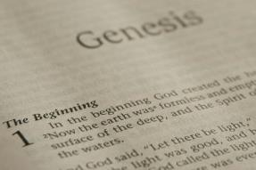
GENESIS STRUCTURE
Genesis 12-50 (four people)
Abraham (12:1–25:11)
Isaac (25:12–26:35)
Jacob (27–36)
Joseph (37–50)

Slide 3
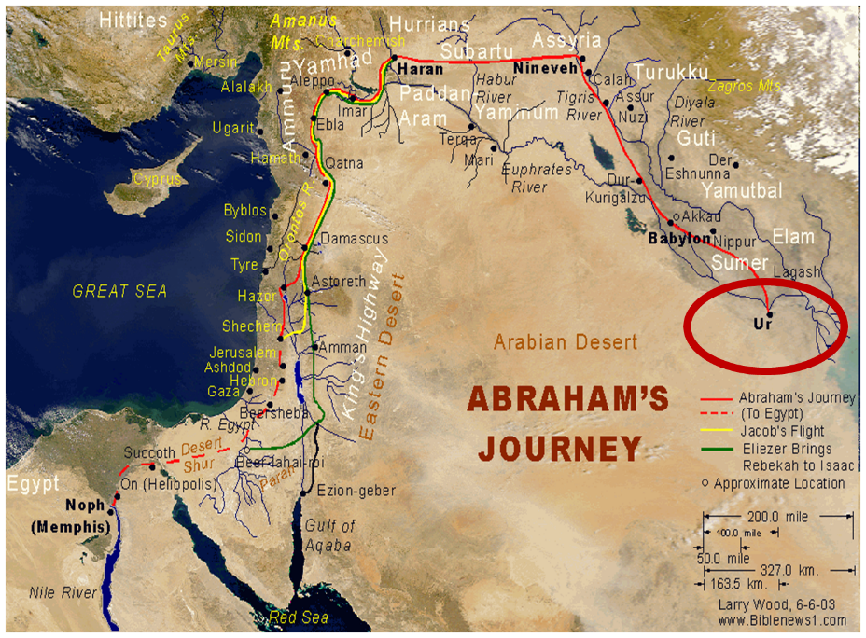

Slide 4
Genesis 31:22-42 Laban’s Pursuit
Report to Laban (22)
Laban’s chase (23)
God’s warning (24)
Laban catches Jacob (25)
Laban’s verbal attack (26-30)
Jacob’s response (31-32)
Laban’s search (33-35)
Jacob’s response (36-42)

Slide 5
Genesis 31:22-42 Laban’s Pursuit
Report to Laban (22)
Laban’s chase (23)
God’s warning (24)
Laban catches Jacob (25)
Laban’s verbal attack (26-30)
Jacob’s response (31-32)
Laban’s search (33-35)
Jacob’s response (36-42)

Slide 6
Genesis 31:22-42 Laban’s Pursuit
Report to Laban (22)
Laban’s chase (23)
God’s warning (24)
Laban catches Jacob (25)
Laban’s verbal attack (26-30)
Jacob’s response (31-32)
Laban’s search (33-35)
Jacob’s response (36-42)

Slide 7
Ordinary and Consecutive Days?
Numerical ordinal modifier used 359 times outside of Genesis 1-2 (Joshua 6:3; Esther 4:16)
“Evening and morning” used 38 times outside of Genesis 1-2
Exodus 20:8-11; 31:17
Adam’s age (Gen. 5:5)

Slide 8
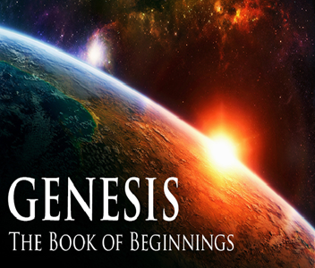
Ken Ham et al, Answers in Genesis, rev ed. (Green Forest, AR: Master Books, 1990), 37-emphasis mine.
“Back in my father’s day, it took ten days to drive across the Australian outback during the day.”

Slide 11
Genesis 31:22-42 Laban’s Pursuit
Report to Laban (22)
Laban’s chase (23)
God’s warning (24)
Laban catches Jacob (25)
Laban’s verbal attack (26-30)
Jacob’s response (31-32)
Laban’s search (33-35)
Jacob’s response (36-42)

Slide 12
Genesis 12‒25 Abraham’s Early Journeys
Unconditional promises (Gen. 12:1-3) From Haran to Canaan (Gen. 12:4-5) In Canaan (Gen. 12:6-9) In Egypt (Gen. 12:10-20) Abram and Lot Separate (Gen. 13:1-13) Reaffirmation of Abram’s promises (Gen. 13:14-18) Abram Rescues Lot (14:1-24) Abrahamic Covenant (15:1-21) Hagar & Ishmael (16:1-16) Circumcision (Gen. 17:1-27) | Sodom & Gomorrah (Gen. 18‒19) Abraham & Abimelech (Gen. 20) Isaac’s birth (Gen. 21:1-7) Ishmael’s expulsion (21:8-21) Abraham & Abimelech’s covenant (21:22-34) Abraham sacrifices Isaac (22) Sarah’s death (23) Isaac’s marriage (24) Abraham & Keturah (25:1-6) Abraham’s death (25:7-11)

Slide 13
Genesis 31:22-42 Laban’s Pursuit
Report to Laban (22)
Laban’s chase (23)
God’s warning (24)
Laban catches Jacob (25)
Laban’s verbal attack (26-30)
Jacob’s response (31-32)
Laban’s search (33-35)
Jacob’s response (36-42)

Slide 14
Genesis 31:22-42 Laban’s Pursuit
Report to Laban (22)
Laban’s chase (23)
God’s warning (24)
Laban catches Jacob (25)
Laban’s verbal attack (26-30)
Jacob’s response (31-32)
Laban’s search (33-35)
Jacob’s response (36-42)

Slide 15
V. Genesis 31:26-30 Laban’s Attack
Laban’s false accusations (26-28a)
Laban’s conclusion (28b)
Laban’s true desire (29a)
God’s warning (29b)
Laban’s true accusation (30)

Slide 16
V. Genesis 31:26-30 Laban’s Attack
Laban’s false accusations (26-28a)
Laban’s conclusion (28b)
Laban’s true desire (29a)
God’s warning (29b)
Laban’s true accusation (30)

Slide 17
Genesis 31:26-28 Laban’s False Accusations
Secret flight (26)
Lack of a feast (27)
Lack of a kiss (28a)

Slide 18
Genesis 31:26-28 Laban’s False Accusations
Secret flight (26)
Lack of a feast (27)
Lack of a kiss (28a)

Slide 19
Genesis 31:26-28 Laban’s False Accusations
Secret flight (26)
Lack of a feast (27)
Lack of a kiss (28a)

Slide 20
Genesis 31:26-28 Laban’s False Accusations
Secret flight (26)
Lack of a feast (27)
Lack of a kiss (28a)

Slide 21
V. Genesis 31:26-30 Laban’s Attack
Laban’s false accusations (26-28a)
Laban’s conclusion (28b)
Laban’s true desire (29a)
God’s warning (29b)
Laban’s true accusation (30)

Slide 22
V. Genesis 31:26-30 Laban’s Attack
Laban’s false accusations (26-28a)
Laban’s conclusion (28b)
Laban’s true desire (29a)
God’s warning (29b)
Laban’s true accusation (30)

Slide 23
1 Corinthians 4:5
“Therefore, do not go on passing judgment before the time, but wait until the Lord comes who will both bring to light the things hidden in the darkness and disclose the motives of men’s hearts; and then each man’s praise will come to him from God.”

Slide 24
V. Genesis 31:26-30 Laban’s Attack
Laban’s false accusations (26-28a)
Laban’s conclusion (28b)
Laban’s true desire (29a)
God’s warning (29b)
Laban’s true accusation (30)

Slide 25
Genesis 12‒25 Abraham’s Early Journeys
Unconditional promises (Gen. 12:1-3) From Haran to Canaan (Gen. 12:4-5) In Canaan (Gen. 12:6-9) In Egypt (Gen. 12:10-20) Abram and Lot Separate (Gen. 13:1-13) Reaffirmation of Abram’s promises (Gen. 13:14-18) Abram Rescues Lot (14:1-24) Abrahamic Covenant (15:1-21) Hagar & Ishmael (16:1-16) Circumcision (Gen. 17:1-27) | Sodom & Gomorrah (Gen. 18‒19) Abraham & Abimelech (Gen. 20) Isaac’s birth (Gen. 21:1-7) Ishmael’s expulsion (21:8-21) Abraham & Abimelech’s covenant (21:22-34) Abraham sacrifices Isaac (22) Sarah’s death (23) Isaac’s marriage (24) Abraham & Keturah (25:1-6) Abraham’s death (25:7-11)

Slide 26
V. Genesis 31:26-30 Laban’s Attack
Laban’s false accusations (26-28a)
Laban’s conclusion (28b)
Laban’s true desire (29a)
God’s warning (29b)
Laban’s true accusation (30)

Slide 27
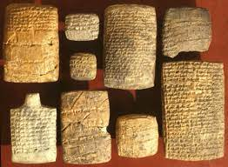
The Nuzi Tablets

Slide 28
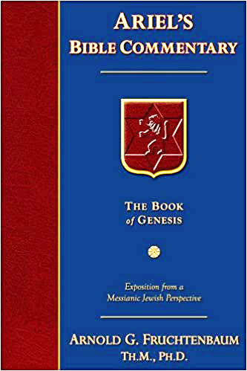
Dr. Arnold G. Fruchtenbaum
The Book of Genesis, 465
“The Code of Hammurabi states that whoever has the household gods owns the property. The Nuzi Tablets record an incident of the person mentioned earlier and states: ‘If Nashwi has a son of his own, he shall divide the estate equally with Wullu, (adopted son), but the son of Nashwi shall take the gods of Nashwi. However, if Nashwi does not have a son of his own, the Wullu shall take the gods.’ So owning the household gods meant the owner could claim the property. Rachel was not worshipping idols, but rather it was her attempt to gain the property of Laban for her husband.”

Slide 29
Joseph P. Free
Joseph P. Free. “Archaeology and the Bible.“ HIS Magazine. 9 (May 1949). Page 20.
The following, from J. P. Free’s Archaeology and the Bible gives a good explanation of not only the episode, but also the background of the Nuzi tablets: “Over 1000 clay tablets were found in 1925 in the excavation of a Mesopotamian site known today as Yorgan Tepe. Subsequent work brought forth another 3000 tablets and revealed the ancient site as ‘Nuzi.’ The tablets, written about 1500 B.C., illuminate the background of the biblical patriarchs, Abraham, Isaac, and Jacob. One instance will be cited: When Jacob and Rachel left the home of Laban, . . .

Slide 30
Joseph P. Free
Joseph P. Free. “Archaeology and the Bible.“ HIS Magazine. 9 (May 1949). Page 20.
…Rachel stole Laban’s family images or ‘teraphim.’ When Laban discovered the theft, he pursued his daughter and son-in-law, and after a long journey overtook them (Genesis 31:19-23). Commentators have long wondered why he would go to such pains to recover images he could have replaced easily in the local shops. The Nuzi tablets record one instance of a son-in-law who possessed the family images having the right to lay legal claim to his father-in-law’s property, a fact which explains Laban’s anxiety.”

Slide 31
Genesis 31:22-42 Laban’s Pursuit
Report to Laban (22)
Laban’s chase (23)
God’s warning (24)
Laban catches Jacob (25)
Laban’s verbal attack (26-30)
Jacob’s response (31-32)
Laban’s search (33-35)
Jacob’s response (36-42)

Slide 32
VI. Genesis 31:31-32 Jacob’s Response
Jacob’s reasons for flight (31)
Jacob’s offer to Laban (32a)
Jacob’s ignorance (32b)

Slide 33
VI. Genesis 31:31-32 Jacob’s Response
Jacob’s reasons for flight (31)
Jacob’s offer to Laban (32a)
Jacob’s ignorance (32b)

Slide 34
VI. Genesis 31:31-32 Jacob’s Response
Jacob’s reasons for flight (31)
Jacob’s offer to Laban (32a)
Jacob’s ignorance (32b)

Slide 35
VI. Genesis 31:31-32 Jacob’s Response
Jacob’s reasons for flight (31)
Jacob’s offer to Laban (32a)
Jacob’s ignorance (32b)

Slide 36
Genesis 31:22-42 Laban’s Pursuit
Report to Laban (22)
Laban’s chase (23)
God’s warning (24)
Laban catches Jacob (25)
Laban’s verbal attack (26-30)
Jacob’s response (31-32)
Laban’s search (33-35)
Jacob’s response (36-42)

Slide 37
VII. Genesis 31:33-35 Laban’s Search
Laban searches the other tents (33a)
Laban searches Rachel’s tent (33b-34)
Rachel’s excuse (35)

Slide 38
VII. Genesis 31:33-35 Laban’s Search
Laban searches the other tents (33a)
Laban searches Rachel’s tent (33b-34)
Rachel’s excuse (35)

Slide 40
VII. Genesis 31:33-35 Laban’s Search
Laban searches the other tents (33a)
Laban searches Rachel’s tent (33b-34)
Rachel’s excuse (35)

Slide 41
VII. Genesis 31:33-35 Laban’s Search
Laban searches the other tents (33a)
Laban searches Rachel’s tent (33b-34)
Rachel’s excuse (35)

Slide 42
Charles Ryrie The Ryrie Study Bible, page 42
Genesis 31:35 (RSBEE:NASB1995U): “31:35 It was customary for children, regardless of age, to stand in the presence of their parents (cf. Lev. 19:32; 1 Kings 2:19), but Rachel claimed to be menstruating.”

Slide 43
Dr. Arnold G. Fruchtenbaum
The Book of Genesis, 470
“So, verse 35a gives Rachel’s excuse: And she said to her father, Let not my lord be angry that I cannot rise before you; for the manner of woman is upon me. What she claimed was that she was now having her period, so she was in pain and discomfort and could not rise. Now if this was true (it may not have been true since she may have been lying), this would have in effect contaminated these household gods, rendering them unclean because of coming into contact with menstrual blood. A woman in the menstrual state did not need to rise. So Laban was deceived by local custom, just as he once deceived Jacob by local custom (29:26). Here again is curse for curse in kind. This indeed actually may have saved Rachel’s life.”

Slide 44
8 New Promises Genesis 12:1-3
Land (Gen. 12:1b)
Great nation (Gen. 12:2a)
Personal blessing (Gen. 12:2b)
Great name (Gen. 12:2c)
Blessing to others (Gen. 12:2d)
Blessing to blessers (Gen. 12:3a)
Cursing to cursers (Gen. 12:3b)
Blessing to the world (Gen. 12:3c)

Slide 45
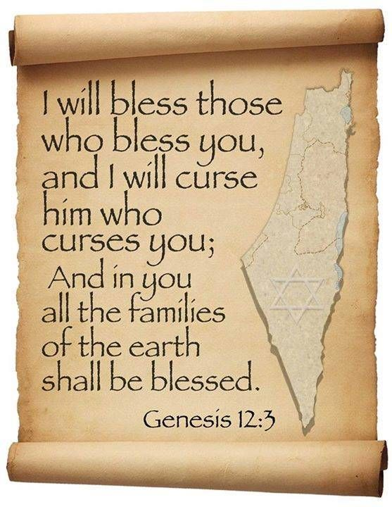
Genesis 12:3
“And I will bless those who bless you, And the one who curses you I will curse. And in you all the families of the earth will be blessed.”

Slide 46
Genesis 31:22-42 Laban’s Pursuit
Report to Laban (22)
Laban’s chase (23)
God’s warning (24)
Laban catches Jacob (25)
Laban’s verbal attack (26-30)
Jacob’s response (31-32)
Laban’s search (33-35)
Jacob’s response (36-42)

Slide 47
VIII. Genesis 31:36-42 Laban’s Search
Emotional response (36a)
Jacob’s challenge (36b-37)
Jacob’s history with Laban (38-42)

Slide 48
VIII. Genesis 31:36-42 Laban’s Search
Emotional response (36a)
Jacob’s challenge (36b-37)
Jacob’s history with Laban (38-42)

Slide 49
VIII. Genesis 31:36-42 Laban’s Search
Emotional response (36a)
Jacob’s challenge (36b-37)
Jacob’s history with Laban (38-42)

Slide 50
VIII. Genesis 31:36-42 Laban’s Search
Emotional response (36a)
Jacob’s challenge (36b-37)
Jacob’s history with Laban (38-42)

Slide 51
Genesis 31:38-42 Jacob’s History with Laban
Jacob’s innocence (38-40)
Laban’s dishonesty (41)
Divine intervention (42)

Slide 52
Genesis 31:38-42 Jacob’s History with Laban
Jacob’s innocence (38-40)
Laban’s dishonesty (41)
Divine intervention (42)

Slide 53
Genesis 31:38-40 Jacob’s Innocence
No flock miscarriages (38a)
No eating of the flock (38b)
Bore loss for torn beasts (39a)
Made good for stolen property (39b)
Severe conditions & sleepless nights (40)

Slide 54
Genesis 31:38-40 Jacob’s Innocence
No flock miscarriages (38a)
No eating of the flock (38b)
Bore loss for torn beasts (39a)
Made good for stolen property (39b)
Severe conditions & sleepless nights (40)

Slide 55
Genesis 31:38-40 Jacob’s Innocence
No flock miscarriages (38a)
No eating of the flock (38b)
Bore loss for torn beasts (39a)
Made good for stolen property (39b)
Severe conditions & sleepless nights (40)

Slide 56
Dr. Arnold G. Fruchtenbaum
The Book of Genesis, 470
“The rams of your flocks have I not eaten; Jacob did not eat of the flocks when he was hungry. According to the Nuzi Tablets, this was a common sin of shepherds, who frequently used the flocks of their masters to feed themselves; but Jacob never did.”

Slide 57
Genesis 31:38-40 Jacob’s Innocence
No flock miscarriages (38a)
No eating of the flock (38b)
Bore loss for torn beasts (39a)
Made good for stolen property (39b)
Severe conditions & sleepless nights (40)

Slide 58
Genesis 31:38-40 Jacob’s Innocence
No flock miscarriages (38a)
No eating of the flock (38b)
Bore loss for torn beasts (39a)
Made good for stolen property (39b)
Severe conditions & sleepless nights (40)

Slide 59
Genesis 31:38-40 Jacob’s Innocence
No flock miscarriages (38a)
No eating of the flock (38b)
Bore loss for torn beasts (39a)
Made good for stolen property (39b)
Severe conditions & sleepless nights (40)

Slide 60
Dr. Arnold G. Fruchtenbaum
The Book of Genesis, 471
“In the Code of Hammurabi, any charge of negligence could be challenged in court. A shepherd gave a receipt to the owner for the animals he took; he had to return the animals with a reasonable increase, although he was allowed to use some for food. He was not responsible for those killed by lions or by lightning, but any loss due to carelessness had to be repaid tenfold. This shows that Jacob did not demand or make use of his own civil rights under the law in effect in that area of the country. This reveals Jacob’s attitude in that he could have had an even greater gain if he had resorted to the laws of his day to his benefit, but he did not. In 31:41, Jacob spelled out Laban’s unfaithfulness: These twenty years have I been in your house, and he went on to divide the timing.”

Slide 61
Genesis 31:38-42 Jacob’s History with Laban
Jacob’s innocence (38-40)
Laban’s dishonesty (41)
Divine intervention (42)

Slide 62
Genesis 31:41 Laban’s Dishonesty
Twenty-year summation (41a)
First fourteen years (41b)
Remaining six years (41b)

Slide 63
Genesis 31:41 Laban’s Dishonesty
Twenty-year summation (41a)
First fourteen years (41b)
Remaining six years (41b)

Slide 64
Genesis 31:41 Laban’s Dishonesty
Twenty-year summation (41a)
First fourteen years (41b)
Remaining six years (41b)

Slide 65
Genesis 31:41 Laban’s Dishonesty
Twenty-year summation (41a)
First fourteen years (41b)
Remaining six years (41b)

Slide 66
Genesis 31:38-42 Jacob’s History with Laban
Jacob’s innocence (38-40)
Laban’s dishonesty (41)
Divine intervention (42)

Slide 67
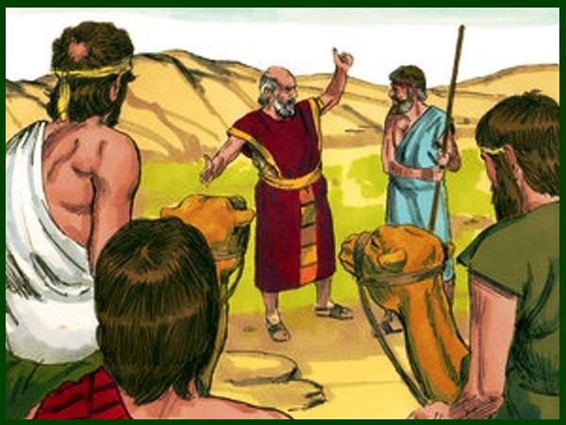
Charles Ryrie The Ryrie Study Bible, page 42
Genesis 31:42 (RSBEE:NASB1995U): “31:42 the fear of Isaac means ‘the God Isaac feared.’”

Slide 69
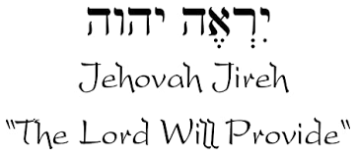

Slide 71
Conclusion

Slide 72
Genesis 31:22-42 Laban’s Pursuit
Report to Laban (22)
Laban’s chase (23)
God’s warning (24)
Laban catches Jacob (25)
Laban’s verbal attack (26-30)
Jacob’s response (31-32)
Laban’s search (33-35)
Jacob’s response (36-42)

Slide 73
²⁴ The Lord bless you, and keep you; ²⁵ The Lord make His face shine on you, And be gracious to you; ²⁶ The Lord lift up His countenance on you, And give you peace.
Numbers 6:24–26 (NASB95)

