Slide 1
Dr. Andy Woods
Senior Pastor – Sugar Land Bible Church
President – Chafer Theological Seminary

Slide 2
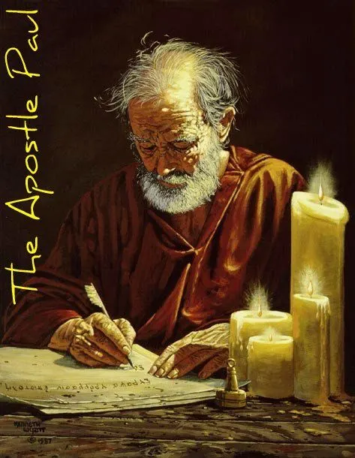
Structure
1 THESSALONIANS 1-3 | 1 THESSALONIANS 4-5
Personal Experience | Practical Exhortation
Looking Back | Looking Forward

Slide 3
Structure
Personal (1–3)
Genuine conversion (1)
Impure motives (2:1-16)
Lack of concern (2:17–3:13)
Practical (4–5)
Immorality (4:1-8)
Laziness (4:9-12)
Eschatology (4:13–5:11)
Ministry imbalances (5:12-15)
Progressive sanctification (5:16-28)

Slide 4
Structure
Personal (1–3)
Genuine conversion (1)
Impure motives (2:1-16)
Lack of concern (2:17–3:13)
Practical (4–5)
Immorality (4:1-8)
Laziness (4:9-12)
Eschatology (4:13–5:11)
Ministry imbalances (5:12-15)
Progressive sanctification (5:16-28)

Slide 5
Church Life
5:12-13 – Attitude toward leaders
5:14-15 – Ministry toward one another

Slide 6
Structure
Personal (1–3)
Genuine conversion (1)
Impure motives (2:1-16)
Lack of concern (2:17–3:13)
Practical (4–5)
Immorality (4:1-8)
Laziness (4:9-12)
Eschatology (4:13–5:11)
Ministry imbalances (5:12-15)
Progressive sanctification (5:16-28)

Slide 7
Practical Sanctification (5:16-24)
Three positive commands (5:16-18)
Three negative commands (5:19-22)
Divine enablement (5:23-24)

Slide 8
Three Positive Commands (5:16-18)
Rejoice always (5:16)
Pray without ceasing (5:17)
Give thanks in all things (5:18)

Slide 9
Practical Sanctification (5:16-24)
Three positive commands (5:16-18)
Three negative commands (5:19-22)
Divine enablement (5:23-24)

Slide 10
Three Negative Commands (5:19-22)
Do not quench the Spirit (5:19)
Do not despise prophetic utterances (5:20-21)
Abstain from evil (5:22)

Slide 11
Practical Sanctification (5:16-24)
Three positive commands (5:16-18)
Three negative commands (5:19-22)
Divine enablement (5:23-24)

Slide 12
Isaiah 9:6-7
^{6 “}For a child will be born to us, a son will be given to us; And the government will rest on His shoulders; And His name will be called Wonderful Counselor, Mighty God, Eternal Father, Prince of Peace.⁷ There will be no end to the increase of His government or of peace, The zeal of the Lord of hosts will accomplish this. On the throne of David and over his kingdom, To establish it and to uphold it with justice and righteousness From then on and forevermore.”

Slide 13
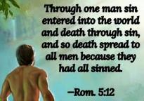
Genesis 2:16-17
“¹⁶ The Lord God commanded the man, saying, ‘From any tree of the garden you may eat freely; ¹⁷ but from the tree of the knowledge of good and evil you shall not eat, for in the day that you eat from it you will surely die (muwth).’”

Slide 15
Scripture’s Four Judgments
NAME | SHEEP AND GOAT | JUDGMENT OF THE JEWS | BEMA SEAT | GREAT WHITE THRONE
SCRIPTURE | Matt 25:31-46 | Ezek 20:33-44 | 1 Cor 3:10-15 | Rev 20:11-15
PLACE | Earth, Jerusalem | Earth, wilderness | Heaven | Earth
AUDIENCE | Gentile Tribulation survivors | Jewish Tribulation survivors | Church Age believers | All unsaved
WHEN | After Tribulation | After Tribulation | After rapture | After Millennium
PURPOSE | Saved Gentiles enter kingdom | Saved Jews enter kingdom | Reward believers | Degree of punishment in hell
EVALUATION | Treatment of Christ’s brethren | Passing under shepherd’s rod | Works taken through fire | Not in the book; judged by books

Slide 16
1 Corinthians 3:10-15
“¹⁰ According to the grace of God which was given to me, like a wise master builder I laid a foundation, and another is building on it. But each man must be careful how he builds on it. ¹¹ For no man can lay a foundation other than the one which is laid, which is Jesus Christ. ¹² Now if any man builds on the foundation with gold, silver, precious stones, wood, hay, straw. ¹⁴ If any man’s work which he …

Slide 17
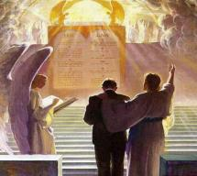
1 Corinthians 3:10-15
. . .has built on it remains, he will receive a reward. ¹⁵ If any man’s work is burned up, he will suffer loss; but he himself will be saved, yet so as through fire.”

Slide 18
Unique Characteristics
Every chapter ends with a reference to the Second Advent
Small amount of time in between planting of the church and the first letter to the church

Slide 19
1 Thessalonians 1:10
“and to wait for His Son from heaven, whom He raised from the dead, that is Jesus, who rescues (rhyomai) us from (ek) the wrath (orgē) to come..”

Slide 20
1 Thessalonians 4:13-18
¹³ "But we do not want you to be uninformed, brethren, about those who are asleep, so that you will not grieve as do the rest who have no hope. ¹⁴ For if we believe that Jesus died and rose again, even so God will bring with Him those who have fallen asleep in Jesus. ¹⁵ For this we say to you by the word of the Lord, that we who are alive and remain until the coming of the Lord, will not precede those who have fallen asleep. ¹⁶ For the Lord Himself will descend from . . .

Slide 21
1 Thessalonians 4:13-18
. . .heaven with a shout, with the voice of the archangel and with the trumpet of God, and the dead in Christ will rise first. ¹⁷ Then we who are alive and remain will be caught up together with them in the clouds to meet the Lord in the air, and so we shall always be with the Lord. ¹⁸ Therefore comfort one another with these words."

Slide 23
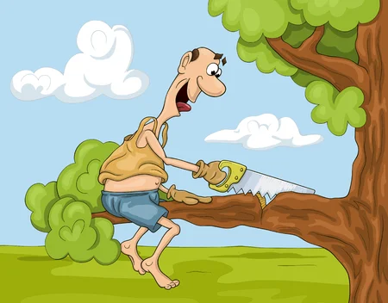
Galatians 3:3
“Are you so foolish? Having begun by the Spirit, are you now being perfected by the flesh?”

Slide 24
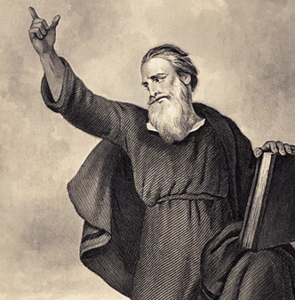
Conclusion (5:25-28)
Three personal requests (5:25-27)
Benediction (5:28)

Slide 25
Conclusion (5:25-28)
Three personal requests (5:25-27)
Benediction (5:28)

Slide 26
Three Personal Requests (5:25-27)
Prayer (5:25)
Greet the brethren (5:26)
Read the letter aloud (5:27)

Slide 27
Three Personal Requests (5:25-27)
Prayer (5:25)
Greet the brethren (5:26)
Read the letter aloud (5:27)

Slide 28
Three Personal Requests (5:25-27)
Prayer (5:25)
Greet the brethren (5:26)
Read the letter aloud (5:27)

Slide 29
Three Personal Requests (5:25-27)
Prayer (5:25)
Greet the brethren (5:26)
Read the letter aloud (5:27)

Slide 30
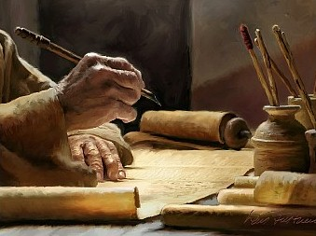
1 Timothy 4:13
“Until I come, give your attention to the public reading, to exhortation, and teaching.”

Slide 31
2 Timothy 3:16-17
“¹⁶ All Scripture is inspired by God [theopneustos] and profitable for teaching, for reproof, for correction, for training in righteousness; ¹⁷ so that the man of God may be adequate, equipped for every good work.”

Slide 32
Emphasis of 2 Timothy
“By my count, there are twenty-seven explicit commands given in the body of this letter. In 27 words Paul tells pastors what to focus on. You have to be blind to miss the thrust of Paul's instructions here, because eighteen of those commands--fully two-thirds--have to do with the ministry of the Word.”
Daniel Wallace, “Crisis of the Word: A Message to Pastors or Would-be Pastors,”
Conservative Theological Journal 1, no. 2 (August 1997): 108.

Slide 33
Conclusion (5:25-28)
Three personal requests (5:25-27)
Benediction (5:28)

Slide 34
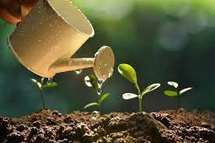
2 Peter 3:18
“ but grow in the grace and knowledge of our Lord and Savior Jesus Christ. To Him be the glory, both now and to the day of eternity. Amen.”

Slide 35
Conclusion

Slide 36
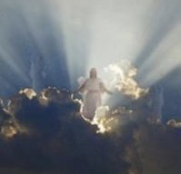
Message
Continued growth in faith, hope, and love in view of the Lord’s imminent return

Slide 37
Structure
Personal (1–3)
Genuine conversion (1)
Impure motives (2:1-16)
Lack of concern (2:17–3:13)
Practical (4–5)
Immorality (4:1-8)
Laziness (4:9-12)
Eschatology (4:13–5:11)
Ministry imbalances (5:12-15)
Progressive sanctification (5:16-28)

