Slide 1
Genesis 12‒50
Israel’s Birth & Preservation

Slide 2
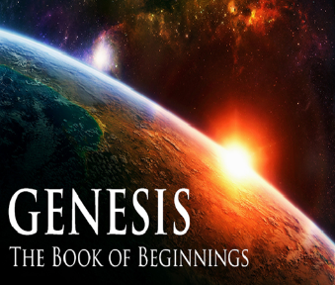
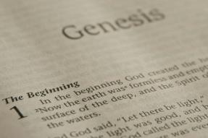
GENESIS STRUCTURE
Genesis 12-50 (four people)
Abraham (12:1–25:11)
Isaac (25:12–26:35)
Jacob (27–36)
Joseph (37–50)

Slide 3
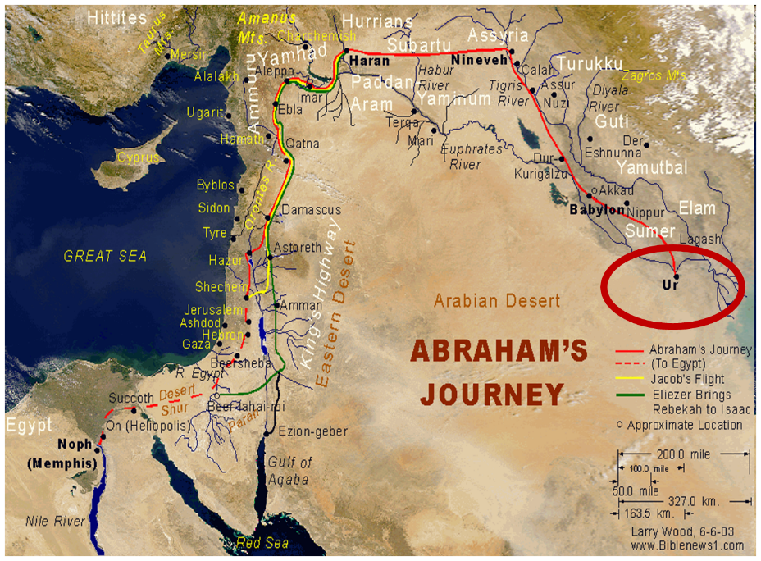

Slide 4
Genesis 31:1-21 Jacob’s Flight From Haran
Jacob’s circumstances (1-3)
Jacob’s discussion with his wives (4-16)
Jacob’s escape (17-21)

Slide 5
Genesis 31:1-21 Jacob’s Flight From Haran
Jacob’s circumstances (1-3)
Jacob’s discussion with his wives (4-16)
Jacob’s escape (17-21)

Slide 6
Genesis 31:1-3 Jacob’s Circumstances
Change of relationship (1-2)
Divine revelation (3)

Slide 7
Genesis 31:1-21 Jacob’s Flight From Haran
Jacob’s circumstances (1-3)
Jacob’s discussion with his wives (4-16)
Jacob’s escape (17-21)

Slide 8
Genesis 31:4-16 Jacob’s Discussion with Wives
Summoning of the wives (4)
Presentation of the case (5-13)
Wives’ response (14-16)

Slide 9
Genesis 31:4-16 Jacob’s Discussion with Wives
Summoning of the wives (4)
Presentation of the case (5-13)
Wives’ response (14-16)

Slide 10
Genesis 31:5-13 Presentation of the Case
Laban’s treachery (5-9)
Divine revelation (10-13)

Slide 11
Genesis 31:5-13 Presentation of the Case
Laban’s treachery (5-9)
Divine revelation (10-13)

Slide 12
Genesis 31:5-9 Laban’s Treachery
Laban’s change of attitude (5)
Jacob’s diligence (6)
Laban’s dishonesty (7-9)

Slide 13
Genesis 31:5-13 Presentation of the Case
Laban’s treachery (5-9)
Divine revelation (10-13)

Slide 14
Genesis 31:10-13 Divine Revelation
Vision (10)
Interpretation (11-12)
Command to return to Canaan (13)

Slide 15
Genesis 31:13 Command to Return to Canaan
God’s identification (13a)
God’s command (13b)

Slide 16
Genesis 31:13 Command to Return to Canaan
God’s identification (13a)
God’s command (13b)

Slide 17
Genesis 31:13 Command to Return to Canaan
God’s identification (13a)
God’s command (13b)

Slide 19
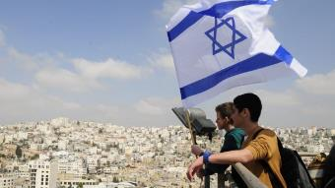
Reliability of the “Divine Regathering” Predictions
 | RETURN | PREDICTED | FULFILLED
1st | From Egypt to Canaan | Gen. 15:13-14 | Joshua 1‒12
2nd | From Babylon to Israel | Jer. 25:11; 29:10 | Ezra & Nehemiah
3rd | From the Diaspora to Israel’s restoration | Ezekiel 36:24-28 | Millennial Kingdom

Slide 20
Genesis 31:4-16 Jacob’s Discussion with Wives
Summoning of the wives (4)
Presentation of the case (5-13)
Wives’ response (14-16)

Slide 21
Genesis 31:14-16 Wives’ Response
Loss of inheritance (14)
Loss of dowry (15)
Divine providence (16a)
Wives’ acceptance (16b)

Slide 22
Genesis 31:14-16 Wives’ Response
Loss of inheritance (14)
Loss of dowry (15)
Divine providence (16a)
Wives’ acceptance (16b)

Slide 23
Genesis 31:14-16 Wives’ Response
Loss of inheritance (14)
Loss of dowry (15)
Divine providence (16a)
Wives’ acceptance (16b)

Slide 24
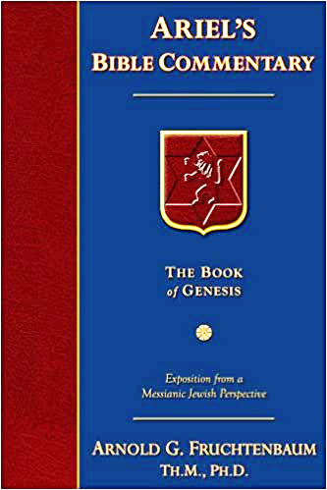
Dr. Arnold G. Fruchtenbaum
The Book of Genesis, 464
“According to the Nuzi Tablets, the father of the bride was to give some of the bride price money from the groom to the bride. Jacob did not give money to Laban, but he gave him seven years of service for each wife. However, no part of the fruit of Jacob’s work was given to the daughters. None of the increase of the flocks was set aside for the daughters. This went contrary to even the custom of their own territory. Therefore, Laban would resort to local custom if it were to his benefit; he would go against it if it did not benefit him. Not Jacob but Laban was the cheat here.”

Slide 25
Genesis 31:14-16 Wives’ Response
Loss of inheritance (14)
Loss of dowry (15)
Divine providence (16a)
Wives’ acceptance (16b)

Slide 26
Genesis 31:14-16 Wives’ Response
Loss of inheritance (14)
Loss of dowry (15)
Divine providence (16a)
Wives’ acceptance (16b)

Slide 28
Genesis 31:1-21 Jacob’s Flight From Haran
Jacob’s circumstances (1-3)
Jacob’s discussion with his wives (4-16)
Jacob’s escape (17-21)

Slide 29
Genesis 31:17-21 Jacob’s Escape
Jacob’s preparation (17-18)
Jacob’s circumstances (19)
Jacob’s deception and flight (20)
Jacob’s direction (21)

Slide 30
Genesis 31:17-21 Jacob’s Escape
Jacob’s preparation (17-18)
Jacob’s circumstances (19)
Jacob’s deception and flight (20)
Jacob’s direction (21)

Slide 31
Genesis 31:17-18 Jacob’s Preparation
Family (17)
Property (18a)
Purpose (18b)

Slide 32
Genesis 31:17-18 Jacob’s Preparation
Family (17)
Property (18a)
Purpose (18b)

Slide 34
Genesis 31:17-18 Jacob’s Preparation
Family (17)
Property (18a)
Purpose (18b)

Slide 35
Genesis 31:17-18 Jacob’s Preparation
Family (17)
Property (18a)
Purpose (18b)

Slide 37
Reliability of the “Divine Regathering” Predictions
 | RETURN | PREDICTED | FULFILLED
1st | From Egypt to Canaan | Gen. 15:13-14 | Joshua 1‒12
2nd | From Babylon to Israel | Jer. 25:11; 29:10 | Ezra & Nehemiah
3rd | From the Diaspora to Israel’s restoration | Ezekiel 36:24-28 | Millennial Kingdom

Slide 38
Genesis 31:17-21 Jacob’s Escape
Jacob’s preparation (17-18)
Jacob’s circumstances (19)
Jacob’s deception and flight (20)
Jacob’s direction (21)

Slide 39
Genesis 31:19 Jacob’s Circumstances
Laban’s distraction (19a)
Rachael’s theft (19b)

Slide 40
Genesis 31:19 Jacob’s Circumstances
Laban’s distraction (19a)
Rachael’s theft (19b)

Slide 41
Genesis 31:19 Jacob’s Circumstances
Laban’s distraction (19a)
Rachael’s theft (19b)

Slide 42
Dr. Arnold G. Fruchtenbaum
The Book of Genesis, 465
“The Code of Hammurabi states that whoever has the household gods owns the property. The Nuzi Tablets record an incident of the person mentioned earlier and states: ‘If Nashwi has a son of his own, he shall divide the estate equally with Wullu, (adopted son), but the son of Nashwi shall take the gods of Nashwi. However, if Nashwi does not have a son of his own, the Wullu shall take the gods.’ So owning the household gods meant the owner could claim the property. Rachel was not worshipping idols, but rather it was her attempt to gain the property of Laban for her husband.”

Slide 43
Joseph P. Free
Joseph P. Free. “Archaeology and the Bible.“ HIS Magazine. 9 (May 1949). Page 20.
The following, from J. P. Free’s Archaeology and the Bible gives a good explanation of not only the episode, but also the background of the Nuzi tablets: “Over 1000 clay tablets were found in 1925 in the excavation of a Mesopotamian site known today as Yorgan Tepe. Subsequent work brought forth another 3000 tablets and revealed the ancient site as ‘Nuzi.’ The tablets, written about 1500 B.C., illuminate the background of the biblical patriarchs, Abraham, Isaac, and Jacob. One instance will be cited: When Jacob and Rachel left the home of Laban, . . .

Slide 44
Joseph P. Free
Joseph P. Free. “Archaeology and the Bible.“ HIS Magazine. 9 (May 1949). Page 20.
…Rachel stole Laban’s family images or ‘teraphim.’ When Laban discovered the theft, he pursued his daughter and son-in-law, and after a long journey overtook them (Genesis 31:19-23). Commentators have long wondered why he would go to such pains to recover images he could have replaced easily in the local shops. The Nuzi tablets record one instance of a son-in-law who possessed the family images having the right to lay legal claim to his father-in-law’s property, a fact which explains Laban’s anxiety.”

Slide 45
Genesis 31:17-21 Jacob’s Escape
Jacob’s preparation (17-18)
Jacob’s circumstances (19)
Jacob’s deception and flight (20)
Jacob’s direction (21)

Slide 46
Genesis 31:17-21 Jacob’s Escape
Jacob’s preparation (17-18)
Jacob’s circumstances (19)
Jacob’s deception and flight (20)
Jacob’s direction (21)

Slide 47
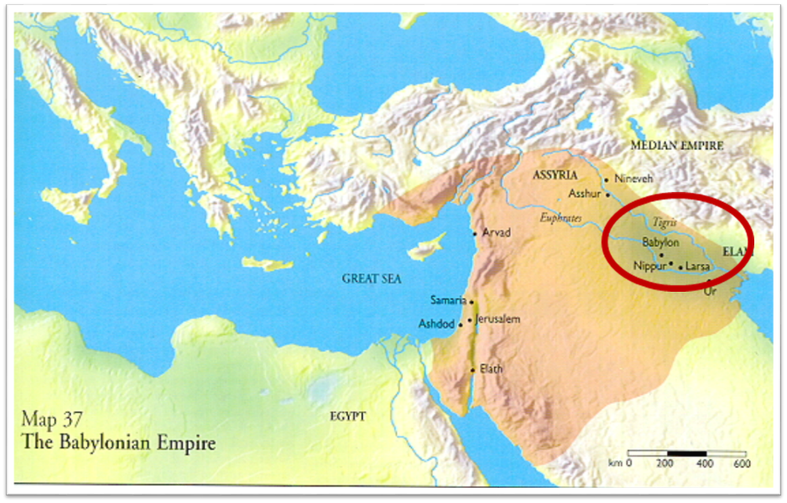

Slide 49
Conclusion

Slide 50
Genesis 31:1-21 Jacob’s Flight From Haran
Jacob’s circumstances (1-3)
Jacob’s discussion with his wives (4-16)
Jacob’s escape (17-21)

Slide 51
²⁴ The Lord bless you, and keep you; ²⁵ The Lord make His face shine on you, And be gracious to you; ²⁶ The Lord lift up His countenance on you, And give you peace.
Numbers 6:24–26 (NASB95)

