Slide 1
Dr. Andy Woods
Senior Pastor – Sugar Land Bible Church
President – Chafer Theological Seminary

Slide 2
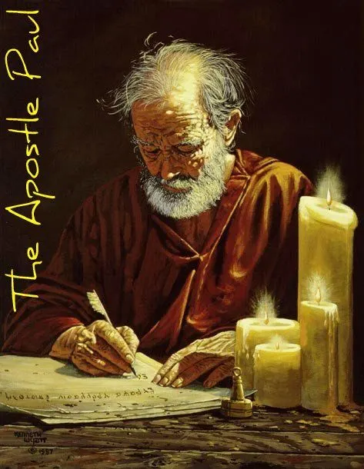
Structure
1 THESSALONIANS 1-3 | 1 THESSALONIANS 4-5
Personal Experience | Practical Exhortation
Looking Back | Looking Forward

Slide 3
Structure
Personal (1–3)
Genuine conversion (1)
Impure motives (2:1-16)
Lack of concern (2:17–3:13)
Practical (4–5)
Immorality (4:1-8)
Laziness (4:9-12)
Eschatology (4:13–5:11)
Ministry imbalances (5:12-15)
Progressive sanctification (5:16-28)

Slide 4
Structure
Personal (1–3)
Genuine conversion (1)
Impure motives (2:1-16)
Lack of concern (2:17–3:13)
Practical (4–5)
Immorality (4:1-8)
Laziness (4:9-12)
Eschatology (4:13–5:11)
Ministry imbalances (5:12-15)
Progressive sanctification (5:16-28)

Slide 5
Church Life
5:12-13 – Attitude toward leaders
5:14-15 – Ministry toward one another

Slide 6
Structure
Personal (1–3)
Genuine conversion (1)
Impure motives (2:1-16)
Lack of concern (2:17–3:13)
Practical (4–5)
Immorality (4:1-8)
Laziness (4:9-12)
Eschatology (4:13–5:11)
Ministry imbalances (5:12-15)
Progressive sanctification (5:16-28)

Slide 7
Three Tenses of Salvation
Phase | Justification | Sanctification | Glorification
Tense | Past | Present | Future
Saved from sin’s: | Penalty | Power | Presence
Scripture | Eph 2:8-9; Titus 3:5 | Philip 2:12 | Rom 5:10

Slide 8
Practical Sanctification (5:16-24)
Three positive commands (5:16-18)
Three negative commands (5:19-22)
Divine enablement (5:23-24)

Slide 9
Practical Sanctification (5:16-24)
Three positive commands (5:16-18)
Three negative commands (5:19-22)
Divine enablement (5:23-24)

Slide 10
Three Positive Commands (5:16-18)
Rejoice always (5:16)
Pray without ceasing (5:17)
Give thanks in all things (5:18)

Slide 11
Three Positive Commands (5:16-18)
Rejoice always (5:16)
Pray without ceasing (5:17)
Give thanks in all things (5:18)

Slide 12
Three Positive Commands (5:16-18)
Rejoice always (5:16)
Pray without ceasing (5:17)
Give thanks in all things (5:18)

Slide 13
Three Positive Commands (5:16-18)
Rejoice always (5:16)
Pray without ceasing (5:17)
Give thanks in all things (5:18)

Slide 14
Practical Sanctification (5:16-24)
Three positive commands (5:16-18)
Three negative commands (5:19-22)
Divine enablement (5:23-24)

Slide 15
Three Negative Commands (5:19-22)
Do not quench the Spirit (5:19)
Do not despise prophetic utterances (5:20-21)
Abstain from evil (5:22)

Slide 16
Three Negative Commands (5:19-22)
Do not quench the Spirit (5:19)
Do not despise prophetic utterances (5:20-21)
Abstain from evil (5:22)

Slide 17
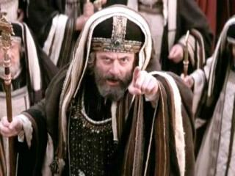
Matthew 12:24
“But when the Pharisees heard this, they said, ‘This man casts out demons only by Beelzebul the ruler of the demons.’”

Slide 18
Matthew Outline
Pedigree of the king (1–2)
Preparation of the king (3–4)
Pedagogy of the king (5–7)
Power of the king (8–9)
Program of the king (10)
Progressive rejection of the king (11–12)
Preparation of the king’s disciples (13–20)
Presentation & rejection of the king (21–23)
Prophecies of the king (24–25)
Passion of the king (26–27)
Proof of the king (28)

Slide 19
1 Corinthians 3:1-3 (NKJV)
¹ And I, brethren, could not speak to you as to spiritual people but as to carnal, as to babes in Christ. ² I fed you with milk and not with solid food; for until now you were not able to receive it, and even now you are still not able; ³ for you are still carnal. For where there are envy, strife, and divisions among you, are you not carnal and behaving like mere men?

Slide 20
Notes:
Ray Steadman – “1st Californians”
Unbelievers vs Categories of Believers
Unbelievers – ψυχικός psuchikós; Natural, pertaining to the natural as distinguished from the spiritual
Spiritual Believers – πνευματικός pneumatikós; of persons who are spiritual, enlightened by the Holy Spirit
Infant Believers – σάρκινος sárkinos; with propensities of the flesh unto sin; νήπιος nḗpios; an infant, child, baby without any definite limitation of age. (This relates to immaturity and lack of instruction)
Carnal Believers – σαρκικός sarkikós; tendency to satisfy the flesh, implying sinfulness, sinful propensity, carnal (This relates to disobedience and open rebellion)

Slide 21
Three Negative Commands (5:19-22)
Do not quench the Spirit (5:19)
Do not despise prophetic utterances (5:20-21)
Abstain from evil (5:22)

Slide 22
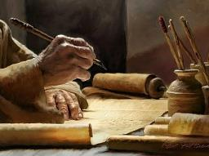
2 Timothy 3:16-17
“¹⁶ All Scripture is inspired by God [theopneustos] and profitable for teaching, for reproof, for correction, for training in righteousness; ¹⁷ so that the man of God may be adequate, equipped for every good work.”

Slide 23
Jude 3
“Beloved, while I was making every effort to write you about our common salvation, I felt the necessity to write to you appealing that you contend earnestly for the faith that was once for all time handed down to the saints.”

Slide 24
Revelation 22:18-19
“I testify to everyone who hears the words of the prophecy of this book: if anyone adds to them, God will add to him the plagues which are written in this book; ¹⁹ and if anyone takes away from the words of the book of this prophecy, God will take away his part from the tree of life and from the holy city, which are written in this book.”

Slide 25
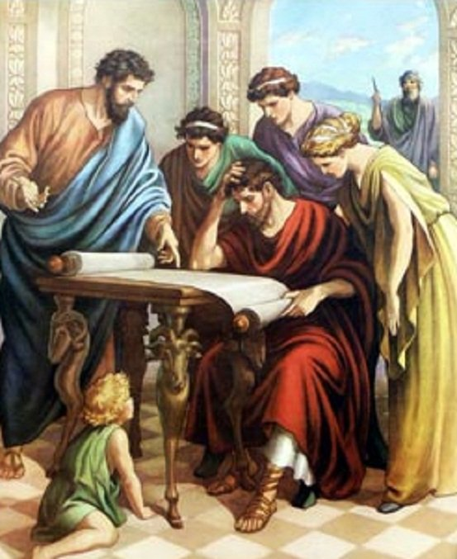
Acts 17:11
“Now these were more noble-minded than those in Thessalonica, for they received the word with great eagerness, examining the Scriptures daily to see whether these things were so.”

Slide 26
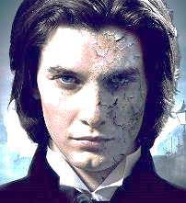
1 John 4:1
“Beloved, do not believe every spirit, but test the spirits to see whether they are from God, because many false prophets have gone out into the world.”

Slide 27
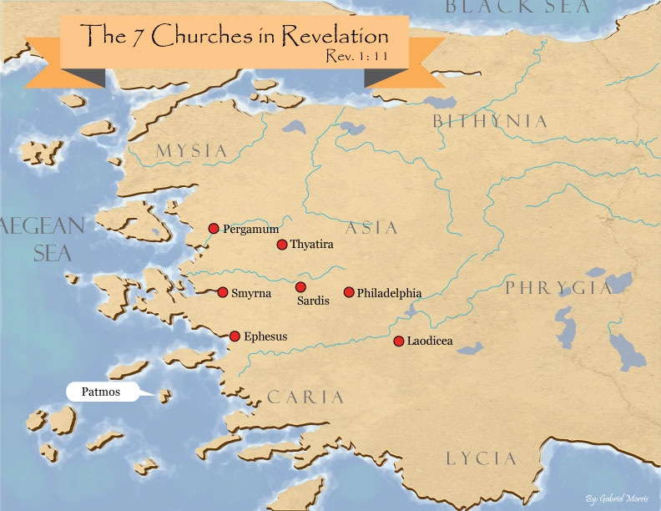

Slide 28
Three Negative Commands (5:19-22)
Do not quench the Spirit (5:19)
Do not despise prophetic utterances (5:20-21)
Abstain from evil (5:22)

Slide 29
Practical Sanctification (5:16-24)
Three positive commands (5:16-18)
Three negative commands (5:19-22)
Divine enablement (5:23-24)

Slide 30
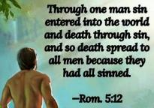
Genesis 2:16-17
“¹⁶ The Lord God commanded the man, saying, ‘From any tree of the garden you may eat freely; ¹⁷ but from the tree of the knowledge of good and evil you shall not eat, for in the day that you eat from it you will surely die (muwth).’”

Slide 32
Scripture’s Four Judgments
NAME | SHEEP AND GOAT | JUDGMENT OF THE JEWS | BEMA SEAT | GREAT WHITE THRONE
SCRIPTURE | Matt 25:31-46 | Ezek 20:33-44 | 1 Cor 3:10-15 | Rev 20:11-15
PLACE | Earth, Jerusalem | Earth, wilderness | Heaven | Earth
AUDIENCE | Gentile Tribulation survivors | Jewish Tribulation survivors | Church Age believers | All unsaved
WHEN | After Tribulation | After Tribulation | After rapture | After Millennium
PURPOSE | Saved Gentiles enter kingdom | Saved Jews enter kingdom | Reward believers | Degree of punishment in hell
EVALUATION | Treatment of Christ’s brethren | Passing under shepherd’s rod | Works taken through fire | Not in the book; judged by books

Slide 33
1 Corinthians 3:10-15
“¹⁰ According to the grace of God which was given to me, like a wise master builder I laid a foundation, and another is building on it. But each man must be careful how he builds on it. ¹¹ For no man can lay a foundation other than the one which is laid, which is Jesus Christ. ¹² Now if any man builds on the foundation with gold, silver, precious stones, wood, hay, straw. ¹⁴ If any man’s work which he …

Slide 34
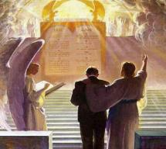
1 Corinthians 3:10-15
. . .has built on it remains, he will receive a reward. ¹⁵ If any man’s work is burned up, he will suffer loss; but he himself will be saved, yet so as through fire.”

Slide 35
Unique Characteristics
Every chapter ends with a reference to the Second Advent
Small amount of time in between planting of the church and the first letter to the church

Slide 37
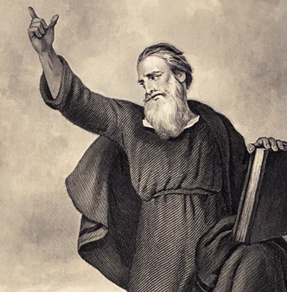
Conclusion (5:25-28)
Three personal requests (5:25-27)
Benediction (5:28)

Slide 38
Conclusion (5:25-28)
Three personal requests (5:25-27)
Benediction (5:28)

Slide 39
Three Personal Requests (5:25-27)
Prayer (5:25)
Greet the brethren (5:26)
Read the letter aloud (5:27)

Slide 40
Three Personal Requests (5:25-27)
Prayer (5:25)
Greet the brethren (5:26)
Read the letter aloud (5:27)

Slide 41
Three Personal Requests (5:25-27)
Prayer (5:25)
Greet the brethren (5:26)
Read the letter aloud (5:27)

Slide 42
Three Personal Requests (5:25-27)
Prayer (5:25)
Greet the brethren (5:26)
Read the letter aloud (5:27)

Slide 43
1 Timothy 4:13
“Until I come, give your attention to the public reading, to exhortation, and teaching.”

Slide 44
2 Timothy 3:16-17
“¹⁶ All Scripture is inspired by God [theopneustos] and profitable for teaching, for reproof, for correction, for training in righteousness; ¹⁷ so that the man of God may be adequate, equipped for every good work.”

Slide 45
Emphasis of 2 Timothy
“By my count, there are twenty-seven explicit commands given in the body of this letter. In 27 words Paul tells pastors what to focus on. You have to be blind to miss the thrust of Paul's instructions here, because eighteen of those commands--fully two-thirds--have to do with the ministry of the Word.”
Daniel Wallace, “Crisis of the Word: A Message to Pastors or Would-be Pastors,”
Conservative Theological Journal 1, no. 2 (August 1997): 108.

Slide 46
Conclusion (5:25-28)
Three personal requests (5:25-27)
Benediction (5:28)

Slide 47
Conclusion

Slide 48
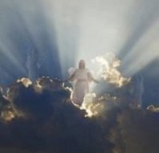
Message
Continued growth in faith, hope, and love in view of the Lord’s imminent return

Slide 49
Structure
Personal (1–3)
Genuine conversion (1)
Impure motives (2:1-16)
Lack of concern (2:17–3:13)
Practical (4–5)
Immorality (4:1-8)
Laziness (4:9-12)
Eschatology (4:13–5:11)
Ministry imbalances (5:12-15)
Progressive sanctification (5:16-28)

