Slide 1
Genesis 12‒50
Israel’s Birth & Preservation

Slide 2
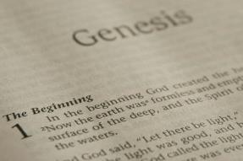
GENESIS STRUCTURE
Genesis 12-50 (four people)
Abraham (12:1–25:11)
Isaac (25:12–26:35)
Jacob (27–36)
Joseph (37–50)

Slide 3
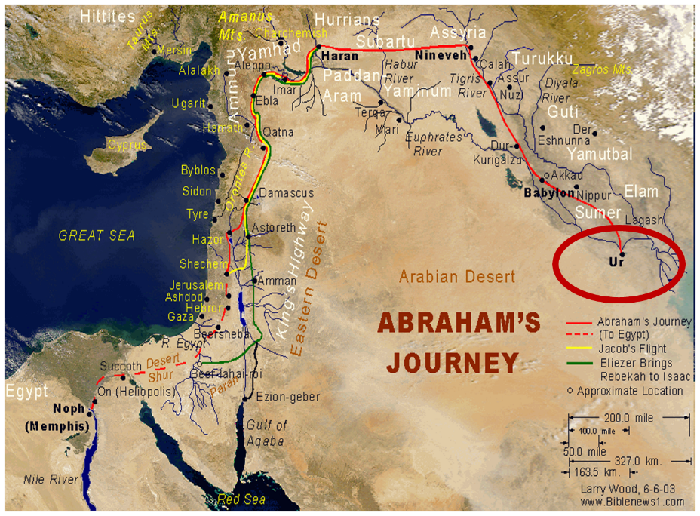

Slide 4
Genesis 31:1-21 Jacob’s Flight From Haran
Jacob’s circumstances (1-3)
Jacob’s discussion with his wives (4-16)
Jacob’s escape (17-21)

Slide 5
Genesis 31:1-21 Jacob’s Flight From Haran
Jacob’s circumstances (1-3)
Jacob’s discussion with his wives (4-16)
Jacob’s escape (17-21)

Slide 6
Genesis 31:1-3 Jacob’s Circumstances
Change of relationship (1-2)
Divine revelation (3)

Slide 7
Genesis 31:1-3 Jacob’s Circumstances
Change of relationship (1-2)
Divine revelation (3)

Slide 8
Genesis 31:1-2 Change of Relationship
Laban’s sons (1)
Laban’s change of attitude (2)

Slide 9
Genesis 31:1-2 Change of Relationship
Laban’s sons (1)
Laban’s change of attitude (2)

Slide 10
8 New Promises Genesis 12:1-3
Land (Gen. 12:1b)
Great nation (Gen. 12:2a)
Personal blessing (Gen. 12:2b)
Great name (Gen. 12:2c)
Blessing to others (Gen. 12:2d)
Blessing to blessers (Gen. 12:3a)
Cursing to cursers (Gen. 12:3b)
Blessing to the world (Gen. 12:3c)

Slide 11
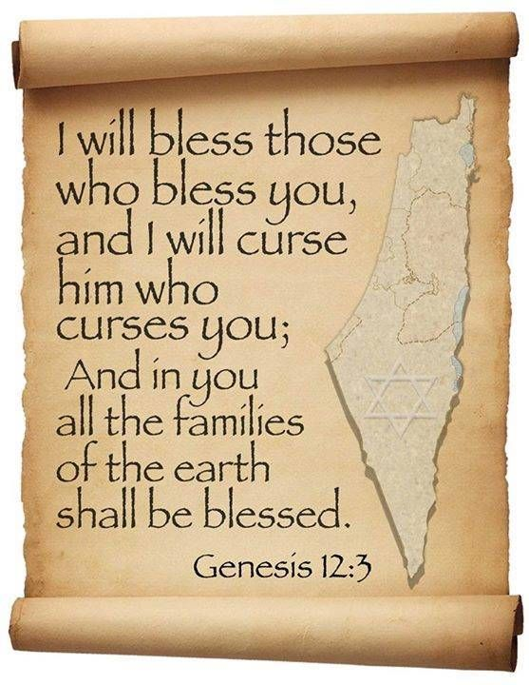
Genesis 12:3
“And I will bless those who bless you, And the one who curses you I will curse. And in you all the families of the earth will be blessed.”

Slide 12
Genesis 31:1-2 Change of Relationship
Laban’s sons (1)
Laban’s change of attitude (2)

Slide 13
Genesis 31:1-3 Jacob’s Circumstances
Change of relationship (1-2)
Divine revelation (3)

Slide 14
Genesis 31:3 Divine Relation
Command (3a)
Promise (3b)

Slide 15
Genesis 31:3 Divine Relation
Command (3a)
Promise (3b)

Slide 17
Ezekiel 36:24-28
“For I will take you from the nations, gather you from all the lands and bring you into your own land. ²⁵ Then I will sprinkle clean water on you, and you will be clean; I will cleanse you from all your filthiness and from all your idols. ²⁶ Moreover, I will give you a new heart and put a new spirit within you; and I will remove the heart of stone from your flesh and give you a heart of flesh. ²⁷ I will put My Spirit within you and cause you to walk in My statutes, and you will be careful to observe My ordinances. ²⁸ You will live in the land that I gave to your forefathers; so you will be My people, and I will be your God.”

Slide 18
Genesis 31:3 Divine Relation
Command (3a)
Promise (3b)

Slide 19
John 14:16-17
¹⁶ I will ask the Father, and He will give you another Helper, that He may be with you forever; ¹⁷ that is the Spirit of truth, whom the world cannot receive, because it does not see Him or know Him, but you know Him because He abides with you and will be in you.

Slide 20
Genesis 31:1-21 Jacob’s Flight From Haran
Jacob’s circumstances (1-3)
Jacob’s discussion with his wives (4-16)
Jacob’s escape (17-21)

Slide 21
Genesis 31:4-16 Jacob’s Discussion with Wives
Summoning of the wives (4)
Presentation of the case (5-13)
Wives’ response (14-16)

Slide 22
Genesis 31:4-16 Jacob’s Discussion with Wives
Summoning of the wives (4)
Presentation of the case (5-13)
Wives’ response (14-16)

Slide 24
Genesis 31:4-16 Jacob’s Discussion with Wives
Summoning of the wives (4)
Presentation of the case (5-13)
Wives’ response (14-16)

Slide 25
Genesis 31:5-13 Presentation of the Case
Laban’s treachery (5-9)
Divine revelation (10-13)

Slide 26
Genesis 31:5-13 Presentation of the Case
Laban’s treachery (5-9)
Divine revelation (10-13)

Slide 27
Genesis 31:5-9 Laban’s Treachery
Laban’s change of attitude (5)
Jacob’s diligence (6)
Laban’s dishonesty (7-9)

Slide 28
Genesis 31:5-9 Laban’s Treachery
Laban’s change of attitude (5)
Jacob’s diligence (6)
Laban’s dishonesty (7-9)

Slide 29
Genesis 31:5-9 Laban’s Treachery
Laban’s change of attitude (5)
Jacob’s diligence (6)
Laban’s dishonesty (7-9)

Slide 30
Genesis 31:5-9 Laban’s Treachery
Laban’s change of attitude (5)
Jacob’s diligence (6)
Laban’s dishonesty (7-9)

Slide 31
Genesis 31:7-9 Laban’s Dishonesty
Change of wages (7)
God’s providence (8)
Result (9)

Slide 32
Genesis 31:7-9 Laban’s Dishonesty
Change of wages (7)
God’s providence (8)
Result (9)

Slide 33
Genesis 31:7-9 Laban’s Dishonesty
Change of wages (7)
God’s providence (8)
Result (9)

Slide 34
Genesis 31:7-9 Laban’s Dishonesty
Change of wages (7)
God’s providence (8)
Result (9)

Slide 35
Genesis 31:5-13 Presentation of the Case
Laban’s treachery (5-9)
Divine revelation (10-13)

Slide 36
Genesis 31:10-13 Divine Revelation
Vision (10)
Interpretation (11-12)
Command to return to Canaan (13)

Slide 37
Genesis 31:10-13 Divine Revelation
Vision (10)
Interpretation (11-12)
Command to return to Canaan (13)

Slide 38
Genesis 31:10-13 Divine Revelation
Vision (10)
Interpretation (11-12)
Command to return to Canaan (13)

Slide 39
Genesis 31:11-12 Interpretation
Divine call (11)
Interpretation (12a)
Reason (12b)

Slide 40
Genesis 31:11-12 Interpretation
Divine call (11)
Interpretation (12a)
Reason (12b)

Slide 41
Genesis 31:11-12 Interpretation
Divine call (11)
Interpretation (12a)
Reason (12b)

Slide 42
Genesis 31:11-12 Interpretation
Divine call (11)
Interpretation (12a)
Reason (12b)

Slide 44
Genesis 12:3
“And I will bless those who bless you, And the one who curses you I will curse. And in you all the families of the earth will be blessed.”

Slide 45
Genesis 12:3
“And I will bless those who bless you, And the one who curses you I will curse. And in you all the families of the earth will be blessed.”

Slide 46
Genesis 12:3
“And I will bless those who bless you, And the one who curses you I will curse. And in you all the families of the earth will be blessed.”

Slide 47
Genesis 31:10-13 Divine Revelation
Vision (10)
Interpretation (11-12)
Command to return to Canaan (13)

Slide 48
Genesis 31:13 Command to Return to Canaan
God’s identification (13a)
God’s command (13b)

Slide 49
Genesis 31:13 Command to Return to Canaan
God’s identification (13a)
God’s command (13b)

Slide 50
Genesis 31:13 Command to Return to Canaan
God’s identification (13a)
God’s command (13b)

Slide 52
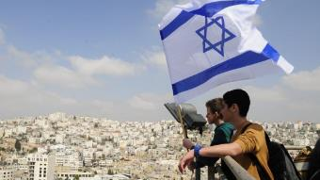
Reliability of the “Divine Regathering” Predictions
 | RETURN | PREDICTED | FULFILLED
1st | From Egypt to Canaan | Gen. 15:13-14 | Joshua 1‒12
2nd | From Babylon to Israel | Jer. 25:11; 29:10 | Ezra & Nehemiah
3rd | From the Diaspora to Israel’s restoration | Ezekiel 36:24-28 | Millennial Kingdom

Slide 53
Genesis 31:4-16 Jacob’s Discussion with Wives
Summoning of the wives (4)
Presentation of the case (5-13)
Wives’ response (14-16)

Slide 54
Genesis 31:14-16 Wives’ Response
Loss of inheritance (14)
Loss of dowry (15)
Divine providence (16a)
Wives’ acceptance (16b)

Slide 55
Genesis 31:14-16 Wives’ Response
Loss of inheritance (14)
Loss of dowry (15)
Divine providence (16a)
Wives’ acceptance (16b)

Slide 56
Genesis 31:14-16 Wives’ Response
Loss of inheritance (14)
Loss of dowry (15)
Divine providence (16a)
Wives’ acceptance (16b)

Slide 57
Dr. Arnold G. Fruchtenbaum
The Book of Genesis, 464
“According to the Nuzi Tablets, the father of the bride was to give some of the bride price money from the groom to the bride. Jacob did not give money to Laban, but he gave him seven years of service for each wife. However, no part of the fruit of Jacob’s work was given to the daughters. None of the increase of the flocks was set aside for the daughters. This went contrary to even the custom of their own territory. Therefore, Laban would resort to local custom if it were to his benefit; he would go against it if it did not benefit him. Not Jacob but Laban was the cheat here.”

Slide 58
Genesis 31:14-16 Wives’ Response
Loss of inheritance (14)
Loss of dowry (15)
Divine providence (16a)
Wives’ acceptance (16b)

Slide 59
Genesis 31:14-16 Wives’ Response
Loss of inheritance (14)
Loss of dowry (15)
Divine providence (16a)
Wives’ acceptance (16b)

Slide 60
Genesis 31:1-21 Jacob’s Flight From Haran
Jacob’s circumstances (1-3)
Jacob’s discussion with his wives (4-16)
Jacob’s escape (17-21)

Slide 61
Genesis 31:17-21 Jacob’s Escape
Jacob’s preparation (17-18)
Jacob’s circumstances (19)
Jacob’s deception and flight (20)
Jacob’s direction (21)

Slide 62
Genesis 31:17-21 Jacob’s Escape
Jacob’s preparation (17-18)
Jacob’s circumstances (19)
Jacob’s deception and flight (20)
Jacob’s direction (21)

Slide 63
Genesis 31:17-18 Jacob’s Preparation
Family (17)
Property (18a)
Purpose (18b)

Slide 64
Genesis 31:17-18 Jacob’s Preparation
Family (17)
Property (18a)
Purpose (18b)

Slide 66
Reliability of the “Divine Regathering” Predictions
 | RETURN | PREDICTED | FULFILLED
1st | From Egypt to Canaan | Gen. 15:13-14 | Joshua 1‒12
2nd | From Babylon to Israel | Jer. 25:11; 29:10 | Ezra & Nehemiah
3rd | From the Diaspora to Israel’s restoration | Ezekiel 36:24-28 | Millennial Kingdom

Slide 67
Genesis 31:17-18 Jacob’s Preparation
Family (17)
Property (18a)
Purpose (18b)

Slide 68
Genesis 31:17-18 Jacob’s Preparation
Family (17)
Property (18a)
Purpose (18b)

Slide 70
Genesis 31:17-21 Jacob’s Escape
Jacob’s preparation (17-18)
Jacob’s circumstances (19)
Jacob’s deception and flight (20)
Jacob’s direction (21)

Slide 71
Genesis 31:19 Jacob’s Circumstances
Laban’s distraction (19a)
Rachael’s theft (19b)

Slide 72
Genesis 31:19 Jacob’s Circumstances
Laban’s distraction (19a)
Rachael’s theft (19b)

Slide 73
Genesis 31:19 Jacob’s Circumstances
Laban’s distraction (19a)
Rachael’s theft (19b)

Slide 74
Dr. Arnold G. Fruchtenbaum
The Book of Genesis, 465
“The Code of Hammurabi states that whoever has the household gods owns the property. The Nuzi Tablets record an incident of the person mentioned earlier and states: ‘If Nashwi has a son of his own, he shall divide the estate equally with Wullu, (adopted son), but the son of Nashwi shall take the gods of Nashwi. However, if Nashwi does not have a son of his own, the Wullu shall take the gods.’ So owning the household gods meant the owner could claim the property. Rachel was not worshipping idols, but rather it was her attempt to gain the property of Laban for her husband.”

Slide 75
Genesis 31:17-21 Jacob’s Escape
Jacob’s preparation (17-18)
Jacob’s circumstances (19)
Jacob’s deception and flight (20)
Jacob’s direction (21)

Slide 76
Genesis 31:17-21 Jacob’s Escape
Jacob’s preparation (17-18)
Jacob’s circumstances (19)
Jacob’s deception and flight (20)
Jacob’s direction (21)

Slide 78
Conclusion

Slide 79
Genesis 31:1-21 Jacob’s Flight From Haran
Jacob’s circumstances (1-3)
Jacob’s discussion with his wives (4-16)
Jacob’s escape (17-21)

Slide 80
²⁴ The Lord bless you, and keep you; ²⁵ The Lord make His face shine on you, And be gracious to you; ²⁶ The Lord lift up His countenance on you, And give you peace.
Numbers 6:24–26 (NASB95)

