Slide 1
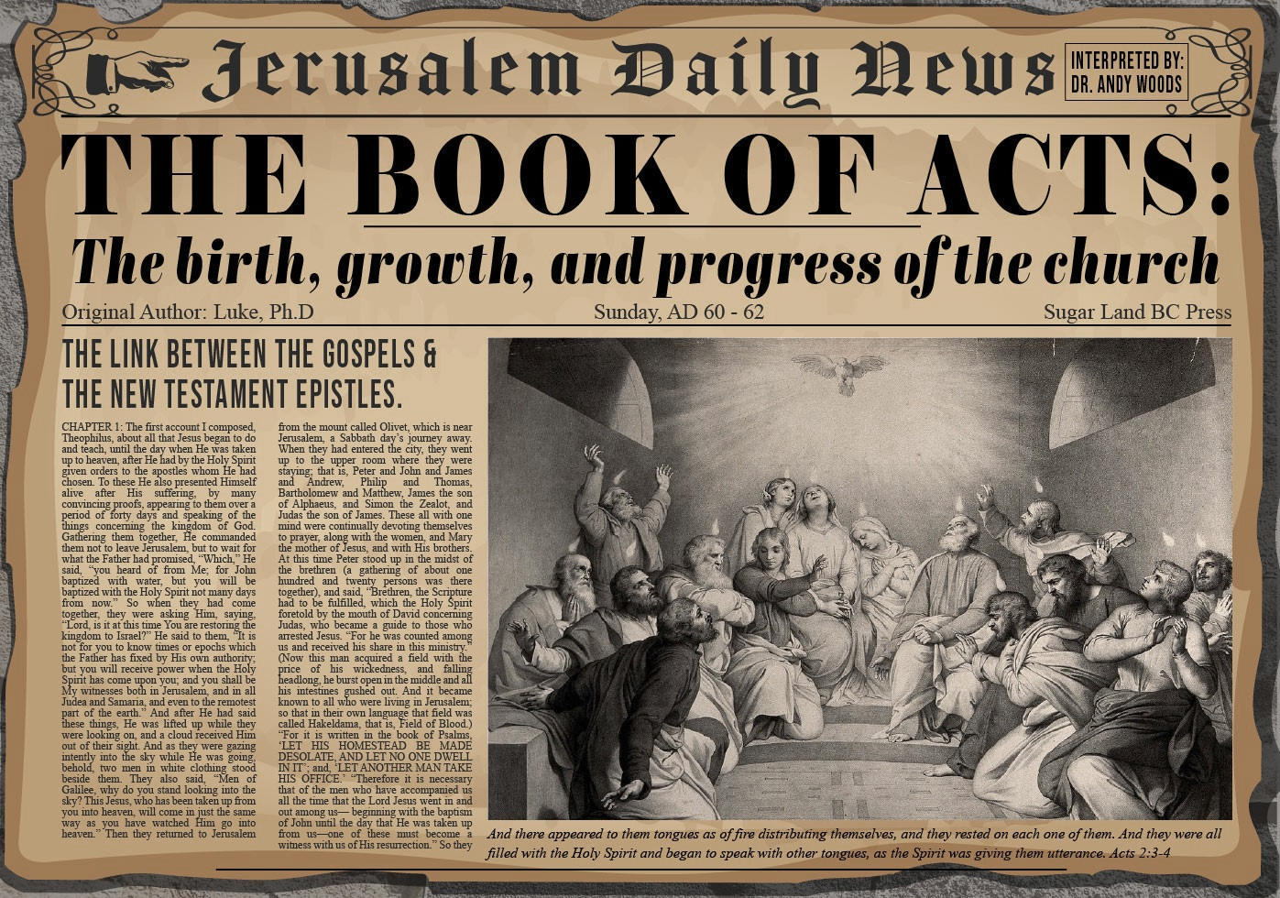


Slide 2
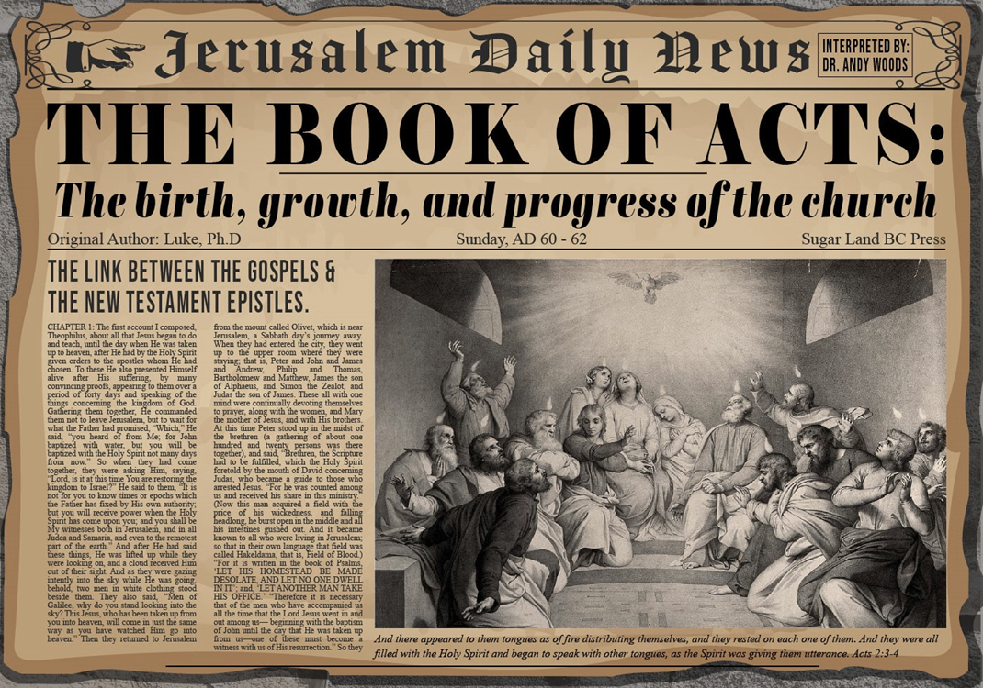
Acts 3
Chapter Summary
  Miraculous Healing (1-11)
  Peter’s Second Sermon (12-26)

Slide 3
Acts 3
Chapter Summary
  Miraculous Healing (1-11)
  Peter’s Second Sermon (12-26)

Slide 4
Miraculous Healing
Acts 3:1-11
  Occasion of the Miracle (1)
  Encounter with the Lame Man (2-3)
  Healing of the Lame Man (4-7)
  Three Results of the Miracle (8-11)

Slide 5
Acts 3
Chapter Summary
  Miraculous Healing (1-11)
  Peter’s Second Sermon (12-26)

Slide 6
Peter’s Second Sermon
Acts 3:12-26
  Israel’s Rejection of her Messiah (12-18)
  Israel’s Responsibility (19-26)

Slide 7
Peter’s Second Sermon
Acts 3:12-26
  Israel’s Rejection of her Messiah (12-18)
  Israel’s Responsibility (19-26)

Slide 8
Acts 3:12-18
Israel’s Rejection of Her Messiah
      Occasion (12)
      Rejection (13-15)
      Jesus Responsible for the Healing (16)
      Conclusion (17-18)

Slide 9
Peter’s Second Sermon
Acts 3:12-26
  Israel’s Rejection of her Messiah (12-18)
  Israel’s Responsibility (19-26)

Slide 10
Acts 3:19-26
Israel’s Responsibility
      Necessity of Repentance (19a)
      Results of Repentance (19b-21)
      Present Fulfilled Prophecy (22-26)

Slide 11
Acts 3:19b-21
Results of Repentance
      Salvation (19b)
      Kingdom (19c)
      Second Advent (20)
      Termination of Present Session (21)

Slide 12
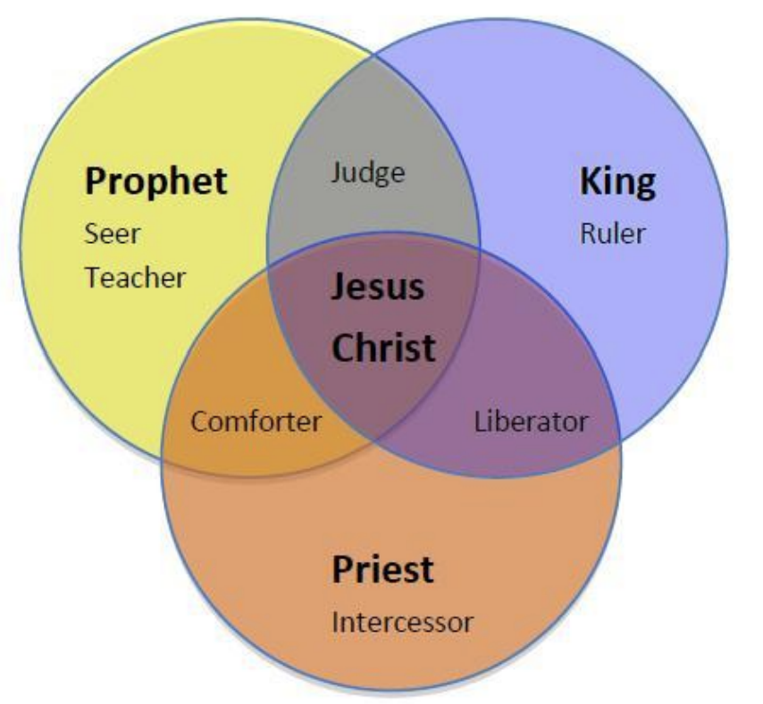
CHRIST’S THREE OFFICES
Prophet (First Coming)
Priest (Present Session)
King (Second Coming)

Slide 13

Isaiah 2:1-4
¹ “The word which Isaiah the son of Amoz saw concerning Judah and Jerusalem.² Now it will come about that In the last days The mountain of the house of the Lord Will be established as the chief of the mountains, And will be raised above the hills; And all the nations will stream to it.³ And many peoples will come and say, “Come, let us go up to the mountain of the Lord, To the house of the God of Jacob; . . .

Slide 14

Isaiah 2:1-4
. . .That He may teach us concerning His ways And that we may walk in His paths.” For the law will go forth from Zion And the word of the Lord from Jerusalem.⁴ And He will judge between the nations, And will render decisions for many peoples; And they will hammer their swords into plowshares and their spears into pruning hooks. Nation will not lift up sword against nation, And never again will they learn war.”

Slide 15
Isaiah 11:6-9
⁶ “And the wolf will dwell with the lamb, And the leopard will lie down with the young goat, And the calf and the young lion and the fatling together; And a little boy will lead them.⁷ Also the cow and the bear will graze, Their young will lie down together, And the lion will eat straw like the ox. ⁸ The nursing child will play by the hole of the cobra, And the weaned child will put his hand on the viper’s den. ⁹ They will not hurt or destroy in all My holy mountain, For the earth will be full of the knowledge of the Lord As the waters cover the sea.”

Slide 16
Isaiah 65:17-25
¹⁷ “For behold, I create new heavens and a new earth; And the former things will not be remembered or come to mind.¹⁸ “But be glad and rejoice forever in what I create; For behold, I create Jerusalem for rejoicing And her people for gladness.¹⁹ “I will also rejoice in Jerusalem and be glad in My people; And there will no longer be heard in her The voice of weeping and the sound of crying.²⁰ “No longer will there be in it an infant who lives but a few days, Or an old man who does not live out his days; For the youth will die at the age of one hundred And the one who does not . . .

Slide 17
Isaiah 65:17-25
...reach the age of one hundred Will be thought accursed.²¹ “They will build houses and inhabit them; They will also plant vineyards and eat their fruit.²² “They will not build and another inhabit, They will not plant and another eat; For as the lifetime of a tree, so will be the days of My people, And My chosen ones will wear out the work of their hands.²³ “They will not labor in vain, Or bear children for calamity; For they are the offspring of those blessed by the Lord, And their descendants…

Slide 18

Isaiah 65:17-25
…with them.²⁴ It will also come to pass that before they call, I will answer; and while they are still speaking, I will hear. ²⁵ The wolf and the lamb will graze together, and the lion will eat straw like the ox; and dust will be the serpent’s food. They will do no evil or harm in all My holy mountain,” says the Lord.

Slide 19
Acts 3:19-26
Israel’s Responsibility
      Necessity of Repentance (19a)
      Results of Repentance (19b-21)
      Present Fulfilled Prophecy (22-26)

Slide 20
Acts 3:22-26
Present Fulfilled Prophecy
      Deuteronomy 18:15 (22)
      Deuteronomy 18:19 (23)
      Prophets’ Summary (24)
      Blessing to the Gentiles (25)
      Application to Israel (26)

Slide 21
Acts 3:22-26
Present Fulfilled Prophecy
      Deuteronomy 18:15 (22)
      Deuteronomy 18:19 (23)
      Prophets’ Summary (24)
      Blessing to the Gentiles (25)
      Application to Israel (26)

Slide 22
Names for Jesus in Acts 3
Holy One (14a)
Righteous One (14b)
Prince of Life (15a)
“Christ” or “The Messiah” (18)
Prophet Like Moses (22-23)
Servant (26)

Slide 23
Acts 3:22-26
Present Fulfilled Prophecy
      Deuteronomy 18:15 (22)
      Deuteronomy 18:19 (23)
      Prophets’ Summary (24)
      Blessing to the Gentiles (25)
      Application to Israel (26)

Slide 24


Slide 25
Six Parts of a Suzerain-Vassal Treaty in Deuteronomy
Preamble (1:1-5)
Prologue (1:6–4:40)
Covenant obligations (5–26)
Storage and reading instructions (27:2-3; 31:9, 24, 26)
Witnesses (32:1)
Blessings and curses (28)

Slide 26
Six Parts of a Suzerain-Vassal Treaty in Deuteronomy
Preamble (1:1-5)
Prologue (1:6–4:40)
Covenant obligations (5–26)
Storage and reading instructions (27:2-3; 31:9, 24, 26)
Witnesses (32:1)
Blessings and curses (28)

Slide 27


Deuteronomy 28:49-50
⁴⁹ “The Lord will bring a nation against you from afar, from the end of the earth, as the eagle swoops down, a nation whose language you shall not understand, ⁵⁰ a nation of fierce countenance who will have no respect for the old, nor show favor to the young.”

Slide 28
ISRAEL'S JUDGMENTS
Division of the kingdom in 931 B.C. (1 Kgs. 12)
Assyrian judgment in 722 B.C. (2 Kgs. 17)
Babylonian captivity in 586 B.C. (2 Kgs. 25)
Rome Diaspora in A.D. 70 (Luke 19:41-44)

Slide 29
ISRAEL'S JUDGMENTS
Division of the kingdom in 931 B.C. (1 Kgs. 12)
Assyrian judgment in 722 B.C. (2 Kgs. 17)
Babylonian captivity in 586 B.C. (2 Kgs. 25)
Rome Diaspora in A.D. 70 (Luke 19:41-44)

Slide 30
Acts 3:22-26
Present Fulfilled Prophecy
      Deuteronomy 18:15 (22)
      Deuteronomy 18:19 (23)
      Prophets’ Summary (24)
      Blessing to the Gentiles (25)
      Application to Israel (26)

Slide 31
Luke 24:27, 44
“²⁷ Then beginning with Moses and with all the prophets, He explained to them the things concerning Himself in all the Scriptures…⁴⁴ Now He said to them, ‘These are My words which I spoke to you while I was still with you, that all things which are written about Me in the Law of Moses and the Prophets and the Psalms must be fulfilled.’”

Slide 32
Acts 3:22-26
Present Fulfilled Prophecy
      Deuteronomy 18:15 (22)
      Deuteronomy 18:19 (23)
      Prophets’ Summary (24)
      Blessing to the Gentiles (25)
      Application to Israel (26)

Slide 33
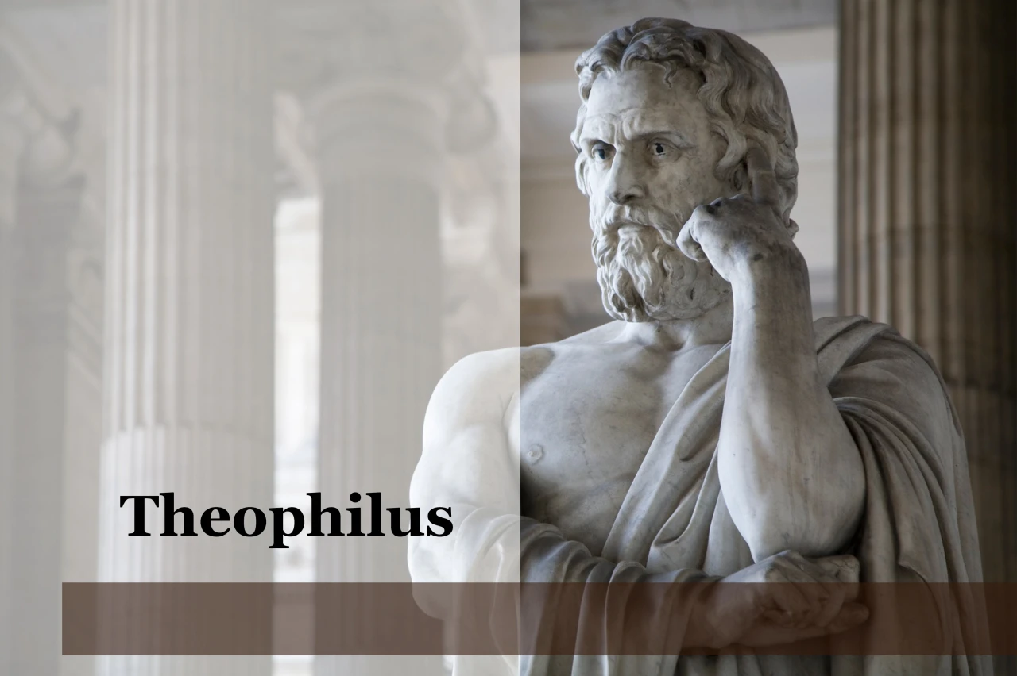
Purpose
  To present Theophilus with an orderly account of the birth and growth of the church so as to affirm him in what he has believed.

Slide 34

Message
  Birth and growth of the church numerically, geographically, ethnically.
  Components
  Numerically (progress reports)
  Geographically (From Jerusalem to Rome)
  Ethnically (From Judaism to Gentile domination)

Slide 35

8 New Promises
Genesis 12:1-3
    Land (Gen. 12:1b)
    Great nation (Gen. 12:2a)
    Personal blessing (Gen. 12:2b)
    Great name (Gen. 12:2c)
    Blessing to others (Gen. 12:2d)
    Blessing to blessers (Gen. 12:3a)
    Cursing to cursers (Gen. 12:3b)
    Blessing to the world (Gen. 12:3c)

Slide 36


Genesis 12:3
“And I will bless those who bless you, And the one who curses you I will curse. And in you all the families of the earth will be blessed.”

Slide 37
Acts 3:22-26
Present Fulfilled Prophecy
      Deuteronomy 18:15 (22)
      Deuteronomy 18:19 (23)
      Prophets’ Summary (24)
      Blessing to the Gentiles (25)
      Application to Israel (26)

Slide 38
Names for Jesus in Acts 3
Holy One (14a)
Righteous One (14b)
Prince of Life (15a)
“Christ” or “The Messiah” (18)
Prophet Like Moses (22-23)
Servant (26)

Slide 39
Messengers of the Kingdom In Matthew
John the Baptist – 3:2
Jesus Christ – 4:17
12 Apostles – 10:5-7
Seventy – Luke 10:1, 9
Toussaint, Behold the King, 18-20

Slide 40
Matthew 10:5-7
“These twelve Jesus sent out after instructing them: “Do not go in the way of the Gentiles, and do not enter any city of the Samaritans; ⁶ but rather go to the lost sheep of the house of Israel. ⁷ And as you go, preach, saying, ‘The kingdom of heaven is at hand.’”

Slide 41
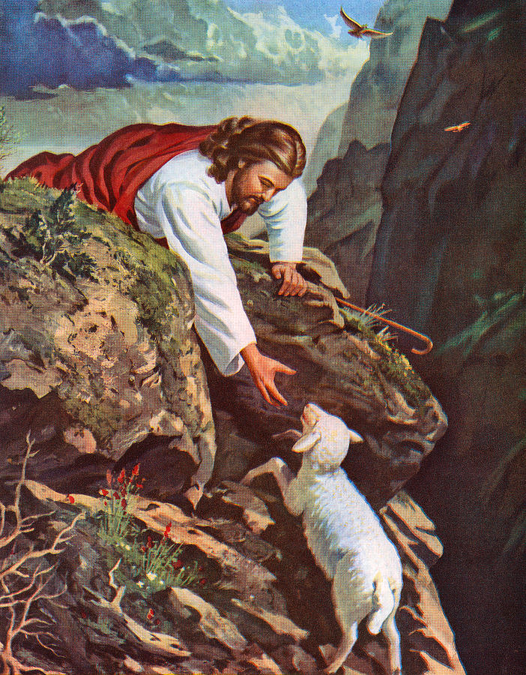
Matthew 15:24
“But He answered and said, ‘I was sent only to the lost sheep of the house of Israel.’”

Slide 42
Conclusion

Slide 43
Acts 3
Chapter Summary
  Miraculous Healing (1-11)
  Peter’s Second Sermon (12-26)

