Slide 1
Genesis 12‒50
Israel’s Birth & Preservation

Slide 2
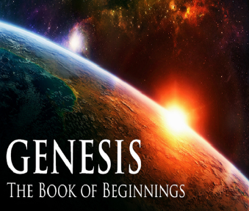
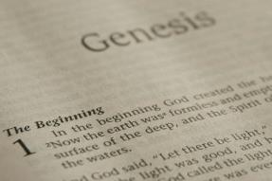
GENESIS STRUCTURE
Genesis 12-50 (four people)
Abraham (12:1–25:11)
Isaac (25:12–26:35)
Jacob (27–36)
Joseph (37–50)

Slide 3
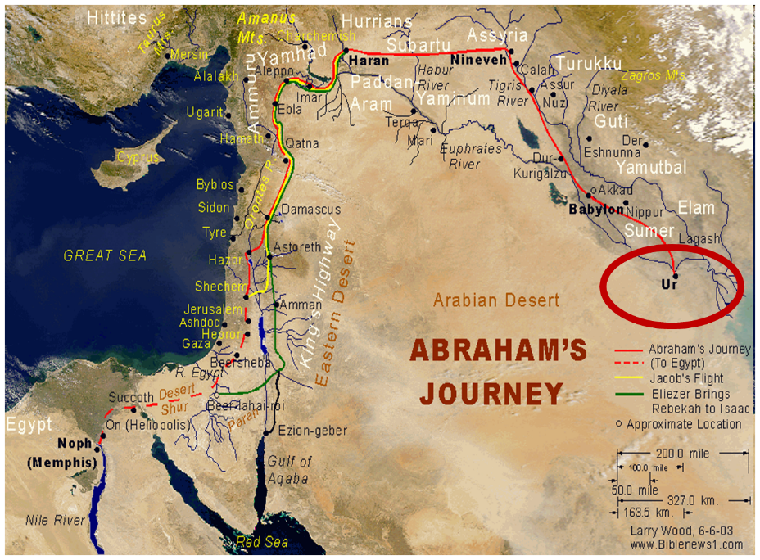

Slide 4
Genesis 30:25-43 Jacob’s Contract & Enrichment
Jacob’s contract (30:25-36)
Jacob’s enrichment (30:37-43)

Slide 5
Genesis 30:25-43 Jacob’s Contract & Enrichment
Jacob’s contract (30:25-36)
Jacob’s enrichment (30:37-43)

Slide 6
I. Genesis 30:25-36 Jacob’s Contract
Jacob’s request (25-26)
Laban’s counter-offer (27-28)
Jacob’s summary (29-30)
Laban’s question (31a)
Jacob’s request (31b-33)
Laban’s agreement (34)
Laban’s dishonesty (35)
Separation (36a)
Jacob fulfills his obligation (36b)

Slide 7
Genesis 30:25-43 Jacob’s Contract & Enrichment
Jacob’s contract (30:25-36)
Jacob’s enrichment (30:37-43)

Slide 8
II. Genesis 30:37-43 Jacob’s Enrichment
Jacob’s rods (37-39)
Jacob’s separation (40)
Jacob’s dealings (41-42)
Jacob’s wealth (43)

Slide 9
II. Genesis 30:37-43 Jacob’s Enrichment
Jacob’s rods (37-39)
Jacob’s separation (40)
Jacob’s dealings (41-42)
Jacob’s wealth (43)

Slide 10
Genesis 30:37-39 Jacob’s Rods
Making (37)
Placing (38a)
Mating (38b-39a)
Product (39b)

Slide 11
Genesis 30:37-39 Jacob’s Rods
Making (37)
Placing (38a)
Mating (38b-39a)
Product (39b)

Slide 12
Genesis 30:37-39 Jacob’s Rods
Making (37)
Placing (38a)
Mating (38b-39a)
Product (39b)

Slide 13
Dr. Henry M. Morris
The Genesis Record, 475
“Critics…raise questions about Jacob’s…knowledge of science. His actions in peeling white stripes in rods from trees of poplar, hazel, and chestnut (or, perhaps more likely, storax, almond, and plane trees), and placing them in the cattle watering troughs, have been attacked as showing his belief in the outmoded ideas of prenatal influence. The idea is that Jacob supposed, by making the animals look at striped rods at the time of conception, he could induce them to bring forth striped offspring. The doctrine of prenatal influence is, of course, believed by modern zoologists to be nothing but an old wives’ tale. It should not be overlooked, however, that Jacob was over ninety years old at this time, that he was a very intelligent and careful observer, and that he had spent most of his long life raising and studying cattle, sheep, and goats. He would have been most unlikely to have been taken in by a groundless superstition.”

Slide 14
Genesis 30:37-39 Jacob’s Rods
Making (37)
Placing (38a)
Mating (38b-39a)
Product (39b)

Slide 15
Dr. Henry M. Morris
The Genesis Record, 475
“The mere sight of the striped rods may have served simply as an aphrodisiac to the cattle when they came to drink. This in fact seems indicated by verse 38, in which the word translated ‘conceive’ in the King James Version is actually the Hebrew yacham, meaning ‘to be hot.’…In some way not understood (but apparently confirmed by many practical animal raisers since), the sight of white-streaked rods seems to stimulate these animals to sexual activity. All things considered, it seems most likely that this is what Jacob had in mind. He wanted to speed up the reproduction process and to induce the animals to have as many offspring as possible in the shortest time possible. This would presumably benefit Laban even more than himself since most of the animals should be of the normal type; but statistically, he knew that a certain proportion would be spotted. The more animals born, the sooner there would be some with the characteristics he was looking for.”

Slide 16
Genesis 30:37-39 Jacob’s Rods
Making (37)
Placing (38a)
Mating (38b-39a)
Product (39b)

Slide 17
II. Genesis 30:37-43 Jacob’s Enrichment
Jacob’s rods (37-39)
Jacob’s separation (40)
Jacob’s dealings (41-42)
Jacob’s wealth (43)

Slide 18
Scripture’s Four Judgments
NAME | SHEEP AND GOAT | JUDGMENT OF THE JEWS | BEMA SEAT | GREAT WHITE THRONE
SCRIPTURE | Matt 25:31-46 | Ezek 20:33-44 | 1 Cor 3:10-15 | Rev 20:11-15
PLACE | Earth, Jerusalem | Earth, wilderness | Heaven | Earth
AUDIENCE | Gentile Tribulation survivors | Jewish Tribulation survivors | Church Age believers | All unsaved
WHEN | After Tribulation | After Tribulation | After rapture | After Millennium
PURPOSE | Saved Gentiles enter kingdom | Saved Jews enter kingdom | Reward believers | Degree of punishment in hell
EVALUATION | Treatment of Christ’s brethren | Passing under shepherd’s rod | Works taken through fire | Not in the book; judged by books

Slide 19
II. Genesis 30:37-43 Jacob’s Enrichment
Jacob’s rods (37-39)
Jacob’s separation (40)
Jacob’s dealings (41-42)
Jacob’s wealth (43)

Slide 20
Genesis 30:41-42 Jacob’s Dealings
With the strong (41)
With the weak (42)

Slide 21
Genesis 30:41-42 Jacob’s Dealings
With the strong (41)
With the weak (42)

Slide 22
Genesis 30:41-42 Jacob’s Dealings
With the strong (41)
With the weak (42)

Slide 23
Dr. Henry M. Morris
The Genesis Record, 477
“A further measure was taken by Jacob to ensure that the flocks so produced would be composed of strong animals. He divided the flocks into two shifts, composed of stronger and weaker animals, respectively. He used the rods in the troughs when the stronger animals drank, but not when the weaker ones came there. Thus the stronger animals were stimulated to mate, and the others were not….It would ensure that, statistically at least, most of the newborn lambs and kids, whether solid color or spotted, would be sturdy and healthy. However, there continued to be produced an abnormally large proportion of spotted and speckled young. This meant that a greater and greater percentage of the animals in Jacob’s flock were strong animals, and an increasing percentage in Laban’s were weaker animals.”

Slide 24
II. Genesis 30:37-43 Jacob’s Enrichment
Jacob’s rods (37-39)
Jacob’s separation (40)
Jacob’s dealings (41-42)
Jacob’s wealth (43)

Slide 25
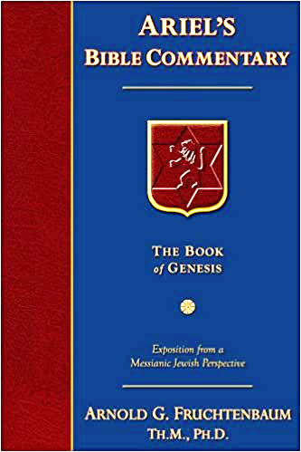
Dr. Arnold G. Fruchtenbaum
The Book of Genesis, 459
“Genesis 30:43 summarizes Jacob’s wealth: And the man increased exceedingly. Again, the word used means an explosion of increase; what was true of Laban’s flock was now true of Jacob’s flock. The word exceeding is actually two Hebrew words that are the same word, meod, meod, meaning ‘very, very.’ This was an ‘explosion of increase very, very.’ It specifies a massive amount of wealth, namely consisting of: large flocks, and maid-servants, and men-servants, and camels and asses. All this in six year’s time, and so indeed he became very wealthy and financially stable.”

Slide 26
Dr. Henry M. Morris
The Genesis Record, 477
“It was not until later that Jacob came to understand the providential intervention that caused the unusual percentage of streaked and spotted animals to be born (see Genesis 32:10). In the meantime, within the space of only a few years—perhaps four or five—Jacob’s flock had grown so large, and he had prospered from it so greatly, that he had to employ many servants, both male and female, and had purchased many camels and asses. He had quickly become a very prosperous rancher. He had done so, not by any dishonest manipulation of his own, but by means of sound practices of animal breeding which, by all normal standards, should have been of even greater benefit to Laban than to himself. The God of his fathers, however, had intervened in a marvelous and mysterious way.”

Slide 27
Dr. Arnold G. Fruchtenbaum
The Book of Genesis, 459-60
“These were superstitious practices. Jacob initially resorted to superstition and had accepted a popular theory in those days of prenatal influence that said a vivid sight during conception or pregnancy would leave its mark on the embryo. That was what Jacob believed, and that is what he practiced here. What he eventually learned, according to 31:10–13, was that it was not the rods that produced it. Rather, it was God working a miracle.”

Slide 28
8 New Promises Genesis 12:1-3
Land (Gen. 12:1b)
Great nation (Gen. 12:2a)
Personal blessing (Gen. 12:2b)
Great name (Gen. 12:2c)
Blessing to others (Gen. 12:2d)
Blessing to blessers (Gen. 12:3a)
Cursing to cursers (Gen. 12:3b)
Blessing to the world (Gen. 12:3c)

Slide 29
Evidence of Abrahamic Covenant’s Unconditional Nature
ANE covenant ratification ceremony (Gen 15)
Lack of stated conditions for Israel’s obedience (Gen 15)
Covenant's eternality (Gen 17:7, 13, 19; Ps. 90:2)
Covenant's immutability (Heb 6:13-18; Mal. 3:6)
Trans-generational reaffirmation despite perpetual national disobedience (Jer 31:35-37)
Walvoord, The Millennial Kingdom, 149-52

Slide 31
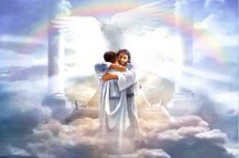
Ephesians 1:3
“Blessed be the God and Father of our Lord Jesus Christ, who has blessed us with every spiritual blessing in the heavenly places in Christ.”

Slide 32
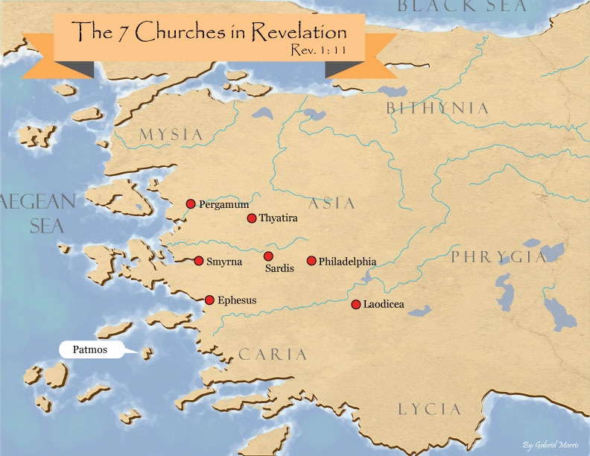

Slide 33
Revelation 2:9
“I know your tribulation and your poverty (but you are rich), and the blasphemy by those who say they are Jews and are not, but are a synagogue of Satan.”

Slide 35
Revelation 3:17
“Because you say, ‘I am rich, and have become wealthy, and have need of nothing,’ and you do not know that you are wretched and miserable and poor and blind and naked.’”

Slide 36
Conclusion

Slide 37
Genesis 30:25-43 Jacob’s Contract & Enrichment
Jacob’s contract (30:25-36)
Jacob’s enrichment (30:37-43)

Slide 38
II. Genesis 30:37-43 Jacob’s Enrichment
Jacob’s rods (37-39)
Jacob’s separation (40)
Jacob’s dealings (41-42)
Jacob’s wealth (43)

Slide 39
²⁴ The Lord bless you, and keep you; ²⁵ The Lord make His face shine on you, And be gracious to you; ²⁶ The Lord lift up His countenance on you, And give you peace.
Numbers 6:24–26 (NASB95)

