Slide 1
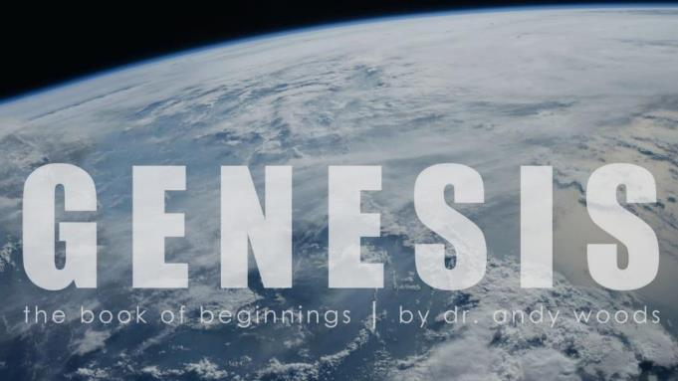
Genesis 12‒50
Israel’s Birth & Preservation

Slide 2
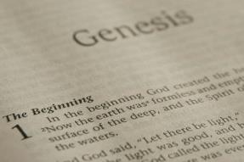
GENESIS STRUCTURE
Genesis 12-50 (four people)
Abraham (12:1–25:11)
Isaac (25:12–26:35)
Jacob (27–36)
Joseph (37–50)

Slide 3
Genesis 30:25-43 Jacob’s Contract & Enrichment
Jacob’s contract (30:25-36)
Jacob’s enrichment (30:37-43)

Slide 4
Genesis 30:25-43 Jacob’s Contract & Enrichment
Jacob’s contract (30:25-36)
Jacob’s enrichment (30:37-43)

Slide 5
I. Genesis 30:25-36 Jacob’s Contract
Jacob’s request (25-26)
Laban’s counter-offer (27-28)
Jacob’s summary (29-30)
Laban’s question (31a)
Jacob’s request (31b-33)
Laban’s agreement (34)
Laban’s dishonesty (35)
Separation (36a)
Jacob fulfills his obligation (36b)

Slide 6
I. Genesis 30:25-36 Jacob’s Contract
Jacob’s request (25-26)
Laban’s counter-offer (27-28)
Jacob’s summary (29-30)
Laban’s question (31a)
Jacob’s request (31b-33)
Laban’s agreement (34)
Laban’s dishonesty (35)
Separation (36a)
Jacob fulfills his obligation (36b)

Slide 7
Genesis 30:25-26 Jacob’s Request
Time (25a)
Request (25b-26a)
Basis (26b)

Slide 8
Genesis 30:25-26 Jacob’s Request
Time (25a)
Request (25b-26a)
Basis (26b)

Slide 10
Genesis 30:25-26 Jacob’s Request
Time (25a)
Request (25b-26a)
Basis (26b)

Slide 11
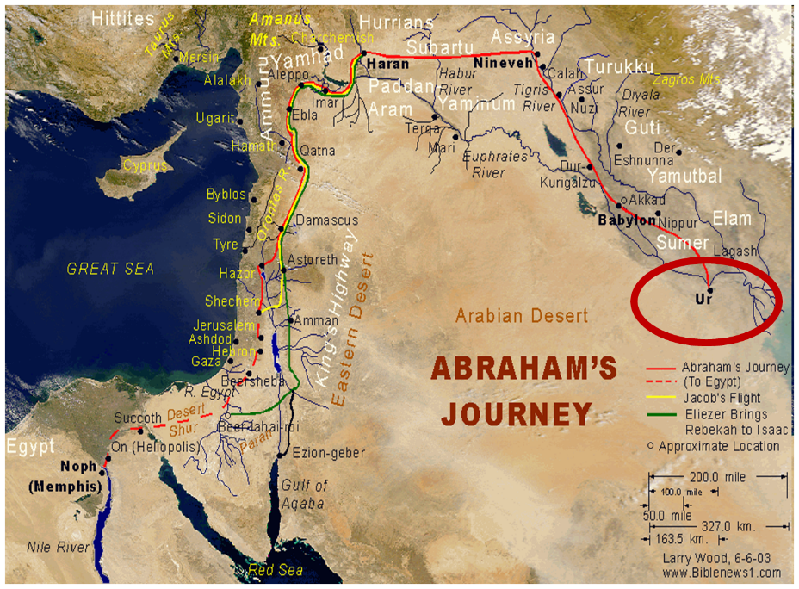

Slide 12
Ezekiel 36:24-28
“For I will take you from the nations, gather you from all the lands and bring you into your own land. ²⁵ Then I will sprinkle clean water on you, and you will be clean; I will cleanse you from all your filthiness and from all your idols. ²⁶ Moreover, I will give you a new heart and put a new spirit within you; and I will remove the heart of stone from your flesh and give you a heart of flesh. ²⁷ I will put My Spirit within you and cause you to walk in My statutes, and you will be careful to observe My ordinances. ²⁸ You will live in the land that I gave to your forefathers; so you will be My people, and I will be your God.”

Slide 13
Genesis 30:25-26 Jacob’s Request
Time (25a)
Request (25b-26a)
Basis (26b)

Slide 15
I. Genesis 30:25-36 Jacob’s Contract
Jacob’s request (25-26)
Laban’s counter-offer (27-28)
Jacob’s summary (29-30)
Laban’s question (31a)
Jacob’s request (31b-33)
Laban’s agreement (34)
Laban’s dishonesty (35)
Separation (36a)
Jacob fulfills his obligation (36b)

Slide 16
Genesis 30:27-28 Laban’s Counter-offer
Laban’s recognition (27)
Laban’s financial offer (28)

Slide 17
Genesis 30:27-28 Laban’s Counter-offer
Laban’s recognition (27)
Laban’s financial offer (28)

Slide 18
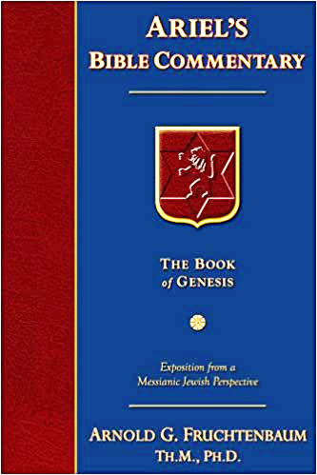
Dr. Arnold G. Fruchtenbaum
The Book of Genesis, 455
“The request Laban made was: If now I have found favor in your eyes, tarry [stay]. He wanted Jacob to stay there. The reason was: for I have divined that Jehovah has blessed me for your sake. The Hebrew word for ‘divine’ has the same root as the word ‘serpent’ and literally means ‘to divine through a serpent.’ Laban was a pagan who practiced such occult divination; and through occult practice, Laban, the pagan, recognized that Jacob’s God, Whoever He might be, was blessing Laban because of his relationship to Jacob.”

Slide 19
Acts 19:19
“And many of those who practiced magic brought their books together and began burning them in the sight of everyone; and they counted up the price of them and found it fifty thousand pieces of silver.”
19

Slide 20
Charles Ryrie
The Ryrie Study Bible
“19:19 Magic. Magical spells written on scrolls. Fifty thousand pieces of silver. If the silver drachma is meant, the value would have been the equivalent of about 138 years’ pay for a rural worker.”
20

Slide 21
8 New Promises Genesis 12:1-3
Land (Gen. 12:1b)
Great nation (Gen. 12:2a)
Personal blessing (Gen. 12:2b)
Great name (Gen. 12:2c)
Blessing to others (Gen. 12:2d)
Blessing to blessers (Gen. 12:3a)
Cursing to cursers (Gen. 12:3b)
Blessing to the world (Gen. 12:3c)

Slide 22
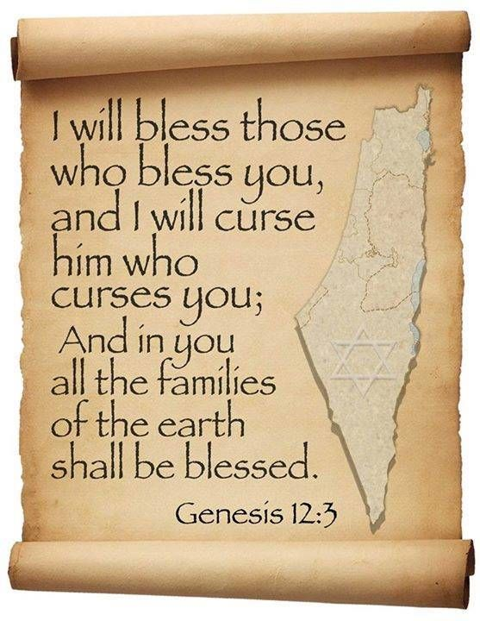
Genesis 12:3
“And I will bless those who bless you, And the one who curses you I will curse. And in you all the families of the earth will be blessed.”

Slide 23
Genesis 30:27-28 Laban’s Counter-offer
Laban’s recognition (27)
Laban’s financial offer (28)

Slide 24
I. Genesis 30:25-36 Jacob’s Contract
Jacob’s request (25-26)
Laban’s counter-offer (27-28)
Jacob’s summary (29-30)
Laban’s question (31a)
Jacob’s request (31b-33)
Laban’s agreement (34)
Laban’s dishonesty (35)
Separation (36a)
Jacob fulfills his obligation (36b)

Slide 25
Genesis 30:29-30 Jacob’s Summary
Jacob’s value (29)
Jacob’s blessing (30a)
Jacob’s desire (30b)

Slide 26
Genesis 30:29-30 Jacob’s Summary
Jacob’s value (29)
Jacob’s blessing (30a)
Jacob’s desire (30b)

Slide 27
Genesis 30:29-30 Jacob’s Summary
Jacob’s value (29)
Jacob’s blessing (30a)
Jacob’s desire (30b)

Slide 28
8 New Promises Genesis 12:1-3
Land (Gen. 12:1b)
Great nation (Gen. 12:2a)
Personal blessing (Gen. 12:2b)
Great name (Gen. 12:2c)
Blessing to others (Gen. 12:2d)
Blessing to blessers (Gen. 12:3a)
Cursing to cursers (Gen. 12:3b)
Blessing to the world (Gen. 12:3c)

Slide 29
Genesis 12:3
“And I will bless those who bless you, And the one who curses you I will curse. And in you all the families of the earth will be blessed.”

Slide 30
Genesis 30:29-30 Jacob’s Summary
Jacob’s value (29)
Jacob’s blessing (30a)
Jacob’s desire (30b)

Slide 32
I. Genesis 30:25-36 Jacob’s Contract
Jacob’s request (25-26)
Laban’s counter-offer (27-28)
Jacob’s summary (29-30)
Laban’s question (31a)
Jacob’s request (31b-33)
Laban’s agreement (34)
Laban’s dishonesty (35)
Separation (36a)
Jacob fulfills his obligation (36b)

Slide 33
I. Genesis 30:25-36 Jacob’s Contract
Jacob’s request (25-26)
Laban’s counter-offer (27-28)
Jacob’s summary (29-30)
Laban’s question (31a)
Jacob’s request (31b-33)
Laban’s agreement (34)
Laban’s dishonesty (35)
Separation (36a)
Jacob fulfills his obligation (36b)

Slide 34
Genesis 30:31b-33 Jacob’s Request
Denial of initial payment (31b)
Offspring of the off colored (31c-32)
Jacob’s honesty (33)

Slide 35
Genesis 30:31b-33 Jacob’s Request
Denial of initial payment (31b)
Offspring of the off colored (31c-32)
Jacob’s honesty (33)

Slide 36
Genesis 30:31b-33 Jacob’s Request
Denial of initial payment (31b)
Offspring of the off colored (31c-32)
Jacob’s honesty (33)

Slide 37
Charles Ryrie
The Ryrie Study Bible
“Genesis 30:31–33 (RSB:NASB1995U): 30:31–33. Jacob agreed to take care of Laban’s flocks if he could keep as his wages the off-colored and spotted animals that would be born.”
37

Slide 38
Genesis 30:31b-33 Jacob’s Request
Denial of initial payment (31b)
Offspring of the off colored (31c-32)
Jacob’s honesty (33)

Slide 39
I. Genesis 30:25-36 Jacob’s Contract
Jacob’s request (25-26)
Laban’s counter-offer (27-28)
Jacob’s summary (29-30)
Laban’s question (31a)
Jacob’s request (31b-33)
Laban’s agreement (34)
Laban’s dishonesty (35)
Separation (36a)
Jacob fulfills his obligation (36b)

Slide 40
I. Genesis 30:25-36 Jacob’s Contract
Jacob’s request (25-26)
Laban’s counter-offer (27-28)
Jacob’s summary (29-30)
Laban’s question (31a)
Jacob’s request (31b-33)
Laban’s agreement (34)
Laban’s dishonesty (35)
Separation (36a)
Jacob fulfills his obligation (36b)

Slide 41
Genesis 30:35 Laban’s Dishonesty
Laban’s removal (35a)
Transfer to sons (35b)

Slide 42
Genesis 30:35 Laban’s Dishonesty
Laban’s removal (35a)
Transfer to sons (35b)

Slide 43
Dr. Arnold G. Fruchtenbaum
The Book of Genesis, 457
“In 30:35–36a, Laban took some precautionary actions, with verse 35 describing the selection. He removed that day: first, the he-goats that were ringstreaked and spotted; second, all the she-goats that were speckled and spotted; third, every one that had white in it; and fourth, all the black ones among the sheep. Therefore, what Laban did was very unfair. Although Jacob was generous, Laban did not respond with generosity. Laban removed everything that would favor Jacob’s increase. What he took aside were the very animals that Jacob was to start with, and his wages were to be the offspring from them; but Laban set them aside. Now Jacob had to start with nothing. So Laban has deceived Jacob for a second time.”

Slide 44
Charles Ryrie
The Ryrie Study Bible
“30:34–36 Laban, true to character and acting in a manner not entirely foreign to the basic laws of heredity, separated the off-colored animals so as to reduce further Jacob’s chances of acquiring a large herd. However, those animals not visibly spotted had latent genes that would produce spotted offspring.”
44

Slide 45
Dr. Arnold G. Fruchtenbaum
The Book of Genesis, 445
“Now the deceiver is deceived, although the motivations differ from good to bad. This is divine retribution in four ways. First, Isaac’s blindness equals the darkness of Jacob’s wedding night, and neither could see well as a result. Second, this Jacob is deceived by being presented the older for the younger, the reversal of Isaac’s presentation of Jacob for Esau. Third, Isaac thought Jacob was Esau and Jacob thought Leah was Rachel. Fourth, Jacob pretended to be his older brother, while Leah pretended to be her younger sister.”

Slide 46
Genesis 30:35 Laban’s Dishonesty
Laban’s removal (35a)
Transfer to sons (35b)

Slide 47
I. Genesis 30:25-36 Jacob’s Contract
Jacob’s request (25-26)
Laban’s counter-offer (27-28)
Jacob’s summary (29-30)
Laban’s question (31a)
Jacob’s request (31b-33)
Laban’s agreement (34)
Laban’s dishonesty (35)
Separation (36a)
Jacob fulfills his obligation (36b)

Slide 48
I. Genesis 30:25-36 Jacob’s Contract
Jacob’s request (25-26)
Laban’s counter-offer (27-28)
Jacob’s summary (29-30)
Laban’s question (31a)
Jacob’s request (31b-33)
Laban’s agreement (34)
Laban’s dishonesty (35)
Separation (36a)
Jacob fulfills his obligation (36b)

Slide 49
Conclusion

Slide 50
I. Genesis 30:25-36 Jacob’s Contract
Jacob’s request (25-26)
Laban’s counter-offer (27-28)
Jacob’s summary (29-30)
Laban’s question (31a)
Jacob’s request (31b-33)
Laban’s agreement (34)
Laban’s dishonesty (35)
Separation (36a)
Jacob fulfills his obligation (36b)

Slide 51
Genesis 30:25-43 Jacob’s Contract & Enrichment
Jacob’s contract (30:25-36)
Jacob’s enrichment (30:37-43)

Slide 52
²⁴ The Lord bless you, and keep you; ²⁵ The Lord make His face shine on you, And be gracious to you; ²⁶ The Lord lift up His countenance on you, And give you peace.
Numbers 6:24–26 (NASB95)

