Slide 1
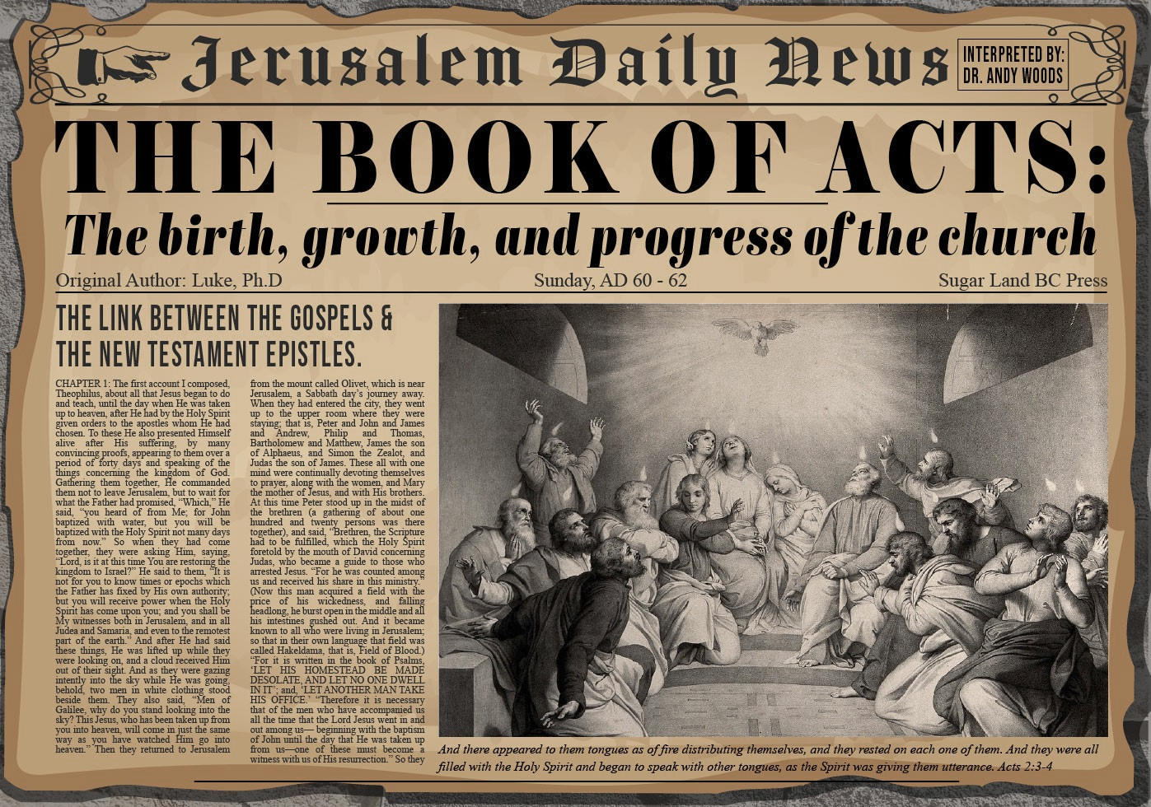


Slide 2
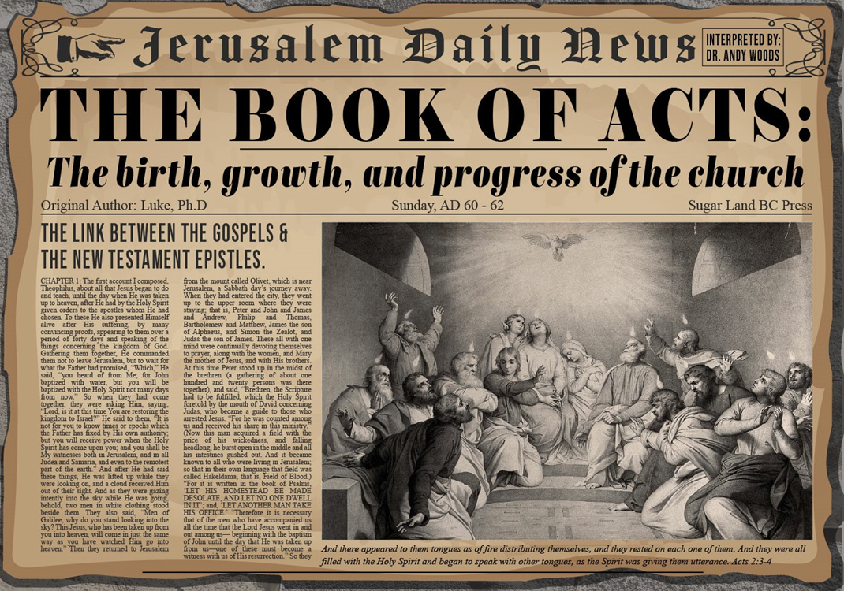
Acts 3
Chapter Summary
  Miraculous Healing (1-11)
  Peter’s Second Sermon (12-26)

Slide 3
Acts 3
Chapter Summary
  Miraculous Healing (1-11)
  Peter’s Second Sermon (12-26)

Slide 4
Miraculous Healing
Acts 3:1-11
  Occasion of the Miracle (1)
  Encounter with the Lame Man (2-3)
  Healing of the Lame Man (4-7)
  Three Results of the Miracle (8-11)

Slide 5
Acts 3
Chapter Summary
  Miraculous Healing (1-11)
  Peter’s Second Sermon (12-26)

Slide 6
Peter’s Second Sermon
Acts 3:12-26
  Israel’s Rejection of her Messiah (12-18)
  Israel’s Responsibility (19-26)

Slide 7
Peter’s Second Sermon
Acts 3:12-26
  Israel’s Rejection of her Messiah (12-18)
  Israel’s Responsibility (19-26)

Slide 8
Acts 3:12-18
Israel’s Rejection of Her Messiah
      Occasion (12)
      Rejection (13-15)
      Jesus Responsible for the Healing (16)
      Conclusion (17-18)

Slide 9
Peter’s Second Sermon
Acts 3:12-26
  Israel’s Rejection of her Messiah (12-18)
  Israel’s Responsibility (19-26)

Slide 10
Acts 3:19-26
Israel’s Responsibility
      Necessity of Repentance (19a)
      Results of Repentance (19b-21)
      Present Fulfilled Prophecy (22-26)

Slide 11
Acts 3:19-26
Israel’s Responsibility
      Necessity of Repentance (19a)
      Results of Repentance (19b-21)
      Present Fulfilled Prophecy (22-26)

Slide 12
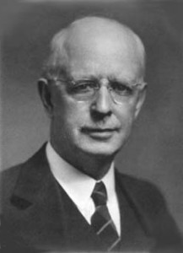
Lewis Sperry Chafer
vol. 7, Systematic Theology (Grand Rapids, MI: Kregel Publications, 1993), 265-66.
“This vital newness of mind is a part of believing, after all, and therefore it may be and is used as a synonym for believing at times (cf. Acts 17:30; 20:21; 26:20; Rom. 2:4; 2Tim. 2:25; 2 Pet. 3:9). Repentance nevertheless cannot be added to believing as a condition of salvation, because upwards of 150 passages of Scripture condition salvation upon believing only (cf. John 3:16; Acts 16:31).”

Slide 13


Matthew 12:24
“But when the Pharisees heard this, they said, ‘This man casts out demons only by Beelzebul the ruler of the demons.’”

Slide 14
Matthew Outline
Pedigree of the king (1–2)
  Preparation of the king (3–4)
    Pedagogy of the king (5–7)
      Power of the king (8–9)
        Program of the king (10)
          Progressive rejection of the king (11–12)
        Preparation of the king’s disciples (13–20)
      Presentation & rejection of the king (21–23)
    Prophecies of the king (24–25)
  Passion of the king (26–27)
Proof of the king (28)

Slide 15

Was the kingdom re-offered in Acts? No!
The king was absent (Acts 1:9-11)
Irreversible language found in the Gospels (Matt. 12:31-32; 21:42; 22:7)
A new age in the kingdom’s absence has already been disclosed (Luke 19:11-27; Matt. 13; 24‒25)
“Kingdom” is mentioned 45x in Luke’s Gospel but only 8x in Acts
Expression “repent for the kingdom of heaven is at hand” is absent from Acts

Slide 16
Was the kingdom re-offered in Acts? No!
Co-mingling of kingdom truth with Church Age truth
The timing of the kingdom has already been fixed by the Father’s authority (Acts 1:6-7)
Peter was merely preaching the personal Gospel in Acts 2
Acts 3:19-21 is laying out the condition by which the kingdom will ultimately come to the earth (Acts 3:19-21)
The miracles in Acts authenticate the new age of the Church (Heb. 2:2-3) and not the ongoing offer of the kingdom

Slide 17


Dr. Arnold G. Fruchtenbaum
The Book of Acts, 98
“Three observations can be made about Peter’s sermon. The first observation is that it was not a re-offer of the Messianic kingdom. The Jewish people had rejected the kingdom in Matthew 12, and from then on, they were under the judgment of the unpardonable sin, the judgment of A.D. 70. That judgment was irrevocable, and there was no possibility for change. Peter simply restated the requirements for the kingdom. The prerequisite for the second coming and the kingdom is Israel’s national salvation.”

Slide 18
Dr. Arnold G. Fruchtenbaum
The Book of Acts, 98
“The Messiah left the earth because of Israel’s rejection and will not come back unless Israel accepts His Messiahship. That will happen someday, but Peter’s words were not a re-offer to this generation since they had already committed the unpardonable sin. Because the sin was unpardonable, they could not see the kingdom established in their day and the judgment of A.D. 70 would come.”

Slide 19

Matthew 23:37-39
³⁷ “Jerusalem, Jerusalem, who kills the prophets and stones those who are sent to her! How often I wanted to gather [episynagō] your children together, the way a hen gathers [episynagō] her chicks under her wings, and you were unwilling. ³⁸ Behold, your house is being left to you desolate! ³⁹ For I say to you, from now on you will not see Me until you say, ‘Blessed is He who comes in the name of the Lord!’”

Slide 20
Acts 3:19-26
Israel’s Responsibility
      Necessity of Repentance (19a)
      Results of Repentance (19b-21)
      Present Fulfilled Prophecy (22-26)

Slide 21
Acts 3:19b-21
Results of Repentance
      Salvation (19b)
      Kingdom (19c)
      Second Advent (20)
      Termination of Present Session (21)

Slide 22
Acts 3:19b-21
Results of Repentance
      Salvation (19b)
      Kingdom (19c)
      Second Advent (20)
      Termination of Present Session (21)

Slide 23
Romans 11:25-26
“²⁵ For I do not want you, brethren, to be uninformed of this mystery—so that you will not be wise in your own estimation—that a partial hardening has happened to Israel until the fullness of the Gentiles has come in; ²⁶ and so all Israel will be saved; just as it is written, ‘The Deliverer will come from Zion, He will remove ungodliness from Jacob.’”

Slide 24
Acts 3:19b-21
Results of Repentance
      Salvation (19b)
      Kingdom (19c)
      Second Advent (20)
      Termination of Present Session (21)

Slide 25
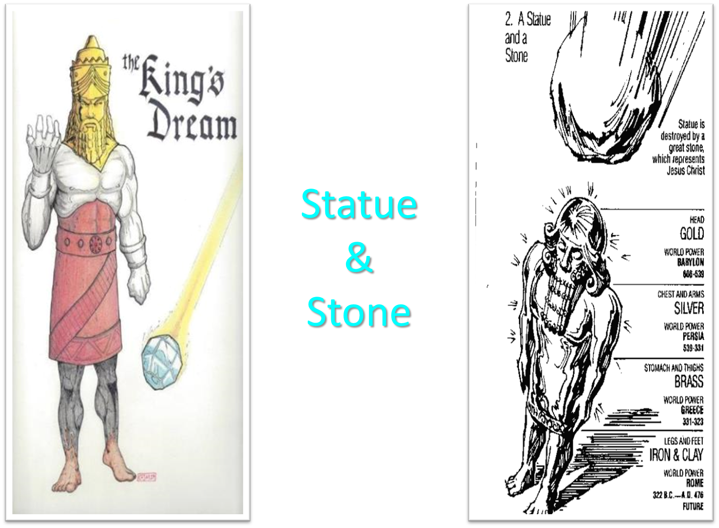

Slide 26
Acts 3:19-21
“¹⁹ Therefore repent and return, so that your sins may be wiped away, in order that times of refreshing may come from the presence of the Lord; ²⁰ and that He may send Jesus, the Christ appointed for you,²¹ whom heaven must receive until the period of restoration of all things about which God spoke by the mouth of His holy prophets from ancient time.”

Slide 27
Acts 3:19-21
“¹⁹ Therefore repent and return, so that your sins may be wiped away, in order that [hopōs] times [kairos] of refreshing may come [erchomai] from the presence of the Lord; ²⁰ and [kai] that He may send [apostellō] Jesus, the Christ appointed for you,²¹ whom heaven must receive until the period [chronos] of restoration of all things about which God spoke by the mouth of His holy prophets from ancient time.”

Slide 28
Acts 3:19-21
“¹⁹ Therefore repent and return, so that your sins may be wiped away, in order that [hopōs] times [kairos] of refreshing may come [erchomai] from the presence of the Lord; ²⁰ and [kai] that He may send [apostellō] Jesus, the Christ appointed for you,²¹ whom heaven must receive until the period [chronos] of restoration of all things about which God spoke by the mouth of His holy prophets from ancient time.”

Slide 29

Acts 3:19-21
Stanley D. Toussaint and Jay A. Quine, “No, Not Yet: The Contingency of God’s Promised Kingdom,” Bibliotheca Sacra 164 (April–June 2007): 138, 144.
“The two clauses that follow ὅπως go together. In other words the clause ‘that the times of refreshing may come from the presence of the Lord’ must be taken with the words ‘and that He may send Jesus.’ As Haenchen puts it, ‘The two promises are complementary statements about one and the same event.’ Nothing grammatically separates the promises; in fact they are joined together by the connective καὶ. The noun ἄναψύξεως, translated ‘refreshing,’ is a New Testament hapax legomenon. It is used in Greek literature in various forms to refer to ‘cooling by blowing, refreshing, relieving, resting.’ It occurs in the Septuagint only in Exodus (Eng., 8:15; lxx, v. 11), where it refers to relief from the plague of frogs.”

Slide 30
Acts 3:19-21
Stanley D. Toussaint and Jay A. Quine, “No, Not Yet: The Contingency of God’s Promised Kingdom,” Bibliotheca Sacra 164 (April–June 2007): 138, 141.
“Schweizer correctly observes, ‘The context makes sense only if the ‘times of refreshing’ are the definitive age of salvation. The expression is undoubtedly apocalyptic in origin. . . . The reference, then, is to the eschatological redemption which is promised to Israel if it repents.’ Furthermore, the plural καιροὶ, ‘times,’ in Acts 3:19, parallels the plural noun χρονῶν, ‘seasons’ or ‘times,’ in verse 21 (which is translated ‘period’ in the nasb). The two terms refer to the same era, and the plural forms simply emphasize duration. The context makes it clear that the synonyms refer to the future kingdom, with καιροὶ emphasizing the quality of time and χρονῶν emphasizing the duration of the time.”

Slide 31
Acts 3:19-21
John A. McLean, “Did Jesus Correct the Disciples’ View of the Kingdom?,” Bibliotheca Sacra 151, no. 602 (April–June 1994): 223–25.
“Bock argues for two separate time periods for these events in support of his ‘already, not yet’ view on the Davidic kingdom. He says the ‘periods of refreshing’ refer to the present time when sins can be wiped away through repentance, and that the ‘times of restoration of all things’ refers to the millennium. ‘Among the points in support of this distinction is that in the LXX translation by Symmachus, a reference to the descent of the Spirit in Isaiah 32:15 uses the term ἀνάψυξις (refreshment), a term related to the one in Acts 3:20.’ However, the context of Isaiah 32:15 refers to millennial blessings to national Israel, a fact that supports the single-stage restoration view, not a two-phase ‘already, not yet’ restoration. Walker suggests a …

Slide 32
Acts 3:19-21
John A. McLean, “Did Jesus Correct the Disciples’ View of the Kingdom?,” Bibliotheca Sacra 151, no. 602 (April–June 1994): 223–25.
… two-stage restoration in Acts 3:19–21. He, like Bock, maintains that the καιροὶ ἀναψύξεως (‘times of refreshing’) relates to special experiences of grace and blessing in this age, whereas the χρόνων ἀποκαταστάσεως (‘period of restoration’) in verse 21 refers to the climactic age of blessings for the nation of Israel in fulfillment of Old Testament messianic promises. . . . The main weakness in dividing these two events into separate time periods is that the text connects the events with a coordinating και (‘and’) in Acts 3:20. The syntactical structure coordinates the two verbs ἔλθωσιν (‘come,’ v. 19) and ἀποστείλῃ (‘send’) of the subordinate clause ὅπως ἂν in verse 20 with the two main verbs μετανοήσατε (‘repent’) and ἐπιστρέψατε ...

Slide 33
Acts 3:19-21
John A. McLean, “Did Jesus Correct the Disciples’ View of the Kingdom?,” Bibliotheca Sacra 151, no. 602 (April–June 1994): 223–25.
… (‘return’) in verse 19. Repentance and turning to God result in the coming of the times of refreshing and the sending of Jesus Christ at the restoration of all things God spoke about in the prophets. The sending of Jesus Christ will provide the personal presence that will result in the times of refreshing. These results are not events separated by time. They are mutual benefits that will come when the Father sends the Son so that believers may be refreshed in His presence. Conzelmann argues that ‘the parallelism between the two halves of the verse shows that the καιροὶ ἀναψύξεως, ‘times of refreshing,’ are not intervals of respite in the eschatological distress, but rather the final salvation (like the χρόνοι ἀποκαταστάσεως, . . .

Slide 34
Acts 3:19-21
John A. McLean, “Did Jesus Correct the Disciples’ View of the Kingdom?,” Bibliotheca Sacra 151, no. 602 (April–June 1994): 223–25.
…‘restoration’). The main weakness in dividing these two events into separate time periods is that the text connects the events with a coordinating και (‘and’) in Acts 3:20. The syntactical structure coordinates the two verbs ἔλθωσιν (‘come,’ v. 19) and ἀποστείλῃ (‘send’) of the subordinate clause ὅπως ἂν in verse 20 with the two main verbs μετανοήσατε (‘repent’) and ἐπιστρέψατε (‘return’) in verse 19. Repentance and turning to God result in the coming of the times of refreshing and the sending of Jesus Christ at the restoration of all things God spoke about in the prophets. The sending of Jesus Christ will provide the personal presence that will result in the times of refreshing. These results are not events separated by time. They…

Slide 35
Acts 3:19-21
John A. McLean, “Did Jesus Correct the Disciples’ View of the Kingdom?,” Bibliotheca Sacra 151, no. 602 (April–June 1994): 223–25.
… are mutual benefits that will come when the Father sends the Son so that believers may be refreshed in His presence. Conzelmann argues that ‘the parallelism between the two halves of the verse shows that the καιροὶ ἀναψύξεως, ‘times of refreshing,’ are not intervals of respite in the eschatological distress, but rather the final salvation (like the χρόνοι ἀποκαταστάσεως, ‘restoration’).”

Slide 36
Acts 3:19b-21
Results of Repentance
      Salvation (19b)
      Kingdom (19c)
      Second Advent (20)
      Termination of Present Session (21)

Slide 37


Slide 38
Acts 3:19b-21
Results of Repentance
      Salvation (19b)
      Kingdom (19c)
      Second Advent (20)
      Termination of Present Session (21)

Slide 39
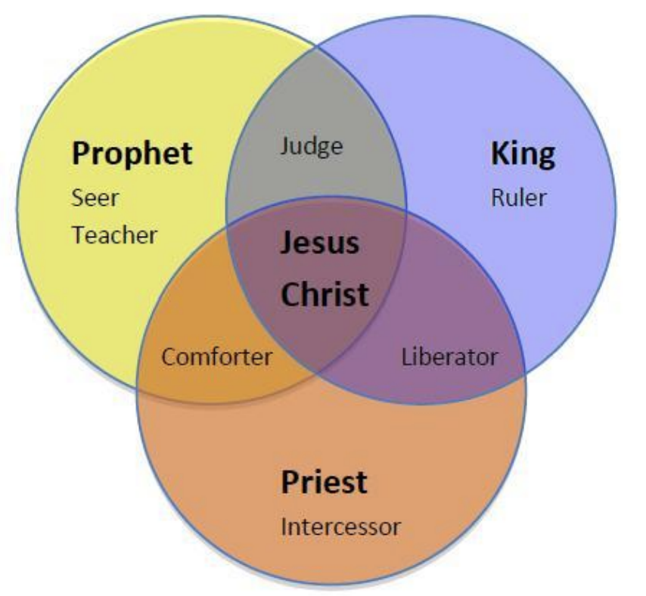
CHRIST’S THREE OFFICES
Prophet (First Coming)
Priest (Present Session)
King (Second Coming)

Slide 40

Isaiah 2:1-4
¹ “The word which Isaiah the son of Amoz saw concerning Judah and Jerusalem.² Now it will come about that In the last days The mountain of the house of the Lord Will be established as the chief of the mountains, And will be raised above the hills; And all the nations will stream to it.³ And many peoples will come and say, “Come, let us go up to the mountain of the Lord, To the house of the God of Jacob; . . .

Slide 41

Isaiah 2:1-4
. . .That He may teach us concerning His ways And that we may walk in His paths.” For the law will go forth from Zion And the word of the Lord from Jerusalem.⁴ And He will judge between the nations, And will render decisions for many peoples; And they will hammer their swords into plowshares and their spears into pruning hooks. Nation will not lift up sword against nation, And never again will they learn war.”

Slide 42
Isaiah 11:6-9
⁶ “And the wolf will dwell with the lamb, And the leopard will lie down with the young goat, And the calf and the young lion and the fatling together; And a little boy will lead them.⁷ Also the cow and the bear will graze, Their young will lie down together, And the lion will eat straw like the ox. ⁸ The nursing child will play by the hole of the cobra, And the weaned child will put his hand on the viper’s den. ⁹ They will not hurt or destroy in all My holy mountain, For the earth will be full of the knowledge of the Lord As the waters cover the sea.”

Slide 43
Isaiah 65:17-25
¹⁷ “For behold, I create new heavens and a new earth; And the former things will not be remembered or come to mind.¹⁸ “But be glad and rejoice forever in what I create; For behold, I create Jerusalem for rejoicing And her people for gladness.¹⁹ “I will also rejoice in Jerusalem and be glad in My people; And there will no longer be heard in her The voice of weeping and the sound of crying.²⁰ “No longer will there be in it an infant who lives but a few days, Or an old man who does not live out his days; For the youth will die at the age of one hundred And the one who does not . . .

Slide 44
Isaiah 65:17-25
...reach the age of one hundred Will be thought accursed.²¹ “They will build houses and inhabit them; They will also plant vineyards and eat their fruit.²² “They will not build and another inhabit, They will not plant and another eat; For as the lifetime of a tree, so will be the days of My people, And My chosen ones will wear out the work of their hands.²³ “They will not labor in vain, Or bear children for calamity; For they are the offspring of those blessed by the Lord, And their descendants…

Slide 45

Isaiah 65:17-25
…with them.²⁴ It will also come to pass that before they call, I will answer; and while they are still speaking, I will hear. ²⁵ The wolf and the lamb will graze together, and the lion will eat straw like the ox; and dust will be the serpent’s food. They will do no evil or harm in all My holy mountain,” says the Lord.

Slide 46
Acts 3:19-26
Israel’s Responsibility
      Necessity of Repentance (19a)
      Results of Repentance (19b-21)
      Present Fulfilled Prophecy (22-26)

Slide 47
Acts 3:22-26
Present Fulfilled Prophecy
      Deuteronomy 18:15 (22)
      Deuteronomy 18:19 (23)
      Prophets’ Summary (24)
      Blessing to the Gentiles (25)
      Application to Israel (26)

Slide 48
Acts 3:22-26
Present Fulfilled Prophecy
      Deuteronomy 18:15 (22)
      Deuteronomy 18:19 (23)
      Prophets’ Summary (24)
      Blessing to the Gentiles (25)
      Application to Israel (26)

Slide 49
Names for Jesus in Acts 3
Holy One (14a)
Righteous One (14b)
Prince of Life (15a)
“Christ” or “The Messiah” (18)
Prophet Like Moses (22-23)
Servant (26)

Slide 50
Acts 3:22-26
Present Fulfilled Prophecy
      Deuteronomy 18:15 (22)
      Deuteronomy 18:19 (23)
      Prophets’ Summary (24)
      Blessing to the Gentiles (25)
      Application to Israel (26)

Slide 51


Slide 52
Six Parts of a Suzerain-Vassal Treaty in Deuteronomy
Preamble (1:1-5)
Prologue (1:6–4:40)
Covenant obligations (5–26)
Storage and reading instructions (27:2-3; 31:9, 24, 26)
Witnesses (32:1)
Blessings and curses (28)

Slide 53
Six Parts of a Suzerain-Vassal Treaty in Deuteronomy
Preamble (1:1-5)
Prologue (1:6–4:40)
Covenant obligations (5–26)
Storage and reading instructions (27:2-3; 31:9, 24, 26)
Witnesses (32:1)
Blessings and curses (28)

Slide 54

Deuteronomy 28:49-50
⁴⁹ “The Lord will bring a nation against you from afar, from the end of the earth, as the eagle swoops down, a nation whose language you shall not understand, ⁵⁰ a nation of fierce countenance who will have no respect for the old, nor show favor to the young.”

Slide 55
ISRAEL'S JUDGMENTS
Division of the kingdom in 931 B.C. (1 Kgs. 12)
Assyrian judgment in 722 B.C. (2 Kgs. 17)
Babylonian captivity in 586 B.C. (2 Kgs. 25)
Rome Diaspora in A.D. 70 (Luke 19:41-44)

Slide 56
ISRAEL'S JUDGMENTS
Division of the kingdom in 931 B.C. (1 Kgs. 12)
Assyrian judgment in 722 B.C. (2 Kgs. 17)
Babylonian captivity in 586 B.C. (2 Kgs. 25)
Rome Diaspora in A.D. 70 (Luke 19:41-44)

Slide 57
Acts 3:22-26
Present Fulfilled Prophecy
      Deuteronomy 18:15 (22)
      Deuteronomy 18:19 (23)
      Prophets’ Summary (24)
      Blessing to the Gentiles (25)
      Application to Israel (26)

Slide 58
Luke 24:27, 44
“²⁷ Then beginning with Moses and with all the prophets, He explained to them the things concerning Himself in all the Scriptures…⁴⁴ Now He said to them, ‘These are My words which I spoke to you while I was still with you, that all things which are written about Me in the Law of Moses and the Prophets and the Psalms must be fulfilled.’”

Slide 59
Acts 3:22-26
Present Fulfilled Prophecy
      Deuteronomy 18:15 (22)
      Deuteronomy 18:19 (23)
      Prophets’ Summary (24)
      Blessing to the Gentiles (25)
      Application to Israel (26)

Slide 60
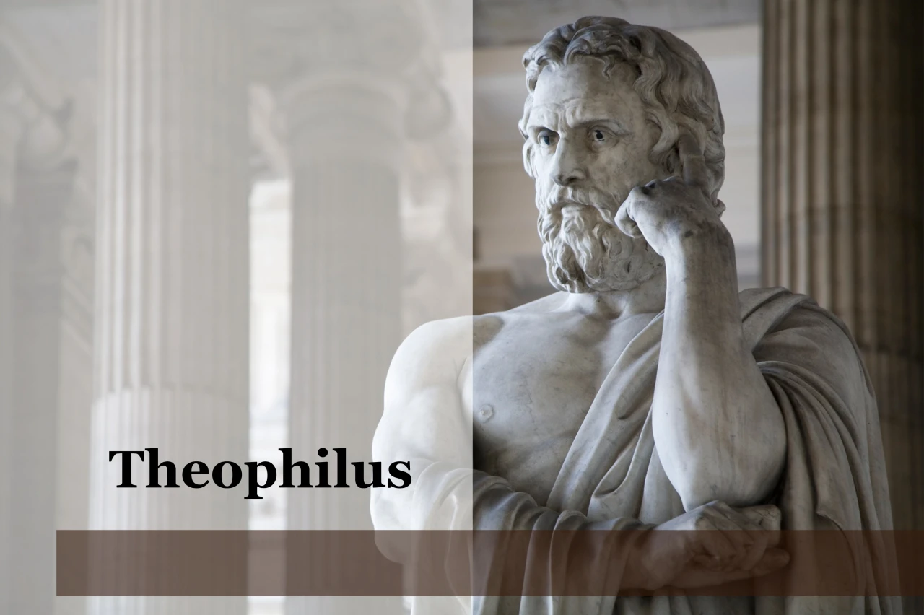
Purpose
  To present Theophilus with an orderly account of the birth and growth of the church so as to affirm him in what he has believed.

Slide 61

Message
  Birth and growth of the church numerically, geographically, ethnically.
  Components
  Numerically (progress reports)
  Geographically (From Jerusalem to Rome)
  Ethnically (From Judaism to Gentile domination)

Slide 62

8 New Promises
Genesis 12:1-3
    Land (Gen. 12:1b)
    Great nation (Gen. 12:2a)
    Personal blessing (Gen. 12:2b)
    Great name (Gen. 12:2c)
    Blessing to others (Gen. 12:2d)
    Blessing to blessers (Gen. 12:3a)
    Cursing to cursers (Gen. 12:3b)
    Blessing to the world (Gen. 12:3c)

Slide 63


Genesis 12:3
“And I will bless those who bless you, And the one who curses you I will curse. And in you all the families of the earth will be blessed.”

Slide 64
Acts 3:22-26
Present Fulfilled Prophecy
      Deuteronomy 18:15 (22)
      Deuteronomy 18:19 (23)
      Prophets’ Summary (24)
      Blessing to the Gentiles (25)
      Application to Israel (26)

Slide 65
Names for Jesus in Acts 3
Holy One (14a)
Righteous One (14b)
Prince of Life (15a)
“Christ” or “The Messiah” (18)
Prophet Like Moses (22-23)
Servant (26)

Slide 66
Messengers of the Kingdom In Matthew
John the Baptist – 3:2
Jesus Christ – 4:17
12 Apostles – 10:5-7
Seventy – Luke 10:1, 9
Toussaint, Behold the King, 18-20

Slide 67
Matthew 10:5-7
“These twelve Jesus sent out after instructing them: “Do not go in the way of the Gentiles, and do not enter any city of the Samaritans; ⁶ but rather go to the lost sheep of the house of Israel. ⁷ And as you go, preach, saying, ‘The kingdom of heaven is at hand.’”

Slide 68
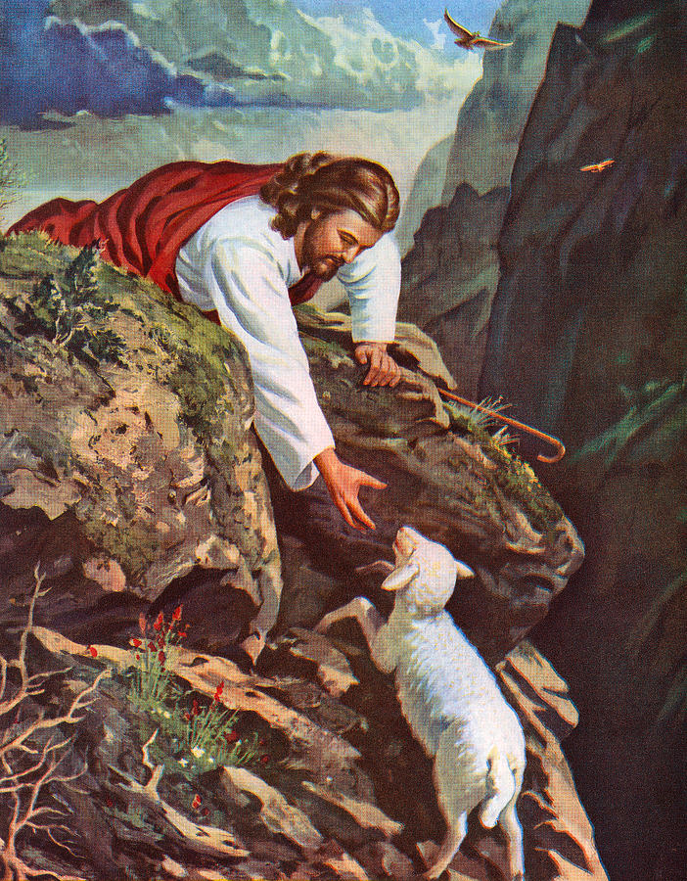
Matthew 15:24
“But He answered and said, ‘I was sent only to the lost sheep of the house of Israel.’”

Slide 69
Conclusion

Slide 70
Acts 3
Chapter Summary
  Miraculous Healing (1-11)
  Peter’s Second Sermon (12-26)

