Slide 1
Dr. Andy Woods
Senior Pastor – Sugar Land Bible Church
President – Chafer Theological Seminary

Slide 2
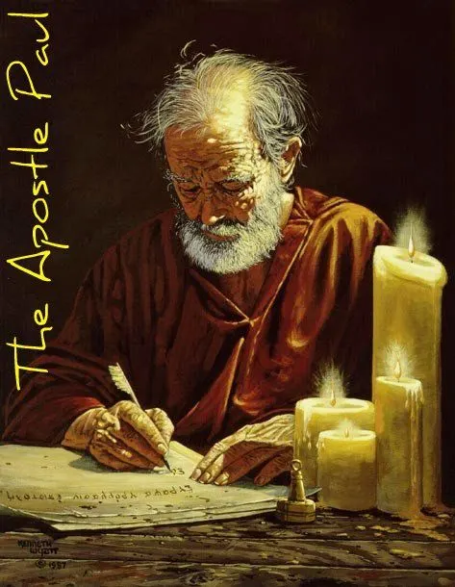
Structure
1 THESSALONIANS 1-3 | 1 THESSALONIANS 4-5
Personal Experience | Practical Exhortation
Looking Back | Looking Forward

Slide 3
Structure
Personal (1–3)
Genuine conversion (1)
Impure motives (2:1-16)
Lack of concern (2:17–3:13)
Practical (4–5)
Immorality (4:1-8)
Laziness (4:9-12)
Eschatology (4:13–5:11)
Ministry imbalances (5:12-15)
Progressive sanctification (5:16-28)

Slide 4
Structure
Personal (1–3)
Genuine conversion (1)
Impure motives (2:1-16)
Lack of concern (2:17–3:13)
Practical (4–5)
Immorality (4:1-8)
Laziness (4:9-12)
Eschatology (4:13–5:11)
Ministry imbalances (5:12-15)
Progressive sanctification (5:16-28)

Slide 5
Church Life
5:12-13 – Attitude toward leaders
5:14-15 – Ministry toward one another

Slide 6
Church Life
5:12-13 – Attitude toward leaders
5:14-15 – Ministry toward one another

Slide 7
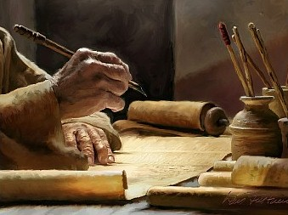
2 Timothy 3:16-17
“All Scripture is inspired by God [theopneustos] and profitable for teaching, for reproof, for correction, for training in righteousness; so that the man of God may be adequate, equipped for every good work.”

Slide 8
Church Life
5:12-13 – Attitude toward leaders
5:14-15 – Ministry toward one another

Slide 9
Structure
Personal (1–3)
Genuine conversion (1)
Impure motives (2:1-16)
Lack of concern (2:17–3:13)
Practical (4–5)
Immorality (4:1-8)
Laziness (4:9-12)
Eschatology (4:13–5:11)
Ministry imbalances (5:12-15)
Progressive sanctification (5:16-28)

Slide 10
Practical Sanctification (5:16-24)
Three positive commands (5:16-18)
Three negative commands (5:19-22)
Divine enablement (5:23-24)

Slide 11
Three Tenses of Salvation
Phase | Justification | Sanctification | Glorification
Tense | Past | Present | Future
Saved from sin’s: | Penalty | Power | Presence
Scripture | Eph 2:8-9; Titus 3:5 | Philip 2:12 | Rom 5:10

Slide 12
Practical Sanctification (5:16-24)
Three positive commands (5:16-18)
Three negative commands (5:19-22)
Divine enablement (5:23-24)

Slide 13
Three Positive Commands (5:16-18)
Rejoice always (5:16)
Pray without ceasing (5:17)
Give thanks in all things (5:18)

Slide 14
Three Positive Commands (5:16-18)
Rejoice always (5:16)
Pray without ceasing (5:17)
Give thanks in all things (5:18)

Slide 15
Three Positive Commands (5:16-18)
Rejoice always (5:16)
Pray without ceasing (5:17)
Give thanks in all things (5:18)

Slide 16
Three Positive Commands (5:16-18)
Rejoice always (5:16)
Pray without ceasing (5:17)
Give thanks in all things (5:18)

Slide 17
Practical Sanctification (5:16-24)
Three positive commands (5:16-18)
Three negative commands (5:19-22)
Divine enablement (5:23-24)

Slide 18
Three Negative Commands (5:19-22)
Do not quench the Spirit (5:19)
Do not despise prophetic utterances (5:20-21)
Abstain from evil (5:22)

Slide 19
Three Negative Commands (5:19-22)
Do not quench the Spirit (5:19)
Do not despise prophetic utterances (5:20-21)
Abstain from evil (5:22)

Slide 20
Three Negative Commands (5:19-22)
Do not quench the Spirit (5:19)
Do not despise prophetic utterances (5:20-21)
Abstain from evil (5:22)

Slide 21
2 Timothy 3:16-17
“¹⁶ All Scripture is inspired by God [theopneustos] and profitable for teaching, for reproof, for correction, for training in righteousness; ¹⁷ so that the man of God may be adequate, equipped for every good work.”

Slide 22
Jude 3
“Beloved, while I was making every effort to write you about our common salvation, I felt the necessity to write to you appealing that you contend earnestly for the faith that was once for all time handed down to the saints.”

Slide 23
Revelation 22:18-19
“I testify to everyone who hears the words of the prophecy of this book: if anyone adds to them, God will add to him the plagues which are written in this book; ¹⁹ and if anyone takes away from the words of the book of this prophecy, God will take away his part from the tree of life and from the holy city, which are written in this book.”

Slide 24
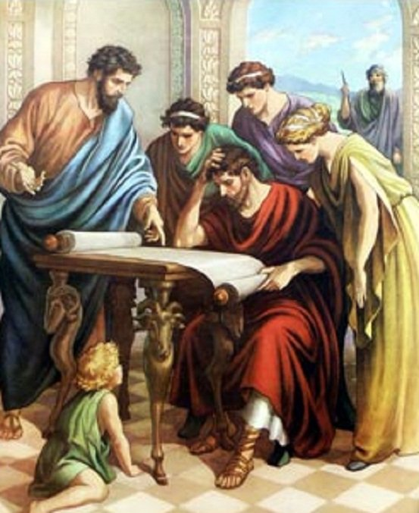
Acts 17:11
“Now these were more noble-minded than those in Thessalonica, for they received the word with great eagerness, examining the Scriptures daily to see whether these things were so.”

Slide 25
1 John 4:1
“Beloved, do not believe every spirit, but test the spirits to see whether they are from God, because many false prophets have gone out into the world.”

Slide 26
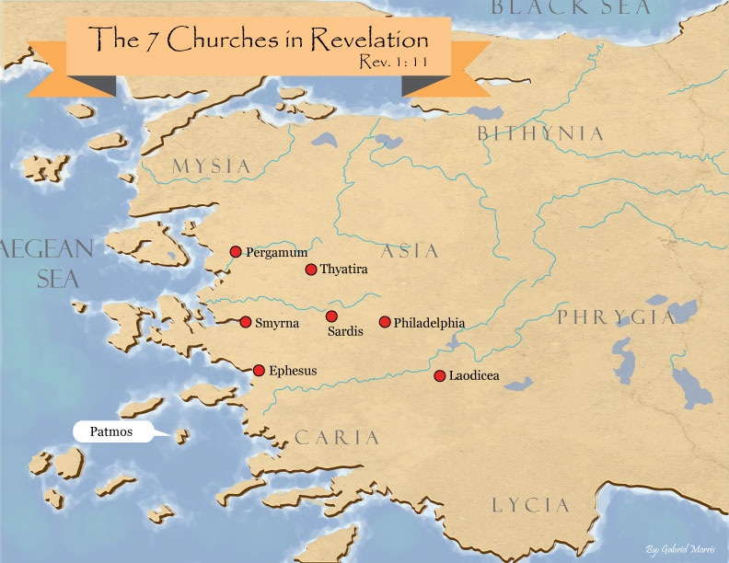

Slide 27
Three Negative Commands (5:19-22)
Do not quench the Spirit (5:19)
Do not despise prophetic utterances (5:20-21)
Abstain from evil (5:22)

Slide 28
Practical Sanctification (5:16-24)
Three positive commands (5:16-18)
Three negative commands (5:19-22)
Divine enablement (5:23-24)

Slide 29
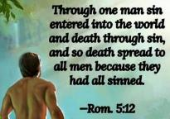
Genesis 2:16-17
“¹⁶ The Lord God commanded the man, saying, ‘From any tree of the garden you may eat freely; ¹⁷ but from the tree of the knowledge of good and evil you shall not eat, for in the day that you eat from it you will surely die (muwth).’”

Slide 31
Scripture’s Four Judgments
NAME | SHEEP AND GOAT | JUDGMENT OF THE JEWS | BEMA SEAT | GREAT WHITE THRONE
SCRIPTURE | Matt 25:31-46 | Ezek 20:33-44 | 1 Cor 3:10-15 | Rev 20:11-15
PLACE | Earth, Jerusalem | Earth, wilderness | Heaven | Earth
AUDIENCE | Gentile Tribulation survivors | Jewish Tribulation survivors | Church Age believers | All unsaved
WHEN | After Tribulation | After Tribulation | After rapture | After Millennium
PURPOSE | Saved Gentiles enter kingdom | Saved Jews enter kingdom | Reward believers | Degree of punishment in hell
EVALUATION | Treatment of Christ’s brethren | Passing under shepherd’s rod | Works taken through fire | Not in the book; judged by books

Slide 32
1 Corinthians 3:10-15
“¹⁰ According to the grace of God which was given to me, like a wise master builder I laid a foundation, and another is building on it. But each man must be careful how he builds on it. ¹¹ For no man can lay a foundation other than the one which is laid, which is Jesus Christ. ¹² Now if any man builds on the foundation with gold, silver, precious stones, wood, hay, straw. ¹⁴ If any man’s work which he …

Slide 33
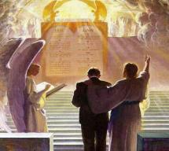
1 Corinthians 3:10-15
. . .has built on it remains, he will receive a reward. ¹⁵ If any man’s work is burned up, he will suffer loss; but he himself will be saved, yet so as through fire.”

Slide 34
Unique Characteristics
Every chapter ends with a reference to the Second Advent
Small amount of time in between planting of the church and the first letter to the church

Slide 36
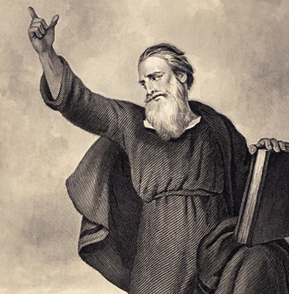
Conclusion (5:25-28)
Three personal requests (5:25-27)
Benediction (5:28)

Slide 37
Conclusion (5:25-28)
Three personal requests (5:25-27)
Benediction (5:28)

Slide 38
Three Personal Requests (5:25-27)
Prayer (5:25)
Greet the brethren (5:26)
Read the letter aloud (5:27)

Slide 39
Three Personal Requests (5:25-27)
Prayer (5:25)
Greet the brethren (5:26)
Read the letter aloud (5:27)

Slide 40
Three Personal Requests (5:25-27)
Prayer (5:25)
Greet the brethren (5:26)
Read the letter aloud (5:27)

Slide 41
Three Personal Requests (5:25-27)
Prayer (5:25)
Greet the brethren (5:26)
Read the letter aloud (5:27)

Slide 42
1 Timothy 4:13
“Until I come, give your attention to the public reading, to exhortation, and teaching.”

Slide 43
2 Timothy 3:16-17
“¹⁶ All Scripture is inspired by God [theopneustos] and profitable for teaching, for reproof, for correction, for training in righteousness; ¹⁷ so that the man of God may be adequate, equipped for every good work.”

Slide 44
Emphasis of 2 Timothy
“By my count, there are twenty-seven explicit commands given in the body of this letter. In 27 words Paul tells pastors what to focus on. You have to be blind to miss the thrust of Paul's instructions here, because eighteen of those commands--fully two-thirds--have to do with the ministry of the Word.”
Daniel Wallace, “Crisis of the Word: A Message to Pastors or Would-be Pastors,”
Conservative Theological Journal 1, no. 2 (August 1997): 108.

Slide 45
Conclusion (5:25-28)
Three personal requests (5:25-27)
Benediction (5:28)

Slide 46
Conclusion

Slide 47
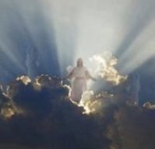
Message
Continued growth in faith, hope, and love in view of the Lord’s imminent return

Slide 48
Structure
Personal (1–3)
Genuine conversion (1)
Impure motives (2:1-16)
Lack of concern (2:17–3:13)
Practical (4–5)
Immorality (4:1-8)
Laziness (4:9-12)
Eschatology (4:13–5:11)
Ministry imbalances (5:12-15)
Progressive sanctification (5:16-28)

