Slide 1
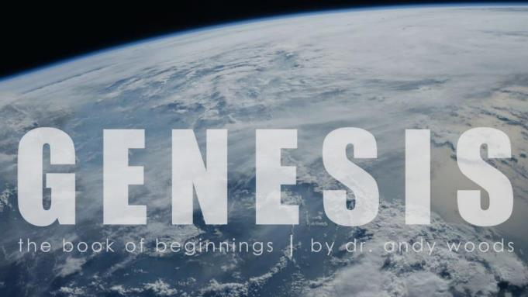
Genesis 12‒50
Israel’s Birth & Preservation

Slide 2
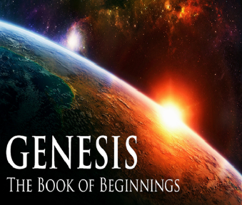
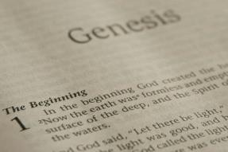
GENESIS STRUCTURE
Genesis 12-50 (four people)
Abraham (12:1–25:11)
Isaac (25:12–26:35)
Jacob (27–36)
Joseph (37–50)

Slide 3
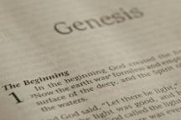
Beginning Themes
Universe Life Man Marriage Evil Clothing | Religion Salvation Language Government Nations Israel
Morris, Genesis Record, 18-20

Slide 4
Distinctions Between 144,000 & Multitude
144,000 | MULTITUDE
Revelation 7:1-8 | Revelation 7:9-17
Numbered | Innumerable
Jews | All nations
Sealed | Slain
Sealed before the Tribulation | Converted out of the Tribulation
Hitchcock and Ice, The Truth Behind Left Behind, 77

Slide 6
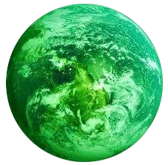
Jerusalem Descending
Notes:
The descending city is described as being like a stone called Jasper, only unlike the earthly stone, this one is clear as crystal. The ultimate state of heaven sounds more like a diamond, doesn’t it?

Slide 7
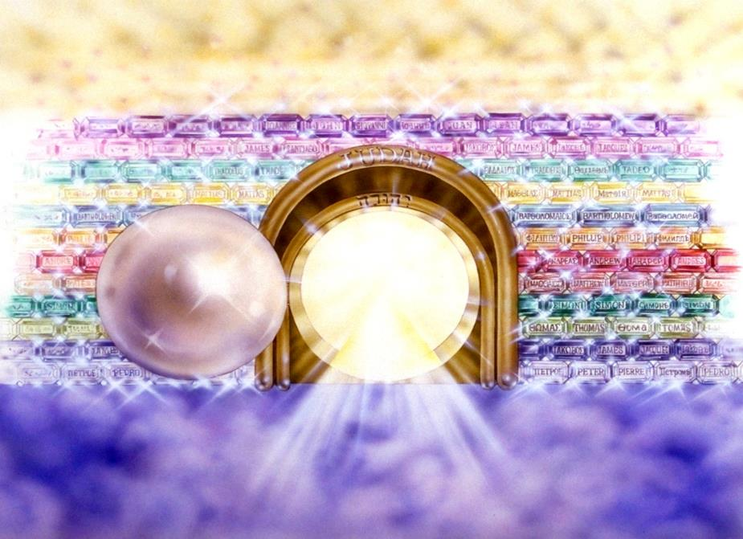
Notes:
Here you see an artist’s ideas of…
12 Gates = 12 Tribes of Israel
12 Foundation Stones = 12 Apostles of the Church

Slide 8
Genesis 29:31‒30:24 Jacob’s Dozen
Leah’s 4 sons (29:31-35)
Bilhah’s 2 sons (30:1-8)
Zilpah’s 2 sons (30:9-13)
Leah’s 2 sons & daughter (30:14-21)
Rachel’s first son (30:22-24)

Slide 9
Genesis 29:31‒30:24 Jacob’s Dozen
Leah’s 4 sons (29:31-35)
Bilhah’s 2 sons (30:1-8)
Zilpah’s 2 sons (30:9-13)
Leah’s 2 sons & daughter (30:14-21)
Rachel’s first son (30:22-24)

Slide 10
Genesis 29:32-35a Leah’s Four Sons
Reuben’s birth (32)
Simeon’s birth (33)
Levi’s birth (34)
Judah’s birth (35a)

Slide 11
Genesis 29:31‒30:24 Jacob’s Dozen
Leah’s 4 sons (29:31-35)
Bilhah’s 2 sons (30:1-8)
Zilpah’s 2 sons (30:9-13)
Leah’s 2 sons & daughter (30:14-21)
Rachel’s first son (30:22-24)

Slide 12
II. Genesis 30:1-8 Bilhah’s 2 Sons
Rachael’s complaint (1)
Jacob’s response (2)
Rachel’s offer (3)
Consummation (4)
Conception (5)
Name: Dan (6)
Second conception (7)
Name: Naphtali (8)

Slide 13
II. Genesis 30:1-8 Bilhah’s 2 Sons
Rachael’s complaint (1)
Jacob’s response (2)
Rachel’s offer (3)
Consummation (4)
Conception (5)
Name: Dan (6)
Second conception (7)
Name: Naphtali (8)

Slide 14
II. Genesis 30:1-8 Bilhah’s 2 Sons
Rachael’s complaint (1)
Jacob’s response (2)
Rachel’s offer (3)
Consummation (4)
Conception (5)
Name: Dan (6)
Second conception (7)
Name: Naphtali (8)

Slide 15
II. Genesis 30:1-8 Bilhah’s 2 Sons
Rachael’s complaint (1)
Jacob’s response (2)
Rachel’s offer (3)
Consummation (4)
Conception (5)
Name: Dan (6)
Second conception (7)
Name: Naphtali (8)

Slide 16
Genesis 12‒25 Abraham’s Early Journeys
Unconditional promises (Gen. 12:1-3) From Haran to Canaan (Gen. 12:4-5) In Canaan (Gen. 12:6-9) In Egypt (Gen. 12:10-20) Abram and Lot Separate (Gen. 13:1-13) Reaffirmation of Abram’s promises (Gen. 13:14-18) Abram Rescues Lot (14:1-24) Abrahamic Covenant (15:1-21) Hagar & Ishmael (16:1-16) Circumcision (Gen. 17:1-27) | Sodom & Gomorrah (Gen. 18‒19) Abraham & Abimelech (Gen. 20) Isaac’s birth (Gen. 21:1-7) Ishmael’s expulsion (21:8-21) Abraham & Abimelech’s covenant (21:22-34) Abraham sacrifices Isaac (22) Sarah’s death (23) Isaac’s marriage (24) Abraham & Keturah (25:1-6) Abraham’s death (25:7-11)

Slide 17
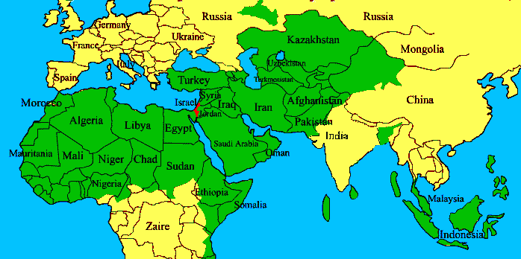
ISRAEL

Slide 18
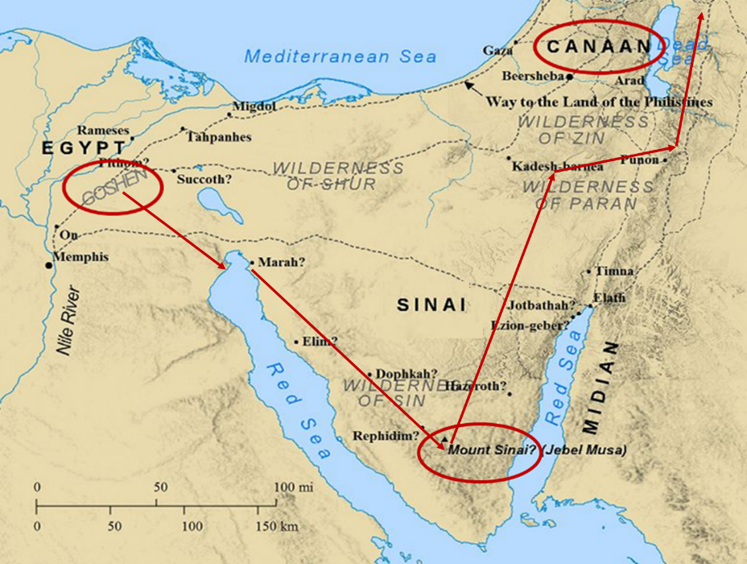

Slide 19
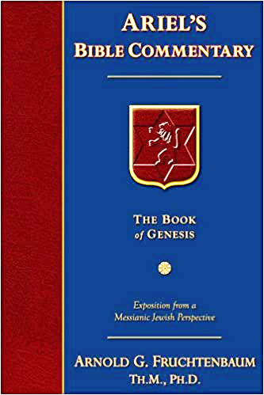
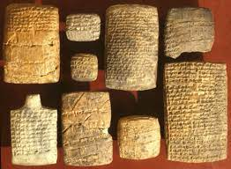
Dr. Arnold G. Fruchtenbaum
The Book of Genesis, 449
“So in 30:3–4, Rachel’s despair led to her offer of Bilhah to Jacob, with verse 3 describing the offer: Behold, my maid Bilhah, go in unto her; that she might bear upon my knees, meaning Rachel would be the legal mother. This was in keeping with Code of Hammurabi, and for that reason, it was Rachel, not Bilhah, who named the children. Because Bilhah was the handmaid of Rachel, Rachel would be the legal mother: and I also may obtain children by her; literally, ‘I may be builded by her.’”

Slide 20
II. Genesis 30:1-8 Bilhah’s 2 Sons
Rachael’s complaint (1)
Jacob’s response (2)
Rachel’s offer (3)
Consummation (4)
Conception (5)
Name: Dan (6)
Second conception (7)
Name: Naphtali (8)

Slide 21
II. Genesis 30:1-8 Bilhah’s 2 Sons
Rachael’s complaint (1)
Jacob’s response (2)
Rachel’s offer (3)
Consummation (4)
Conception (5)
Name: Dan (6)
Second conception (7)
Name: Naphtali (8)

Slide 22
II. Genesis 30:1-8 Bilhah’s 2 Sons
Rachael’s complaint (1)
Jacob’s response (2)
Rachel’s offer (3)
Consummation (4)
Conception (5)
Name: Dan (6)
Second conception (7)
Name: Naphtali (8)

Slide 23
Distinctions Between 144,000 & Multitude
144,000 | MULTITUDE
Revelation 7:1-8 | Revelation 7:9-17
Numbered | Innumerable
Jews | All nations
Sealed | Slain
Sealed before the Tribulation | Converted out of the Tribulation
Hitchcock and Ice, The Truth Behind Left Behind, 77

Slide 24
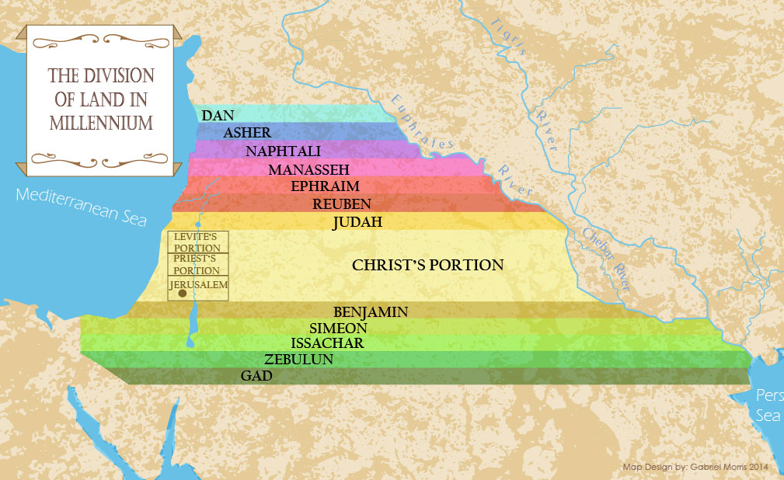

Slide 25
II. Genesis 30:1-8 Bilhah’s 2 Sons
Rachael’s complaint (1)
Jacob’s response (2)
Rachel’s offer (3)
Consummation (4)
Conception (5)
Name: Dan (6)
Second conception (7)
Name: Naphtali (8)

Slide 26
II. Genesis 30:1-8 Bilhah’s 2 Sons
Rachael’s complaint (1)
Jacob’s response (2)
Rachel’s offer (3)
Consummation (4)
Conception (5)
Name: Dan (6)
Second conception (7)
Name: Naphtali (8)

Slide 27
Genesis 29:31‒30:24 Jacob’s Dozen
Leah’s 4 sons (29:31-35)
Bilhah’s 2 sons (30:1-8)
Zilpah’s 2 sons (30:9-13)
Leah’s 2 sons & daughter (30:14-21)
Rachel’s first son (30:22-24)

Slide 28
III. Genesis 30:9-13 Zilpah’s 2 Sons
Leah’s offer (9)
Birth (10)
Name: Gad (11)
Second birth (12)
Name: Asher (13)

Slide 29
III. Genesis 30:9-13 Zilpah’s 2 Sons
Leah’s offer (9)
Birth (10)
Name: Gad (11)
Second birth (12)
Name: Asher (13)

Slide 31
III. Genesis 30:9-13 Zilpah’s 2 Sons
Leah’s offer (9)
Birth (10)
Name: Gad (11)
Second birth (12)
Name: Asher (13)

Slide 32
III. Genesis 30:9-13 Zilpah’s 2 Sons
Leah’s offer (9)
Birth (10)
Name: Gad (11)
Second birth (12)
Name: Asher (13)

Slide 33
III. Genesis 30:9-13 Zilpah’s 2 Sons
Leah’s offer (9)
Birth (10)
Name: Gad (11)
Second birth (12)
Name: Asher (13)

Slide 34
III. Genesis 30:9-13 Zilpah’s 2 Sons
Leah’s offer (9)
Birth (10)
Name: Gad (11)
Second birth (12)
Name: Asher (13)

Slide 35
Genesis 29:31‒30:24 Jacob’s Dozen
Leah’s 4 sons (29:31-35)
Bilhah’s 2 sons (30:1-8)
Zilpah’s 2 sons (30:9-13)
Leah’s 2 sons & daughter (30:14-21)
Rachel’s first son (30:22-24)

Slide 36
IV. Genesis 30:14-21 Leah’s Additional 2 Sons & Daughter
Mandrakes (14-15)
Consummation (16)
Leah’s fifth son (17)
Name: Issachar (18)
Leah’s sixth son (19)
Name: Zebulun (20)
Leah’s daughter: Dina (21)

Slide 37
IV. Genesis 30:14-21 Leah’s Additional 2 Sons & Daughter
Mandrakes (14-15)
Consummation (16)
Leah’s fifth son (17)
Name: Issachar (18)
Leah’s sixth son (19)
Name: Zebulun (20)
Leah’s daughter: Dina (21)

Slide 38
Dr. Arnold G. Fruchtenbaum
The Book of Genesis, 451
“Leah again begins to bear children, with verses 14–16 giving the background concerning the mandrakes. Verse 14a records Reuben’s gift. The timing was: Reuben went out in the days of wheat harvest, which would make it around the months of May and June. The result was: and found mandrakes in the field. In Hebrew, the word for mandrakes is dudaim, literally meaning ‘love apples.’ These are berries that have white and reddish blossoms and a yellow fruit similar to small apples. It is mentioned in Song of Solomon 7:13 and was considered an aphrodisiac; and, therefore, the Hebrew root is the same as the Hebrew word for ‘lover.’…based on it being a sexual stimulant.”

Slide 39
IV. Genesis 30:14-21 Leah’s Additional 2 Sons & Daughter
Mandrakes (14-15)
Consummation (16)
Leah’s fifth son (17)
Name: Issachar (18)
Leah’s sixth son (19)
Name: Zebulun (20)
Leah’s daughter: Dina (21)

Slide 40
IV. Genesis 30:14-21 Leah’s Additional 2 Sons & Daughter
Mandrakes (14-15)
Consummation (16)
Leah’s fifth son (17)
Name: Issachar (18)
Leah’s sixth son (19)
Name: Zebulun (20)
Leah’s daughter: Dina (21)

Slide 41
IV. Genesis 30:14-21 Leah’s Additional 2 Sons & Daughter
Mandrakes (14-15)
Consummation (16)
Leah’s fifth son (17)
Name: Issachar (18)
Leah’s sixth son (19)
Name: Zebulun (20)
Leah’s daughter: Dina (21)

Slide 42
IV. Genesis 30:14-21 Leah’s Additional 2 Sons & Daughter
Mandrakes (14-15)
Consummation (16)
Leah’s fifth son (17)
Name: Issachar (18)
Leah’s sixth son (19)
Name: Zebulun (20)
Leah’s daughter: Dina (21)

Slide 43
IV. Genesis 30:14-21 Leah’s Additional 2 Sons & Daughter
Mandrakes (14-15)
Consummation (16)
Leah’s fifth son (17)
Name: Issachar (18)
Leah’s sixth son (19)
Name: Zebulun (20)
Leah’s daughter: Dina (21)

Slide 44
IV. Genesis 30:14-21 Leah’s Additional 2 Sons & Daughter
Mandrakes (14-15)
Consummation (16)
Leah’s fifth son (17)
Name: Issachar (18)
Leah’s sixth son (19)
Name: Zebulun (20)
Leah’s daughter: Dina (21)

Slide 45
Genesis 29:31‒30:24 Jacob’s Dozen
Leah’s 4 sons (29:31-35)
Bilhah’s 2 sons (30:1-8)
Zilpah’s 2 sons (30:9-13)
Leah’s 2 sons & daughter (30:14-21)
Rachel’s first son (30:22-24)

Slide 46
V. Genesis 30:22-24 Rachel’s First Son
God’s providence (22)
Rachel’s first natural son (23a)
Name: Joseph (23b-24)

Slide 47
V. Genesis 30:22-24 Rachel’s First Son
God’s providence (22)
Rachel’s first natural son (23a)
Name: Joseph (23b-24)

Slide 48
Dr. Arnold G. Fruchtenbaum
The Book of Genesis, 175
“The turning point begins with the remembrance of God in verse 1a: And God remembered Noah, and all the beasts, and all the cattle that were with him in the ark. The word remember does not mean remember in the sense that God temporarily forgot about the ark and its inhabitants; rather it means remembering in the sense of movement toward the object. For example, in Genesis 19:29, God remembered Abraham with a view to saving Lot; in Exodus 2:24, God remembered His covenant with the Patriarchs with a view to rescuing Israel; in Jeremiah 2:2, God remembered Israel with a view toward her restoration; in Jeremiah 31:20, God remembered . . .

Slide 49
Dr. Arnold G. Fruchtenbaum
The Book of Genesis, 175
“… Ephraim with a view toward extending mercy to him; and in Luke 1:54–55, God remembered Israel with a view toward sending the Messiah to Israel. Furthermore, the sense was that of God remembering a covenant; although in this case the covenant itself had not yet been made. He said earlier in chapter 6, that He would establish His covenant with Noah. Furthermore, in 7:4 God remembered that the rain would only last forty days. All these usages fit into the word ‘remember.’”

Slide 50
V. Genesis 30:22-24 Rachel’s First Son
God’s providence (22)
Rachel’s first natural son (23a)
Name: Joseph (23b-24)

Slide 51
V. Genesis 30:22-24 Rachel’s First Son
God’s providence (22)
Rachel’s first natural son (23a)
Name: Joseph (23b-24)

Slide 52
GENESIS STRUCTURE
Genesis 12-50 (four people)
Abraham (12:1–25:11)
Isaac (25:12–26:35)
Jacob (27–36)
Joseph (37–50)

Slide 55
Conclusion

Slide 56
Genesis 29:31‒30:24 Jacob’s Dozen
Leah’s 4 sons (29:31-35)
Bilhah’s 2 sons (30:1-8)
Zilpah’s 2 sons (30:9-13)
Leah’s 2 sons & daughter (30:14-21)
Rachel’s first son (30:22-24)

Slide 57
²⁴ The Lord bless you, and keep you; ²⁵ The Lord make His face shine on you, And be gracious to you; ²⁶ The Lord lift up His countenance on you, And give you peace.
Numbers 6:24–26 (NASB95)

