Slide 1
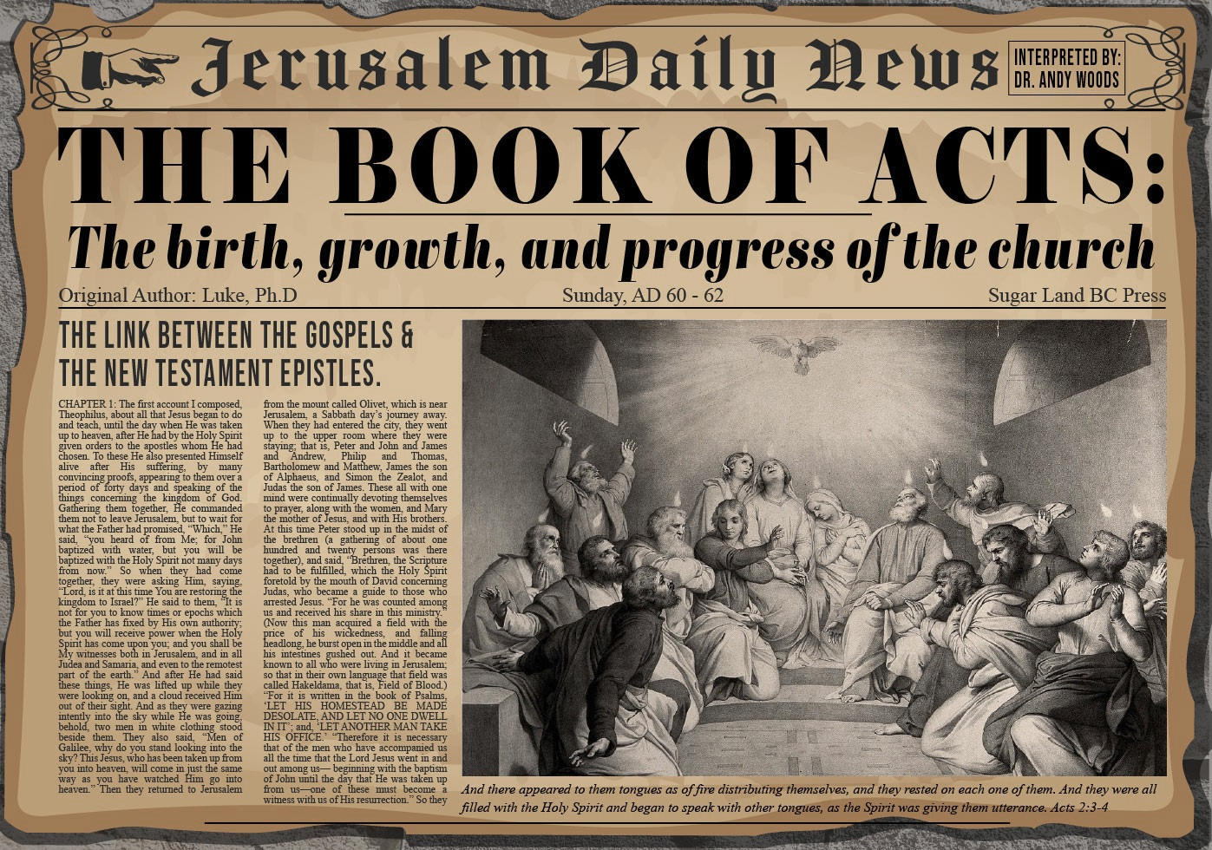


Slide 2
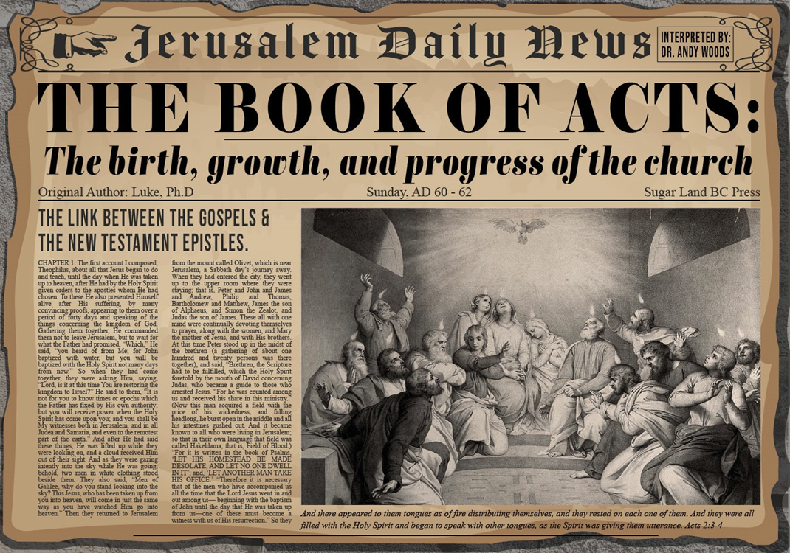
Acts 3
Chapter Summary
  Miraculous Healing (1-11)
  Peter’s Second Sermon (12-26)

Slide 3
Acts 3
Chapter Summary
  Miraculous Healing (1-11)
  Peter’s Second Sermon (12-26)

Slide 4
Miraculous Healing
Acts 3:1-11
  Occasion of the Miracle (1)
  Encounter with the Lame Man (2-3)
  Healing of the Lame Man (4-7)
  Three Results of the Miracle (8-11)

Slide 5
Miraculous Healing
Acts 3:1-11
  Occasion of the Miracle (1)
  Encounter with the Lame Man (2-3)
  Healing of the Lame Man (4-7)
  Three Results of the Miracle (8-11)

Slide 6
ISRAEL’S FOUR TEMPLES
Solomon’s pre-exilic temple (Kings and Chronicles)
Zerubbabel’s post exilic temple (Ezra 1-6; John 2:20)
Antichrist's temple (Dan. 9:27; Matt. 24:15; 2 Thess. 2:4; Rev. 11:1-2)
Millennial temple (Ezek. 40-48)

Slide 7


Dr. Arnold G. Fruchtenbaum
The Book of Acts, 89
“The occasion for the events of Acts 3 and 4 is given in verse 1: Now Peter and John were going up into the temple at the hour of prayer, being the ninth hour. These two Jewish believers in the Messiahship of Yeshua, Peter and John, did not see a contradiction in attending the Temple service. The verb in the Greek text is in the imperfect tense, emphasizing continuous action in the past and reaching into the present. It was a habitual practice for Peter and John to go to the Temple to pray.”

Slide 8
Miraculous Healing
Acts 3:1-11
  Occasion of the Miracle (1)
  Encounter with the Lame Man (2-3)
  Healing of the Lame Man (4-7)
  Three Results of the Miracle (8-11)

Slide 9
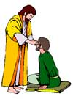
“SEVEN SIGNS” in Gospel of John
1. Changing Water into Wine | 2:11
2. Healing official’s son | 4:46-54
3. Healing an invalid at the Pool of Bethesda | 5:1-18
4. Feeding the 5,000 | 6:5-14
5. Walking on water | 6:16-21
6. Healing a blind man | 9:1-7
7. Raising dead Lazarus | 11:1-45

Slide 10
Peter’s Sermon
Acts 2:14-36
  Introduction (14)
  Refutation of Drunkenness Charge (15-35)
  Conclusion (36)

Slide 11
Miraculous Healing
Acts 3:1-11
  Occasion of the Miracle (1)
  Encounter with the Lame Man (2-3)
  Healing of the Lame Man (4-7)
  Three Results of the Miracle (8-11)

Slide 12
Dr. Arnold G. Fruchtenbaum
The Book of Acts, 91
“There is a legend that has circulated for years about a discussion between Pope Innocent II and Thomas Aquinas. While counting a large sum of money, the Pope said, “You see, Thomas, the church can no longer say, ‘Silver and gold have I none.’” Thomas answered, “That is true, Holy Father, but neither can she still say, ‘Arise and walk.’”

Slide 13
Miraculous Healing
Acts 3:1-11
  Occasion of the Miracle (1)
  Encounter with the Lame Man (2-3)
  Healing of the Lame Man (4-7)
  Three Results of the Miracle (8-11)

Slide 14
Acts 3:8-11
Three Results of the Miracle
      Beggar (8)
      Reaction of the People (9-10)
      Gathering of the People (11)

Slide 15
Acts 3:8-11
Three Results of the Miracle
      Beggar (8)
      Reaction of the People (9-10)
      Gathering of the People (11)

Slide 16
Acts 3:8-11
Three Results of the Miracle
      Beggar (8)
      Reaction of the People (9-10)
      Gathering of the People (11)

Slide 17
Acts 3:8-11
Three Results of the Miracle
      Beggar (8)
      Reaction of the People (9-10)
      Gathering of the People (11)

Slide 18
Dr. Arnold G. Fruchtenbaum
The Book of Acts, 91-92
“When the people saw this, they recognized who he was and began running together to a place known as Solomon’s Porch, which was located at the eastern end of the Court of the Gentiles. It was called Solomon’s Porch because it was built on the remains of the ancient foundation of the Solomonic Temple.”

Slide 19


Slide 20
Acts 3
Chapter Summary
  Miraculous Healing (1-11)
  Peter’s Second Sermon (12-26)

Slide 21
Peter’s Second Sermon
Acts 3:12-26
  Israel’s Rejection of her Messiah (12-18)
  Israel’s Responsibility (19-26)

Slide 22
Peter’s Second Sermon
Acts 3:12-26
  Israel’s Rejection of her Messiah (12-18)
  Israel’s Responsibility (19-26)

Slide 23
Acts 3:12-18
Israel’s Rejection of Her Messiah
      Occasion (12)
      Rejection (13-15)
      Jesus Responsible for the Healing (16)
      Conclusion (17-18)

Slide 24
Acts 3:12-18
Israel’s Rejection of Her Messiah
      Occasion (12)
      Rejection (13-15)
      Jesus Responsible for the Healing (16)
      Conclusion (17-18)

Slide 25
Acts 3:12-18
Israel’s Rejection of Her Messiah
      Occasion (12)
      Rejection (13-15)
      Jesus Responsible for the Healing (16)
      Conclusion (17-18)

Slide 26
Acts 3:13-15
Israel’s Rejection of Her Messiah
      God sent His Son (13a)
      Delivered to Pilate (13b)
      Rejection of the Holy & Righteous One (14)
      Killed the Prince of Life (15a)
      Messiah was Resurrected (15b)

Slide 27
Acts 3:13-15
Israel’s Rejection of Her Messiah
      God sent His Son (13a)
      Delivered to Pilate (13b)
      Rejection of the Holy & Righteous One (14)
      Killed the Prince of Life (15a)
      Messiah was Resurrected (15b)

Slide 28
Acts 3:13-15
Israel’s Rejection of Her Messiah
      God sent His Son (13a)
      Delivered to Pilate (13b)
      Rejection of the Holy & Righteous One (14)
      Killed the Prince of Life (15a)
      Messiah was Resurrected (15b)

Slide 29

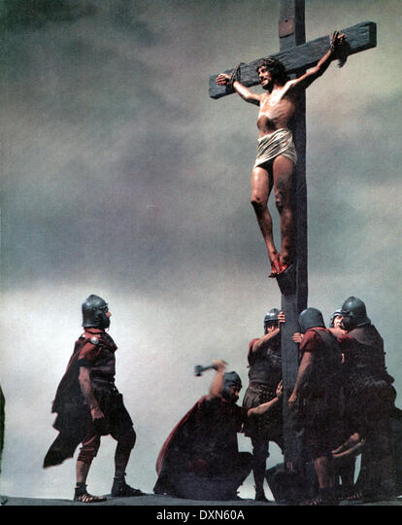
Acts 2:23
“this Man, delivered over by the predetermined plan and foreknowledge of God, you nailed to a cross by the hands of godless men and put Him to death.”

Slide 30
Acts 3:13-15
Israel’s Rejection of Her Messiah
      God sent His Son (13a)
      Delivered to Pilate (13b)
      Rejection of the Holy & Righteous One (14)
      Killed the Prince of Life (15a)
      Messiah was Resurrected (15b)

Slide 31
Names for Jesus in Acts 3
Holy One (14a)
Righteous One (14b)
Prince of Life (15a)
“Christ” or “The Messiah” (18)
Prophet Like Moses (22-23)
Servant (26)

Slide 32
Names for Jesus in Acts 3
Holy One (14a)
Righteous One (14b)
Prince of Life (15a)
“Christ” or “The Messiah” (18)
Prophet Like Moses (22-23)
Servant (26)

Slide 33
Names for Jesus in Acts 3
Holy One (14a)
Righteous One (14b)
Prince of Life (15a)
“Christ” or “The Messiah” (18)
Prophet Like Moses (22-23)
Servant (26)

Slide 34
Acts 3:13-15
Israel’s Rejection of Her Messiah
      God sent His Son (13a)
      Delivered to Pilate (13b)
      Rejection of the Holy & Righteous One (14)
      Killed the Prince of Life (15a)
      Messiah was Resurrected (15b)

Slide 35
Names for Jesus in Acts 3
Holy One (14a)
Righteous One (14b)
Prince of Life (15a)
“Christ” or “The Messiah” (18)
Prophet Like Moses (22-23)
Servant (26)

Slide 36
Daniel 9:26
“Then after the sixty-two weeks the Messiah will be cut off and have nothing, and the people of the prince who is to come will destroy the city and the sanctuary. And its end will come with a flood; even to the end there will be war; desolations are determined.”

Slide 37
Dr. Arnold G. Fruchtenbaum
Arnold G. Fruchtenbaum, Israelology: The Missing Link in Systematic Theology, rev. ed. (Tustin, CA: Ariel, 1994), 190.
“The problem Amillennialism faces is that while the Bible portrays the relationship between Christ and the Church in various metaphors (head and body, groom and bride, vine and branches, foundation and stones of the building, etc.), king and kingdom is not one of them. . . . Christ is indeed referred to as the head of the Church, but never its king.”

Slide 38
Acts 3:13-15
Israel’s Rejection of Her Messiah
      God sent His Son (13a)
      Delivered to Pilate (13b)
      Rejection of the Holy & Righteous One (14)
      Killed the Prince of Life (15a)
      Messiah was Resurrected (15b)

Slide 39
Acts 2:15-35
Refutation of the Charge of Drunkenness
      Too early (15)
      Use of Joel 2:28-32 (16-21)
      Christ’s miracles (22)
      Crucifixion (23)
      Resurrection (24)
      Use of Psalm 16:8-11 (25-29)
      Use of Psalm 132:11 (30-32)
      High priestly ministry (33)
      Use of Psalm 110:1 (34-35)

Slide 40
Christ's Resurrection Attested to by Eyewitnesses
(1 Corinthians 15:5-11)
Cephas (5a)
The twelve (5b)
The five hundred (6)
James (7a)
The rest of the apostles (7b)
Paul (8-11)

Slide 41
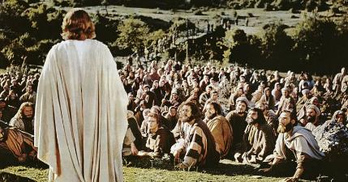
1 Corinthians 15:6-7
“⁶ After that He appeared to more than five hundred brethren at one time, most of whom remain until now, but some have fallen asleep; ⁷ then He appeared to James, then to all the apostles…”

Slide 42
Acts 3:12-18
Israel’s Rejection of Her Messiah
      Occasion (12)
      Rejection (13-15)
      Jesus Responsible for the Healing (16)
      Conclusion (17-18)

Slide 43
Peter’s Sermon
Acts 2:14-36
  Introduction (14)
  Refutation of Drunkenness Charge (15-35)
  Conclusion (36)

Slide 44
Acts 2:22
“Men of Israel, listen to these words: Jesus the Nazarene, a man attested to you by God with miracles and wonders and signs which God performed through Him in your midst, just as you yourselves know.”

Slide 45
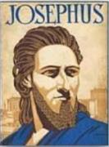
Josephus
Antiquities 18.3.3
“About this time there lived Jesus, a wise man, if indeed one ought to call him a man. For he was one who performed surprising deeds and was a teacher of such people as accept the truth gladly. He won over many Jews and many of the Greeks. He was the Christ. And when, upon the accusation of the principal men among us, Pilate had condemned him to a cross, those who had first come to love him did not cease. He appeared to them spending a third day restored to life, for the prophets of God had foretold these things and a thousand other marvels about him. And the tribe of the Christians, so called after him, has still to this day not disappeared.”

Slide 46
Dr. René A. Lopez
“MacArthur says that the phrase ‘faith which comes through Him’ means that faith is a divine gift. However, in the first part of this verse faith is the means by which the healing took place, and ‘in His name’ stresses the object (God) of that faith. The latter half of the passage is repetitious in order to rule out anything magical about the source of the healing. The man‘s faith in Peter‘s words resulted in healing through Jesus. ‘Such faith was possible through Jesus: the proclamation of his power made it possible for people to believe.’ Therefore, nothing in Acts 3:16 supports the gift-of-faith view.”
“Is Faith a Gift From God or a Human Exercise?,” Bibliotheca Sacra 164 (July–September 2007): 268-69.

Slide 47
Acts 3:12-18
Israel’s Rejection of Her Messiah
      Occasion (12)
      Rejection (13-15)
      Jesus Responsible for the Healing (16)
      Conclusion (17-18)

Slide 48
Acts 3:17-18
Conclusion
      Israel’s Ignorance (17)
      Fulfilled Prophecy (18)

Slide 49
Acts 3:17-18
Conclusion
      Israel’s Ignorance (17)
      Fulfilled Prophecy (18)

Slide 50
Acts 3:17-18
Conclusion
      Israel’s Ignorance (17)
      Fulfilled Prophecy (18)

Slide 51
Luke 24:27, 44
“²⁷ Then beginning with Moses and with all the prophets, He explained to them the things concerning Himself in all the Scriptures…⁴⁴ Now He said to them, ‘These are My words which I spoke to you while I was still with you, that all things which are written about Me in the Law of Moses and the Prophets and the Psalms must be fulfilled.’”

Slide 52
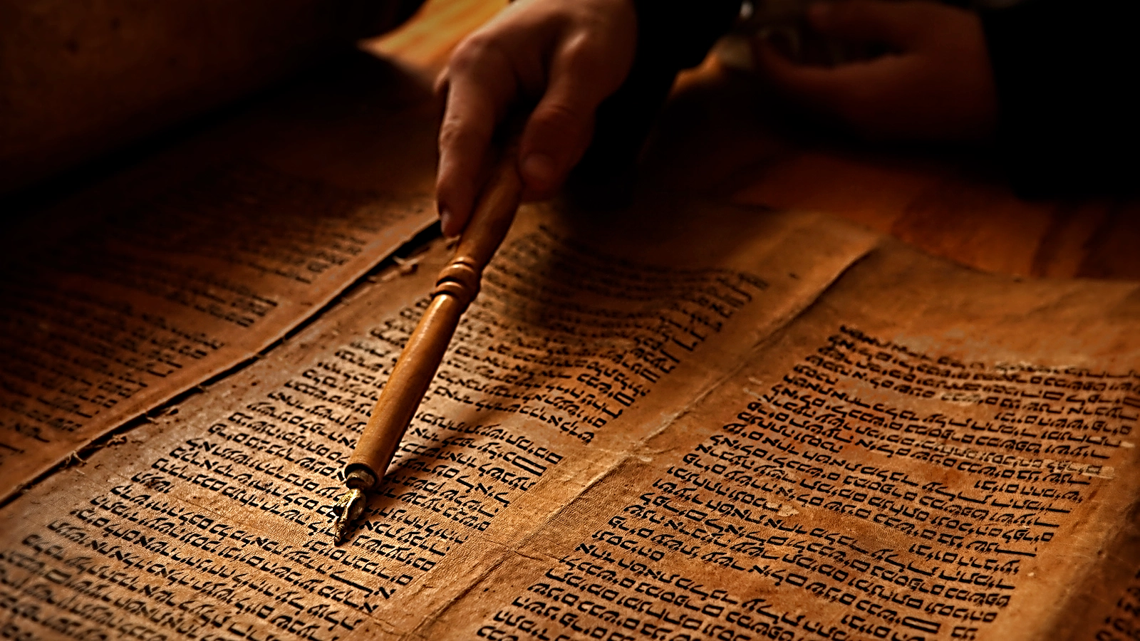
John 5:39, 46
“³⁹ You search the Scriptures because you think that in them you have eternal life; it is these that testify about Me…⁴⁶ For if you believed Moses, you would believe Me, for he wrote about Me.”

Slide 53

Acts 17:1–3
¹ Now when they had traveled through Amphipolis and Apollonia, they came to Thessalonica, where there was a synagogue of the Jews. ² And according to Paul’s custom, he went to them, and for three Sabbaths reasoned with them from the Scriptures, ³ explaining and giving evidence that the Christ had to suffer and rise again from the dead, and saying, “This Jesus whom I am proclaiming to you is the Christ.”

Slide 54

1 Corinthians 15:3-4
“³ For I handed down to you as of first importance what I also received, that Christ died for our sins according to the Scriptures, ⁴ and that He was buried, and that He was raised on the third day according to the Scriptures.”

Slide 55
Josephus
Antiquities 18.3.3
“About this time there lived Jesus, a wise man, if indeed one ought to call him a man. For he was one who performed surprising deeds and was a teacher of such people as accept the truth gladly. He won over many Jews and many of the Greeks. He was the Christ. And when, upon the accusation of the principal men among us, Pilate had condemned him to a cross, those who had first come to love him did not cease. He appeared to them spending a third day restored to life, for the prophets of God had foretold these things and a thousand other marvels about him. And the tribe of the Christians, so called after him, has still to this day not disappeared.”

Slide 56
OT Prophecies About Christ
Prophecy | Scripture | Years in Advance
Manner of Birth | Isaiah 7:14 | 700 years
Place of Birth | Micah 5:2 | 700 years
Nationality | Numbers 24:17 | 1400 years
Tribe | Genesis 49:10 | 1800 years
Time of and Response to His Messiahship | Dan. 9:25-26 | 600 years

Slide 57
OT Prophecies About Christ
Prophecy | Scripture | Years in Advance
Crucified Between Thieves | Isaiah 53:9 | 700 years
Pierced | Isaiah 53:5 | 700 years
No Broken Bones | Psalm 22:17 | 1000 years
Gamble for His Clothing | Psalm 22:18 | 1000 years
Buried in Rich Man’s Tomb | Isaiah 53:9 | 700 years
Notes:
109 prophecies…
Peter Stoner – SCIENCE SPEAKS, An Evaluation of Certain Christian Evidences
To fulfill just 8 prophecies =1 X 10 to the twenty-eighth power!
Can we visualize this with an illustration? Suppose we took an atheistic professor, blindfolded him and covered the state of Texas two feet deep with silver dollars. Then we put a check on one of those silver dollars and mixed them up. The odds of one person fulfilling just these eight prophecies would be the same as this atheistic professor selecting the silver dollar upon which we have placed a check, in his first try.
https://www.bereanpublishers.com/the-odds-of-eight-messianic-prophecies-coming-true/

Slide 58
Daniel 9:26
“Then after the sixty-two weeks the Messiah will be cut off and have nothing, and the people of the prince who is to come will destroy the city and the sanctuary. And its end will come with a flood; even to the end there will be war; desolations are determined.”

Slide 59
Names for Jesus in Acts 3
Holy One (14a)
Righteous One (14b)
Prince of Life (15a)
“Christ” or “The Messiah” (18)
Prophet Like Moses (22-23)
Servant (26)

Slide 60
Peter’s Second Sermon
Acts 3:12-26
  Israel’s Rejection of her Messiah (12-18)
  Israel’s Responsibility (19-26)

Slide 61
Acts 3:19-26
Israel’s Responsibility
      Necessity of Repentance (19a)
      Results of Repentance (19b-21)
      Present Fulfilled Prophecy (22-26)

Slide 62
Acts 3:19-26
Israel’s Responsibility
      Necessity of Repentance (19a)
      Results of Repentance (19b-21)
      Present Fulfilled Prophecy (22-26)

Slide 63
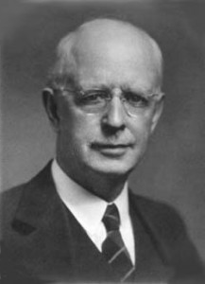
Lewis Sperry Chafer
vol. 7, Systematic Theology (Grand Rapids, MI: Kregel Publications, 1993), 265-66.
“This vital newness of mind is a part of believing, after all, and therefore it may be and is used as a synonym for believing at times (cf. Acts 17:30; 20:21; 26:20; Rom. 2:4; 2Tim. 2:25; 2 Pet. 3:9). Repentance nevertheless cannot be added to believing as a condition of salvation, because upwards of 150 passages of Scripture condition salvation upon believing only (cf. John 3:16; Acts 16:31).”

Slide 64

Matthew 12:24
“But when the Pharisees heard this, they said, ‘This man casts out demons only by Beelzebul the ruler of the demons.’”

Slide 65
Matthew Outline
Pedigree of the king (1–2)
  Preparation of the king (3–4)
    Pedagogy of the king (5–7)
      Power of the king (8–9)
        Program of the king (10)
          Progressive rejection of the king (11–12)
        Preparation of the king’s disciples (13–20)
      Presentation & rejection of the king (21–23)
    Prophecies of the king (24–25)
  Passion of the king (26–27)
Proof of the king (28)

Slide 66

Was the kingdom re-offered in Acts? No!
The king was absent (Acts 1:9-11)
Irreversible language found in the Gospels (Matt. 12:31-32; 21:42; 22:7)
A new age in the kingdom’s absence has already been disclosed (Luke 19:11-27; Matt. 13; 24‒25)
“Kingdom” is mentioned 45x in Luke’s Gospel but only 8x in Acts
Expression “repent for the kingdom of heaven is at hand” is absent from Acts

Slide 67
Was the kingdom re-offered in Acts? No!
Co-mingling of kingdom truth with Church Age truth
The timing of the kingdom has already been fixed by the Father’s authority (Acts 1:6-7)
Peter was merely preaching the personal Gospel in Acts 2
Acts 3:19-21 is laying out the condition by which the kingdom will ultimately come to the earth (Acts 3:19-21)
The miracles in Acts authenticate the new age of the Church (Heb. 2:2-3) and not the ongoing offer of the kingdom

Slide 68
Dr. Arnold G. Fruchtenbaum
The Book of Acts, 98
“Three observations can be made about Peter’s sermon. The first observation is that it was not a re-offer of the Messianic kingdom. The Jewish people had rejected the kingdom in Matthew 12, and from then on, they were under the judgment of the unpardonable sin, the judgment of A.D. 70. That judgment was irrevocable, and there was no possibility for change. Peter simply restated the requirements for the kingdom. The prerequisite for the second coming and the kingdom is Israel’s national salvation.”

Slide 69
Dr. Arnold G. Fruchtenbaum
The Book of Acts, 98
“The Messiah left the earth because of Israel’s rejection and will not come back unless Israel accepts His Messiahship. That will happen someday, but Peter’s words were not a re-offer to this generation since they had already committed the unpardonable sin. Because the sin was unpardonable, they could not see the kingdom established in their day and the judgment of A.D. 70 would come.”

Slide 70

Matthew 23:37-39
³⁷ “Jerusalem, Jerusalem, who kills the prophets and stones those who are sent to her! How often I wanted to gather [episynagō] your children together, the way a hen gathers [episynagō] her chicks under her wings, and you were unwilling. ³⁸ Behold, your house is being left to you desolate! ³⁹ For I say to you, from now on you will not see Me until you say, ‘Blessed is He who comes in the name of the Lord!’”

Slide 71
Acts 3:19-26
Israel’s Responsibility
      Necessity of Repentance (19a)
      Results of Repentance (19b-21)
      Present Fulfilled Prophecy (22-26)

Slide 72
Acts 3:19b-21
Results of Repentance
      Salvation (19b)
      Kingdom (19c)
      Second Advent (20)
      Termination of Present Session (21)

Slide 73
Acts 3:19b-21
Results of Repentance
      Salvation (19b)
      Kingdom (19c)
      Second Advent (20)
      Termination of Present Session (21)

Slide 74
Romans 11:25-26
“²⁵ For I do not want you, brethren, to be uninformed of this mystery—so that you will not be wise in your own estimation—that a partial hardening has happened to Israel until the fullness of the Gentiles has come in; ²⁶ and so all Israel will be saved; just as it is written, ‘The Deliverer will come from Zion, He will remove ungodliness from Jacob.’”

Slide 75
Acts 3:19b-21
Results of Repentance
      Salvation (19b)
      Kingdom (19c)
      Second Advent (20)
      Termination of Present Session (21)

Slide 76
Acts 3:19-21
“¹⁹ Therefore repent and return, so that your sins may be wiped away, in order that times of refreshing may come from the presence of the Lord; ²⁰ and that He may send Jesus, the Christ appointed for you,²¹ whom heaven must receive until the period of restoration of all things about which God spoke by the mouth of His holy prophets from ancient time.”

Slide 77
Acts 3:19-21
“¹⁹ Therefore repent and return, so that your sins may be wiped away, in order that [hopōs] times [kairos] of refreshing may come [erchomai] from the presence of the Lord; ²⁰ and [kai] that He may send [apostellō] Jesus, the Christ appointed for you,²¹ whom heaven must receive until the period [chronos] of restoration of all things about which God spoke by the mouth of His holy prophets from ancient time.”

Slide 78

Acts 3:19-21
Stanley D. Toussaint and Jay A. Quine, “No, Not Yet: The Contingency of God’s Promised Kingdom,” Bibliotheca Sacra 164 (April–June 2007): 138, 144.
“The two clauses that follow ὅπως go together. In other words the clause ‘that the times of refreshing may come from the presence of the Lord’ must be taken with the words ‘and that He may send Jesus.’ As Haenchen puts it, ‘The two promises are complementary statements about one and the same event.’ Nothing grammatically separates the promises; in fact they are joined together by the connective καὶ. The noun ἄναψύξεως, translated “refreshing,” is a New Testament hapax legomenon. It is used in Greek literature in various forms to refer to ‘cooling by blowing, refreshing, relieving, resting.’ It occurs in the Septuagint only in Exodus (Eng., 8:15; lxx, v. 11), where it refers to relief from the plague of frogs.”

Slide 79
Acts 3:19-21
Stanley D. Toussaint and Jay A. Quine, “No, Not Yet: The Contingency of God’s Promised Kingdom,” Bibliotheca Sacra 164 (April–June 2007): 138, 141.
“Schweizer correctly observes, ‘The context makes sense only if the ‘times of refreshing’ are the definitive age of salvation. The expression is undoubtedly apocalyptic in origin. . . . The reference, then, is to the eschatological redemption which is promised to Israel if it repents.’ Furthermore the plural καιροὶ, ‘times,’ in Acts 3:19, parallels the plural noun χρονῶν, ‘seasons’ or ‘times,’ in verse 21 (which is translated ‘period’ in the nasb). The two terms refer to the same era, and the plural forms simply emphasize duration. The context makes it clear that the synonyms refer to the future kingdom, with καιροὶ emphasizing the quality of time and χρονῶν emphasizing the duration of the time.”

Slide 80
Acts 3:19-21
John A. McLean, “Did Jesus Correct the Disciples’ View of the Kingdom?,” Bibliotheca Sacra 151, no. 602 (April–June 1994): 223–25.
“Bock argues for two separate time periods for these events in support of his ‘already, not yet’ view on the Davidic kingdom. He says the ‘periods of refreshing’ refer to the present time when sins can be wiped away through repentance, and that the ‘times of restoration of all things’ refers to the millennium. ‘Among the points in support of this distinction is that in the LXX translation by Symmachus, a reference to the descent of the Spirit in Isaiah 32:15 uses the term ἀνάψυξις (refreshment), a term related to the one in Acts 3:20.’ However, the context of Isaiah 32:15 refers to millennial blessings to national Israel, a fact that supports the single-stage restoration view, not a two-phase ‘already, not yet’ restoration. Walker suggests a …

Slide 81
Acts 3:19-21
John A. McLean, “Did Jesus Correct the Disciples’ View of the Kingdom?,” Bibliotheca Sacra 151, no. 602 (April–June 1994): 223–25.
… two-stage restoration in Acts 3:19–21. He, like Bock, maintains that the καιροὶ ἀναψύξεως (‘times of refreshing’) relates to special experiences of grace and blessing in this age, whereas the χρόνων ἀποκαταστάσεως (‘period of restoration’) in verse 21 refers to the climactic age of blessings for the nation of Israel in fulfillment of Old Testament messianic promises. . . .” “The main weakness in dividing these two events into separate time periods is that the text connects the events with a coordinating και (‘and’) in Acts 3:20. The syntactical structure coordinates the two verbs ἔλθωσιν (‘come,’ v. 19) and ἀποστείλῃ (‘send’) of the subordinate clause ὅπως ἂν in verse 20 with the two main verbs μετανοήσατε (‘repent’) and ἐπιστρέψατε ...

Slide 82
Acts 3:19-21
John A. McLean, “Did Jesus Correct the Disciples’ View of the Kingdom?,” Bibliotheca Sacra 151, no. 602 (April–June 1994): 223–25.
… (‘return’) in verse 19. Repentance and turning to God result in the coming of the times of refreshing and the sending of Jesus Christ at the restoration of all things God spoke about in the prophets. The sending of Jesus Christ will provide the personal presence that will result in the times of refreshing. These results are not events separated by time. They are mutual benefits that will come when the Father sends the Son so that believers may be refreshed in His presence. Conzelmann argues that ‘the parallelism between the two halves of the verse shows that the καιροὶ ἀναψύξεως, ‘times of refreshing,’ are not intervals of respite in the eschatological distress, but rather the final salvation (like the χρόνοι ἀποκαταστάσεως, . . .

Slide 83
Acts 3:19-21
John A. McLean, “Did Jesus Correct the Disciples’ View of the Kingdom?,” Bibliotheca Sacra 151, no. 602 (April–June 1994): 223–25.
…‘restoration’).” “The main weakness in dividing these two events into separate time periods is that the text connects the events with a coordinating και (‘and’) in Acts 3:20. The syntactical structure coordinates the two verbs ἔλθωσιν (‘come,’ v. 19) and ἀποστείλῃ (‘send’) of the subordinate clause ὅπως ἂν in verse 20 with the two main verbs μετανοήσατε (‘repent’) and ἐπιστρέψατε (‘return’) in verse 19. Repentance and turning to God result in the coming of the times of refreshing and the sending of Jesus Christ at the restoration of all things God spoke about in the prophets. The sending of Jesus Christ will provide the personal presence that will result in the times of refreshing. These results are not events separated by time. They…

Slide 84
Acts 3:19-21
John A. McLean, “Did Jesus Correct the Disciples’ View of the Kingdom?,” Bibliotheca Sacra 151, no. 602 (April–June 1994): 223–25.
… are mutual benefits that will come when the Father sends the Son so that believers may be refreshed in His presence. Conzelmann argues that ‘the parallelism between the two halves of the verse shows that the καιροὶ ἀναψύξεως, ‘times of refreshing,’ are not intervals of respite in the eschatological distress, but rather the final salvation (like the χρόνοι ἀποκαταστάσεως, ‘restoration’).”

Slide 85
Acts 3:19b-21
Results of Repentance
      Salvation (19b)
      Kingdom (19c)
      Second Advent (20)
      Termination of Present Session (21)

Slide 86


Slide 87
Acts 3:19b-21
Results of Repentance
      Salvation (19b)
      Kingdom (19c)
      Second Advent (20)
      Termination of Present Session (21)

Slide 88
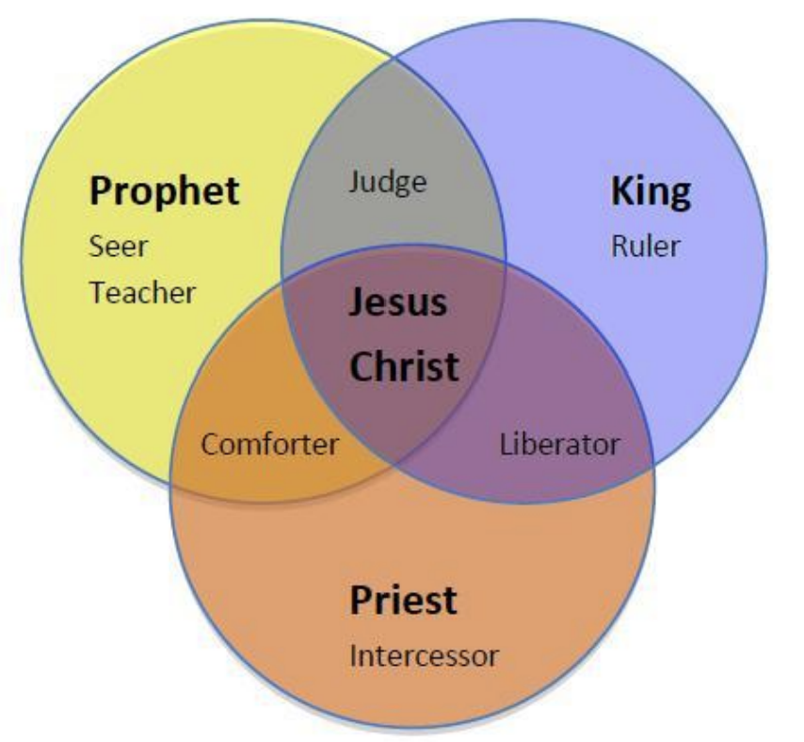
CHRIST’S THREE OFFICES
Prophet (First Coming)
Priest (Present Session)
King (Second Coming)

Slide 89

Isaiah 2:1-4
¹ “The word which Isaiah the son of Amoz saw concerning Judah and Jerusalem.² Now it will come about that In the last days The mountain of the house of the Lord Will be established as the chief of the mountains, And will be raised above the hills; And all the nations will stream to it.³ And many peoples will come and say, “Come, let us go up to the mountain of the Lord, To the house of the God of Jacob; . . .

Slide 90

Isaiah 2:1-4
. . .That He may teach us concerning His ways And that we may walk in His paths.” For the law will go forth from Zion And the word of the Lord from Jerusalem.⁴ And He will judge between the nations, And will render decisions for many peoples; And they will hammer their swords into plowshares and their spears into pruning hooks. Nation will not lift up sword against nation, And never again will they learn war.”

Slide 91
Isaiah 11:6-9
⁶ “And the wolf will dwell with the lamb, And the leopard will lie down with the young goat, And the calf and the young lion and the fatling together; And a little boy will lead them.⁷ Also the cow and the bear will graze, Their young will lie down together, And the lion will eat straw like the ox. ⁸ The nursing child will play by the hole of the cobra, And the weaned child will put his hand on the viper’s den. ⁹ They will not hurt or destroy in all My holy mountain, For the earth will be full of the knowledge of the Lord As the waters cover the sea.”

Slide 92
Isaiah 65:17-25
¹⁷ “For behold, I create new heavens and a new earth; And the former things will not be remembered or come to mind.¹⁸ “But be glad and rejoice forever in what I create; For behold, I create Jerusalem for rejoicing And her people for gladness.¹⁹ “I will also rejoice in Jerusalem and be glad in My people; And there will no longer be heard in her The voice of weeping and the sound of crying.²⁰ “No longer will there be in it an infant who lives but a few days, Or an old man who does not live out his days; For the youth will die at the age of one hundred And the one who does not . . .

Slide 93
Isaiah 65:17-25
...reach the age of one hundred Will be thought accursed.²¹ “They will build houses and inhabit them; They will also plant vineyards and eat their fruit.²² “They will not build and another inhabit, They will not plant and another eat; For as the lifetime of a tree, so will be the days of My people, And My chosen ones will wear out the work of their hands.²³ “They will not labor in vain, Or bear children for calamity; For they are the offspring of those blessed by the Lord, And their descendants…

Slide 94

Isaiah 65:17-25
…with them.²⁴ It will also come to pass that before they call, I will answer; and while they are still speaking, I will hear. ²⁵ The wolf and the lamb will graze together, and the lion will eat straw like the ox; and dust will be the serpent’s food. They will do no evil or harm in all My holy mountain,” says the Lord.

Slide 95
Acts 3:19-26
Israel’s Responsibility
      Necessity of Repentance (19a)
      Results of Repentance (19b-21)
      Present Fulfilled Prophecy (22-26)

Slide 96
Acts 3:22-26
Present Fulfilled Prophecy
      Deuteronomy 18:15 (22)
      Deuteronomy 18:19 (23)
      Prophets’ Summary (24)
      Blessing to the Gentiles (25)
      Application to Israel (26)

Slide 97
Acts 3:22-26
Present Fulfilled Prophecy
      Deuteronomy 18:15 (22)
      Deuteronomy 18:19 (23)
      Prophets’ Summary (24)
      Blessing to the Gentiles (25)
      Application to Israel (26)

Slide 98
Names for Jesus in Acts 3
Holy One (14a)
Righteous One (14b)
Prince of Life (15a)
“Christ” or “The Messiah” (18)
Prophet Like Moses (22-23)
Servant (26)

Slide 99
Acts 3:22-26
Present Fulfilled Prophecy
      Deuteronomy 18:15 (22)
      Deuteronomy 18:19 (23)
      Prophets’ Summary (24)
      Blessing to the Gentiles (25)
      Application to Israel (26)

Slide 100


Slide 101
Six Parts of a Suzerain-Vassal Treaty in Deuteronomy
Preamble (1:1-5)
Prologue (1:6–4:40)
Covenant obligations (5–26)
Storage and reading instructions (27:2-3; 31:9, 24, 26)
Witnesses (32:1)
Blessings and curses (28)

Slide 102
Six Parts of a Suzerain-Vassal Treaty in Deuteronomy
Preamble (1:1-5)
Prologue (1:6–4:40)
Covenant obligations (5–26)
Storage and reading instructions (27:2-3; 31:9, 24, 26)
Witnesses (32:1)
Blessings and curses (28)

Slide 103

Deuteronomy 28:49-50
⁴⁹ “The Lord will bring a nation against you from afar, from the end of the earth, as the eagle swoops down, a nation whose language you shall not understand, ⁵⁰ a nation of fierce countenance who will have no respect for the old, nor show favor to the young.”

Slide 104
ISRAEL'S JUDGMENTS
Division of the kingdom in 931 B.C. (1 Kgs. 12)
Assyrian judgment in 722 B.C. (2 Kgs. 17)
Babylonian captivity in 586 B.C. (2 Kgs. 25)
Rome Diaspora in A.D. 70 (Luke 19:41-44)

Slide 105
ISRAEL'S JUDGMENTS
Division of the kingdom in 931 B.C. (1 Kgs. 12)
Assyrian judgment in 722 B.C. (2 Kgs. 17)
Babylonian captivity in 586 B.C. (2 Kgs. 25)
Rome Diaspora in A.D. 70 (Luke 19:41-44)

Slide 106
Acts 3:22-26
Present Fulfilled Prophecy
      Deuteronomy 18:15 (22)
      Deuteronomy 18:19 (23)
      Prophets’ Summary (24)
      Blessing to the Gentiles (25)
      Application to Israel (26)

Slide 107
Luke 24:27, 44
“²⁷ Then beginning with Moses and with all the prophets, He explained to them the things concerning Himself in all the Scriptures…⁴⁴ Now He said to them, ‘These are My words which I spoke to you while I was still with you, that all things which are written about Me in the Law of Moses and the Prophets and the Psalms must be fulfilled.’”

Slide 108
Acts 3:22-26
Present Fulfilled Prophecy
      Deuteronomy 18:15 (22)
      Deuteronomy 18:19 (23)
      Prophets’ Summary (24)
      Blessing to the Gentiles (25)
      Application to Israel (26)

Slide 109
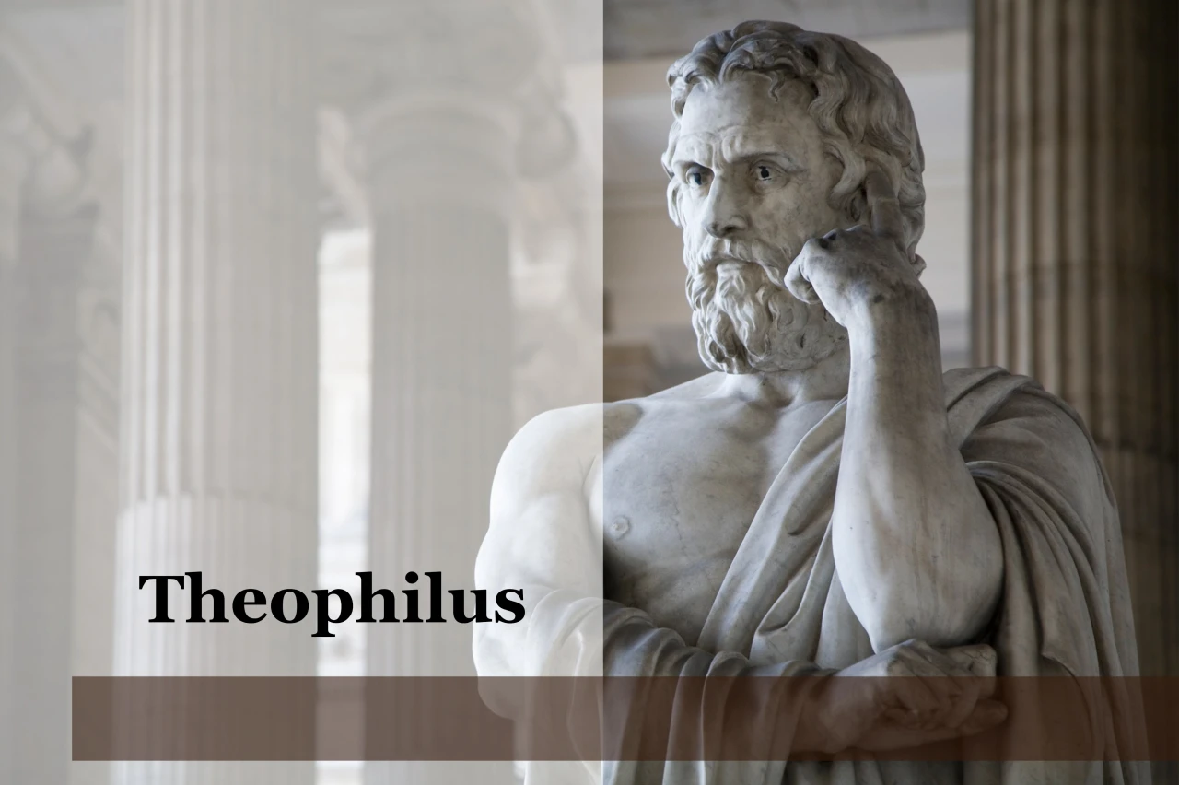
Purpose
  To present Theophilus with an orderly account of the birth and growth of the church so as to affirm him in what he has believed.

Slide 110

Message
  Birth and growth of the church numerically, geographically, ethnically.
  Components
  Numerically (progress reports)
  Geographically (From Jerusalem to Rome)
  Ethnically (From Judaism to Gentile domination)

Slide 111

8 New Promises
Genesis 12:1-3
    Land (Gen. 12:1b)
    Great nation (Gen. 12:2a)
    Personal blessing (Gen. 12:2b)
    Great name (Gen. 12:2c)
    Blessing to others (Gen. 12:2d)
    Blessing to blessers (Gen. 12:3a)
    Cursing to cursers (Gen. 12:3b)
    Blessing to the world (Gen. 12:3c)

Slide 112


Genesis 12:3
“And I will bless those who bless you, And the one who curses you I will curse. And in you all the families of the earth will be blessed.”

Slide 113
Acts 3:22-26
Present Fulfilled Prophecy
      Deuteronomy 18:15 (22)
      Deuteronomy 18:19 (23)
      Prophets’ Summary (24)
      Blessing to the Gentiles (25)
      Application to Israel (26)

Slide 114
Names for Jesus in Acts 3
Holy One (14a)
Righteous One (14b)
Prince of Life (15a)
“Christ” or “The Messiah” (18)
Prophet Like Moses (22-23)
Servant (26)

Slide 115
Messengers of the Kingdom In Matthew
John the Baptist – 3:2
Jesus Christ – 4:17
12 Apostles – 10:5-7
Seventy – Luke 10:1, 9
Toussaint, Behold the King, 18-20

Slide 116
Matthew 10:5-7
“These twelve Jesus sent out after instructing them: “Do not go in the way of the Gentiles, and do not enter any city of the Samaritans; ⁶ but rather go to the lost sheep of the house of Israel. ⁷ And as you go, preach, saying, ‘The kingdom of heaven is at hand.’”

Slide 117
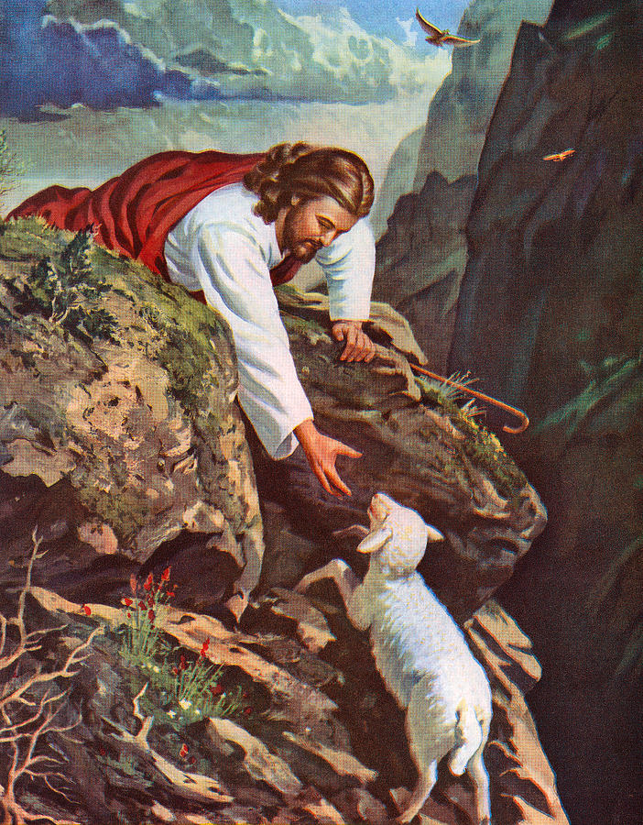
Matthew 15:24
“But He answered and said, ‘I was sent only to the lost sheep of the house of Israel.’”

Slide 118
Conclusion

Slide 119
Acts 3
Chapter Summary
  Miraculous Healing (1-11)
  Peter’s Second Sermon (12-26)

