Slide 1
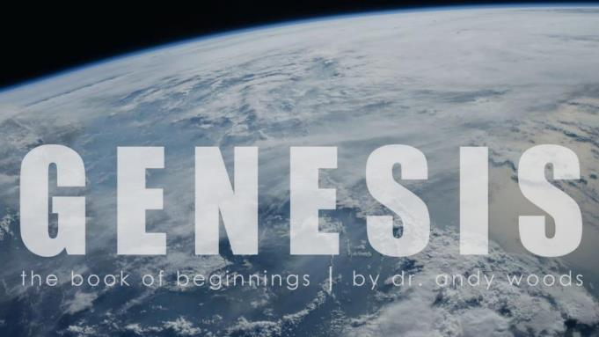
Genesis 12‒50
Israel’s Birth & Preservation

Slide 2
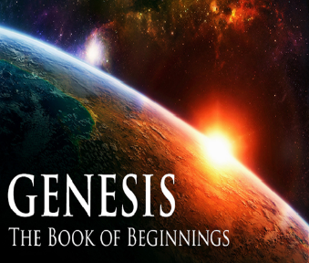
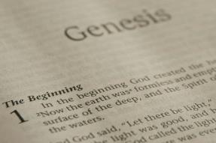
GENESIS STRUCTURE
Genesis 12-50 (four people)
Abraham (12:1–25:11)
Isaac (25:12–26:35)
Jacob (27–36)
Joseph (37–50)

Slide 3
Distinctions Between 144,000 & Multitude
144,000 | MULTITUDE
Revelation 7:1-8 | Revelation 7:9-17
Numbered | Innumerable
Jews | All nations
Sealed | Slain
Sealed before the Tribulation | Converted out of the Tribulation
Hitchcock and Ice, The Truth Behind Left Behind, 77

Slide 5
Jerusalem Descending
Notes:
The descending city is described as being like a stone called Jasper, only unlike the earthly stone, this one is clear as crystal. The ultimate state of heaven sounds more like a diamond, doesn’t it?

Slide 6
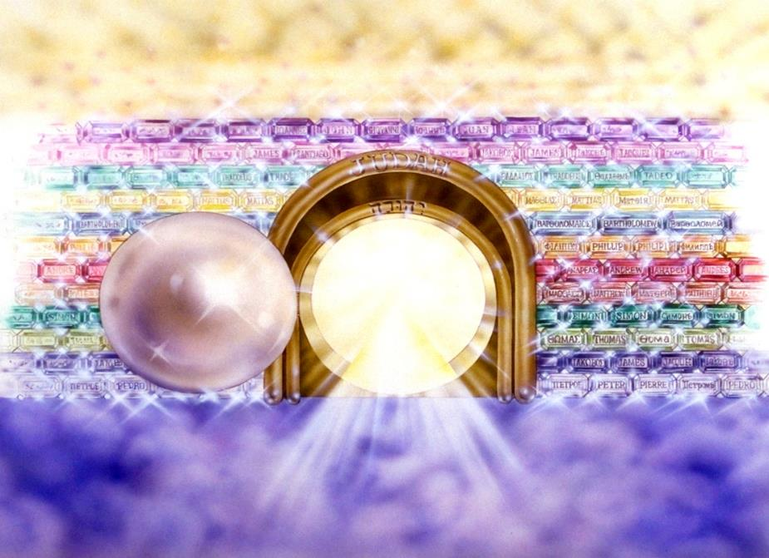
Notes:
Here you see an artist’s ideas of…
12 Gates = 12 Tribes of Israel
12 Foundation Stones = 12 Apostles of the Church

Slide 7
Genesis 29:31‒30:24 Jacob’s Dozen
Leah’s 4 sons (29:31-35)
Bilhah’s 2 sons (30:1-8)
Zilpah’s 2 sons (30:9-13)
Leah’s 2 sons & daughter (30:14-21)
Rachel’s first son (30:22-24)

Slide 8
Genesis 29:31‒30:24 Jacob’s Dozen
Leah’s 4 sons (29:31-35)
Bilhah’s 2 sons (30:1-8)
Zilpah’s 2 sons (30:9-13)
Leah’s 2 sons & daughter (30:14-21)
Rachel’s first son (30:22-24)

Slide 9
I. Genesis 29:31-35 Leah’s 4 Sons
God’s providence (31)
Leah’s four sons (32-35a)
Conclusion (35b)

Slide 10
I. Genesis 29:31-35 Leah’s 4 Sons
God’s providence (31)
Leah’s four sons (32-35a)
Conclusion (35b)

Slide 11
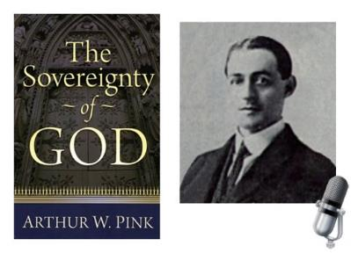
A. W. Pink
Sovereignty of God, p. 160, 163.
“The fact is, that the love of God, is a truth for the Saints only…In like manner, the ‘world’ in John 3:16 must, in the final analysis, refer to the world of God’s people.”

Slide 12
I. Genesis 29:31-35 Leah’s 4 Sons
God’s providence (31)
Leah’s four sons (32-35a)
Conclusion (35b)

Slide 13
Genesis 29:32-35a Leah’s Four Sons
Reuben’s birth (32)
Simeon’s birth (33)
Levi’s birth (34)
Judah’s birth (35a)

Slide 14
Genesis 29:32-35a Leah’s Four Sons
Reuben’s birth (32)
Simeon’s birth (33)
Levi’s birth (34)
Judah’s birth (35a)

Slide 15
Genesis 29:32-35a Leah’s Four Sons
Reuben’s birth (32)
Simeon’s birth (33)
Levi’s birth (34)
Judah’s birth (35a)

Slide 16
Genesis 29:32-35a Leah’s Four Sons
Reuben’s birth (32)
Simeon’s birth (33)
Levi’s birth (34)
Judah’s birth (35a)

Slide 17
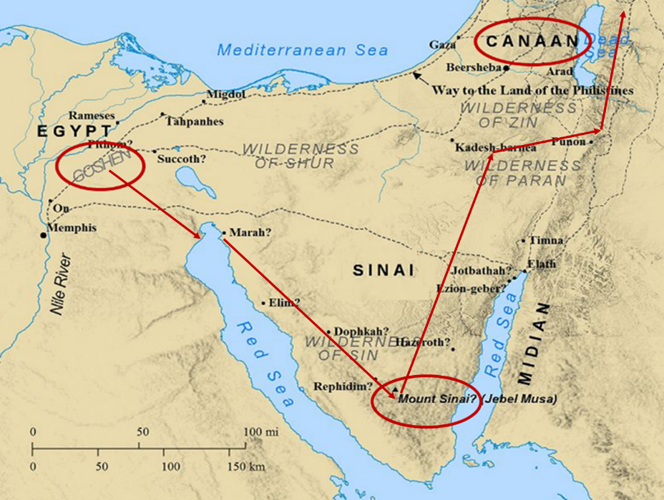

Slide 18
Genesis 29:32-35a Leah’s Four Sons
Reuben’s birth (32)
Simeon’s birth (33)
Levi’s birth (34)
Judah’s birth (35a)

Slide 19
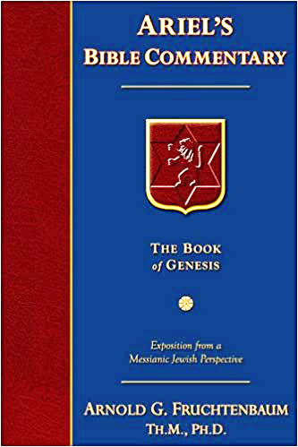
Dr. Arnold G. Fruchtenbaum
The Book of Genesis, 448
“In the naming of the first three sons, Leah named them with a basic hope that Jacob would learn to love her or at least treat her equally. That never happened. By the time she came to her fourth son, she focused on God and not on Jacob, realizing that although not loved by Jacob, she was loved by God. The two key institutions of Israel, priesthood (Levi) and royalty (Judah), came from an unplanned and unwanted marriage.”

Slide 20
Dr. Arnold G. Fruchtenbaum
The Book of Genesis, 448
“In the naming of the first three sons, Leah named them with a basic hope that Jacob would learn to love her or at least treat her equally. That never happened. By the time she came to her fourth son, she focused on God and not on Jacob, realizing that although not loved by Jacob, she was loved by God. The two key institutions of Israel, priesthood (Levi) and royalty (Judah), came from an unplanned and unwanted marriage.”

Slide 21
I. Genesis 29:31-35 Leah’s 4 Sons
God’s providence (31)
Leah’s four sons (32-35a)
Conclusion (35b)

Slide 22
Genesis 29:31‒30:24 Jacob’s Dozen
Leah’s 4 sons (29:31-35)
Bilhah’s 2 sons (30:1-8)
Zilpah’s 2 sons (30:9-13)
Leah’s 2 sons & daughter (30:14-21)
Rachel’s first son (30:22-24)

Slide 23
II. Genesis 30:1-8 Bilhah’s 2 Sons
Rachael’s complaint (1)
Jacob’s response (2)
Rachel’s offer (3)
Consummation (4)
Conception (5)
Name: Dan (6)
Second conception (7)
Name: Naphtali (8)

Slide 24
II. Genesis 30:1-8 Bilhah’s 2 Sons
Rachael’s complaint (1)
Jacob’s response (2)
Rachel’s offer (3)
Consummation (4)
Conception (5)
Name: Dan (6)
Second conception (7)
Name: Naphtali (8)

Slide 25
II. Genesis 30:1-8 Bilhah’s 2 Sons
Rachael’s complaint (1)
Jacob’s response (2)
Rachel’s offer (3)
Consummation (4)
Conception (5)
Name: Dan (6)
Second conception (7)
Name: Naphtali (8)

Slide 26
II. Genesis 30:1-8 Bilhah’s 2 Sons
Rachael’s complaint (1)
Jacob’s response (2)
Rachel’s offer (3)
Consummation (4)
Conception (5)
Name: Dan (6)
Second conception (7)
Name: Naphtali (8)

Slide 28
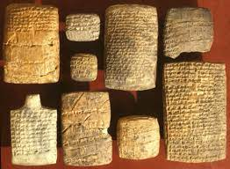
Dr. Arnold G. Fruchtenbaum
The Book of Genesis, 449
“So in 30:3–4, Rachel’s despair led to her offer of Bilhah to Jacob, with verse 3 describing the offer: Behold, my maid Bilhah, go in unto her; that she might bear upon my knees, meaning Rachel would be the legal mother. This was in keeping with Code of Hammurabi, and for that reason, it was Rachel, not Bilhah, who named the children. Because Bilhah was the handmaid of Rachel, Rachel would be the legal mother: and I also may obtain children by her; literally, ‘I may be builded by her.’”

Slide 29
II. Genesis 30:1-8 Bilhah’s 2 Sons
Rachael’s complaint (1)
Jacob’s response (2)
Rachel’s offer (3)
Consummation (4)
Conception (5)
Name: Dan (6)
Second conception (7)
Name: Naphtali (8)

Slide 30
II. Genesis 30:1-8 Bilhah’s 2 Sons
Rachael’s complaint (1)
Jacob’s response (2)
Rachel’s offer (3)
Consummation (4)
Conception (5)
Name: Dan (6)
Second conception (7)
Name: Naphtali (8)

Slide 31
II. Genesis 30:1-8 Bilhah’s 2 Sons
Rachael’s complaint (1)
Jacob’s response (2)
Rachel’s offer (3)
Consummation (4)
Conception (5)
Name: Dan (6)
Second conception (7)
Name: Naphtali (8)

Slide 32
II. Genesis 30:1-8 Bilhah’s 2 Sons
Rachael’s complaint (1)
Jacob’s response (2)
Rachel’s offer (3)
Consummation (4)
Conception (5)
Name: Dan (6)
Second conception (7)
Name: Naphtali (8)

Slide 33
II. Genesis 30:1-8 Bilhah’s 2 Sons
Rachael’s complaint (1)
Jacob’s response (2)
Rachel’s offer (3)
Consummation (4)
Conception (5)
Name: Dan (6)
Second conception (7)
Name: Naphtali (8)

Slide 34
Genesis 29:31‒30:24 Jacob’s Dozen
Leah’s 4 sons (29:31-35)
Bilhah’s 2 sons (30:1-8)
Zilpah’s 2 sons (30:9-13)
Leah’s 2 sons & daughter (30:14-21)
Rachel’s first son (30:22-24)

Slide 35
III. Genesis 30:9-13 Zilpah’s 2 Sons
Leah’s offer (9)
Birth (10)
Name: Gad (11)
Second birth (12)
Name: Asher (13)

Slide 36
III. Genesis 30:9-13 Zilpah’s 2 Sons
Leah’s offer (9)
Birth (10)
Name: Gad (11)
Second birth (12)
Name: Asher (13)

Slide 38
III. Genesis 30:9-13 Zilpah’s 2 Sons
Leah’s offer (9)
Birth (10)
Name: Gad (11)
Second birth (12)
Name: Asher (13)

Slide 39
III. Genesis 30:9-13 Zilpah’s 2 Sons
Leah’s offer (9)
Birth (10)
Name: Gad (11)
Second birth (12)
Name: Asher (13)

Slide 40
III. Genesis 30:9-13 Zilpah’s 2 Sons
Leah’s offer (9)
Birth (10)
Name: Gad (11)
Second birth (12)
Name: Asher (13)

Slide 41
III. Genesis 30:9-13 Zilpah’s 2 Sons
Leah’s offer (9)
Birth (10)
Name: Gad (11)
Second birth (12)
Name: Asher (13)

Slide 42
Genesis 29:31‒30:24 Jacob’s Dozen
Leah’s 4 sons (29:31-35)
Bilhah’s 2 sons (30:1-8)
Zilpah’s 2 sons (30:9-13)
Leah’s 2 sons & daughter (30:14-21)
Rachel’s first son (30:22-24)

Slide 43
IV. Genesis 30:14-21 Leah’s Additional 2 Sons & Daughter
Mandrakes (14-15)
Consummation (16)
Leah’s fifth son (17)
Name: Issachar (18)
Leah’s sixth son (19)
Name: Zebulun (20)
Leah’s daughter: Dina (21)

Slide 44
IV. Genesis 30:14-21 Leah’s Additional 2 Sons & Daughter
Mandrakes (14-15)
Consummation (16)
Leah’s fifth son (17)
Name: Issachar (18)
Leah’s sixth son (19)
Name: Zebulun (20)
Leah’s daughter: Dina (21)

Slide 45
IV. Genesis 30:14-21 Leah’s Additional 2 Sons & Daughter
Mandrakes (14-15)
Consummation (16)
Leah’s fifth son (17)
Name: Issachar (18)
Leah’s sixth son (19)
Name: Zebulun (20)
Leah’s daughter: Dina (21)

Slide 46
IV. Genesis 30:14-21 Leah’s Additional 2 Sons & Daughter
Mandrakes (14-15)
Consummation (16)
Leah’s fifth son (17)
Name: Issachar (18)
Leah’s sixth son (19)
Name: Zebulun (20)
Leah’s daughter: Dina (21)

Slide 47
IV. Genesis 30:14-21 Leah’s Additional 2 Sons & Daughter
Mandrakes (14-15)
Consummation (16)
Leah’s fifth son (17)
Name: Issachar (18)
Leah’s sixth son (19)
Name: Zebulun (20)
Leah’s daughter: Dina (21)

Slide 48
IV. Genesis 30:14-21 Leah’s Additional 2 Sons & Daughter
Mandrakes (14-15)
Consummation (16)
Leah’s fifth son (17)
Name: Issachar (18)
Leah’s sixth son (19)
Name: Zebulun (20)
Leah’s daughter: Dina (21)

Slide 49
IV. Genesis 30:14-21 Leah’s Additional 2 Sons & Daughter
Mandrakes (14-15)
Consummation (16)
Leah’s fifth son (17)
Name: Issachar (18)
Leah’s sixth son (19)
Name: Zebulun (20)
Leah’s daughter: Dina (21)

Slide 50
IV. Genesis 30:14-21 Leah’s Additional 2 Sons & Daughter
Mandrakes (14-15)
Consummation (16)
Leah’s fifth son (17)
Name: Issachar (18)
Leah’s sixth son (19)
Name: Zebulun (20)
Leah’s daughter: Dina (21)

Slide 51
Genesis 29:31‒30:24 Jacob’s Dozen
Leah’s 4 sons (29:31-35)
Bilhah’s 2 sons (30:1-8)
Zilpah’s 2 sons (30:9-13)
Leah’s 2 sons & daughter (30:14-21)
Rachel’s first son (30:22-24)

Slide 52
V. Genesis 30:22-24 Rachel’s First Son
God’s providence (22)
Rachel’s first natural son (23a)
Name: Joseph (23b-24)

Slide 53
V. Genesis 30:22-24 Rachel’s First Son
God’s providence (22)
Rachel’s first natural son (23a)
Name: Joseph (23b-24)

Slide 54
Dr. Arnold G. Fruchtenbaum
The Book of Genesis, 175
“The turning point begins with the remembrance of God in verse 1a: And God remembered Noah, and all the beasts, and all the cattle that were with him in the ark. The word remember does not mean remember in the sense that God temporarily forgot about the ark and its inhabitants; rather it means remembering in the sense of movement toward the object. For example, in Genesis 19:29, God remembered Abraham with a view to saving Lot; in Exodus 2:24, God remembered His covenant with the Patriarchs with a view to rescuing Israel; in Jeremiah 2:2, God remembered Israel with a view toward her restoration; in Jeremiah 31:20, God remembered . . .

Slide 55
Dr. Arnold G. Fruchtenbaum
The Book of Genesis, 175
“… Ephraim with a view toward extending mercy to him; and in Luke 1:54–55, God remembered Israel with a view toward sending the Messiah to Israel. Furthermore, the sense was that of God remembering a covenant; although in this case the covenant itself had not yet been made. He said earlier in chapter 6, that He would establish His covenant with Noah. Furthermore, in 7:4 God remembered that the rain would only last forty days. All these usages fit into the word ‘remember.’”

Slide 56
V. Genesis 30:22-24 Rachel’s First Son
God’s providence (22)
Rachel’s first natural son (23a)
Name: Joseph (23b-24)

Slide 57
V. Genesis 30:22-24 Rachel’s First Son
God’s providence (22)
Rachel’s first natural son (23a)
Name: Joseph (23b-24)

Slide 59
Conclusion

Slide 60
Genesis 29:31‒30:24 Jacob’s Dozen
Leah’s 4 sons (29:31-35)
Bilhah’s 2 sons (30:1-8)
Zilpah’s 2 sons (30:9-13)
Leah’s 2 sons & daughter (30:14-21)
Rachel’s first son (30:22-24)

Slide 61
²⁴ The Lord bless you, and keep you; ²⁵ The Lord make His face shine on you, And be gracious to you; ²⁶ The Lord lift up His countenance on you, And give you peace.
Numbers 6:24–26 (NASB95)

